Slide 1
APIC Grand Canyon 088
March 2026 CHAPTER MEETING

Slide 2
Agenda
Welcome
New Certification Celebration
President’s Update
Membership Committee Update
Treasurer’s Update
Connie Cutler-Speaker Introduction
Dr. Al Mohajer- CBIC
Evaluations

Slide 3
Welcome & Introduction
First time attendees
Share your: Name, Organization, Role & Fun Fact (optional)

Slide 4
Celebrating Achievements
• a-IPC®
• CIC®
• LTC-CIC®
• ALCIP®
• FAPIC®

Slide 5
President’s Update
National News:
a-IPC Beta Testing- Open now, closing May 4, 2026 50% Discount on the CBIC® website
2026 IPC Collaboration Series & AI Summit Call for Speakers: All submissions must be received by 11:59 p.m. ET on April 10, 2026.
National Conference: Nashville June 15-17 2026
Notes:
aIPC beta testing open now closing 5/4/26- there is a 50% discount available on the CBIC website.
2026 IPC Collaboration Series & AI Summit Call for Speakers: All submissions must be received by 11:59 p.m. ET on April 10, 2026.
Reminder-National Conference is in Nashville 6-15 thru 6-17-26* Early bird discount ends next week– 4/3/26

Slide 6







2026 Strategic Plan
People
*Strengthening Membership
*Developing Leadership
*Building Connections
Purpose
*Advancing Prevention through Collaboration
*Aligning Strategy with Member Feedback
*Measurable Impact
Practice
*Elevating Evidence-Based Prevention Education
*Prevention and Outbreak Readiness
*Accessible Support
Notes:
Our board is on target to reach our quarterly goals based on your membership feedback.
We will be checking in and following up every meeting to keep you in the loop. Today we are focusing on our pillar for “people” discussing advancing knowledge through certification.
We have a fantastic speaker lined up for you.

Slide 7
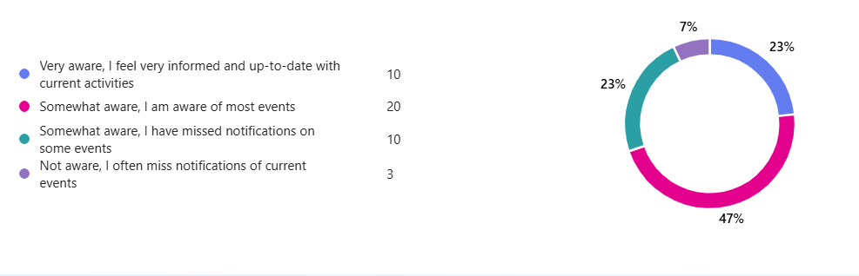
Expanded Communication
Notes:
To continue on our missing to keep you in the loop I wanted to take a minute to discuss your feedback on the recent membership survey. Many of you felt you were possibly missing some communication, so we have made a few changes.
We have a few communication pathways that have launched this quarter:
Our newly developed website: The website has a lot of new developments there and is a central hub for communication. Thank you to our Social administration and webmaster Martin for your hard work on this.

Slide 8
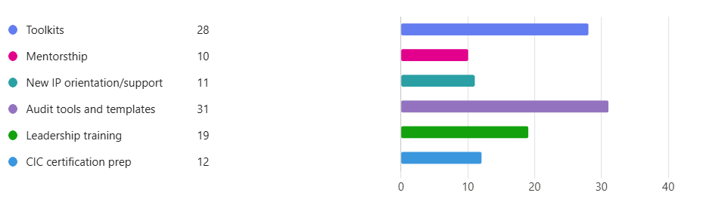
Education Requests

Slide 9


Global Health Survey Update
Open NOW! Due April 10 2026
Hospital IP Survey -https://redcap.link/5uxirots
LTCF Survey - https://redcap.link/ltc_az

Slide 10
Membership Committee Update
Purpose: Support chapter growth through membership recruitment, develop informational tools to support oncoming and new members, and conduct biennial assessment to discover member needs to continue engagement.
2026 Strategic Alignment:
  People - Conjoin with other Chapter Board committees to develop and implement programs to increase member engagement
  Purpose - Support members and provide tools to advance the science and practice of infection prevention and control
  Practice / Impact - Monitor membership roster at least monthly, assist members to keep current or updated contact information, and continuous campaign for new membership through communication
Key Goals for 2026: Engage, Gain, Retain
Current roster 196 members, # new members since 02/16/26- 13
SMART Goal - 25% of current roster = 50 more members by 12/31/26 = 246 total members

Slide 11
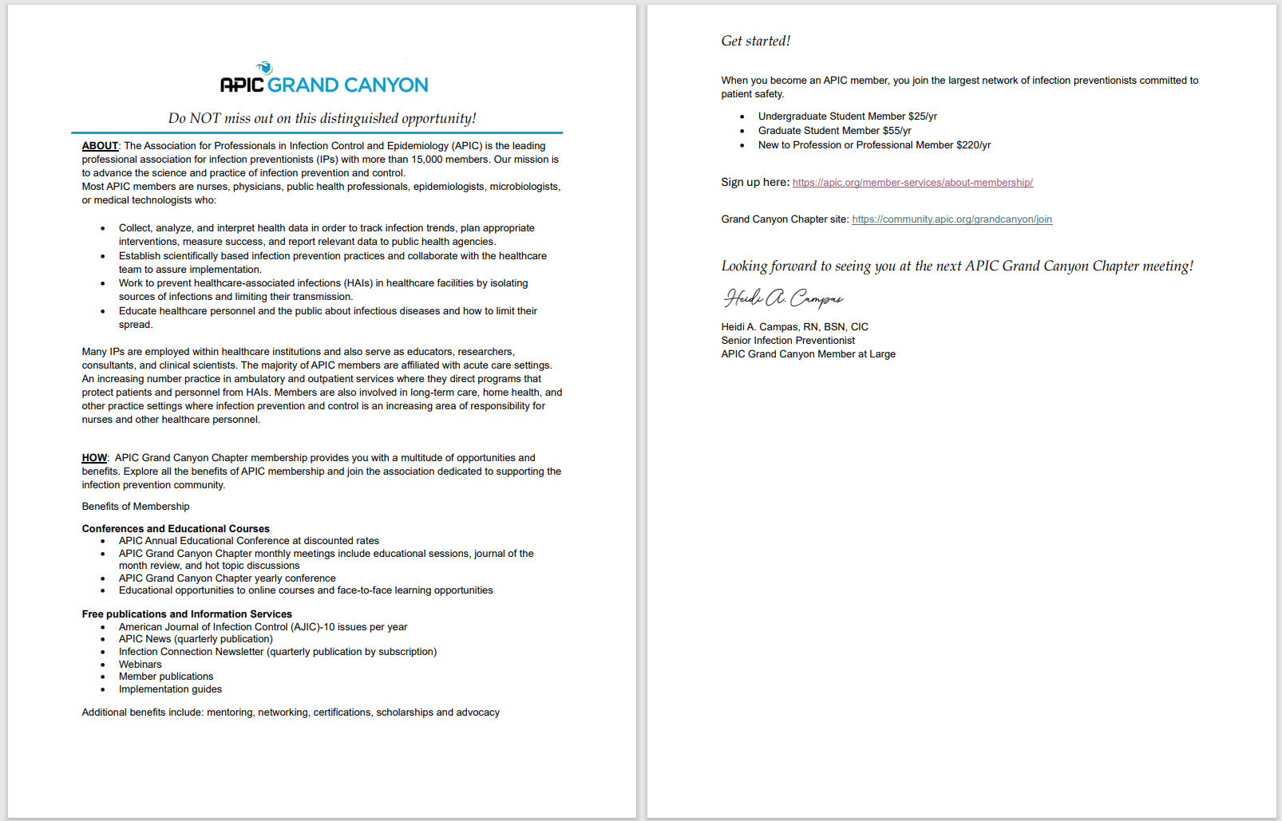

Slide 12
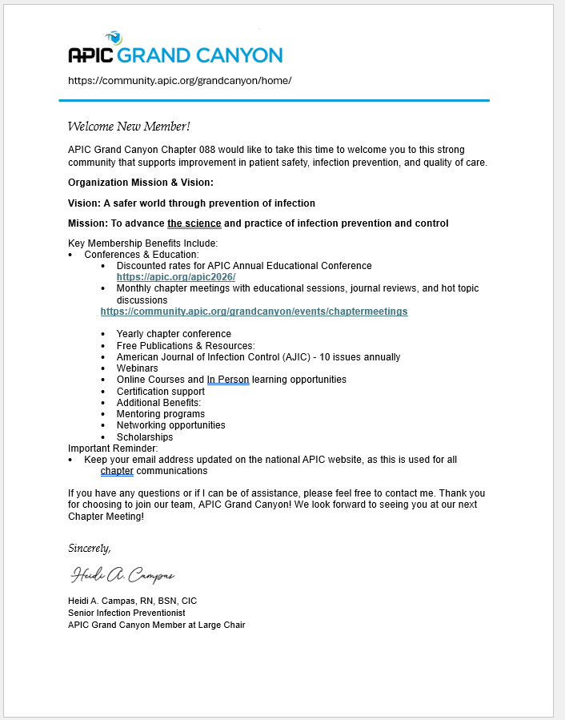

Slide 13




Slide 14




Slide 15
Treasurer's Update

Slide 16
Connie Cutler- Speaker Introduction

Slide 17

A-IPC CIC LTC-CIP AL-CIP
A-IPC CIC LTC-CIP AL-CIP
A-IPC CIC LTC-CIP AL-CIP
A-IPC CIC LTC-CIP AL-CIP
A-IPC CIC LTC-CIP AL-CIP
A-IPC CIC LTC-CIP AL-CIP
A-IPC CIC LTC-CIP AL-CIP
A-IPC CIC LTC-CIP AL-CIP
A-IPC CIC LTC-CIP AL-CIP
A-IPC CIC LTC-CIP AL-CIP
A-IPC CIC LTC-CIP AL-CIP
A-IPC CIC LTC-CIP AL-CIP
A-IPC CIC LTC-CIP AL-CIP
A-IPC CIC LTC-CIP AL-CIP
A-IPC CIC LTC-CIP AL-CIP
A-IPC CIC LTC-CIP AL-CIP
A-IPC CIC LTC-CIP AL-CIP
A-IPC CIC LTC-CIP AL-CIP
A-IPC CIC LTC-CIP AL-CIP
A-IPC CIC LTC-CIP AL-CIP
A-IPC CIC LTC-CIP AL-CIP
A-IPC CIC LTC-CIP AL-CIP
A-IPC CIC LTC-CIP AL-CIP
A-IPC CIC LTC-CIP AL-CIP
A-IPC CIC LTC-CIP AL-CIP
A-IPC CIC LTC-CIP AL-CIP
A-IPC CIC LTC-CIP AL-CIP
A-IPC CIC LTC-CIP AL-CIP
A-IPC CIC LTC-CIP AL-CIP
A-IPC CIC LTC-CIP AL-CIP
CBIC Updates: APIC Grand Canyon
PRESENTED BY
Mayar Al Mohajer, MD MPH MBA AL-CIP FIDSA FSHEA FAPIC FACHE

Slide 18

Mayar Al Mohajer, MD MPH MBA AL-CIP FIDSA FSHEA FAPIC FACHE
CBIC President-Elect
Chief of Infectious Disease at Baylor St. Luke’s
First CIC® Certified: 2019
LTC-CIP® Certified: 2022
AL-CIP™ Certified: 2024

Slide 19
Objectives
Evaluate the professional benefits and career impact of certification
Review what certification is right for you
Describe the recertification process and its requirements
Review the Advanced Leadership Certification

Slide 20
What is CBIC?
Certification Board of Infection Control and Epidemiology, Inc.​
Voluntary, autonomous, multidisciplinary board
MISSION: Provide pathways to demonstrate and maintain competence in infection prevention and control.​
VISION: A world free of infections through demonstrated professional competency.
Notes:
We are based in the United States but have over 10,000 certificants in over 47 countries. Multidisciplinary: not just nurses, public health professionals, those with lab backgrounds, physicians, microbiologists.

Slide 21



Organizational structure:
Association for Professionals in Infection Control & Epidemiology
APIC Consulting
Certification Board of Infection Control & Epidemiology

Slide 22
CBIC Strategic Plan
Sustain Excellence and Credibility of Certifications & Strengthen Global Reach
Market the Value of Certification
Build Global Partnerships for Accessible Certification
Notes:
Refer to initiatives –
LMIC fee structure
Int’l Advisory Taskforce
Spanish translation
a-IPC Scholarship

Slide 23
CBIC Certifications
Novice
a-IPC™
A measure of basic infection prevention knowledge
Early/Mid-Career
CIC®/LTC-CIP®
Standardized measure of the basic knowledge, skills and abilities expected of professionals working in the field of infection prevention and control
Expert
AL-CIP
Demonstration of professional expertise in infection prevention and control through portfolio submission. CIC®/LTC-CIP® is a pre-requisite.
Notes:
We have three different certifications– all are delivered in a high stakes proctored environment. No matter where the IPC professional is in their career journey, we have a certification.

Slide 24
Certificate vs Certification
A certificate is awarded following the completion of a course or series of courses that provides education and training around an intended learning outcome.
A certification is awarded following successful completion of a comprehensive examination process and provides an independent assessment of the knowledge, skills, and/or competencies required for competent performance of an occupation or professional role.

Slide 25
CBIC Exam Development Cycle
Conduct the practice analysis
Develop test specifications
Ongoing test maintenance
Write items to the test specifications
Set the passing score
Assemble Test Forms
Conduct the beta test
Notes:
We want the candidate to feel that they are being tested on what they actually do in practice. Additionally, the exam needs to be reliable and not give any particular candidate an unfair advantage.
- The test development cycle is followed carefully to ensure a valid and reliable certification exam. Every 5 years we conduct a practice analysis, sometimes called a job task analysis. The practice analysis is conducted via a large-scale survey and this is when we find out from active certificants what they are doing in their infection prevention and control roles, how often tasks are completed and the level of importance. This ensures the CIC exam remains aligned with professional practice.
The practice analysis is what informs the test specifications or content outline of the examination. Our certified, volunteers that make up the test committee write test questions according to the content outline. From there, we assemble test forms which are a collection of test questions that make up the actual examination. Once the exam is assembled, we beta test the examination to gain valuable statistics on how test questions are performing and from there we determine the passing standard.
This cycle repeats itself every five years and is essential to maintain an exam that meets the highest level of credentialing industry standards and ensures we are measuring the basic knowledge, skills and abilities expected of professionals working in the field of infection prevention and control.

Slide 26
The Value of Certification
A-IPC CIC LTC-CIP AL-CIP
A-IPC CIC LTC-CIP AL-CIP
A-IPC CIC LTC-CIP AL-CIP
A-IPC CIC LTC-CIP AL-CIP
A-IPC CIC LTC-CIP AL-CIP
A-IPC CIC LTC-CIP AL-CIP
A-IPC CIC LTC-CIP AL-CIP
A-IPC CIC LTC-CIP AL-CIP
A-IPC CIC LTC-CIP AL-CIP
A-IPC CIC LTC-CIP AL-CIP
A-IPC CIC LTC-CIP AL-CIP
A-IPC CIC LTC-CIP AL-CIP
A-IPC CIC LTC-CIP AL-CIP
A-IPC CIC LTC-CIP AL-CIP
A-IPC CIC LTC-CIP AL-CIP
A-IPC CIC LTC-CIP AL-CIP
A-IPC CIC LTC-CIP AL-CIP
A-IPC CIC LTC-CIP AL-CIP
A-IPC CIC LTC-CIP AL-CIP
A-IPC CIC LTC-CIP AL-CIP
A-IPC CIC LTC-CIP AL-CIP
A-IPC CIC LTC-CIP AL-CIP
A-IPC CIC LTC-CIP AL-CIP
A-IPC CIC LTC-CIP AL-CIP
A-IPC CIC LTC-CIP AL-CIP
A-IPC CIC LTC-CIP AL-CIP
A-IPC CIC LTC-CIP AL-CIP
A-IPC CIC LTC-CIP AL-CIP
A-IPC CIC LTC-CIP AL-CIP
A-IPC CIC LTC-CIP AL-CIP
The Value of Certification

Slide 27
Value to All Certificants
  Increased recognition by peers and respect of colleagues in the profession
  Improved opportunities for employability and advancement — Greater confidence in their professional competence
  Increased professional trust from employers or the public
  Increased autonomy in the workplace
  Better compensation and career longevity
Content for this statement inspired by the Institute for Credentialing Excellence, 2012, A Look at the Value of Professional Certification https://www.credentialingexcellence.org/

Slide 28
Value to the public
  Through increasing competencies, patient outcomes can improve!
  Hospitals with a CIC certified IP participated in infection prevention collaboratives and were more likely to use evidence-based catheter-related bloodstream infection prevention practices.
  Hospitals with a CIC certified IP supported evidence-based antimicrobial stewardship, device-associated health care–associated infection interventions, nurse-initiated urinary catheters discontinue protocols, and ventilator-associated pneumonia prevention practices.
American Journal of Infection Control 47 (2019) 1265−1269
American Journal of Infection Control Published online: June 25, 2022
p334-339

Slide 29
Value to Employers and Hiring Managers
  Research has shown that organizations value certifications highly when making selection decisions.¹
  When determining a practitioner‘s commitment to a profession, HR specialists consider knowledge, skill, and performance value factors, as well as the role of certifications. Thus, certification may reduce employee turnover and enhance employee satisfaction.
¹Garza, Adela & Morgeson, Frederick. (2012). Exploring the link between organizational values and human resource certification. Human Resource Management Review. 22. 271–278. 10.1016/j.hrmr.2012.06.011.

Slide 30
How to prepare for CBIC certification- Step 1
Review the eligibility guidelines and understand the differences between certifications. These guidelines are designed to set candidates up for success on exam day.

Slide 31


INFECTION PREVENTION AND CONTROL
ASSOCIATE

Slide 32
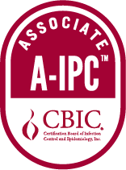
CBIC Certification: a-IPC™
Entry-level certification examination is a measure of basic infection prevention knowledge.
Recertification is completed via infection prevention units or examination.
Intended for those interested in gaining expertise or pursuing careers in infection prevention and control.
Successful certificants have a credential that demonstrates their level of interest and dedication to the field.
Can help with a transition to acute or long-term care.
Demonstrates proficiency in what you do.
Stands out to hiring managers!

Slide 33
a-IPC™ Beta Testing
Effective May 22, 2026, there will be a new content outline for the a-IPC™. The current outline will remain in effect through May 11, 2026, and applies only to individuals who have already applied and have scheduled—or will schedule—an exam appointment with Prometric on or before that date.
CBIC will conduct a beta administration of the a-IPC™ exam under the revised content outline from May 22–July 2, 2026. During the beta period, candidates will take the new version of the exam; however, results will not be released immediately.
Scoring will be based on data collected from all beta testers, with scores released during the week of August 18, 2026.
CBIC will extend a 50% reduction in exam fees from February 17, 2026, through May 4, 2026. There is also a 50% discount on the APIC online learning system.

Slide 34
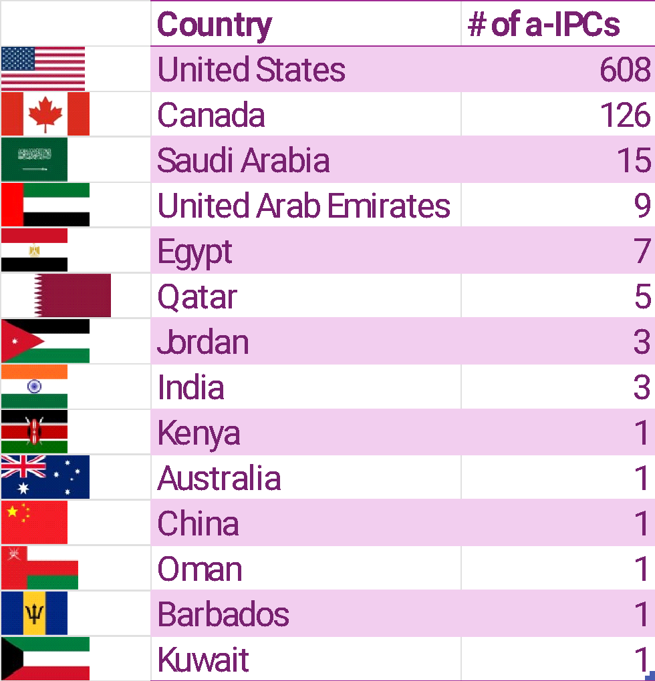
Where in the world are a-IPCs?
782 a-IPCs worldwide
Exam released in 2020

Slide 35
INFECTION CONTROL
CERTIFIED
IN

Slide 36

CIC® Eligibility Guidelines
Completed post-secondary education in a health-related field including but not limited to medicine, nursing, laboratory technology, or public health. Post-secondary includes public or private universities, colleges, community colleges, etc.
Direct responsibility for the infection prevention program activities in a healthcare setting

Slide 37
CIC® Eligibility Guidelines
Work experience, defined as active engagement in infection prevention, determined by a current job description, for compensation, for a minimum of:
At least one-year full-time employment OR
Two (2) years part-time employment OR
Completed 3,000 hours of infection prevention work experience earned during the previous three (3) years

Slide 38
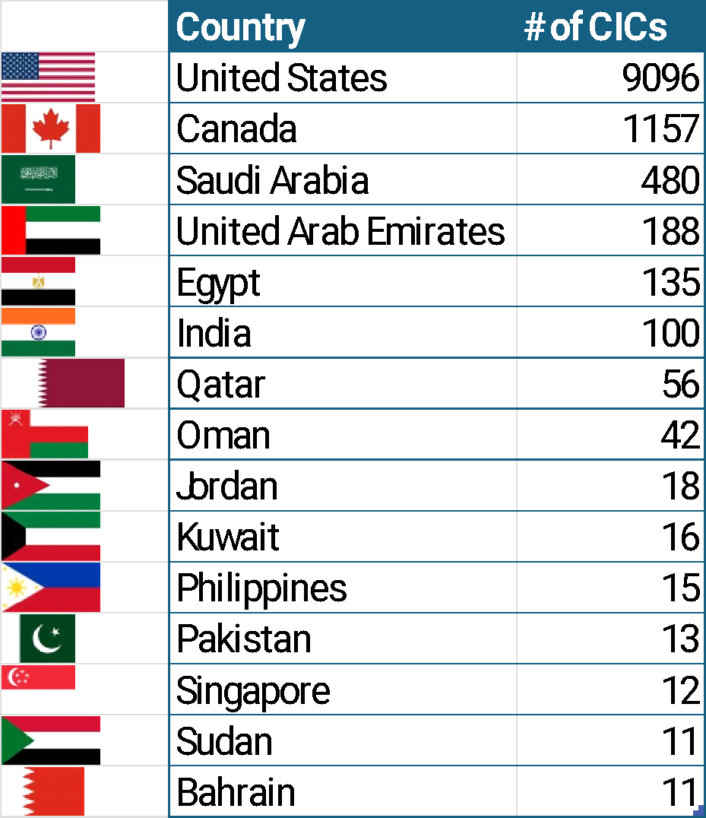
Where in the world are CICs?
11,423 CICs worldwide in 52 countries
Countries with 10+ CICs listed

Slide 39
LONG-TERM CARE CERTIFICATION
INFECTION CONTROL
IN

Slide 40
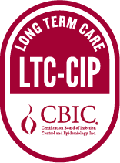
CBIC Certification: LTC-CIP®
Long-term care is a unique setting
  Nursing homes
  Skilled nursing facilities
  Assisted living facilities
Recent surveys and interviews reveal the LTC-CIP:
  Prepares IPC professionals to prevent and handle outbreaks
  Increases interfacility collaboration and communication
  Improves resident and staff safety
  Encourages the use of evidence-based data
  Is well respected by surveyors and can improve survey outcomes
Schweon SJ and Pogorzelska-Maziarz M. Survey said! LTC-CIP certificant’s perspective with passing the certification exam. Am J Infect Control. 2025;53(3):291-296.

Slide 41
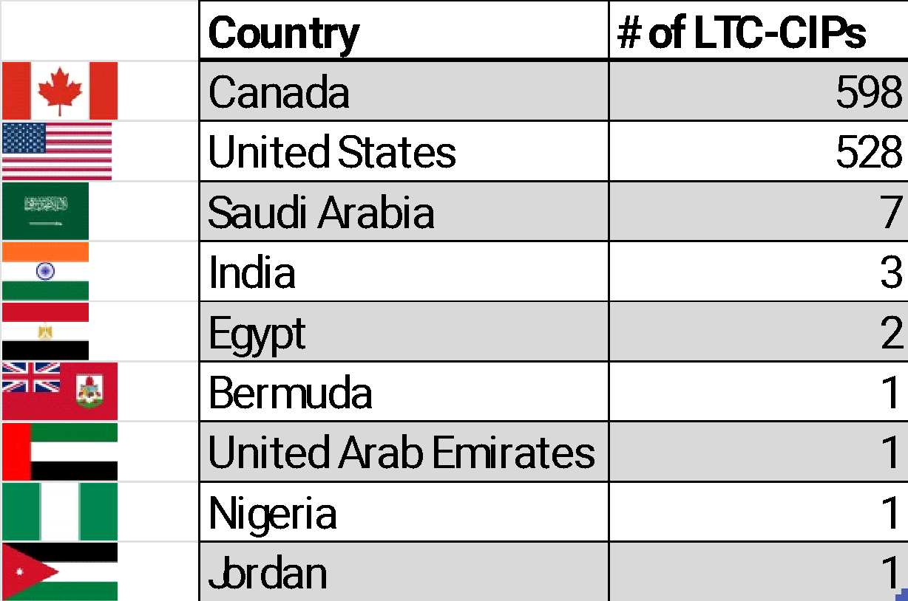
Where in the world are LTC-CIPs?
1,142 LTC-CIPs worldwide
Exam released in 2023

Slide 42
How to prepare for CBIC certification- Step 2
Review the examination content outline.

Slide 43
CIC® Content Outline
Identification of infectious disease processes
Surveillance and epidemiologic investigation
Preventing and controlling the transmission of infectious agents
Environment of care
Cleaning, disinfection, sterilization, and asepsis
Employee / occupational health
Management and communication
Education and research
Notes:
🡪 Effective May 22, 2026, there will be a new content outline for the a-IPC™. The current outline will remain in effect through May 11, 2026. There will be a blackout period from May 12-21, 2026 during which time the exam will not be available.
This updated outline is the result of a practice analysis (also called a job task analysis) conducted by CBIC to ensure that the exam continues to reflect the current knowledge, skills, and responsibilities of professionals working in infection prevention and control. Practice analyses are performed regularly to keep certification exams valid, reliable, and aligned with the evolving practice of the field.
To support this transition, CBIC will be beta testing the a-IPC™ exam under the revised content outline from May 22–July 2, 2026. During the beta period, candidates will take the new version of the exam, but results will not be released immediately, as scoring will be based on data collected from all beta testers.
The last day to register for the current version of the a-IPC™ exam will be February 1, 2026.

Slide 44
a-IPC™ Content Outline: Effective May 22, 2026
Processes to Identify Infectious Diseases
Surveillance and epidemiologic investigation
Preventing and controlling the transmission of infectious agents
Employee/
Occupational Health
Management and Communication of the Infection Prevention Program
Education and Research
Environment of Care
Cleaning, Disinfection, Sterilization of Medical Devices and Equipment
Notes:
Stay tuned for information about scholarship opportunities to serve as a beta tester for the new a-IPC certification.
Some of the content areas have been reorganized, renamed, or reweighted to better reflect current roles and responsibilities. Here are the overall themes
The 2020 outline emphasized higher-level planning, program development, and leadership — closer to CIC®-level expectations.
The 2025 outline is more entry-level and hands-on, aligning better with the intent of the associate-level credential.
Surveillance now carries greater weight and detail.
Management, Education, and Research domains have been streamlined with a more practical focus.
Language has shifted from “develop, lead, design” to “participate, assist, recognize, monitor.
*****Neither exam is easier or harder. The updated exam reflects the most current job tasks and expectations for a minimally qualified candidate. The standard of competence being measured stays the same — what changes is how the exam aligns with today’s practice.

Slide 45
LTC-CIP® Content Outline
Long-Term Care Settings
Management and Communication of the Infection Prevention Program
Identification of Infectious Diseases
Surveillance and Epidemiologic Investigation
Prevention and Control of Infectious and Communicable Diseases
Environment of Care
Cleaning, Disinfection, Sterilization of Medical Devices and Equipment
Antimicrobial Stewardship
Employee/Occupational Health

Slide 46
How to prepare for CBIC certification- Step 3
Develop a study plan and a timeline – work backwards from when you would like to take the exam.

Slide 47
Helpful Hints:
Take a practice test. Use the results to determine where you should focus your studying.
Review questions you answered incorrectly and learn from those questions.
Review the primary and secondary resources used to develop the examination – these are the only resources used to develop the content.
Develop a study plan and dedicate time each day to reviewing content.

Slide 48
Helpful Hints:
Join a study group! Learning with others can help with motivation. Celebrate your successes and help each other throughout the process. Your local APIC Chapter can be a great source of support.
Follow the timing & break structure that is used on exam day
  Two hours for the a-IPC™
  Three hours for the CIC® & LTC-CIP®
Understand that all exams are given with forward navigation – once you answer a question, you cannot go back to it.
Don’t memorize – understand the content!

Slide 49
Resources to Prepare for your Exam:
Exam prep resources: https://www.cbic.org/CBIC/Exam-Preparation-Resources.htm
Free webinar series and slides for the LTC-CIP®: https://blog.cbic.org/resources-to-help-you-prepare-for-the-ltc-cip/
APIC webinar series: https://apic.org/ltc-resources/
APIC online learning system & prep courses: https://learnipc.apic.org/ltc-cip-certification/
CBIC cannot recommend or endorse any study guides or review courses

Slide 50
How to prepare for CBIC certification- Step 4
Review the CBIC Candidate Handbook

Slide 51
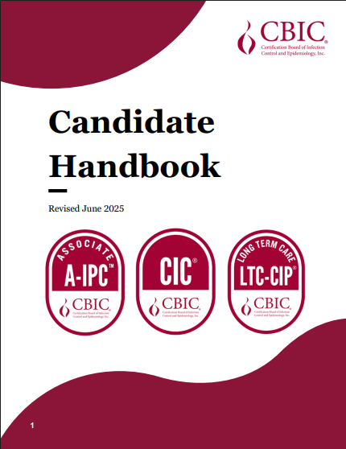
CBIC Candidate Handbook
Candidates are responsible for reviewing the polices and information contained in the Candidate Handbook prior to applying for and becoming certified.
Once a candidate has been approved to test, they are given a 90-day testing window.
Schedule your appointment with Prometric as soon as you are approved to test. Appointments are first come first serve.
Review the Prometric cancellation/rescheduling policy.

Slide 52
How to prepare for CBIC certification- Step 5
Prepare for exam day

Slide 53

Candidate Testing Experience
Candidates can take the exam at a physical testing center or via Prometric’s live remote proctoring option, Pro Proctor
Testing is available 5-7 days a week depending on location

Slide 54
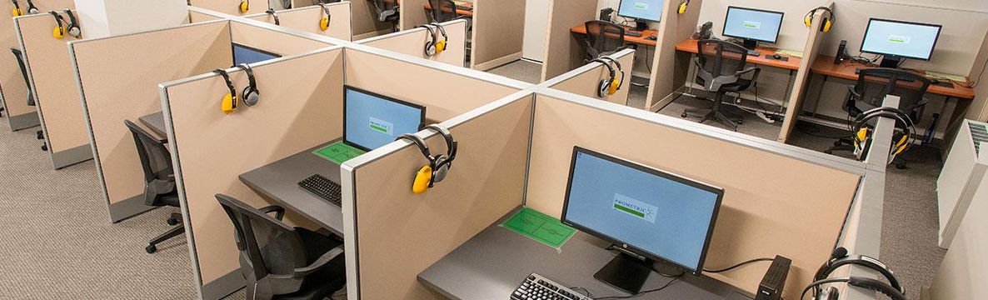
Prometric Testing Centers
Located worldwide in 160+ countries
Testing available 5-7 days a week during normal business hours
Candidates are monitored throughout the exam in a secure environment

Slide 55

Prometric – Remote Proctoring
Candidates can take the exam at home
A live, remote proctor locks down the candidate’s browser
360-degree environment check done of candidate workspace

Slide 56
After the Exam
Results are available immediately after submitting the post-examination survey.
Passing candidates will receive a Pass message. No numerical scaled score is reported to passing candidates.
Unsuccessful candidates will receive a score and performance level description.
Candidates are required to wait 90 days (CIC® & LTC-CIP®) between exam attempts and six months for a-IPC™ if unsuccessful.

Slide 57
Maintaining Certification
Understand your options & start early

Slide 58
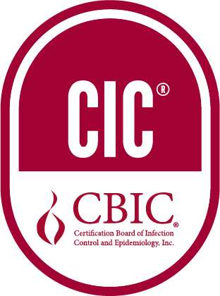
CIC® Recertification

Slide 59
CIC® Recertification Overview
CIC® certification is valid for five years from the year of successful examination
Recertification takes place every five years
Recertification can be completed via infection prevention units (IPUs) or taking the CIC® examination.

Slide 60
CIC® Recertification Overview - Updates
The open-book unproctored recertification examination is no longer offered.
Recertification will be obtainable through infection prevention units (IPUs) or by retaking the initial CIC® proctored examination.

Slide 61
Recertification by IPUs

Slide 62
What is an IPU?
IPU = Infection Prevention Unit (IPU) = continuing education credits
Can be achieved by*:
Presenting at conferences,
Authoring publications
Attending local or national conferences,
Participating in a professional organization in a position of leadership
And more! IPU guide available online.
*must be infection prevention related

Slide 63
Recertification by IPUs
Candidates must submit an IPU portfolio demonstrating completion of a minimum of 40 IPUs (a-IPCs have a prorated amount through 2029)
IPUs must be provided by a credible organization and at least 20/40 infection prevention units must be sponsored through an accredited organization or state licensing board.
Candidates can accumulate IPUs any time after their previous recertification submission date throughout their five-year recertification period
Candidates may access IPU portfolio once certified and must submit by December 1 of their expiration year.
Notes:
We updated this deadline!

Slide 64
Recertification by IPUs
To promote continuous learning, effective 2028, candidates must demonstrate that a portion of their IPUs have been attained in different years of the 5-year recertification cycle.
Effective 2028, for multi-session Infection Control Courses that offer continuous education units, an IPU may be awarded for each educational session of 1 hour or more, to a maximum of 30 IPUs for the course.
The CBIC Board recommends candidates earn at least two IPUs from DEI and Health Equity within healthcare as a part of the minimum required 40 IPUs. DEI and Health Equity should be self-evident in the title or learning objectives.
CICs who showcase leadership skills via participation in a formal mentorship program through a professional organization related to infection prevention and control may now earn 3 IPUs per year of program participation.

Slide 65
Recertification by IPUs Timeline
Professional portfolio available once certified.
Record activities and upload verification documents
Submit portfolio by December 1
CBIC reviews all portfolios
If successful, new five-year recertification period begins

Slide 66
Recertification by IPUs: Helpful Hints
Submit your IPUs as you earn them!
Don't wait until the last minute to submit your portfolio
Reach out to staff with questions
Once your credits have been approved, you will receive a new 5-year certification and can begin submitting IPUs for your next portfolio, due in five years.

Slide 67
CIC® Domains (6/8 required)
Identification of Infectious Disease Processes
Surveillance and Epidemiologic Investigation
Preventing/Controlling the Transmission of Infectious Agents
Employee/Occupational Health
Management and Communication
Education and Research
Environment of Care
Cleaning, Sterilization, Disinfection, Asepsis

Slide 68
a-IPC™ Domains (6/8 required)
Processes to Identify Infectious Diseases
Surveillance and Epidemiologic Investigation
Preventing/Controlling the Transmission of Infectious Agents
Employee/Occupational Health
Management and Communication of the Infection Prevention Program
Education and Research
Environment of Care
Cleaning, Disinfection, Sterilization of Medical Devices and Equipment

Slide 69
LTC-CIP Domains (7/9 required)
Long-Term Care Settings
Management and Communication of the Infection Prevention Program
Identification of Infectious Diseases
Surveillance and Epidemiologic Investigation
Prevention and Control of Infectious and Communicable Diseases
Environment of Care
Cleaning, Disinfection, Sterilization of Medical Devices and Equipment
Antimicrobial Stewardship
Employee/Occupational Health

Slide 70

Certified as a CIC® and LTC-CIP®?
Credits can be used in both portfolios if the IPUs are earned within your 5-year certification cycle.

Slide 71

IPUs and Chapter Activities
Does my Chapter activity count towards IPUs?
Subject matter related to infection prevention and control, and falls within at least one of the eight domains
Able to verify chapter member attendance or participation by providing required documentation
YES!

Slide 72
IPU Conversion Chart
 | Duration of participation/instruction | CEUs | CMEs | CNEs | IPUs
Applicable Activities: Online, paper, or live format education Attendance at national conference IP-related sessions Teaching | 60 minutes of instruction or 1 "contact hour" | 0.1 | 1 | 1 | 1

Slide 73
IPUs Resources
IPUs FAQ page
IPUs downloadable Criteria Chart
IPUs Portfolio Manual
Maintaining your CBIC certification through Infection Prevention Units webinar

Slide 74
ADVANCED LEADERSHIP CERTIFICATION
INFECTION PREVENTION
IN

Slide 75
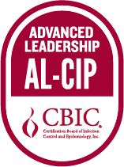
CBIC Certification: AL-CIP™
  The Advanced Leadership Certification in Infection Prevention & Control (AL-CIP) is an assessment of knowledge, skills and abilities expected of individuals who demonstrate professional expertise, leadership and impact in the field of infection prevention and control.
  Portfolio-based assessment.
  Demonstrates leadership within infection prevention and control that has a measurable impact.
  Next application cycle: July 13-August 17, 2026

Slide 76
AL-CIP™ in the News
From the American Journal of Infection Control: Leadership experiences of infection prevention and control professionals: Findings from the Leadership Evaluation and Development for Infection Preventionists (LEAD-IP) study
Certified IPs described a transition from task-oriented roles to systems-level leadership, emphasizing data use, structured improvement models, inclusive team engagement, communication, and psychological safety.
The AL-CIP™ was seen as reinforcing leadership identity, confidence, credibility, and career growth, underscoring the value of targeted leadership development in strengthening IPC workforce capacity.
Leadership experiences of infection prevention and control professionals: Findings from the Leadership Evaluation and Development for Infection Preventionists (LEAD-IP) study
Ruch, Kayla E. et al.
American Journal of Infection Control, Volume 0, Issue 0

Slide 77
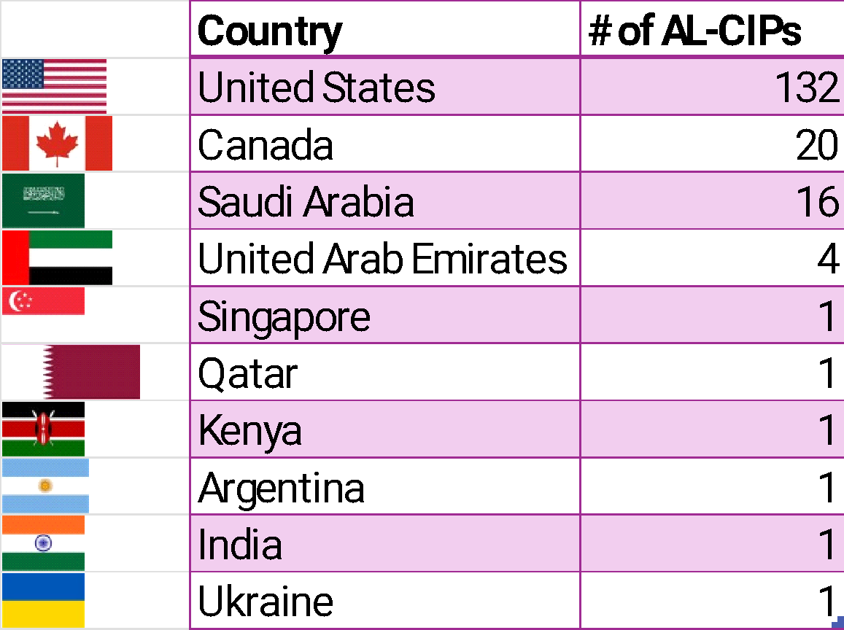
AL-CIP™ Certificants Around the World
178 AL-CIPs worldwide
Released in 2025

Slide 78
AL-CIP™ Eligibility Requirements
Active CIC® or LTC-CIP® certification
Demonstrated positive impact on the profession: Active engagement and advanced infection prevention and control practice, leadership, education, research, policy and/or advocacy for a recommended minimum of 7-10 years.

Slide 79
AL-CIP™ Framework
AL-CIP™ Framework
Domain I: Leadership
Domain II: Professionalism
Competencies
Practice & Innovation
Accountability
Competencies
Change Management & Quality Improvement
Inclusivity
Advocacy
Professional Development
Notes:
The framework for the AL-CIP resulted in two domains: leadership and professionalism. Each domain contains defined competencies. Details will be provided on the following slides.
Leadership: Advanced ability to inspire excellence, create a shared vision and successfully manage change to attain strategic goals
Professionalism: Advanced ability to incorporate and promote ethical and professional standards that include accountability, inclusivity, a service orientation, and a commitment to lifelong learning and improvement

Slide 80
Examples of evidence*:
Publications (e.g., peer and non-peer-reviewed journal article, guidelines, compendium)​. For this type of evidence, include a description of your role in the publication and/or your role in the activities described in the publication in your rationale.
Presentations (e.g., chapter, regional, national, or international conferences; in-person, virtual, classroom, workshop; poster presentation)​. For this type of evidence, describe your role in the presentation (development, implementation, delivery, etc.) in your rationale.
Work product (e.g., toolkits, guidance documents, strategic plan, website, practice changes)​. For this type of evidence, clearly describe your contribution to the work product (e.g., independent, as part of a team, activities, outcomes as a result of the product) in your rationale.
*all supporting evidence provided must be within the last ten years
Notes:
There are various types of evidence. I will highlight a few that you may consider in your portfolio submission.
Publication of guidelines, journal article, compendium; Presentation at a regional, national or international conference; the development of a work product such as a toolkit on CLABSI prevention; program development of an academic course syllabus for credit; and of course the CIC certification. All supporting evidence must be within the last ten years and must be relevant to leadership in IPC within the professionalism and leadership domains. If you submitted a publication on congestive heart failure, this would not be accepted since it is not related to IPC. The evidence should also be at the state, regional, national or international level.

Slide 81
Examples of evidence*:
Program development materials (e.g., academic syllabus, website, course materials, program evaluation)​. For this type of evidence, describe your role in the program (e.g., original proposer, development, teaching, co-teaching, etc.) in your rationale.
Credential / certifications relevant to leadership in IPC (e.g., Six sigma black belt, CPHQ, CPH, CEU/CPD)​. For this type of evidence, describe programs or outcomes that resulted from you having achieved this credential or certification, in your rationale.
*all supporting evidence provided must be within the last ten years
Notes:
There are various types of evidence. I will highlight a few that you may consider in your portfolio submission.
Publication of guidelines, journal article, compendium; Presentation at a regional, national or international conference; the development of a work product such as a toolkit on CLABSI prevention; program development of an academic course syllabus for credit; and of course the CIC certification. All supporting evidence must be within the last ten years and must be relevant to leadership in IPC within the professionalism and leadership domains. If you submitted a publication on congestive heart failure, this would not be accepted since it is not related to IPC. The evidence should also be at the state, regional, national or international level.

Slide 82
AL-CIP™ Resources
Visit the CBIC website to learn more: https://www.cbic.org/CBIC/Get-Certified/Get-Started/Advanced-Certification-in-Infection-Prevention.htm
Frequently asked questions
Tips for Success Document
Pre-recorded webinar
Sign up for an informational session
Read more about the framework

Slide 83
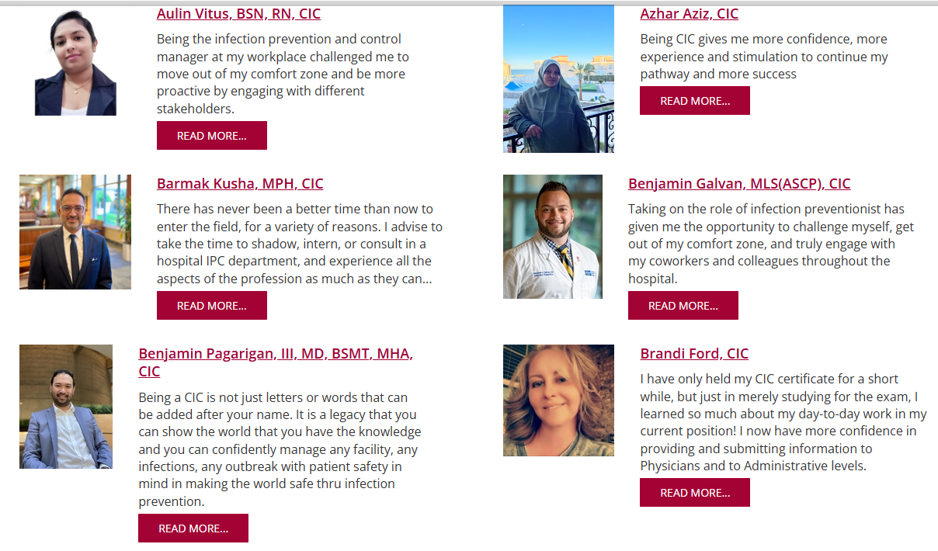
We asked! What does certification mean to you?

Slide 84
We asked! What does certification mean to you?
Being a CIC® means that I have reached a level of proficiency as an IP professional where I am respected and relied on for my expertise. I take pride in being recognized for the professional practice experience and scientific knowledge base required to be an independent IP professional.
I became CIC® certified for a few reasons. To identify any knowledge gaps while I was learning to be an IP, validate my self-training, in other words to prove to myself and others that “I knew what I knew”.
I have worked in the senior living industry for 30 years and feel that learning and growth are essential to nursing practices. This certification adds another layer of expertise and can be applied to many different aspects of care delivery.

Slide 85
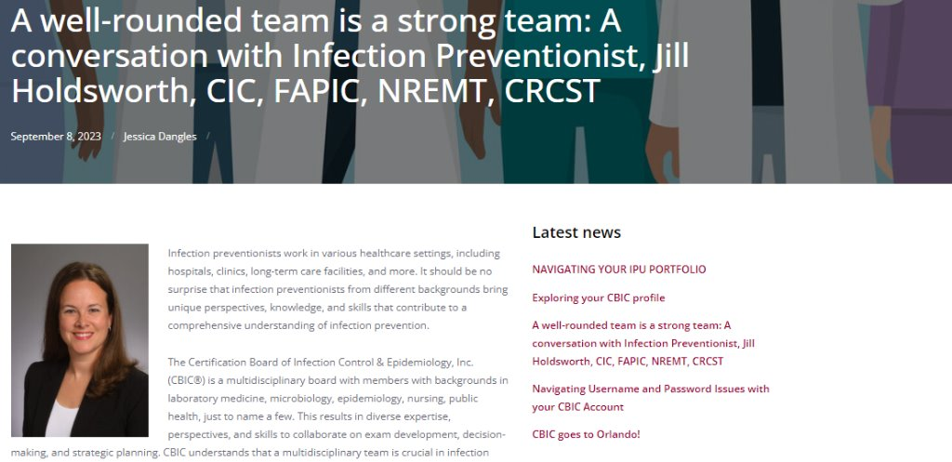
Celebrate your certification!
CBIC Corner: Share your certification journey with us
Notes:
We’d love for you to share your story with us and be featured on the CBIC blog

Slide 86
Thank you!
Notes:
Questions??

Slide 87
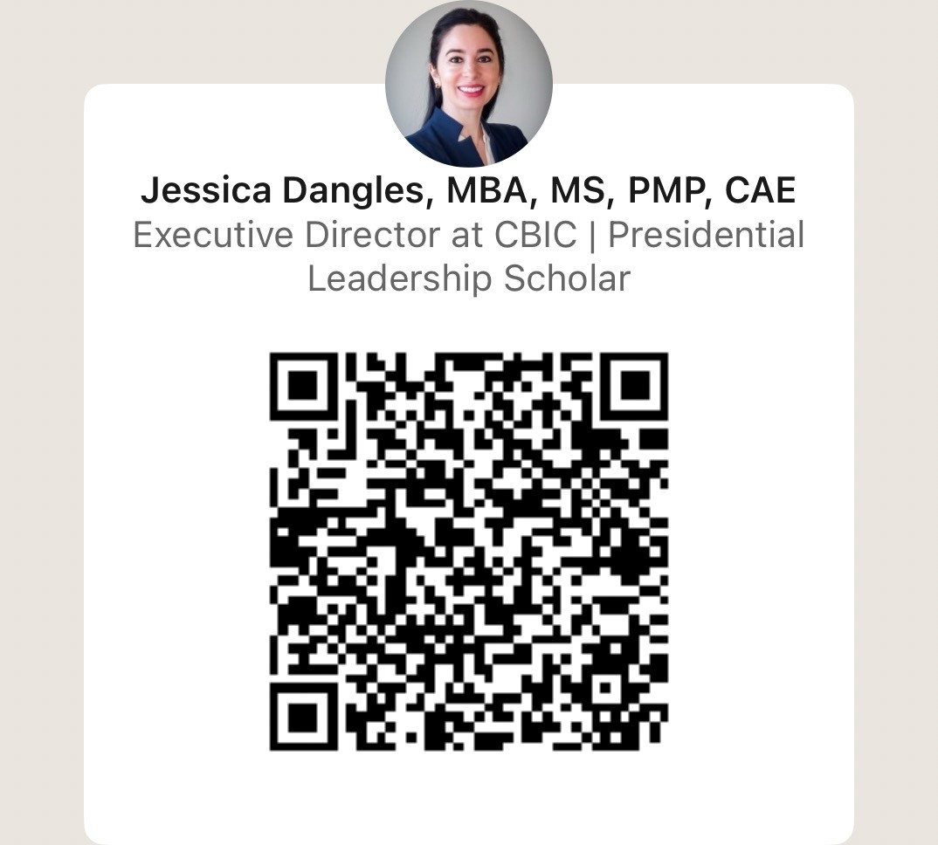
Contact CBIC:
jdangles@cbic.org or info@cbic.org

Slide 88

Presenter Evaluation/IPU/Cert of Completion

Slide 89

SSI Questions for Dr. Edmiston
SSI Office Hours 3rd Friday of the Month 2-3 pm

Slide 90
Thank YOU!
Next Chapter Meeting:
April 24, 2026
11 AM- 330 PM
Banner UMC Tucson Duval Auditorium
*Communication coming 4/3/26*

Slide 91


Closing
This Photo by Unknown Author is licensed under CC BY-SA

