Slide 1
Targeted Multidrug-resistant Organisms
Epidemiology and Public Health Response in Kansas
Stephanie Lindemann, MPH
April 12, 2022

Slide 2
Objectives
Understand the epidemiology and disease reporting regulations for targeted multi-drug resistant organisms (MDROs).
Demonstrate knowledge and understanding to implement the MDRO Containment Strategy alongside public health recommendations when a targeted MDRO is identified in your facility.
Maintain updated contact information with the HAI/AR Program staff through utilization of the K-COMS system.

Slide 3
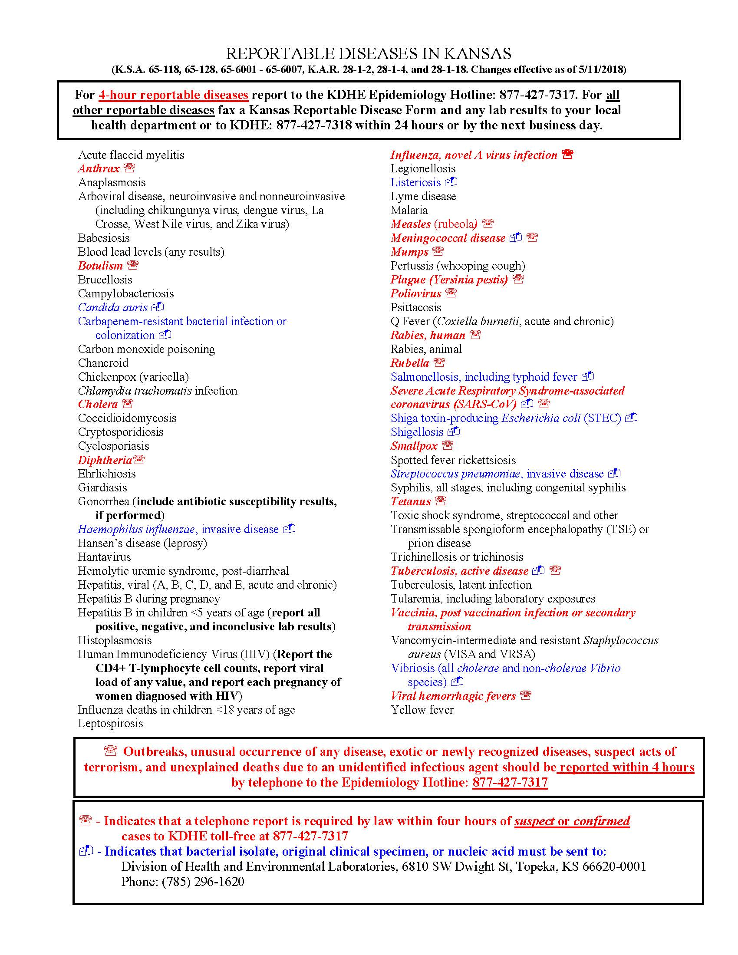



Reportable diseases
Reportable MDROs
Candida auris
Carbapenem-resistant bacterial infection or colonization (CRE, CRAB, CRPA)
Vancomycin-intermediate and resistant Staphylococcus aureus (VISA and VRSA)
Indicates that bacterial isolate or original clinical specimen must be sent to the Department of Health and Environmental Laboratories:
6810 SW Dwight Street, Topeka, KS 66620-0001
Phone: 785.296.1620
Carbapenem-resistant bacteria submission guidelines:
https://www.kdhe.ks.gov/DocumentCenter/View/14254
KDHE 24/7 Epidemiology Hotline
Phone: 877-427-7317 | Fax: 877-427-7318
https://www.kdhe.ks.gov/1492

Slide 4


Carbapenem-resistant bacteria – 2017
Carbapenem-resistant Enterobacteriaceae (CRE) considered an urgent public health threat
13,100 infections, 1,100 deaths
Carbapenem-resistant Acinetobacter baumannii (CRAB) considered an urgent public health threat
8,500 infections, 700 deaths per year
Multi-drug resistant Pseudomonas aeruginosa including Carbapenem-resistant Pseudomonas aeruginosa (CRPA) considered a serious public health threat
32,600 infections, 2,700 deaths per year

Slide 5
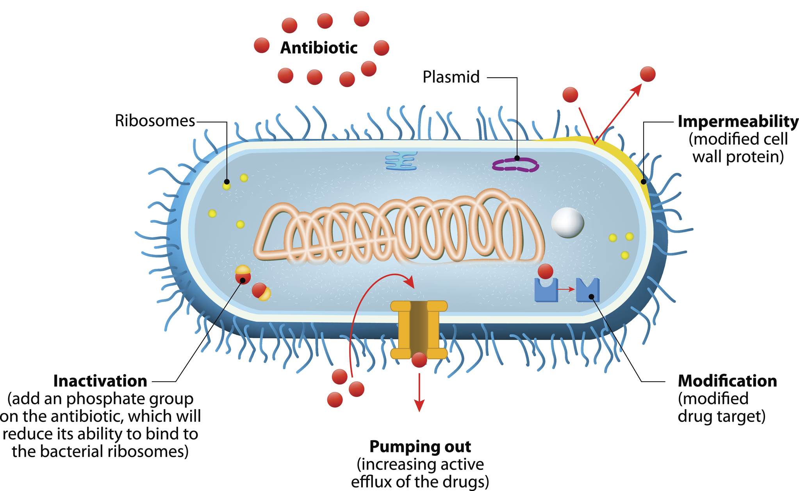
Mechanisms of antibiotic resistance

Slide 6
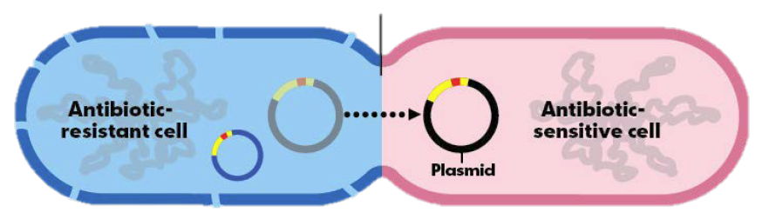
Carbapenemase enzymes
Carbapenemases are enzymes that degrade carbapenem antibiotics
Public Health concern due to potential for rapid spread, outbreaks
Carbapenemase genes are often on mobile genetic elements that can be transferred among other gram-negative organisms.
Common carbapenemases: KPC, NDM, VIM, OXA, and IMP
Found in Enterobacteriaceae (CRE), Pseudomonas aeruginosa, and Acinetobacter baumannii (CRAB)

Slide 7
Carbapenemase classifications
Enzyme | Classification | Activity
Klebsiella pneumoniae carbapenemase (KPC) | Class A | Hydrolyzes all β-lactam agents
New Delhi Metallo-β-lactamase (NDM) | Class B | Hydrolyzes all β-lactam agents except aztreonam
Imipenemase (IMP)
Verona Integron Mediated Metallo-β-lactamase (VIM)
Oxacillinase (OXA) | Class D | Hydrolyzes carbapenems but not active against 3rd generation cephalosporins

Slide 8
Carbapenemase-producing CRE in Kansas, 2017-2021
*includes all isolates submitted to KHEL; preliminary, subject to change

Slide 9
CP-CRE carbapenemase variants in Kansas, 2017-2021
*includes all isolates submitted to KHEL; preliminary, subject to change

Slide 10
Carbapenemase-producing CRAB in Kansas, 2019-2021
*includes all isolates submitted to KHEL; preliminary, subject to change

Slide 11
CP-CRAB carbapenemase variants in Kansas, 2019-2021
*includes all isolates submitted to KHEL; preliminary, subject to change

Slide 12
CP-CRAB antibiogram
Cumulative antimicrobial susceptibility report
Percent Susceptible 2018-2021 Isolates | Total No. of Isolates | Aminoglycosides |  |  |  | Polymyxins |  | β-Lactams |  |  | β-Lactam/ inhibitor combo |  |  | Cephalosporins |  |  |  |  | Carbapenems |  |  |  |  | Folate pathway inhibitor | Fluoro quinolones |  | Glyco pep tides | Lincosa mides | Lipo pep tides | Macro lides |  | Mono bac tam | Nitro fur ans | Oxazo lidin one | Tetracyclines
 |  |  |  |  |  |  |  |  |  |  |  |  |  | 3rd | 4th | 5th
 |  | Amikacin | Gentamicin | Tobramycin | Plazomicin | Polymyxin B | Colistin | Ampicillin | Oxacillin | Penicillin | Amoxicillin/clavulante | Ampicillin/sulbactam | Pipercillin-tazobactam | Ceftazidime | Cefepime | Cefiderocole | Ceftazidime-avibactam | ceftolozane-tazobactam | Ertapenem | Imipenem | Imipenem-cilastatin-relebactam | Meropenem | Meropenem-vaborbactam | Trimethoprim/ sulfamethoxazole | Ciprofloxacin | Levofloxacin | Vancomycin | Clindamycin | Daptomycin | Azithromycin | Erythromycin | Aztreonam | Nitrofurantoin(1) | Linezolid | Minocycline | Fosfomycin (Monurol)
Acinetobacter baumannii | 134 | 26% | 18% | 19% | NT | 95% | 94% |  |  |  |  | 29% | 0% | 1% | 3% | NT | NT | NT |  | 0% | NT | 0% | NT | 4% | 0% | 0% |  |  |  |  |  |  |  |  | 63%
*prepared by Dr. Kellie Wark

Slide 13
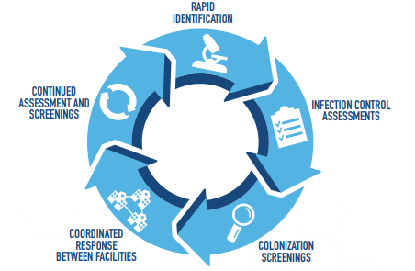
The containment strategy

Slide 14
The containment strategy
Transmission appears to have the highest risk in post–acute care facilities with higher acuity patients
Long duration of facility stay
Less aggressive use of transmission-based precautions (concerns about residents’ quality of life)
High staff turnover
Less expertise and training in infection control
Ongoing support required when targeted resistant organisms are identified
Infection control assessments
Screening of contacts
Education

Slide 15
Case study – CP-CRAB in Facility A (SNF)
Specimen source | Isolates tested | Isolates positive
Axilla/groin | 100 | 12
Rectal | 28 | 0
Wound | 13* | 3*
Tracheal aspirate | 0 | 0
*includes index case and two additional cases identified at a hospital

Slide 16
Case study – CP-CRAB in Facility B (SNF)
Specimen source | Isolates tested | Isolates positive
Axilla/groin | 99 | 10
Rectal | 5 | 1
Wound | 2* | 2*
Tracheal aspirate | 1 | 1
*includes index case and one additional case identified at a hospital

Slide 17
Case study – CP-CRAB in Facility C (SNF)
Specimen source | Isolates tested | Isolates positive
Axilla/groin | 104 | 7
Rectal | 44 | 3
Wound | 4* | 3*
Tracheal aspirate | 1 | 0
*includes index case

Slide 18
Case study – CP-CRAB in Facility D (ACH)
Increase noted in the beginning of 2018
Six cases in a 3-week period
Outbreak period occurred for ~8 months
CRAB isolated from different sites of infection
Wounds
Respiratory tract
Bloodstream infections (CLABSI)
11 clinical and environmental samples
All genetically related (0-2 SNPs)
OXA-24 variant

Slide 19


Case study – CP-CRAB in Facility D (ACH)
Units with positive CRAB environmental cultures:
OR, ICU, ED trauma bay, rehab unit, burn unit, med-surg, pulmonary step-down, and oncology unit
Positive environmental culture sources:
Bedrails, computer keyboard, wound scissors (after being soaked in bleach), medicine cabinet, patient chart, chair, trauma bay counter, telemetry leads, Pyxis, and anesthesia machine in OR
Acinetobacter is VERY good at contaminating the environment!

Slide 20
How bacteria is transmitted
Person-to-Person
Hands of healthcare workers
Contact with Body Fluids
Drainage from wounds, urine, stool, blood
Contaminated Medical Equipment
Bed rails, IV poles, catheters, mobile medical carts, shared medical equipment

Slide 21
IP Response to CRAB, CRE, and CRPA
Isolation Precautions
Single patient room, if possible
Enhanced Barrier Precautions
Flag medical record for MDRO
Lab Surveillance
Retrospective review
Prospective review
Ensure lab reporting
Observation and audits
Hand hygiene and environmental services observations
Communication
Frontline staff education
Patient education
External facilities on transfer

Slide 22
Provider and patient education about MDROs
Public Relations
Identification of a MDRO at a facility does not equate to acquisition at the facility
State and CDC guidelines for response and containment are being followed
Opportunity to demonstrate responsible and proactive efforts in combatting AR
Colonization screening
Provider perspectives of screening has been shown to influence patient’s perception
KDHE and CDC have resources available to facilitate clear communication about the importance of screening for these urgent public health threats and address common patient concerns
CMS supports collaboration with public health on responding to MDROs
“Additionally, we strongly encourage the use of available technical resources, especially when novel organisms appear or there is an outbreak in your area. In many cases the Centers for Disease Control and Prevention is the first entity to release information on novel organisms…All facilities must comply with state and local public health authority requirements for identification, reporting, and containing communicable diseases and outbreaks. Many infection prevention and control resources are available to you to prevent and control infections in your facility.” (https://www.cms.gov/files/document/qso-20-03-nh.pdf)
Currie, K., King, C., McAloney-Kocaman, K., Roberts, N.J., MacDonald, J., Dickson, A., Cairns, S., Khanna, N., Flowers, P., Reilly, J., & Price, L. (2018). The acceptability of screening for Carbapenemase Producing Enterobacteriaceae (CPE): cross-sectional survey of nursing staff and the general publics perceptions. Antimicrobial Resistance & Infection Control. 144(7). https://doi.org/10.1186/s13756-018-0434-x

Slide 23
Antibiotic Stewardship
Core elements
Hospital Leadership Commitment
ASP Team Development
Pharmacy Expertise
Action
Tracking
Reporting
Education
KDHE Antimicrobial Stewardship Toolkits:
Critical Access Hospitals - https://www.kdhe.ks.gov/DocumentCenter/View/14468
Long-Term Care - https://www.kdhe.ks.gov/DocumentCenter/View/14470
CDC Antimicrobial Stewardship resources:
https://www.cdc.gov/antibiotic-use/index.html

Slide 24
Core infection control practices
Inter-facility patient transfer forms
Easy communication of patients with history/acute illness of targeted MDROs
Patient transfer referrals
Healthcare facilities should NOT decline to accept patient based on colonization status
Specific recommendations on isolation measures in long-term settings
Enhanced Barrier Precautions
https://www.kdhe.ks.gov/DocumentCenter/View/14469

Slide 25

The KDHE HAI/AR Program is growing!
Program Director
Senior HAI/AR Epidemiologist
Senior Infection Preventionist
Advanced HAI Response Epidemiologist
Antimicrobial Resistance Epidemiologist
AR Epi/Lab Coordinator
3 Infection Preventionists
7 Regional Infections Preventionists
Hiring:
3 additional Epidemiologists
2 additional Infection Preventionists

Slide 26
KDHE HAI/AR Program
kdhe.HAIAR@ks.gov
785.296.4167 Office
HAI/AR Program webpage
24/7 Epidemiology Hotline
877.427.7317 Phone
877.427.7318 Fax
Thank you!
Justin Blanding, MPH
Senior HAI/AR Epidemiologist
Justin.Blanding@ks.gov
785.296.1242 Office
Stephanie Lindemann, MPH
AR Epidemiologist
Stephanie.Lindemann@ks.gov
785.296.5588 Office
785.250.4638 Mobile

Slide 27


Updated COVID-19 Reporting Requirements
CLIA Certificate Type | (+) NAAT | (-) NAAT | (+) Antigen | (-) Antigen
Certificate of Waiver (CoW)
Moderate Complexity
High Complexity
NAAT= nucleic acid amplification test (e.g. PCR)
Certificate of Waiver= most LTCFs operate under a CLIA CoW. They are not required to report negative results to public health; however, they are required under HIPAA to provide results to the patient for any test conducted. If facilities are using LabXChange this platform has process to allow patients to access their test results.
Data elements= Ask on Order Entry (AOE) questions are no longer required to be submitted by laboratories. All other reporting elements have not changed (e.g., patient name, test type, demographics, ordering physician).
LTCF= CMS-certified LTCFs may report into NHSN if they do not report to KDHE. The preferred CMS and CDC method is for LTCFs to report into NHSN.
Serology/antibody testing= Serology/antibody testing does not need to be reported regardless of result or CLIA certificate.

Slide 28
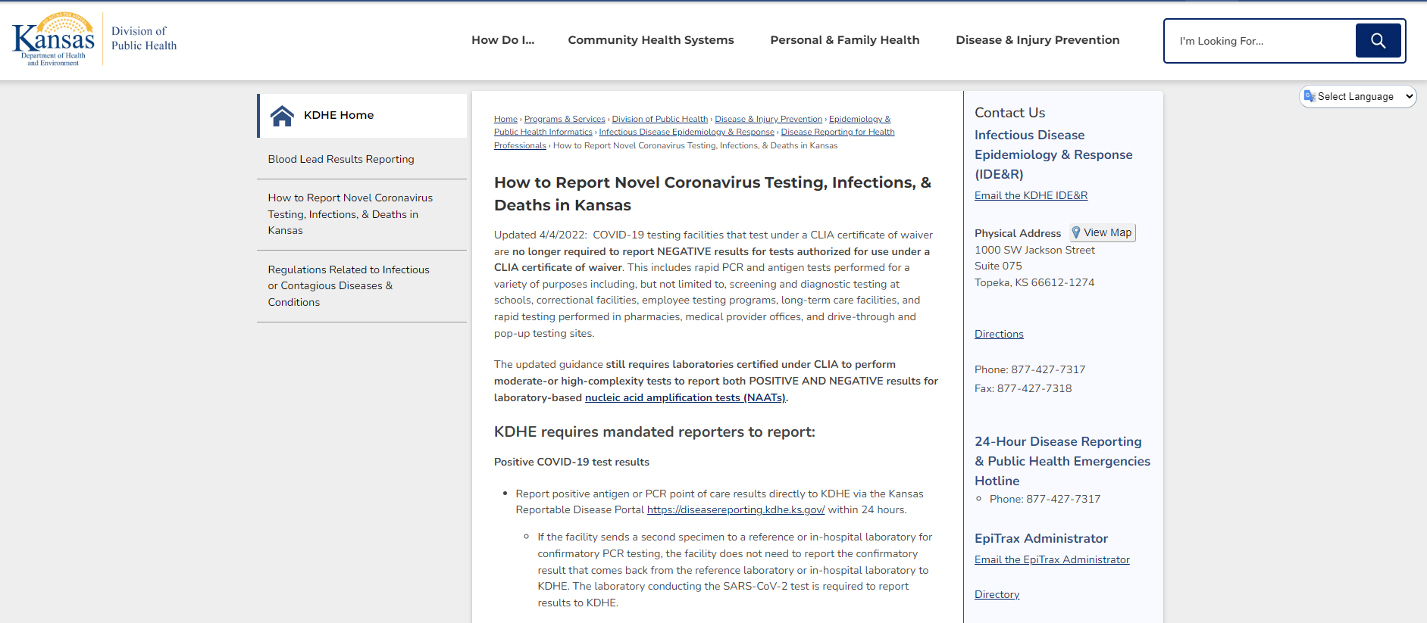
Updated COVID-19 Reporting Requirements
https://www.kdhe.ks.gov/1500

Slide 29


