Slide 1
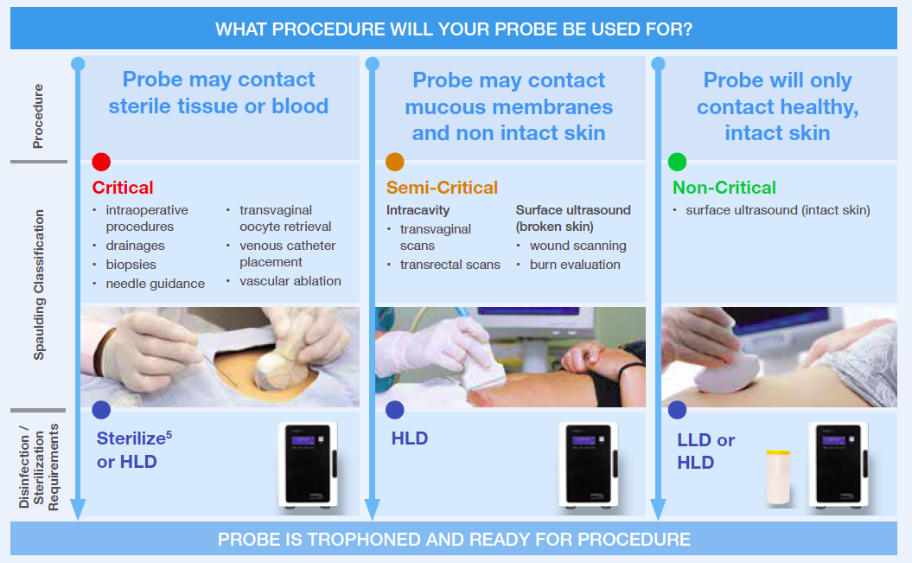
There is international consensus on the requirement to apply HLD to semi-critical ultrasound (US) transducers (including surface probes), regardless of whether a probe cover/sheath is used.
Note, critical US transducers should be sterilized, or can also be HLD and used with a sterile sheath.
When do I need to apply HLD?
Notes:
Reference
5. Rutala WA, Weber DJ, Healthcare Infection Control Practices Advisory Committee (HICPAC), Centers for Disease Control and Prevention (CDC). USA. Guideline for Disinfection and Sterilization in Healthcare Facilities. 2008 (Updated 15 February 2017). Available at: https://www.cdc.gov/infectioncontrol/pdf/guidelines/disinfection-guidelines.pdf.
Critical – Critical probes should be sterilized, or can also be HLD and used with a sterile sheath.
Note: The use of a sheath does not negate the need for HLD

Slide 2
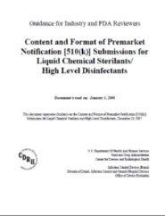
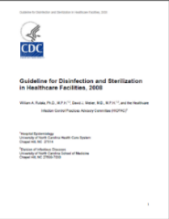

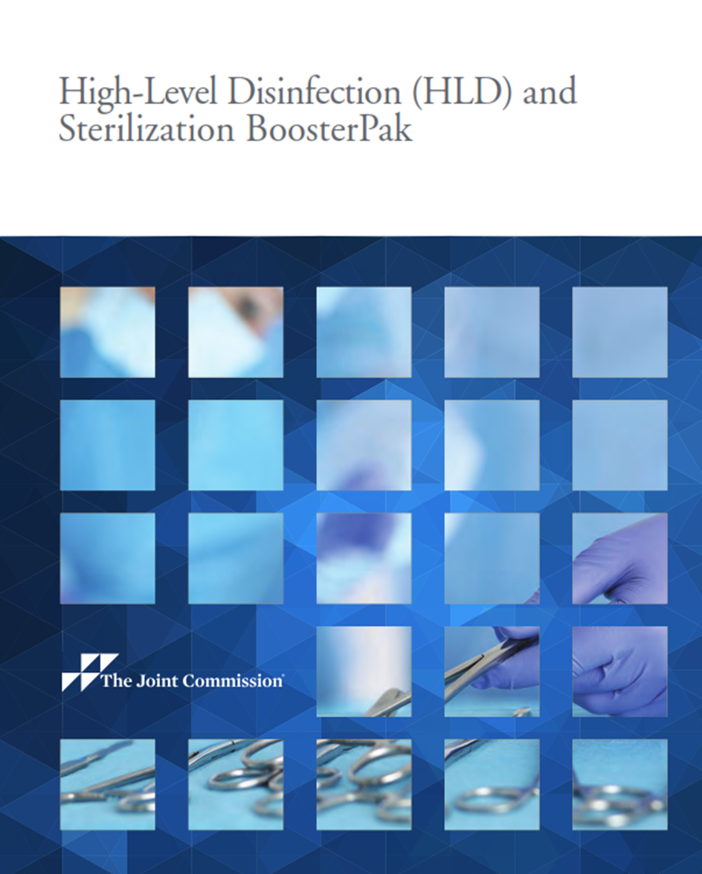
Current Guidelines
Standards and Guidelines recommend HLD
Current Standards
FDA
CDC
“Semicritical devices…sterilize these devices between uses whenever feasible, but high level disinfection is minimally acceptable.” ³
-“…because condoms/probe covers can fail, the [semi-critical ultrasound] probe also should be high-level disinfected.”¹
- Ultrasound probes used during surgical procedures also can contact sterile body sites. These probes can be covered with a sterile sheath to reduce the level of contamination on the probe and reduce the risk for infection. However, because the sheath does not completely protect the probe, the probes should be sterilized between each patient use as with other critical items. If this is not possible, at a minimum the probe should be high-level disinfected and covered with a sterile probe cover.”
AAMI
“Semicritical devices should be sterilized, if possible. However, if sterilization is not feasible, the device, at a minimum, must be subjected to a high-level disinfection process…” ⁴
TJC
Semi-critical devices that contact mucous membranes or non-intact skin should minimally undergo High Level Disinfection. ⁵
Agree
Agree
Semi-critical and critical ultrasound transducers must minimally undergo HLD even if used with a sheath
Semi-critical reusable medical devices must minimally undergo HLD
Notes:
What are the differences between guidelines vs standards?
Guidelines provide recommendations for best practice
Standards define parameters that need to be met in order to meet a particular standard
Both can be enforceable for example, the TJC accredits healthcare facilities based on their compliance with guidelines and standards.
In a healthcare setting it is important from a legal liability perspective that the facility is following best practice. ( complying with guidelines and standards)
If they are not they may be considered negligible if a patient is harmed
References
1. Rutala WA, Weber DJ, HICPAC. Guideline for Disinfection and Sterilization in Healthcare Facilities. USA: Centers for Disease Control; CDC 2008. (https://www.cdc.gov/infectioncontrol/pdf/guidelines/disinfection-guidelines.pdf)
2. American Institute of Ultrasound in Medicine. Guidelines for cleaning and preparing external and internal-use ultrasound probes between patients. AIUM Official Statement. Online at: http://www.aium.org/officialStatements/57. Accessed March 8, 2016.
3. Federal Drug Administration. Guidance for Industry and FDA Reviewers: Content and Format of Premarket Notification [510(k)] Submissions for Liquid Chemical Sterilants/High Level Disinfectants. 200 http://www.aami.org/standards/index.aspx?navItemNumber=504 0.
4. AMMI http://www.aami.org/standards/index.aspx?navItemNumber=504
5. Electronically accessed: Joint Commission Alert is Another Wake-Up Call for Awareness of Improper HLD or Sterilization. http://www.infectioncontroltoday.com/articles/2014/08/joint-commission-alert-is-a-another-wakeup-call-for-awareness-of-improper-hld-or-sterilization.aspx

