Slide 1

Nasal Colonization
Management

Slide 2
DISCLOSURES
Ernest W. (Bill) Spannhake, PhD, Chief Science Officer, Global Life Technologies Corp.
Tarina Garcia-Concheso, VP of Clinical Training, Global Life Technologies Corp.
Gregg Wilkinson, EVP, Strategy and Product Management, Global Life Technologies Corp.
Melanie Harder, Director of Sales, Global Life Technologies Corp.

Slide 3
NASAL COLONIZATION MANAGEMENT
Definition of Nasal Bacterial Carriage
Impact of Nasal Colonization on Infection Rates
Tools available to Reduce Nasal Colonization
Leveraging Nasal Decolonization to Improve Care and Reduce Costs

Slide 4
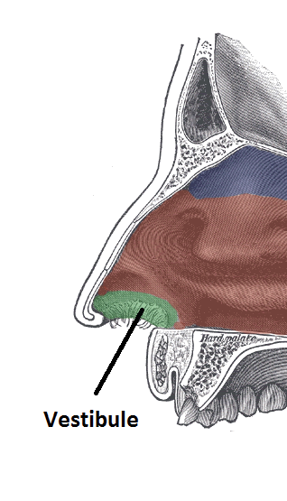
Nasal Bacterial Carriage – What is it?
The NOSE: A Major Reservoir for Bacteria
Nasal Carriage of Bacteria is present in Everyone, even in healthy individuals without symptoms
Nasal Repository is a Source for Contamination of Self, Others and Patient/Staff Environment
Nasal Bacterial Carriage is a Primary Threat to Hand Hygiene

Slide 5
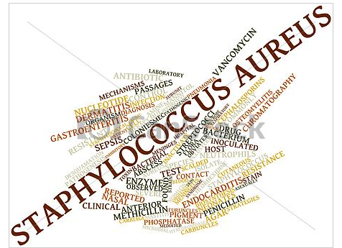


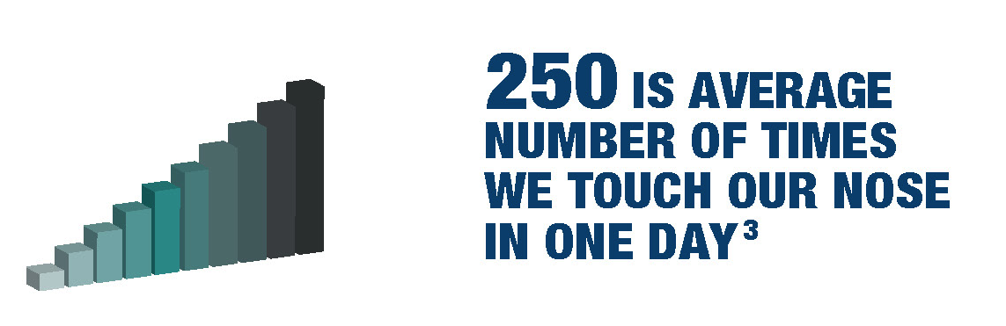
Nasal Bacterial Carriage - What is it?
S. aureus is the #1 cause of HAIs
~30% of population carries Staph aureus in their nasal vestibules, including MRSA and MSSA
In HCW: 50% of hand contamination with S. aureus is Self Inoculated

Slide 6
FACTS: Nasal Decolonization and SSIs
80% of post-op MRSA infections can be traced to the patient’s own nasal colonies.
20% comes from the Environment- most likely from Peri-op and ICU Staff and Caregivers at home.
Little has been done to Address the Major Components of Risk.

Slide 7
Nasal Decolonization
MRSA Nasal Colonization is associated with:
Increased Risk of Infection after Hospital Discharge ¹
Worse Clinical Outcomes ²
Increased Risk of Death ^{2,3}
Increased Hospital Stay ³
Higher Costs of Care ^{3,4}
¹ Huang SS et al. Clin Infect Dis 2003;36:53-594
² Cosgrove SE et al. CID 2003;36(1):53-9
³ Cosgrove SE et al. ICHE 2005;26(2):166-74
⁴ McHugh CH et al. ICHE 2004;25:425-430
Notes:
Higher costs associated with Isolation protocols, meds, re-admits

Slide 8

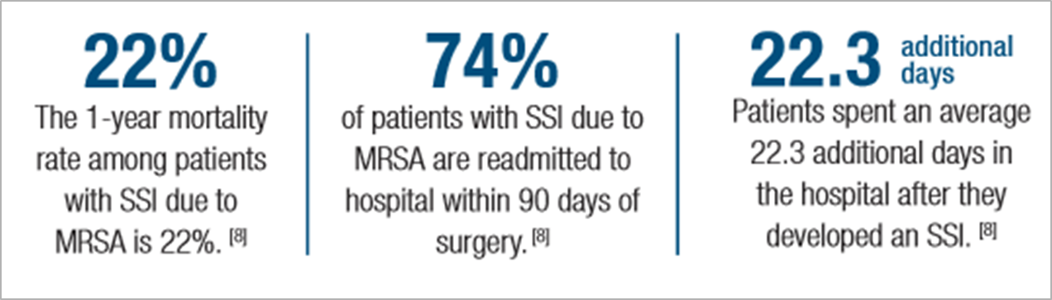
SSI STUDY DATA

Slide 9
Colonization vs. Infection
MRSA Colonization
A Health State in which Patient carries Bacteria with No Clinical Infection
MRSA Infection
A Health State in which Patient develops an Invasive Infection. Common infections: SSI, UTI, BSI, Pneumonia.

Slide 10
Nasal Decolonization - Risk Analysis
FACTS
8-10% of ICU patients (range 2-20%) are MRSA carriers ⁽⁶⁻⁸⁾ on admission
8 % of patients become MRSA colonized in the ICU ⁽⁵⁾
33% of colonized patients develop MRSA infection during ICU stay ⁽²⁾
The mortality rate of patients developing an invasive MRSA infection (bacteremia) is 30% ⁽⁴⁾
25% of MRSA infections in ICUs are BSIs ⁽¹⁾

Slide 11
Components of Risk
Risk # 1 – Colonized patient infects self
Risk # 2 – Patient becomes colonized from another source, infects self
Risk #3 – Colonized patient infects another patient

Slide 12
Current Nasal Decolonization Protocols
Where is Nasal Decolonization used today?
Pre-Op
Ortho, Spine and Heart procedures with very High Risk of post op infections
ICUs when Nasal Carriage is Confirmed
What is used?
Pre-op uses Antibiotic, PVI or Alcohol
What about ICU and Post-op?
Notes:
Opportunity to treat post op
Opportunity to treat staff – carriers…….. Nurse NICU – lost job story?

Slide 13
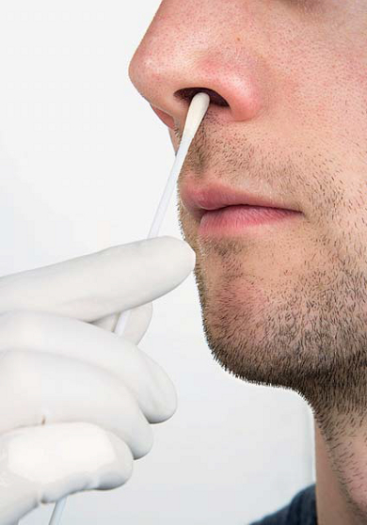
Nasal Decolonization Products
Nasal Antibiotics
Mupirocin
Nasal Antiseptics
5% Povidone-iodine
Alcohol-based product

Slide 14
Nasal Decolonization Tool Box
Key Factors | Alcohol-based Antiseptic | Antibiotic Prophylactic (mupirocin) | 5% Povidone-iodine
Effective | ✔ | ✔ | ✔
Non-antibiotic | ✔ | ✖ | ✔
Same day use | ✔ | ✖ | ✔
Compliance assurance | ✔ | ✖ | ✔
Easy to use / Pleasant | ✔ | ✖ | ✖
Sustained decolonization | ✔ | ✖ | ✖
All-inclusive: HCW/Caregiver use | ✔ | ✖ | ✖
Low cost | ✔ | ✔ | ✖

Slide 15
Nasal Decolonization Summary
MRSA Nasal Colonization Leads to Infections
MRSA is Largest Single Component of total HAIs
Lack of Flexible Tools Limits Use of Nasal Decolonization as Major Weapon against infection
New Studies support Nasal Decolonization
Penalties for HAIs (especially MRSA)

Slide 16
FACTS: Nasal Decolonization and SSIs
MRSA Nasal Colonization is #1 marker for SSIs
All Patients are at Risk of Nasal Colonization and/or Infection
High Risk Procedures and/or High Risk Patients are targeted for Nasal Decolonization
Consideration for Infection Risk Pre-Op and Post-Op

Slide 17
TRIAL - ICU Decolonization
REDUCE MRSA Trial: 3 arm Cluster Randomized Trial
74 ICUs, 43 hospitals, 74,000 patients
18 month intervention (Apr 2010 – Sept 2011)
33% of Patients - Screen and Isolate (gold standard control)
33% of Patients - Targeted Nasal Decolonization/CHG bathing if MRSA+
33% of Patients - Universal Nasal Decolonization/CHG bathing for all
Universal Decolonization Arm = BEST OUTCOMES
Primary goal met: 37% decrease in MRSA clinical cultures
44% Decrease in all Blood Stream Infections
28% Reduction in MRSA Blood Stream Infections
Most Cost-effective – saves $171/patient in CP costs
Huang SS et al. NEJM 2013; 368 (24):2255-65

Slide 18
Safely Eliminating MRSA CP Programs
110 bed Medical Center in California
Replaced Screen and Isolate with Universal Nasal Decolonization
Realized $73,000 in Direct Cost Reductions
Significant Improvements in Patient Care and Satisfaction Scores

Slide 19
What is the Risk? Patient Populations
Incidence of ICU-HAI is 5 to10 x higher than HAI rates in general wards
Oral Cancer Patients demonstrated 77.8% MRSA colonization and Infection. Other studies in Cancer Patients show Staph Positive carriage at 70% with a prevalence of MRSA infection of 17.5%
In Non-neutropenic Cancer Patients, the prevalence of MRSA Infections was 54.7%. Skin and soft tissue Infections (27%); Pneumonia (24%) and Primary Bacteremia (14%)
Dialysis Patients - S. aureus accounts for >8% of the Mortality and is Leading Cause of Vascular Access-Site–Related Infections
Notes:
Patients with malignancy, especially those with hematological malignancy, are well known to be very susceptible to infection in general, because of bone marrow suppression induced by anticancer chemotherapy in addition to the nature of the disease itself. Accordingly, the risk of MRSA infection is very high in these patients, and the infection is often fatal.
Cancer patients may have multiple predisposing factors that increase the risk of infection. Chemotherapy, radiation therapy, surgery, stem cell transplantation, bone marrow transplantation or steroids in addition to the cancer itself can suppress the immune system.
Hemodialysis patients have a strongly increased absolute risk and relative risk (RR) for morbidity and mortality from MRSA. Infection accounts for 12 to 36% of the mortality in patients with ESRD (end-stage renal disease) and is second only to cardiovascular disease as a cause of death. Septicemia is responsible for approximately three quarters of the infectious mortality
.
Dialysis Patients are particularly vulnerable to infections caused by S. aureus. S. aureus accounts for >8% of the mortality in the dialysis population and is the leading cause of mainly Vascular Access-site–related infections

Slide 20
SUMMARY
30% of All Populations are MSSA or MRSA Colonized
Reducing Nasal Colonization Reduces Infection Risk
Specific PROTOCOLS have been Proven to
Reduce Infections
Improve Patient Outcomes and Satisfaction
Save Money
New TOOLS are Available that make Nasal Colonization Management Faster, Easier, Cheaper

Slide 21
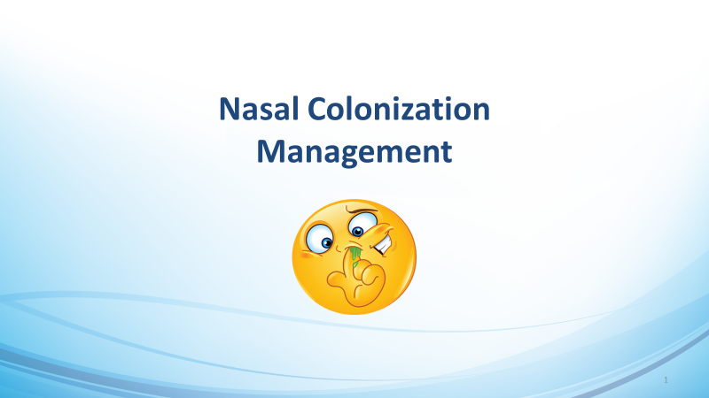

Slide 22
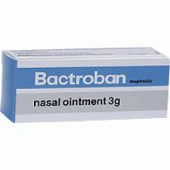
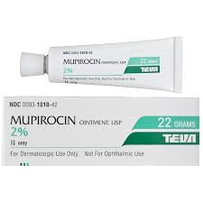
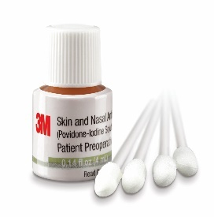
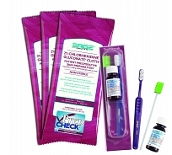
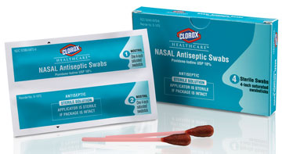
Decolonization Options
Antibiotic (Mupirocin)
Antibiotic – How manage Antibiotic Stewardship?
Must Screen first – cannot be used prophylactically. Risk to Patient if not Colonized
Five-day Protocol Pre-op
Poor Compliance – < 40% Patients Complete Process
Povidone Iodine Swabs
Works slowly – 1 Hour to reach Full Effect
Application can be Messy and Unpleasant for Staff and Patient
Indicated for Pre-op Use
Notes:
Mupirocin is an antibiotic- it can only be used with patients that are known carriers. Should not be used prophylactically. That means it can not be used for universal decolonization of surgery patients – even though every surgery has a risk of SSI.
Compliance with mupirocin is about 60% - so 40% of all patients who show up for surgery have not followed the application protocol – they are not decolonized. NOZIN eliminates this risk because you apply immediately before surgery
Povidone iodine is a messy, unpleasant product that can only be used once, pre-op. Patients and staff hate it.
Show the video – our best sales tool.

Slide 23
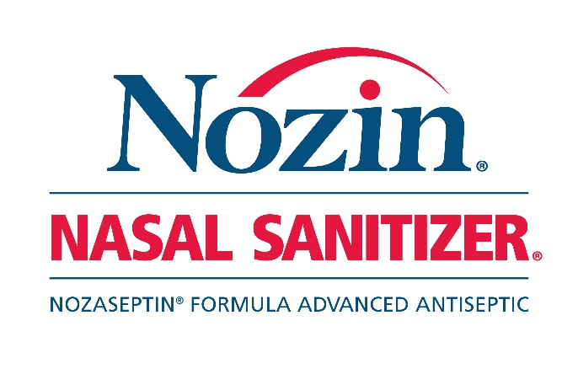
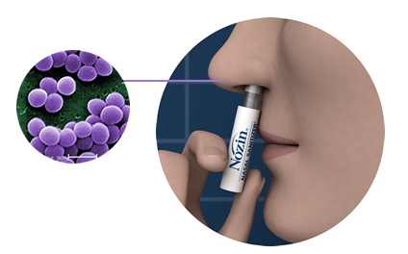
What is Nozin® Nasal Sanitizer®?
A safe, effective, proven method for decolonization without antibiotics
Nozin® Nozaseptin® patented formulation utilizes the trusted, highly effective, antimicrobial power of alcohol, pleasantly balanced by moisturizing oils and other natural emollients. Safety tested and well tolerated

Slide 24
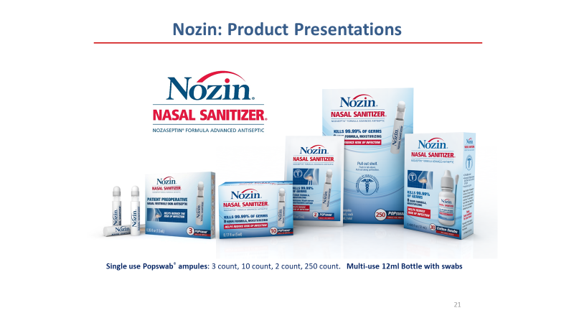

Slide 25
Nozin® Nasal Sanitizer® Benefits
Clinically proven 99% Staph aureus carriage reduction*
Effective from day one
Topically applied, can be self-administered
Pleasant to use, good compliance
Non-antibiotic, nonprescription, can be safely used for longer periods of time
Cost-effective – decolonization can be maintained for less than $4 per day
*Steed L, et al. Reduction of nasal Staph aureus carriage. American Journal of Infection Control, 2014:42(8):841-846.

Slide 26
Nozin SSI Protocols
Nozin 360™ Perioperative Protocol
User | Recommended Protocol
Patient | 3 Nozin® applications 1 hour prior to surgery
 | Then 2 Nozin® applications per day for 5-8 days
OR Staff | 1 Nozin® applications per 12h shift
 | Include all with patient contact
Visitors | Apply Nozin® before entering patient room
 | Then every 12 hours
Caregiver | 2 Nozin® applications per day for 5-8 days
Continue the other components of your pre-op protocols. Nozin® Nasal Sanitizer® is for nasal decolonization only.

