Slide 1
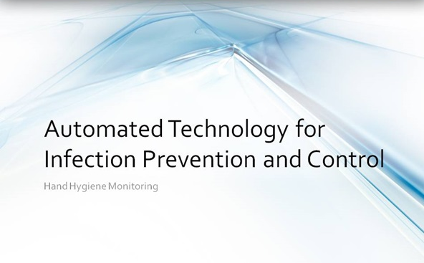

Slide 2
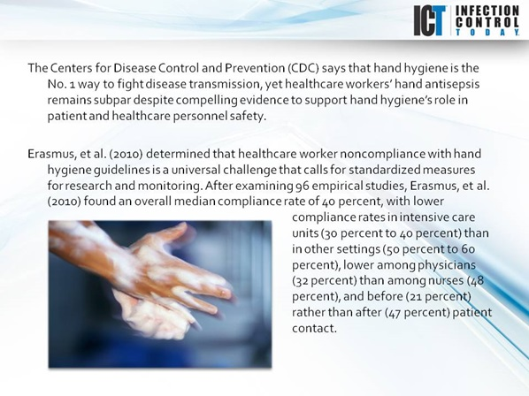
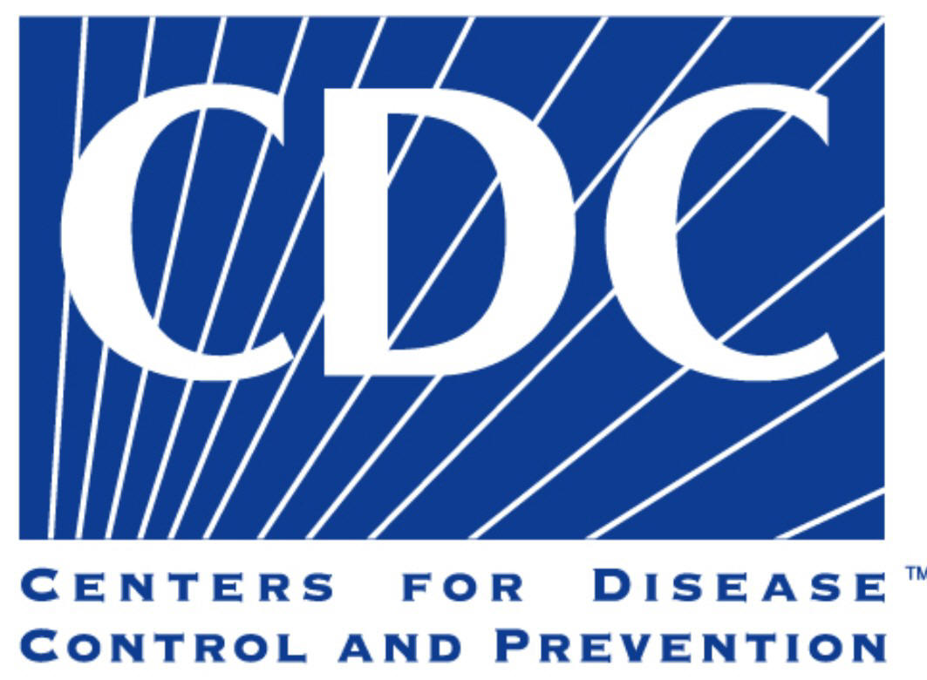

Slide 3

The Problem…
Stewardson and Pettit (2011) “Most HCW’s know the risks posed by inadequate hand hygiene and want to improve. Yet we are poor at estimating our own performance, thus mandating the use of an alternative method.”
The limitations of direct observation, include:
Hawthorne effect
Small sample sizes
Observer bias
Physical restrictions
Extensive required resources
Timeliness of data

Slide 4
Erasmus, et al. (2010)
Erasmus, et al. (2010) determined that HCW's non-compliance with HH guidelines is a universal challenge that calls for standardized measures for research and monitoring.
After examining 96 empirical studies, Erasmus, et al. (2010) found an overall median compliance rate of 40%
With lower compliance rates in ICU's (30-40%) than other settings (50-60%).
Physician showed lower (32%) compliance than nurses (48%)
And rates of 21% before patient contact compared to 47% after patient contact.

Slide 5
Kovacs, et al. (2016)
Sunnybrook Health Sciences Centre, a 1250-bed trauma (largest in Canada) medical center in Toronto.
Covertly observed HH compliance was 50.0% compared with 83.7% recorded by hospital auditors during the same time period (P < 0.0002).
The difference in physician compliance between hospital auditors and covert observers was 19.0% (73.2% vs. 54.2%)
For nurses this difference was much higher at 40.7% (85.8% vs. 45.1%) (P < 0.0001)

Slide 6
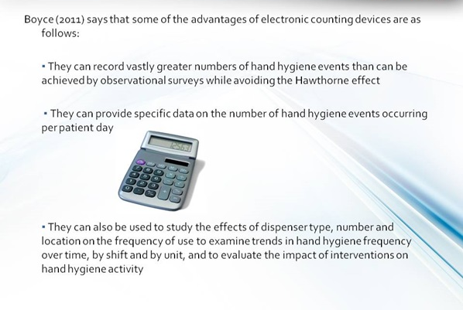

Slide 7
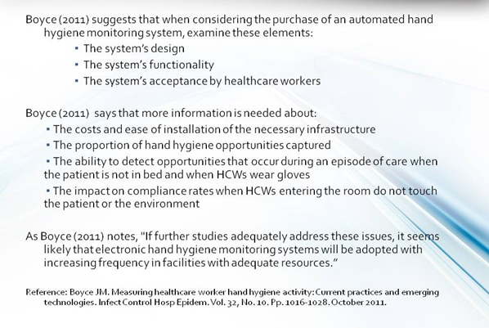

Slide 8
Evolving Techniques for HH Monitoring:
Video Surveillance
Dispenser/Consumption Associated Systems
3) RTLS Monitoring Systems

Slide 9
Dispenser/Consumption Associated Systems
Measures the frequency of product use with electronic counting devices
Organization-wide product utilization rates have also been calculated and tracked over time to estimate compliance.
Some dispenser-associated systems use “total count in and out of room” activity to approximate the number hand hygiene opportunities.
Process does not readily include an accurate denominator (e.g., number of hand hygiene opportunities) needed to calculate a compliance rate.
No individualized data

Slide 10
RTLS Monitoring Systems
Integrated technology into employee name badges and/or motion-detecting devices (located at doorways, sinks, dispensers, and patient beds) to capture and record the number of hand hygiene events, usually in and out of room, so that a surrogate compliance rate can be calculated.
RTLS technology highlights:
Some systems uses electronic technology to track when a healthcare professional enters and exits a room, as well as monitoring hand hygiene occurrences utilizing sensors attached to sinks and hand hygiene product dispensers. “In and out of room” activity is used to calculate a denominator for a hand hygiene compliance rate.
For those organizations that desire to know the compliance rate for a specific healthcare provider, a badge with an identifying chip has been developed so that the hand hygiene activity of an individual can be monitored.
Some electronic monitoring systems provide voice prompts or blinking lights if hand hygiene is not performed.

Slide 11
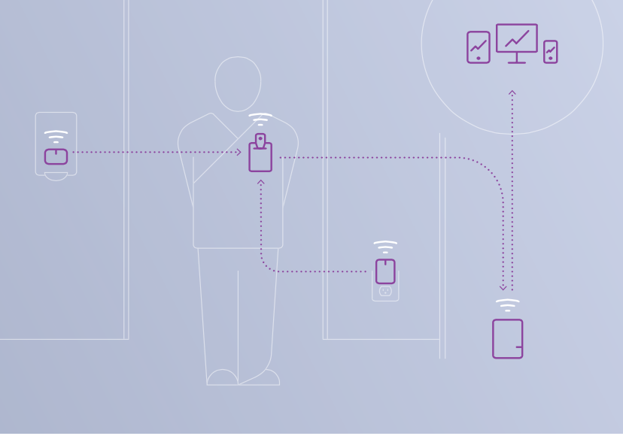
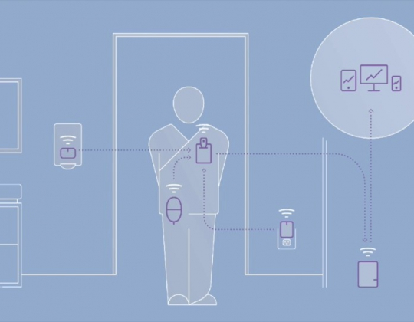
How does SwipeSense Work?
Wearable HCW Badge
Drip Guard sensors for wall-mounted dispensers
Room Hubs
Communication Hubs

Slide 12
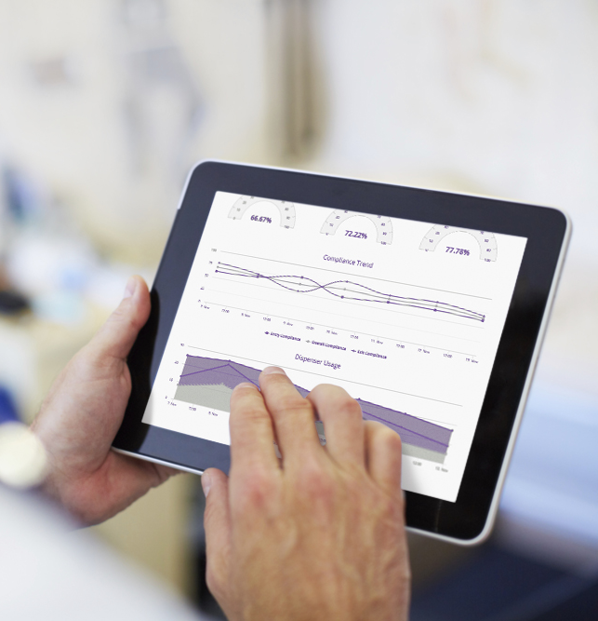
Advantages of data specific to each HCW
Overall compliance data is available 24/7/365.
Specificity by facility
By department
By unit
Patient room
Or individual caregiver

Slide 13
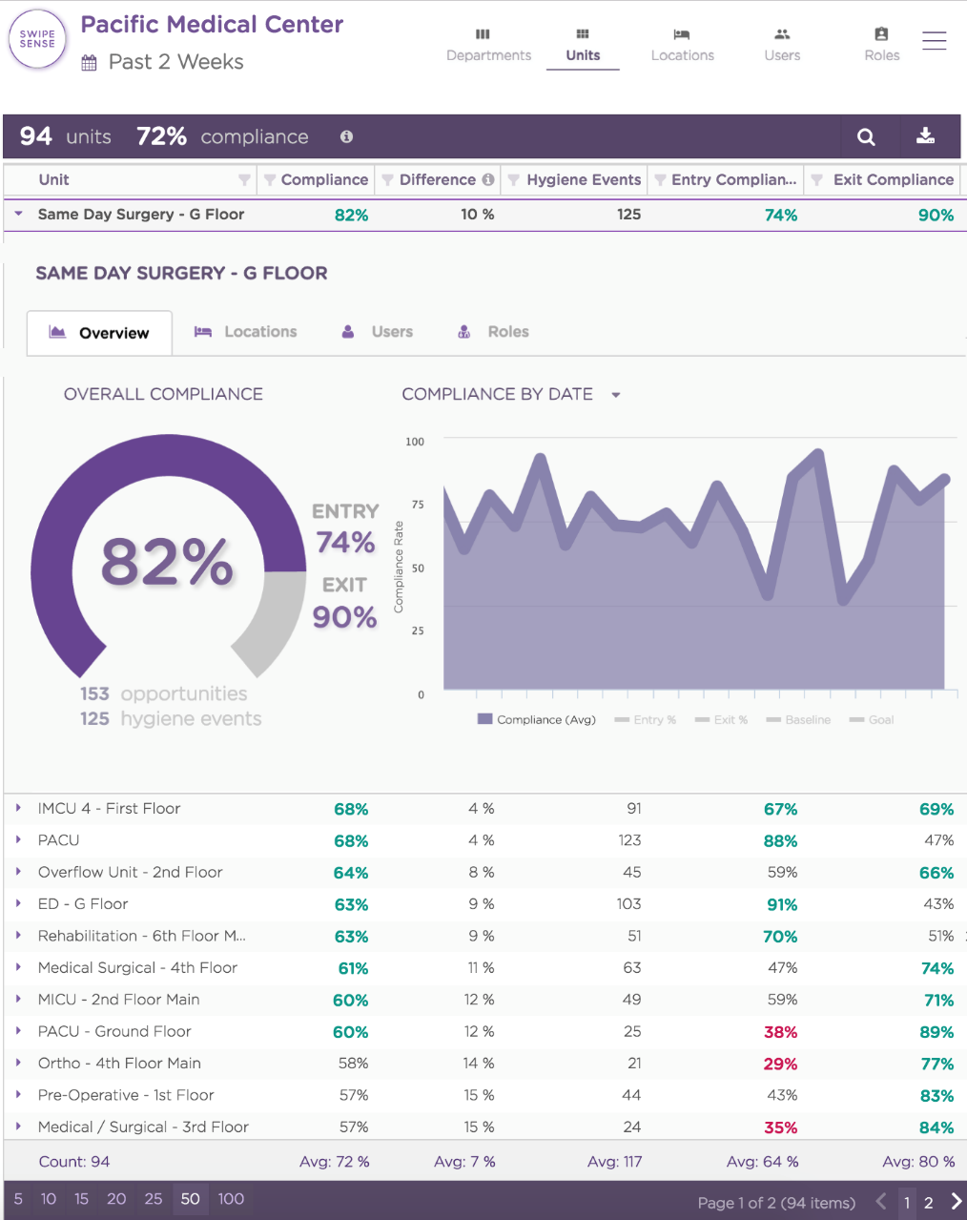
View compliance for entire network
Customized by any date range, including shift.
View compliance rate breakdowns by Entry, Exit, and Overall, including trends over time.
Easily monitor dispenser usage by type.

Slide 14
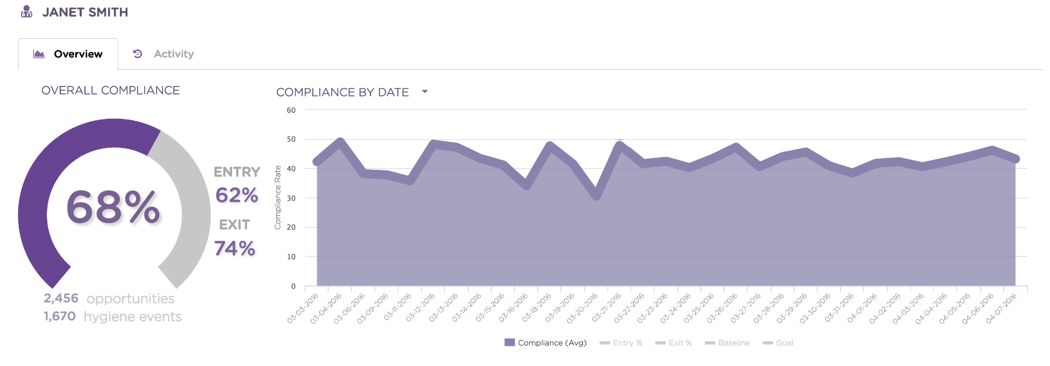
Changing HH culture through positive feedback
View compliance trends over time
By role and specialty
Emphasizing top users

Slide 15
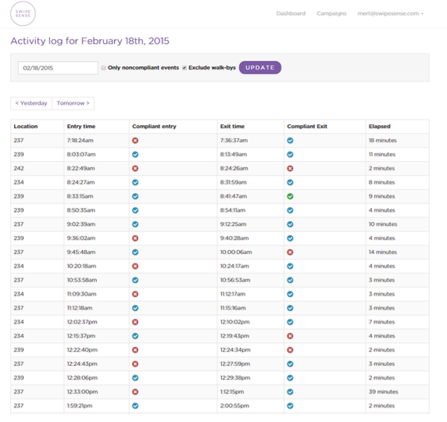
Record and restrict possible outbreaks
Room level visibility for each staff member.
Restrict possible outbreaks by knowing who visited a specific room or area in real-time.

Slide 16
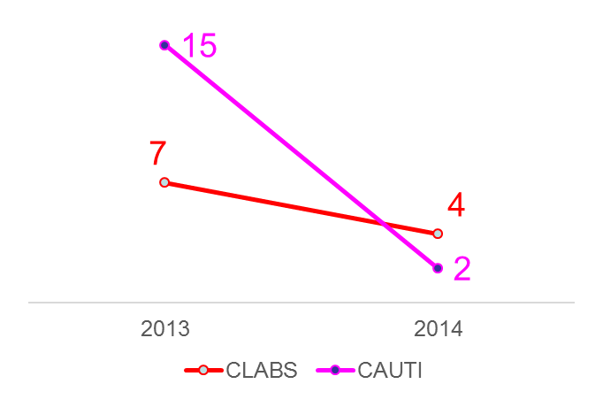
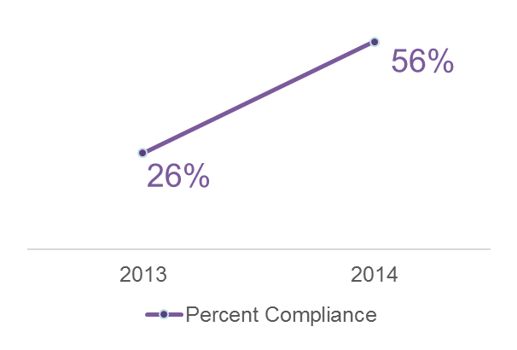
SwipeSense customer experience *following full-year system use
+115%
-43%
-87%
“We are seeing improvement and more importantly we are beginning to see a culture shift. That could not have happened without this technology.”
- Director, Infection Prevention & Control.

Slide 17

The SwipeSense Advantage
Accuracy Industry leading verified by thousands of manually observed events compared to actual system generated data.
Compatibility Compatible with all hand sanitizing hardware (soap, foam or alcohol dispensers).
API interface option to allow data to be transferred with current hospital IT platforms.
Seamless Workflow Before, during, and after implementation SwipeSense does not interrupt workflow-No hardwiring involved in installation process. Our Trained staff needs just two minutes to complete the setup in each room.
No implementation fees & multiple options for purchase Yearly license fee per active bed, leasing, or capital purchase options

