Slide 1
Bugs, Drugs, and Disinfectants in Your Compounding Pharmacy

Slide 2
Learning Objectives
Identify key governmental regulations that address Hygiene in pharmacies
Differences between cleaning and disinfection cleanrooms in pharmacies versus other healthcare environments
Recognize shared practices such as aseptic technique and monitoring of cleaning efficacy that can enhance collaboration between infection prevention and the pharmacy

Slide 3
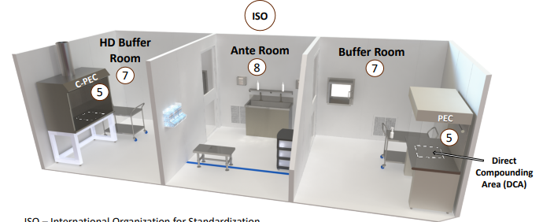
What is a Compounding Pharmacy?
A cleanroom suite for Sterile Compounding

Slide 4
Why are Pharmacies Inspected?
Impacts from errors can be catastrophic for patients

Slide 5
When inspecting pharmacies they are looking for:
Incorrect Ingredients
Incorrect Concentration
Equipment Used Incorrectly
Physicochemical Issues
Microbiological Contamination
Analytical Testing Issues
Microbiological Testing Issues
Miscellaneous Issues
According to the 2024 Pharmacy,Purchasing and Products Survey
Patients incidents involving compounding errors were 29% that’s almost 3 of 10 patients that are affected

Slide 6
Now Lets Talk bout’Bugs!
Greatest risk is from growth of microbes in a CSP
Even normally “innocuous” microbes could cause harm to patients
-Bacteria, Fungi
Reduce risk by:
-Contamination Control
-Beyond-use Dates (BUDs)

Slide 7
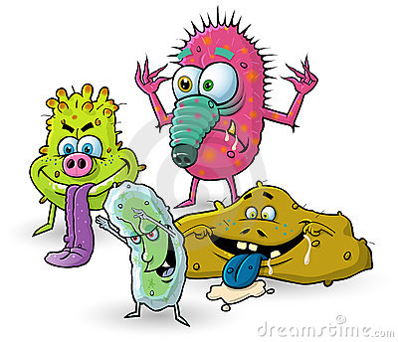
How many microbes are in the cleanrooms?
-Air sampling has to be done 2x year for viable and non-viable (Done by an impaction Sampler for the air)
Surface sampling is now done monthly (this can be done by contact plates)

Slide 8
Hazardous Drugs Health Risk from Exposure to HDs
Genotoxic effects ‒ The studies have found that the Nucleic Acids in our bodies are affected by HDS if appropriate precautions are not taken
This leads to Cancer
Cancer occurrence
-Non-melanoma skin cancer (1.5 fold increase in pharmacy techs)
-Increase in acute Leukemia (Nurses) who administer Chemotherapy drugs
-All cancer types(3.3 fold increase in nurses)
Adverse reproductive outcomes
-Infertility (1.4 fold increase)
-Miscarriage (2 to 3.5 fold increase)
-Learning disabilities in offspring (2.6 fold increase)

Slide 9
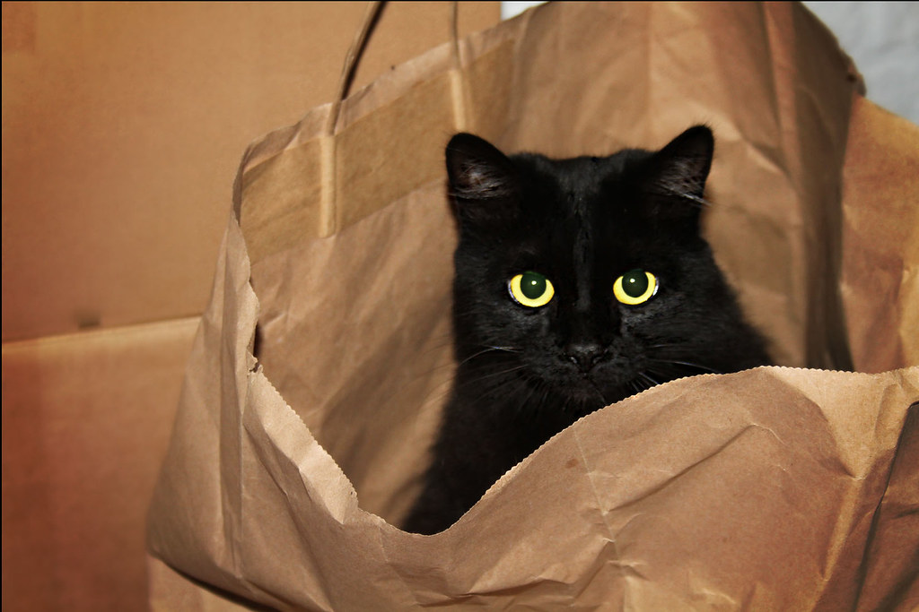
How Does the Cat (HD) Get Out of the Bag?

Slide 10
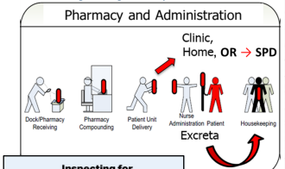
In the Pharmacy:
Concentrated or RTU drugs arrive in bulk packaging
Compounders dilute concentrates, reconstitute powders, dispense into small containers/unit doses
Then sent to locations for administration:
Hospital, Clinic or Home

Slide 11
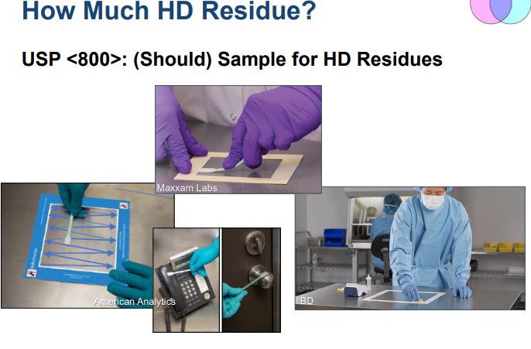

Slide 12
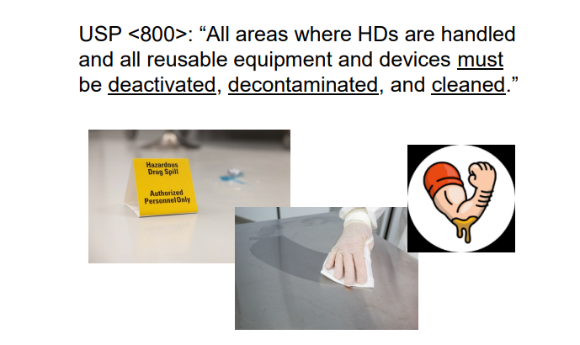
Decontamination of HD Spills, Residue

Slide 13
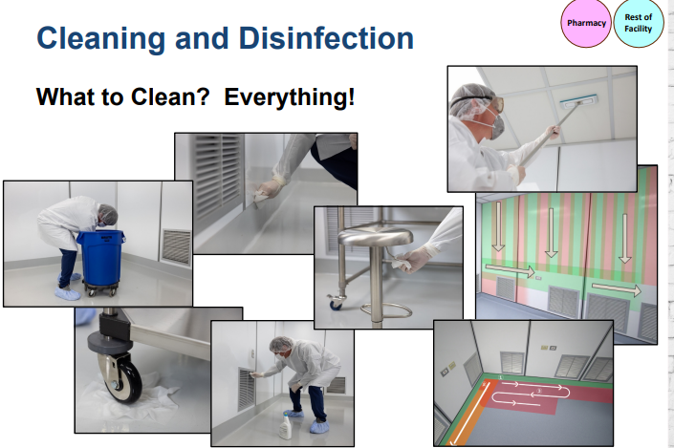

Slide 14
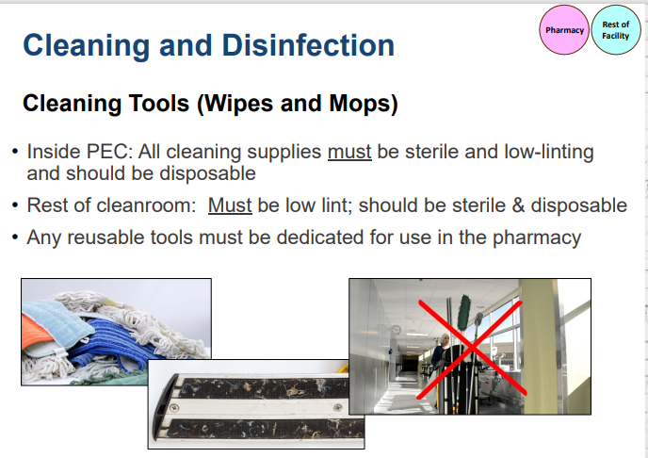

Slide 15
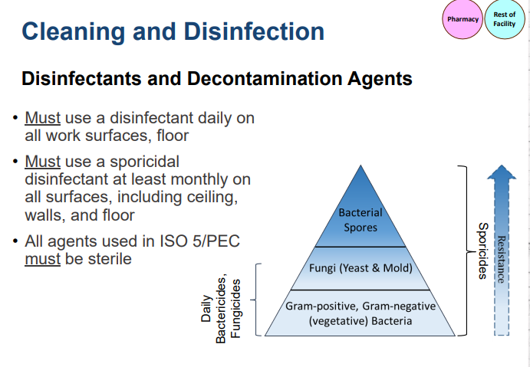

Slide 16
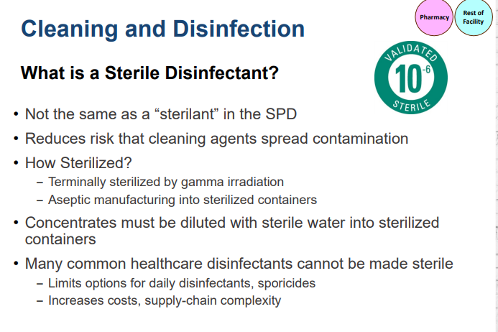

Slide 17
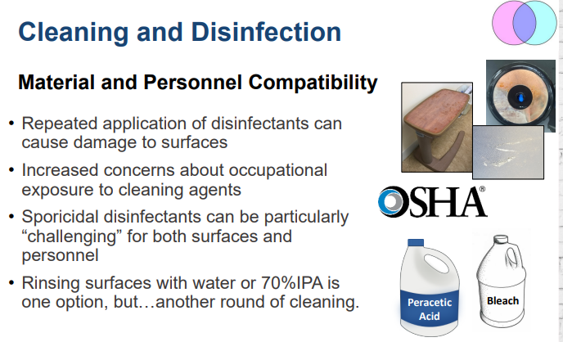

Slide 18
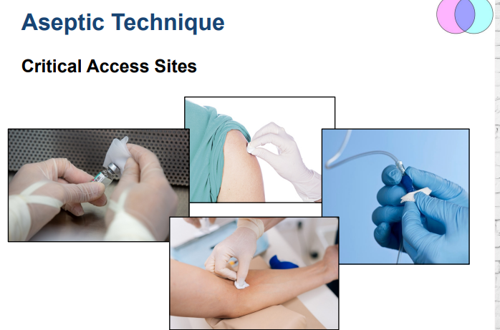

Slide 19
