Slide 1
MC-003155
ARROW® PICC with Chlorag⁺ard® Technology

Slide 2
Goal of Zero
Malposition
Insertion Related Complications
Post-Insertion Complications
ZERO
Complications
Infection
Thrombosis
Notes:
As national attention is drawn to complications of hospitalizations, recognition of complications associated with central venous catheters has gained moved to the forefront. Whether the morbidity associated with CRBSI or the costs (and lack of reimbursement) has created the attention, Arrow, as a leader in central venous catherization has taken a role in reduction of not only CRBSI, but other “not so recognized” complications, such as thrombosis. What do the three corners of this triangle have in common? They are all associated with negative outcomes associated with CVC’s. There are direct and indirect ties between each corner of the triangle, which will be discussed in this presentation. Infection may be the most recognized, but that does not mean it is the most serious. All three—infection, thrombosis and catheter tip malposition all interact to create negative outcomes for the patient. These consequences increase morbidity and mortality for patients and affect hospitals financially.
Think of your facility….are you only looking at CRI? Have you seen CRT? ARE your CVC tips located in the most appropriate location? If you are not tracking or are not aware of your results, I hope you will see value in the approach that Arrow has taken to show the relationship between these complication as well the solutions that we have for addressing all three.
(REP: Use pointer to point out direct relationship between infection and thrombosis and for malposition and thrombosis. Discuss the indirect relationship between malposition and infection.)

Slide 3
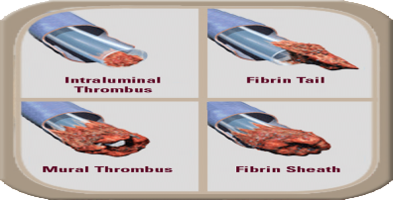
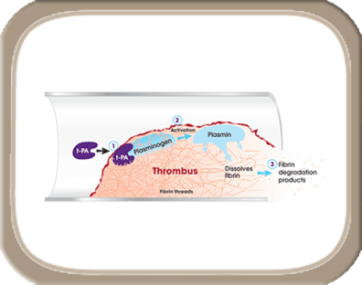
Triple Threat of Vascular Catheter Complications
CLABSI is only a portion of
the story
Infection:
Internal Occlusion:
33% of catheters become occluded
TPA Declot is $100.00 per lumen
Catheter-Assoc. Thrombosis:
3-7% symptomatic
61.9% asymptomatic
Cost To Treat $11,957
71.7% occur after 5 days
Most costly HAC
Cost to Treat:$29,000

Slide 4
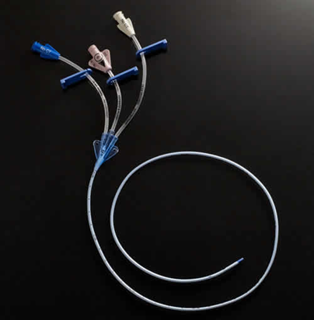

Innovative. Protective. Powerful.
The ARROW® PICC with Chlorag⁺ard® Technology

Slide 5
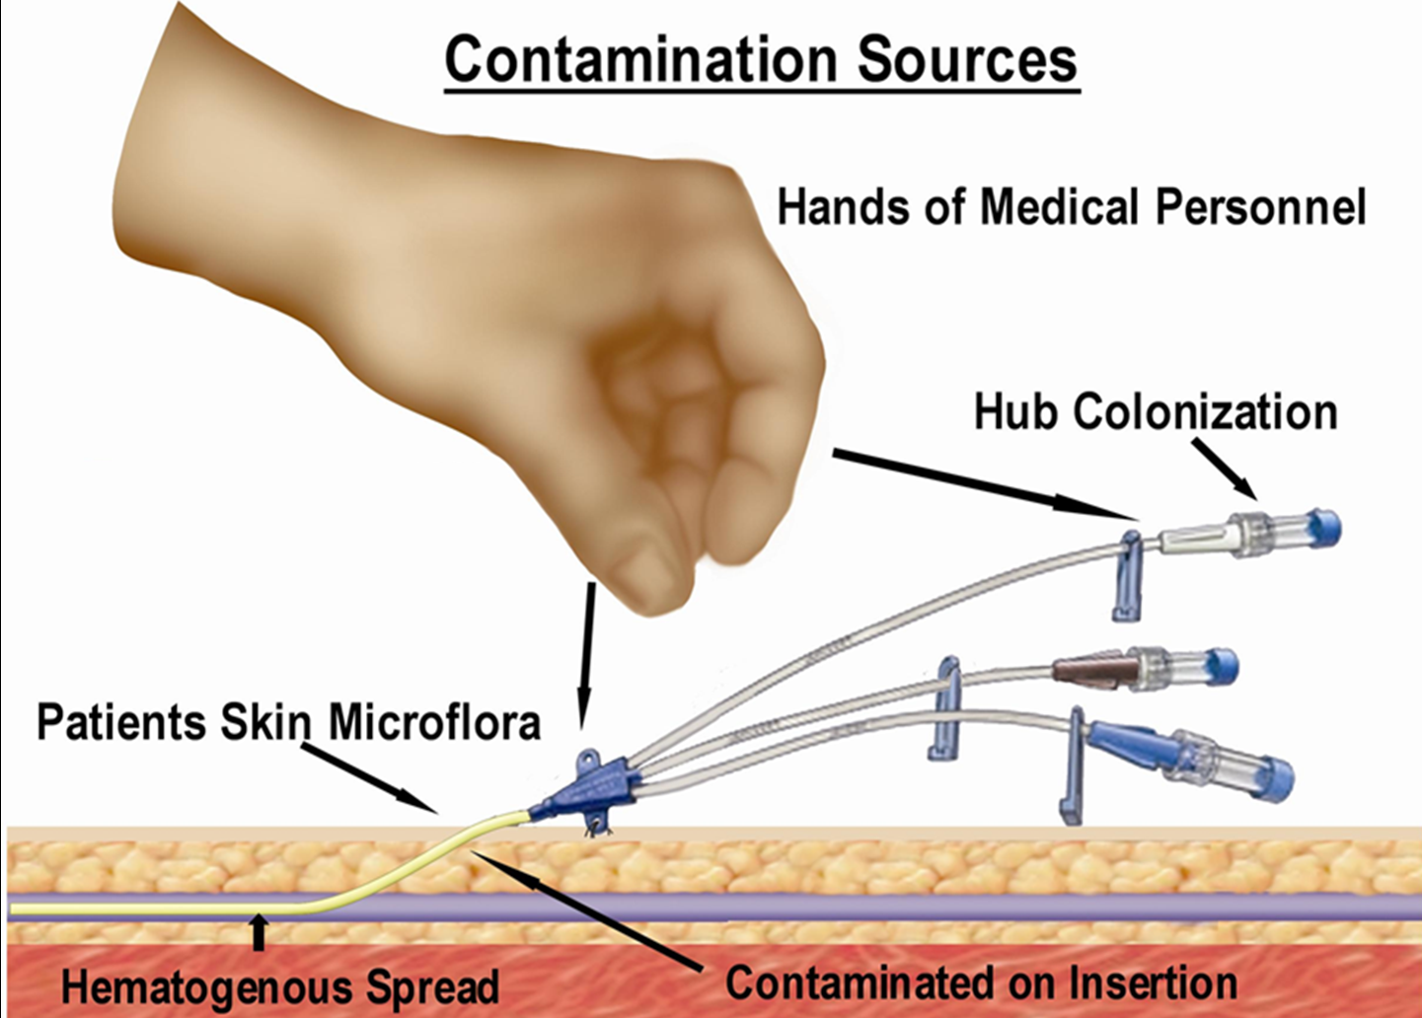
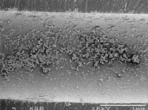
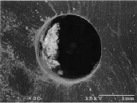
5 Sources of CLABSI
Extraluminal
70%*
Intraluminal
‘
20-30%*
Notes:
: PICC-related bloodstream infection is a significant clinical concern. In a 2006 CVC meta-analysis, hospitalized patients with PICC’s had similar rates of bloodstream infections as those with uncoated central venous catheters--2.1/1000 catheter days compared to 2.7/1000 catheter days.¹ Costs associated with one occurrence of a catheter related bloodstream infection exceeds $29,000⁴ with an attributable mortality rate of 12 to 25%.⁶ The skin surface remains a source for extraluminal catheter infection, which accounts for more than 60% of catheter related infection⁷. Despite the rigorous use of broad spectrum prepping solutions and the incorporation of maximum sterile barriers, 20% of skin flora remains on the skin after antisepsis.⁵ Surviving pathogens then gain access to the percutaneous catheter tract at the time of the initial needle and sheath insertion, then travel thru the skin track by means of capillary action. These microflora then adhere to and colonize the catheter. Once the catheter is contaminated, the pathogens begin to multiply and colonize the device. Another potential source of extraluminal catheter infection results from hematogenous seeding, in which pathogens migrate from a distant site of infection and adhere to the catheter surface. Hematogenous seeding is responsible for about 5% of catheter related infections.⁷
5

Slide 6
ARROW® Technology: Proven 99.99% (4 log) reduction in colonization³⁴
CLABSI PATHOGENS ASSOCIATED WITH HEALTHCARE INFECTIONS⁴
ORGANISM | PATHOGEN | Proven Effective? |  | CLABSI % | RANK
 |  | Chlorag+ard | AGB+
Gram positive | CoNs (coagulase negative) | YES | YES | 20.5 | 1
 | Enterococcus species - VRE | YES | YES | 18.1 | 2
 | Staphylococcus aureus | YES | YES | 12.3 | 4
Gram negative | Klebsiella pneumoniae | YES | YES | 7.9 | 5
 | Enterobacter species | YES | YES | 4.5 | 6
 | Escherichia coli | YES | YES | 4.0 | 7
 | Pseudomonas aeruginosa | YES | YES | 3.8 | 8
 | Acinetobacter baumannii | YES | YES | 2.1 | 10
 | Serratia | TBD | YES | 2.5 | 9
Fungi | Candida species | YES | YES | 14.6 | 3
CONFIDENTIAL — NOT FOR DISTRIBUTION

Slide 7
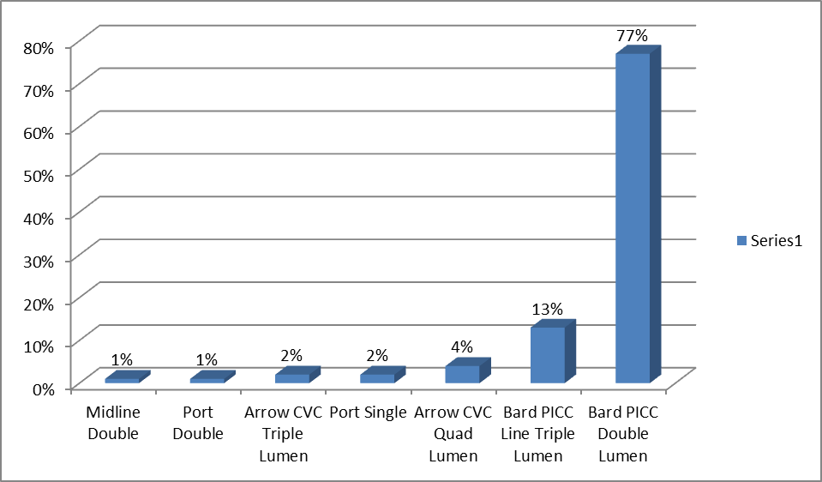
The Cathflo Spend for Occlusion
Real Example of a 400 Bed Hospital
Data Collected Over 2 Months and Annualized

Slide 8
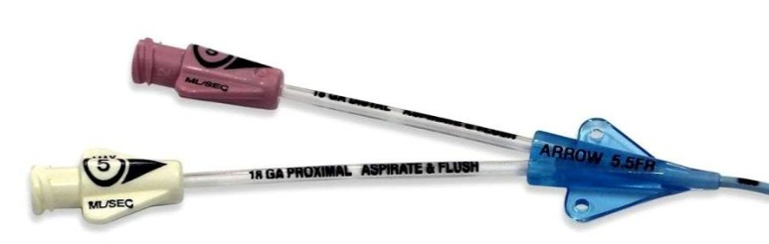
ARROW® PICC with Chlorag⁺ard® Technology
Differentiated Position:
The World’s First and Only Antimicrobial and Antithrombogenic PICC
Key Benefits
99% colonization reduction
61% reduction of thrombus accumulation
When challenged with infection, 92% reduction in thrombus accumulation
Reduction of thrombotic occlusion
Protection on external and internal catheter surfaces
Hub(s)
Extension lines
Proven effective for at least 30 days

Slide 9
How Does Chlorag⁺ard® Technology Work?
Chlorag⁺ard technology:
Provides a controlled release of chlorhexidine acetate on catheter surfaces
Reduces thrombus accumulation on catheter surfaces by inhibiting thrombin
Inhibition of thrombin does not allow the final step of the common pathway of blood coagulation – the conversion of soluble fibrinogen to fibrin clot
What is the Coagulation cascade
Several step process by which blood forms clots
Last step is thrombin converting fibrinogen to fibrin
Chloarg⁺ard is a registered trademark of Teleflex Incorporated or its affiliates.
Notes:
One of the most common questions that we get asked is how does chlorhexidine cause this process to occur. It is pretty scientific method but I’ll make it simple.
The chlorhexidine acetate on this catheter is a unique formula. The formula itself and the process for application are proprietary and exclusive to this Arrow product. The solution was formulated so that the release of the CH was controlled and eluded over a period of time.
The coagulation cascade is the normal body process where the blood forms clots. It’s a very complicated process and one. The last step in the coagulation cascade is the conversion of fibrinogen to fibrin, thus forming a clot or hemostatic plug!
I know it may sound complicated to you, but this last step in the process is what actually give the AT PICC the properties to reduce thrombus accumulation on the catheter and protection of the vessel walls.
REP: FYI:
Coagulation is the process by which blood forms clots. It is an important part of hemostasis, the cessation of blood loss from a damaged vessel, wherein a damaged blood vessel wall is covered by a platelet and fibrin-containing clot to stop bleeding and begin repair of the damaged vessel. Disorders of coagulation can lead to an increased risk of bleeding (hemorrhage) or obstructive clotting (thrombosis).^{[1]}
Final common pathway
Thrombin has a large array of functions. Its primary role is the conversion of fibrinogen to fibrin, the building block of a hemostatic plug.

Slide 10
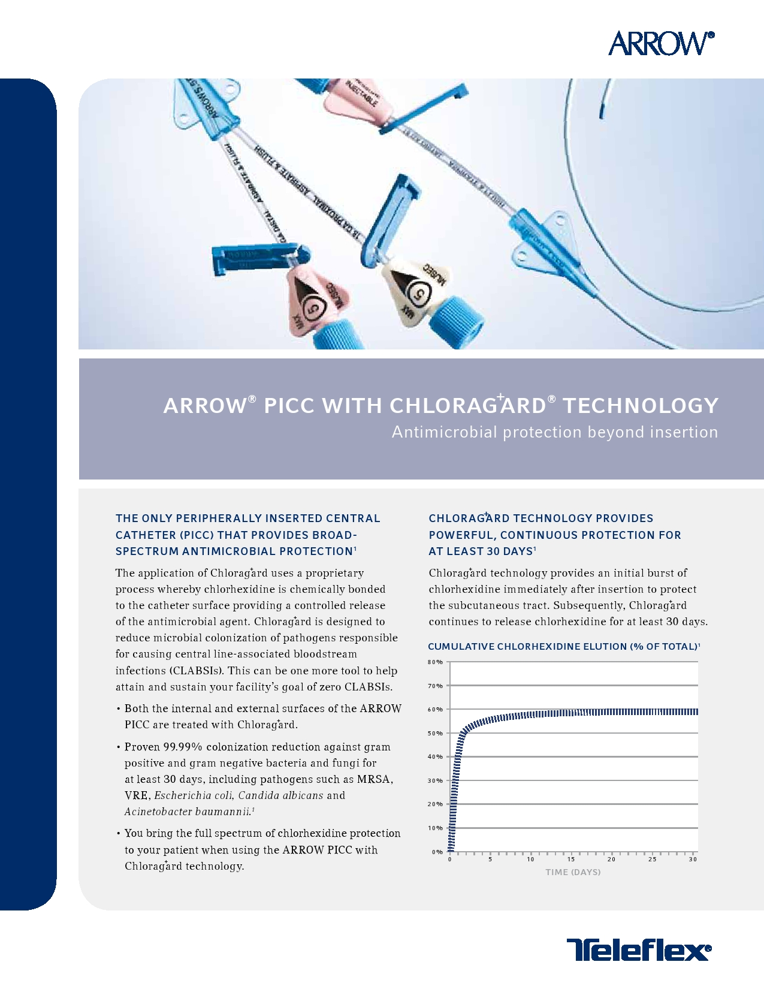
Chlorag⁺ard® Technology
Continuous protection for at least 30 days³⁴
Elution of Chlorag⁺ard technology continues past Day 30
Chloarg⁺ard is a registered trademark of Teleflex Incorporated or its affiliates.
Notes:
The Chloragard technology provided continuous coverage for 30 days. Let’s look at the graph. As you can see there is an initial burst of chlorhexidine at the time of insertion. (REP: point to the spike on the graph at the 0 mark across the bottom pointing at how it immediately moves upward, releasing a large amount of CH)
The initial burst also compliments the maximum sterile barriers, CH skin prep, CH sponge procedure the clinician practices. It’s also important to note that even with the use of CH skin prep, 20% of skin organism remain on the surface providing the opportunity for extraluminal catheter infection or transmission of pathogens down the subcutaneous skin tract. This initial burst releases about 60% of the CH over the first 10 days or so, leaving 40% remaining.
There is a slow release of remaining CH across the 30 days (REP: point out the fairly straight line moving from left to right across the graph; be aware that the line is on line-60, meaning that 60% is eluded and 40% remains.) Nevertheless, there is a 4 log reduction of pathogens whether it is day 0, 15 or even 30 --meaning that only 1 in 10,000 organisms can survive.
(REP: move pointer to last day 30 on graph.) As you can see the protection is fairly consistent from about day 10 thru day 30. In looking at day 30, what happens to the CH? (PAUSE) We did not initially test this catheter past 30 days but as you can see, I doubt that there is an immediate drop of CH. With 40 % remaining on day 30, the protection most likely is continuing. This is certainly something that I am sure our company is investigating.
As the previous slide showed us with the 2011 Davis article, after day 5 the majority of catheter infection is likely from an intraluminal source. The continual slow release of CH provides protection for these internal sources of infection originating from the catheter hub.

Slide 11
Chlorag⁺ard® Technology: A Study in Protection
ARROW® PICC with Chlorag⁺ard® Technology Day 31
Unprotected Control PICC #2 Day 31
Unprotected Control PICC #1 Day 7
ARROW and Chloarg⁺ard are registered trademarks of Teleflex Incorporated or its affiliates.

Slide 12
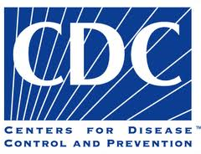
Use of Anti-Infective PICCs: CDC Category 1A
CDC Guidelines: Antimicrobial/Antiseptic Impregnated Catheters and Cuffs
Use a chlorhexidine/silver sulfadiazine or minocycline/rifampin -impregnated CVC in patients whose catheter is expected to remain in place >5 days if, after successful implementation of a comprehensive strategy to reduce rates of CLABSI, the CLABSI rate is not decreasing. The comprehensive strategy should include at least the following three components: educating persons who insert and maintain catheters, use of maximal sterile barrier precautions, and a >0.5% chlorhexidine preparation with alcohol for skin antisepsis during CVC insertion [106–113]. Category IA
2011 Infusion Nurses Standards of Practice
“Nurse should collaborate with the multidisciplinary team to consider anti-infective Central Vascular Access Devices (Non-tunneled, PICC, Tunneled, Implanted Port) in the following circumstances……Neutropenic patient, hemodialysis patient, burn patient, critically ill patient, transplant patient, catheter insertion or exchange in patients with infection or bacteremia, expected dwell of greater than 5 days, emergency insertions, CR-BSI rate remains high after employing other preventative strategies
Notes:
The CDC 2011 Guidelines for Reduction of BSI have made several 1A and 1B recommendations. Antimicrobial catheters have a 1A recommendation as well as the CH skin prep. CH sponge has a 1B recommendation. (1A recommendation is one with strongly recommended for implementation and strongly supported by well-designed experimental, clinical, or epidemiologic studies. 1B recommendation are strongly recommended, supported by SOME experimental, clinical or epidemiologic studies and strong theoretical rationale.
Antimicrobial catheters are recommended if the CVC is expected to dwell greater than 5 days or if you r infection rate is not where you want it….is this zero? (REP: see statement below describing the CDC statement)
How about INS? (You have an INS slide) Their Standards of Practice are much more descriptive…..identifying who should receive a AM PICC—dwell > 5 days, neutropenic, transplant, burn, hemodialysis, or critically patients, catheter insertion or exchange with infection or bacteremia; or for emergency situations
(CDC, 2011: Use a Chlorhexidine/silver sulfadiazine or minocycline/rifampin impregnated CVC in patients whose catheter is expected to remain in place > 5 days if, after successful implementation of a comprehensive strategy to reduce rates of CLABSI, the CLABSI rate is not decreasing. The comprehensive strategy should include at least the following three components: educating persons who insert and maintain catheters, use of maximal sterile barrier precautions, and >0.5% chlorhexidine preparation with alcohol for skin antisepsis during CVC insertion. Category 1A

Slide 13
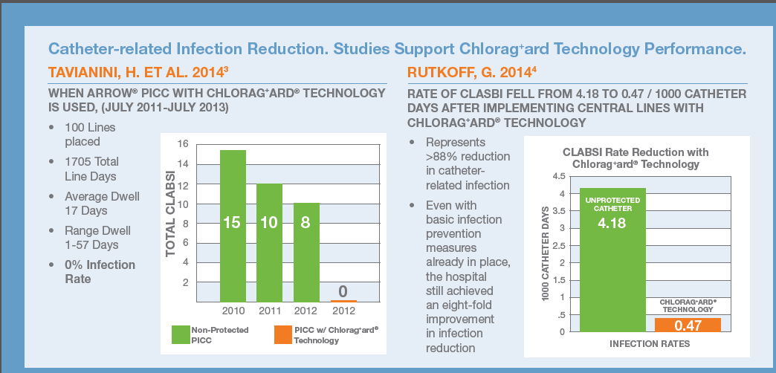
Peer Reviewed Studies
Tavianini, H. ET Al. 2014 Rutkoff, G. 2014

Slide 14
VPS Rhythm

Slide 15
VPS Rhythm™ Device – PICC Tip Navigation and Confirmation
Navigate
TipTracker™ Navigation
Confirm
Using Familiar ECG Technology
CC
Using Familiar ECG Technology
Eliminate
No chest
X-ray
Find Your Rhythm

Slide 16
What Makes the VPS Rhythm™ Device Different?
No calibration
Use with any brand of PICC
See potential problems earlier
Use on variety of patient sizes
Visualize:
Looping /
Contralateral / IJ

Slide 17
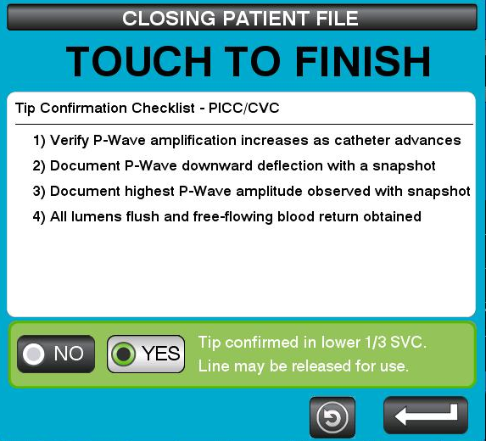
Eliminate Chest X-ray*
Visual navigation and tip confirmation for PICC placement
Incorporates familiar ECG modality
Indicated to eliminate chest X-ray using ECG and Tip Confirmation Checklist
Four simple checkpoints
*With appropriate institutional policy and procedure in place. See VPS Rhythm™ Device Operator’s Manual or TipTracker Stylet or pre-loaded PICC Instructions for Use for full Indications for Use.

Slide 18

Teleflex Academy
http://www.teleflexacademy.com/index.html
Our comprehensive approach is designed to inspire confidence and advance care

Slide 19
Thank You
Thank You
LabelWriter and Dymo are trademarks or registered trademarks of Newell Brands Incorporated.
Teleflex, the Teleflex logo, Arrow, Chlorag⁺ard, TipTracker and VPS Rhythm are trademarks or registered trademarks of Teleflex Incorporated or its affiliates, in the U.S. and/or other countries.
© 2017 Teleflex Incorporated. All rights reserved. MC-003155

