Slide 1
Chapter Legislative Representative Meeting
March 25, 2024

Slide 2
APIC Advocacy

Slide 3
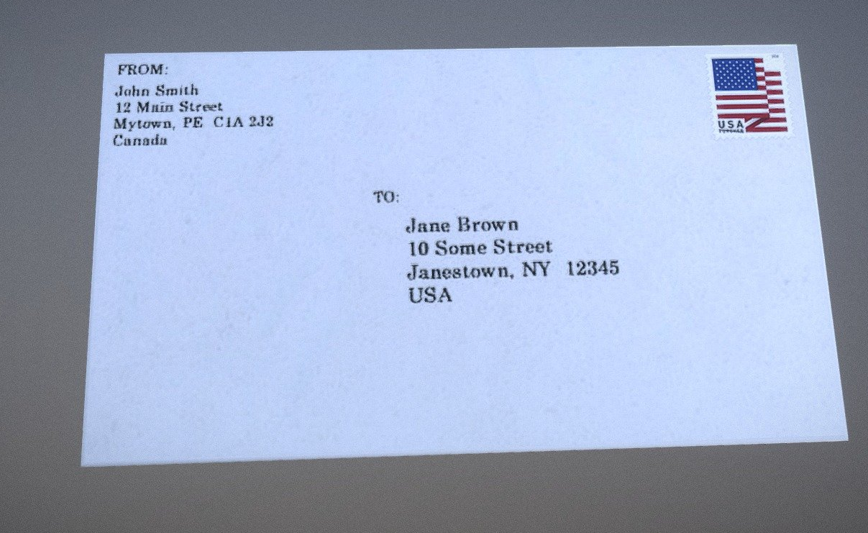
APIC Advocacy
Coalition Letters:
Letter supporting the Public Health Loan Repayment Program and the Bio-Preparedness Workforce Pilot Program.
American Statistical Association letter supporting increased funding for the National Center for Health Statistics
Data: Elemental to Health letter supporting the Data Modernization Initiative and the Center for Forecasting and Analytics.
CDC Coalition letter supporting $11.6 billion in topline funding for the CDC.

Slide 4

Become an APIC Virtual Advocate!
Virtual Advocacy
Scan QR code to access the virtual advocacy network!
APIC is searching for new virtual advocates!
Should take less than 2 minutes to fill out.
Opportunity for meetings with your legislative members to influence change on the state and local level!
APIC staff will provide talking points throughout the process and be available for any questions!

Slide 5

Invite Us to a Chapter Meeting!
Chapter Meetings
APIC Public Policy staff would love an opportunity to update your chapter on the lasting policy items
Reach out to Rosha (rchowdhury@apic.org) or Rich at (rcapparell@apic.org) to learn more
Thank you to the chapters that have reached out so far this year

Slide 6
State Update

Slide 7
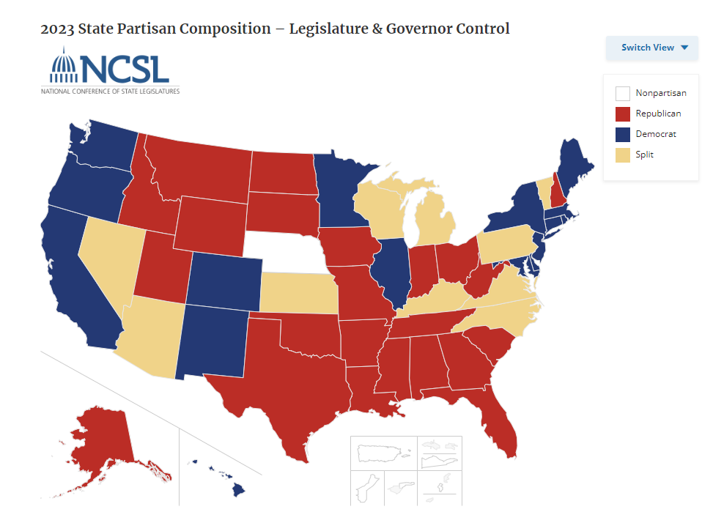
State Advocacy
State legislative sessions coming to an end:
Florida – 3/8
Georgia – 3/28
Idaho – 3/29
Indiana – 3/8
Iowa – 4/16
Kentucky – 4/15
Maine – 4/17
Maryland – 4/8
Nebraska – 4/18
New Mexico – 2/15
Oregon – 3/7
South Dakota – 3/25 (ENDS TODAY)
Utah – 3/1
Virginia – 3/9
Washington – 3/7
West Virginia – 3/9
Wisconsin – 3/12
Wyoming – 3/8

Slide 8
Federal Update

Slide 9

Current State of Appropriations – FY 2024
Federal Environment
Finally passed all bills for FY 2024
March 9 - VA, Transportation, State etc.
March 23 – 70% of discretionary spending including Defense and Labor-HHS
Most of our priorities were flat funded
One of the latest budgets in the modern era – this was supposed to be in place October 1st of last year
On to FY 2025!

Slide 10
FY 2024 Appropriations
Funding Level | FY 2025 President Budget | FY 2024 | FY 2023
Advanced Molecular Detection | $40M | $40M | $40M
Agency for Healthcare Research and Quality | $387.3M | $369M | $373.5M
Antibiotic Solutions Resistance Initiative | $207M | $197M | $197M
Center for Forecasting and Outbreak Analytics | $50M | $50M | $55M*
Centers for Disease Control and Prevention | $9.683B | $9.2B | $9.2B
Department of Health and Human Services | $130.7B | $127.3B | $117.5B
Epidemiology and Laboratory Capacity | $40M | $40M | $40M
Healthcare-Associated Infections | $12M | $12M | $12M
National Healthcare Safety Network | $24M | $50M | $24M
Federal Environment

Slide 11
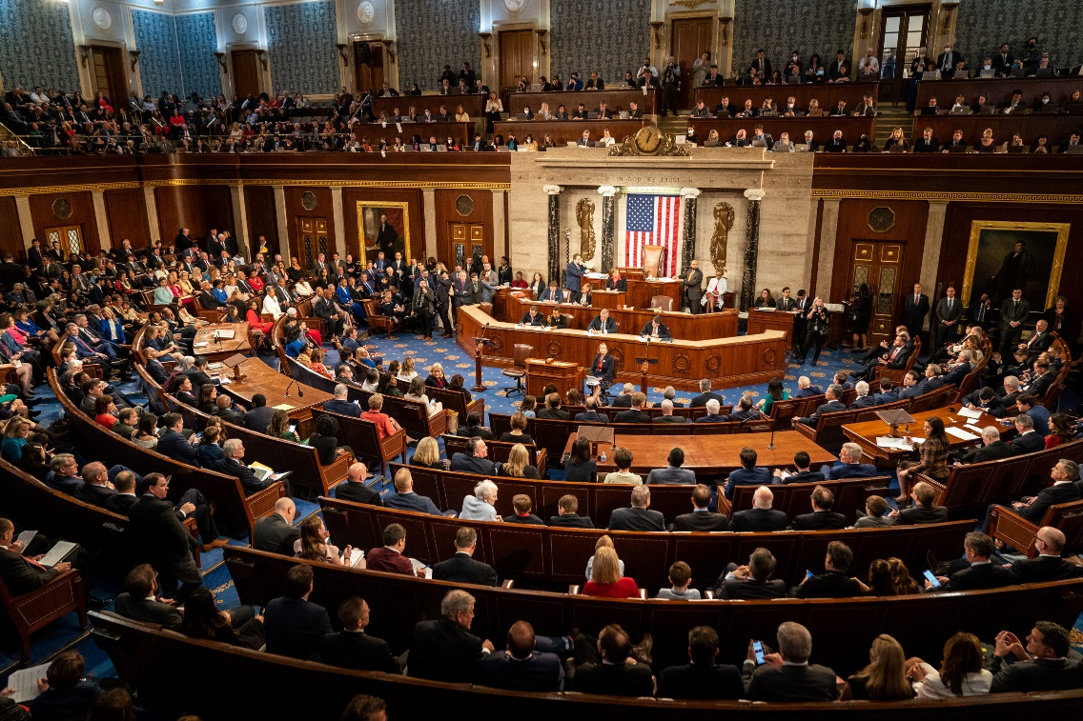
118th Congress
Government Affairs and Practice Guidance Update
APIC Federal Priorities
Representative Kay Granger is stepping down from the Appropriations Committee
Representatives Mike Gallagher (April 19) and Ken Buck (March 22) departures make an even thinner majority
Senate Minority Leader McConnell leaving leadership
Representative Marjorie Taylor Greene filed a motion to vacate the Speaker

