Slide 1
Catheter-associated urinary tract infections
Etiology, prevalence & best practices
25588 Feb 2018

Slide 2
Disclaimers
No off-label information will be presented.
This presentation was developed by Stryker.
Do not distribute, copy, or otherwise utilize without permission.
Accreditation
Stryker is accredited as a provider of continuing education in nursing by the
California Board of Registered Nursing (provider number CEP 15927).
Credit designation
Stryker designates this educational activity for 1 contact hour of
continuing nursing education credit.

Slide 3
Objectives
List three complications associated with CAUTI.
Identify three practices called for by CAUTI prevention guidelines.
Identify sources of urinary catheter contamination.
Describe how the use of bath basins can contribute to catheter contamination.

Slide 4
Urinary tract infections
  Of 34.4 million annual hospital admissions, 12-16% of all adult patients will have a urinary catheter placed¹
  Most common type of HAI
    >80% of HAIs are hospital-associated UTIs²
    Estimated 560,000 UTIs annually are hospital-acquired³
      Up to 450,000 annually are catheter-associated⁴
  Increased morbidity and mortality
    13,000 attributable deaths annually⁵
    Leading cause of secondary bloodstream infections³
      10% mortality rate
1. Sutherland, T., Beloff, J., McGrath, C., Liu, X., Pimentel, M. T., Kachalia, A., ... & Urman, R. D. (2015). A single-center multidisciplinary initiative to reduce catheter-associated urinary tract infection rates: quality and financial implications. The health care manager, 34(3), 218-224. 2. Huang, S. S., Septimus, E., Hayden, M. K., Kleinman, K., Sturtevant, J., Avery, T. R., ... & Kaganov, R. E. (2016). Effect of body surface decolonisation on bacteriuria and candiduria in intensive care units: an analysis of a cluster-randomised trial. The Lancet Infectious Diseases, 16(1), 70-79. 3. Centers for Disease Control and Prevention; Division of Healthcare Quality Promotion. Catheter-associated Urinary Tract Infection (CAUTI) Toolkit. 4. Scott, R. D. (2009). The direct medical costs of healthcare-associated infections in US hospitals and the benefits of prevention. 5. Klevens RM et al. "Pub Health Report 2007";122:160-6 Green MS et al. J Infect Dis 1982;145:667-72
Notes:
UTIs impact more patients annually than any other HAI.

Slide 5
Urinary tract infections
  Increase length of stay of up to 7 days¹
  Additional average expenses of $3,803 to $4,687¹
  Unnecessary antimicrobial use
  65-70% are preventable²
    Up to 9,000 preventable deaths per year³
    Costs of preventable CAUTIs estimated $115M - $1.82B annually²
1. Chen, Y. Y., Chou, Y. C., & Chou, P. (2005). Impact of nosocomial infection on cost of illness and length of stay in intensive care units. Infection Control & Hospital Epidemiology, 26(3), 281-287. 2. Umscheid, C. A., Mitchell, M. D., Doshi, J. A., Agarwal, R., Williams, K., & Brennan, P. J. (2011). Estimating the proportion of healthcare-associated infections that are reasonably preventable and the related mortality and costs. Infection Control & Hospital Epidemiology, 32(2), 101-114. 3. Gould, C. V., Umscheid, C. A., Agarwal, R. K., Kuntz, G., Pegues, D. A., & Healthcare Infection Control Practices Advisory Committee. (2010). Guideline for prevention of catheter-associated urinary tract infections 2009. Infection Control & Hospital Epidemiology, 31(4), 319-326.
Notes:
UTIs impact more patients annually than any other HAI.

Slide 6
Financial impact
Hospital-acquired infections
infection | cost per incident
VAPs | $40,000¹
HAPs | $28,008²
CAUTIs | $3,803³
Stage III & IV pressure ulcers | $43,180⁴
SSIs | $25,546⁵
1. Kollef, M. H., Hamilton, C. W., & Ernst, F. R. (2012). Economic impact of ventilator-associated pneumonia in a large matched cohort. Infection Control & Hospital Epidemiology, 33(3), 250-256. 2. Kalsekar, I., Amsden, J., Kothari, S., Shorr, A. F., & Zilberberg, M. D. (2010). Economic and utilization burden of hospital-acquired pneumonia (HAP): a systematic review and meta-analysis. Chest, 138(4), 739A. 3. Association for Professionals in Infection Control and Epidemiology, Inc. (2018). Guide to the Elimination of Catheter-Associated Urinary Tract Infections (CAUTIs); Developing and Applying Facility Based Prevention Interventions in Actue and Long-Term Care Settings. 4. Zaratkiewicz, S., Whitney, J. D., Lowe, J. R., Taylor, S., O'donnell, F., & Minton‐Foltz, P. (2010). Development and Implementation of a Hospital‐Acquired Pressure Ulcer Incidence Tracking System and Algorithm. Journal for Healthcare Quality, 32(6), 44-51.
5. Stone, P. W., Braccia, D., & Larson, E. (2005). Systematic review of economic analyses of health care-associated infections. American journal of infection control, 33(9), 501-509.

Slide 7
Policy and compliance
 | % of hospitals with policy in place | % adherence to policy
CLABSI | 87-97% | 37-71%
VAP | 69-91% | 45-55%
CAUTI | 27-68% | 6-27%
Stone, P. W., Pogorzelska-Maziarz, M., Herzig, C. T., Weiner, L. M., Furuya, E. Y., Dick, A., & Larson, E. (2014). State of infection prevention in US hospitals enrolled in the National Health and Safety Network. American journal of infection control, 42(2), 94-99.
Notes:
Hospitals have policies, but are policies being followed?
At most, 71% are following CLABSI policy,
At most ONLY 27% are following CAUTI

Slide 8
Risk factors of UTIs
Female sex
  Vaginal tissue composition
  Shorter urethral length
Age > 65¹
Compromised immune system
Conditions that promote colonization
  Sexual activity
  Spermicide
  Estrogen depletion
  Antimicrobial use
Length of ICU stay²
Reduced urine flow³
Facilitation of ascent of bacteria
  Catheterization
    Microbial colonization occurs within 5-7 days of catheter placement⁴
Urinary incontinence
Fecal incontinence
Residual urine
1. Utsumi, M., Yamada, M., Nishi, I., Nabetani, Y., & Makimoto, K. (2007). Risk Factors of Catheter-Associated Urinary Tract Infections Determined after Adjustment for Antibiotic Treatment. American Journal of Infection Control, 35(5), E188. 2. Laupland, K. B., Zygun, D. A., Davies, H. D., Church, D. L., Louie, T. J., & Doig, C. J. (2002). Incidence and risk factors for acquiring nosocomial urinary tract infection in the critically ill. Journal of critical care, 17(1), 50-57. 3. Kaufmann, M., Badalato, G. (2016) American Urological Association. Adult UTI. Medical Student Education Curriculum. Available at http://www.auanet.org/education/auauniversity/medical-student-education/medical-student-curriculum/adult-uti. 4. Averch, T.D., Stoffel, J., Goldman, H.B., (2014) American Urological Association. CAUTI White Paper 2014. Catheter-Associated Urinary Tract Infections: Definitions and Significance in the Urologic Patient. Available at http://www.auanet.org/guidelines/catheter-associated-urinary-tract-infections.
Notes:
Utsumi, M., Yamada, M., Nishi, I., Nabetani, Y., & Makimoto, K. (2007). Risk Factors of Catheter-Associated Urinary Tract Infections Determined after Adjustment for Antibiotic Treatment. American Journal of Infection Control, 35(5), E188.
Chicago

Slide 9
Anatomical impact
Females more susceptible to UTI
  Due to endogenous flora
Vaginal colonization with uropathogens precedes most UTIs¹
  E Coli is the predominant pathogen causing urinary tract infections in women^{SCHAEFFER 1999}
  The bacteria responsible for UTIs are normally present in the bowel
By the age of 34, 50% of women reported having had at least 1 UTI²
Host genetic, biological, and behavioral factors predispose healthy, young women to uncomplicated UTIs²
1. Schaeffer, A. J., Rajan, N., Cao, Q., Anderson, B. E., Pruden, D. L., Sensibar, J., & Duncan, J. L. (2001). Host pathogenesis in urinary tract infections. International journal of antimicrobial agents, 17(4), 245-251. 2. Schaeffer, A. J., Rajan, N., Wright, E. T., Duncan, J. L., & Anderson, B. E. (1999). Role of vaginal colonization in urinary tract infections (UTIs). In Advances in bladder research (pp. 339-349). Springer, Boston, MA.
2 Hooton, T. M. (2012). Uncomplicated urinary tract infection. New England Journal of Medicine, 366(11), 1028-1037.

Slide 10
Reduction of urinary flow
  Immobility can cause urinary stasis
  Difficulty voiding due to positioning may cause patient to avoid/postpone urination
  UTI due to pooling of urine
  Calculus formation can occur
Notes:
Mobility directly impacts stasis of urine in the kidney pelvis and bladder. As the patient is more mobile, fluid is mobilized as well, increasing renal blood flow and diuresis occurs. Reduction in the formation of renal calculi also occurs due to the movement of fluid.

Slide 11
Healthcare Infection Control Practices Advisory Committee (HICPAC)
Updated prevention guidelines focus on:
  Appropriate Urinary Catheter Use
    Patient has acute urinary retention or bladder outlet obstruction
    Patient anticipated to receive large-volume infusions or diuretics during surgery
  Proper Techniques for Urinary Catheter Insertion
    Perform hand hygiene immediately before and after insertion or any manipulation of the catheter device or site
    In the acute care hospital setting, insert urinary catheters using aseptic technique and sterile equipment
  Proper Techniques for Urinary Catheter Maintenance
    Maintain unobstructed urine flow/ maintain a closed drainage system
    Do not clean the periurethral area with antiseptics to prevent CAUTI while the catheter is in place. Routine hygiene (e.g., cleansing of the meatal surface during daily bathing or showering) is appropriate
Gould, C. V., Umscheid, C. A., Agarwal, R. K., Kuntz, G., Pegues, D. A., & Healthcare Infection Control Practices Advisory Committee. (2010). Guideline for prevention of catheter-associated urinary tract infections 2009. Infection Control & Hospital Epidemiology, 31(4), 319-326.

Slide 12
CAUTI bundle components
Appropriate Use
Maintenance
Insertion
Prompt
Removal
Surveillance
Centers for Disease Control and Prevention; Division of Healthcare Quality Promotion. Catheter-associated Urinary Tract Infection (CAUTI) Toolkit
Notes:
Must follow and adhere to all to be consistent

Slide 13
Appropriate use
Insert indwelling urinary catheters (IUC) only for appropriate indications
  Patient has acute urinary retention or bladder outlet obstruction
  Need for accurate measurements of urinary output in critically ill patients
  Perioperative use for selected surgical procedures:
    Urologic surgery
    Anticipated prolonged duration of surgery (IUC should be removed in PACU)
    Anticipated to receive large volume infusions or diuretics during surgery
    Need for intraoperative monitoring of urinary output
  To assist in healing of open sacral or perineal wounds in incontinent patients
  Patient requires prolonged immobilization (unstable spine, multiple traumatic injuries)
  Comfort in end-of-life care
Gould, C. V., Umscheid, C. A., Agarwal, R. K., Kuntz, G., Pegues, D. A., & Healthcare Infection Control Practices Advisory Committee. (2010). Guideline for prevention of catheter-associated urinary tract infections 2009. Infection Control & Hospital Epidemiology, 31(4), 319-326.

Slide 14
Insertion
Only properly trained personnel insert and maintain catheters
Insert using aseptic technique and sterile equipment
Maintain a closed drainage system
Maintain obstructed urine flow
Follow hand hygiene and standard precautions
Gould, C. V., Umscheid, C. A., Agarwal, R. K., Kuntz, G., Pegues, D. A., & Healthcare Infection Control Practices Advisory Committee. (2010). Guideline for prevention of catheter-associated urinary tract infections 2009. Infection Control & Hospital Epidemiology, 31(4), 319-326.

Slide 15
Prompt removal
Leave IUC in place only as long as needed
  In postoperative patients, remove within 24 hours
Utilize programs to enhance appropriate use and prompt removal
  Alerts/reminders
  Automatic stop orders
  Daily rounds
  Nurse-directed removal protocols
  Guidelines/algorithms
Consider alternatives to IUC devices
Gould, C. V., Umscheid, C. A., Agarwal, R. K., Kuntz, G., Pegues, D. A., & Healthcare Infection Control Practices Advisory Committee. (2010). Guideline for prevention of catheter-associated urinary tract infections 2009. Infection Control & Hospital Epidemiology, 31(4), 319-326.

Slide 16
Surveillance
Examples of metrics
  # of CAUTIs per 1000 catheter days
  # of Bloodstream Infections (BSI) secondary to CAUTI per 1,000 catheter days
  Catheter utilization ratio (IUC days/patient days x 100)
  Use CDC/NHSN definitions for symptomatic UTI
Process Measures
  Compliance to documentation on insertion/removal dates
  Compliance to documentation insertion/removal indications
Gould, C. V., Umscheid, C. A., Agarwal, R. K., Kuntz, G., Pegues, D. A., & Healthcare Infection Control Practices Advisory Committee. (2010). Guideline for prevention of catheter-associated urinary tract infections 2009. Infection Control & Hospital Epidemiology, 31(4), 319-326.

Slide 17
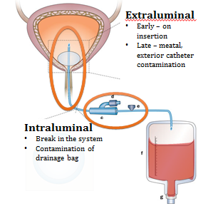
Maintenance:
Meatal contamination
Extraluminal
Early – insertion
Late – meatal, exterior catheter contamination
Intraluminal
Break in the system
Contamination of the drainage bag
Tambyah, P. A., Halvorson, K. T., & Maki, D. G. (1999, February). A prospective study of pathogenesis of catheter-associated urinary tract infections. In Mayo clinic proceedings(Vol. 74, No. 2, pp. 131-136). Elsevier.
Notes:
Organisms gain access in one of 2 ways, extraluminal or intraluminal
Almost half of contamination comes from catheter contamination/maintenance

Slide 18
Maintenance:
Meatal contamination
Extraluminal - Late
Intraluminal
Extraluminal - Insertion
Tambyah, P. A., Halvorson, K. T., & Maki, D. G. (1999, February). A prospective study of pathogenesis of catheter-associated urinary tract infections. In Mayo clinic proceedings(Vol. 74, No. 2, pp. 131-136). Elsevier.
Notes:
Almost half of contamination comes from catheter contamination/maintenance

Slide 19
Maintenance:
Meatal cleansing
The perineal area and urethral meatus should be cleaned with soap and water or a perineal cleanser routinely, avoiding frequent and vigorous cleansing of the area¹
Daily cleansing and PRN using the hospital-approved bathing products²
1. Senese, V., Hendricks, M. B., Morrison, M., & Harris, J. (2006). Care of the patient with an indwelling catheter. Urology Nursing, 26(1), 80-81.
2. Oman, K. S., Makic, M. B. F., Fink, R., Schraeder, N., Hulett, T., Keech, T., & Wald, H. (2012). Nurse-directed interventions to reduce catheter-associated urinary tract infections. American journal of infection control, 40(6), 548-553.
Notes:
Almost half of contamination comes from catheter contamination/maintenance

Slide 20
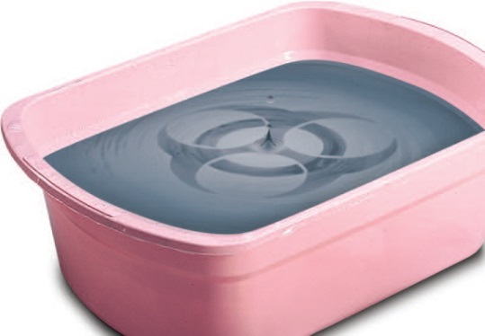
Maintenance:
The problem with basin bathing
The basin: a proven CAUTI risk factor
The basin has been proven time and time again to be inferior to other bathing methods
Now there’s clinical proof linking the basin to catheter-associated urinary tract infections (CAUTIs)
  In a study presented at APIC 2010, infection control practitioners noted an increase in CAUTIs, so they eliminated the basin from the bedside of catheterized patients. Within a month, the incidence of CAUTIs was reduced to zero¹
  Another study at a long-term care facility found infections rates reduced by
  78% after removing basins and revising its bathing protocol²
1. Stone, S., Chaffee, D., Rowin, K., & Chasin, M. (2010). Removal of bath basins to reduce catheter-associated urinary tract infections. Poster presented at APIC. 2. Hamman, H. (2011, July). Goodbye UTIs: Removal of traditional basin bathing methods leads to 78% reduction in UTIs. In NADONA Annual Conference.

Slide 21
Maintenance:
The problem with basin bathing
The basin: a reservoir of bacteria
A study analyzing the basin sampling results of 1,103 basins from 88 hospitals across the U.S. found that bath basins frequently harbor pathogens associated with nosocomial infections
In addition:
  62.2% of basins were contaminated with one or more of the following: Enterococcus species, Staphylococcus aureus, or gram-negative bacilli
  34.9% of basins were colonized with VRE
  44.9% were colonized with gram-negative bacilli
  100% of hospitals in this study had basins that tested positive for bacteria
Marchaim, D., Taylor, A. R., Hayakawa, K., Bheemreddy, S., Sunkara, B., Moshos, J., ... & Lephart, P. R. (2012). Hospital bath basins are frequently contaminated with multidrug-resistant human pathogens. American journal of infection control, 40(6), 562-564.

Slide 22
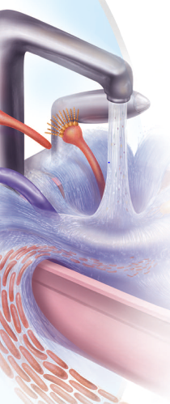
Maintenance:
The problem with basin bathing
  Bath water: another proven infection source
  The high bacteria count in bath water is similar to the number in urine from patients with UTIs
  Other basin uses, including emesis and incontinence cleanup, increase the risks
  Nurses frequently make contact with equipment, including sink handles, where contaminated water is disposed. This can expose everyone in the room to potential contamination
Shannon, R. J., Allen, M., Durbin, A. J., Brecher, S. M., & Goodman, R. P. (1999). Patient bath water as a source of nosocomial microbiological contamination: an intervention study using chlorhexidine. Journal of healthcare safety compliance and infection control, 3, 180-184.

Slide 23
Maintenance:
The problem with basin bathing
  Tap water: overlooked source of hospital-acquired infections
  More than 29 studies incriminate the hospital water system as the source of serious waterborne hospital-acquired infections.¹
  Reports recommend minimizing exposure to tap water for all patients who are immunocompromised, have fresh surgical wounds, or are at higher risk for infections.^{1,2}
  Biofilm-forming pathogens can create potent biofilms in hospital pipes, hot water tanks, sinks, and even touchless faucets, contaminating water on contact.³
1. Anaissie, E. J., Penzak, S. R., & Dignani, M. C. (2002). The hospital water supply as a source of nosocomial infections: a plea for action. Archives of Internal Medicine, 162(13), 1483-1492.
2. Clark, A. P., & John, L. D. (2006). Nosocomial infections and bath water: any cause for concern?. Clinical Nurse Specialist, 20(3), 119-123.
3. Lineweaver, L., Hayes, L., Stiesmeyer, J., McCede, L., & Vollman, K. M. (2007). Bugs be gone: identify potential source of HAIs, the basin. Poster Presented at Institute for Healthcare Improvement (IHI), Orlando, FL.

Slide 24
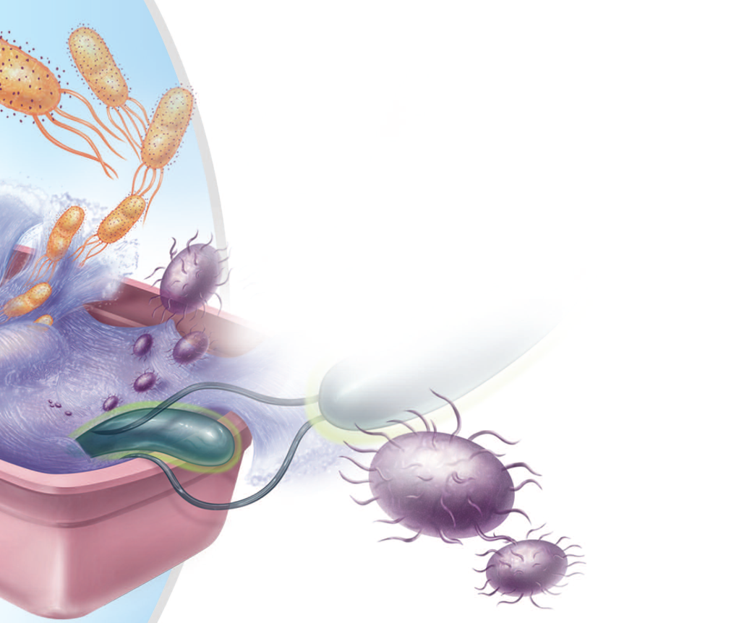
Maintenance:
Despite the known risks nurses are still using basin baths
  Nurses expressed a clear and significant preference for the disposable bath
  95% consider prepackaged bathing to be a more convenient and potentially safer method than basin bathing
Disposable bath is a desirable form of bathing for patients who are unable to bathe themselves in critical care and long-term care settings
Larson, E. L., Ciliberti, T., Chantler, C., Abraham, J., Lazaro, E. M., Venturanza, M., & Pancholi, P. (2004). Comparison of traditional and disposable bed baths in critically ill patients. American Journal of Critical Care, 13(3), 235-241.

Slide 25
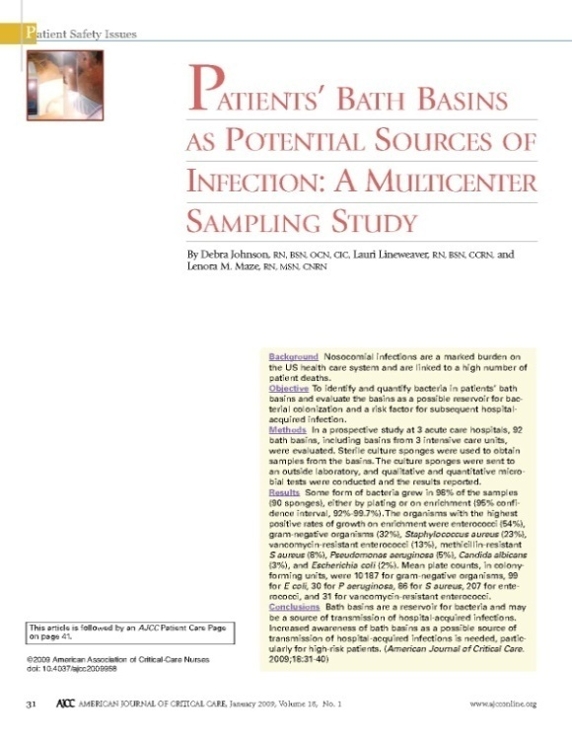
Maintenance:
Patients bath basins as potential sources of infection
A multi-center sampling study
  [The research] “justified and validated what I thought was going on already. These basins are basically cootie carriers.”
  – Deb Johnson
Authors:
Debra Johnson, RN, BSN, OCN, CIC
Lauri Lineweaver, RN, BSN, CCRN and
Lenora Maze, RN, MSN, CNRN
Facility:
Multi-Center Study
Background:
Nosocomial infections are a burden on US healthcare and are linked to patient deaths. This study aimed to identify and quantify bacteria in patient bath basins and evaluated the basins as a potential risk factor for HAIs.
Intervention:
Prospective study at 3 acute care facilities. 92 basins were sampled for bacteria.
Conclusion:
Some form of bacteria grew in 98% of the basins sampled. Gram-negative bacteria grew in 32% of the basins. MRSA grew in 8% of basins sampled. MRSA was found in the basin of a patient that was not a carrier of MRSA. Bath basins are a reservoir for bacteria and may be a source of transmission of HAI’s.
Johnson, D., Lineweaver, L., & Maze, L. M. (2009). Patients’ bath basins as potential sources of infection: a multicenter sampling study. American Journal of Critical Care, 18(1), 31-40.

Slide 26
Maintenance:
Removal of bath basins to reduce catheter-associated urinary tract infections
Authors:
Susanne Stone, RN, BSN, CIC; Donna Chaffee, RN; Kenneth Rowin, MD; Marco Chasin, MD
Facility:
Good Samaritan Hospital
Background:
The facility noted an upward trend in urinary tract infections. In May 2009 the bath basins were removed to study the effect on CAUTIs.
Intervention:
6 month study, 2 med-surg units that accounted for 30-40% of Foley catheter usage. Examined the effects of replacing the basins with pre-packaged bath cloths on the units’ CAUTI rates.
Conclusion:
  Removing bath basins and replacing them with pre-packaged bath resulted in a STATISTICALLY SIGNIFICANT reduction in CAUTIs from 4.42 to .46 per 1,000 catheter days, 89.5% reduction. The incidence of CAUTI was reduced to 0 within 1 month of initiating use and remained 0 through the end of April 2010, except for a slight spike in November 2009.
Stone, S., Chaffee, D., Rowin, K., & Chasin, M. (2010). Removal of bath basins to reduce catheter-associated urinary tract infections. Poster presented at APIC.

Slide 27
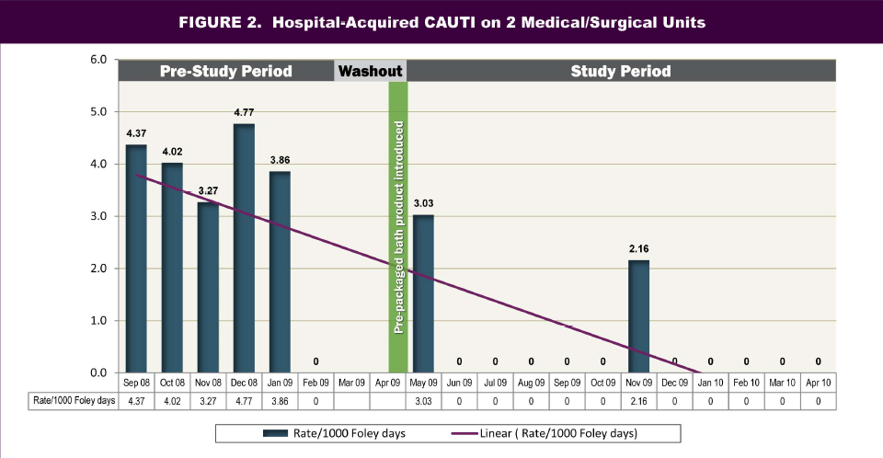
Maintenance:
Removal of bath basins to reduce catheter-associated urinary tract infections
Stone, S., Chaffee, D., Rowin, K., & Chasin, M. (2010). Removal of bath basins to reduce catheter-associated urinary tract infections. Poster presented at APIC.

Slide 28
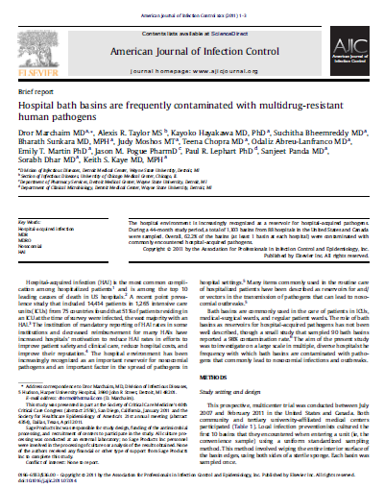
Maintenance:
Hospital bath basins are frequently contaminated with multidrug-resistant human pathogens
Author:
Dror Marchaim MD, Dr. Keith Kaye MD, MPH
Facility:
Detroit Medical Center
Background:
Determine what pathogens are contaminating patient bath basins and if the
basin should be considered a source of transmission of these pathogens.
Intervention:
  44 month study, 88 hospitals across the United States and Canada. Bath basins were randomly sampled by infection preventionists in each of these hospitals to determine what pathogens were in the patient bath basins.
Conclusion:
  Over 62% of the 1,103 basins were contaminated with some form of harmful bacteria. 45% were contaminated with gram-negative bacteria. 35% were contaminated with VRE. Over 3% were contaminated with MRSA. 100% of the hospitals that were included had dirty basins.
Marchaim, D., Taylor, A. R., Hayakawa, K., Bheemreddy, S., Sunkara, B., Moshos, J., ... & Lephart, P. R. (2012). Hospital bath basins are frequently contaminated with multidrug-resistant human pathogens. American journal of infection control, 40(6), 562-564.

Slide 29
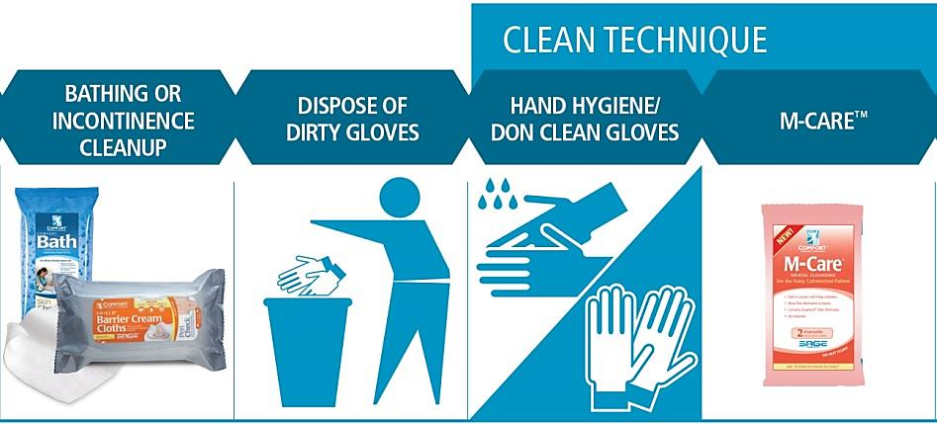
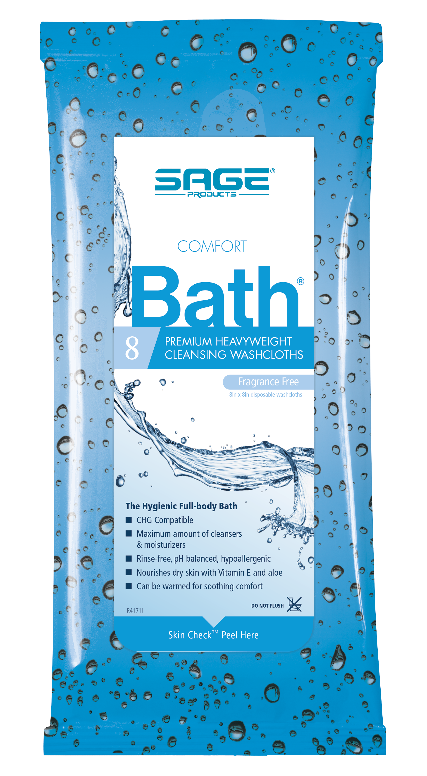
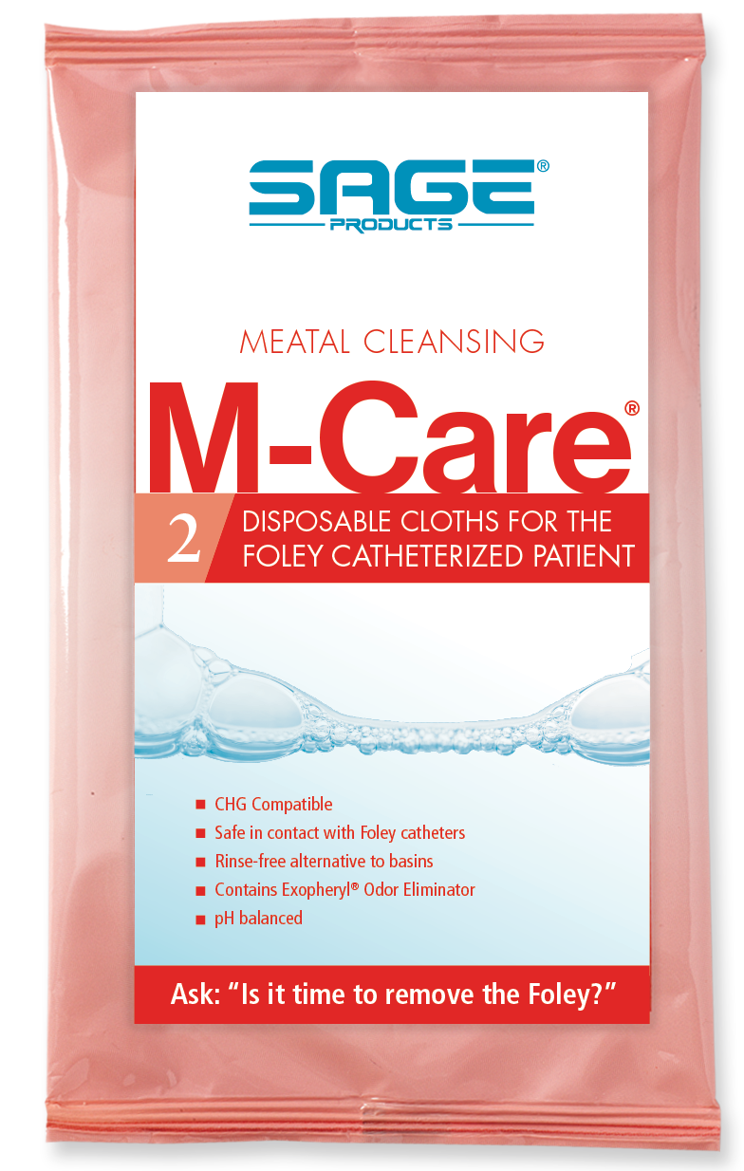
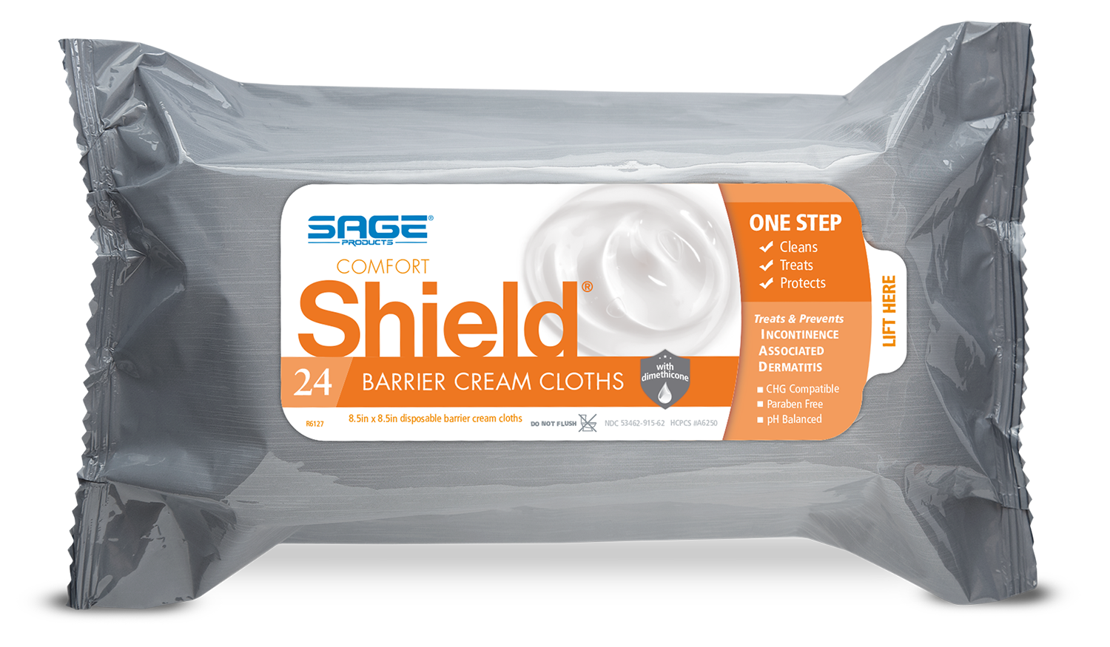
Maintenance:
It’s all about the process…
®
…and having the ability to track compliance to protocol

Slide 30
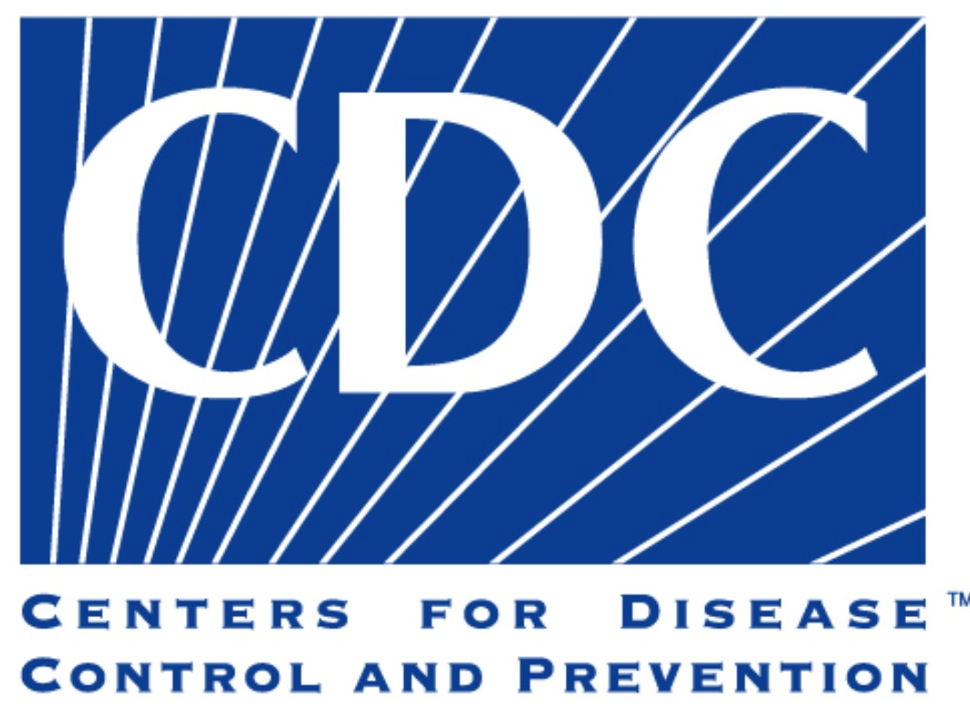



Maintenance:
Guidelines Say
1
2
  Perform hand hygiene immediately before / after any manipulation of the catheter device or site.
  Do not clean periurethral area with antiseptics to prevent CAUTI while the catheter is in place. Routine hygiene (cleansing of meatal surface during bathing or showering) is appropriate.
  Perform hand hygiene prior to catheter manipulation.
  Routine meatal cleansing without antiseptic.
3
4
  Ensure that health care workers perform hand hygiene before manipulating the urinary catheter or cleansing periurethral area.
  Cleanse the periurethral area routinely.
  Practice hand hygiene immediately before / after any manipulation of catheter site.
  Employ routine meatal hygiene; cleaning meatal area with antiseptic solutions is unnecessary
1. Gould, C. V., Umscheid, C. A., Agarwal, R. K., Kuntz, G., Pegues, D. A., & Healthcare Infection Control Practices Advisory Committee. (2010). Guideline for prevention of catheter-associated urinary tract infections 2009. Infection Control & Hospital Epidemiology, 31(4), 319-326. 2. Association for Professionals in Infection Control and Epidemiology, Inc. (2014). Implementation Guide: Guide to Preventing Catheter-Associated Urinary Tract infections. 3. Joint Commission. Clinical Care Improvement Strategies: Preventing Catheter-Associated Urinary Tract Infections, 2011. 4. Lo, E., Nicolle, L., Classen, D., Arias, K. M., Podgorny, K., Anderson, D. J., ... & Fraser, V. (2008). Strategies to prevent catheter-associated urinary tract infections in acute care hospitals. Infection Control & Hospital Epidemiology, 29(S1), S41-S50.

Slide 31
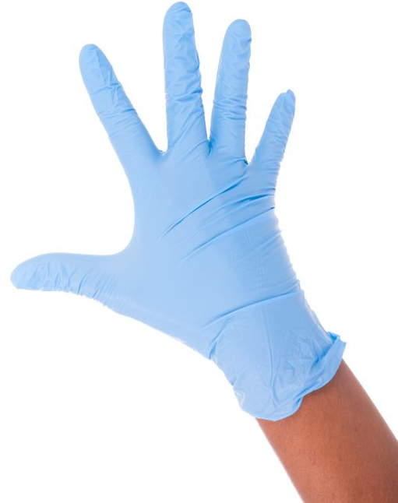
Maintenance:
Clean technique – The Joint Commission
Clean technique should be used to reduce the number of microorganisms and minimize risk of transmission from the environment or healthcare personnel by:
  Appropriate hand hygiene
  Clean gloves
  Efforts to prevent direct contamination
  of supplies and materials
The Joint Commission. Preventing Central Line–Associated Bloodstream Infections: Useful. Tools, An International Perspective. Nov 20, 2013. Accessed Feb 2018. http://www.jointcommission.org/CLABSIToolkit
Image credit: Copyright: <a href='https://www.123rf.com/profile_michel74100'>michel74100 / 123RF Stock Photo</a>

Slide 32
Maintenance:
Your current practice
Do you have a protocol in place for meatal cleansing?
Do you measure compliance to overall perineal and catheter cleansing?
  Is meatal care monitored?
  What are the nurses doing to ensure clean technique?
What is your protocol for monitoring and removing the catheter?
Joint Commission. Clinical Care Improvement Strategies: Preventing Catheter-Associated Urinary Tract Infections, 2011.

Slide 33
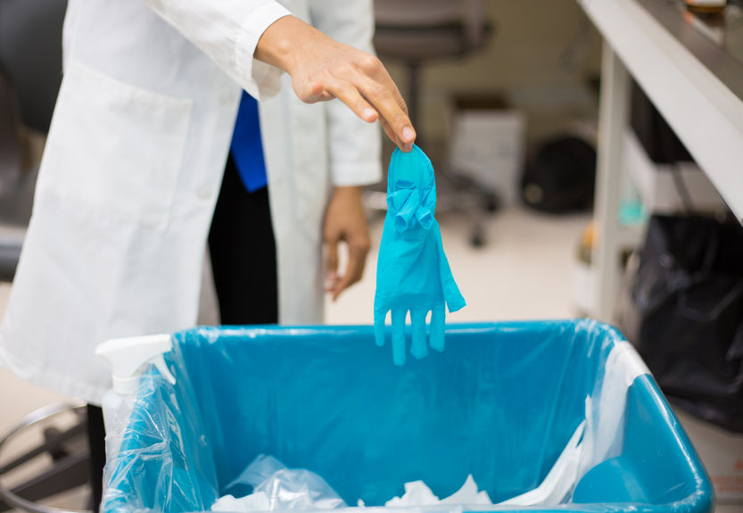
Maintenance:
Bedside reality
Meatal hygiene is getting lumped in with bathing and incontinence care
  1st stool clean up
  Then, with the same gloves and same contaminated products, the meatus is wiped
Image credit: copyright: <a href='https://www.123rf.com/profile_atic12'>atic12 / 123RF Stock Photo</a>
Notes:
Because it’s only once a day and after incontinence, it is getting lumped in with daily bathing and incontinence clean up. With reason, it is more efficient, it is what they are set up to do, and it has become one of those basic nursing procedures that gets lost in the shuffle and doesn’t get the respect it deserves. From a nursing perspective, this is a miss.

Slide 34
Maintenance:
Tenet of quality improvement
Process variation
Quality
Woodard, T., Journal of Healthcare Management 50:4 July/August 2005
Notes:
Quality improvement is essential. Quality decreases when there is increases process variation. No consistency of doing the appropriate procedure

Slide 35
Maintenance:
Conventional bathing preparation
Sally, RN
John, RN
Process and preparation is dependent on:
Personal preference
Time available
Availability of supplies
Lineweaver, Lauri, et al. "Bugs be gone: identify potential source of HAIs, the basin." Poster Presented at Institute for Healthcare Improvement (IHI), Orlando, FL (2007).
Notes:
First thing we can do is simplify the process
Remember the various ways and items that were used to bath a patient?

Slide 36
Maintenance:
Is prepackaged bathing a viable solution?
High colony count found in bath water is similar to the number of bacteria found in urine from patients with UTIs¹
Bath water could serve as a high magnitude microbial reservoir of potentially antibiotic resistant organisms²
Prepackaged bathing showed lower microbial counts than basins²
Disposable bed baths are a desirable form of bathing critically ill patients ²
1. Shannon RJ, et al., J Healthcare Safety, Compliance & Infection Control. Apr 1999;3(4):180-4. 5.
2. M. Vernon, et al, Archives of Internal Medicine, February 2006
Notes:
Well, with the High colony counts in bath water similar to bacteria in UTI’s
And also serving as a HIGH microbial reservoir …I would say yes.
Pre packaged bathing showed lower counts vs basins
Convenient and again, give you the ability to do everything you did with a basin (except emesis) and provides additional benefits (reducing process variation, convenience, purified water, soft washcloths, etc.)

Slide 37
Maintenance:
Benefits of prepackaged bathing
Can reduce microbial counts and avoid exposing patient to potential sources of contamination¹
Reduces introduction of bacteria from one body site to another, which may occur with traditional bathing¹
Efficiency
  Prepackaged bathing system takes less time to complete than the basin bath, contributing to protocol compliance²
1. Johnson, D., Lineweaver, L., & Maze, L. M. (2009). Patients’ bath basins as potential sources of infection: a multicenter sampling study. American Journal of Critical Care, 18(1), 31-40. 2. Hamman, H. (2011, July). Goodbye UTIs: Removal of traditional basin bathing methods leads to 78% reduction in UTIs. In NADONA Annual Conference.

Slide 38
Maintenance:
Benefits of prepackaged bathing
Single-patient use
  The same washcloth is not used to bathe the entire body, thus possibly reducing the potential for spread of bacteria from one area of the body to another
The use of bath packs would also allow bathing methods to be standardized, thus reducing variability in technique between nurses
Skin-friendly
  Avoid the skin-drying effects associated with the use of soap, water, and towel drying
Johnson, D., Lineweaver, L., & Maze, L. M. (2009). Patients’ bath basins as potential sources of infection: a multicenter sampling study. American Journal of Critical Care, 18(1), 31-40.

Slide 39
Questions?

