Slide 1

Antibiotic Resistance: What All Healthcare Providers Should Know
Emily Lutterloh, MD, MPH
Director, Bureau of Healthcare Associated Infections
New York State Department of Health

Slide 2
Disclosures
Nothing to disclose
(grant support to New York State Department of Health through the federal Epidemiology and Laboratory Capacity Cooperative Agreement)

Slide 3
Outline
Background
AR Threats
Scope of problem
C. difficile
Outpatient prescribing
US and New York
CDC’s “Be Antibiotics Aware” program
New York initiatives
Inpatient prescribing
Antibiotic stewardship
Resistance in New York
MRSA, CRE, etc.
Candida auris
How you can help
The future

Slide 4
Background

Slide 5
AR Threats per CDC
Urgent
Clostridium difficile
CRE
Neisseria gonorrhoeae
Serious
MDR Acinetobacter
Drug-resistant Campylobacter
Fluconazole-resistant Candida
ESBL
VRE
MDR Pseudomonas aeruginosa
Drug-resistant non-typhoidal Salmonella
Drug-resistant Salmonella Typhi
Drug-resistant Shigella
MRSA
Drug-resistant Strep pneumo
Drug-resistant tuberculosis
Concerning
VRSA
Erythromycin-resistant Group A Strep
Clindamycin-resistant Group B Strep

Slide 6
Scope of the Problem
CDC estimates that 30% of antibiotics prescribed in outpatient settings in the U.S. are unnecessary
Up to 70% of nursing home residents receive antibiotics each year
Up to 75% are prescribed incorrectly

Slide 7
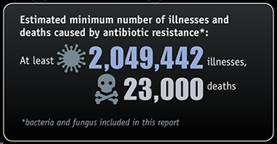
Scope of the Problem

Slide 8
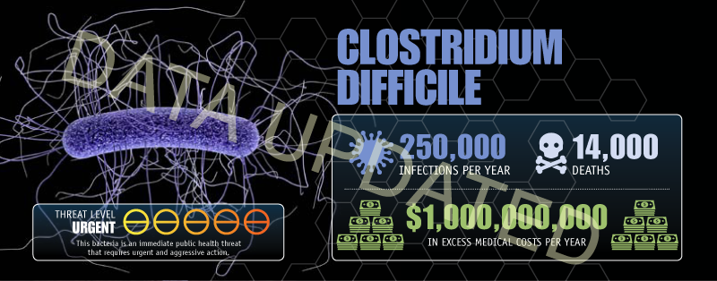
Clostridium difficile
New numbers:
500,000 infections, 15,000 deaths, $3,8 billion dollars excess costs

Slide 10
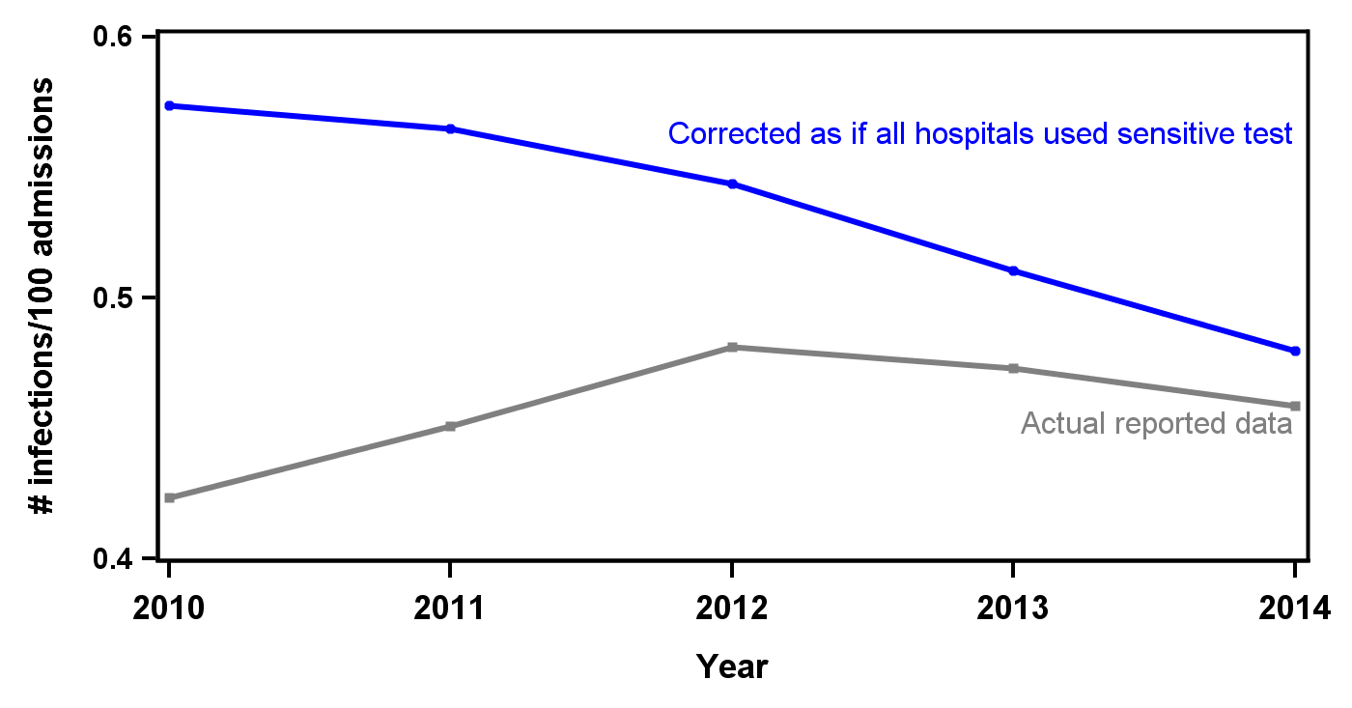
Clostridium difficile
Trend in C. difficile admission prevalence rate, New York State 2010-2014

Slide 11
Clostridium difficile
Trend in C. difficile admission prevalence rates, New York State 2015-2016
Trend in C. difficile hospital onset rates, New York State 2015-2016

Slide 13
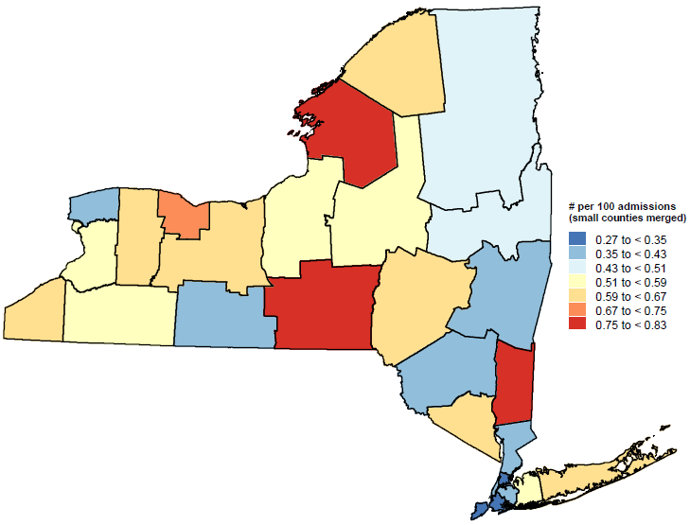
Clostridium difficile
Admission Prevalent

Slide 14
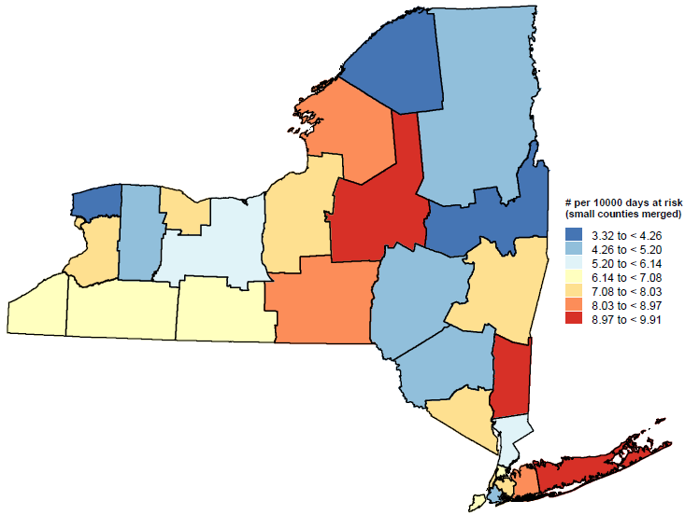
Clostridium difficile
Hospital Onset

Slide 15
Outpatient Prescribing

Slide 16
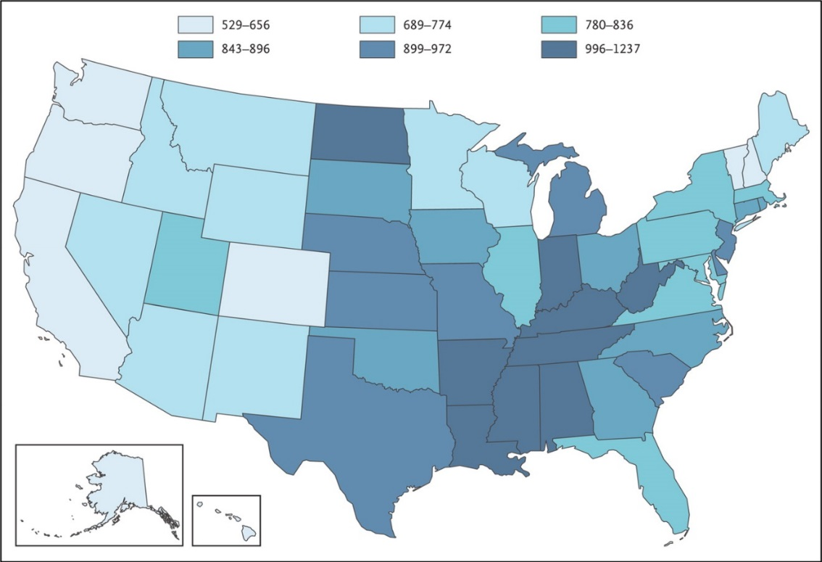
Antibiotic Prescribing, U.S., 2010
Highest prescribing rate (1237/1000)
Lowest prescribing rate (529/1000)
Hicks LA et al. N Engl J Med 2013;368:1461-1462

Slide 17
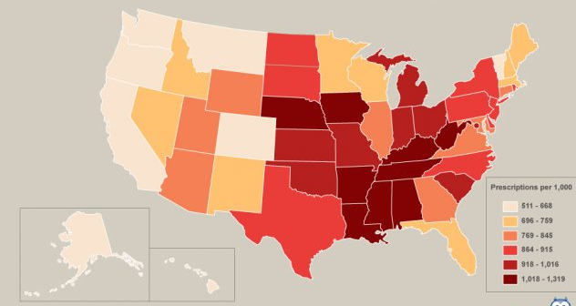
Antibiotic Prescribing, U.S., 2015
https://www.cdc.gov/antibiotic-use/stewardship-report/outpatient.html

Slide 18
Targeted Intervention: Data Analysis
2013 New York State Medicaid population
Age 3 months to 64 years old
Identify initial visits to outpatient providers (including emergency department visits) for acute upper respiratory infections (ARIs)
Use pharmacy claims to identify visits when an antibiotic was prescribed and subsequently filled
Determine regional rates of antibiotic prescribing for ARIs to identify targets for intervention

Slide 19
Antibiotic Prescribing Rates
In NYS, children (aged 3 months to 17 years) had lower antibiotic prescribing rates compared to adults
Focus on adult prescribing
Adult antibiotic prescribing rates were calculated at the county level to identify areas in need of improvement

Slide 20
2010
Potentially Avoidable Outpatient
Acute Upper Respiratory Infection
Antibiotic Prescribing,
Adjusted Rates by County
New York Medicaid
Adults 18-64 years old

Slide 21
2011
Potentially Avoidable Outpatient
Acute Upper Respiratory Infection
Antibiotic Prescribing,
Adjusted Rates by County
New York Medicaid
Adults 18-64 years old

Slide 22
2012
Potentially Avoidable Outpatient
Acute Upper Respiratory Infection
Antibiotic Prescribing,
Adjusted Rates by County
New York Medicaid
Adults 18-64 years old

Slide 23
2013
Potentially Avoidable Outpatient
Acute Upper Respiratory Infection
Antibiotic Prescribing,
Adjusted Rates by County
New York Medicaid
Adults 18-64 years old

Slide 24
2014
Potentially Avoidable Outpatient
Acute Upper Respiratory Infection
Antibiotic Prescribing,
Adjusted Rates by County
New York Medicaid
Adults 18-64 years old

Slide 25
2015
Potentially Avoidable Outpatient
Acute Upper Respiratory Infection
Antibiotic Prescribing,
Adjusted Rates by County
New York Medicaid
Adults 18-64 years old

Slide 26
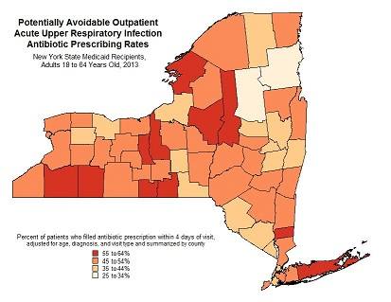
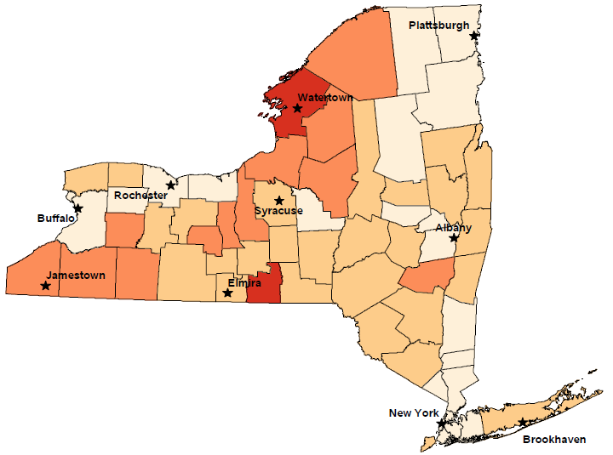
Adult and Pediatric Maps

Slide 27
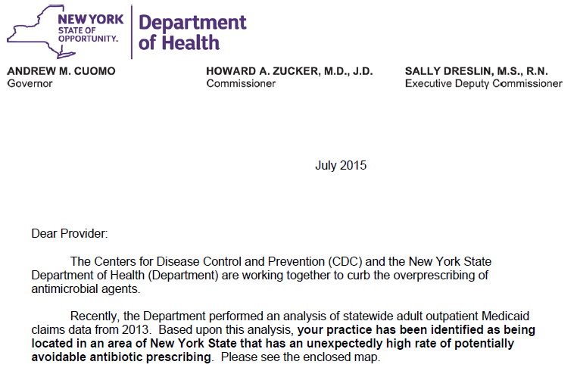
Letter to Prescribers
NYSDOH analyzed 2013 Medicaid claims data to determine NY counties where there is a high rate of avoidable antibiotic prescribing
Based on analysis, NYSDOH sent “Dear Provider” letters to all potential antibiotics prescribers in high-prescribing counties
Notes:
Letters were sent to all potential antibiotics prescribers, regardless of their individual prescribing rates.

Slide 28
Identifying our population
Message not focused on individual prescribing history
All providers within the county who could be identified
Used existing resources to identify providers
Limited to those most likely to see patients with acute upper respiratory infections
Primary care, emergency care, urgent care
~2900 providers in 11 counties
Physicians, nurse practitioners and physician assistants
https://www.health.ny.gov/health_care/medicaid/redesign/providernetwork/

Slide 29
Outreach Strategy
Three phase outreach to the 11 counties with the highest rates:
Provided information to providers in these areas
Including the map
Follow-up mailing with educational materials
Provide viral prescription pads for use as a patient take-away
Supply posters and brochures for patient education
Recruitment of local champions to provide outreach and support the project locally
Academic detailing
Local Health Departments
Notes:
Looking to alert providers to the issue of potential over prescribing where they are practicing and requesting for any one interested to reach out to us as potential collaborator.
Some of the LHDs have taken this and started campaigns and outreach on their own.

Slide 30
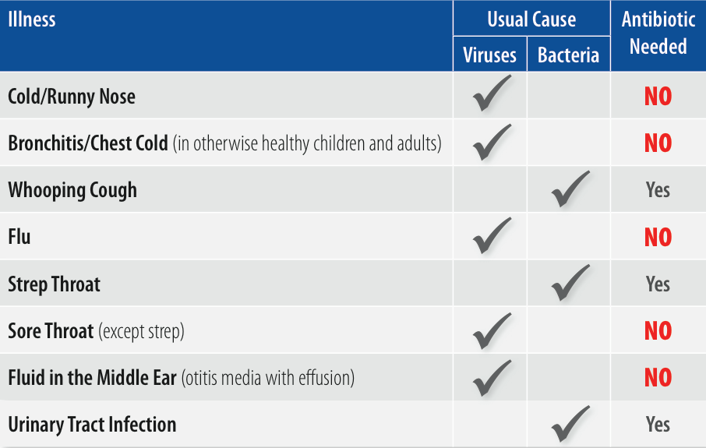
Focus
Acute upper respiratory infections account for 75% of all antibiotics prescribed by office based physicians
Shapiro DJ, Hicks LA, Pavia AT, Hersh AL. Antibiotic prescribing for adults in ambulatory care in the USA, 2007-09. The Journal of antimicrobial chemotherapy. 2014 Jan;69(1):234-40.

Slide 31
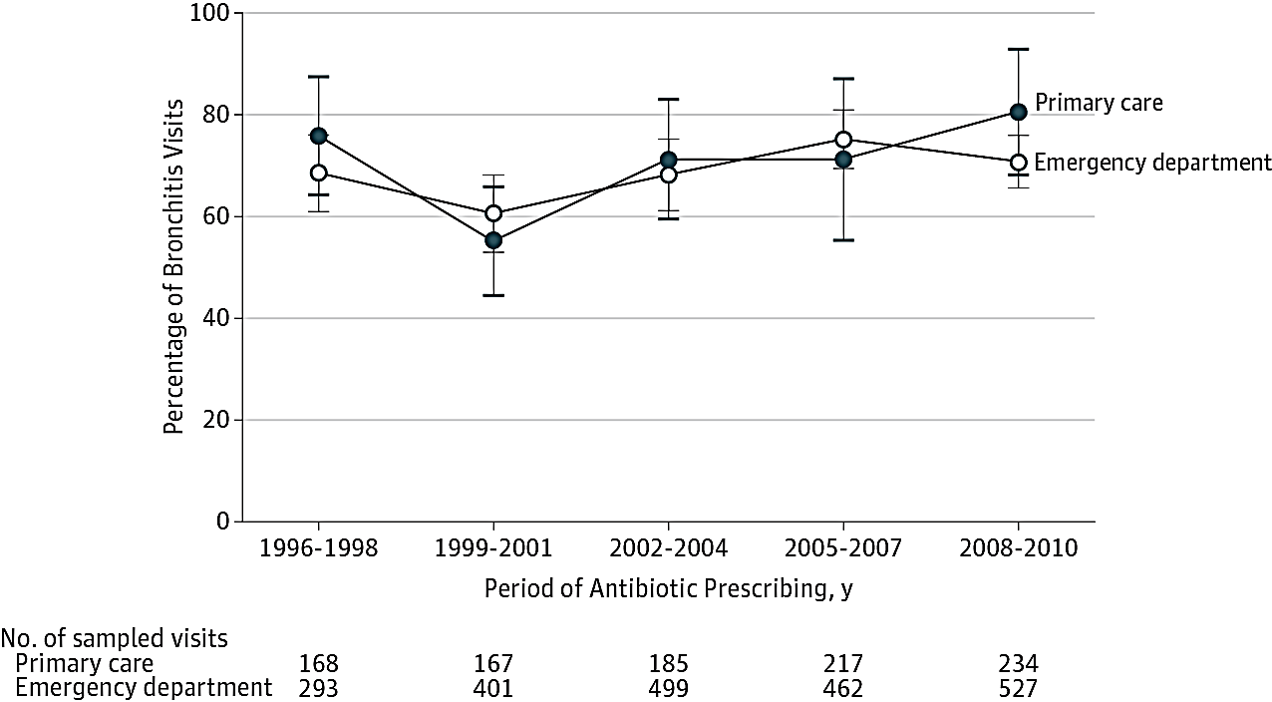
National Data: Prescribing for acute bronchitis in ambulatory care, 1996-2010
Bottom line: No improvement and getting worse!
Slide from CDC Get Smart Program
Barnett et al. JAMA. 2014; 311(19):2020-22.
Notes:
These slides reveal that there is opportunity for improvement here.
This data is similar to statewide data that is publicly available annual quality assurance reporting requirements for managed care plans, consistent with 65-75% of adults with acute bronchitis in NYS, are getting antibiotics, across various managed care plans.

Slide 32

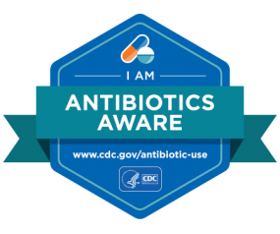
“Be Antibiotics Aware: Smart Use, Best Care”
CDC campaign to “improve antibiotic prescribing and use and to help combat antibiotic resistance”

Slide 33
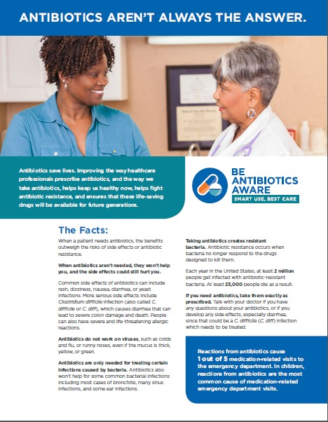
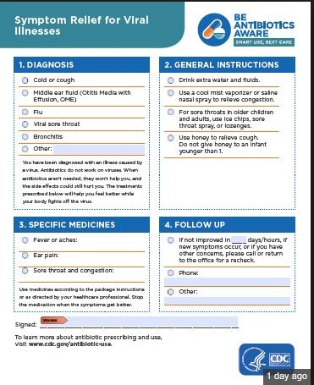
CDC’s “Be Antibiotics Aware”

Slide 34
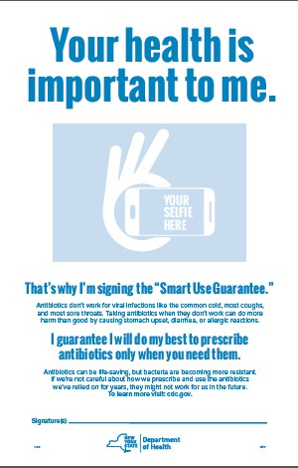

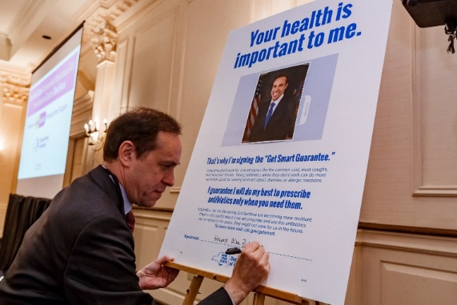
New York Initiatives
Medicaid mapping project
Antibiotic Resistance Task Force (ARTF)
“Smart Use Guarantee” poster for providers

Slide 35
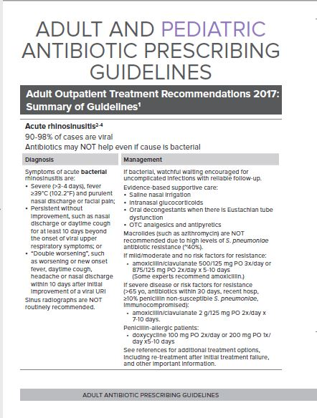
New York Initiatives
Antibiotic prescribing guidelines
https://www.health.ny.gov/professionals/protocols_and_guidelines/antibiotic_resistance/

Slide 36
Antibiotic Prescribing Guidelines

Slide 37
Antibiotic Prescribing Guidelines

Slide 38
Antibiotic Prescribing Guidelines
Adult
Acute rhinosinusitis
Acute uncomplicated bronchitis
Common cold/non-specific URI
Pharyngitis
Acute uncomplicated cystitis
Pediatric
Acute rhinosinusitis
Acute otitis media
Pharyngitis
Common cold/non-specific URI
Bronchiolitis
UTI

Slide 39
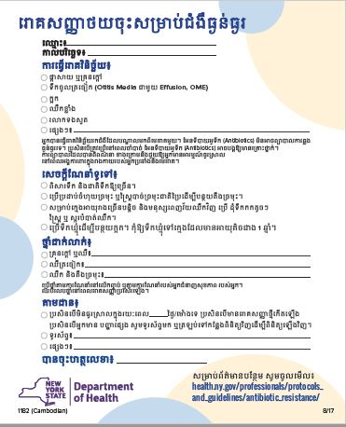
New York Initiatives
Viral “prescription” pad translation

Slide 40
Interventions that Work
Print materials alone have little impact on prescribing
Audit and feedback of current practice has been successful
Academic detailing, opinion leader education effective
Clinical decision support promising
Other options:
Delayed prescribing practices
Poster interventions involving public commitment to prescribe judiciously
Arnold et al. Cochrane Database Syst Rev. 2005 Oct 19;(4):CD003539.
Forrest et al. Pediatrics 2013 Apr;131(4):e1071-81.
Little et al. Lancet 2013 Oct 5;382(9899):1175-82.
Meeker et al. JAMA Intern Med. 2014;174(3):425-31.

Slide 41
Inpatient Prescribing

Slide 42
Antibiotics in Hospitals
30-50% of antibiotics prescribed in hospitals are unnecessary or inappropriate
Improving prescribing can reduce Clostridium difficile and antibiotic resistance

Slide 43
Antibiotics in Hospitals
Half of all hospital patients receive an antibiotic
Doctors in some hospitals prescribe 3x as many antibiotics as doctors in other hospitals

Slide 44
Antibiotic Stewardship in Long-Term Care Facilities
Extension of multi-year program
Clostridium difficile
Interfacility transfer
Current project:
Voluntary participation
Antibiotic stewardship
UTIs
NHSN reporting

Slide 45
Antibiotic Stewardship
Interventions to help improve prescribing
Core Elements
Leadership commitment
Accountability
Drug expertise
Action (implementing interventions)
Tracking
Reporting
Education

Slide 46
Antibiotic Stewardship
Examples of Interventions
Antibiotic “time out”
Require indication and duration
Facility-specific treatment recommendations
Audit and feedback
Rapid diagnostics

Slide 47
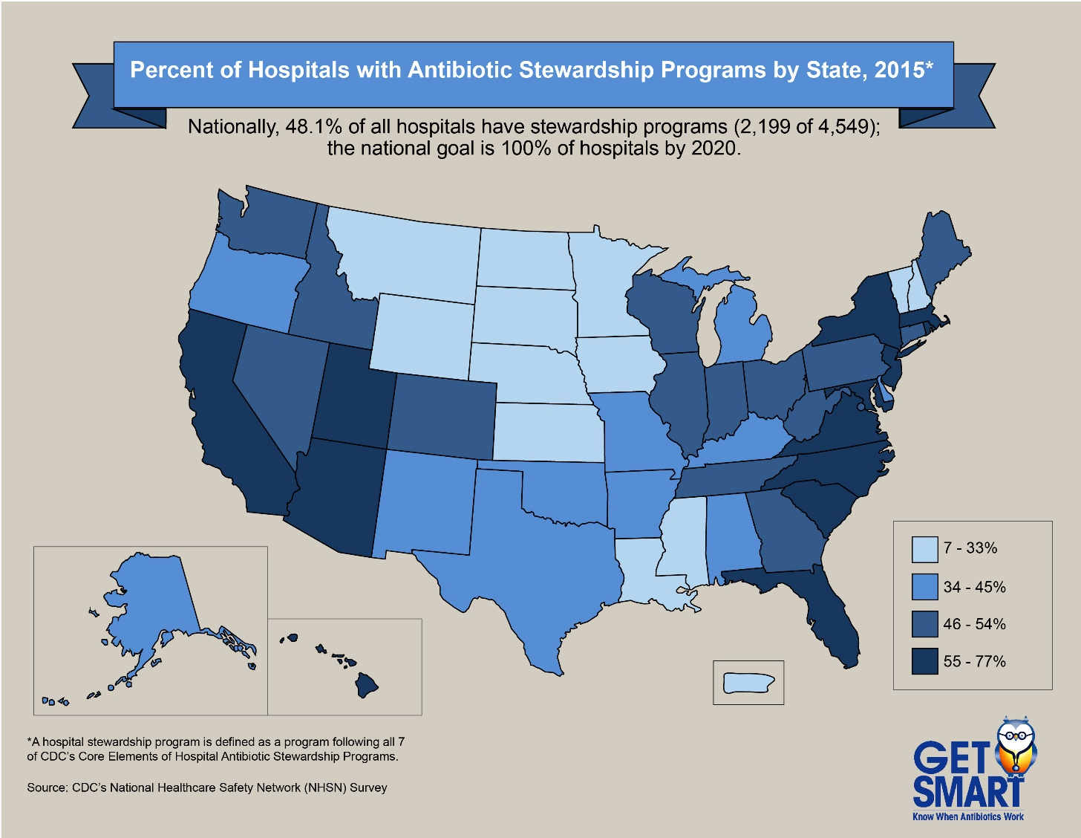

Slide 48
Antibiotic Stewardship
CDC Core Elements | 2015 % hospitals with | 2016 % hospitals with
Leadership commitment | 80.6 | 89.9
Accountability | 88.6 | 96.6
Drug expertise | 90.9 | 95.5
Action (implementing interventions) | 98.3 | 99.4
Tracking (abx use, adherence to policies) | 86.3 | 93.3
Reporting | 88.6 | 93.8
Education | 75.4 | 90.4
Total (meet all 7 core elements) | 59.4 | 77.0

Slide 49
Antibiotic Stewardship
Action | 2015 % hospitals with | 2016 % hospitals with
Policy requiring documentation of indication | 50.3 | 53.9
Facility-specific treatment recommendations | 78.9 | 83.7
Antibiotic time-out | 34.3 | 41.0
Certain antibiotics need approval | 81.7 | 79.2
Review of antibiotic courses, communication with prescribers | 83.4 | 90.4

Slide 50
CRE Activities
Applicable to a variety of MDROs
CRE/AR Coordinator in metropolitan NYC area
Education
Site visits
Outbreaks

Slide 51
CRE Activities
Survey of healthcare facilities
What are they doing?
What more is feasible?
Regional/statewide plan to coordinate efforts

Slide 52
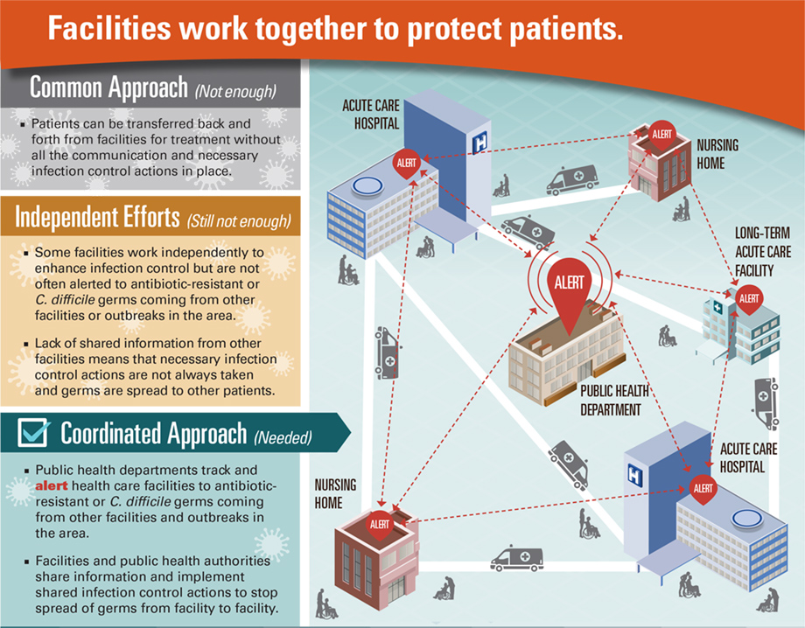
http://www.cdc.gov/vitalsigns/stop-spread/index.html

Slide 53
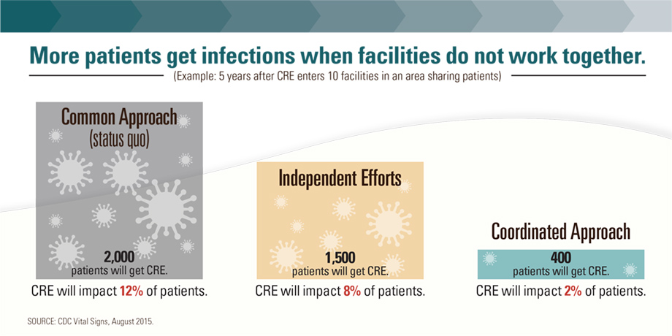

Slide 54
Resistance in New York

Slide 55
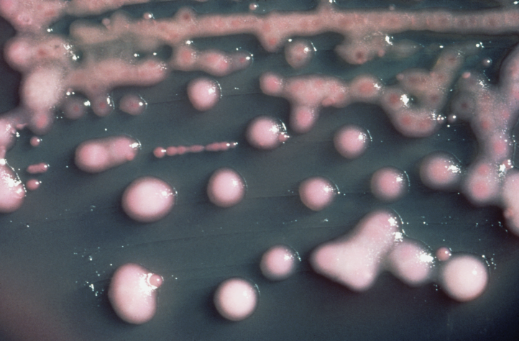
Carbapenem-Resistant Enterobacteriaceae
Bacteria like E. coli and Klebsiella that commonly cause infections in hospitalized patients
Resistant to most antibiotics

Slide 56
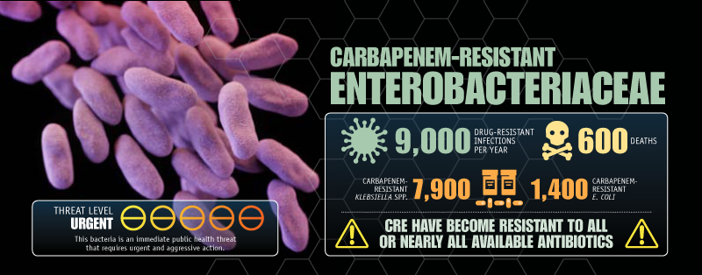
Carbapenem-Resistant Enterobacteriaceae

Slide 57
Carbapenem-Resistant Enterobacteriaceae

Slide 58

Candida auris
A yeast
First reported from Japan in 2009
Has since emerged around the world
Pakistan
Venezuela
Israel
United Kingdom
S. Africa
Kenya
Kuwait
Japan
South Korea
India
2009 2010 2011 2012 2013 2014 2015 2016

Slide 59
Candida auris
An example of an “emerging pathogen”
Why are we concerned?
Often multi-drug resistant
Hard for labs to identify
Causes healthcare-associated infections and outbreaks
Most cases in the US are in New York

Slide 60



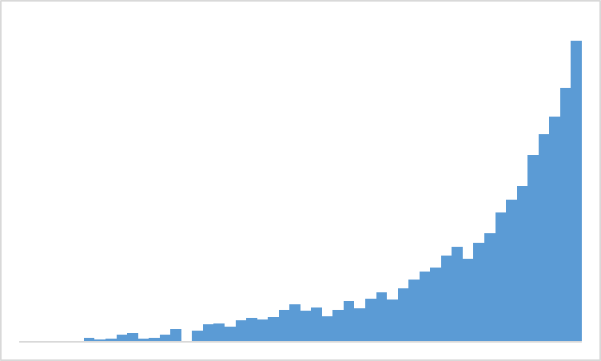
The Future of C. auris
?

Slide 61
The Future

Slide 62
Conclusions
Doom and gloom?
No antibiotics to treat simple infections like UTIs or ear infections
Increased cost, increased risk, increased deaths
The antimicrobial resistance threat is real
‘Everyone should be concerned about this issue because antibiotic resistance anywhere is antibiotic resistance everywhere’
Dr. Lauri Hicks, Director for CDC’s Office of Antibiotic Stewardship

Slide 63
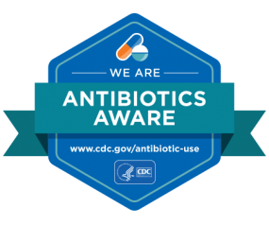
Thank you!
Questions?
Contacts:
Emily Lutterloh, MD, MPH
Mary Beth Wenger
Project Coordinator

