Slide 1
Circle, Circle, Dot, Dot Who’s getting their cootie shots?
Daliya Khuon, MD
October 10, 2024

Slide 2
No disclosures

Slide 3
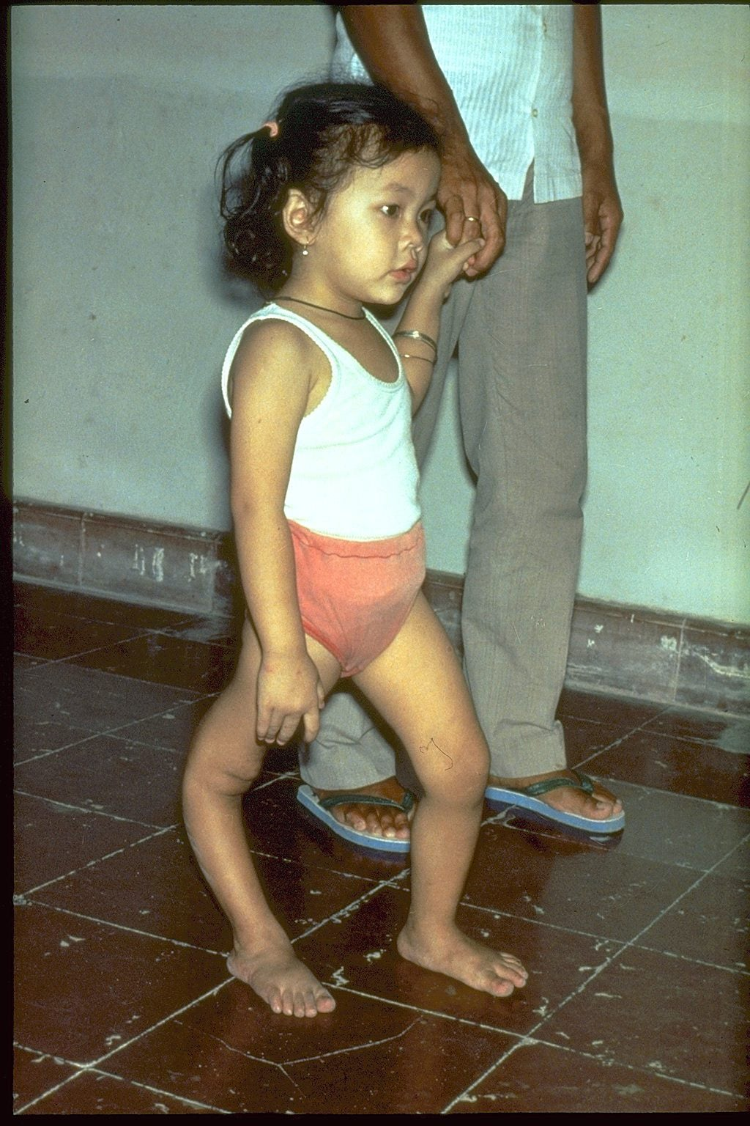
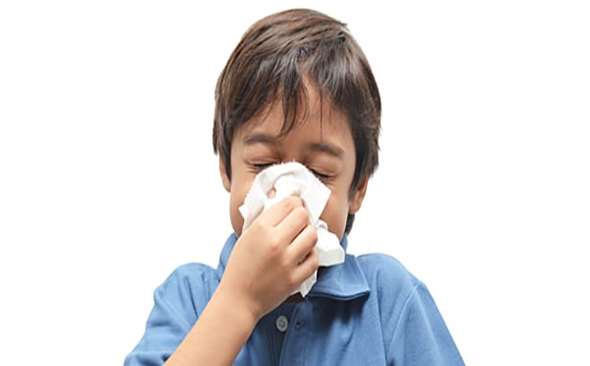
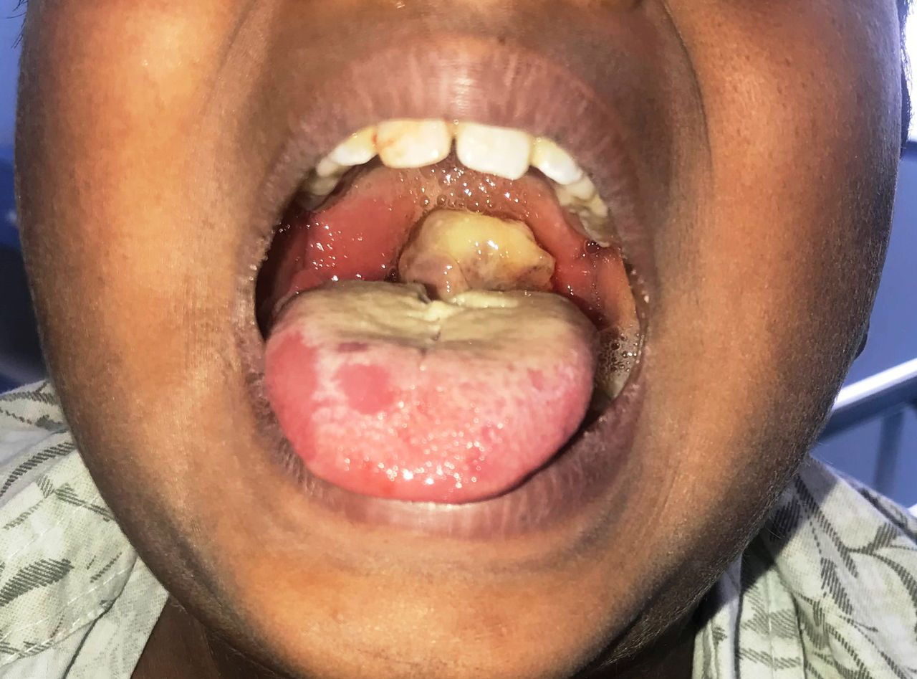
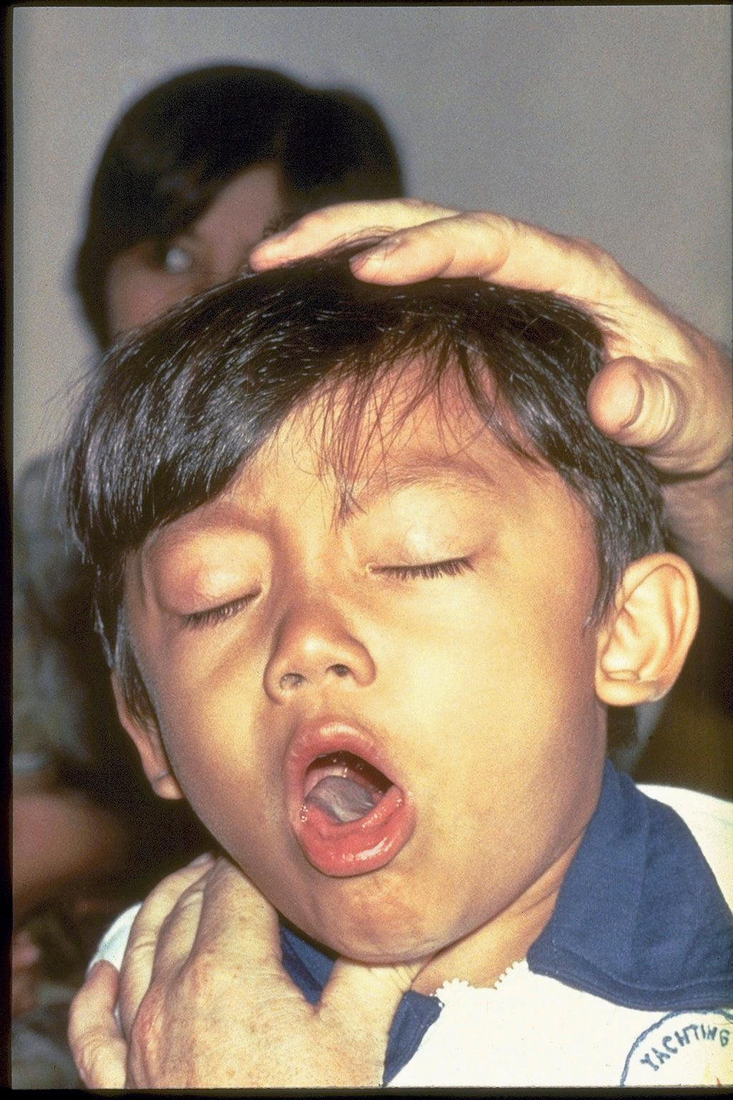
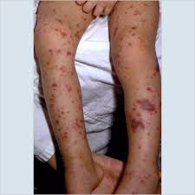
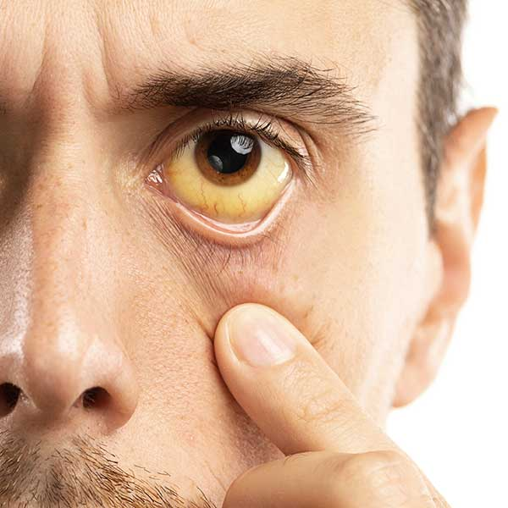
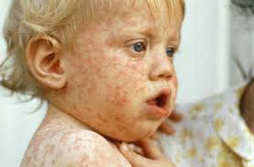
17
Notes:
There are 17 vaccine preventable infections on the CDC/ACIP immunization schedule
Range from prevention of common childhood viruses (measles, mumps, etc) to causes of invasive bacterial infections, viral hepatitis, diarrheal illnesses, respiratory viruses

Slide 4
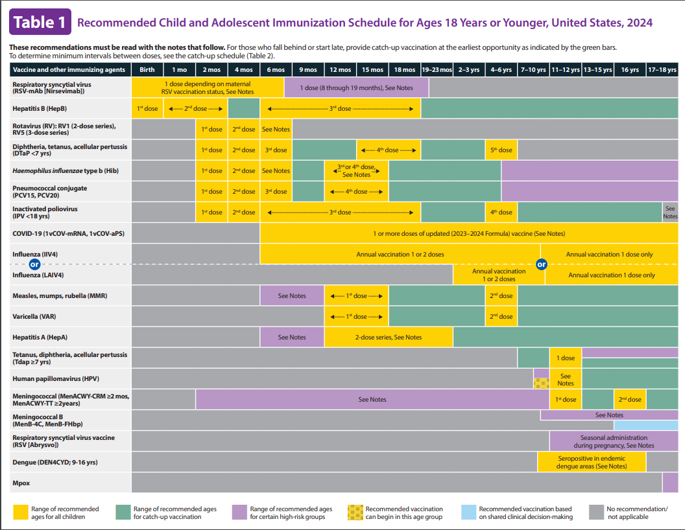
Notes:
Vaccine schedule

Slide 5
Why bother vaccinating?
01
Lost school and work days from mild illness
02
Prevent complications and death from infections
03
Protect those who cannot be vaccinated

Slide 6
Vaccine success stories

Slide 7
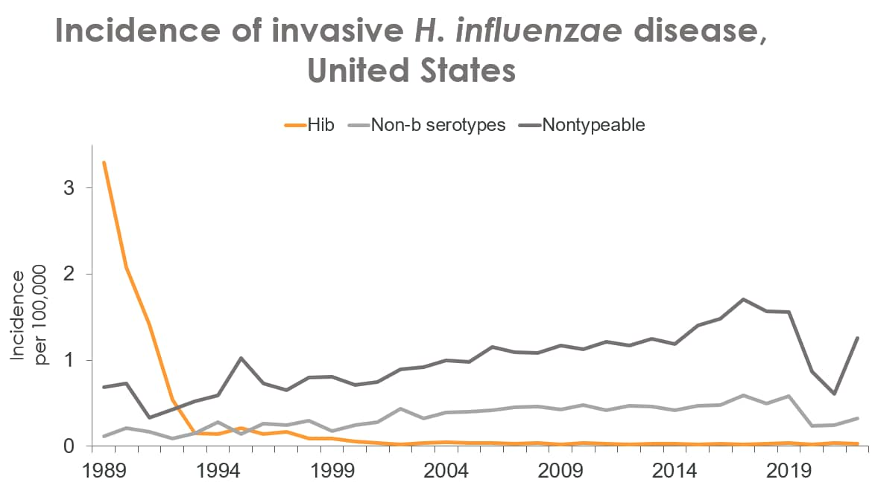
Haemophilus influenzae type B
Encapsulated bacteria that commonly causes ear infection, epiglotitis, pneumonia, bacteremia, meningitis
First Hib vaccine licensed in 1987
Prior to vaccine
20,000/ year with severe disease
1000 deaths/ year

Slide 8
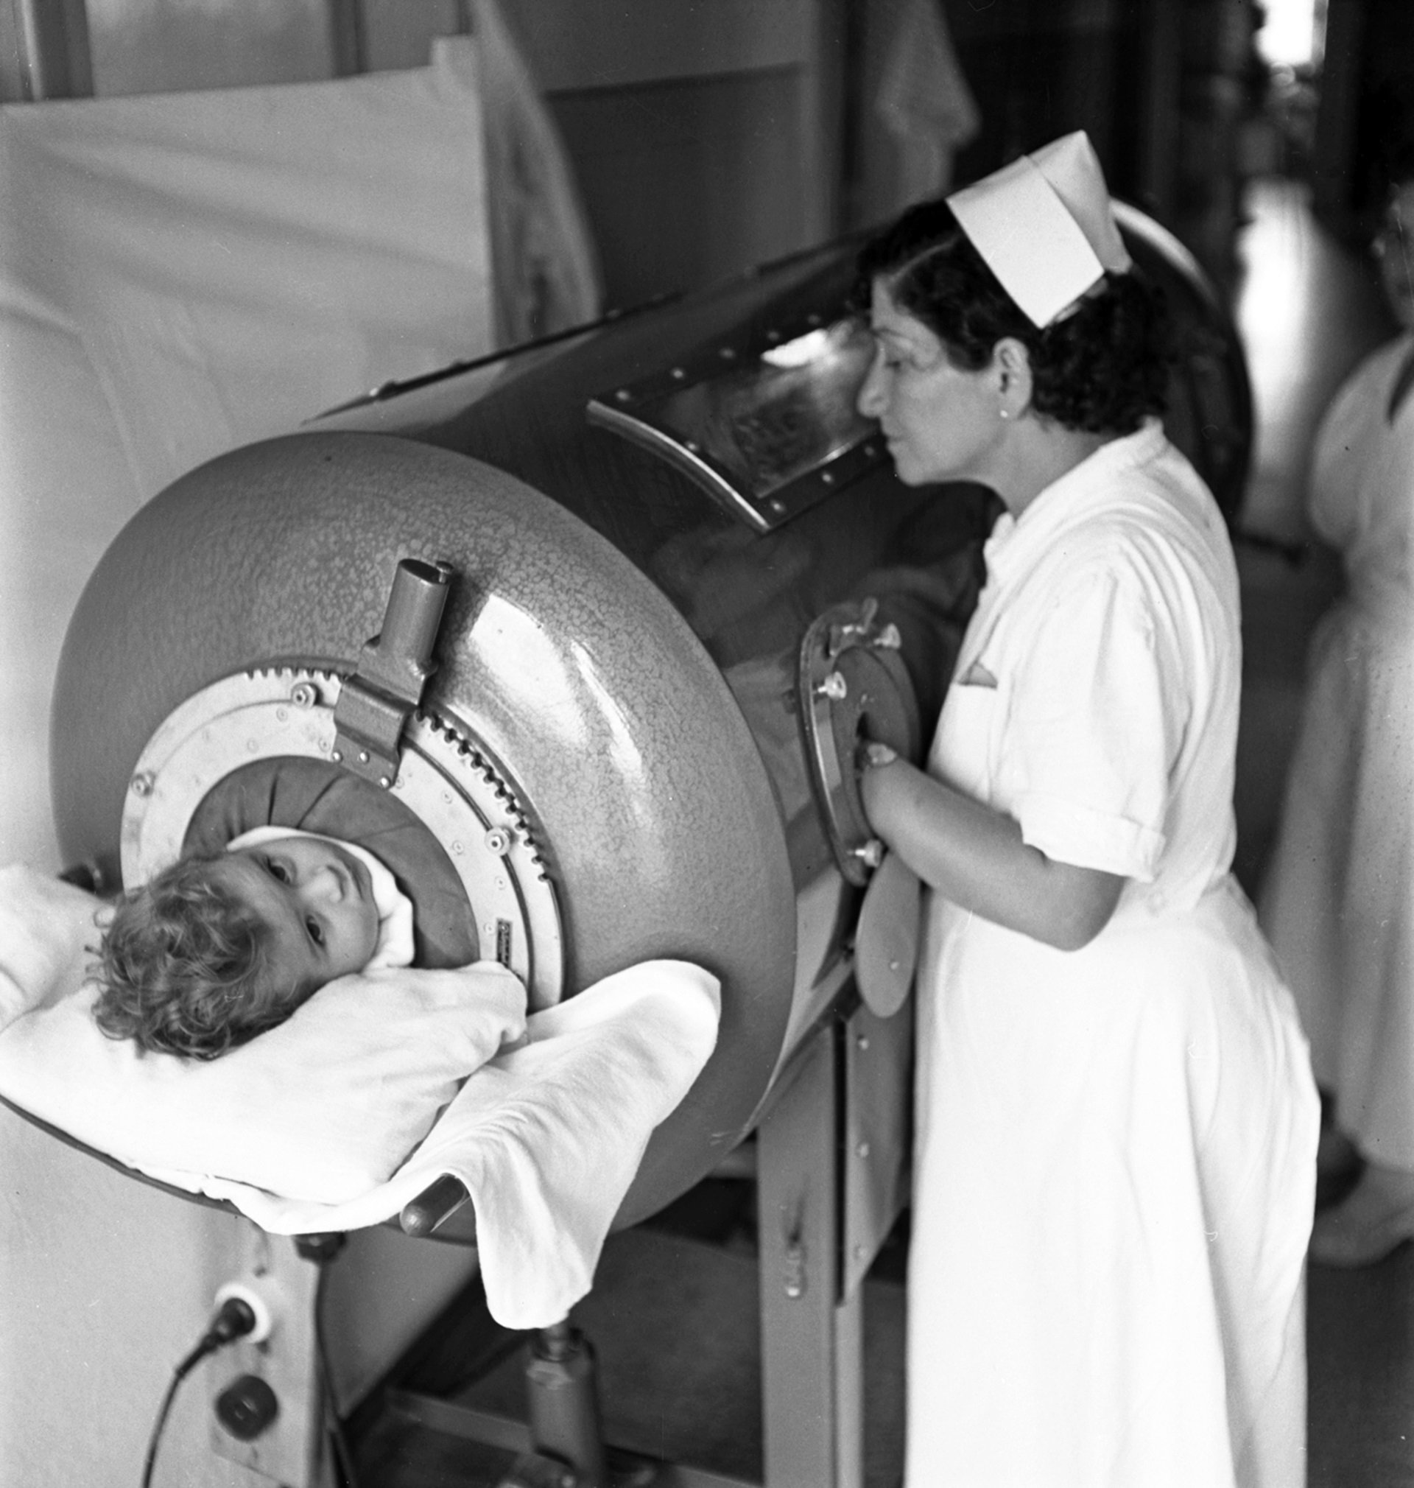
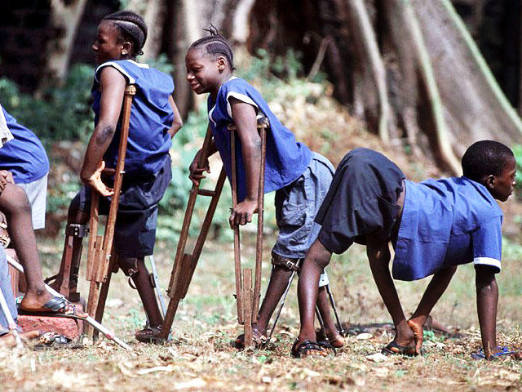
Polio
70% of children are asymptomatic
<1% acute flaccid paralysis, 2/3 of those patient have residual paresis
1979 – polio eradicated in the US
1999 – Wildtype 2 eradicated
2020 – Wildtype 3 eradicated
Wildtype 1 – still out there in Afghanistan and Pakistan*

Slide 9
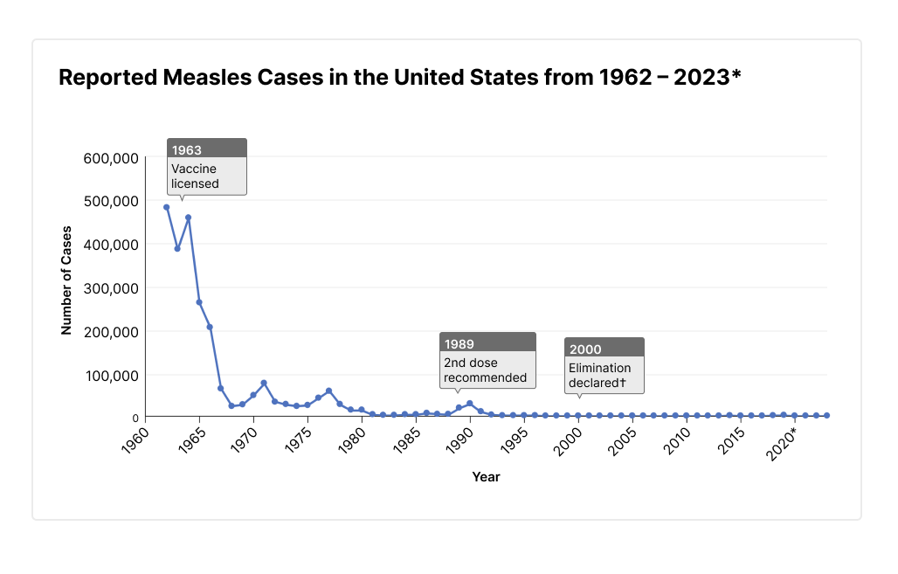
Measles
Most cases are characterized by a mild illness
1/1000 encephalitis
1/1000 mortality rate
Immune system “amnesia”
Subacute sclerosing panencephalitis – progressive brain inflammation that is universally fatal 6-15 years after measles infection

Slide 10
Vaccines prevent 4 million deaths worldwide EVERY YEAR
1 in 5 children do not have access to childhood vaccines, so we can do better!
For every $1 spent on vaccines, we save $52

Slide 11

Vaccines are awesome… so why don’t people vaccinate?

Slide 12

Vaccine hesitancy is not new!

Slide 13
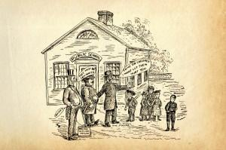
Vaccine hesitancy: Tale as old as Jenner’s smallpox vaccine
Early 1800s – fear of inoculation with cowpox to prevent smallpox
Vaccination would turn people into cows
It’s against God’s will
1982 - “DPT: Vaccine Roulette”
Documentary claiming diphtheria-pertussis-tetanus vaccine caused seizures and permanent brain damage
Took research out of context
Decreased vaccine rates and lawsuits
Nearly destroyed vaccine manufacturing industry in the US
Creation of National Childhood Vaccine Injury Act and the Vaccine Adverse Events Report System (VAERS)

Slide 14
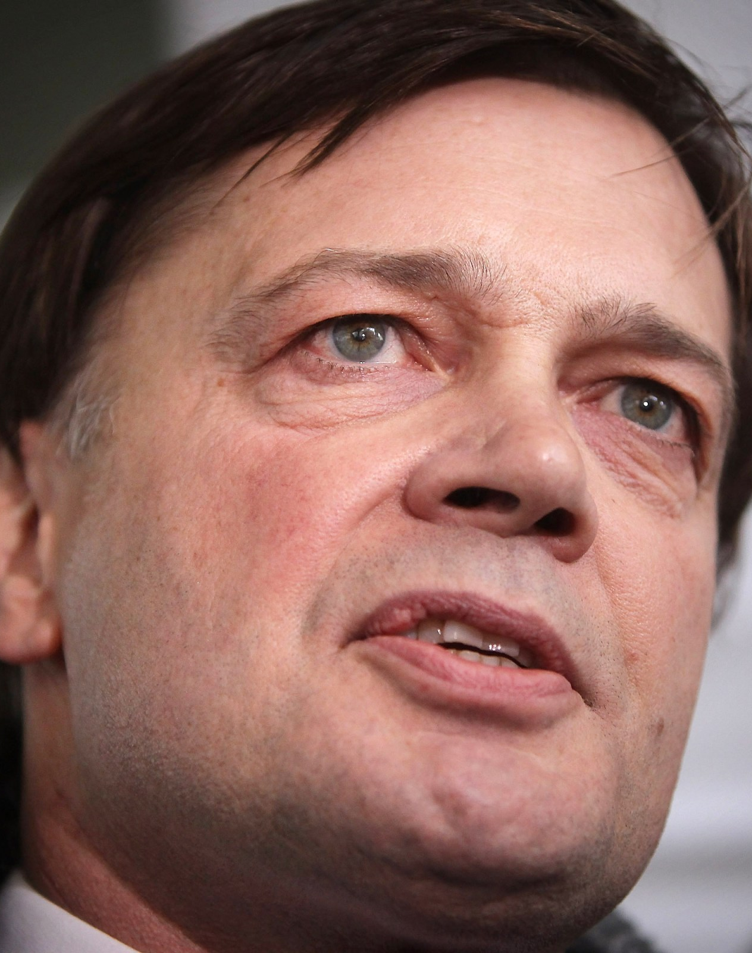
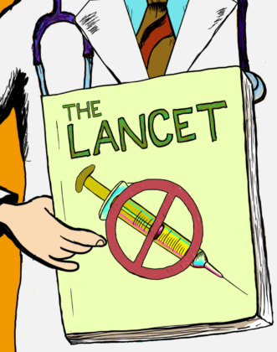
Vaccine hesitancy: the Wakefield Controversy
1998 paper “linking” MMR and autism
Cherry picked and falsified data
2 decades of papers since disproving this
Ulterior motives
Funded by lawyers representing the parents of children trying to sue vaccine manufacturers
Working on another vaccine and was trying to get rid of the competition
In the UK alone – 12,000 measles of cases, hundreds of hospitalizations, 3 deaths

Slide 15





Vaccine hesitancy – follow us on:

Slide 16
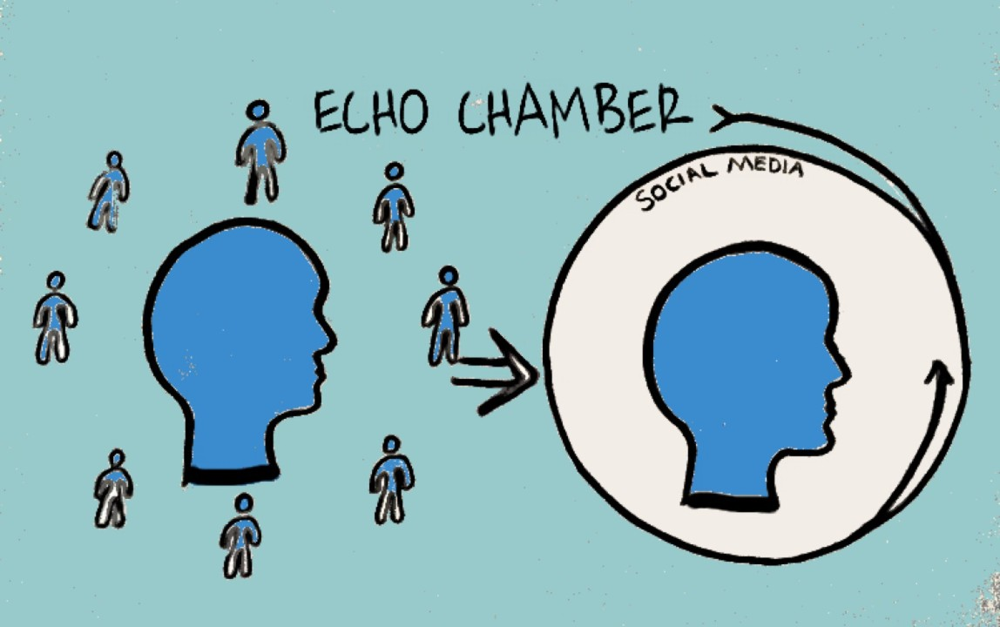
Vaccine hesitancy: The modern (Post-COVID) era
Social uncertainty and conspiracy theory
Tend to flourish during a time of heightened fear and anxiety
People are trying to simplify and make sense of a complex and new environment
The COVID pandemic worsened the anxieties already circulating due to the MMR autism issues
Now more than ever, anyone with a smartphone has a platform
Social media is designed to keep you scrolling – the algorithms work against us
As more people spend time getting their news and information from social media, their trust in more traditional media decreases

Slide 17



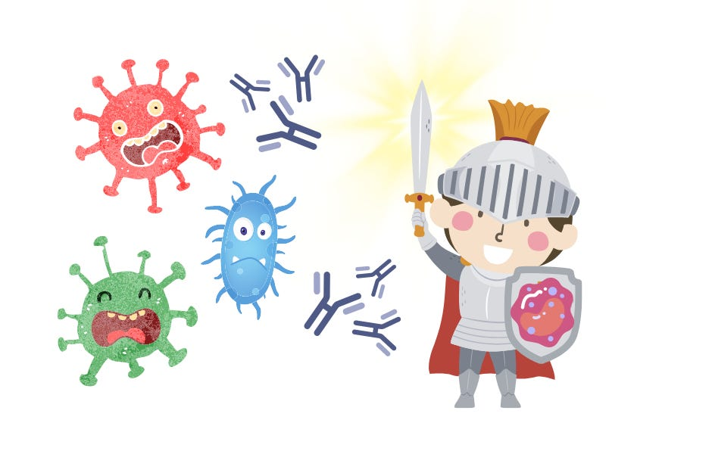
Vaccine myths
Vaccines cause autism/ diabetes/ MS/ IBD/ SID
They’re full of toxins
Vaccines change your DNA
They put a microchip in the vaccines
Vaccines cause the disease they’re preventing
It’s too many shots – our immune system can’t handle it

Slide 18

The inevitable outcome of decreased vaccination rates
Outbreaks

Slide 19
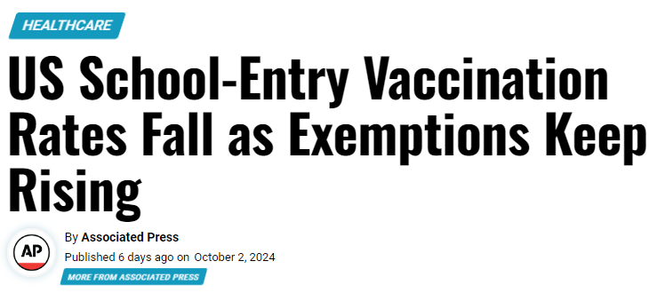
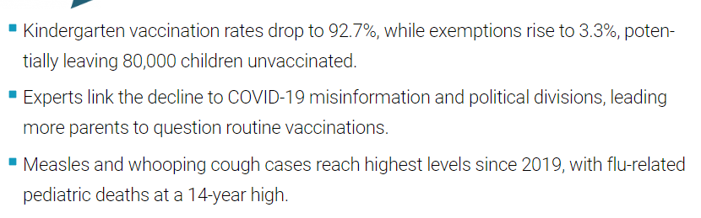
Notes:
* Increase in exemptions doesn’t tell the whole story – exemptions tend to cluster

Slide 20
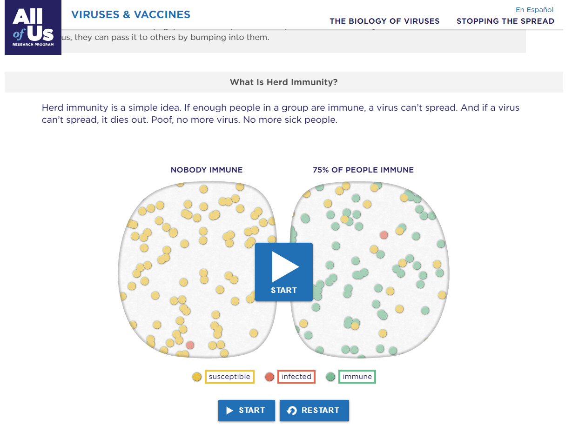
Implications for decreased vaccine rates
Previously rare infections can return
Individual children are less well protected
Vulnerable patient populations are at increased risk
Loss of herd immunity → more outbreaks
The contagiousness of the virus matters – because measles is so contagious we need 95% of the population to be immune in order to prevent transmission
https://virusinfo.joinallofus.org/herd-immunity

Slide 21
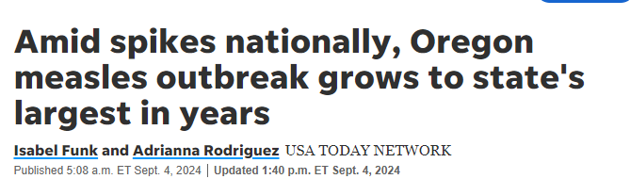
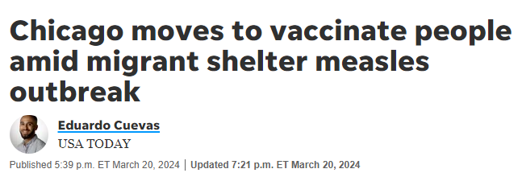
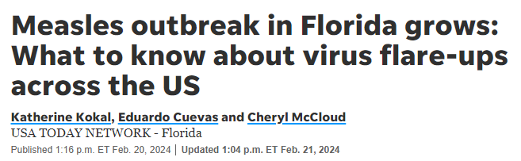
Notes:
31 cases of measles reported in this outbreak
Primarily unvaccinated children
In 2023, US had 58 cases
As of August, US had 236 cases

Slide 22
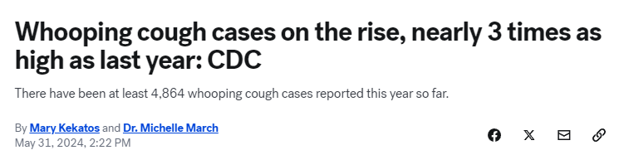

Slide 23
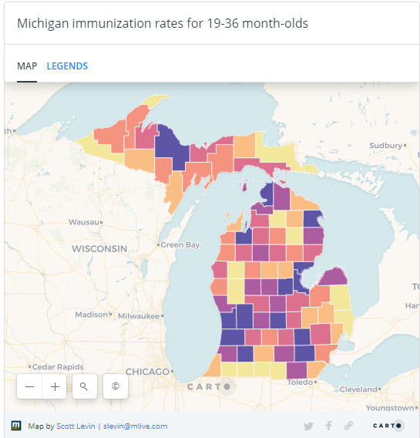
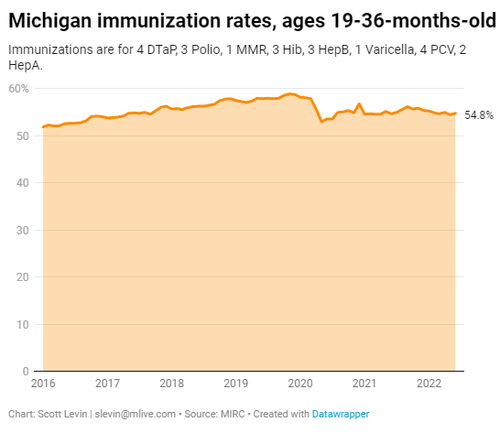

What about Michigan?

Slide 24
What about Michigan?
Mumps in northern Michigan
Pertussis throughout the state

Slide 25
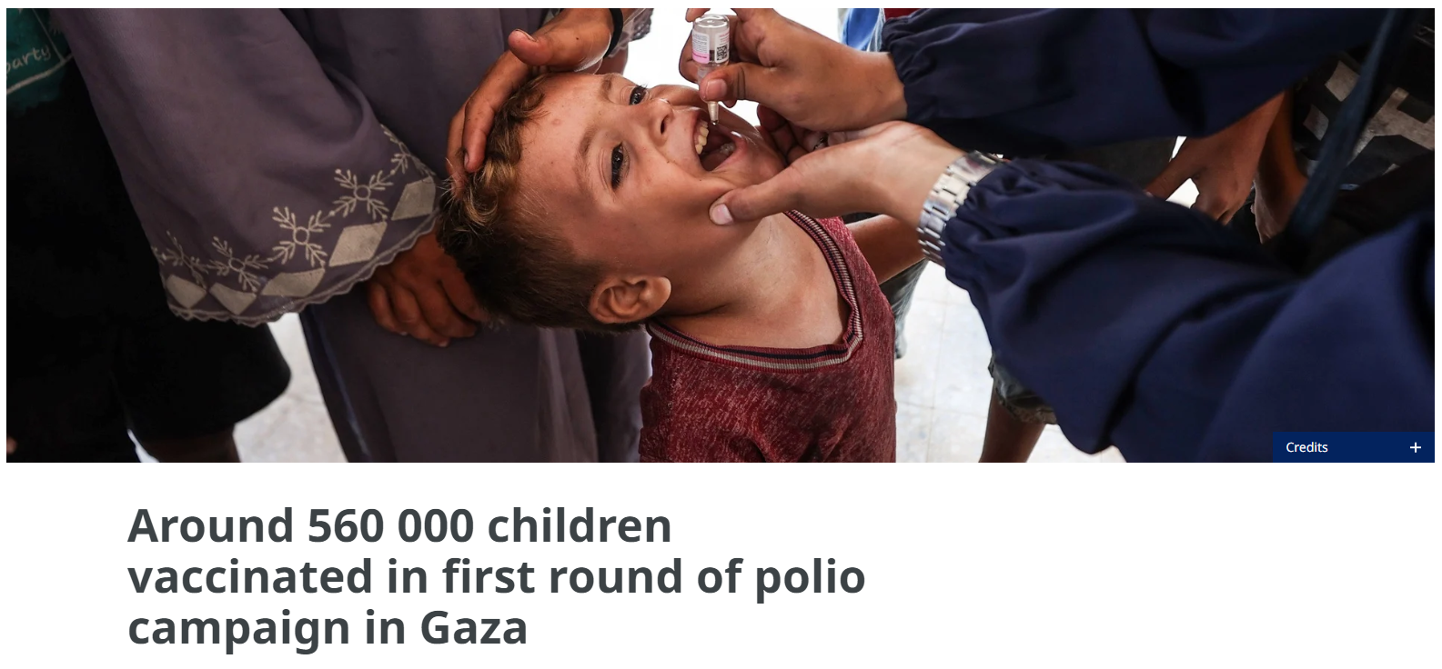
Notes:
* 10 MO boy in Gaza recently paralyzed by polio, first in 25 years
Humanitarian cease fire
Global conflicts can create the perfect storm
Global society- it can travel

Slide 26
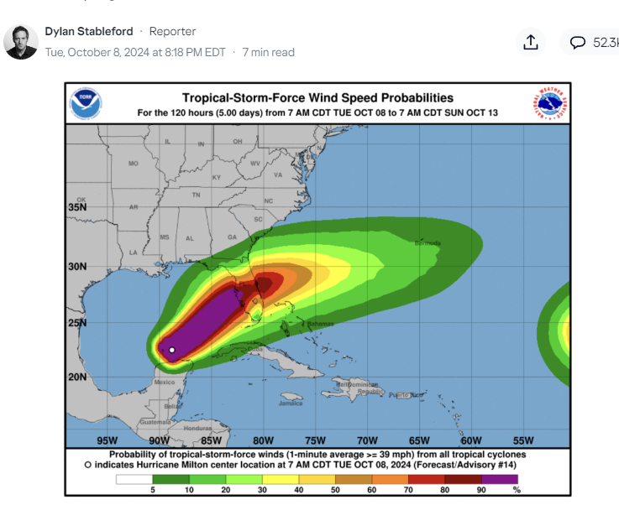
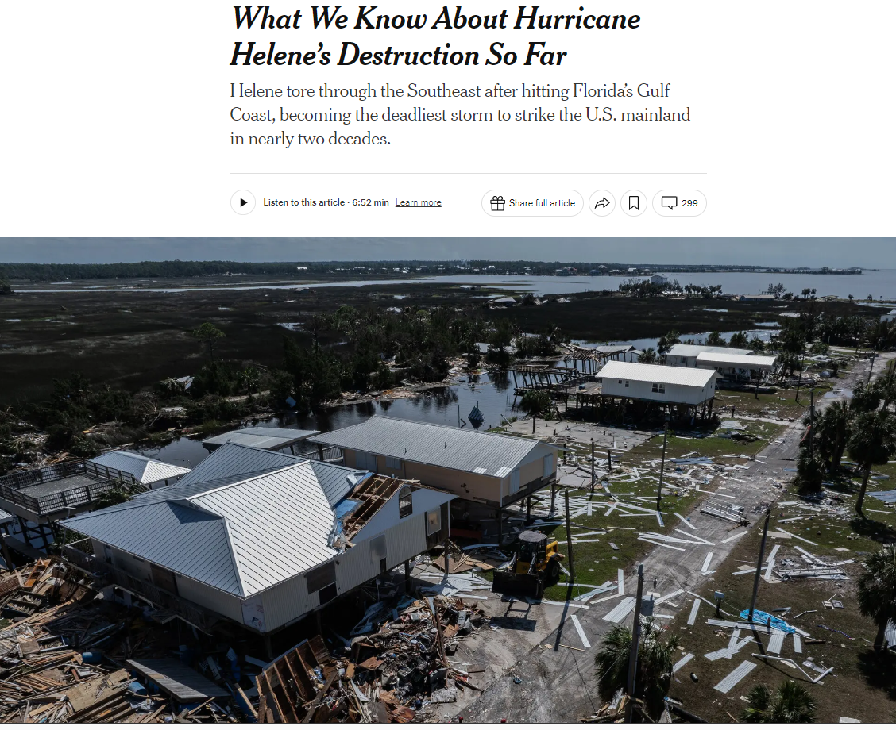
Natural disasters
Notes:
* As climate change causes more natural disasters, decreased access to health care and crowding may further exacerbate vaccine hesitancy

Slide 27
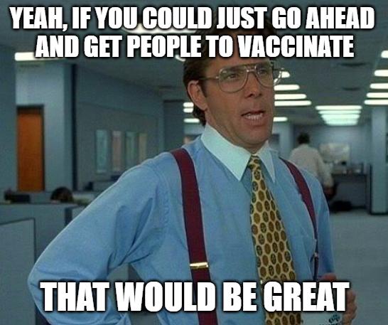

Slide 28



Tips on how to talk to patients and families about vaccines
Infection Preventionists don’t often have direct patient contact, but can act as a community resource as well as a resource for providers
Know your websites for reputable resources:
WHO: https://www.who.int/news-room/questions-and-answers/item/vaccines-and-immunization-what-is-vaccination
CDC: https://www.cdc.gov/vaccines/hcp/vis/vis-statements/multi.html
https://www.cdc.gov/vaccines/hcp/resources/index.html
AAP: https://www.healthychildren.org/English/safety-prevention/immunizations/Pages/default.aspx

Slide 29
Tips on how to talk to patients and families about vaccines
Listen with empathy
Don’t be dismissive
Acknowledge their feelings without agreeing with them – their reasoning may be wrong but that doesn’t mean that their fears or concerns are invalid.
Operate under the assumption that parents and patients are trying to make the best decision
Notes:
This is one of the hardest things for providers to do. It’s often helpful for busy physicians to schedule an appointment specifically to address vaccine hesitancy.

Slide 30
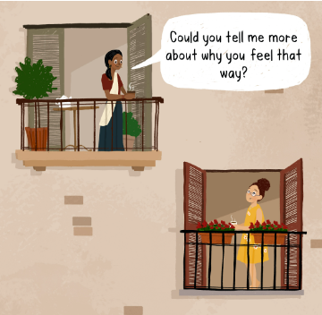
Tips on how to talk to patients and families about vaccines
Ask open ended questions
This will only work if the patient is willing to be vulnerable
Try not to judge! It does come through in nonverbal communication

Slide 31
Tips on how to talk to patients and families about vaccines
Have printed material or easily accessible websites that you can share with the patient that they can go to
Absent a direction, people will google or use social media for information
They might choose those anyway, but at least you’re presenting them with an alternative

Slide 32
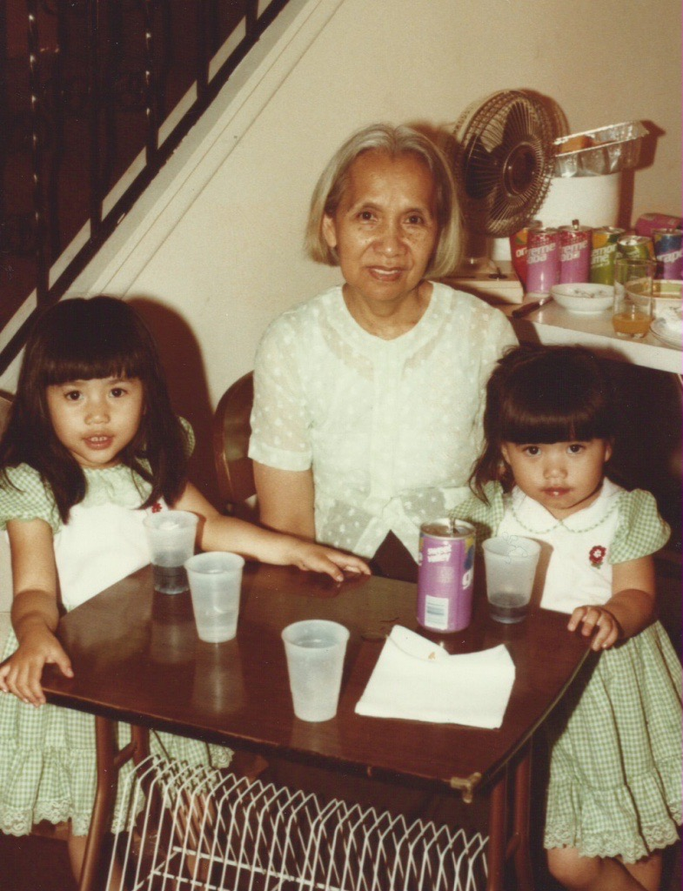
Explore reasons for wanting to get vaccinated
Get personal – share your own reasons for vaccinating
Share your experiences with vaccines
Be positive about all the benefits of vaccinating
Ex: mothers vaccinating against RSV, flu, COVID, and pertussis to help protect their babies when they’re most vulnerable
Preventing cancer

Slide 33
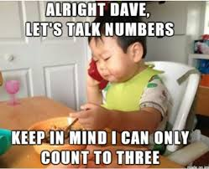
Tips on how to talk to patients and families about vaccines
Be honest
Acknowledge the side effects
Discuss the rare ones and how often you personally see them
Risks and percentages are difficult for people to understand
Explain how often you see the rare complication and put it in the context of your practice/ local area
Action resulting in a rare risk of side effect can feel worse than inaction leading to the disease

Slide 34
Tips on how to talk to patients and families about vaccines
Educate early and often
Talk to parents about vaccination and provide them with web-based content when they first become pregnant
Every contact with healthcare is an opportunity – it can even be a casual statement.
“I see you didn’t get the flu vaccine last year and have said that you never want to get it. Let me know if you change your mind, I’m happy to answer any questions you have”
If you’re comfortable, education can occur on social media. Share your positive stories, stay factual, and don’t get engage with keyboard warriors

Slide 35
Tips on how to talk to patients and families about vaccines
Establish trust
Develop a relationship
Educate people in your social circle with whom you already have an established relationship
Notes:
* Example – COVID deniers and people who saw it first hand

Slide 36

Daliya Khuon
daliya.khuon@helendevoschildrens.org

Slide 37
Mark Your Calendar!
What an Infection Preventionist in Sterile Processing Wants Infection Preventionists to Know about Sterile Processing.
Rebecca T. Alvino RN, MS, CNS, CIC, CNOR, CRCST, FAPIC
UCSF Health
November 19, 2024 1 PM via Zoom
Mentoring session to follow at 2 PM

Slide 38

Raffles!

Slide 39
APIC – GL Business Meeting
(Members only)

Slide 40
APIC – GL Business Meeting Agenda
Nicole Nomides - President’s Welcome
Red Blazer award
Retired APIC-GL members recognition
Chapter mentoring program
Alex Wells - Treasurer Report
Amanda Valyko - Legislative updates

Slide 41
Nicole Nomides – President’s Welcome
Red Blazer award
Retired APIC-GL members recognition
Chapter mentoring program (Peer-to-Peer Mentorship Roundtable)
WHAT:
A facilitated time following APIC-GL monthly education webinars where members will have the opportunity to share challenges, ask questions, and seek advice from fellow member IPs.
WHO:
All APIC-GL members can participate and benefit.
HOW:
Submit questions anonymously through Google Forms. Questions/situations will be presented to the group for discussion.

Slide 42
Treasurer Update
Fall Conference 2024
Alex Wells

Slide 43
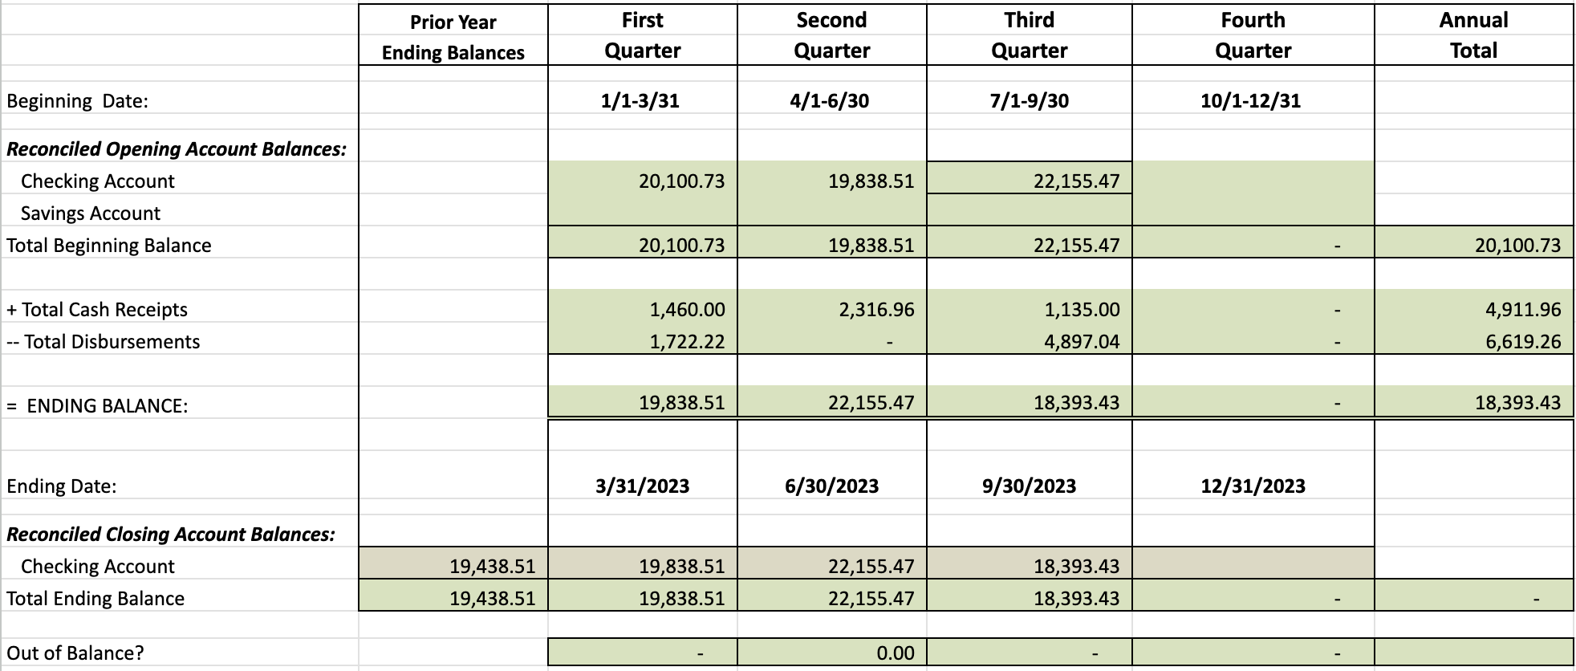
2024 Financial Report

Slide 44
Tentative Conference Expenses and Ticket Sales
Expenses: $15,519.51
Ticket Sales (includes Strategic Partner Tables): $24,825.00

Slide 45
