Slide 1


APIC - Great Lakes 2024 Fall Education Conference! “You Have Friends in IP”
Thursday October 10th, 2024
Eagle Eye Golf Club, Bath MI

Slide 2
Oral Care for Prevention of Non-Vent HAP: Firsthand Experience
APIC Great Lakes Fall Conference
October 10, 2024
Annie Wendt, BS MPH
Bronson Healthcare Group Infection Prevention System Manager

Slide 3

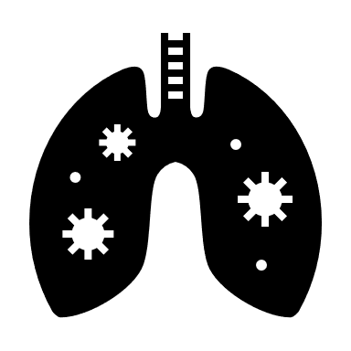

Objectives
Consider statistics on the burden of hospital-acquired pneumonia
Inventory the non-vented prevention recommendations from leading organizations
Describe why hospitalized patients are at increased risk for pneumonia
Understand the importance of oral hygiene in reducing risk for HAP
Share how Bronson Healthcare Group implemented routine oral hygiene as an intervention to prevent NV-HAP
Notes:
Today we will talk about
Burden
prevention recommendations
why hospitalized patients are at increased risk
how oral hygiene reduces risk
and our experience at Bronson with implementing routine oral care to prevent NV-HAP
If you aren’t already working on NV-HAP, I hope today will get you fired up to go back to your organizations and start this work.
Fired up, and also with some background gathered in one spot to help you get started putting your case together for leadership.

Slide 4
Outline
Non-vented Hospital-Acquired Pneumonia (NV-HAP)
Burden
Prevention recommendations
Pathophysiology of pneumonia and oral hygiene as prevention
Bronson oral health initiative
Start up
Challenges
Hospitals and LTC experience
Lessons learned
Future

Slide 5
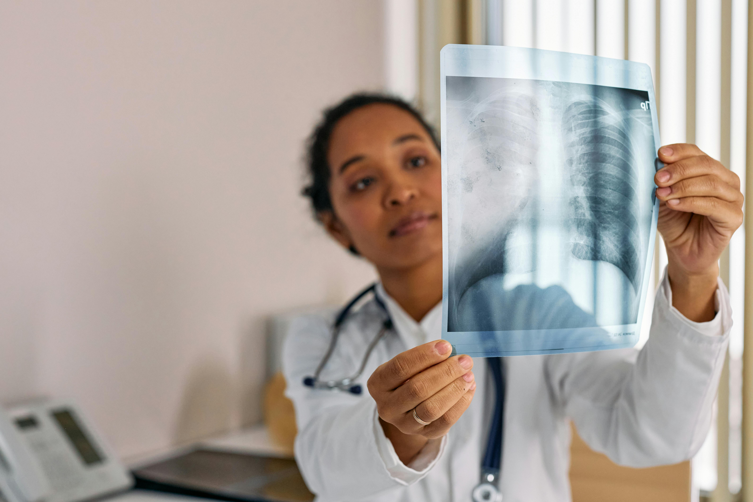
Defining Clinical Pneumonia
New lung infiltrate and clinical evidence that the infiltrate is of an infectious origin, such as the new onset of fever, purulent sputum leukocytosis, and decline in oxygenation
American Thoracic Society (ATS) and Infectious Diseases Society of America (IDSA)

Slide 6


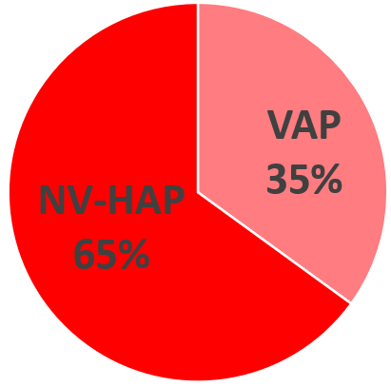
Epidemiology of Hospital Acquired Pneumonia
Most common HAI (1 in 4 HAIs)
Leading cause of death among HAIs
HAP defined by clinical pneumonia case with onset 48 hrs or later in an admission to a healthcare facility
Hospital acquired pneumonia cases:
35% Ventilator-associated
65% Non-ventilator associated
Changes in Prevalence of Health Care–Associated Infections in U.S. Hospitals New England Journal of Medicine Volume 379, Number 18, November 1, 2018, Pages 1732-1744
AJIC: American Journal of Infection Control, 2020-05-01, Volume 48, Issue 5, Pages A1-A2, Copyright © 2020
Notes:
NVHAP is one of the most common healthcare-associated infections, but it is not tracked, reported, or actively prevented by most hospitals.
Epi stats on HAP come from point prevalence studies. The most recent published CDC HAI prevalence study looked at patients in 2015.
199 hospitals in 10 states participated, over 12,000 patients included:
Pneumonia is the most common HAI (1 in 4)
Leading cause of death among HAIs
Incidence of NV-HAP is almost twice that of VAP
Similar mortality rates for VAP and NV-HAP
Most NV-HAP happens outside of the ICU

Slide 7
Defining Hospital Acquired Pneumonia
HAP
Clinical pneumonia case with onset 48 hrs or later in an admission to a healthcare facility
VAP
Patients who have been intubated and have been receiving mechanical ventilation for at least 48 hrs prior to onset
NV-HAP
Patients who have not been intubated/received mechanical ventilation leading up to onset
VAE, Peds VAE
PNEU
Pneumonia (Ventilator-associated [VAP] and non-ventilator associated Pneumonia [PNEU]) Event
APIC Text 14th ed, updated 2024. Pneumonia chapter
Notes:
Most hospitals only conduct surveillance and prevention programs for VAP. Currently, few hospitals track or are actively engaged in strategies to prevent NV-HAP and surveillance data on NV-HAP are limited
Acute care IPs are all very familiar with the challenges of pneumonia surveillance – NHSN definitions for pneumonia are not conducive to automation/EHR tools to start case finding, and the review for a single pneumonia case can be very involved. Criteria are subjective and rely on finding the applicable terms in notes at the right time.
HA Pneumonia is not required reporting, and for us looking for pneumonia broadly in our non-vented population is not something we have capacity to do using NHSN surveillance definitions

Slide 8

Poll Everywhere
Respond at:
Webpage: PollEv.com​/chaunguyen481
Text Messaging: Send chaunguyen481 to 22333
QR Code:

Slide 9
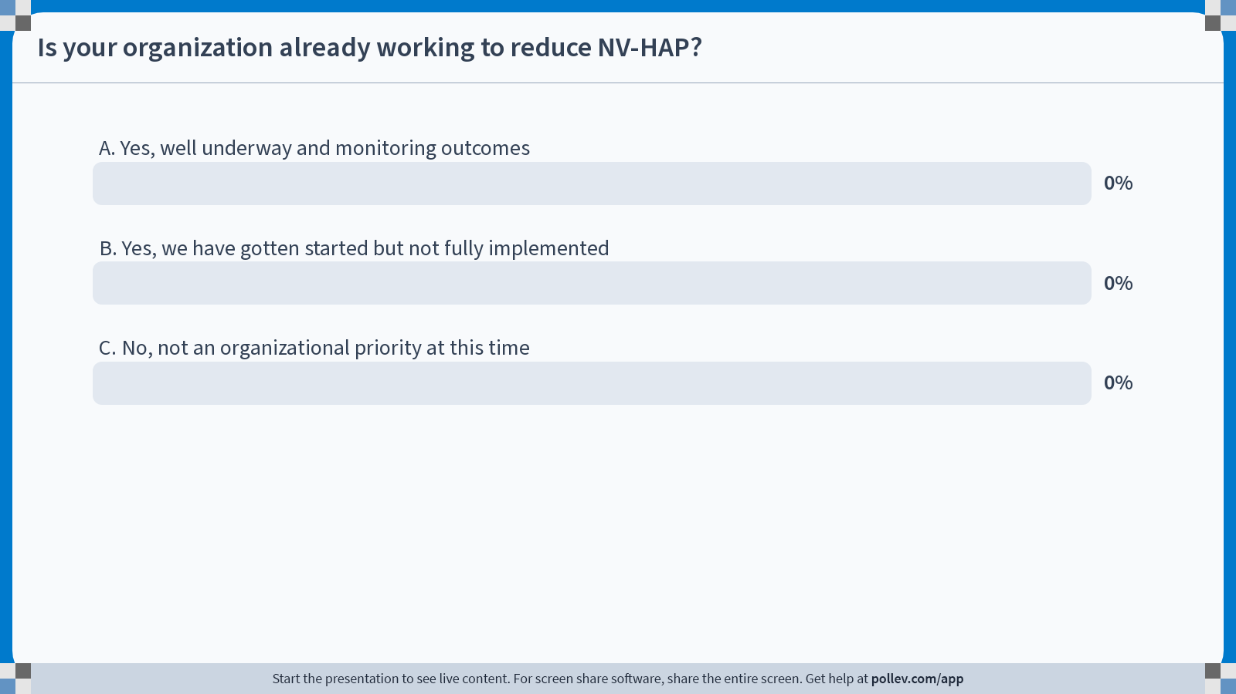
Notes:
Poll Title: Do not modify the notes in this section to avoid tampering with the Poll Everywhere activity. More info at polleverywhere.com/support Is your organization already working to reduce NV-HAP (other than having patients use an incentive spirometer)? https://www.polleverywhere.com/multiple_choice_polls/qNTQkOeHAd1K1gLDVFtcz?state=opened&flow=Default&onscreen=persist

Slide 10
First Poll:
Is your organization already working to reduce NV-HAP (other than having patients use an incentive spirometer)?
Yes, well underway and monitoring outcomes
Yes, we have gotten started
No, not an organizational priority at this time

Slide 11
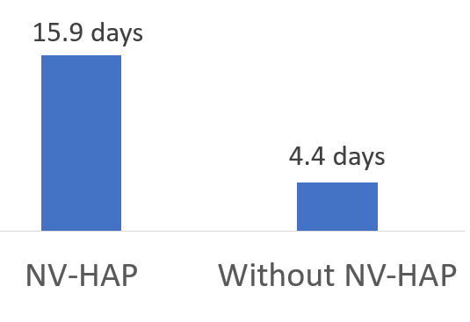
Burden of NV-HAP: Hospital
1.6% of patients develop NV-HAP
8.4x more likely to die than patients without
7.3% of all hospital deaths attributed to NV-HAP
Cost of a NV-HAP case $20,189
Antibiotic use
Increased Length of Stay
American Journal of Infection Control, 2018 March;46(3):322-327
American Journal of Infection Control, 2020 May;48(5):A1-A2
American Journal of Infection control, 2023 Feb;51(2):227-230
American Journal Critical Care, 2020 Jan;29(1):9-14
Chest, 2016 Nov;150(5):1008-1014
Journal of the American Medical Association, 2023 May;6(5):e2314185
Notes:
Non-ventilator hospital-acquired pneumonia (NV-HAP) is associated with increased cost of care, hospital length of stay, and mortality.
1.6% of patients develop NV-HAP
8.4x more likely to die than patients without
7.3% of all hospital deaths attributed to NV-HAP
The estimated increase in cost for a NV HAP patient’s admission vs. a non-vented patient with no HAP on average is $20,189 per case
Increase in antibiotic use

Slide 12
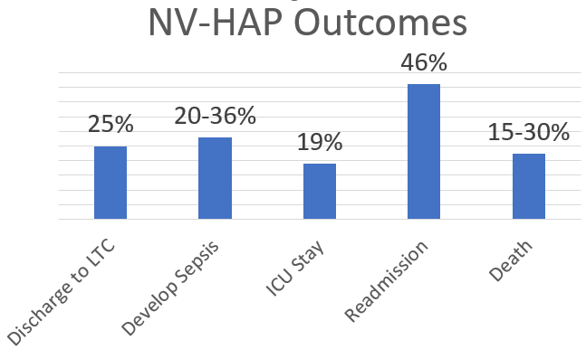
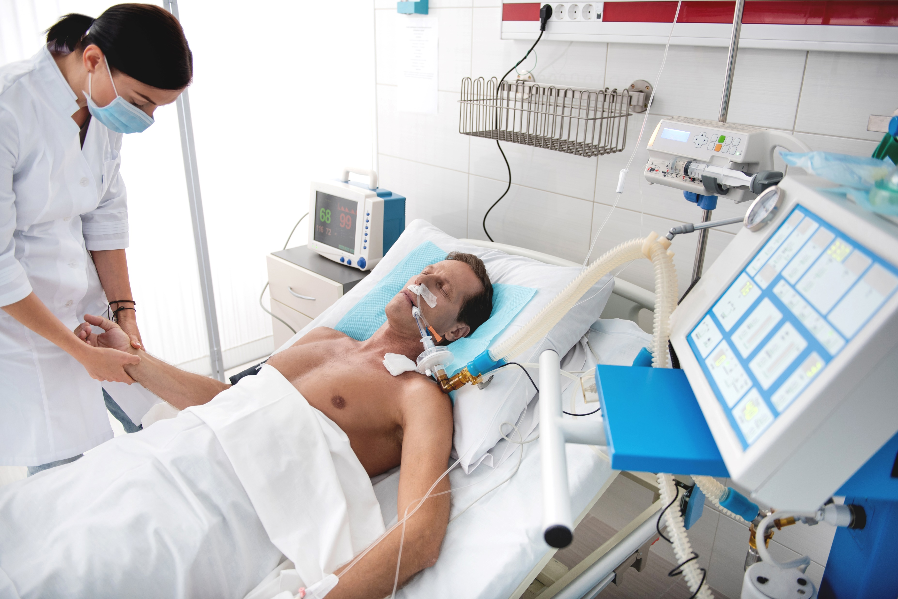
Burden of NV-HAP: Hospital
Notes:
Stats come from refs on previous slide.
From the literature:
NV-HAP patients had a greater need for post discharge care at another healthcare facility than any of the comparison groups.
20%-36% of NV-HAP patients develop sepsis
19% had to spend time in the ICU, and 46% were readmitted.
NV-HAP patients have an estimated 15-30% mortality rate
Lots of stats options to build a case for change in your organization and engaging facility leaders.

Slide 13
Burden of NV-HAP: LTC
. 2023 Feb;51(2):227-230.
Pneumonia is the leading cause of death and a major cause of hospitalization of LTC patients and residents.
10-18% of patients admitted to hospitals for pneumonia are LTC residents/patients
Pneumonia incidence from 0.3 to 2.5 cases per 1,000 resident-days
American Journal of Infection Control, 2020 May;48(5):A14-A16
Notes:
Those were publications and burden stats for hospitalized patients
Turning to LTC:
Pneumonia is leading cause of death and hospitalization for LTC patients and residents
10-18% in the hospital for pneu come from LTC
Estimated pneu incidence

Slide 14
NV-HAP Prevention Recommendations

Slide 15
National Organizations’ Prevention Recommendations
APIC American Journal of Infection Control May 2020 issue was all about prevention of NV-HAP
National Organization to Prevent Hospital-Acquired Pneumonia (NOHAP) Call to Action published 2021 Infection Control & Hospital Epidemiology
Joint Commission 2021 Quick Safety issue Preventing Non-Ventilator Hospital Acquired Pneumonia
SHEA/IDSA/APIC/AHA/Joint Commission/CDC representation: Strategies to prevent ventilator-associated pneumonia, ventilator-associated events, and non-ventilator hospital-acquired pneumonia in acute-care hospitals: 2022 Compendium Update
APIC text Pneumonia chapter 14th edition updated 2024
CDC Oral Health in Healthcare Settings to Prevent Pneumonia Toolkit 2024
Notes:
Prevention recommendations come from our usual leading organizations.
If you save all your AJIC journals filed away on your desk like me, there was full journal dedicated to prevention of NV-HAP put out in May 2020. That volume has articles both for prevention in acute care and Long term care.
In 2021 there was an article in the journal Infection Control & Hospital Epidemiology (ICHE) that detailed a call to action to address NVHAP. The purpose was to begin a national health care conversation about NV-HAP prevention and to encourage researchers to develop new strategies for NVHAP prevention and surveillance. This Call to Action was a collaboration of national organizations including the Veteran’s Health Administration, CDC, Joint Commission, American Dental Association and others.
Joint Commission followed by putting out a Quick Safety bulletin highlighting the Call to Action’s challenge to health care systems: to implement and support NVHAP prevention, and to add NVHAP prevention measures to education for patients, health care professionals and students.
The following year when SHEA published the updated prevention compendiums, the pneumonia prevention compendium called out non-ventilator HAP prevention and included specific recommendations for prevention.
The APIC text Pneumonia chapter was updated in 2024 and recommendations are consistent with the SHEA 2022 Pneumonia prevention compendium, including oral hygiene recommendations. The chapter now also refers IPs to the CDC “Oral Health in Healthcare Settings to Prevent Pneumonia Toolkit” to promote oral care within their facility.
All of these organizations’ recommendations to prevent NV-HAP include oral hygiene.

Slide 16
APIC’s American Journal of Infection Control: Implementation Guide for Non-Ventilator Associated Hospital Acquired Pneumonia
May 2020
Literature review, prevention, surveillance techniques for NV-HAP
COVID-19
AJIC: American Journal of Infection Control, 2020-05-01, Volume 48, Issue 5, Pages A1-A2, Copyright © 2020
Notes:
From these recommending bodies, we can start with APIC’s NV-HAP implementation guide that was published in May 2020.
Intended for IPs, nurses, and others who are involved in infection prevention efforts across the continuum of care.
Reviews current literature, prevention strategies, and potential tools and techniques to guide surveillance, detection, and prevention efforts for NV-HAP.
Covers both inpatient and outpatient settings, acute care and long term care
Not a poll, but did anyone read this when it came out in 2020? We were all a little busy that spring, so it was not on our radar at the time.

Slide 17
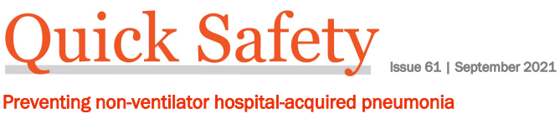
Joint Commission Quick Safety Issue 2021
Maintaining regular oral care
Maintaining patient mobility
Elevating the head of the patient’s bed
Reducing the use of acid-suppressing medications
Minimizing sedation
Performing dysphagia screening in high-risk patients
Using modified diets and feeding strategies for patients with abnormal swallowing
Following standardized processes to place and manage feeding tubes
Breathing exercises
Using chest physiotherapy
Using incentive spirometry
Educating the patient and family about NVHAP prevention
Source: quick-safety-61-nvha-pneumonia-final-9-3-21.pdf (jointcommission.org)
Notes:
This slide has the full list from the JC Quick Safety Issue that followed the Call to Action publication.
Most prevention measures target primary source control and this is reflects the interaction of care practices and patient treatments that increase or decrease the risk for pneumonia.
The very first item on their list is regular oral care. Oral care among hospitalized patients is a low-cost, low risk intervention to reduce NV-HAP.

Slide 18
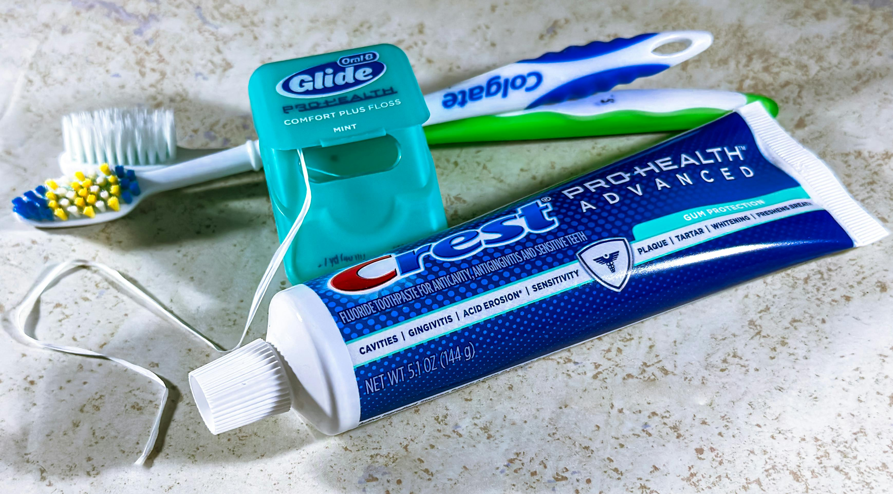


SHEA Compendium 2022: Essential Practices to Prevent NV-HAP
Provide regular oral hygiene with daily toothbrushing
Screen for and treat dysphagia
Mobilize early and regularly
Strategies to prevent ventilator-associated pneumonia, ventilator-associated events, and non-ventilator hospital-acquired pneumonia in acute-care hospitals: 2022 Compendium Update SHEA/IDSA/APIC/AHA/Joint Commission/CDC representation
Notes:
This is the list of essential practices in the 2022 SHEA pneumonia compendium for prevention of NV-HAP.
(Read the three)
It is a short list of essential practices specifically for NV HAP, and notice that the first thing listed is regular oral hygiene.

Slide 19
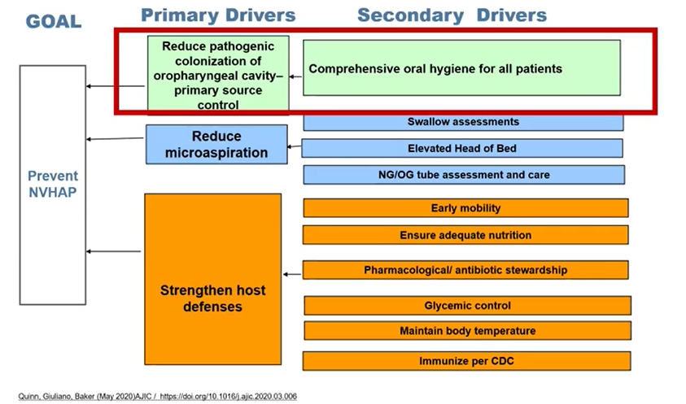
APIC: Driver Diagram of NV-HAP Prevention Strategies
SHEA:
Provide regular oral hygiene with daily toothbrushing
Screen for and treat dysphagia
Mobilize early and regularly
Source: Quinn B, Giuliano KK, Baker D. Non-ventilator health care-associated pneumonia (NV-HAP): Best practices for prevention of NV-HAP. Am J Infect Control. 2020 May;48(5S):A23-A27.
Notes:
This graphic is from the APIC text updated pneumonia chapter, with source paper cited here.
It’s difficult to read on the slide, but the Goal is to prevent NV HAP.
The second column boxes show primary drivers of NV HAP:
Reduce pathogenic colonization of oropharyngeal cavity for primary source control
Reduce microaspiration
Strengthen host defenses
The third column shows the secondary drivers, and for what we are focused on today, you can see that oral hygiene for all patients is the upstream tactic to reduce pathogenic colonization of the oral cavity.
This Driver Diagram in the APIC text is similar to the three essential practices in the SHEA compendium to prevent NV HAP: oral hygiene, reducing aspiration risk (screen for/treat dysphagia), and in addition to early and regular patient mobilization, the Driver Diagram includes several more tactics to strengthen host defenses.

Slide 20
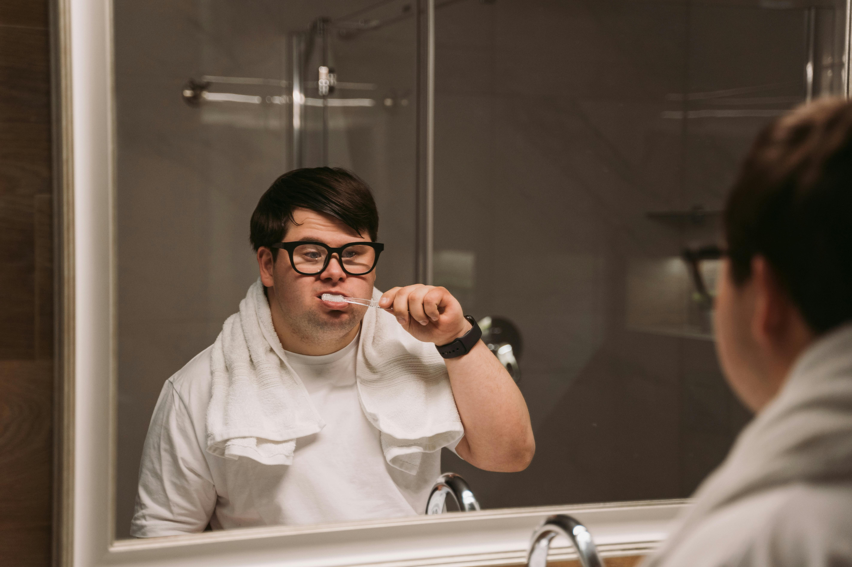
CDC: Oral Health in Healthcare Settings to Prevent Pneumonia Toolkit
Designed for an organization’s NV-HAP prevention team to use as resource on how to promote and provide oral care to hospitalized patients
Background on oral care and pneumonia prevention
Encourages engaging multidisciplinary leadership support
Oral health assessment on admission
Sample procedures for oral care based on patient population
Oral health education for patients
Reference/resources list
Notes:
At Bronson, we had already gone down our implementation path prior to this toolkit being published in March of 2024, so my presentation today is not going to be about how we applied the CDC toolkit.
Reviewing the toolkit, our project did incorporate some of the same steps but in the interest of transparency, I can tell you as we strengthen the program we will consider additional approaches that are included.
NEXT SLIDE Now the most interesting (and for me the most motivating) part of pneumonia prevention. Learning about the pathophysiology and how pneumonia develops.

Slide 21
Pathophysiology of Pneumonia
Notes:
Now the most interesting (and for me the most motivating) part of pneumonia prevention. Learning about the pathophysiology and how pneumonia develops.

Slide 22





One Shared Germ Population
Lungs and oropharyngeal cavity are one physiological system: one microbiome
Oral dysbiosis
Oral dysbiosis = lung dysbiosis
Viral, bacterial, fungal
We all microaspirate into our lungs
Aspiration of pathogens leads to lung dysbiosis
Notes:
Lungs are not sterile, and are the largest surface area exposed to the environment (2x gut, 33x skin)
Lungs and oropharyngeal cavity are one physiological system: one microbiome
The germs in the oral cavity are the same as the ones in the lungs. Whatever is in the mouth has direct access and is going to effect the lung.
If the oral cavity is in dysbiosis, by extension the lungs are in dysbiosis.
All microaspirate
When we are up and around and healthy, small numbers of pathogens we aspirate are cleared.
If we can’t clear them, they get into the lungs and lead to dysbiosis

Slide 23
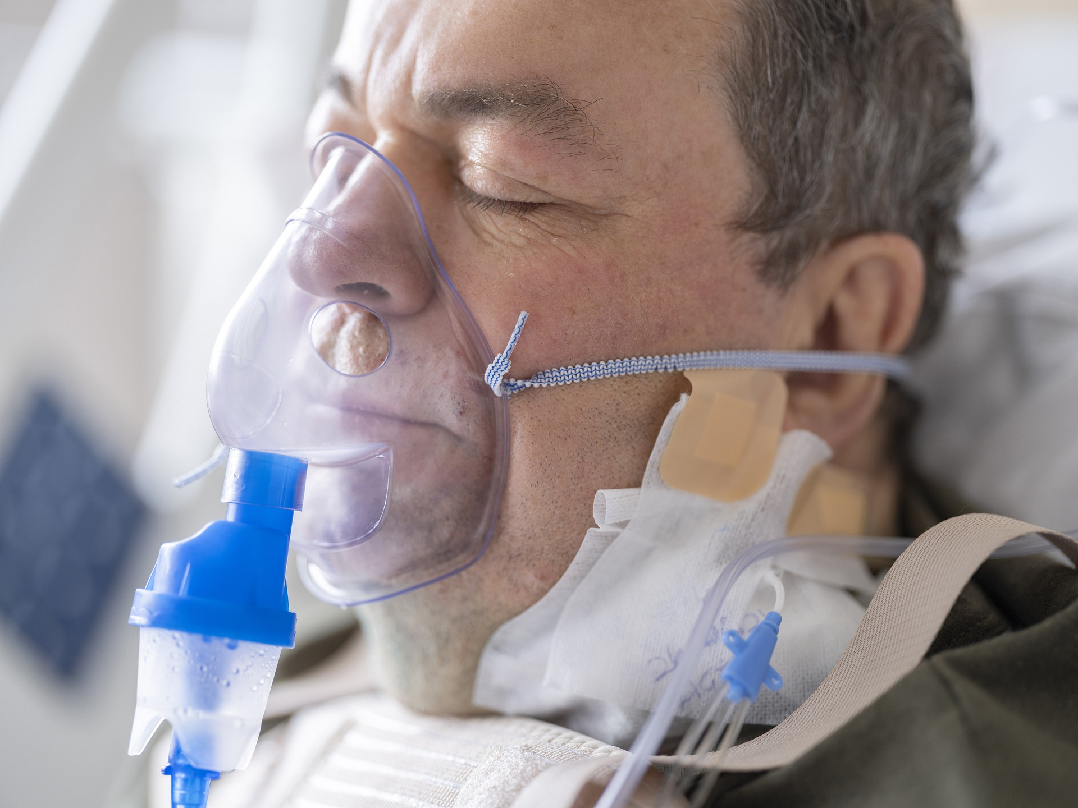
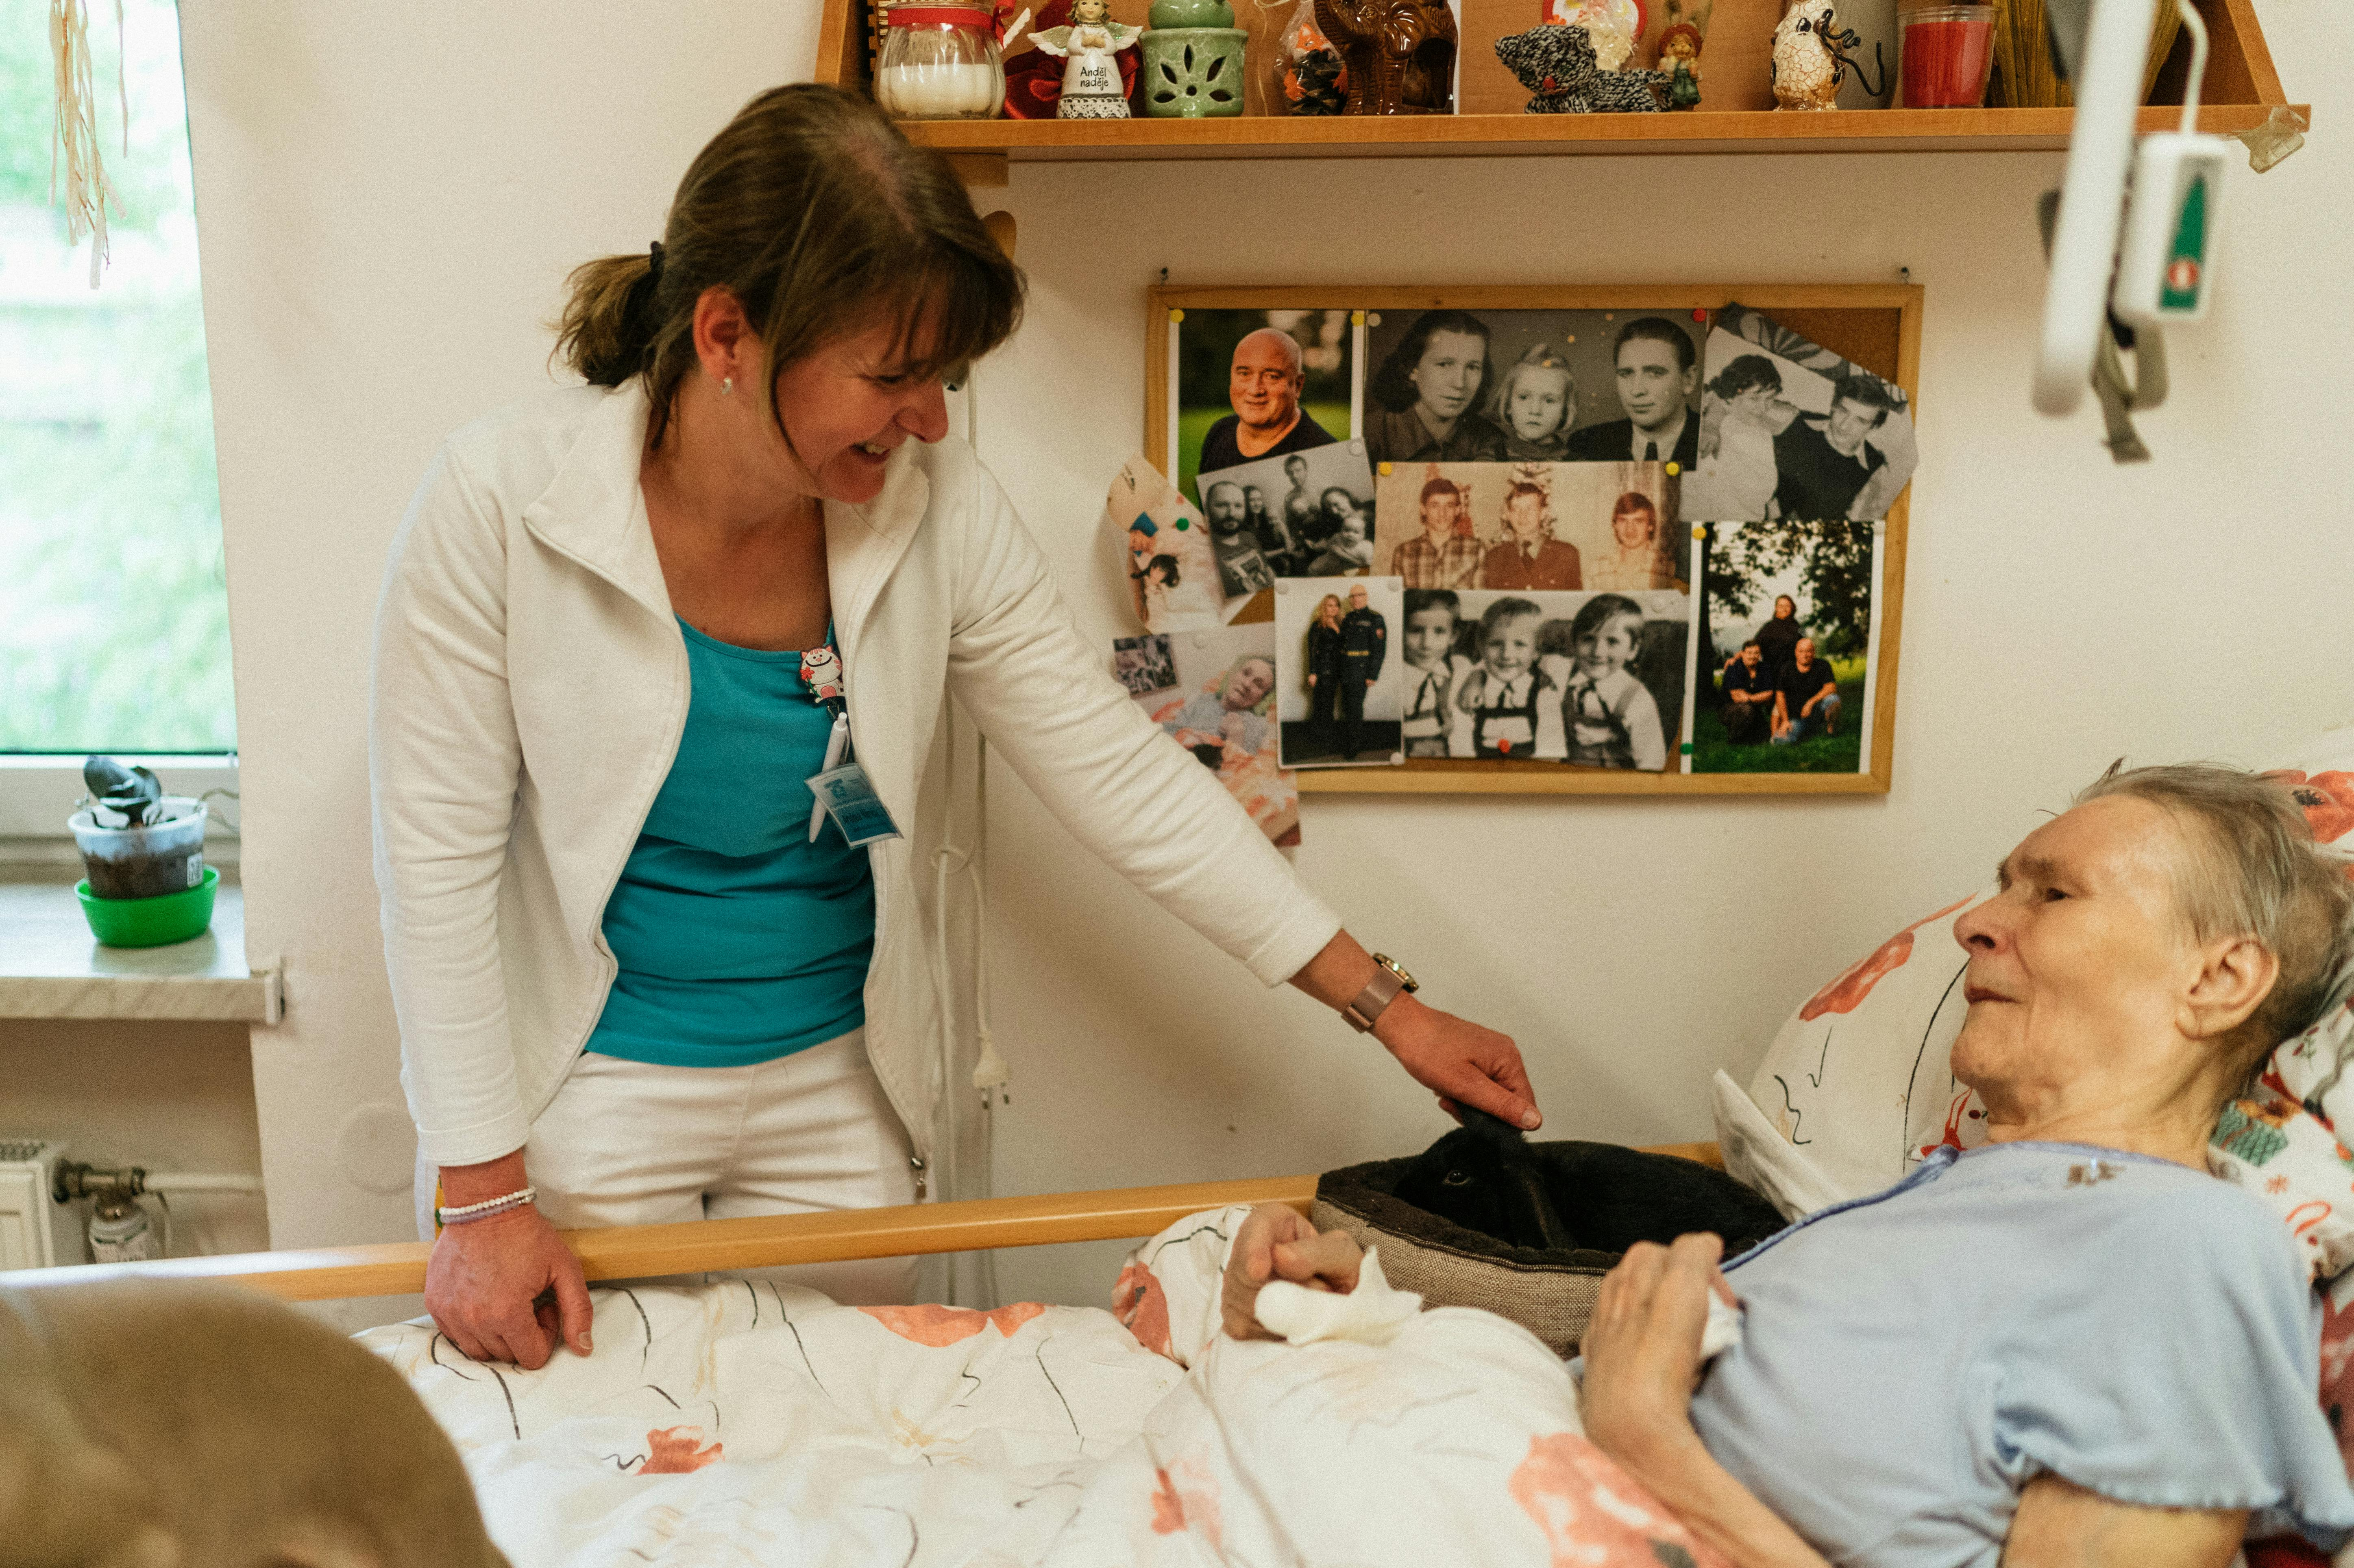
Oral Microbiome Disruptions in the Hospital and LTC
Medications that alter their oral microbiome
Change saliva pH, cause dry mouth (xerostermia)
Immobility disrupts immune system (ability to cough and deep breathe)
Dietary changes
Oral dysbiosis + microaspiration +reduced clearance:
pathogens have entry into the lungs
Notes:
Why are patients in the hospital or long term care are so much more vulnerable to oral microbiome disruptions, and subsequently lung dysbiosis?
Medications impact the oral microbiome by causing dry mouth or changing saliva pH.
When we are healthy and not in the hospital, we have cough, deeper breathing, and cilia in the respiratory tract to clear pathogens before they cause an infection.
While a patient is in the hospital or long term care that changes these normal, healthy mechanisms.
Dietary changes alter the microbiome as well.

Slide 24
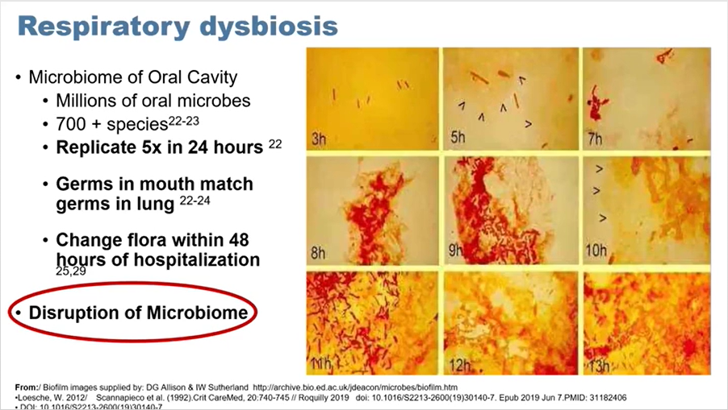
Slide courtesy of Dr. Dian Baker
Notes:
I borrowed this slide with permission from Dr. Dian Baker, a professor and researcher whose name you will start to see on a lot of NV-HAP prevention papers and guidelines. She is a leader in this movement for oral care to prevent pneumonia.
This picture illustrates how quickly microbes in the mouth multiply, without being removed by oral hygiene.
A lot is growing in there. When a patient goes into the hospital, their normal microbiome is now disrupted and is in a state of dysbiosis, so the there is a lot more here than the usual commensal organisms that help to maintain a healthy microbiome and suppress pathogens.
As you think about how quickly the mouth germs are multiplying, consider what this means for the patient who doesn’t do any oral hygiene or oral hygiene is days apart while they are hospitalized.

Slide 25
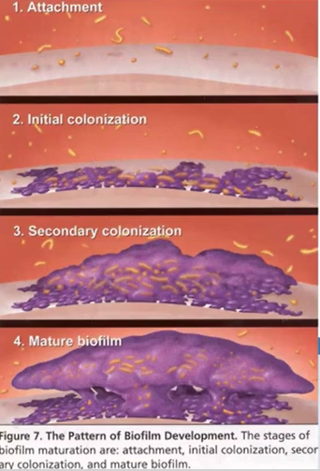
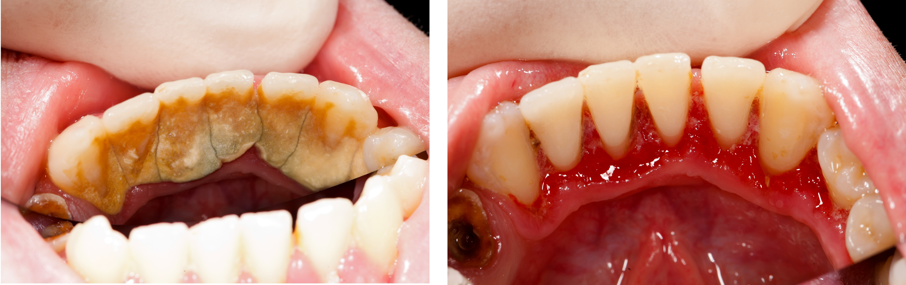
Biofilm formation in the mouth
Sticky and hard to remove
Mechanical removal of biofilm requires toothbrushing
Germs + proinflammatory cytokines
Image taken from Dr. Dian Baker’s webinar
Source:Nield-Gehrig JS and Willmann DE. Foudations of Periodontics for the Dental Hygienist. Philadelphia: Lippincott Williams & Wilkins Textbook 2003:67-73
Notes:
These multiplying germs attach to mucosal surfaces and teeth
Pathogens colonize together
Start to form their own biofilm
Then the clusters merge with other clusters to make a super biofilm cluster. Once that hardens, that is plaque that we have to go get scraped off at the dentist.
These biofilms are the source of infection: germs are flourishing within them, and patients are microaspirating into the lungs.
Sticky and hard to remove
Mechanical removal of biofilm requires toothbrushing
Oral rinse alone is not enough, foam swabs not enough.
Inside biofilms germs are multiplying and protected.
These biofilms also secrete proinflammatory cytokines that reduce the immune response.
These can also be microaspirated and directly cause lung inflammatory response.
When biofilms in the mouth link up with each other and harden – this is what plaque is. At that point biofilm needs to be scraped off with tools by a dental hygienist.

Slide 26
Oral Care Intervention Successes

Slide 27
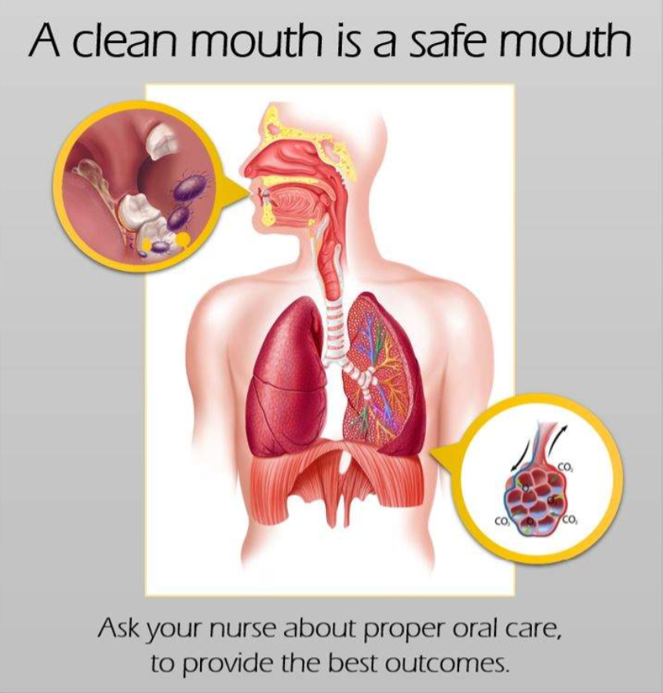
Oral Care as Prevention for NV-HAP A Four-Unit Cluster Randomized Study
85% reduction on adult medical unit
65% reductions on adult surgical unit
American Journal of Nursing 121(6):p 24-33, June 2021.
Notes:
The primary aim of this study was to determine the effectiveness of a universal, standardized oral care protocol in preventing NV-HAP in the acute care setting. The primary outcome measure was NV-HAP incidence per 1,000 patient-days.
12-month study was conducted on four units at an 800-bed tertiary medical center. Patients on one medical and one surgical unit were randomly assigned to receive enhanced oral care (intervention units); patients on another medical and another surgical unit received usual oral care (control units).
For both medical and surgical units, oral care frequency increased from approximately 1x to 2x per day.
In the medical control versus intervention units, there was a significant 85% reduction in the NV-HAP incidence rate. The odds of developing NV-HAP were 7.1 times higher on the medical control versus intervention units, a significant finding.
For the surgical control versus intervention units, they had a 56% reduction in the NV-HAP incidence rate. The odds of developing NV-HAP were 1.6 times higher on the surgical control versus intervention units, although this result did not reach significance.

Slide 28

Reducing missed oral care opportunities to prevent NV HAP at the Department of Veterans Affairs
Pre-intervention: usual care in preventing NV-HAP
Retrospective analysis of 14,396 patient days
Established pre-intervention nursing care provided and NV-HAP prevalence
Intervention:
standard procedures for oral care including oral health assessment
providing tools and encouragement for independent patients to do their own oral care
brushing teeth for patients needing assistance
using suction toothbrush for patients with aspiration risk
and documentation of oral care completed
Appl Nurs Res. 2018 Dec:44:48-53.
Notes:
Another implementation study comes from the Veteran’s Health Administration.
This 2018 study is significant because it led to overhauling oral care in all VA hospitals as a quality improvement protocol and is now standard of care (toothbrushing twice a day to prevent pneumonia)
Aim: Determine the effect of a twice daily oral care initiative on the incidence and cost of NV-HAP
They did an intervention study that used pre/post population data to determine the effectiveness of a universal, standardized oral care protocol vs. usual care in preventing NV-HAP.

Slide 29
Reducing missed oral care opportunities to prevent NV HAP at the Department of Veterans Affairs
Outcomes:
Twice daily oral care increased by 75% at pilot sites
NV-HAP incidence decreased from 105 to 8.3 cases/1,000 patient days
Prevented 71 cases and yielded an estimated cost avoidance of $2.84 million and 13 lives saved in 19 months
Notes:
Their observed NV-HAP incidence decreased from 105 to 8.3 cases per 1,000 patient days (by 92%) in the first year. The intervention yielded an estimated cost avoidance of $2.84 million and 13 lives saved in 19 months post-implementation.
Other pilot sites followed with similar prevention outcomes.
This project resulted in development of the national VHA oral care implementation toolkit, public service announcements, and patient education materials.
In 2016, this intervention was selected for national VHA dissemination as QI and by July 2021 the initiative had spread to every single VHA Medical Center in the nation as standard of care.

Slide 30
Veteran’s Health Administration
Patient education video, part of VA’s HAPPEN program (Hospital-Acquired Pneumonia Prevention by Engaging Nurses to provide oral care)
Notes:
The toolkit for expansion of the oral care initiative at VA hospitals emphasis motivating clinical staff and patients to consistently perform oral care. This is a motivating video the VA shows their patients.
Healthy Teeth, Healthy You (youtube.com)
https://www.youtube.com/watch?v=9wT-jx3E1wU
Next: Poll #2

Slide 31
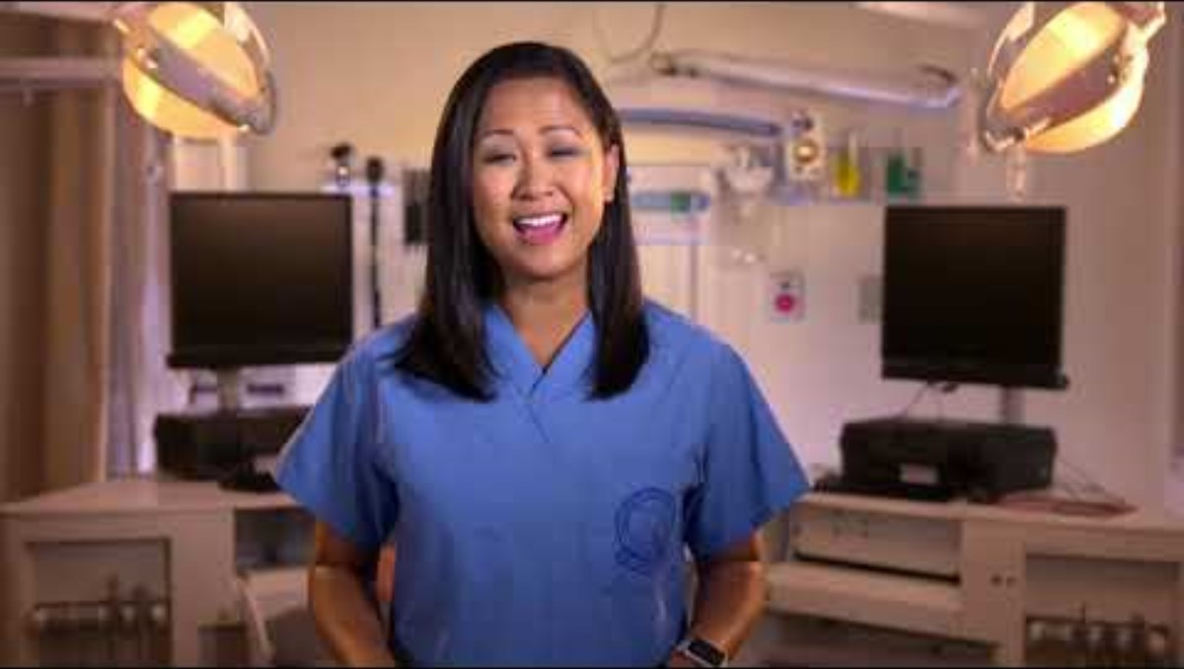
Healthy Teeth, Healthy You Video
Notes:
The toolkit for expansion of the oral care initiative at VA hospitals emphasis motivating clinical staff and patients to consistently perform oral care. This is a motivating video the VA shows their patients.
Healthy Teeth, Healthy You (youtube.com)
https://www.youtube.com/watch?v=9wT-jx3E1wU
Next: Poll #2

Slide 32
Poll Everywhere
Respond at:
Webpage: PollEv.com​/chaunguyen481
Text Messaging: Send chaunguyen481 to 22333
QR Code:

Slide 33
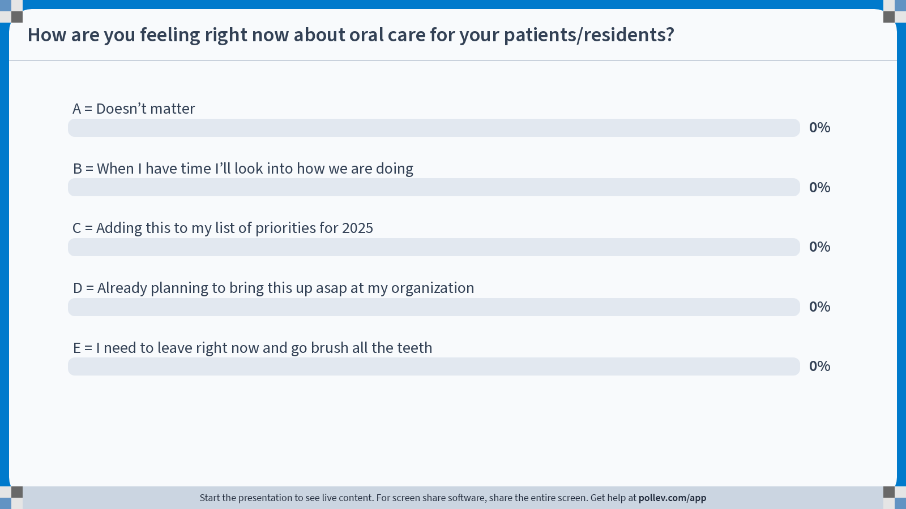
Notes:
Poll Title: Do not modify the notes in this section to avoid tampering with the Poll Everywhere activity. More info at polleverywhere.com/support On a scale of 1 to 5, how are you feeling right now about oral care for your patients/residents? https://www.polleverywhere.com/multiple_choice_polls/QxenN3Bj871eJK4314SH4?state=opened&flow=Default&onscreen=persist

Slide 34
Second Poll:
On a scale of 1 to 5, how are you feeling right now about oral care for your patients/residents?
A = Doesn’t matter
B = When I have time I’ll look into how we are doing
C = Adding this to my list of priorities for 2025
D = Already planning to bring this up asap at my organization
E = I need to leave right now and go brush all the teeth
Notes:
E. I was at E as soon as I learned about the forming biofilms and the interconnectedness with the lungs.

Slide 35
Bronson’s NV-HAP Prevention Journey: Oral Hygiene

Slide 36
Previous Proposals
July 2017
IP and PS&Q (only)
MHA Regional Keystone Learning session: Hygiene
July 2023
IP and PS&Q (only)
“Prioritization Committee”
Notes:
Our team first became aware of oral care as a pneumonia prevention strategy at a MHA Keystone HAI prevention regional learning session, back in June 2017.
We brought the concept back and over a couple of years, tried to bring this forward with Patient Safety and Quality as a “new” intervention with nursing leaders. At the time there was emerging research but only a handful of papers, no strong consensus recommendations yet. It made a lot of sense, but will all the priorities already being worked on and the ever-short staffing concerns, it was not the right time. Looking back we did not emphasize potential harm or potential cost avoidance.
A couple of years later we tried to bring it forward again in the same way (around 2019), and we still did not have the buy-in with clinical leaders. Why would it be so easy, right? Then it was 2020…we all blinked and then it was 2022.
In 2023, we put a proposal together for Bronson’s Prioritization Committee, made up of high level leaders who annually select ONE organizational project to support. Selected projects are ones that are challenging and multidisciplinary, and have a demonstrable positive impact on our patients.
Oral care for NV-HAP prevention seemed a solid case and proposal to us. How could they NOT select this as the best and most important project for the organization? We had such a giant gap and opportunity to do this great intervention/practice change for our patients that would save lives and avoid huge costs for the system.
This time we brought potential cost savings in prevention, estimated NV-HAP cases in the hospitals annually, and SHEA and JC recommendations.
Looking back now we didn’t include what our current oral care lack of compliance looked like and we didn’t impress upon them the mechanisms of pneumonia development.
Not selected as the one project they were going to endorse and follow through the coming year, but were encouraged by our VP for Quality to pursue the project anyway

Slide 37
Where are all the toothbrushes?
Assessment summer 2023
Oral rinse for non-vented patients is not antiseptic
Toothbrush is cheaply made
Toothpaste does not meet ADA recommendations
Toothbrushes not cleanly stored
 | Bronson Battle Creek Hospital (24 rooms) | Bronson Methodist Hospital (33 rooms)
Toothbrush and toothpaste in the room? | 33% | 58%
Toothbrush used? | 25% | 27%
Oral rinse in the room? | 29% | 12%
Notes:
After making our proposal to a high level committee in June 2023, we garnered key support from a nursing director who is our go-to champion for infection control tactics.
We completed an on-unit assessment for a sample of units at our two biggest hospitals, and were able to demonstrate not only that charting did not reflect good oral care, but that on the floor, we validated that patients many times did not even have toothbrushes provided in their rooms.

Slide 38
Trying Again, Fall 2023
IP, Patient Safety and Quality (for IP and for Hospitalists), Nursing Director champion
Product research in collaboration with Purchasing
Data analysis SBAR for Products approval committee
Gap between current oral care policy and oral hygiene frequency
Product changes needed for effectiveness
Consequences: patient harm, prolonged hospitalization, antibiotic use, readmissions, and potentially secondary blood stream infections
8.2% of med-surg discharged patients had a readmission within 30 days for pneumonia
Joint Commission, SHEA/IDSA and AACN recommendations
Notes:
Together with PS&Q we completed data analysis on hospitalized patients with coding for HAP. A small proportion of these were known PVAPs. We were able to put a much more compelling picture together for nursing leadership to gain there support for moving forward.
Product changes: Evidence shows that use of certain products decreases the development of non-vented HAP. It is recommended that Bronson switch to the below oral care products:
Antiseptic mouthwash (alcohol free) – one being used was for minty fresh breath, contained no antiseptic
Toothpaste with sodium bicarbonate – toothpaste was not ADA approved
Soft bristle toothbrush (with proper storage) – 5 cent toothbrush.
Non-petroleum based mouth moisturizer – had chapstick type product and biotene spray for severe dry mouth, but not doing routine mouth moisturizer for non-vented patients
[In addition to looking at oral care compliance, highly recommend seeing what products are stocked and if they meet recommendations to prevent pneumonia.]
Among patients discharged from Bronson Adult Med-Surg departments 2022, there were an estimated 420 readmissions within 30 days with pneumonia. This includes only patients who did not have a pneumonia diagnosis during their initial stay; if hospital acquired pneumonia during the initial stay had been included this number would be higher. 420/5129=81.9 per 1,000 admissions for system, or 8.2% of med-surg discharged patients. (420 is an annual estimate based on one month of 2022 data available at this time)

Slide 39
Baseline Stats and Justification
$20,189 increased cost for a NV HAP patient’s admission compared with a comparable patient without NV HAP
Based on 408 annual NV-HAP cases: $8,237,112 for the system in 2022.
New Products Committee: proposal submitted December 2023, presented at January 2024 February 2024, and March 2024 meetings
Notes:
Despite what we thought was a concise but compelling summary document, it took multiple meetings over a few months to convey the need to change products and implement a comprehensive program. Overcoming the tendency towards wanting to do “small tests of change”.
Increase in expected volume, not only increase in product costs.
Presenting cost increase and prevention opportunities (saving) still took multiple meetings to get through.
Were approved for toothpaste, oral rinse, and toothbrush that met criteria. And a case so the toothbrush could be covered, not out in the open in the patient’s room.
The estimated increase in cost for a NV HAP patient’s admission vs. a non-vented patient with no HAP on average is $20,189 per case.
408 NV HAPs resulted in an estimated additional expense of $8,237,112 for our system in 2023.
One of the challenges with making the financial case for change was that we weren’t spending a lot on oral care products and our proposal was a cost increase: we not only were needing to change to effective products, but we needed to buy a lot more of them because compliance was very poor.

Slide 40
Policy Revision and Education
Background about pneumonia prevention with oral care
Clean storage for oral care supplies
Toothbrush for teeth and edentulate patients
Antiseptic oral rinse
Published 4/22/24
Notes:
Per policy, was already not optional. We know policies don’t change practice, but they are the reference point for education.
Knowing that we weren’t achieving oral care 2x a day for non-vented patients, this was a clue that it was going to take more than educating on the policy update.

Slide 41
American Association of Critical Care Nurses (AACN)
Consider using the following tools:
soft-bristled toothbrush
toothpaste with fluoride
alcohol-free antiseptic oral rinse such as 1% hydrogen peroxide (H₂O₂) or 0.075%–1% cetylpyridinium (CPC)
non–petroleum-based moisturizer
Source: American Association of Critical Care Nurses Procedure Manual for Progressive and Critical Care, 8th ed (2024), Endotracheal tube care and oral care practices for ventilated and non-ventilated patients (procedure 3)
Notes:
The reference for products to use comes from the American Association of Critical Care Nurses Procedure Manual for High Acuity, Progressive and Critical Care, 7th ed (2016),
In reviewing available toothpaste and oral rinse products, there was not a large list of choices that met criteria in AACN recommendations and that were available for healthcare. Tracking down products was a challenge but having this reference as our criteria did help with getting these accepted through Purchasing.

Slide 42
AACN Oral Care Procedure
Independent Self-Care
Instruct to brush gently for 1–2 minutes and swish with oral rinse 30 seconds. Moisturize lips and mouth as needed for dryness.
Encourage brushing at least 2 times a day, to include gums and tongue
Dependent, Unable to Manage Own Oral Care or Secretions Safely
Brush with a suction toothbrush for 2 minutes, swab mouth with oral rinse 30 seconds, moisturize mouth as needed.
Edentulate Patients, Dentures
Gently brush gums, tongue 1-2 minutes at least 2 times a day
Apply antiseptic oral rinse with moistened swab and suction. Apply moisturizer with swab.
Denture care: rinse and brush with a soft bristle or denture brush and a nonabrasive cleanser. Remove and store dentures, covered with water at night and when not wearing
Source: American Association of Critical Care Nurses Procedure Manual for Progressive and Critical Care, 8th ed (2024), Endotracheal tube care and oral care practices for ventilated and non-ventilated patients (procedure 3)
Notes:
Toothbrushing removes buildup of plaque and bacteria that coat the teeth and mouth, while antiseptic oral rinse reaches areas toothbrushing cannot reach, further reducing oral pathogens.
We used the AACN procedure to inform policy changes. In the hospital policy prior, antiseptic oral rinse was not routine oral care.
Patients without teeth were not having gums brushed with a toothbrush.
For dependent patients, suctioning during and after toothbrushing may reduce the risk of aspiration and prevent pneumonia in patients at higher aspiration risk
Dentures can be a reservoir for pathogens, and wearing dentures during sleep is a significant risk factor for pneumonia

Slide 43
Education in Acute Care

Slide 44
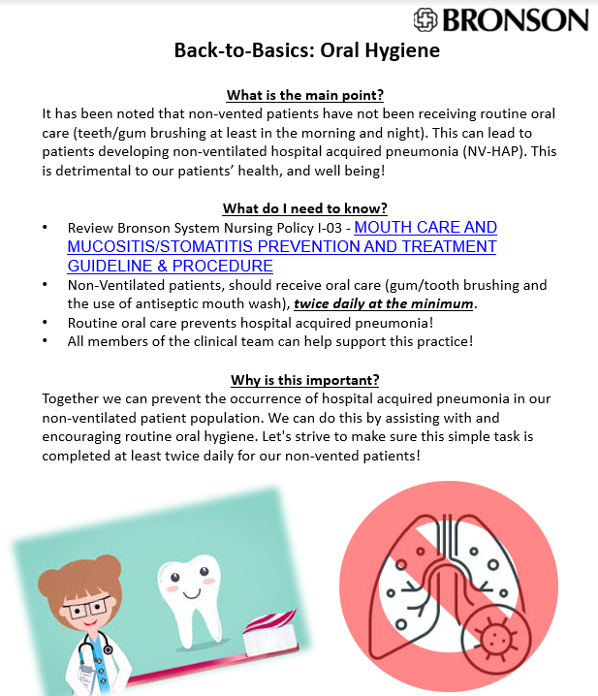
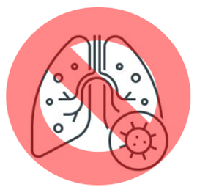


Slide 45
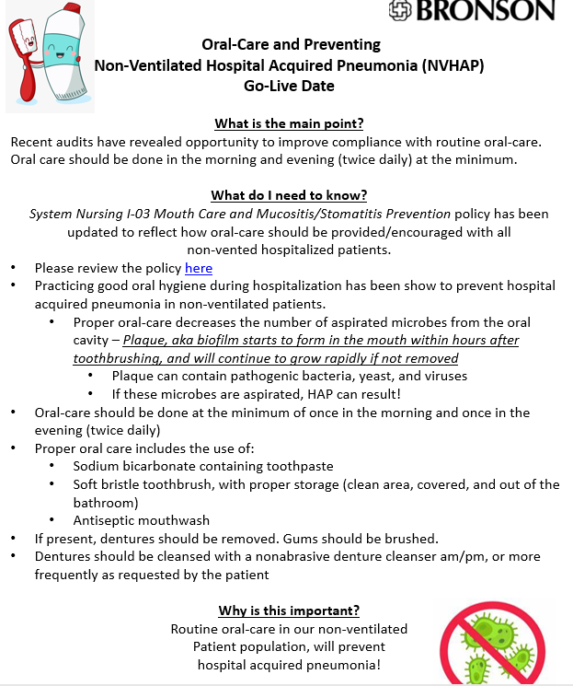

Slide 46
Product Changes
Purchasing and researching products
AACN recommendations
Education on product changes 7/15/24
Notes:
Case/cover still needed to be selected in the summer prior to education go live. First one identified by Purchasing was too small for the brush. Back to searching. Ended up with just a cap cover for the bristles.

Slide 47
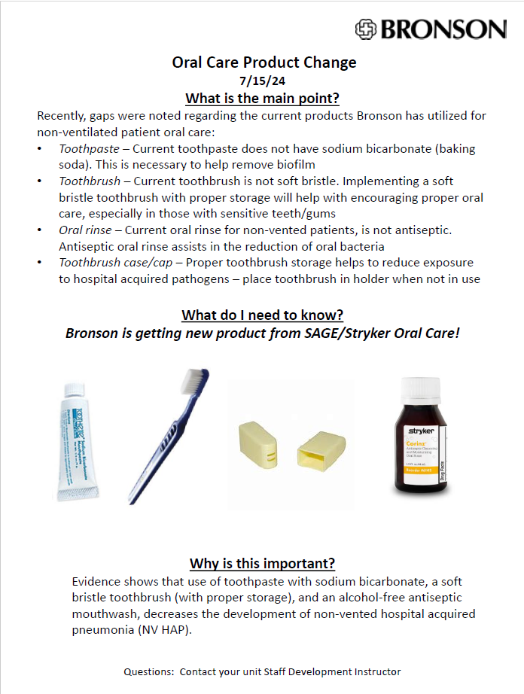

Slide 48
EHR Support: Task for Acute Care in Epic

Slide 49
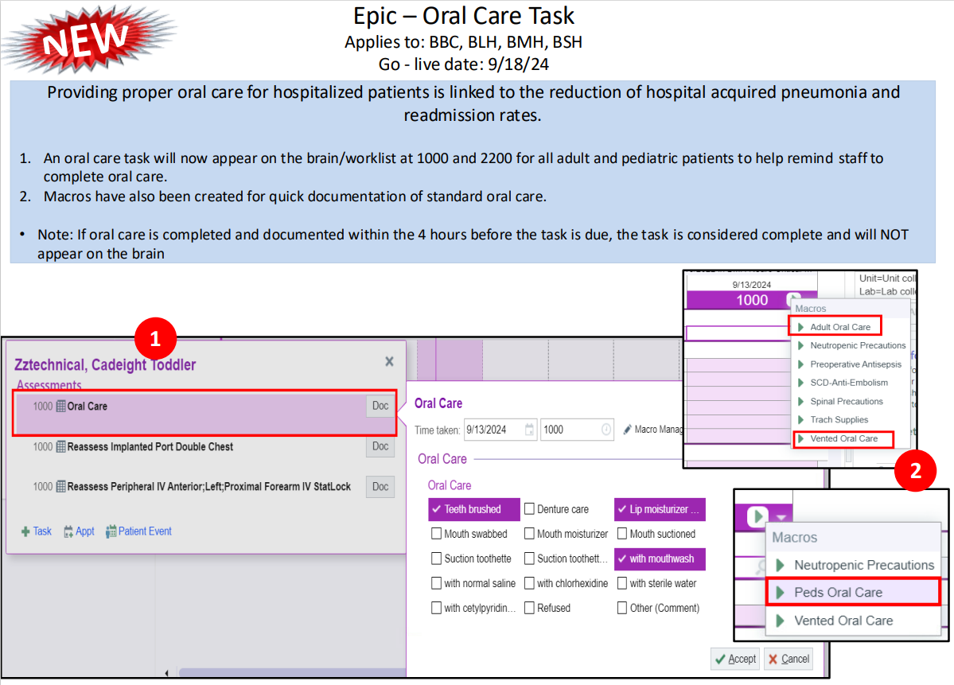
Notes:
Task for Acute Care in Epic: go live was actually 9/25/24
Task appears in Epic at 10:00 and 22:00 for all patients to remind staff to ensure oral care is completed and documented.
The task does appear for PCA’s and LPNs, and when this rolled out clinical informatics nurses rounded with a focus on providing this info to the PCAS, and reminding nursing to delegate if they still see the task at 10am.
Nursing and PCAs were very receptive to this.

Slide 50
Checking in: Assessment Part 2
Assessment fall 2024
 |  | Bronson Methodist Hospital (31 rooms)
Toothbrush and toothpaste in the room? |  | 61%
Toothbrush used? |  | 39%
Oral rinse in the room? |  | 19%
Antiseptic oral rinse
Quality soft toothbrush
Toothpaste meets ADA recommendations (sodium bicarbonate)
Toothbrushes still not cleanly stored
Patients wanted supplies when offered
Patients with no teeth did not think they needed a toothbrush
Notes:
The next assessment we did was a couple of weeks ago, and limited to one hospital but we revisited the same two units.
I was pretty disappointed what we found, there seemed to be minimal practice changes since the year prior.
We intended to do assessment this after the Task in Epic had gone live, but learned later that it had been delayed so this is still pre-Task go live.
However this IS after the go live of policy, deployment of all the new products, and education rounding from dept. staff development instructors using the learning aids I showed previously.
Spot checking a sample of patients a week later also showed that oral care was not being documented as completed for most patients, most days.
So we still have work to do. I did not expect to have outcomes to share by the time of this conference, but I expect to have some signals that compliance had greatly improved.

Slide 51
Needs Improvement
Culture that oral care is low priority in the non-vented patient
Fully engage clinical team: rationale, importance and overall outcome goals
Spend money to save money (and lives!)
Patient engagement
Products available in all places they are needed (e.g. suction toothbrush for med-surg units)
Notes:
On positive side, we have laid groundwork for implementation and are reconvening those who worked on this over the past year and half and will strategize together what next steps are.
What we have learned:
With time limitations for nurses during a shift, oral care twice a day becomes low priority. Educators are working with units on delegation to patient care assistants and engagement with patients to do their own oral care as much as possible.
Frugal clinical staff? Not distributing oral rinse to all non-vented patients. Kits could help.
Feedback to depts on their compliance rates with both toothbrushing and oral rinse together could help.
Patient education: barrier is it’s one more thing we ask patients to be educated on. An alternative could be posted information in the room. Including oral care on board in room with goals for the day.

Slide 52
Bronson Commons Setting
Bronson Commons is a Post-Acute Care &
Rehabilitation Services Facility
Short-Term Care
We specialize in short-term nursing care and therapy for adult patients following illness, injury or hospitalization.
Long-Term Care
We have a unit devoted to long-term care in a secure, homelike environment.

Slide 53
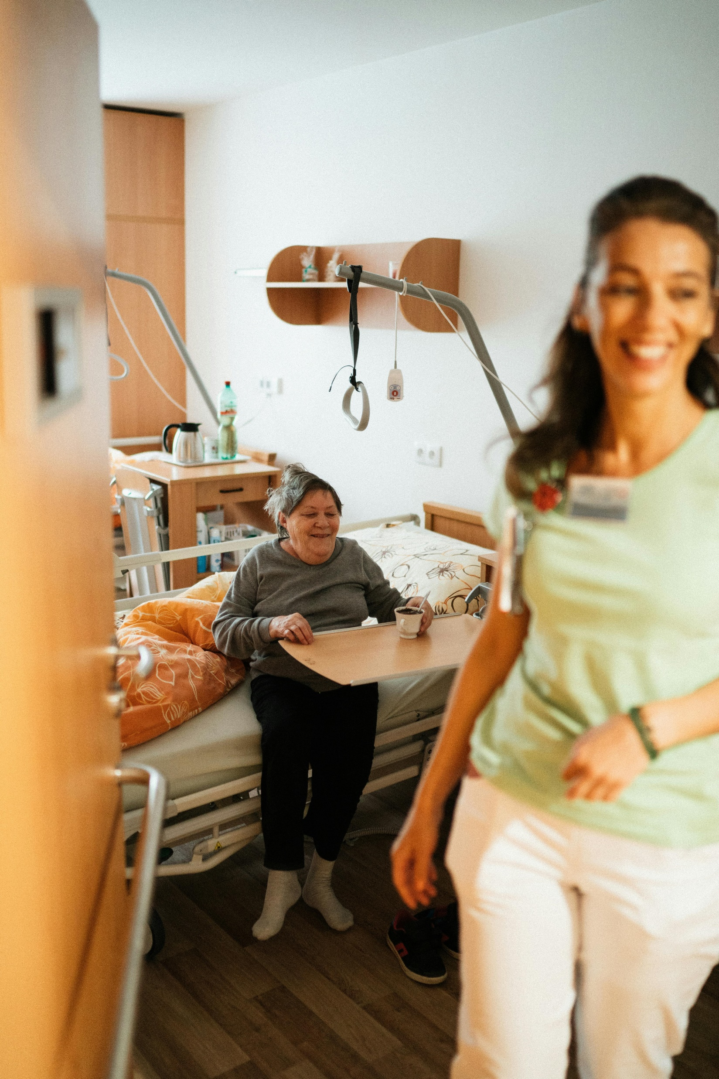
Bronson Commons HA Pneumonia
BCOM Baseline: 0.64 NV HAP cases/1,000 patient days
Literature: Pneumonia incidence from 0.3 to 2.5 cases per 1,000 resident-days
Notes:
Bronson Commons incidence of NV-HAP falls on the lower end of estimates in the literature.

Slide 54


Long Term Care State Licensing Epxectations
State Operations manual defines Oral Care and outlines care plan expectations for oral care:
Notes:
Does not define products or frequency. At Bronson Commons, the expectation was already twice daily prior to this pneumonia prevention initiative.

Slide 55
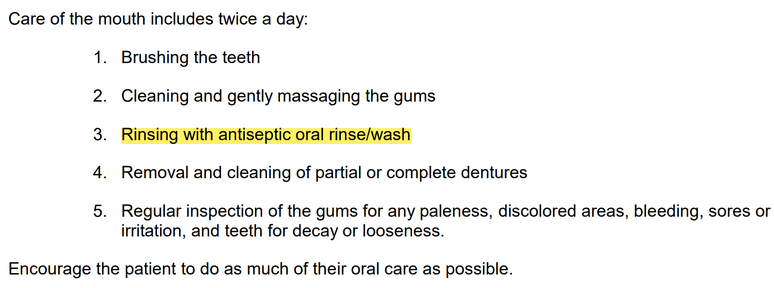
Bronson Commons Oral Care Policy Updated
Notes:
Oral Care policy change was made in March 2024: Antiseptic oral rinse was added as routine to the twice daily oral care regimen. Previously verbiage was “mouthwash as desired” throughout this policy.
BCOM-NSG-GEN-23 ORAL HYGIENE v.5 (policytech.com)

Slide 56
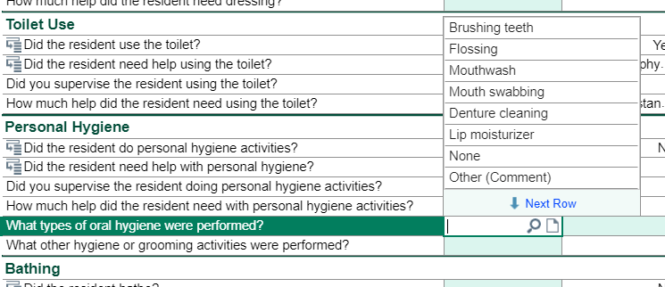
Oral Care Documentation
Notes:
Oral Care is including in the Flowsheet rows that are standard expectations for CNAs to document.
There is a “Required Documentation” link in EPIC however oral care is currently not included in the mapping of the link.
In the future if compliance needs to be improved, this could be a strategy to help with that.
There is also not a fill-in option for oral rinse, so this needs to be added.

Slide 57
Education and Acceptance
Staff meeting education was presented to all nurses and CNAs via six presentations in August 2024
Staff and patient acceptance
Notes:
Standard protocol already required oral care twice a day on all patients unless otherwise stated in their care plan.
The initiative to prevent pneumonia did not change this.
Education was specific to the product changes and also including oral rinse with the twice daily oral care regimen.
This was well-received as oral care has always been the standard of care at Bronson Commons. The biggest change was the supplies.
At this time, no education has been provided to patients. Patients are accepting of the new products and voiced no complaints.
If patient acceptance is identified to be a barrier, this could be added.

Slide 58
Bronson Commons Implementation
Challenges:
Obtaining the supplies
Size of the paste tube
Going well:
Staff and patient acceptance
Staff reports new supplies are easy to use
Twice daily oral care is not new
Notes:
Obtaining the supplies was the initial and ongoing challenge. And the size of the paste tube is not beneficial for LTC residents. However, it’s adequate for rehab.

Slide 59
Future
Continue to work as a multidisciplinary team
Monitor compliance with feedback to hospital depts and BCOM units
On-unit assessments repeated and expanded in hospitals
Engage nursing leadership again with stronger rationale
Ensure tools available for dependent patient oral care outside of critical care depts (suction toothbrush)
SDIs working with their clinical staff to do chart review and address gaps with individuals
Video and/or CBL for staff
Pursue kits (again)
Educational materials for patients
Add to the new patient in-hospital welcome booklet in the infection prevention section
Analyze for NV-HAP outcomes

Slide 60
Hygiene as Infection Prevention
Daily CHG wipes in critical care
Vented patient oral care bundle
Indwelling urinary catheter cleaning
Pre-op antisepsis bundle (oral, nasal, wipes)
Comprehensive oral hygiene for all patients (non-vented)
Bath wipes for bed bathing (no basins)
Notes:
These are all practices that we consider infection prevention tactics: for CAUTI, CLABSI, SSI, post-op pneumonia, and VAP. It matters how this hygiene is done, when it is done, how often. Kits help support compliance with bundles.
Now we can add oral hygiene for non-vented patients to this list. This tactic needs to be given the same weight and attention as these other hygiene practices.
Our organizations need to make that shift from viewing oral hygiene as being optional, low priority, just for patient comfort or by patient request – to an infection prevention tactic.
If this was new for you I hope that this got you as fired up as I was when I first learned about the impact this simple intervention can have. Hopefully this was a helpful gathering of info, and the the resources we talked about will help you make the case to convene your own team to implement oral care for NV-HAP prevention.

Slide 61
Notes:
If this was new for you I hope that this got you as fired up as I was when I first learned about the impact this simple intervention can have. Hopefully this was a helpful gathering of info, and the the resources we talked about will help you make the case to convene your own team to implement oral care for NV-HAP prevention.
If you are already underway and have your own success story, I’d love to hear what you found to be key tactics for your organization.

