Slide 1

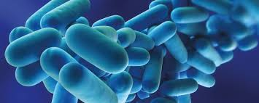
Legionellosis: Surveillance & Investigations
Mike Swain
Epidemiologist
Mark Hansell
Chief Public Health

Slide 2

What is Legionella?
Causes Legionnaires’ disease, a serious type of pneumonia
Occurs when people breath in small droplets of water or accidentally swallow water containing Legionella into the lungs
Named after 1976 Philadelphia outbreak (American Legion convention)
10,000 cases reported in the U.S. 2018 (but underreported)
Approximately a 10% case-fatality rate
Is not transmitted person-to-person

Slide 3
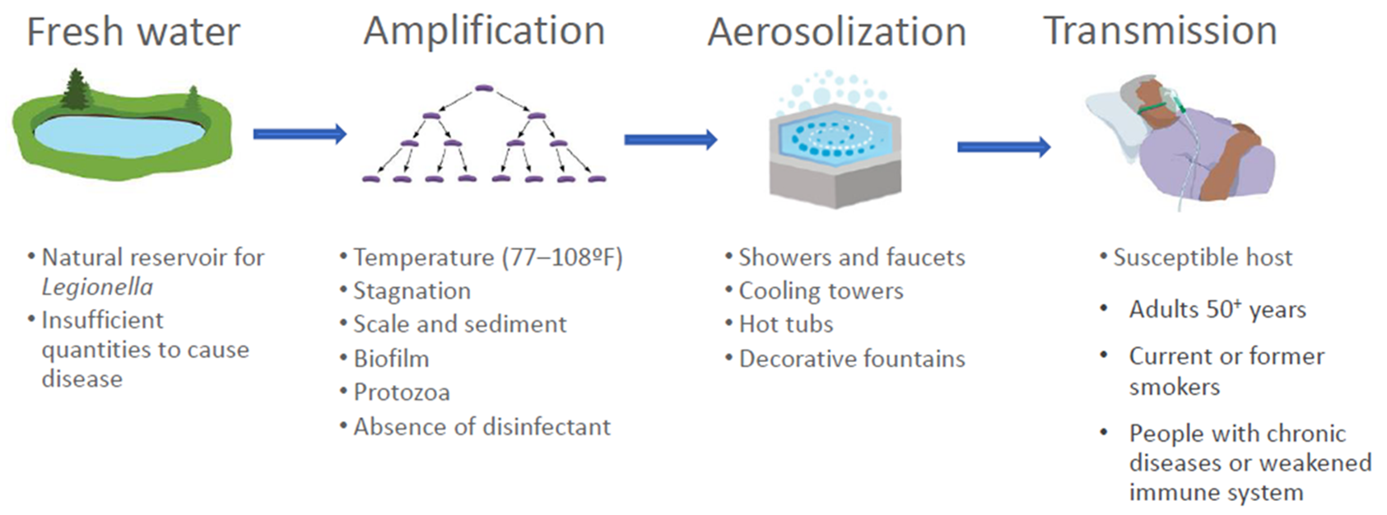
Transmission
Notes:
Legionella naturally occurs in freshwater. This could include water that is being pumped through community water supplies. But drinking water with legionella bacteria will most likely not make you sick. Rather, to make a person sick legionella must be aerosolized (forming droplets that breathed in by a person). But the perfect conditions also have to occur. Stagnant water, water between 77 and 108 degrees and a lack of disinfectant (such as chlorine) are also conditions that allow for the growth of legionella. Then to aerosolize: cooling towers (that cool large buildings), hot tubs, fountains, showers all aerosolize water. If the water is between 77 and 108 degrees and lacks disinfectant, the risk of Legionnaires Disease is much greater. Home and car air-conditioning units do not use water to cool air, so are not a risk for Legionella growth. The host, or the person who gets sick, is often older, has a history of smoking and may have a weakened immune system. Most cases of Legionnaires Disease are among individuals with these risk factors. Luckily, this process allows for prevention in the environment by focusing on disinfectant and temperature while also removing risks such as decorative fountains from locations where at risk populations are located (such as hospitals).

Slide 4
Local Water Infrastructure
Source (surface water or groundwater well)
Water Treatment Plan
Distribution System
Private Service Line
Healthcare Facility
Notes:
People in Oakland County receive drinking water from several different sources. Those sources range from wholesale purchases from the Great Lakes Water Authority, community well water systems and individual noncommunity wells.

Slide 5
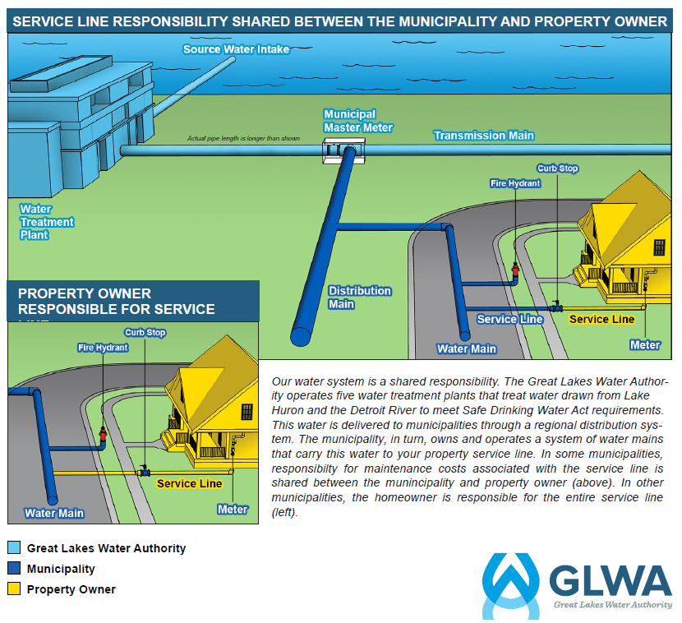
Local Water Infrastructure
Notes:
The water of a community water supply is tested before it leaves the water treatment plant and at various points in distribution.
The responsibility of the community supply stops at the ‘Curb stop’. Sampling from that point forward is the responsibility of the customer – in this case, the health care facility.

Slide 6
Health Department Investigations
Investigations by OCHD are based on information received from the state surveillance system
Providers are required to report cases of Legionnaires Disease and Pontiac Fever
OCHD nurses conduct interviews with cases to determine potential exposures
Exposures are traced 14 days prior to symptom onset
Notes:
Interviews by OCHD nurses are thorough and ask about symptoms, collect medical records (including test results) and ask about all locations and potential risk factors. If the case is not able to complete the interview, often a relative will be asked. Importantly, this interview helps establish the onset date.

Slide 7
Health Department Investigations
If a case spent any part of the 14-day period at a healthcare facility, they are considered a possible healthcare associated case
If a case spent 10 or more continuous days of the 14-day period at a healthcare facility, they are considered a presumptive healthcare associated case
2 possible cases at the same facility within 12 months or 1 presumptive case prompt an investigation
Notes:
Additionally, cases are asked about non-healthcare exposures which OCHD tracks. Should there be multiple cases at the same location within 12 months, OCHD will also conduct an investigation. Here an investigation refers to an environmental investigation. More on this next.

Slide 8
Health Department Investigations
Legionnaires cases are likely underreported
Too often, providers do not test patients who present with symptoms that indicate testing
A urine antigen test is the most common test, but only detects one serogroup
A sputum culture will detect multiple serogroups and can be further analyzed to match clinical and environmental specimens
Notes:
By not testing at all or only testing for one serogroup, cases are underreported. CDC guidelines for clinical testing include the following:
-Patients who have failed outpatient antibiotic therapy for community-acquired pneumonia
- Patients with severe pneumonia, in particular those requiring intensive care
- Immunocompromised patients with pneumonia*
- Patients with a travel history (patients who have traveled away from their home within 14 days before the onset of illness)
- All patients with pneumonia in the setting of a Legionnaires’ disease outbreak
Patients at risk for Legionnaires’ disease with healthcare-associated pneumonia (pneumonia with onset ≥48 hours after admission)
Or meeting the risk factors already presented
CDC also recommends testing for patients in healthcare facilities where there have been positive Legionella environmental samples – but most health care facilities do not test environment (water systems) unless required. Also recommended if health care facility has low chlorine levels (or other changes in water)

Slide 9
Health Department Investigations
Recommendations for providers:
  Administer both urine antigen and sputum tests when indicated
  Share complete progress notes with your local health department to assist in determining onset date

Slide 10
Health Department Investigations
Environmental investigations:
  Initiated once criteria is met
  Starts with CDC environmental assessment form
    Helps identify possible sources of Legionella in the facility
    Multi-step process that provides an understanding of the facility’s water system
    Includes visual inspections and testing
    Similar to risk assessments included in water management plans
Notes:
Criteria based on how long patient was in facility, other cases, time (as mentioned in earlier slide). CDC environmental assessment form is completed by OCHD on-site with assistance from the site’s facilities and medical staff (such as Director of Nursing, epidemiologist, medical director). Often starts with a sit-down, then an inspection of the facility.

Slide 11
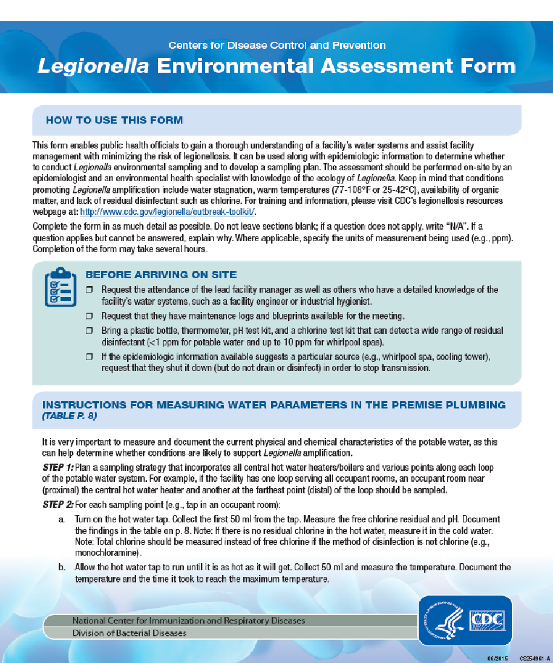
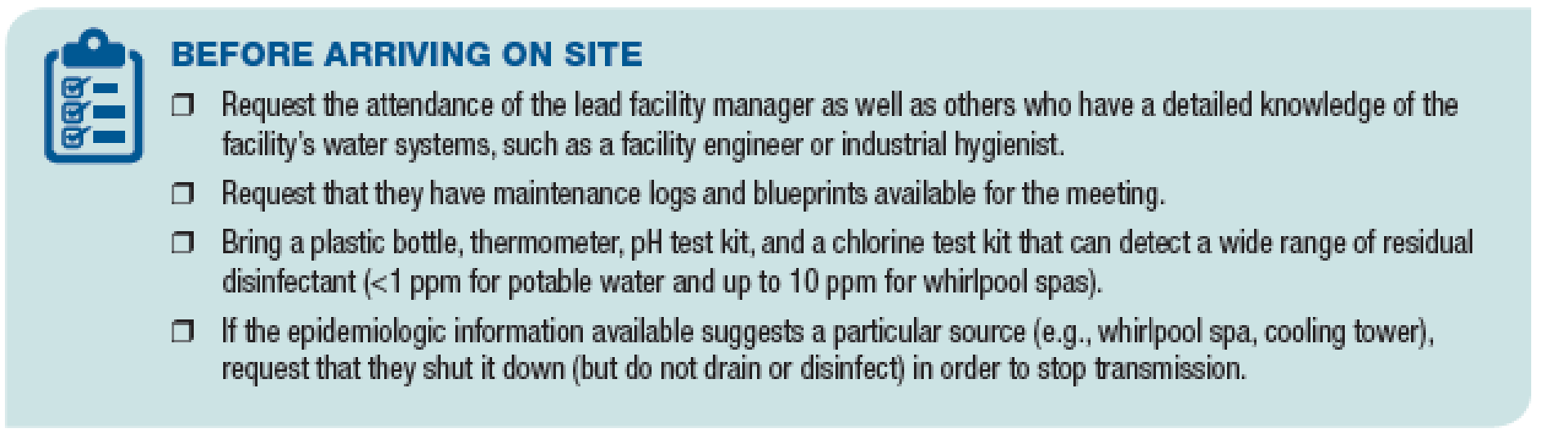

Health Department Investigations
Notes:
This assessment form is available through the CDC Legionella website it has multiple pages and helps walk you through a facility assessment. It gathers information about how the facility is used (patient acuity, patient census) and the manner in which water is generated and flows through the facility. It is great to forward this document to the facility for completion prior to meeting. A review of the assessment information upon arrival will help guide the environmental sampling process.

Slide 12
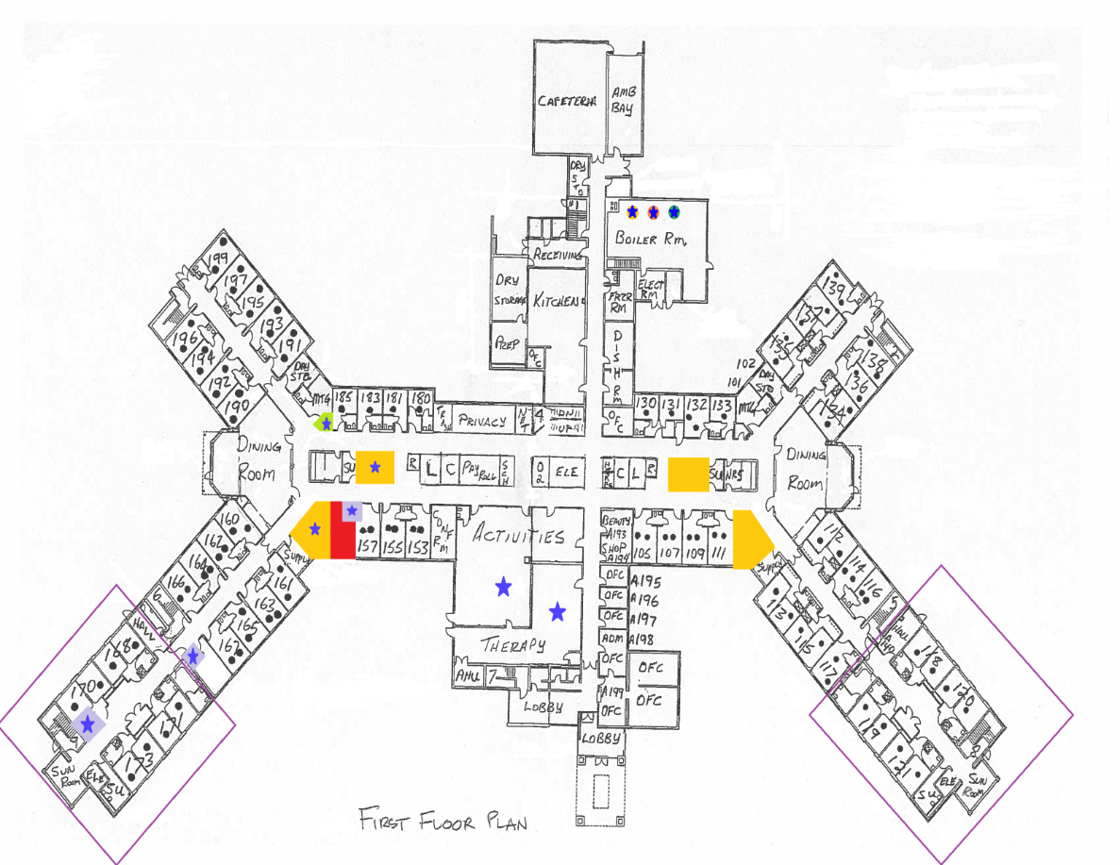
Health Department Investigations
Plumbing plan review
Notes:
A review of building plumbing plans, along with floor plans, helps determine locations where legionella may grow (such as where temperature might be low and chlorine might be low – such as dead legs) and where aerosolized water may be utilized. When these two conditions are present, the chance of exposure increases. These locations should be investigated and sampled.

Slide 13
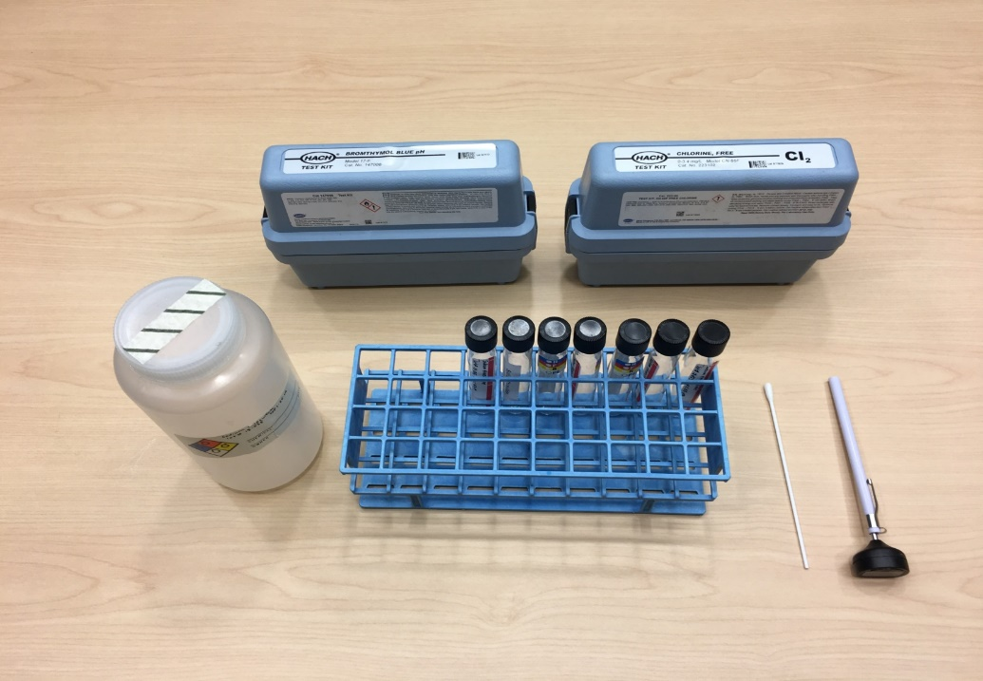
Health Department Investigations
Sampling:
  OCHD will determine sampling sites throughout the facility depending on the case’s path and high-risk fixtures
Notes:
After the assessment has been completed and sampling locations determined. The act of collecting samples is fairly easy. What is shown here are the basic tools for collection of environmental samples. The one liter bottle is for bulk water collection, the test tubes will house the swab after collection, the two test kits are for pH and free chlorine residuals, and the thermometer is used to determine temperature of the water. The patient path is where the Legionnaires case had travelled in the facility and other locations from where the case consumed food or drink.
.

Slide 14
Health Department Investigations
Follow the “path of the patient(s)”
Collect water quality parameters
  Temperature – Legionella grows best between 77°-113° F
  Disinfectant – A detectable level is need to limit growth
  PH – Disinfectants are more effective at a neutral pH
Establish sampling locations
  Highest interest are the hot water systems
  Patient sinks and shower area
  Features and equipment capable of producing aerosols
Notes:
At the original visit, OCHD will collect parameters and identify sampling locations. After this, the facility will be required to collect parameters and samples. Often facilities work with a water consultant. Samples must be sent to a CDC-certified ELITE lab – only a handful in Michigan. A typical sampling regimen for facilities under investigation is bi-weekly for 3 months and then monthly for an additional 3 months. Locations and frequency may change based on results.

Slide 15
Health Department Investigations
MDHHS and your local health department strongly recommend facilities contract with a professional water systems consultant to:
  Conduct the environmental sampling
  Perform the water quality parameters
  Relationship with an ELITE certified lab
  Assist with remediation if needed
  Assist in updating WMP
  Communicate with your local health department and MDHHS

Slide 16
Health Department Investigations
OCHD has been actively involved in monitoring and investigating Legionnaires Disease for several years
First OCHD-led investigation in 2016
Since then, normally OCHD will investigate several health care facilities each year based on CDC and MDHHS criteria
Notes:
Again, these investigations are based on diagnosis criteria and length of exposure. Additionally, some years have more cases than others – potentially due to weather. Often more cases will equal more investigations.

Slide 17
Case Study
Large Hospital Complex in Oakland County
OCHD notified of 2 cases associated with the same hospital in the summer of 2017
MDHHS Legionellosis Surveillance and Investigation Protocol:
  “An outbreak is defined as two or more cases who have been exposed to the same hospital, long-term care facility, hotel, or job site, for example, at about the same time.”
Notes:
Each of these cases would be “possible healthcare-associated” meaning exposure to a healthcare facility for a portion of the 10 days prior to illness onset.
“…at about the same time.” is interpreted as within 6 months of each other. You will remember from previous slides, a full investigation would be done in this case. The other trigger for a full investigation would be the definition of ‘definitely healthcare-associated’ - In the facility the entire 10 days prior to onset. OR 2 common exposures – hotel, workplace…

Slide 18
Case Study – LEAF
Legionella Environmental Assessment Form (LEAF)
https://www.cdc.gov/investigate-legionella/Legionella-Environmental-Assessment-Form.pdf
First step in an investigation
Conducted by LHD, with facility’s nursing and facilities staff

Slide 19
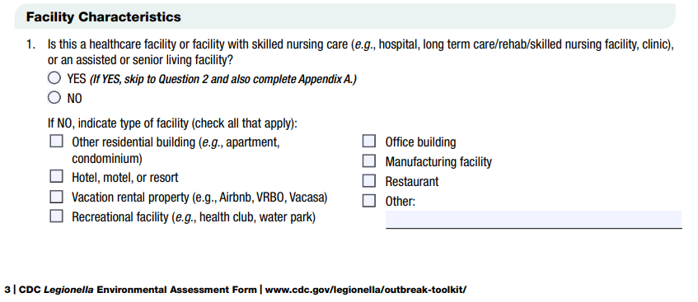
Case Study – LEAF
Pages 3-5:
  Facility characteristics

Slide 20
Case Study – LEAF
Number of buildings on premises and number being assessed
  Depends on the exposure location(s) and water systems
  Ideal for health care facilities to limit employee and patient movement between water systems
Occupancy: if low occupancy, concern is stagnant water
Emergency water systems
Hot tubs and spas

Slide 21
Case Study – LEAF
Page 5:
  Ice machines
  Sprinkler systems
  Construction
  Water management plan
    Validation sampling could limit the scope of an investigation
Page 6:
  Summarizes building information

Slide 22
Case Study – LEAF
Page 7, Water Supply Source
  Public water systems not responsible past the curb, but hydrant flushing has been requested in the past
    Often based on incoming disinfectant parameter
  Boil water advisories and water disruptions are tracked by OCHD

Slide 23
Case Study – LEAF
Page 8, Premise Plumbing System
  Recirculation systems
  Mixing valves
Page 9
  Hot water systems classified by boiler and/or loop number
Page 10
  Max. hot water temperature permitted
  Historic parameters should be available
  Supplemental disinfection systems must be permitted to be installed

Slide 24
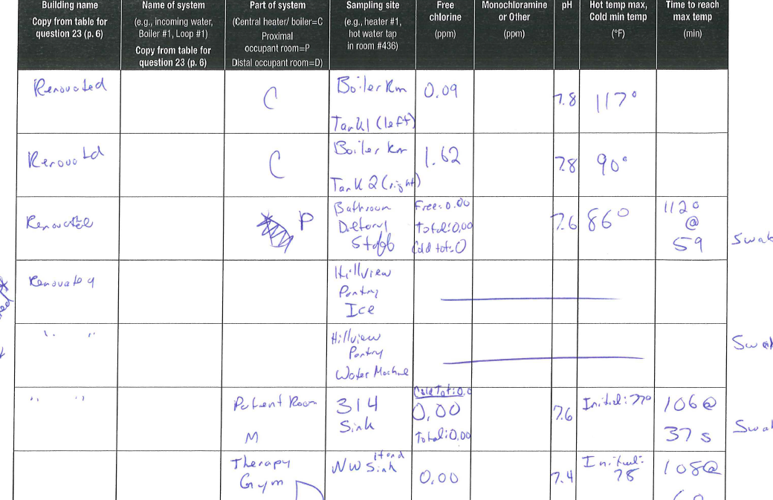
Case Study – LEAF
Page 11, Measured Water System Parameters
  Starts at incoming line and follows the path of the patient, collecting parameters
  Patient path often includes room sink, shower room (if not in patient room), kitchen, therapy rooms
  Distal location(s)
  Capture photos of each
  sampling location

Slide 25
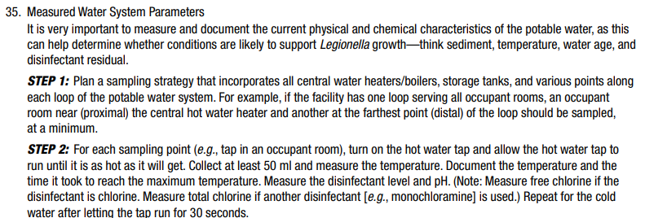
Case Study – LEAF
Page 11, Measured Water System Parameters

Slide 26
Case Study – LEAF
Page A-1, Appendix A
  Ice machines
  Respiratory therapy equipment
Page B-1, Appendix B
  Cooling towers – requires facilities expertise to complete; often a consultant just for cooling towers
  A known source of community-acquired LD
  Seasonality
  Looking for biofilm build-up, water clarity, sediment and scale on drift eliminators

Slide 27
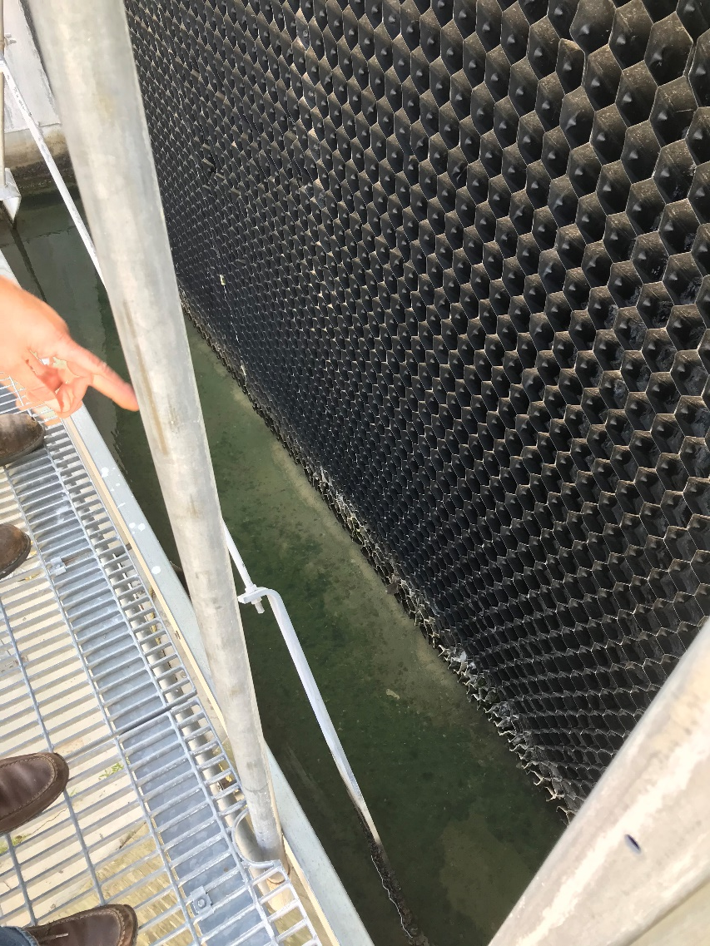
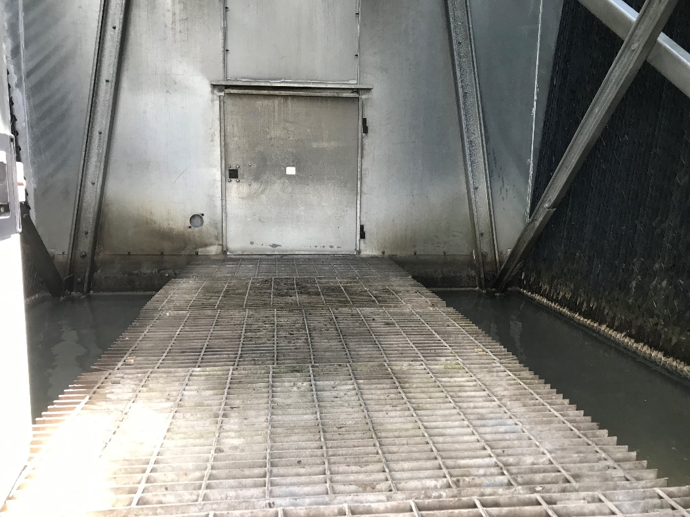
Case Study – LEAF
Appendix B

Slide 28
Case Study – LEAF
CDC Legionella Sampling Procedure
  https://www.cdc.gov/investigate-legionella/media/pdfs/cdc-sampling-procedure.pdf
  Where and what (bulk, swab) to collect
  Cooling tower specific instructions

Slide 29
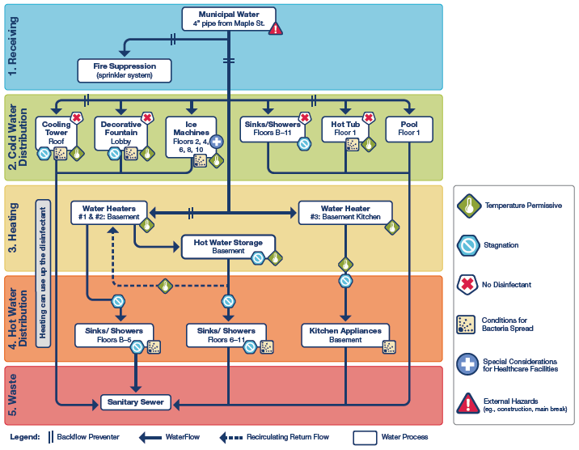
Case Study
First Steps:
  Meet with hospital personnel
  Performed the environmental assessment
  Requested follow-up information
    Plumbing schematic
    Water management plan
    Cooling tower maintenance records
    Hot water distribution system
    Chart review of all cases of pneumonia over the past 6 months
  Request patient sampling
  Request environmental sampling
Notes:
Had a really good turnout from the hospital personnel including the hospital president, infectious disease doc, Chief Medical Doc, Facilities Director, Nursing Director, and their contracted water management consultants.
Used the CDC Legionella Environmental Assessment Form
The facility had a water management plan – but it was pretty general, outline format, tried to cover all facilities in the network. They had begun assembling a team and had a bid out for 3rd party assistance to create a comprehensive water management plan and had only begun creating plumbing diagrams for this very complex water system.
Request Patient Sampling: Begin to test anyone presenting with pneumonia upon admission and all hospital acquired pneumonias with urine antigen and sputum culture.

Slide 30
Case Study
Environmental Sampling Results
  One area (A) had no legionella detected
  Area (B) had significant detections
Need for immediate remediation steps
  Dismantling, cleaning and sanitizing of sinks
  Installation of 0.2 micron point-of-use filters
Need for expanded sampling in Area B
Notes:
A total of 11 fixtures were sampled initially, 6 in area A and 5 in area B.
Area B had a 600, 81 and 77 CFU at patient area procedural sinks
200 filters were ordered and delivered overnight. Every sink on that loop received a filter.
16 more sampling locations were added to Area B. Using a 3rd party consultant to collect the samples – National company that uses a CDC ELITE laboratory in Illinois.
Planned hyper-chlorination on the hot water loop serving this patient area.

Slide 31
Case Study
Continued to get results from ND to 112 CFU over the next 2 rounds of sampling (13 days)
Planning for Remediation
  Temporarily increase temperature in the hot water loop to achieve return temperature of 124° F
  Shock Hyper-chlorination of 50ppm and maintain between 20 and 50ppm for up to 4 hours.
Receive notification of a 3rd ‘possibly healthcare-associated’ case – Area (C).
Notes:
Increased temperatures are not a bad idea, but for remediation, 160-170°F with flushing of 10-30 minutes is necessary (EPA)
At this time, the hospital was making plans to add a secondary disinfection system to maintain free chlorine residual throughout the hot water loop.
A third case, in a third area of the hospital added an additional 6 sample locations – all later returning as ND

Slide 32
Case Study
Post Hyper-Chlorination
  Next 2 rounds of sampling ranged from ND to 4 CFU
Installed a continuous feed, secondary chlorination system on the hot water loop.
Sampling since has showed very low levels of Legionella or non-detect

Slide 33
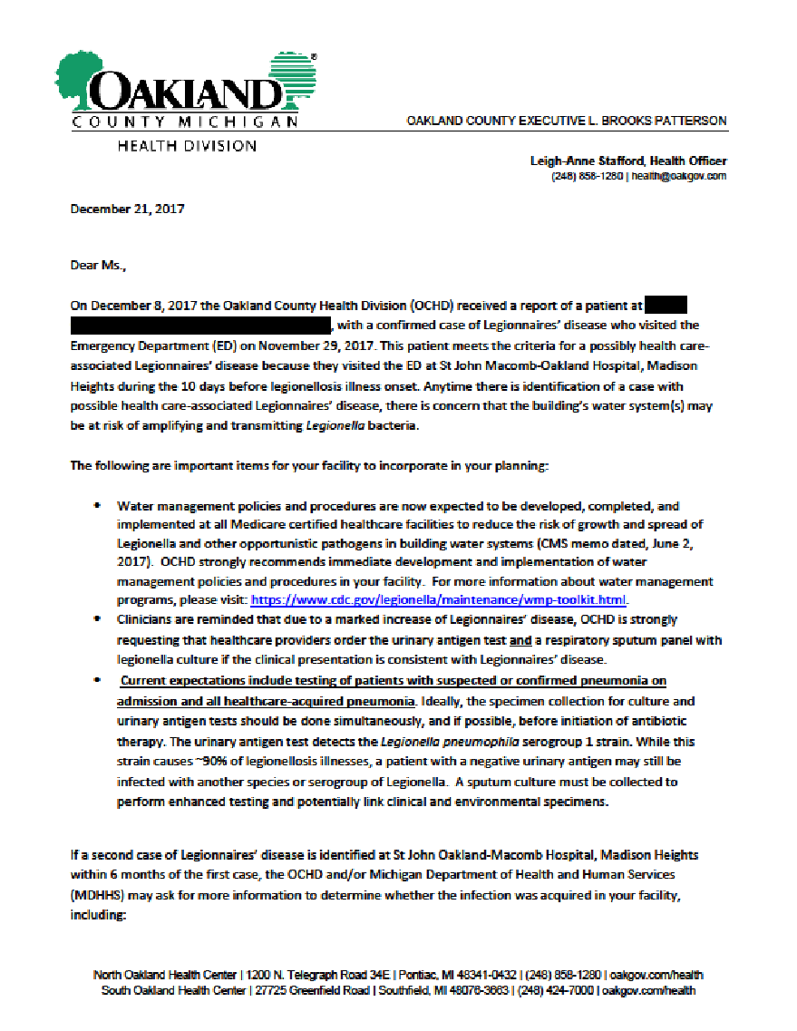
Other OCHD Activities
Healthcare facilities with a single “possible” healthcare associated case receive a letter from OCHD notifying them of possible case and information on how to prevent growth

Slide 34
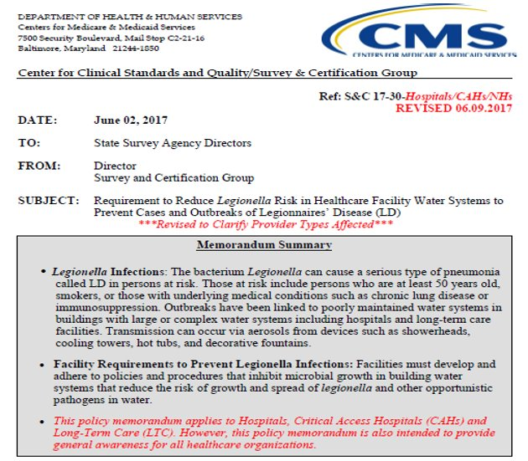
CMS Memo, QSO-17-30
Released June 2017
Requires healthcare facilities to develop and adhere to policies to inhibit microbial growth in building water systems (water management programs)
Effective Immediately
Notes:
Adhering to CMS memo is important for CMS funding. Can be enforced by various agencies at multiple levels of government. Requires facilities to have a comprehensive water management plan. Also must conduct a risk assessment, specifies testing protocols and acceptable ranges of control measures. Updated in 2018 with clarified expectations.

Slide 35
CMS Memo, QSO-17-30
42 CFR §482.42 for hospitals:
  “The hospital must provide a sanitary environment to avoid sources and transmission of infections and communicable diseases. There must be an active program for the prevention, control, and investigation of infections and communicable diseases.”
42 CFR §483.80 for skilled nursing facilities and nursing facilities:
  “The facility must establish and maintain an infection prevention and control program designed to provide a safe, sanitary, and comfortable environment and to help prevent the development and transmission of communicable diseases and infections.”
42 CFR §485.635(a)(3)(vi) for critical access hospitals (CAHs):
  CAH policies must include: “A system for identifying, reporting, investigating and controlling infections and communicable diseases of patients and personnel.”

Slide 36
CMS Memo, QSO-17-30
Facilities must have water management plans and documentation that, at a minimum, ensure each facility:
  Conducts a facility risk assessment to identify where Legionella and other opportunistic waterborne pathogens could grow and spread
  Develop and implement a WMP that considers the ASHRAE industry standard and the CDC toolkit
  Specifies testing protocols and acceptable ranges for control measures, and document the results of testing and corrective actions taken when control limits are not maintained
  Note: CMS does not require water cultures for Legionella or other opportunistic water borne pathogens. Testing protocols are at the discretion of the provider.
Notes:
In terms of testing, it is recommended but not required when not under investigation. We recommend it to validate the water management plan. Is the water management plan working? If so should have regular sampling showing non-detects for Legionella.

Slide 37
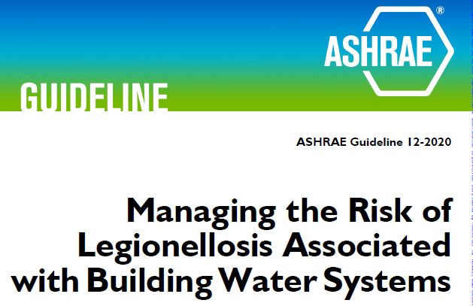
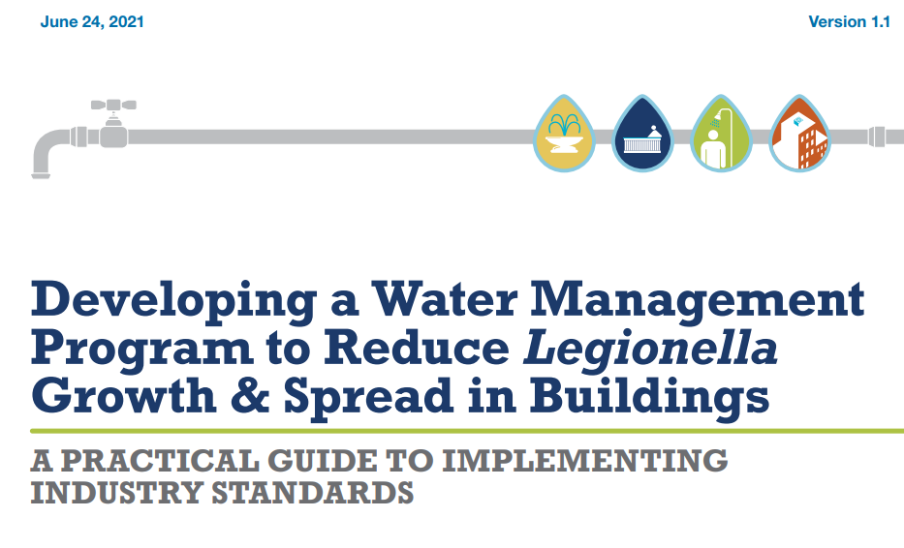
Tools to Assist Facilities
CDC Toolkit
ASHRAE Guideline
Notes:
The CDC Toolkit pictured here uses the American Society of Heating, Refrigeration, and Air-Conditioning Engineers (ASHRAE) Standard 188 as a reference throughout the document. Standard 188 is a voluntary American National Standard in conjunction with the American National Standards Institute (ANSI)
The purpose of Standard 188 is to establish minimum Legionellosis risk management requirements for building water systems.
The CDC Toolkit is a little easier to follow than the Standard, but may lack some detail.
Both are designed to identify and manage hazardous conditions that support the growth and spread of legionella.

Slide 38
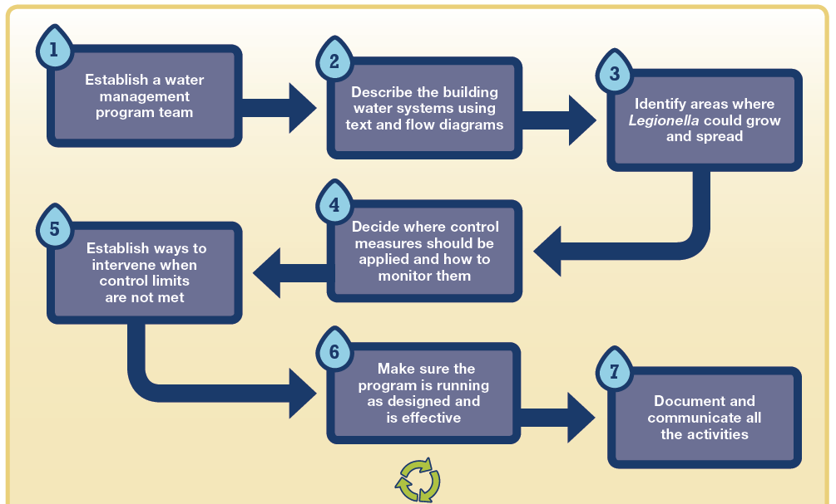
Water Management Plans
Do we really need a water management program to prevent Legionella growth?
  If your building is a healthcare facility, the answer is YES.
Developing and maintaining a water management program is a multi-step process:
Notes:
Water management plan identifies areas where legionella can grow and spread so that the risk can be reduced.
Both the CDC Toolkit and Standard 188 emphasize the special considerations necessary in health care facilities. Standard 188 has a special Annex (Normative Annex A – part of the Standard) for Health Care Facilities.
Steps/Elements:
Establish a water management team
Describe the building water systems
Identify areas where Legionella can grow and spread
Describe control measures
Establish intervention when control limits are not met
Confirm the program through verification and validation
Documentation and communication

Slide 39
Step 1: Establishing a WMP Team
Identify the persons responsible for developing and implementing the program
  Building owner/administration
  Maintenance/Engineering
  Equipment/chemical suppliers
  Safety Officers
  Consultants
For Health Care Facilities:
  Infection Prevention and Control
  Risk Management
  Someone knowledgeable in the accreditation or licensing standards
Notes:
Identify the team lead and document individual responsibilities: Someone that can approve final decisions; People very familiar with the building water system and equipment.
Standard 188 requires someone certified in infection control or an epidemiologist with a master’s degree at a minimum

Slide 40
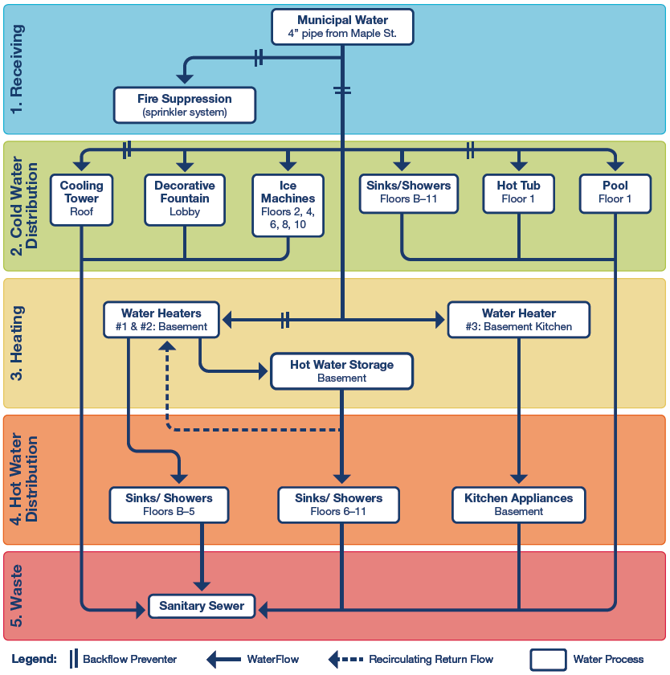
Step 2: Describe the System
Write a simple description of the building water system and how it is distributed throughout the building.
The information from the written flow is then shown by diagram(s)
Notes:
Written water flow basics:
Water enters from…
Cold water is distributed to…
Cold water is heated at…
Hot water is distributed to…
Water is sent to waste through/by…
Diagram:
The diagram shows the step-by-step process of water flow through the building. The diagram must have sufficient detail to enable the identification, analysis, and management of the risk of legionellosis throughout the building.
Update descriptions and diagrams if there is repair, replacement, expansion or any other changes to the water system.
Every building is unique. Use the information to develop and implement a program specific to your building.

Slide 41
Step 3: Identify Locations
Determine where in the water system is a risk or has potential for hazardous conditions of legionella growth.
Establish control points, control limits and corrective actions for conditions outside of control limits.
Notes:
Factors that can lead to growth:
Biofilm – protects legionella
Scale/Sediment – uses up disinfectant
Temperature fluctuations – legionella grows best at 77 – 108 F)
Water Pressure Changes/construction – can dislodge biofilm
pH – there is a range where disinfectant is most effective
Disinfectant levels – too low to prevent growth
Water Stagnation – leads to biofilm growth, low disinfectant and temperature fluctuations.
Special Considerations for Health Care Facilities:
Areas where medical procedures may expose patients to water droplets; hydrotherapy
Areas where patients are more vulnerable to infection such as oncology or intensive care
Clinical Support and patient care areas
Water use end-points: Cooling towers, water features, spas/whirlpool, pools, ice machines, humidifiers, others…
Have a relationship with your water provider so that you are aware of maintenance and repairs outside of your facility. Boil water, loss of pressure, loss of disinfectant, interruption in service.
Diagram:
The diagram shows the step-by-step process of water flow through the building. The diagram must have sufficient detail to enable the identification, analysis, and management of the risk of legionellosis throughout the building.
Update descriptions and diagrams if there is repair, replacement, expansion or any other changes to the water system.
Every building is unique. Use the information to develop and implement a program specific to your building.

Slide 42
Step 4: Control Measures
Monitoring will be needed to ensure your control measures are performing as designed.
Chemical or physical parameters must be maintained and have designated minimum and maximum values.
  Water quality should be measured throughout (chlorine)
  Water heaters maintained at proper temperature
  Decorative fountains free of debris or biofilm
  Disinfectant levels in cooling towers maintained
Testing of patients with healthcare-associated pneumonia for Legionnaires’ disease.
Notes:
For Steps 3 & 4, separate diagrams for the individual control points may be helpful:
Show the control point and detail the control measure (Hot tub – temperature and disinfectant). Indicate monitoring frequency and document results. If temperature or disinfectant is too low, document and take corrective action. Increase monitoring until assured actions were effective. Document, document, document…
For Healthcare Facilities, testing patients is especially important when the following are identified in your facility:
Patients with Legionnaires’ disease, no matter where they acquired the infection
There is a positive environmental test for legionella
Changes in water quality that may lead to legionella growth (such as low chlorine levels)
Controls and monitoring procedures should also be in place for events not occurring every day, such as increase monitoring when:
System start-up/shut down
Scheduled maintenance
Renovations/new equipment
Equipment failure

Slide 43
Step 5: Interventions
Corrective actions are taken in response to systems performing outside of control limits
A contingency response is a reaction to control measures that are persistently outside of control limits
  Always required when Legionnaires’ occurs
  Even the most closely monitored systems may sometimes require adjustments.
Notes:
In our previous hot tub example:
It is observed that the initial actions of increasing temperature or disinfectant level becomes a more common occurrence. Further actions or assessments of the heating and disinfection equipment may reveal failing equipment.

Slide 44
Step 6: Validation
Verification: Are we doing what we said?
  Confirm both initially and on an ongoing basis that the water management program is being implemented as designed
Validation: Is our program actually working?
  Confirm both initially and on an ongoing basis that the water management program effectively controls the hazardous conditions throughout the building water systems
    Environmental testing
    Infection control data
Notes:
Validation testing (sampling for Legionella) can occur at lower costs than costs incurred during an investigation (and potentially prevent morbidity and mortality). Costs may be lower based on larger selection of labs to choose from and smaller bottle sizes and fewer sampling locations. Highly recommended.

Slide 45
Step 7: Documentation
Documentation – Your written program should include at least the following:
  Program team including names, titles contacts information and roles
  Building description including age, use, occupants and visitors
  Water system description
  Control measures
  Confirmation procedures
  Collection and transport of environmental samples; laboratory name/address/contact
Communicate
  Notify employees that you have a plan
  Communicate the plan on regular basis and use this as opportunity for improvements

Slide 46
WICRA
Water Infection Control Risk Assessment for Healthcare Settings
  https://www.cdc.gov/healthcare-associated-infections/media/pdfs/water-assessment-tool-508.pdf
  A component of a WMP
  Classifies locations based on risk

Slide 47
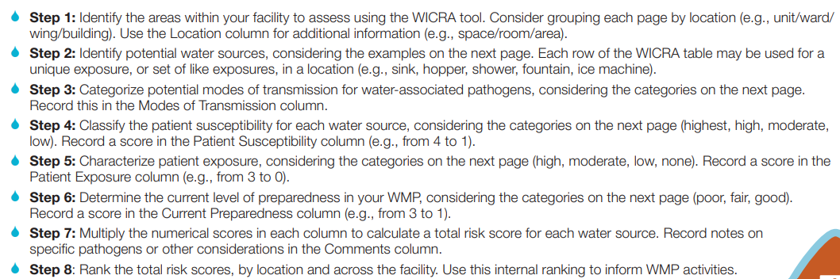
WICRA

Slide 48
WICRA
Considers:
  Water sources
  Modes of transmission
    Inhalation of aerosols dispersed from water sources is the pathway for LD (or rarely, aspiration)
  Patient susceptibility
  Patient exposure
  Current preparedness

Slide 49


Slide 50


Member Recognition

Slide 51

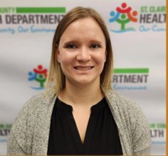


Congratulations to our new CICs!
  New CIC’s not in attendance today:
  Emilia Cirrincione
  Haley Gurney
  Jason Weaver
  Jovana Hoti
  Kristen Flory
  Nicole Pirlot
  Shannon Gotha
  Sharon Boyd
Bailee Danneels
Michael David
Bethany Stibbe

Slide 52

Congratulations to our new LTC-CIPs!
  New LTC-CIP not in attendance today:
  Stephanie Franklin
Amy Huff

