Slide 1
H5N1 Update
Natasha Bagdasarian MD, MPH, FIDSA, FACP
Chief Medical Executive, State of Michigan

Slide 2
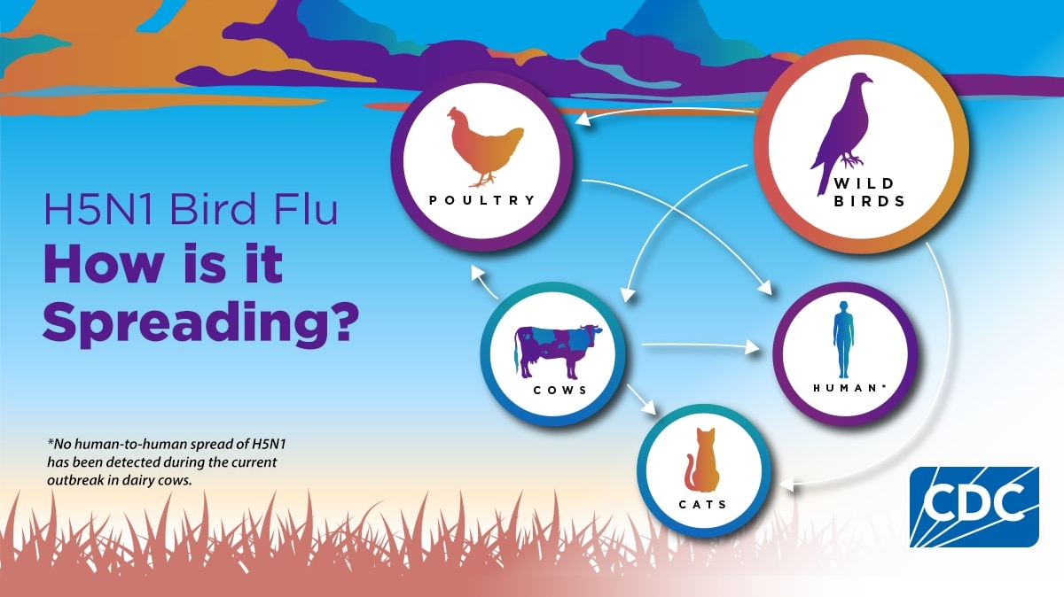

Slide 3
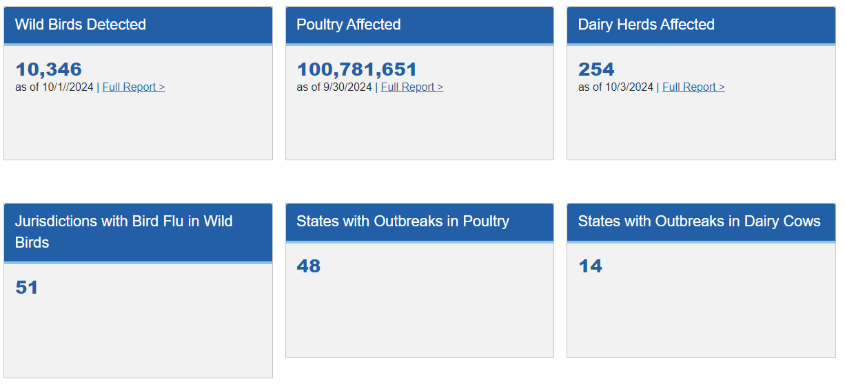
H5N1 in the U.S.
https://www.cdc.gov/bird-flu/situation-summary/index.html

Slide 4
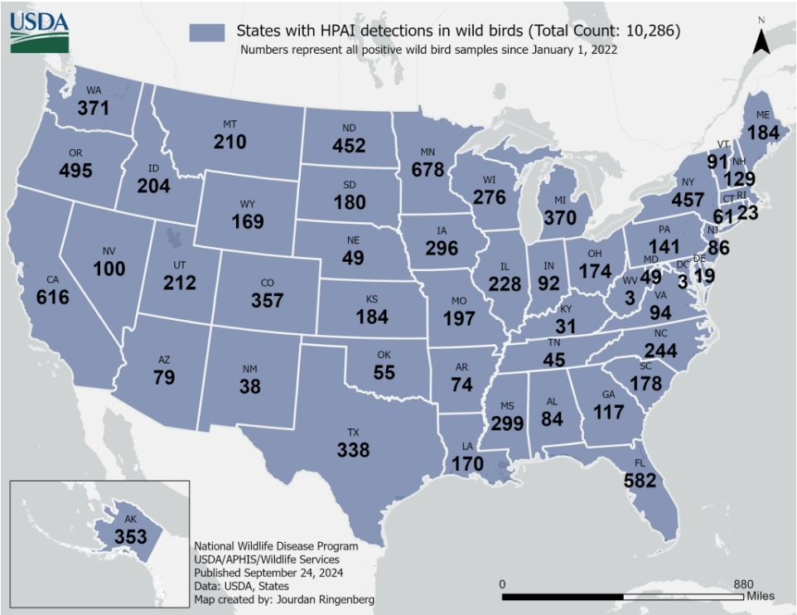
H5N1 in Wild Birds
https://www.aphis.usda.gov/livestock-poultry-disease/avian/avian-influenza/hpai-detections/wild-birds

Slide 5
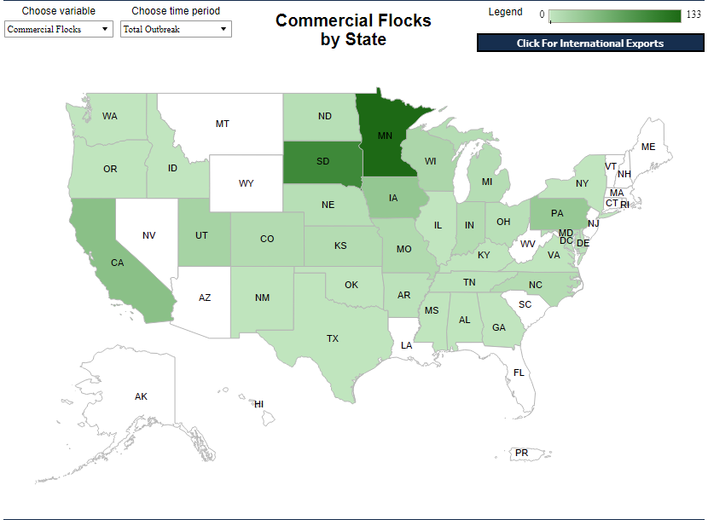
H5N1 in Commercial Poultry
https://www.aphis.usda.gov/livestock-poultry-disease/avian/avian-influenza/hpai-detections/commercial-backyard-flocks

Slide 6
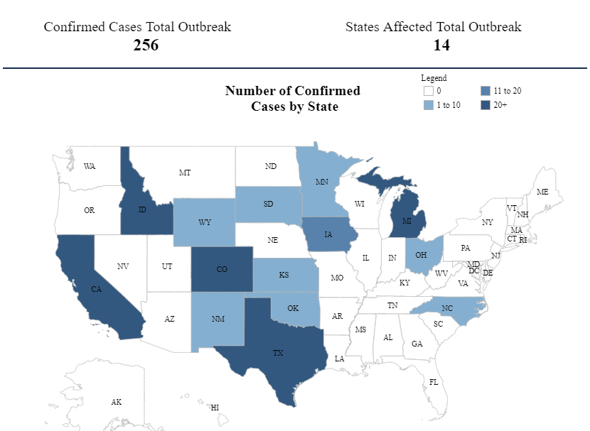
H5N1 in Dairy Herds
https://www.aphis.usda.gov/livestock-poultry-disease/avian/avian-influenza/hpai-detections/hpai-confirmed-cases-livestock

Slide 7
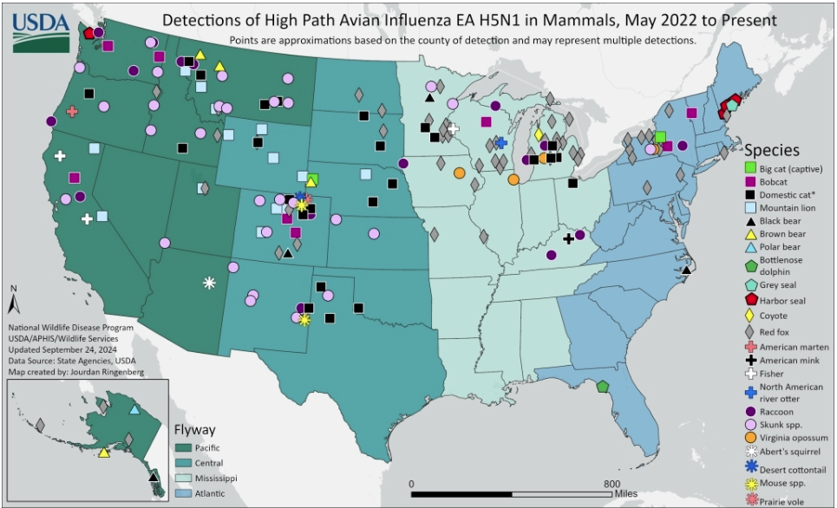
https://www.aphis.usda.gov/livestock-poultry-disease/avian/avian-influenza/hpai-detections/mammals

Slide 8
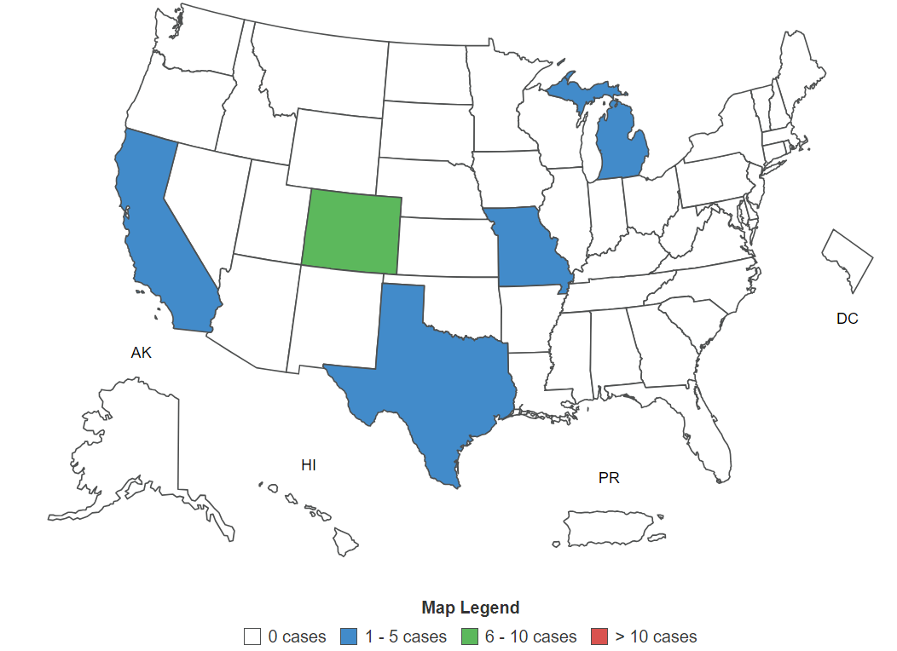
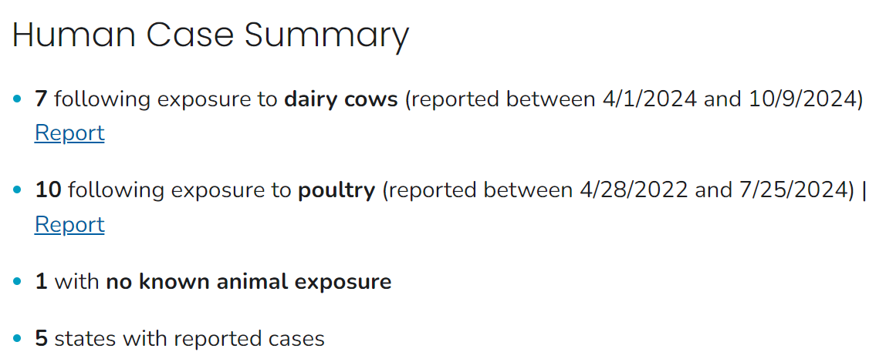
H5N1 in Humans
https://www.cdc.gov/bird-flu/h5-monitoring/index.html

Slide 9
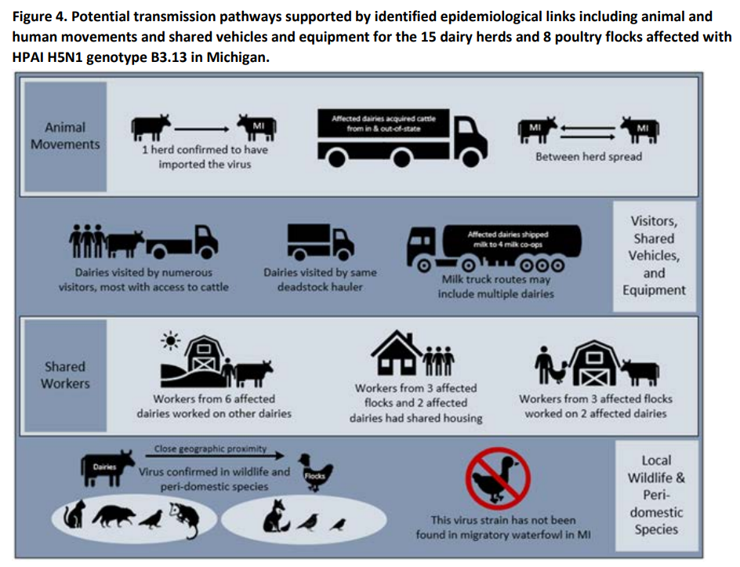
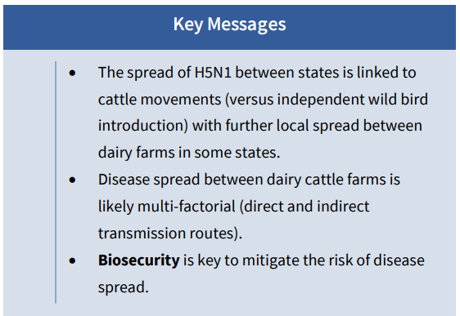
Highly Pathogenic Avian Influenza H5N1 Genotype B3.13 in Dairy Cattle: National Epidemiologic Brief (usda.gov)

Slide 10
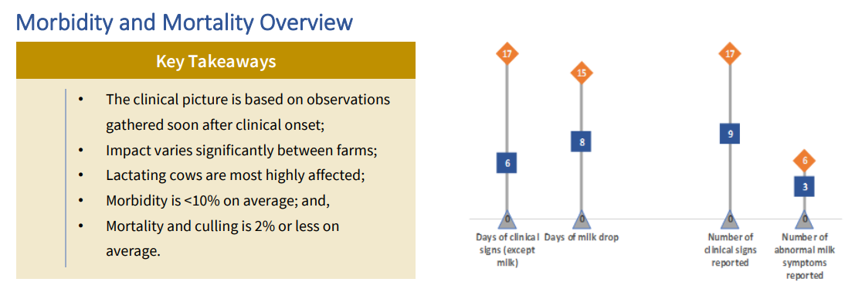
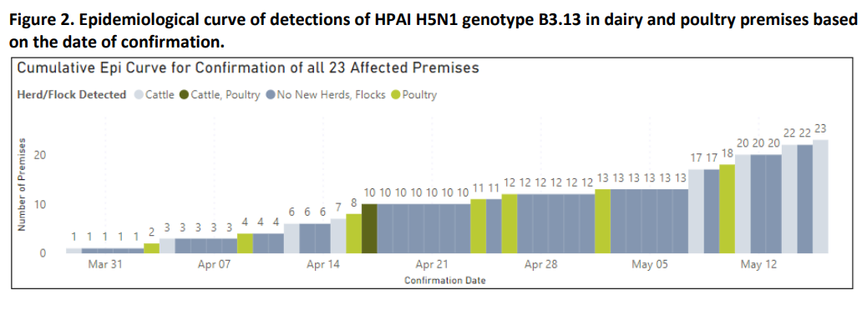
Highly Pathogenic Avian Influenza H5N1 Genotype B3.13 in Dairy Cattle: National Epidemiologic Brief (usda.gov)

Slide 11
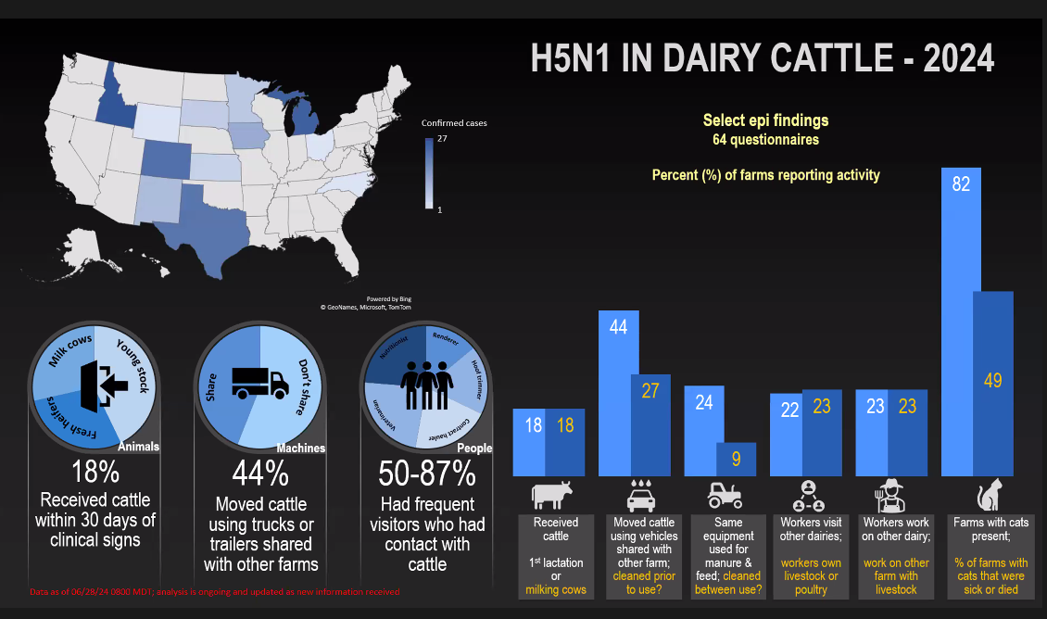

Slide 12
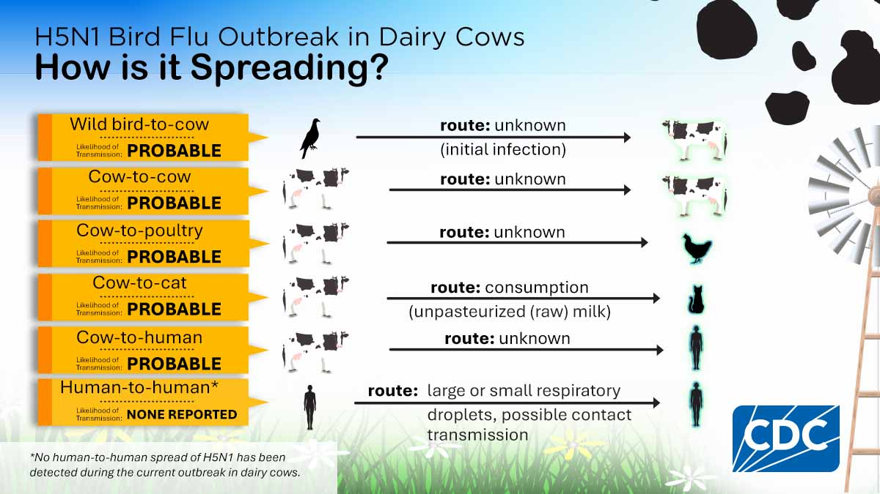

Slide 13
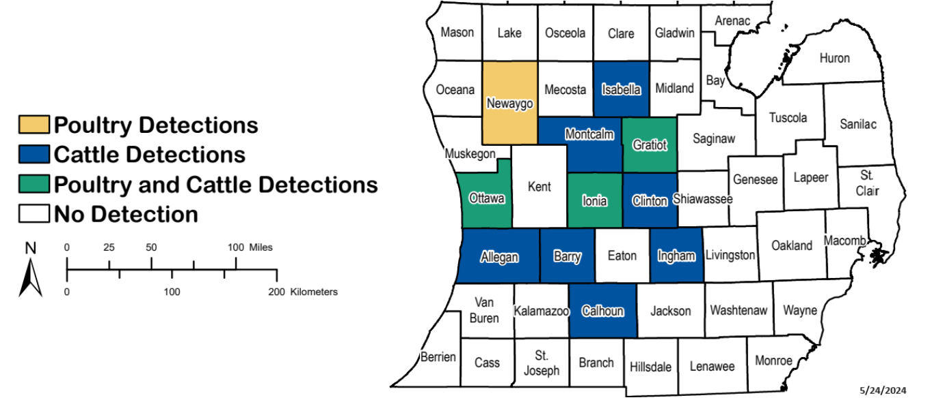
H5N1 in MI

Slide 14
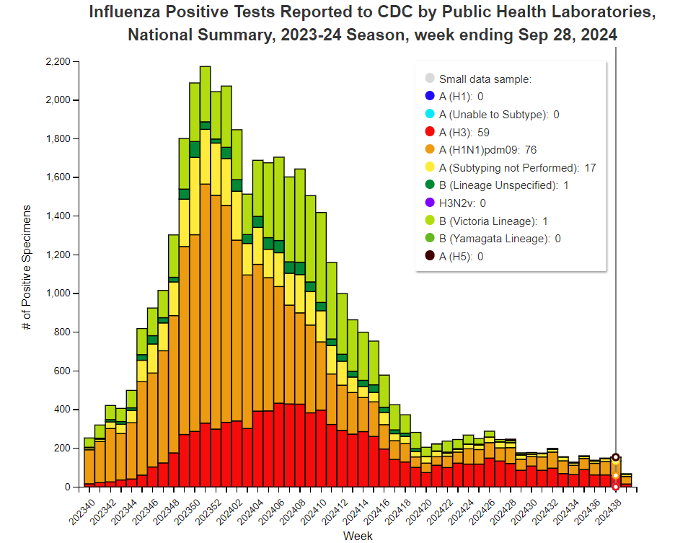
Influenza Surveillance in the U.S.

Slide 15
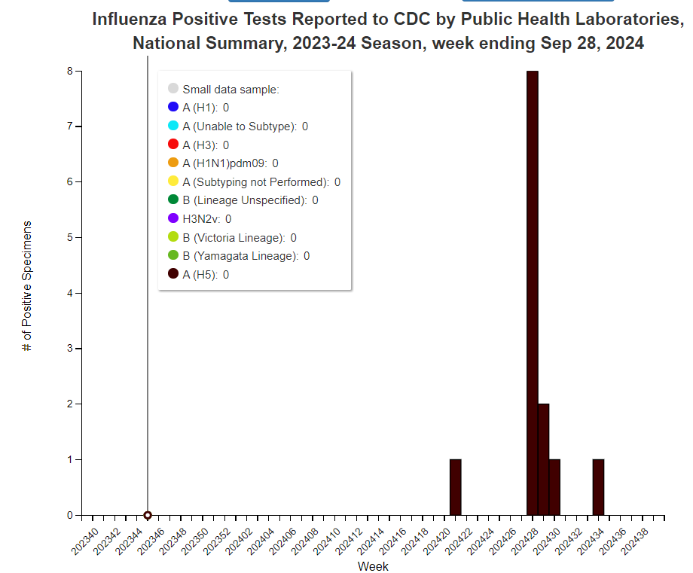
Influenza H5 Surveillance in the U.S.

Slide 16
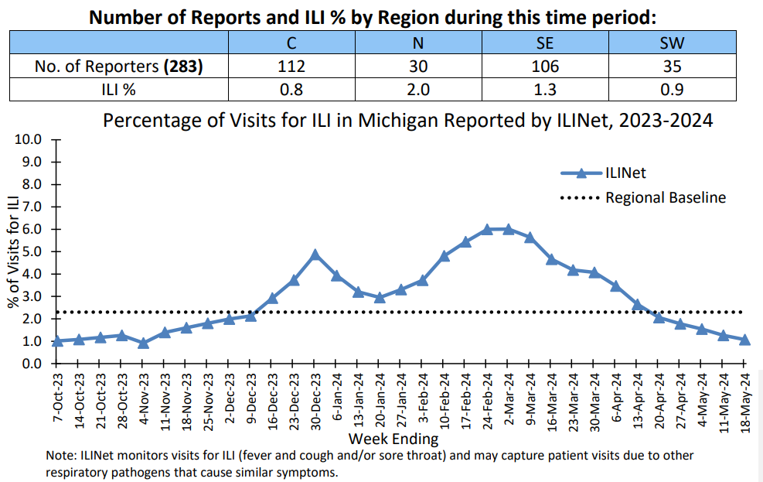
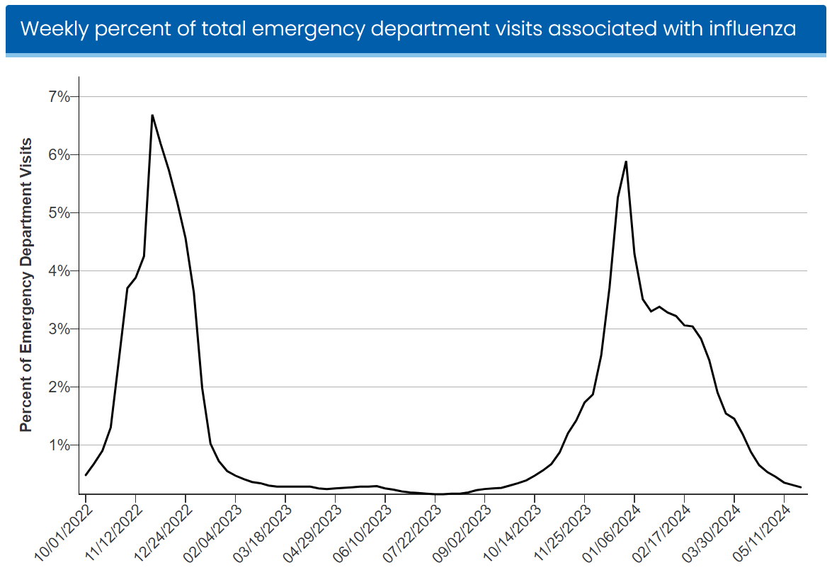
Influenza Surveillance

Slide 17
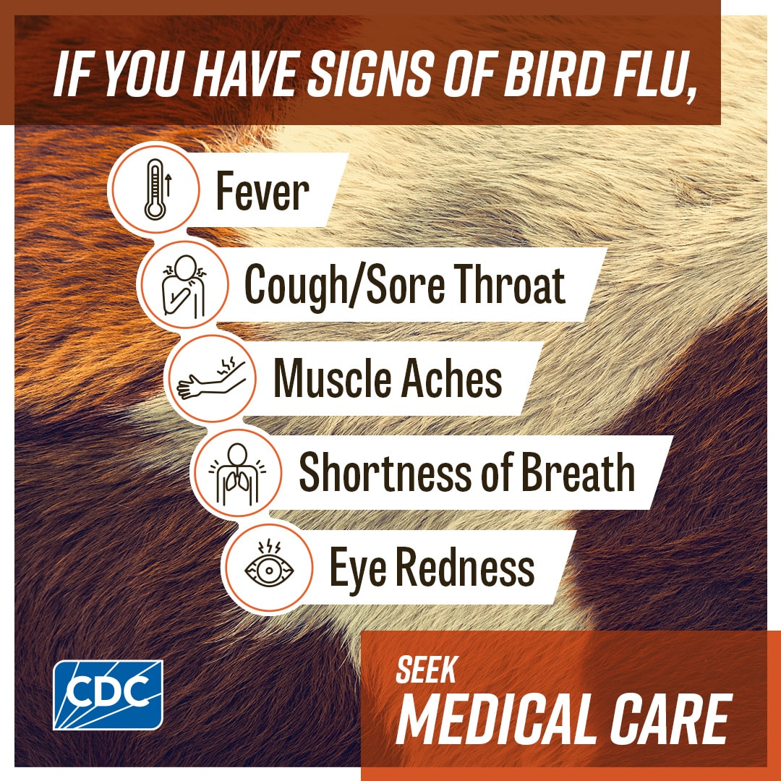
H5N1 Guidance for the Public
Avoid unprotected exposures to sick or dead animals.
Cook poultry, eggs, and beef to a safe internal temperature to kill bacteria and viruses.
Choose pasteurized milk and dairy products.
If exposed, monitor for symptoms for 10 days.

Slide 18
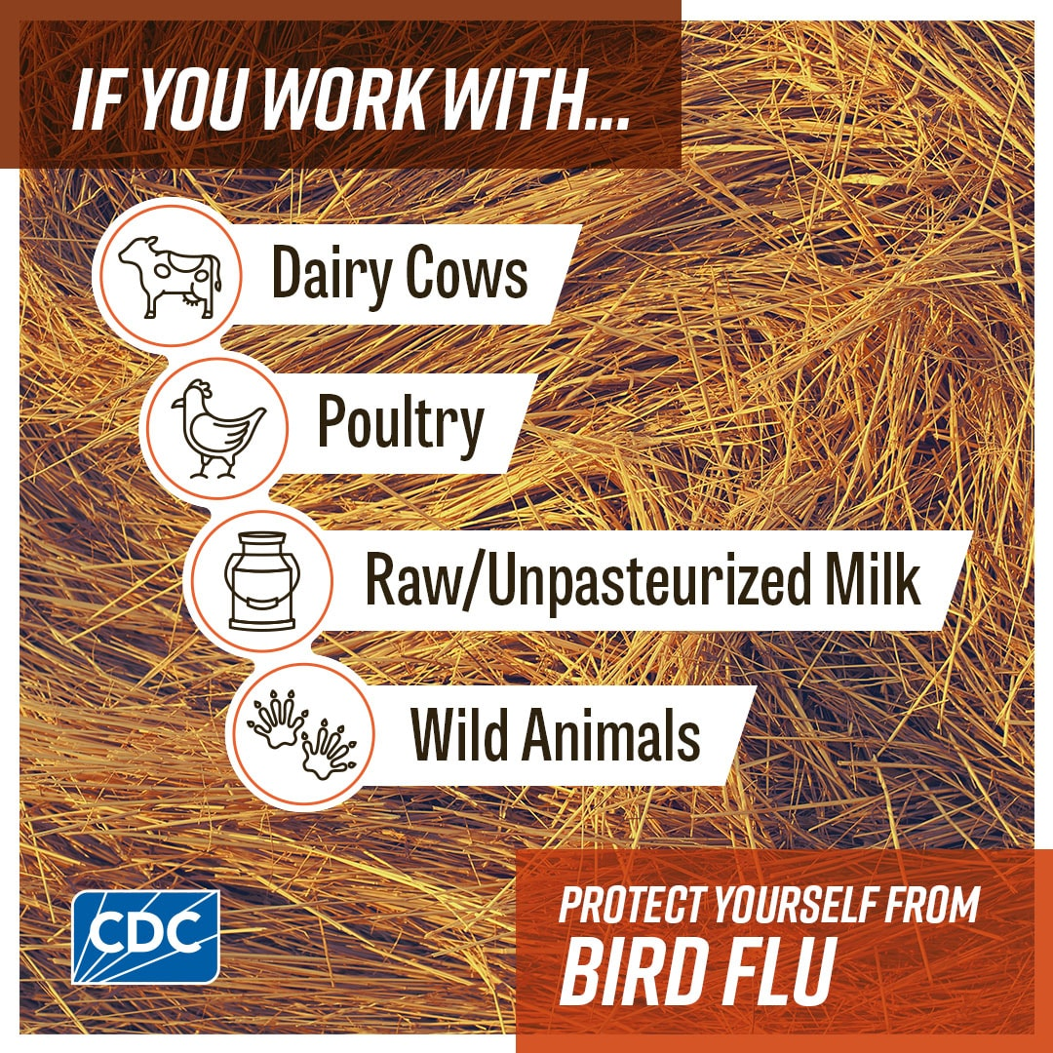
H5N1 Guidance for Farm Workers
Avoid unprotected contact with:
Sick birds, livestock, or other animals
Carcasses of birds, livestock, or other animals
Feces or litter
Raw milk
Surfaces and water (e.g., ponds, waterers, buckets, pans, troughs) that might be contaminated with animal excretions.

Slide 19
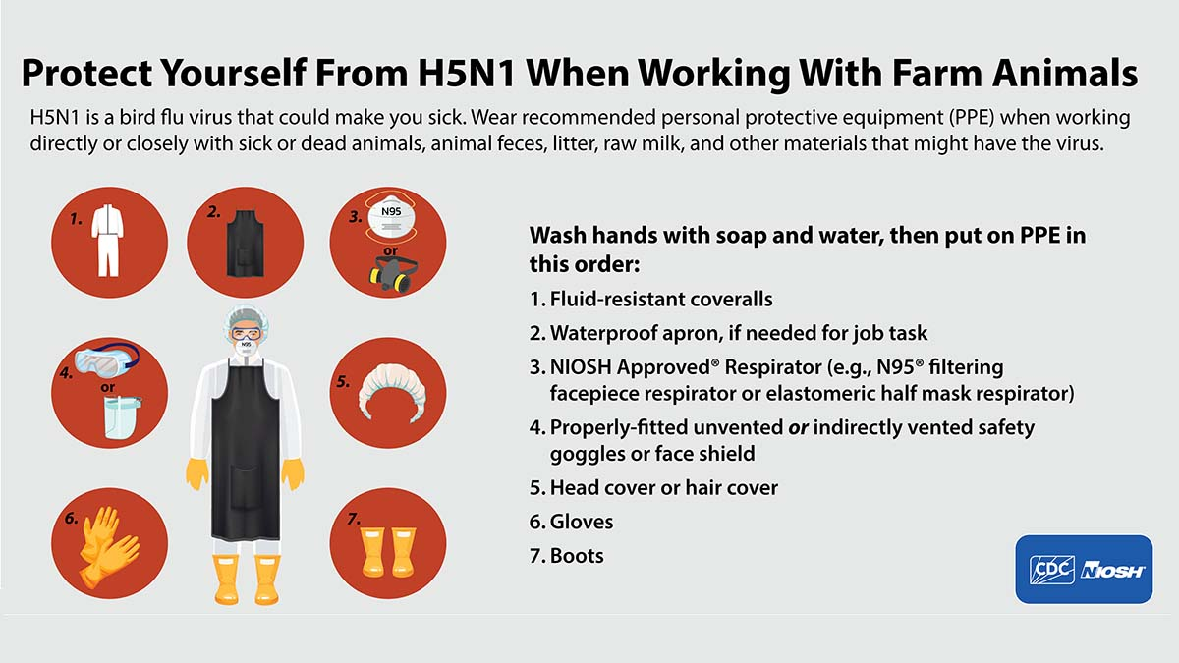

Slide 20
If H5N1 is Suspected
Isolate patient and follow infection control recommendations, including using personal protective equipment (PPE).
Initiate empiric antiviral treatment as soon as possible. Do not delay treatment while awaiting laboratory results.
Notify state and local health departments to arrange testing for influenza A (H5N1) virus.
Collect specimens to test for influenza A (H5N1) virus at the state health department.
If the exposed person has conjunctivitis, with or without respiratory symptoms, both a conjunctival swab and a nasopharyngeal swab

Slide 21
Lesson Learned in Michigan

Slide 22
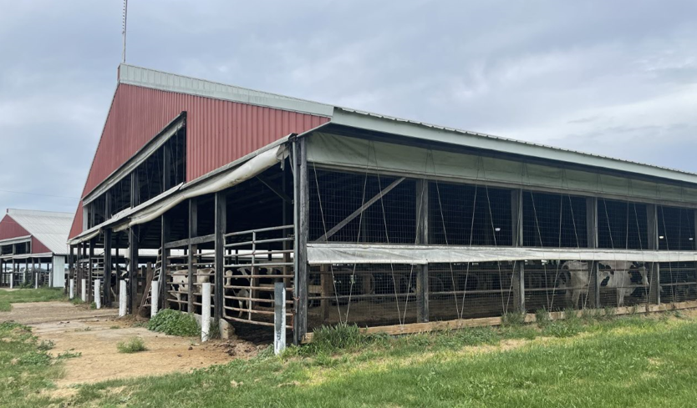
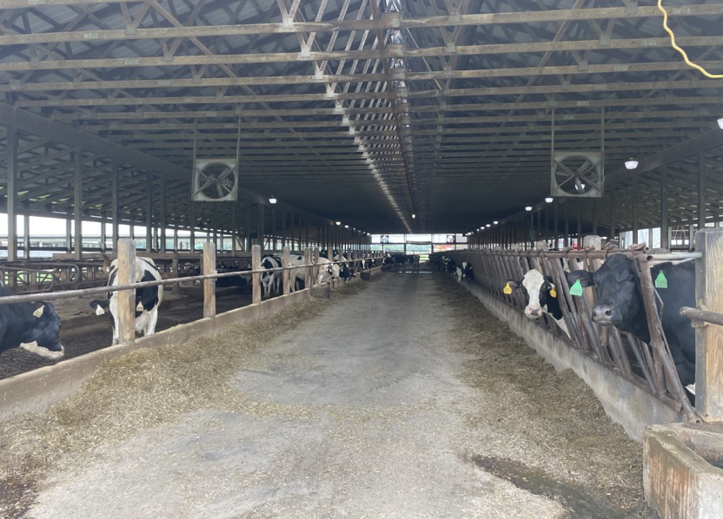
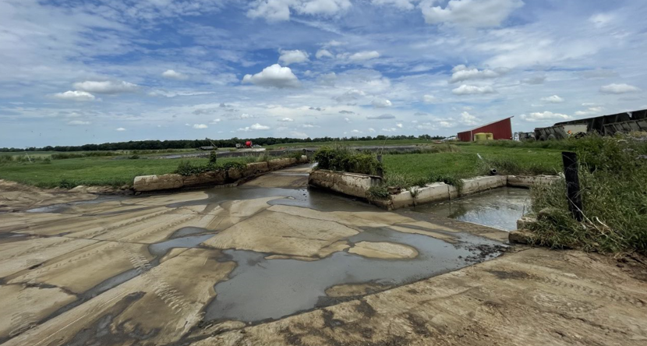

Slide 23
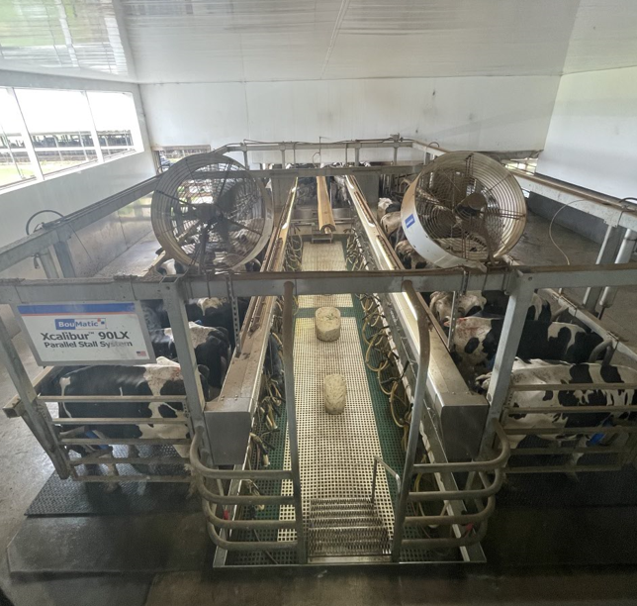
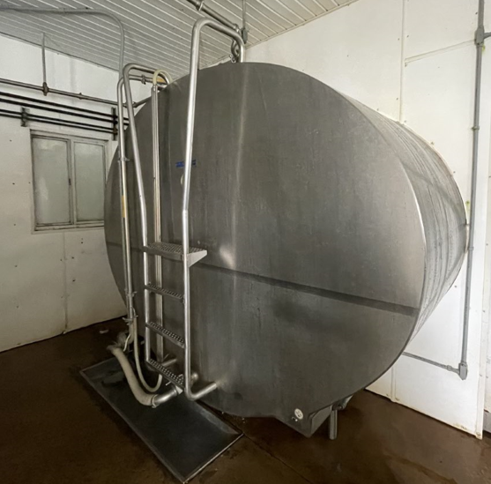
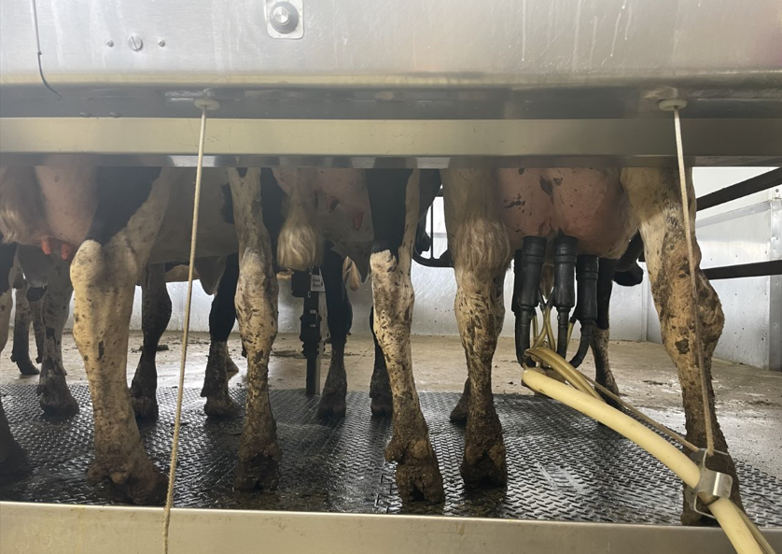

Slide 24
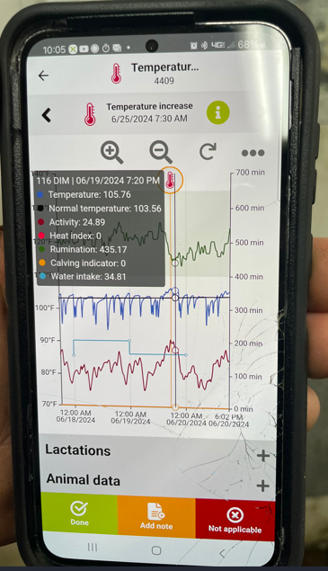
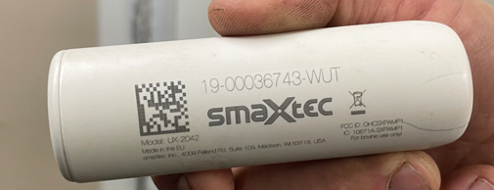

Slide 25
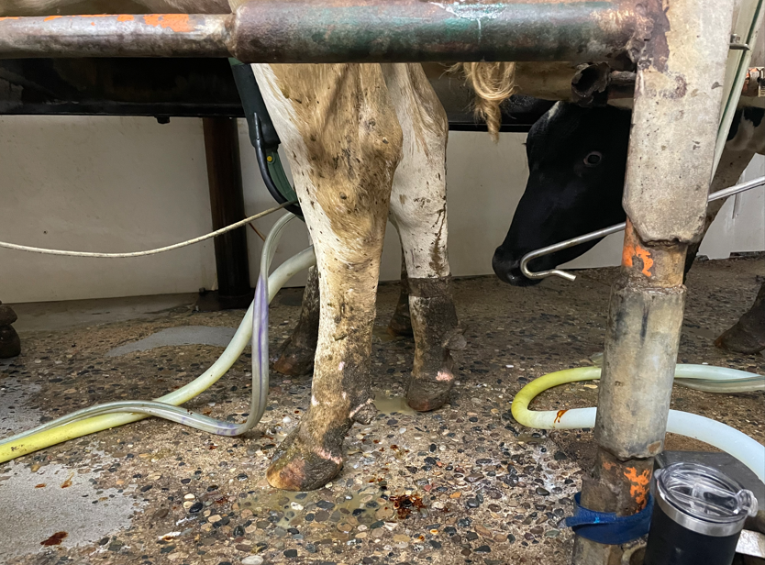
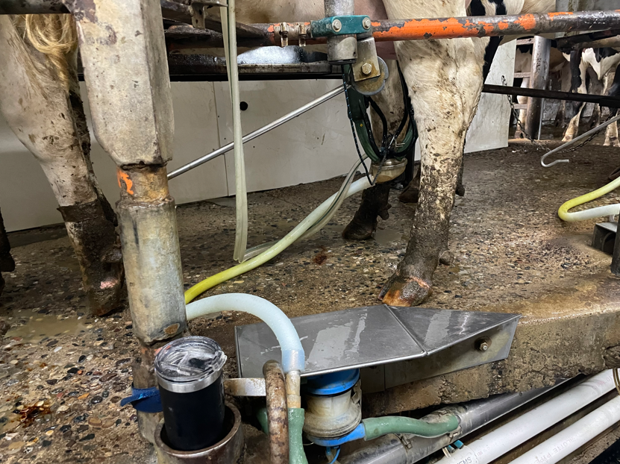

Slide 26
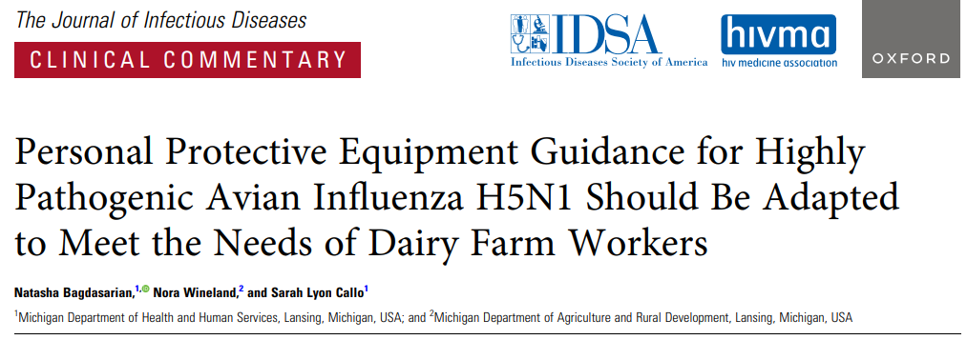
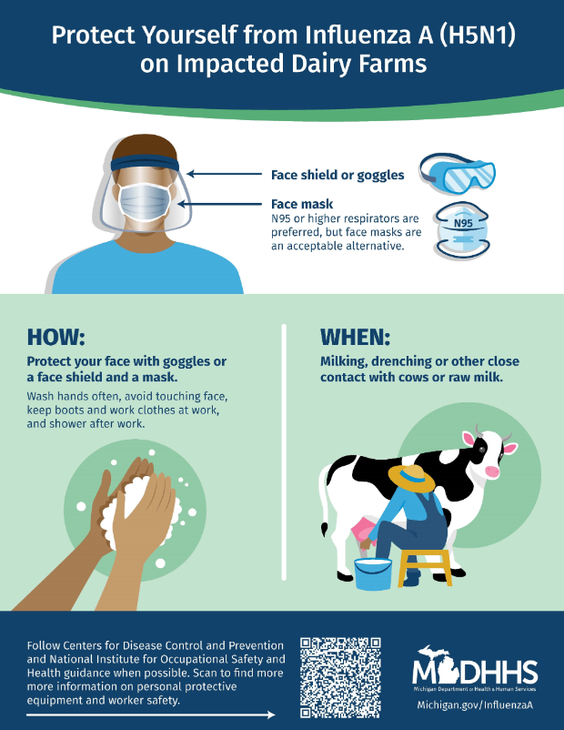

Slide 27
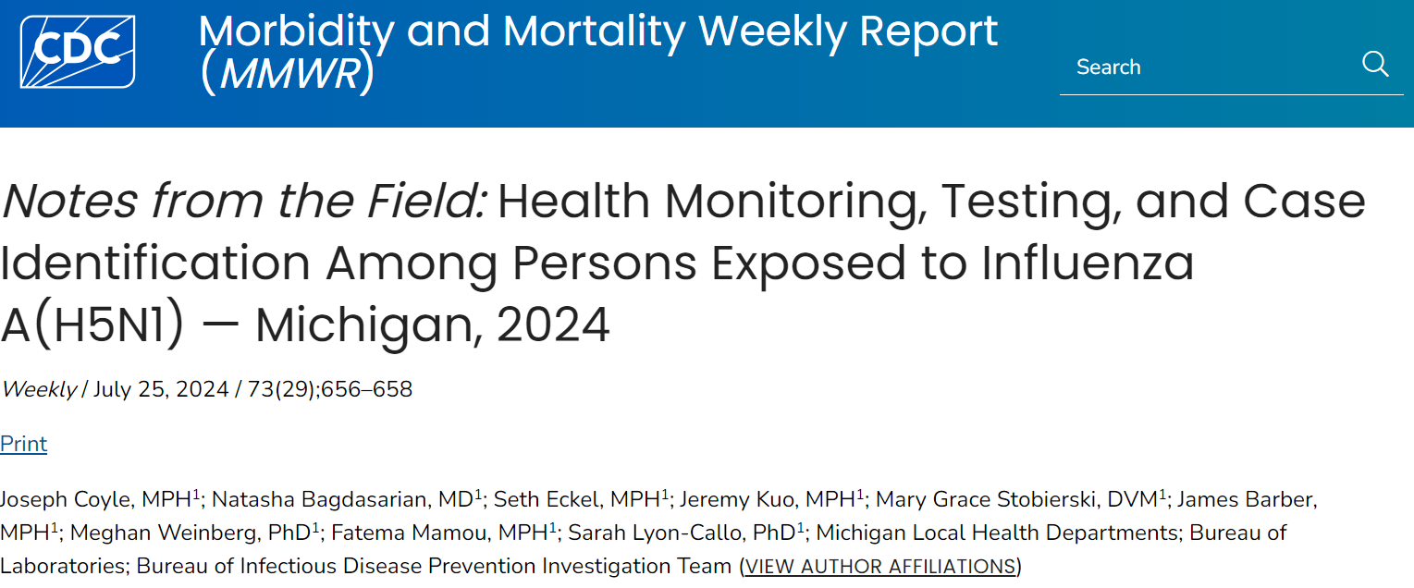
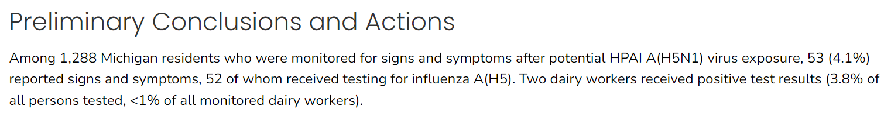

Slide 28
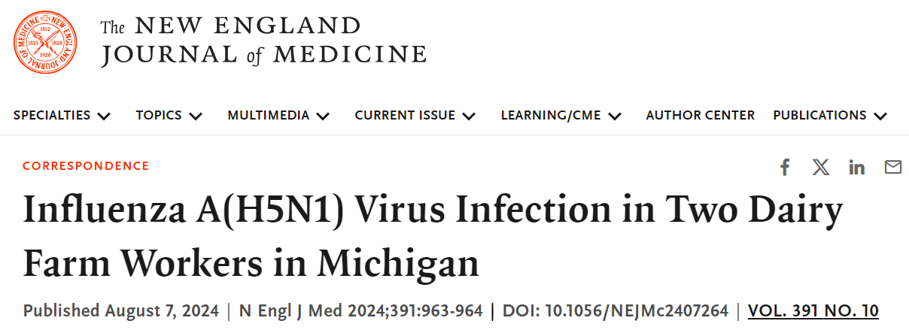
Dairy worker MI-A had discomfort in the right eye 1 day after milk had splashed in that eye while the worker was milking an ill cow.
The worker had not been using personal protective equipment.
Dairy worker MI-B, had onset of cough, shortness of breath, headache, sore throat, fatigue, nasal congestion, and rhinitis.
The worker presented to a local urgent care clinic.
No influenza virus testing was performed, and no treatment was prescribed.

Slide 29
MI Seroprevalence Study
Blood samples were collected in June 2024 from 35 people who work on dairies in Michigan with herds that were confirmed positive for HPAI A(H5N1) virus.
Most worked directly with sick cattle.
Fewer than half reported using masks or goggles.
None had neutralizing antibodies specific to influenza A(H5N1).
Many of the people had neutralizing antibodies to seasonal flu.
https://www.cdc.gov/bird-flu/spotlights/h5n1-response-07192024.html

Slide 30
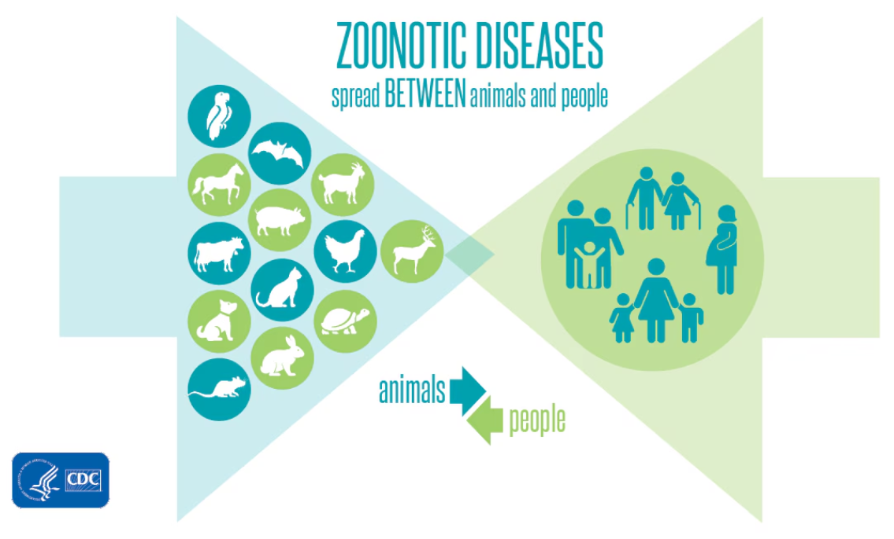
Environmental Health
Animal Health
Human Health
One Health

Slide 31

APIC-GL 2025 Open Board of Directors Positions!
If you are interested in joining the APIC Great Lakes board, we are currently accepting Willingness to Serve forms! There are five (5) positions open for 2025 (2024 election):
President Elect (One (1) year team)
Membership Secretary (Two (2) year term)
Nominating Committee (One (1) year term consisting of up to three (3) committee members)
Nominations due by Tuesday, October 15, 2024
An initial email was sent on 9/24 regarding election details and includes a Willingness to Serve form. Please ensure your email address is correct and current in your APIC account to ensure you are receiving Chapter emails.
Notes:
Chelsea Ludington speaking

