Slide 1

APIC GREAT LAKES
2026 VIRTUAL EDUCATION
APIC-GL Member Presentations
August 11, 2026

Slide 2

October 15, 2026
Kellogg Center
East Lansing
Check your inbox for the registration link.
- $85 for APIC-GL Members
- $110 for non-members
Attendees will receive 5 IPUs!
Bridging the Gap Between Expertise and Impact
Chaz Rhone, MPH, CIC, FAPIC
Fact, Fear, and Fiction: Navigating Vaccine Hesitancy
Terri Rebmann, PhD, RN, CIC, FAPIC
From Notification to Clean Up: Improving Water Intrusion Mitigation Efforts through Application of an Emergency Management Framework
Alex Hamer, MPH, CIC, CPHQ
Sarah Prascius, MPH, CIC
Healthcare Policy Panel
Carrie Linderoth, J.D.
Kelsey Ostergren, MPH, CIC
Viviana Saez, BSN, RN, CIC
Christina Harrington, MPH
Notes:
https://linkprotect.cudasvc.com/url?a=https%3a%2f%2fgivebutter.com%2f2026APIC-GL&c=E,1,6XkYSYMIIt_9MyAWNgbKz0gu94T2nMVZQHBjnXLqDp18nfcBN-H6mQ-si_4WmSMMzll14iWa5VxUOXX7_bJbg01DUCWlJOatjU6mis_XGYM,&typo=1

Slide 3
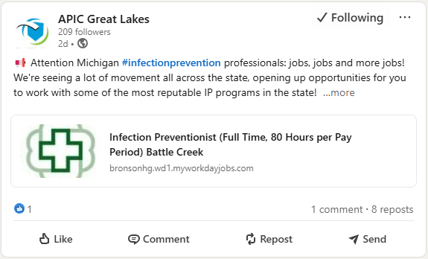
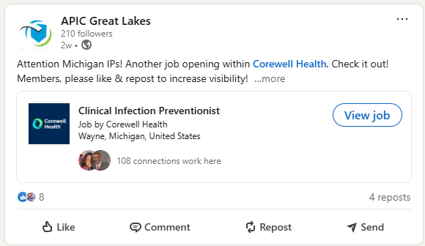
Job Alert!
The APIC Great Lakes Jobs board has moved to the APIC Great Lakes LinkedIn page.
Send job openings you want posted to APICgreatlakes@gmail.com
Notes:
https://www.linkedin.com/company/apic-great-lakes/posts/?feedView=all

Slide 4
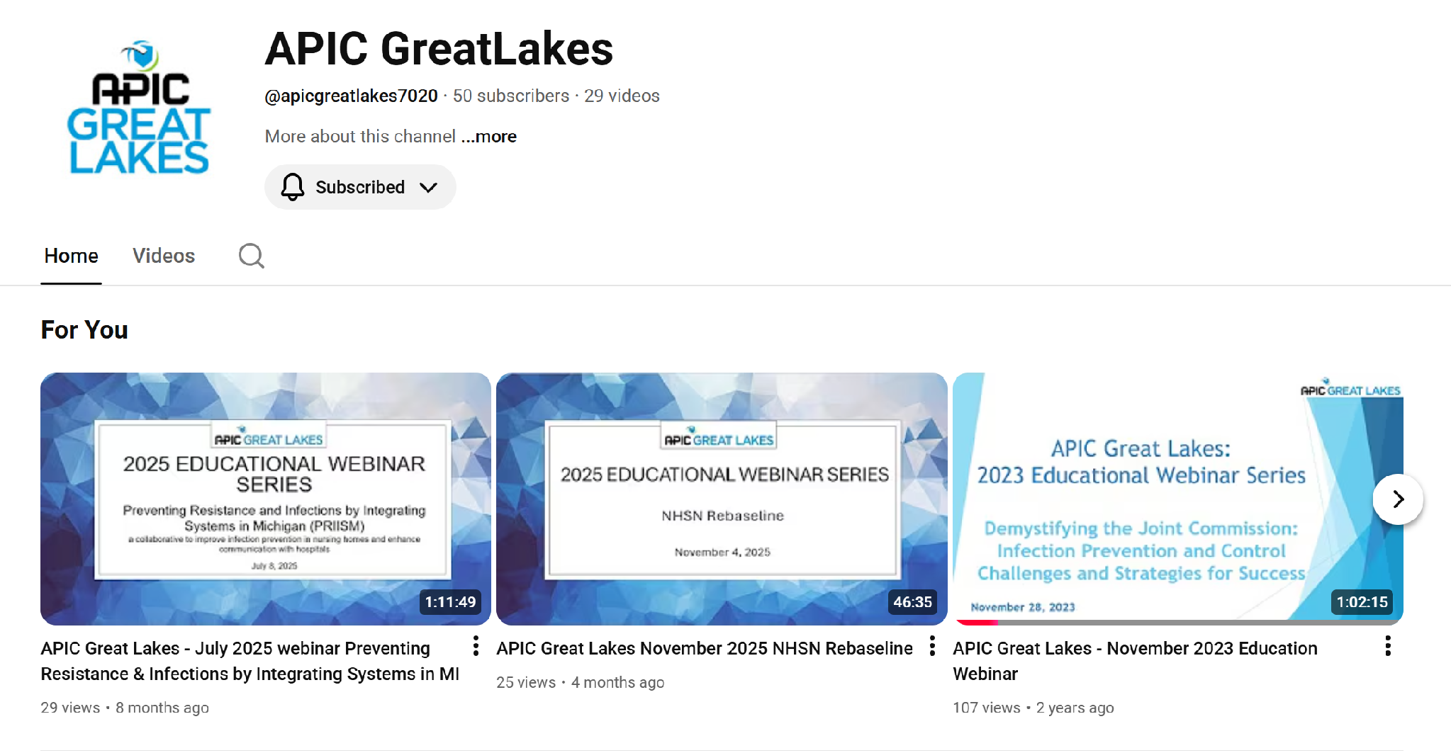
Catch up on missed content any time!
Monthly educational webinars are posted on our YouTube Channel
Notes:
https://www.youtube.com/@apicgreatlakes7020

Slide 5
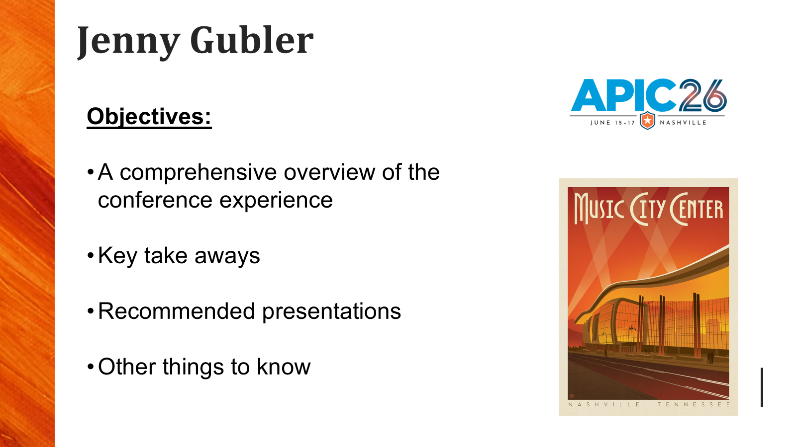
Jenny Gubler

Slide 6
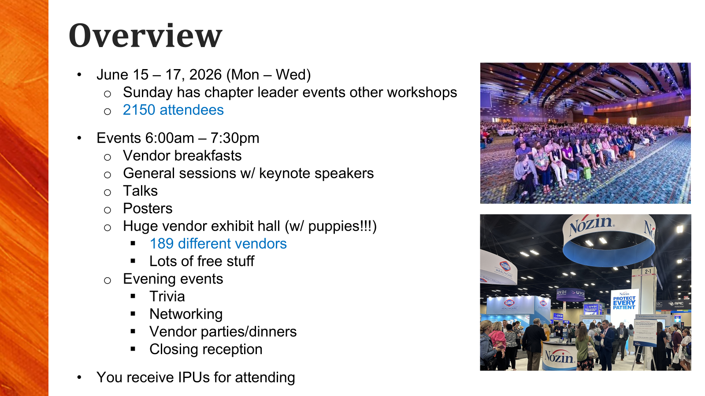
Jenny Gubler

Slide 7

Jenny Gubler

Slide 8
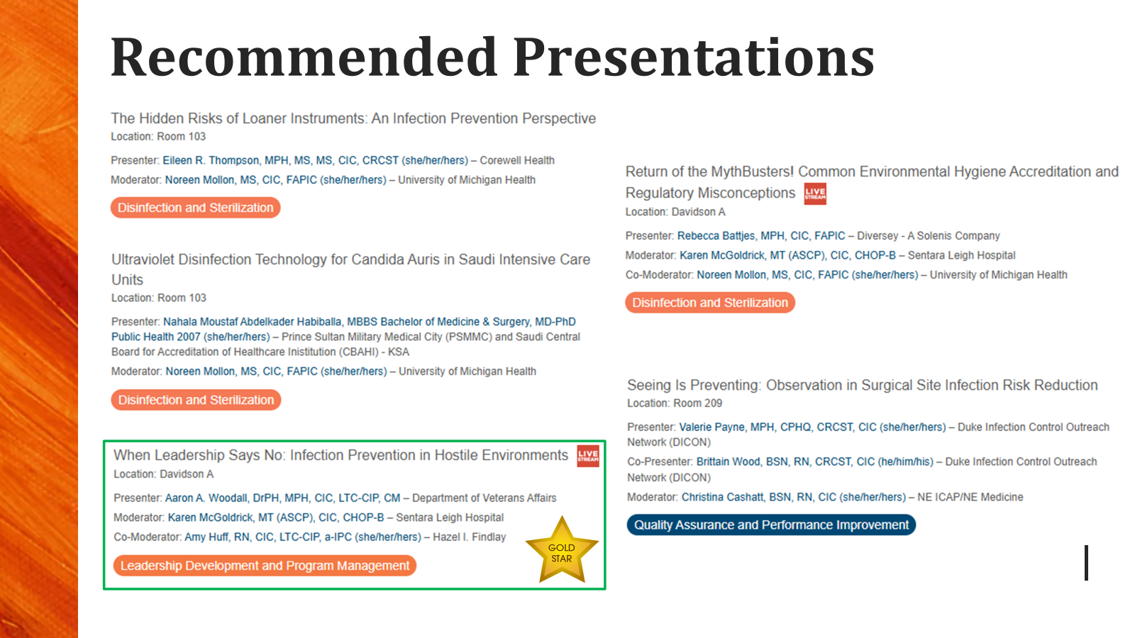
Jenny Gubler

Slide 9
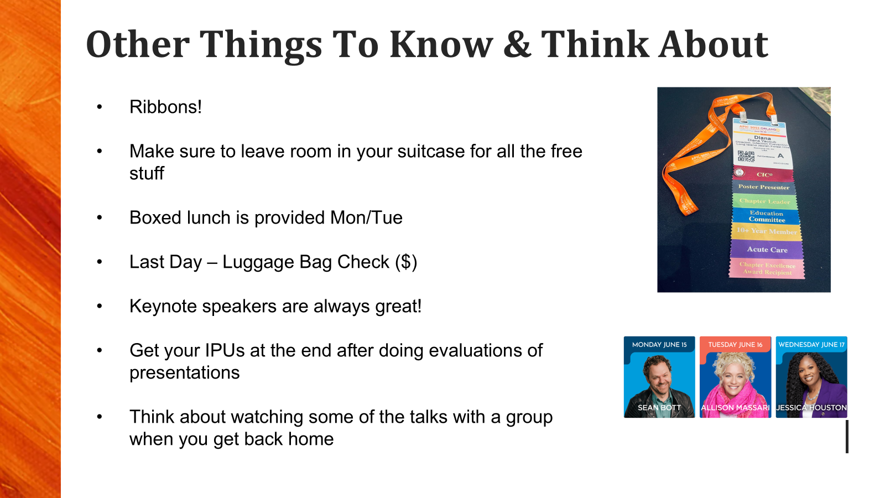
Jenny Gubler

Slide 10
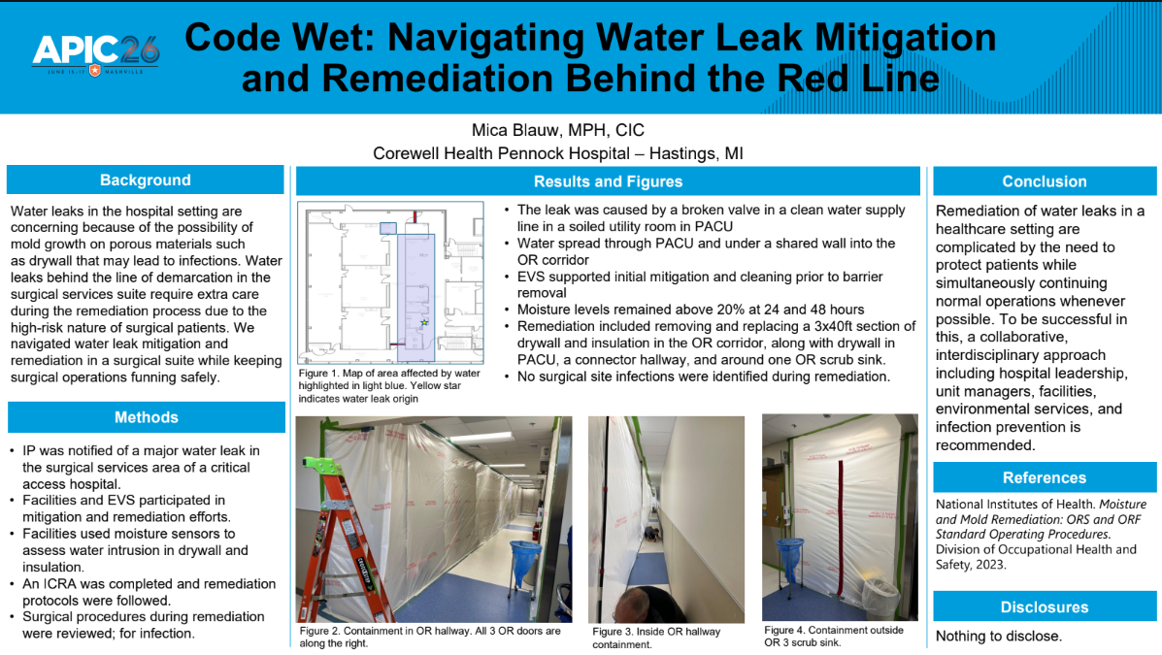

Slide 11
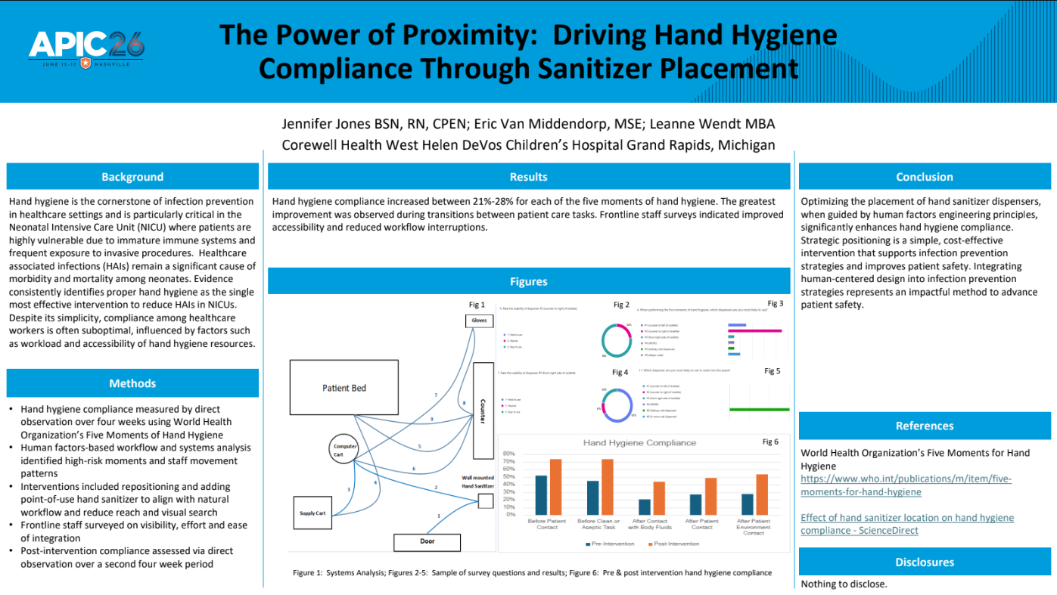

Slide 12
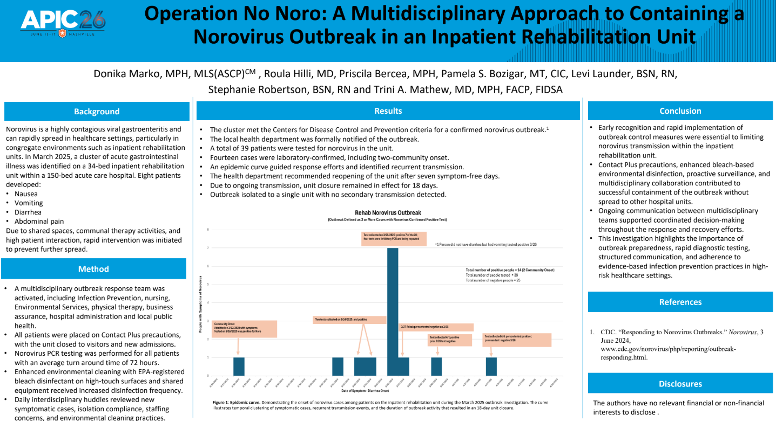

Slide 13
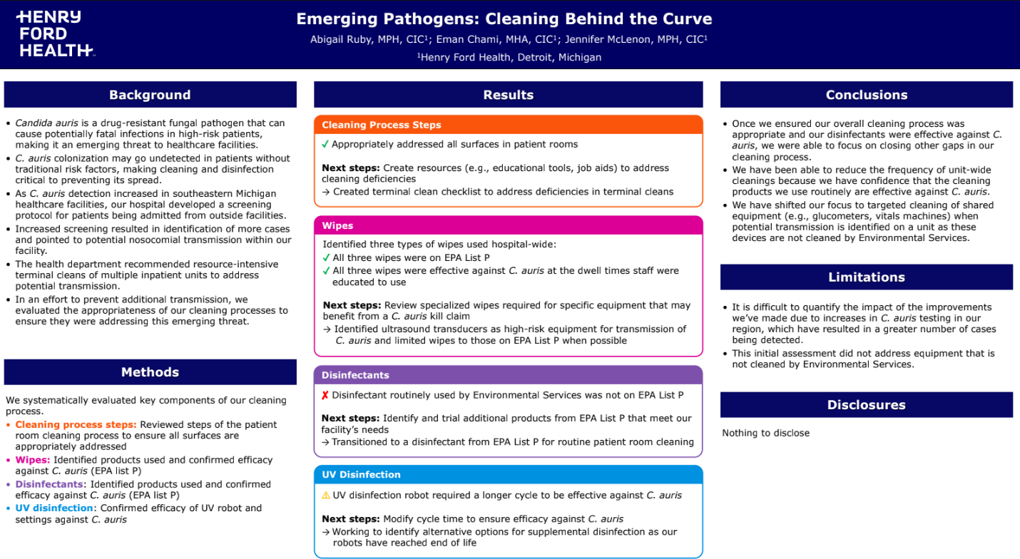

Slide 14
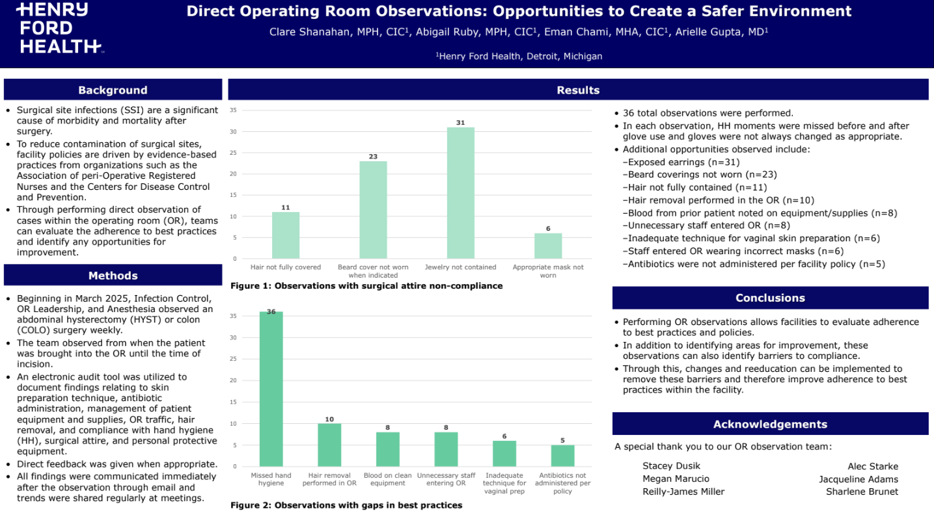

Slide 15
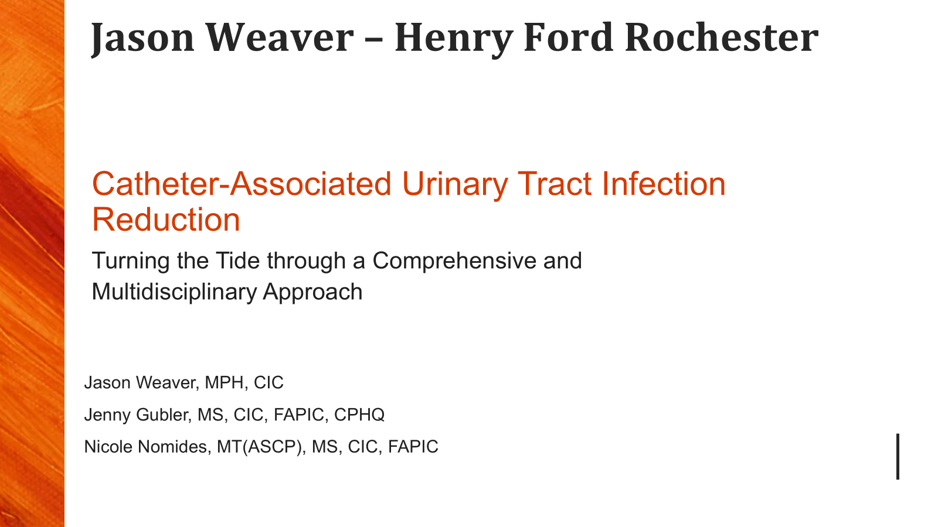
Jason Weaver

Slide 16
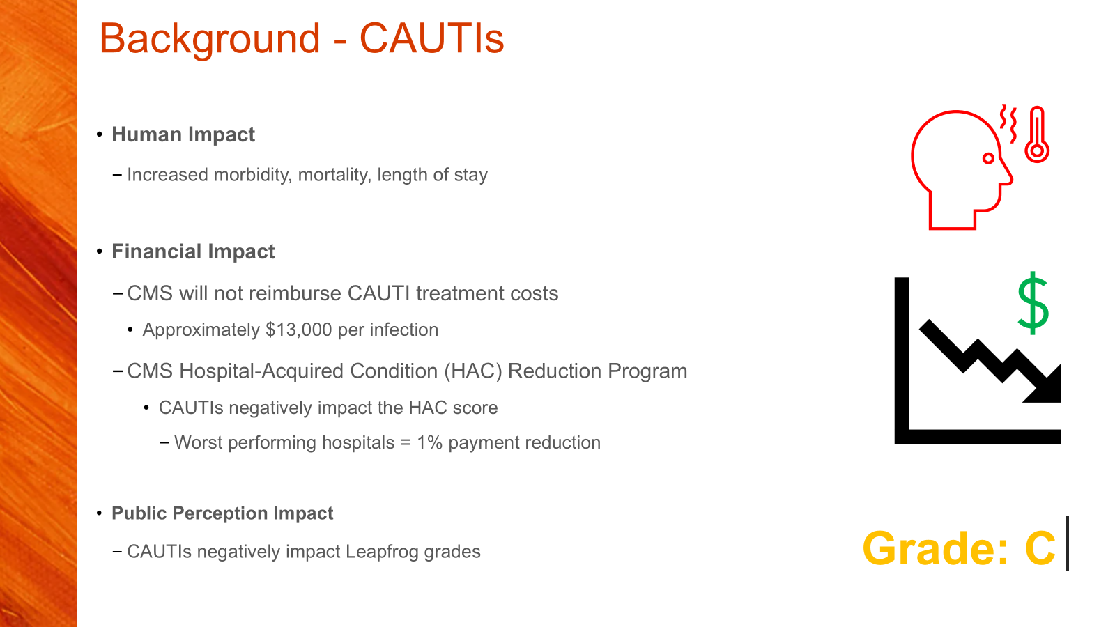
Jason Weaver

Slide 17
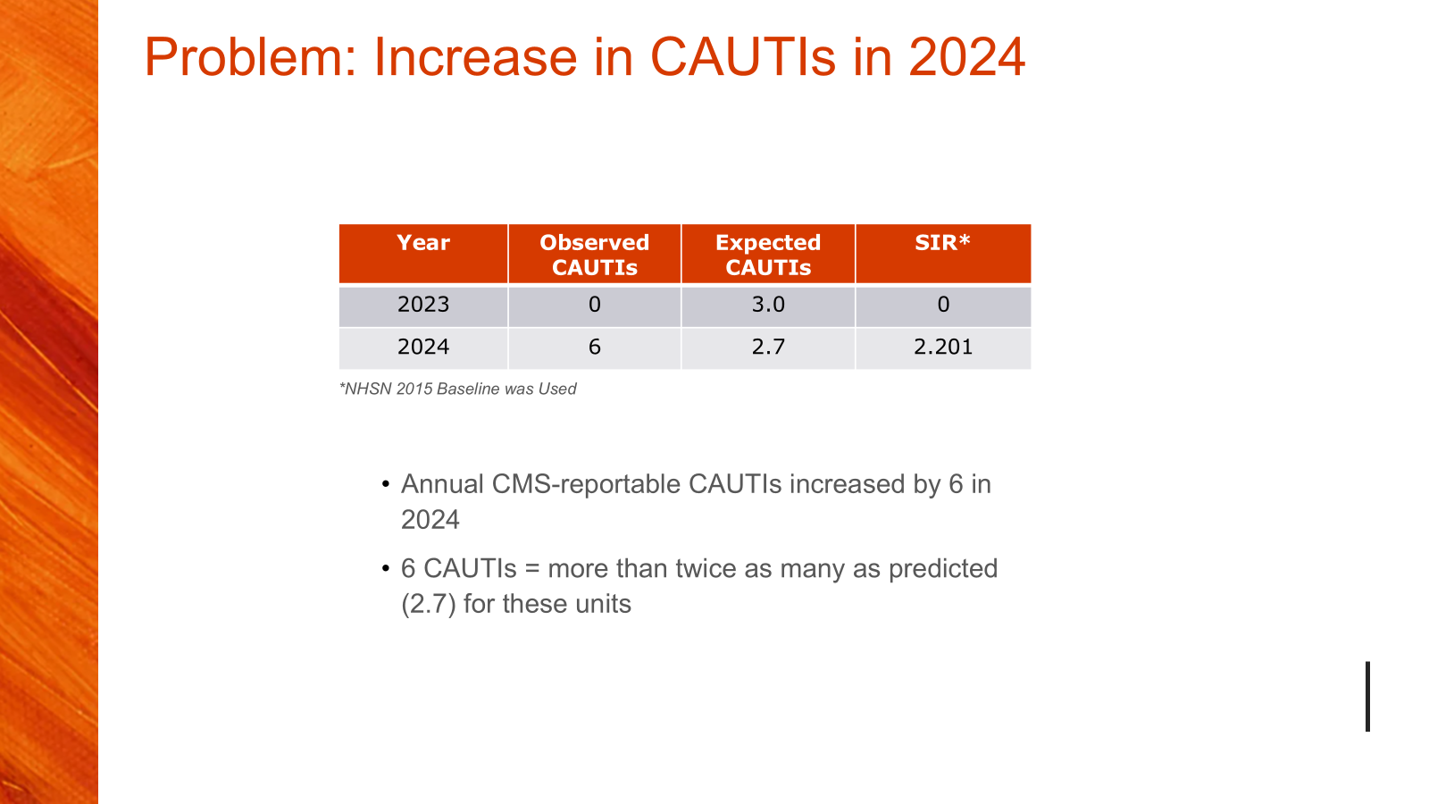
Jason Weaver

Slide 18
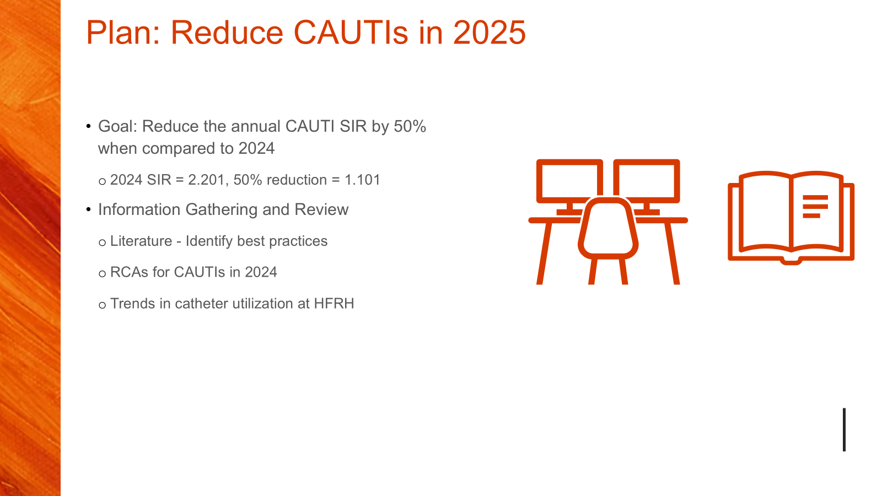
Jason Weaver

Slide 19
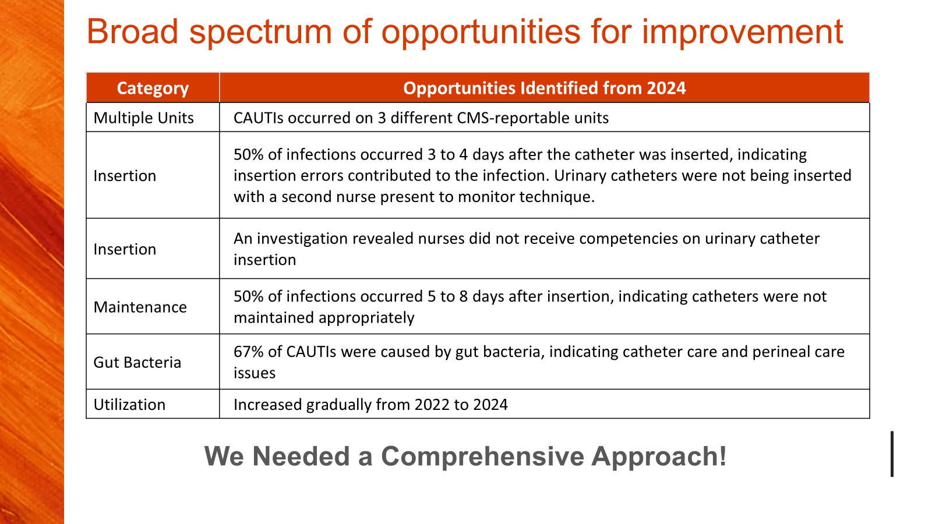
Jason Weaver

Slide 20
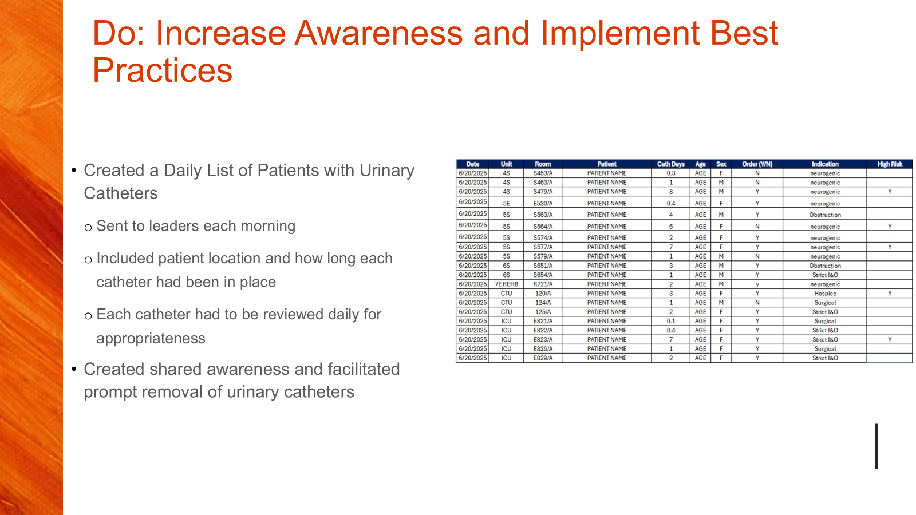
Jason Weaver

Slide 21
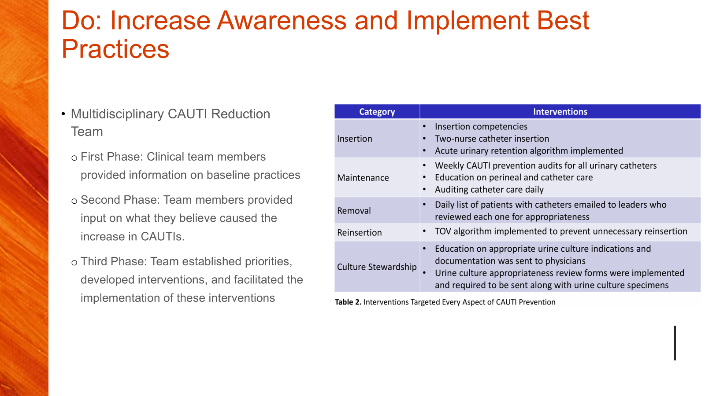
Jason Weaver

Slide 22
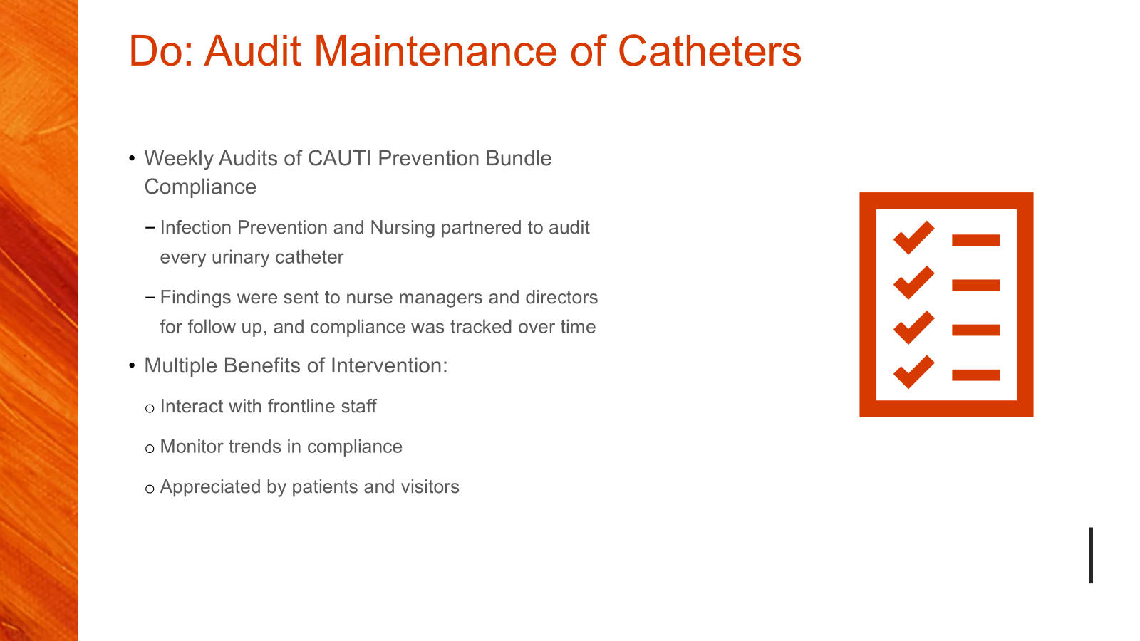
Brianne Bachman

Slide 23
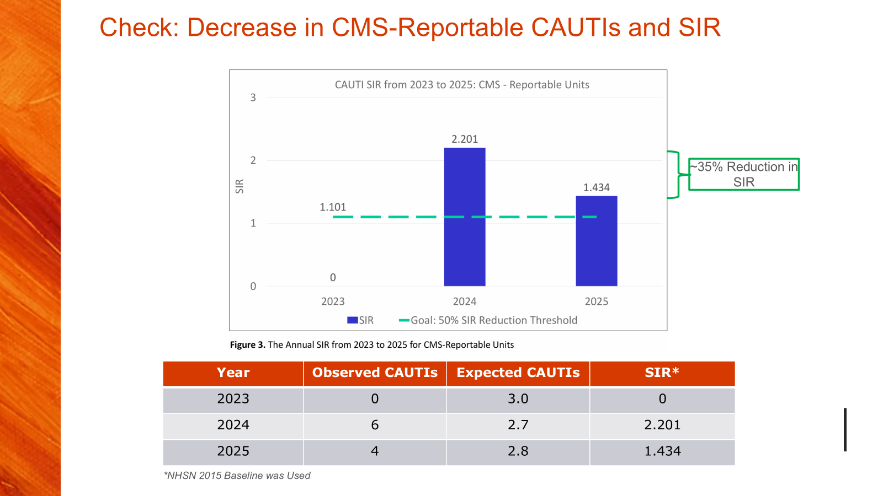
Brianne Bachman

Slide 24
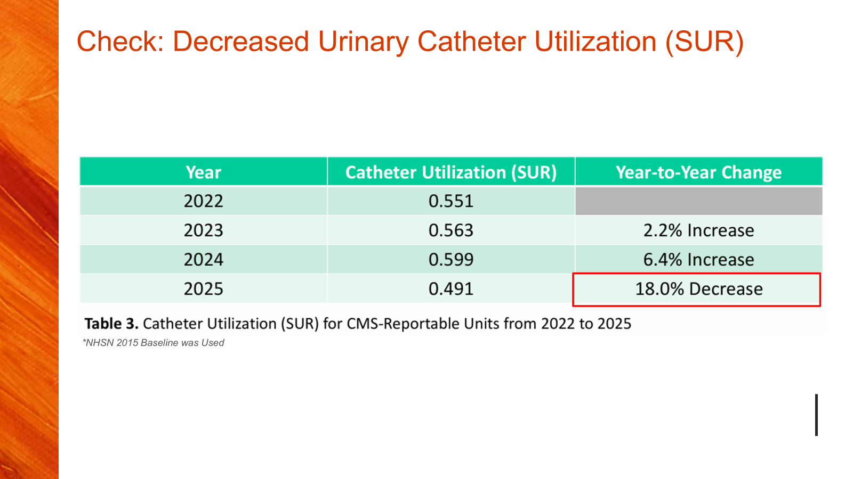
Brianne Bachman

Slide 25
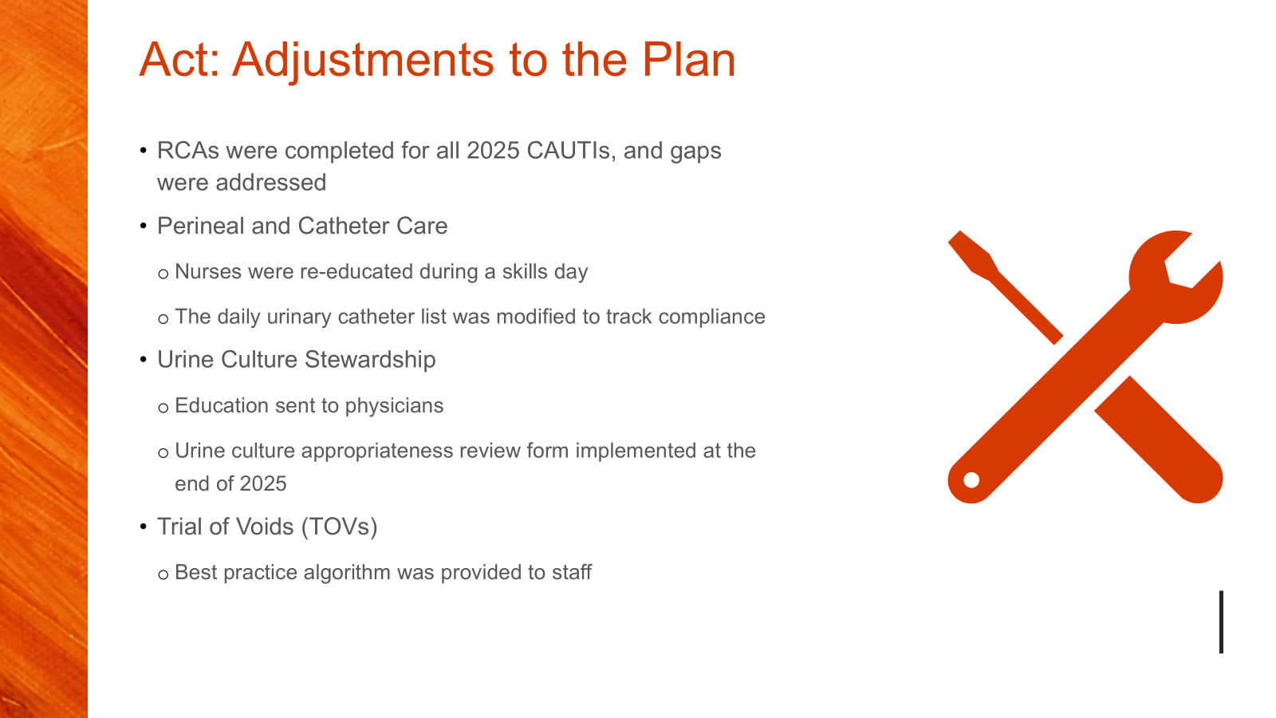
Brianne Bachman

Slide 26
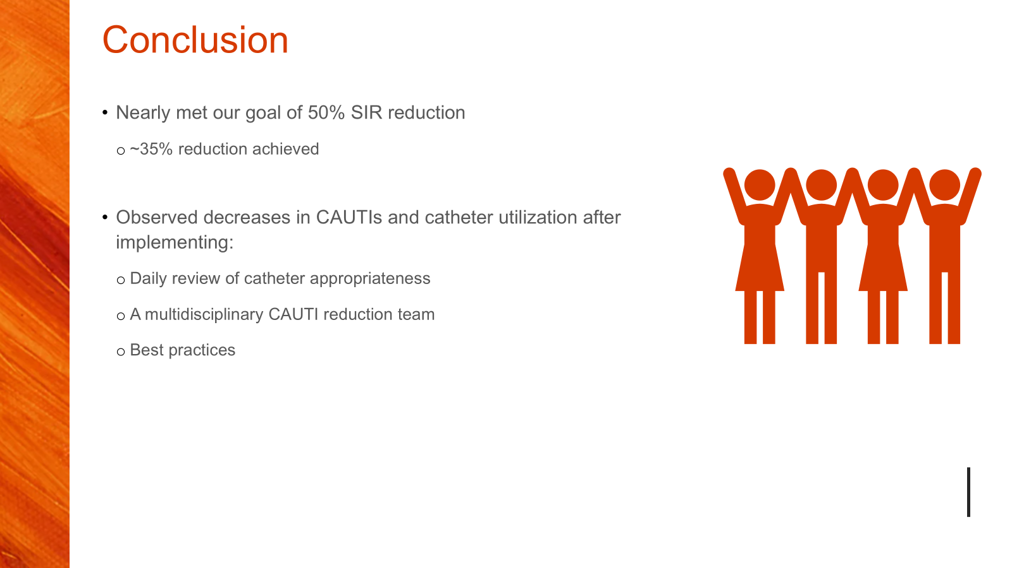
Brianne Bachman

Slide 27
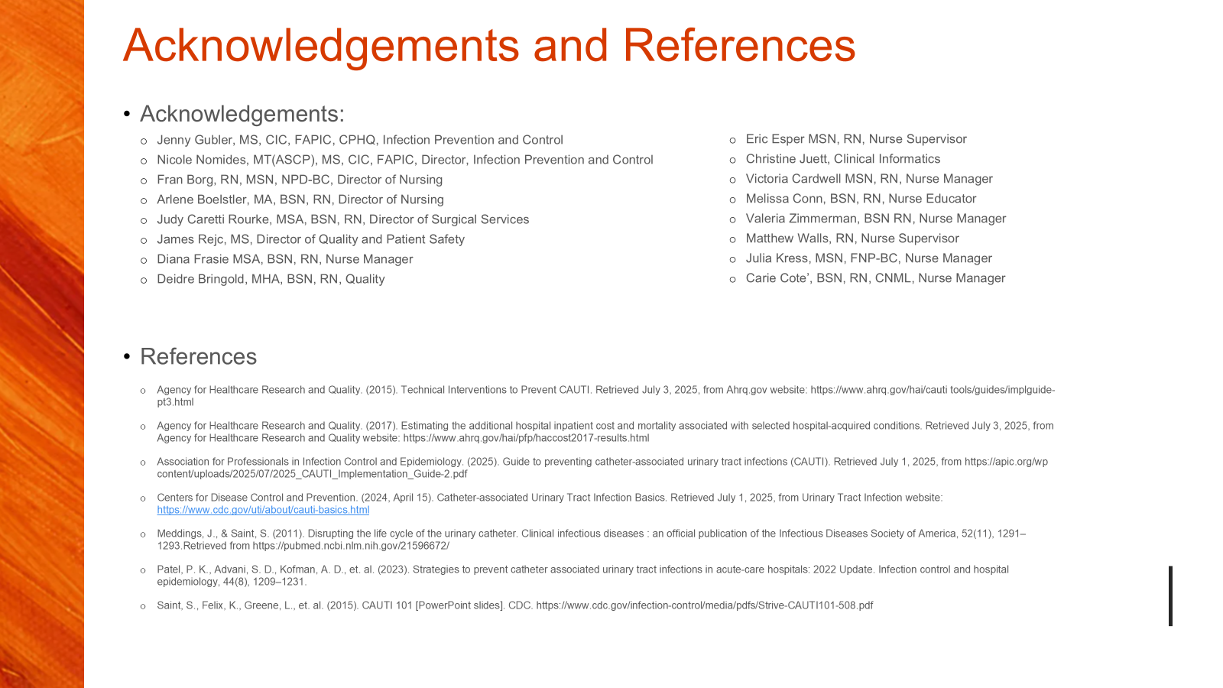
Brianne Bachman

Slide 28

Brianne Bachman, MPH, CIC, Jennifer Jones BSN, RN, CPEN, Jessica McClusky DNP, RN, CPN, CIC, and Mallory Davis, PhD, MS, CIC
Corewell Health West Grand Rapids, Michigan
Simulation-based education has emerged as a transformative tool in healthcare, bridging the gap between theoretical knowledge and clinical practice.
In the realm of infection prevention, simulation offers a controlled, risk-free environment to reinforce essential protocols, build competency, and identify system level vulnerabilities before harm occurs.
•Baseline needs assessment conducted via surveys and audits
•Simulation scenarios developed to reflect real-world challenges
•Data collected pre- and post-simulation assessing perceived confidence and adherence to infection prevention practices such as compliance with hand hygiene and personal protective equipment (PPE)
Background
Methods

Slide 29
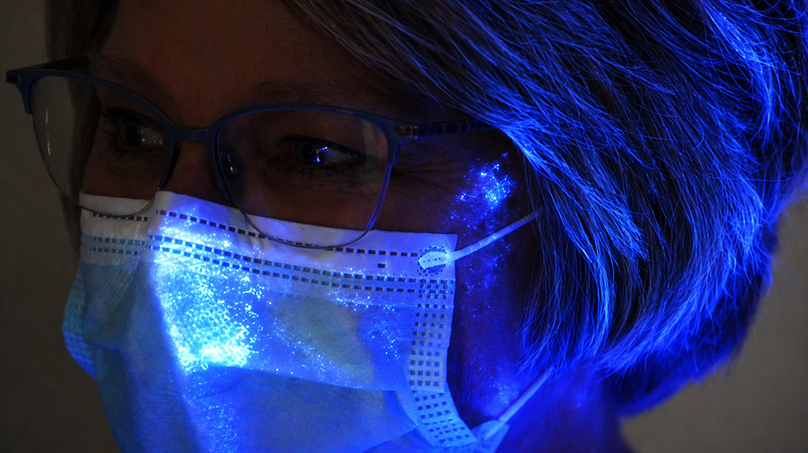
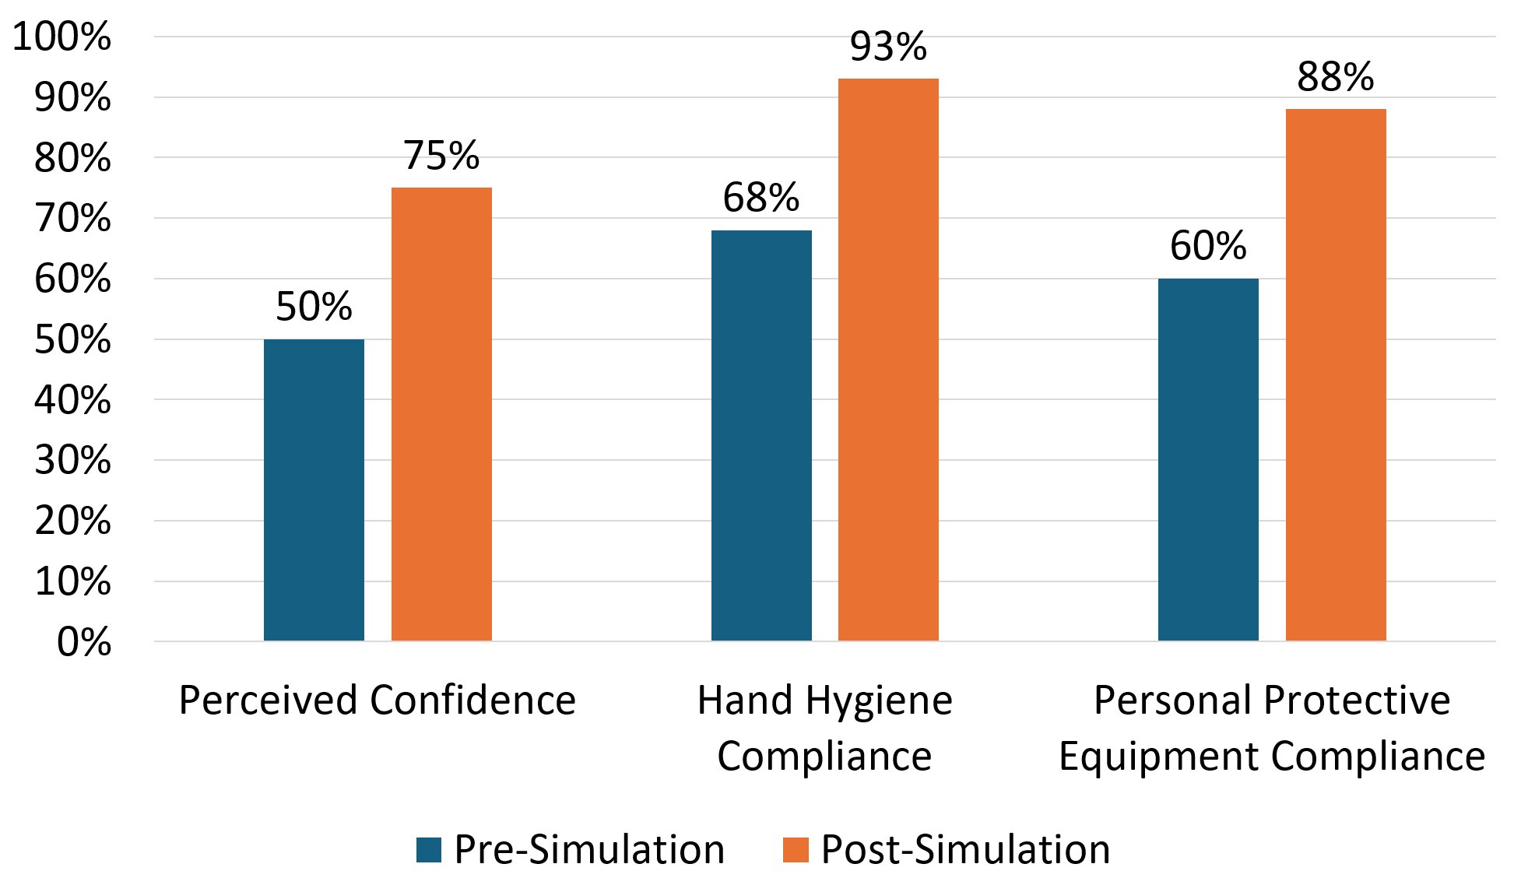
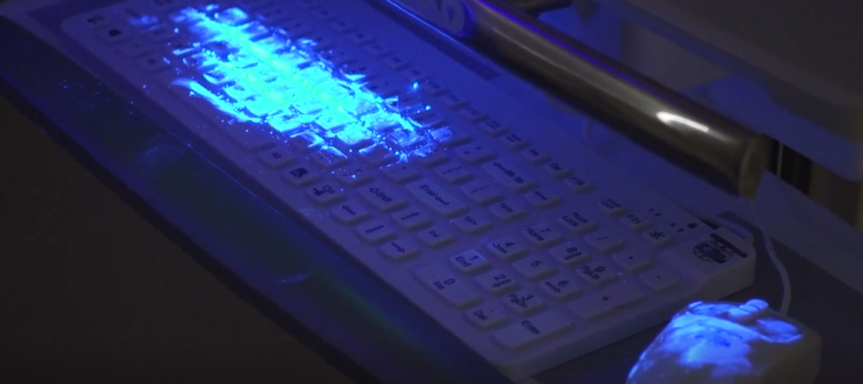
Results
Implementation of simulation-based infection prevention training yielded measurable improvements in both knowledge and practice across participating units. Post-simulation surveys showed an increase in perceived confidence from 50% to 75%. Audits of clinical practice conducted before and after simulation sessions revealed noted improvements in both hand hygiene compliance and PPE adherence. Hand hygiene compliance increased from 68% to 93%, and correct PPE donning and doffing improved from 60% to 88%. Debriefs indicated simulation sessions were a psychologically safe space to practice, make mistakes, and ask questions.
Images: Points of contamination and potential transmission demonstrated by glow germ that occurred during the simulation.
Figure: Pre- and post simulation confidence and compliance data.

Slide 30
Conclusion
Integrating infection prevention into simulation ensures that foundational practices are not only taught but deeply embedded in clinical culture, ultimately reducing healthcare associated infections and improving patient outcomes.
Infection preventionists across various healthcare settings play a vital role in simulation-based education through scenario development, debriefing, and translating insights into sustainable practice change.
Bienstock, Jared MS, CCP, CES-A∗; Heuer, Albert PhD, MBA, RRT. A review on the evolution of simulation-based training to help build a safer future. Medicine 101(25):p e29503, June 24, 2022. | DOI: 10.1097/MD.0000000000029503
Elendu C, Amaechi DC, Okatta AU, Amaechi EC, Elendu TC, Ezeh CP, Elendu ID. The impact of simulation-based training in medical education: A review. Medicine (Baltimore). 2024 Jul 5;103(27):e38813. doi: 10.1097/MD.0000000000038813. PMID: 38968472; PMCID: PMC11224887.
Konia M, Yao A. Simulation-a new educational paradigm? J Biomed Res. 2013 Mar;27(2):75-80. doi: 10.7555/JBR.27.20120107. Epub 2013 Feb 10. PMID: 23554798; PMCID: PMC3602865.
References

Slide 31
Julie Engels
julie.engels@corewellhealth.org
Kelsey Ostergren
kostergren@mha.org
Eileen Thompson eileen.thompson@corewellhealth.org
APIC GL – EDUCATION COMMITTEE

