Slide 1
Midlines from the Infection Prevention
Side of the Table
Michelle DeVries MPH, CIC, VA-BC
Senior Infection Control Officer
Methodist Hospitals
Gary IN

Slide 2
Disclosures
Michelle DeVries is sponsored by Access Scientific
Also on Speaker’s Bureau with: Becton Dickinson, Eloquest and Ethicon
IIS grant funding: Johnson and Johnson
AVA involvement: Project Infuse (PIV Task Force); Vascular Access Specialty Task Force
Griffith University: Adjunct Research Fellow (AVATAR)

Slide 3
Objectives
Describe the current evidence regarding the use of midlines as part of a CLABSI reduction strategy
Collaborate with Infection Prevention to determine mutually agreeable objectives for a safe and monitored framework for a robust midline program and potential for extended dwell peripheral catheters
Review recent developments about peripheral vascular access complications

Slide 4
Here’s what I’m not going to talk about
What you can infuse
What you should not infuse
This is a presentation focused on infection prevention strategies in midlines…which is a separate conversation

Slide 5
Opening questions…
How is your performance on Hospital Compare? For CLABSIs? For MRSA Lab ID events? For C. diff?
How is your performance on state based public reporting?
How is central line utilization?
  Specific units or types of units with high utilization?
  Is there an understanding of “why” the central lines are used? Is there a policy?
  What percent of your PICCs are placed for difficult access?
  How many “drive-by PICCs”?

Slide 6
More questions
For Vascular Access teams…
  Are there other infections that go unreported (opinion?)
  Do you have ongoing dialogue with Infection Control about the above measures?
  Are you invovled in developing and managing the action plans around these measures?
  Are you part of the Value Analysis teams? Shared Governance councils? How is your expertise communicated to the organization?

Slide 7
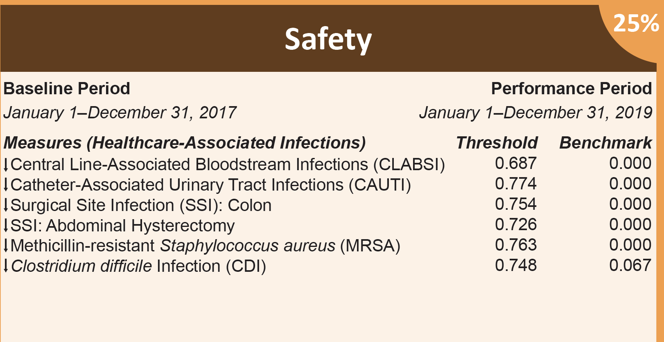
Value based purchasing
It’s more than just the ICU that “matters” now
/
Notes:
777

Slide 8
The message to
Infection Preventionists
The internal and external pressure to REPORT zero has literally changed how surveillance numbers are collected and used
We need to ensure that emphasis shifts back to truly getting to zero…rather than simply reporting zero
Partnering with vascular access for their expertise is crucial for understanding the full spectrum of considerations beyond the more traditional infection control strategies.

Slide 9
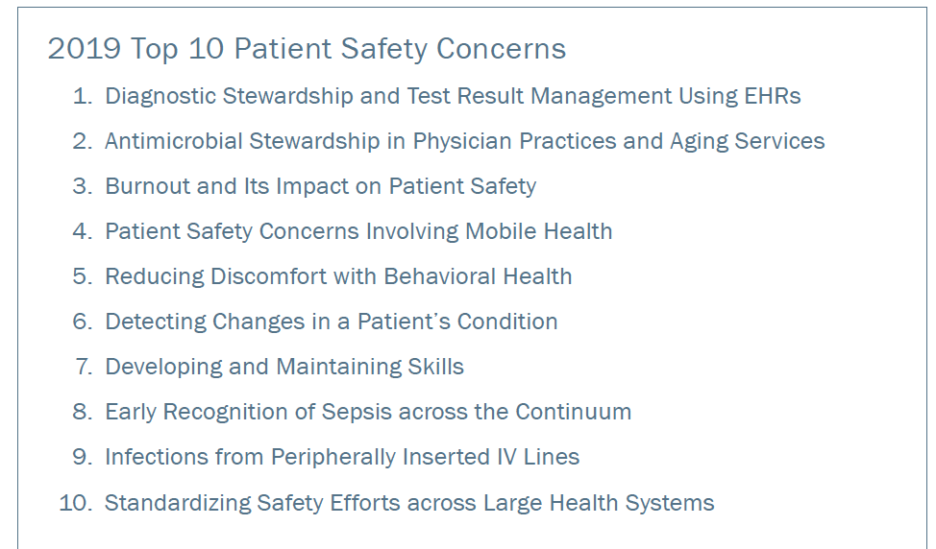
DO YOU Know…
ECRI has included PIV bloodstream infections as one of the Top 10 Patient Safety Risks for 2019?

Slide 10
Do you know…
CDC is considering expanding surveillance to include ALL hospital onset bacteremias?
CLABSI would be a subset of this protocol
Creating a framework where every bloodstream infection is evaluated can help raise awareness about current under evaluated risks
Public comment is open until April 15

Slide 11
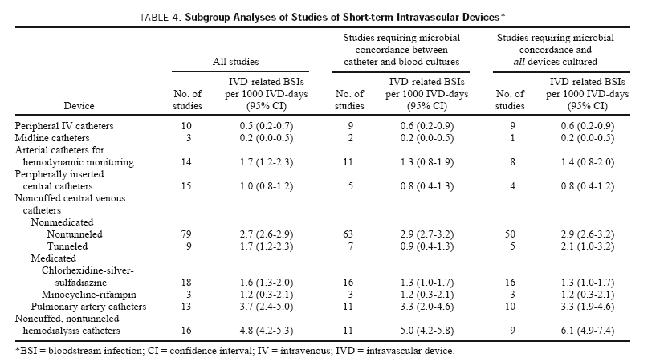
Maki, D. G., et al. (2006). "The risk of bloodstream infection in adults with different intravascular devices: a systematic review of 200 published prospective studies." Mayo Clin Proc 81(9): 1159-1171.

Slide 12
Establishing an Effective Midline Program
Defining the goals and targeted patient population:
  Decrease central lines and provide access for difficult access patients
Hospital 1 – 58% decrease in PICC insertions
  78% reduction in CLABSI
  0 midline infections
Hospital 2 – 0 CLABSIs and 0 midline infections
No midline associated bloodstream infections reported from either facility
Moureau N, Sigl G, Hill M. How to Establish an Effective Midline Program: A Case Study of 2 Hospitals. JAVA 2015. 20(3): 179-188

Slide 13
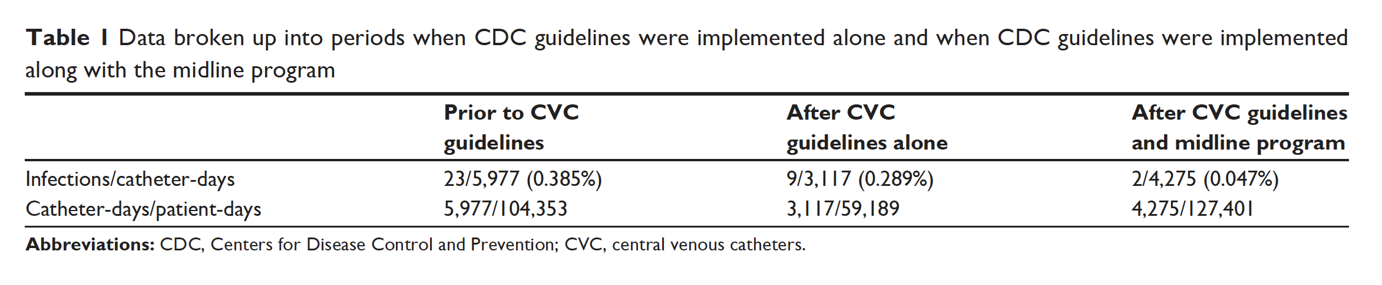
Midlines: CLABSI anD cost reduction in a community hospital
Objective: To evaluate whether the institution of a midline program for vascular access at a community hospital can reduce the number of central line catheter-days and the associated CLABSI rate, incidence, and cost.
Conclusion: Midlines can decrease the overall incidence of CLABSIs in a community hospital after a midline program is initiated.
It saves the cost in a number of ways:
1. Inserted by a nurse rather than a physician.
2. No post-insertion X-ray needed to confirm position.
3. Decreases the incidence of CLABSI and the associated costs to the hospital.
4. Patients who require to be discharged with IV medications can go home or to the nursing home with a midline.
5. No complications such as bleeding, pneumothorax, or cardiac arrhythmias.
6. The chance of getting a deep vein thrombosis is <2% as opposed to 1%–38.5% with a PICC line.
Pathak, R., Gangina, S., Jairam, F., & Hinton, K. (2018). A vascular access and midlines program can decrease hospital-acquired central line-associated bloodstream infections and cost to a community-based hospital. Ther Clin Risk Manag, 14, 1453-1456. doi:10.2147/TCRM.S171748

Slide 14
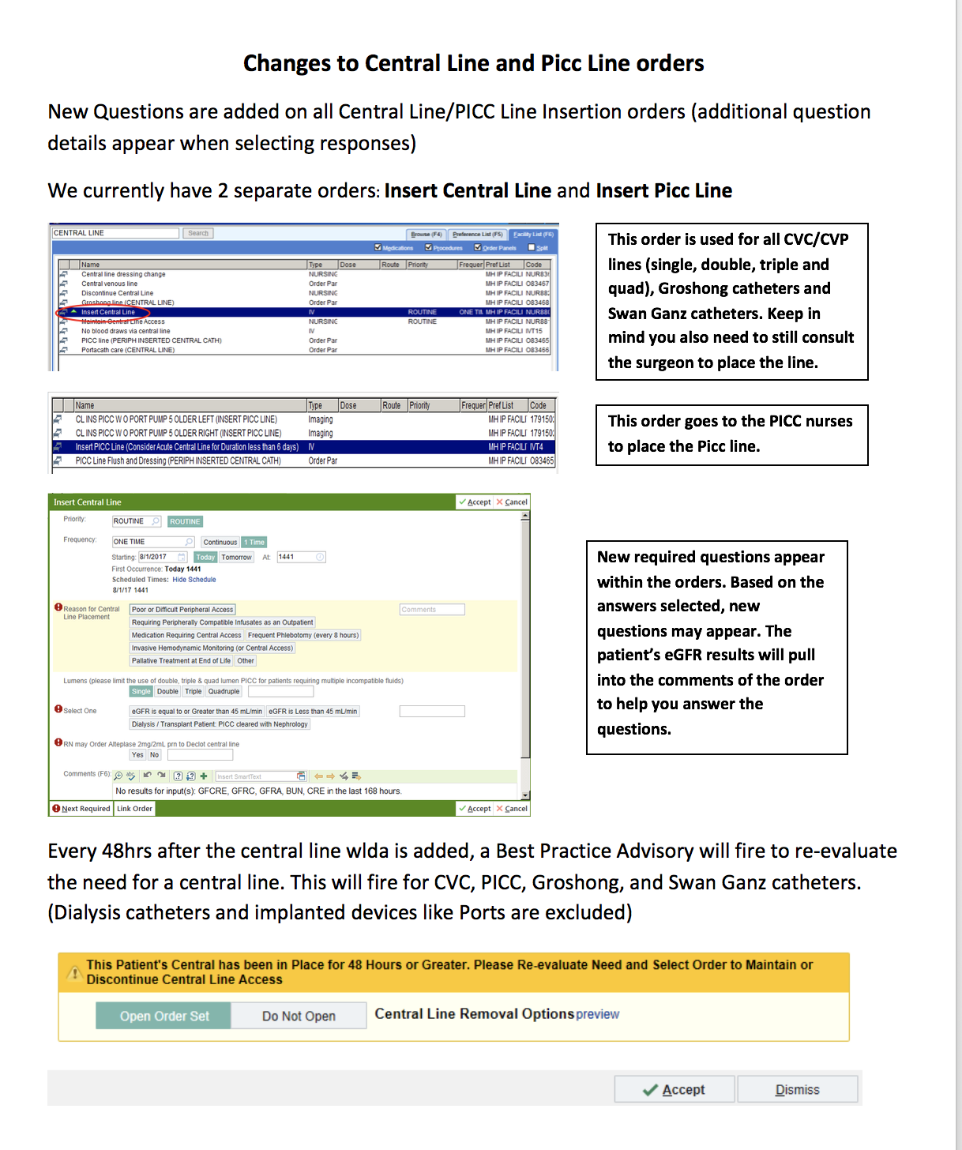
Central line indication

Slide 15
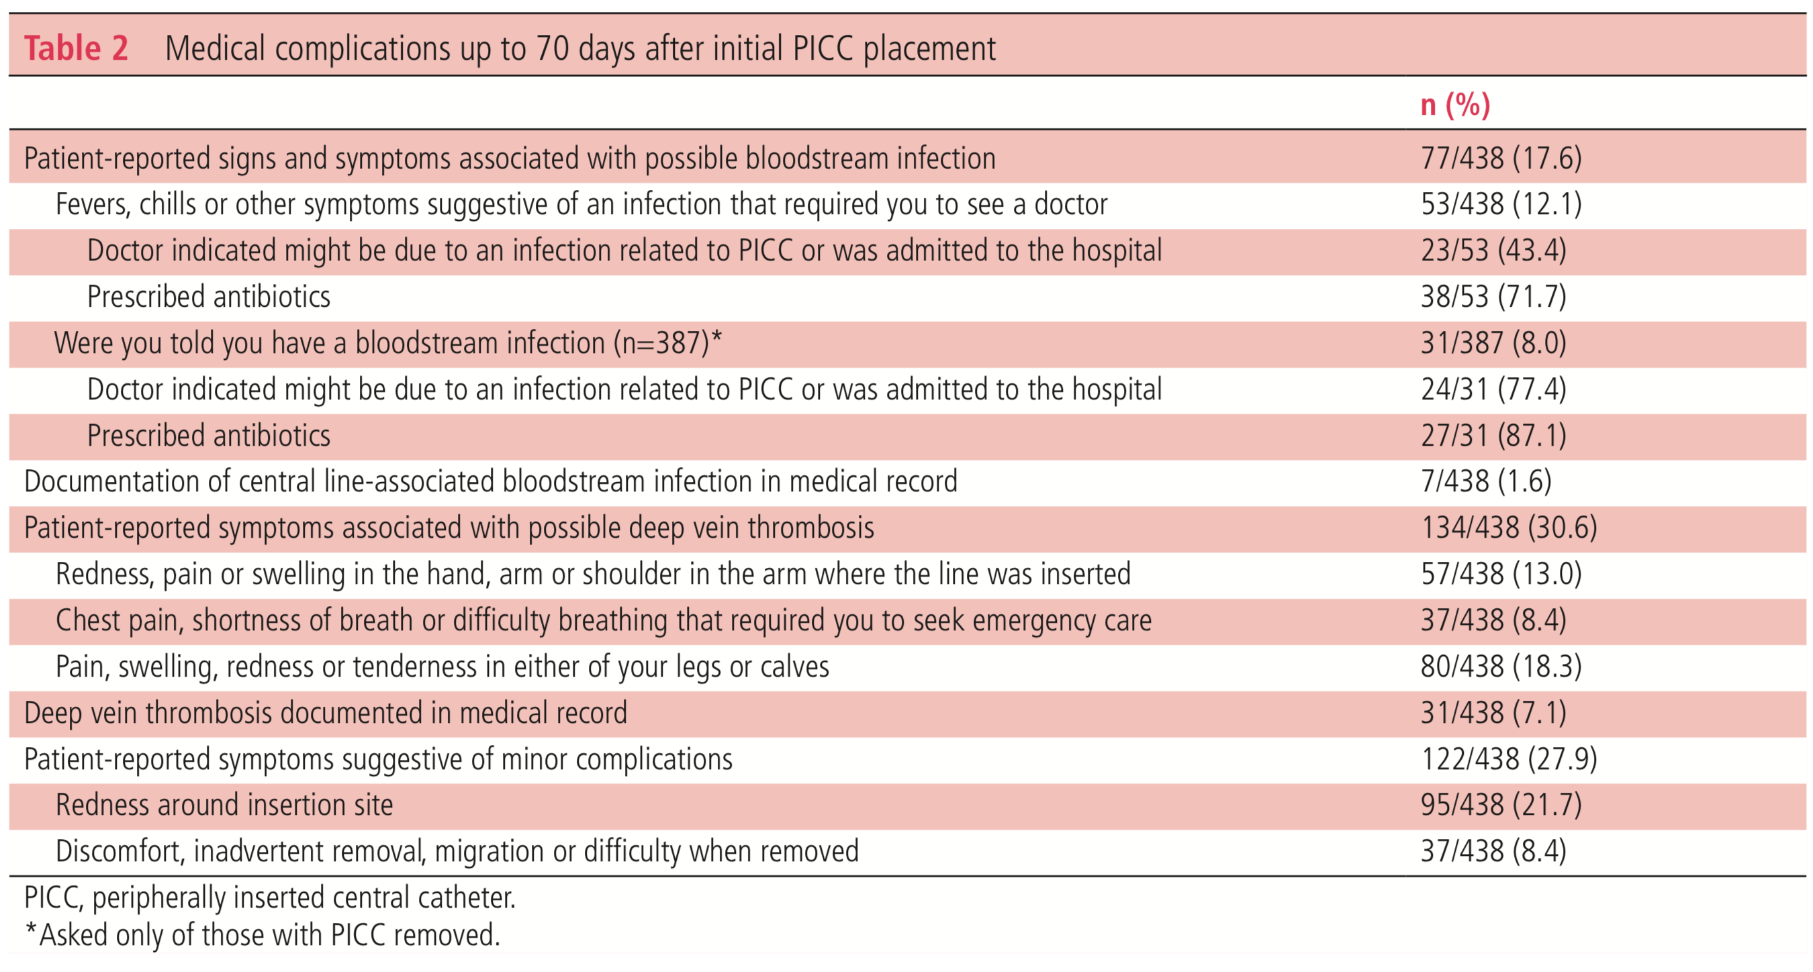
Patient perspective on PICC complications

Slide 16
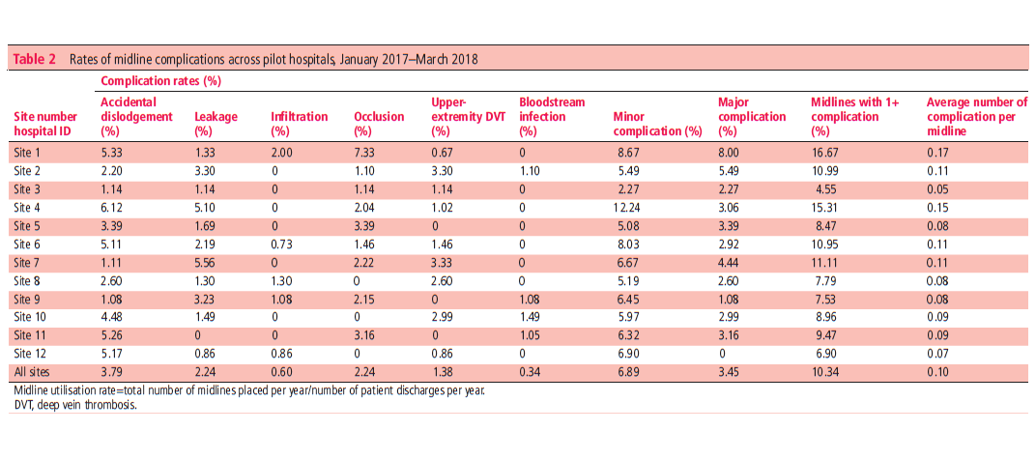
Midline performance

Slide 17
Identifying existing risks
Prior to the 2016 Infusion Therapy Standards of practice there was no true maximum number of peripheral IV attempts that were permitted in standards.
2011 standards said no more than 2 attempts per clinician
In an effort to “get the line” patients may be repeatedly stuck.
With S. aureus as a frequently isolated pathogen in PIV associated bloodstream infections this association may be significant

Slide 18
Starting where it starts: Emergency Room
Several studies have examined the role of ER started peripheral IV catheters and their risk of bloodstream infection
Internal review of data suggests that over 40% of all PIVs may be started in the ER
  Failure of these catheters can set up a cascade for future lines
Obtaining early reliable cannulation in the ER can impact overall hospitalization
Recent studies have suggested significant success and improved outcomes with ER initiated, ultrasound guided midlines (8-10 cm)
  Absence of visible/palpable veins or 2 or more failed PIV attempts
  73% lasted beyond 7 days
  Placed with sterile drape, sterile gel and probe cover
Scoppettuolo, G., et al. (2016). "Ultrasound-guided "short" midline catheters for difficult venous access in the emergency department: a retrospective analysis." Int J Emerg Med 9(1): 3

Slide 19
Midlines/extended dwell catheters for Difficult Access
Selecting a site most likely to last the patient’s full course of therapy may also include consideration of a midline, particularly as ultrasound becomes the expectation for difficult access and failed attempts
Take into consideration that every failure increases risk of future failure and that a recent study suggests that a large percentage (79%) of peripheral IV associated S aureus infections occurred at old IV sites (and 29% of those assessments were missed by the bedside staff)
Austin, E. D., et al. (2016). "Peripheral Intravenous Catheter Placement Is an Underrecognized Source of Staphylococcus aureus Bloodstream Infection." Open Forum Infect Dis 3(2): ofw072

Slide 20
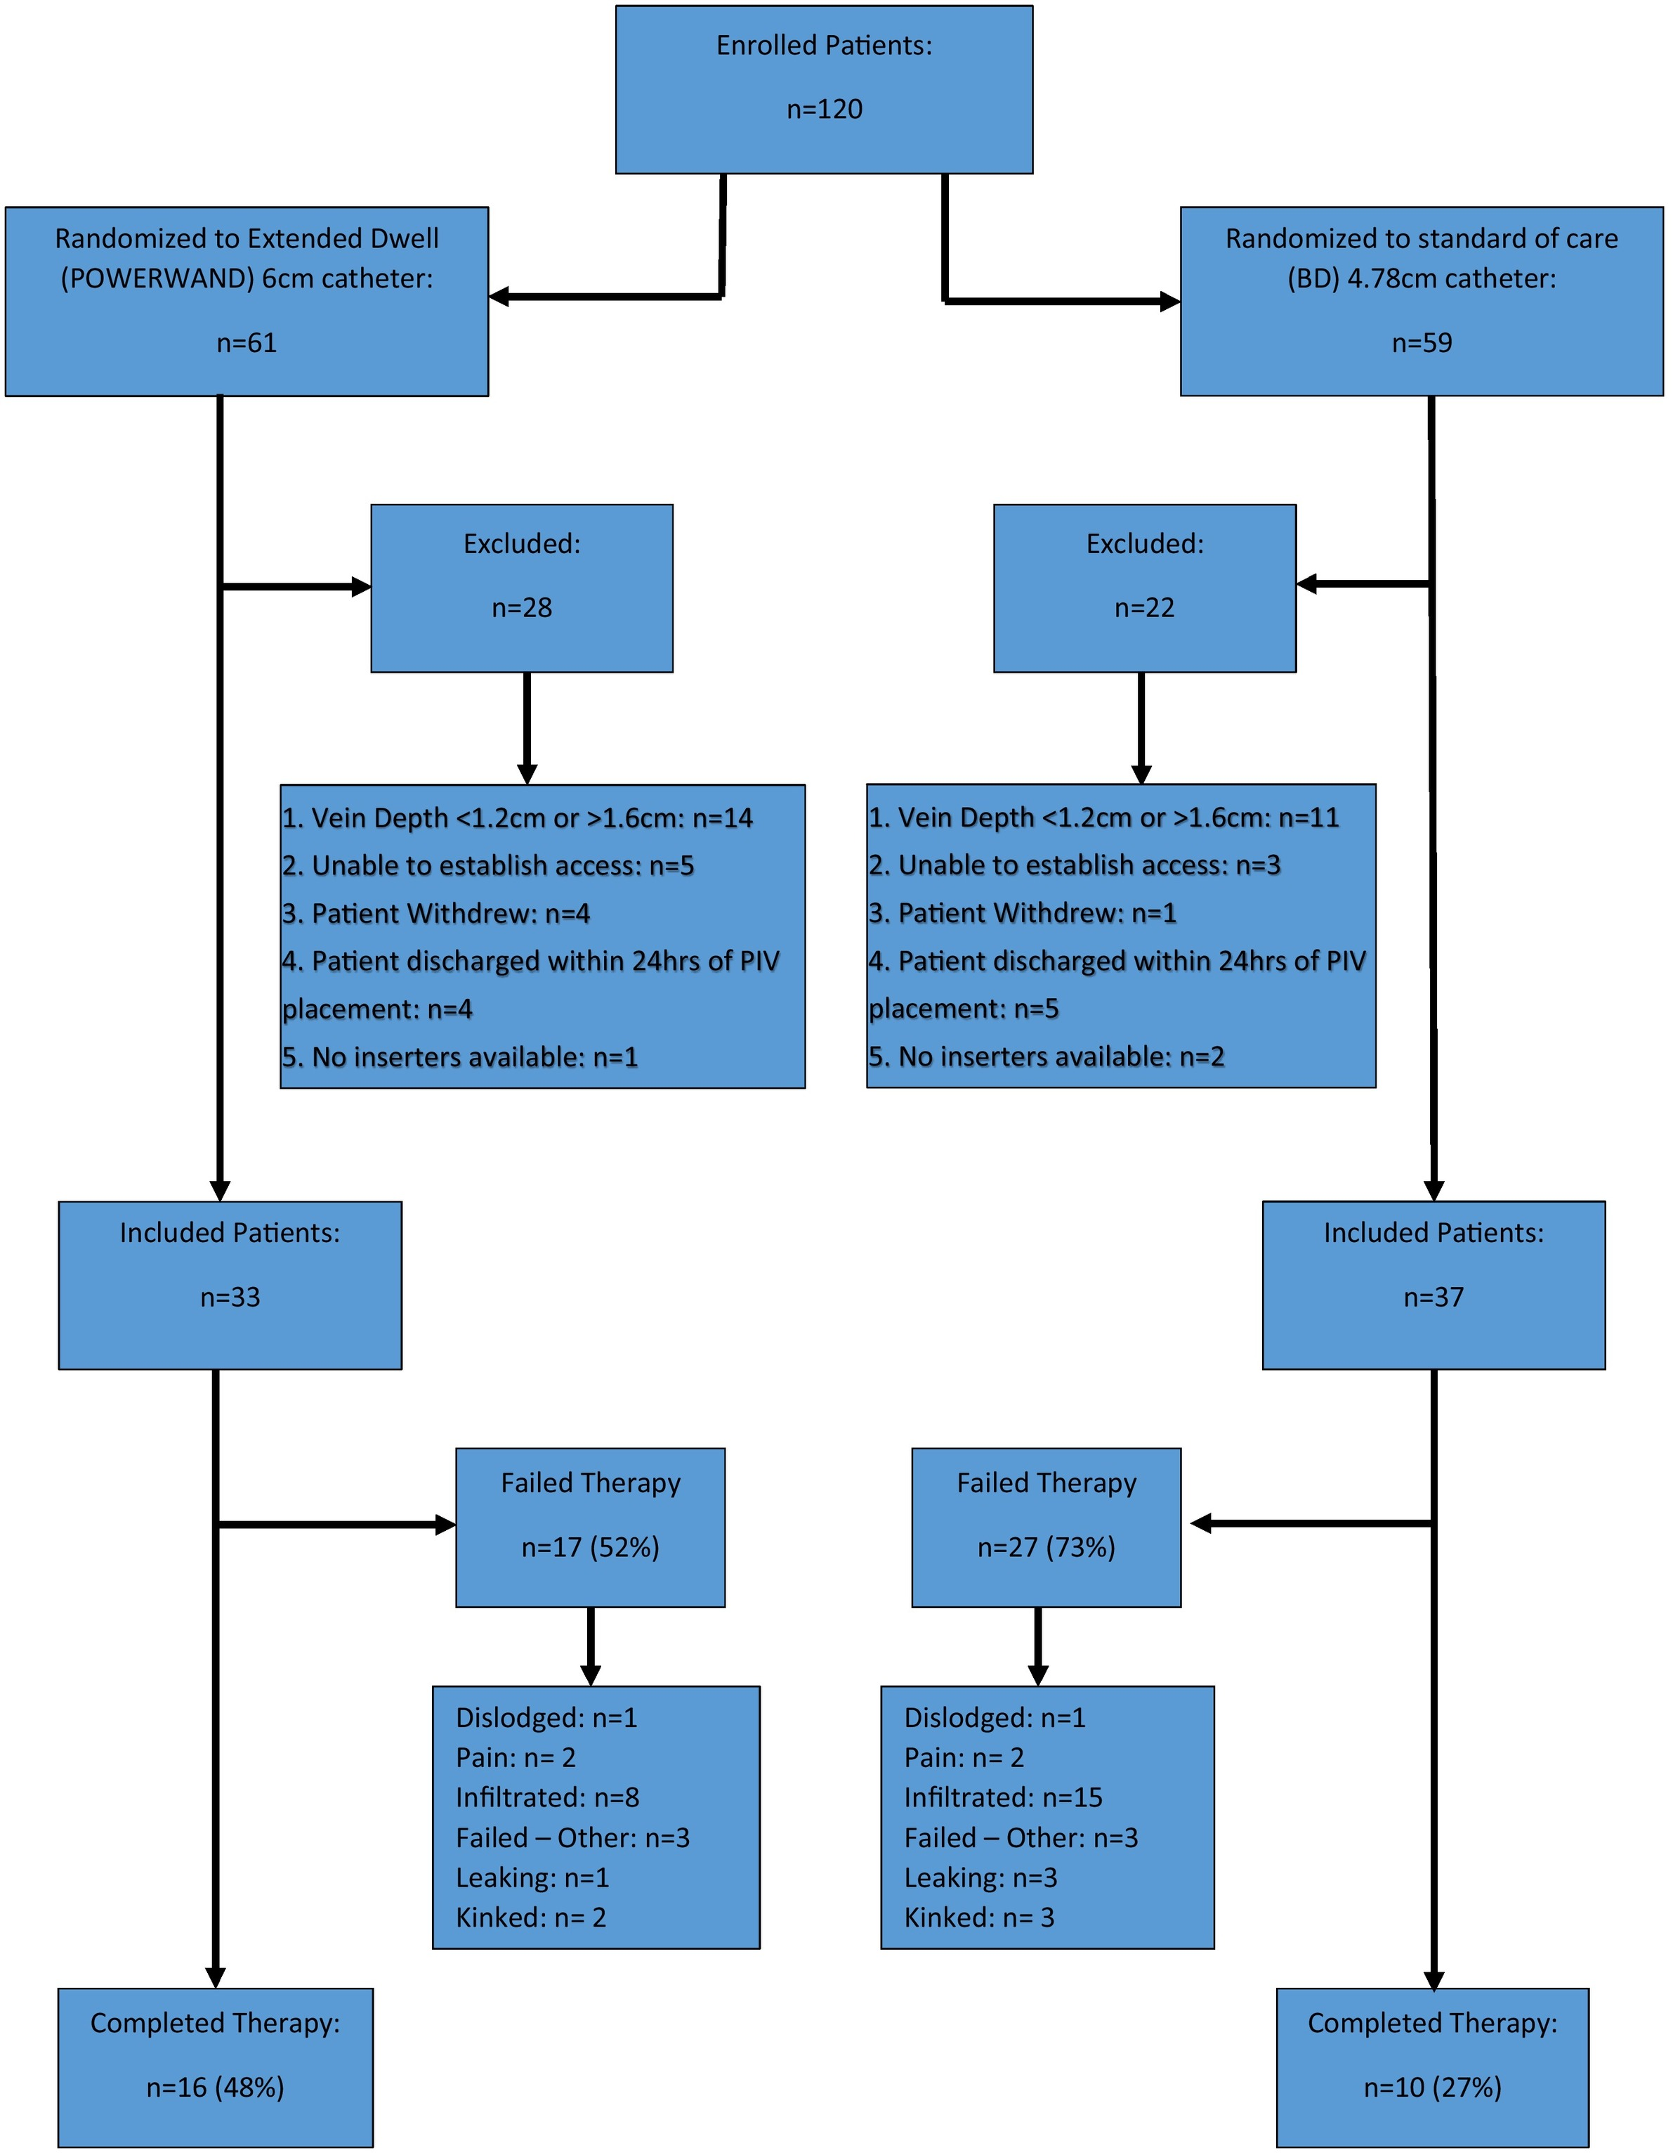
ER Success with 19.5G (3Fr), 6cm Device
Adult DIVA patients in the ER with vessel depth of 1.2. -1.6 cm and an expected admission of at least 24 hours
Lower rates of failure compared to standard long PIV
Median to failure 4.04 days versus 1.25 days for standard long PIV
Bahl A, et al, Standard long IV catheters versus extended dwell catheters: A randomized comparison of ultrasound guided
catheter survival, American Journal of Emergency Medicine (2018), https://doi.org/10.1016/j.ajem.2018.07.031

Slide 21
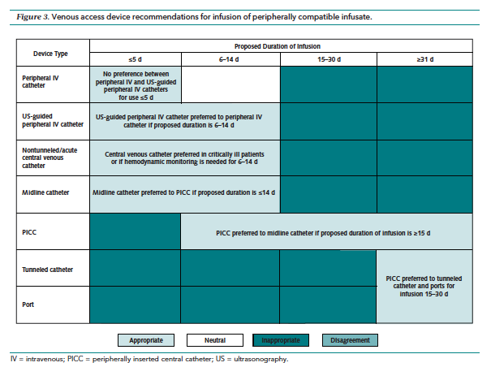
Ready for some MAGIC?

Slide 22
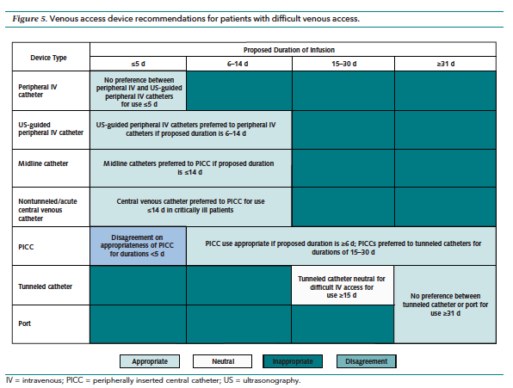

Slide 23
Understanding NHSN data for targeted improvements
Device utilization ratios/standardized utilization ratios (SUR)
Lab ID events for MRSA
CLABSI rates and standardized infection ratios (SIR)
TAP analysis
These are all tools that your Infection Preventionists can show you how to access and analyze

Slide 24
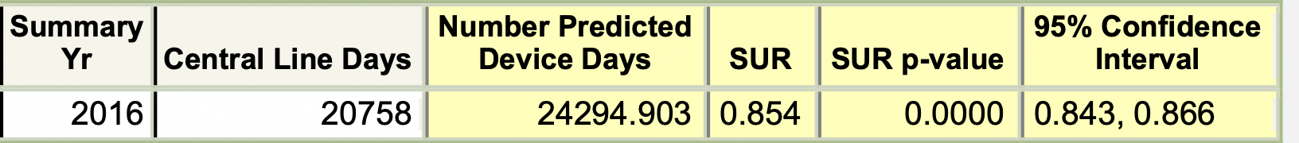
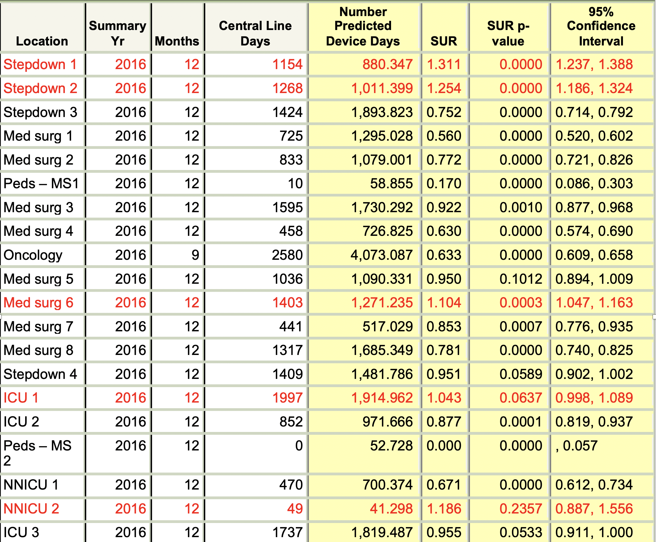
Standardized utilization ratios

Slide 25
What about the rest of the patients?
Summary Yr | Events | Number Predicted | Central Line Days | SIR | SIR p-value | 95% Confidence Interval
2015 | 14 | 18.936 | 18677 | 0.739 | 0.2539 | 0.421, 1.211
2016 | 25 | 18.475 | 18178 | 1.353 | 0.1420 | 0.895, 1.968
Location Type | Summary Yr | Events | Number Predicted | Central Line Days | SIR | SIR p-value | 95% Confidence Interval
CC | 2015 | 2 | 4.840 | 4606 | 0.413 | 0.1850 | 0.069, 1.365
CC | 2016 | 4 | 4.819 | 4586 | 0.830 | 0.7642 | 0.264, 2.002
CC_N | 2015 | 1 | 0.791 | 482 | . | .
CC_N | 2016 | 1 | 0.821 | 519 | . | .
STEP | 2015 | 4 | 5.410 | 5148 | 0.739 | 0.5839 | 0.235, 1.784
STEP | 2016 | 10 | 5.522 | 5255 | 1.811 | 0.0808 | 0.920, 3.228
WARD | 2015 | 7 | 7.895 | 8441 | 0.887 | 0.7940 | 0.388, 1.754
WARD | 2016 | 10 | 7.312 | 7818 | 1.368 | 0.3247 | 0.695, 2.438
At Hospital X there were 10 CLABSIs on step down critical care units….which are NOT reportable
There are over 5000 central line days
Secondary complications (C. Diff) or MRSA bacteremia are still reported, however

Slide 26

What’s happening at Methodist?
1st Place Poster CVAA 2018
Year one demonstrated a 35% reduction in PICC lines placed

Slide 27
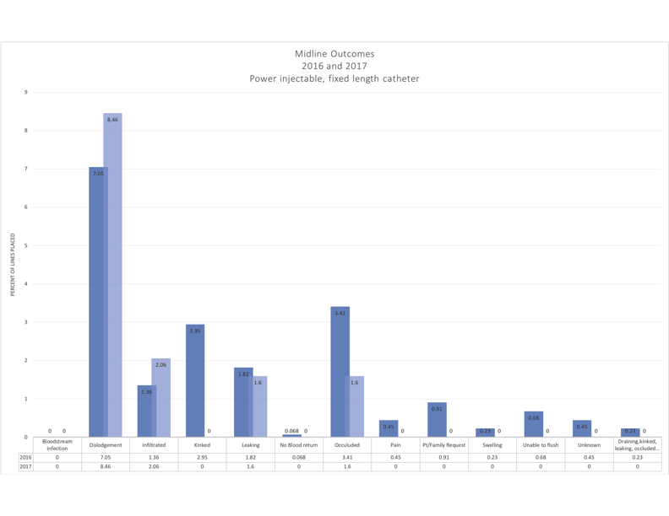
Comparison of first two years performance
DeVries M, Lee J, Hoffman L. Infection Free Midline Catheter Implementation at a Community
Hospital (2 years). American Journal of Infection Control. In press 2019.

Slide 28
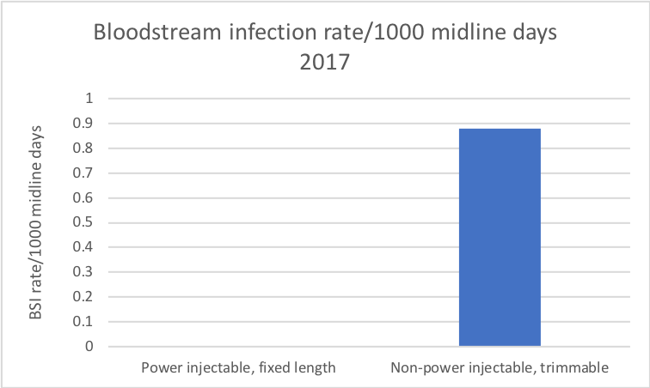
Bloodstream infections
“Prior to the introduction of the midline catheter program, the 5430 Powerwand days reported in this paper would most likely have become PICC days based on the previous insertion decisions made by the team. Extrapolating that to the PICC CLABSI rate noted during that time, this may have been associated with 10 (9.77) additional CLABSIs, and at least one avoided death using a conservative 15% mortality estimate for CLABSI. “
M. DeVries. AJIC 2019
DeVries M, et al Consistent midline outcomes after 2 years: Zero bloodstream infections. Poster presentation AVA 2018

Slide 29
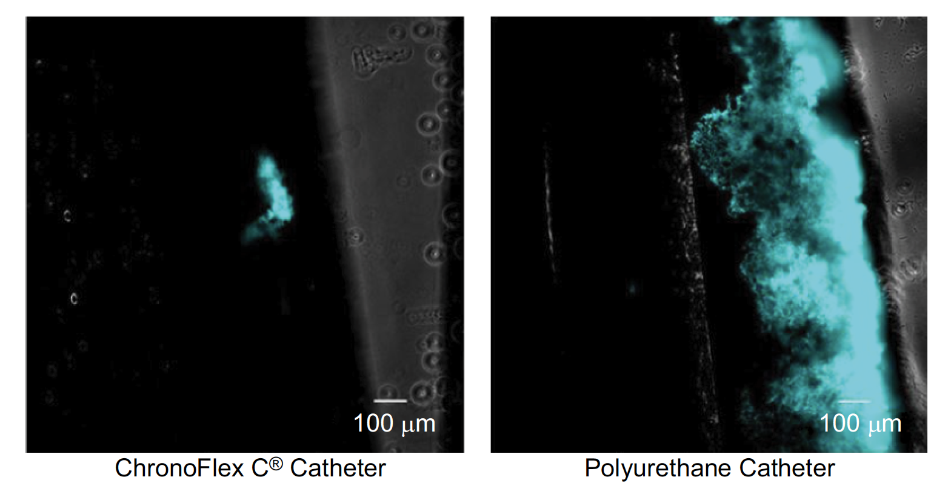
Why aren’t infections being seen?
Comparison of Chronoflex C to standard polyurethane catheter to compare bacterial attachment and biofilm formation
  5 times more bacteria were able to attach and grow on the control polyurethane material than on the study material
  When bacteria were able to attach to the study catheter, they were 1.5 times more likely to die as compared with attached bacteria on the polyurethane control catheter.

Slide 30
lessons learned
Starting in summer of 2016, Home Health began accepting patients with midlines
Starting in January 2017, parallel data is being aggregated monthly for PICCs and midlines placed by the team
Vascular access policies updated with further guidance on device selection summer 2017 to enhance staff understanding of appropriateness
Order sets updated summer 2017 to assist providers with device selection criteria (aligned with MAGIC recommendations)

Slide 31

Change One Thing

Slide 32
Conclusions
Infection Prevention and Vascular Access have a shared interest in preventing infections and other harm in our patients
Working together to review existing data looking at trends for CLABSI, central line device utilization, MRSA lab ID events and peripheral IV infections and complications can help identify where opportunities may exist for inclusion of midlines or extended dwell catheters for specific patient populations
  There is no single device type that will meet the needs of every patient. Careful assessment against established criteria are necessary to keep this a clinical decision.
For objectivity and patient safety, develop plans for surveillance across all devices not just central lines and include those measures in analysis
Change one thing!!

Slide 33
Thank you
INFECTIONPREVENTION@COMCAST.NET

