Slide 1
CDPH HAI Program Overview
San Francisco Bay Area APIC
Burlingame
September 14, 2016
Lynn Janssen, Chief
Healthcare-Associated Infections Program
Center for Health Care Quality
California Department of Public Health
Notes:
1

Slide 2
Objectives
Describe the CDPH HAI Program and activities
Discuss future HAI prevention plans
Seek input of APIC / infection preventionists on how public health can assist in HAI prevention

Slide 3
HAI Program, Center for Health Care Quality
Created by mandate to oversee the prevention, surveillance, and reporting of healthcare-associated infections, and to:
Produce annual HAI public reports to support informed choices for healthcare consumers and prompt providers to take actions to prevent infections.
Actively engage in HAI prevention by performing site visits to hospitals, SNF, and other healthcare facilities, convening regional collaboratives, and providing education
Provide consultation and assistance to local public health for infection prevention and outbreaks that occur in healthcare facilities.

Slide 4
Additional CDC-Supported HAI Prevention Activities
Activities | Timeframe
HAI Program infrastructure Antimicrobial resistance program Dialysis BSI prevention program Injection safety program | 2014-2019
Assessment for CA Ebola hospitals Strengthening outbreak response | 2015-2017
Expanding healthcare assessments to build infection prevention capacity broadly | 2016-2018

Slide 5
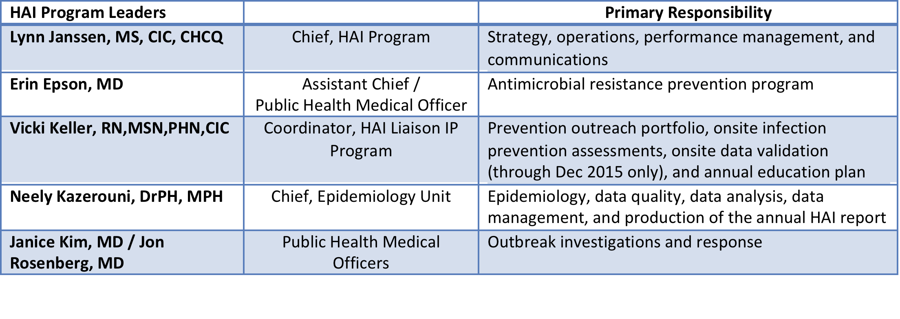
HAI Program Leaders
and HAI outbreaks team lead
Lori Schaumleffel HAI Performance Ebola assessments and reporting, monitoring progress of
Coordinator grant-related performance metrics
Teresa Nelson LTAC Liaison IP Outreach and prevention plans for California’s 24 LTAC Coordinator hospitals

Slide 6
HCP Influenza Vaccination - Annual Report
Data reported by 400 acute care hospitals to NHSN
Published via a web page that includes report of key findings and public health actions, 5 data tables, technical report
2014-2015 flu season data continued to show incremental improvement in HCP vaccination rates

Slide 7
HAI in California Hospitals - Annual Report
Data reported by 400 acute care hospitals (no exclusions for size) to the National Healthcare Safety Network (NHSN)
Published via a web page that includes
Summary report of key findings and public health action
>95 data tables
Interactive map
Technical reports for each infection type

Slide 8
Annual Report of HAI in CA Hospitals, 2014

Slide 9
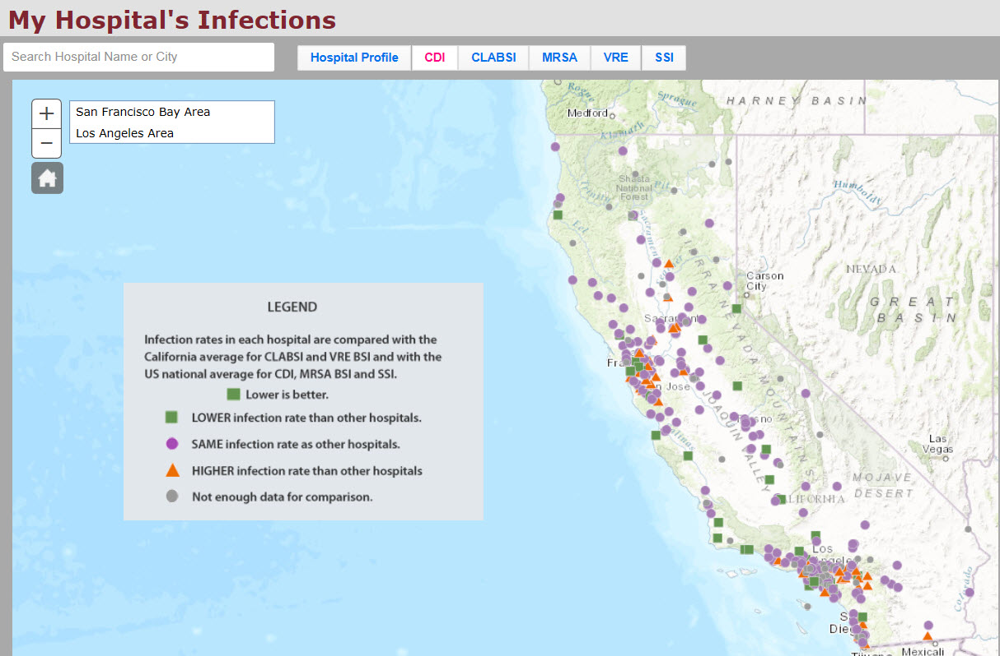

Slide 10
HAI Liaison IP Program
Supervisor – Vicki Keller
Liaison IPs Northern CA –
Terry Nelson
Lori Schaumleffel
Aileen de los Angeles
Liaison IPs Southern CA –
Idamae Kennedy
Tracy Lanier
Zenith Khwaja
Statewide –
Teresa Nelson – LTAC Hospitals/Injection Safety
Sheila Segura – Outpatient Dialysis Clinics
Hosniyeh Bagheri – Smaller Volume Hospitals

Slide 11
Liaison Infection Preventionist (IP) Program
Regionally-based Liaison IPs, highly experienced, certified in infection control and epidemiology (CIC)
Assigned approximately 45 larger volume hospitals each
One Liaison IP assigned 140 smaller volume hospitals
Conduct monthly regional calls to connect with their area hospitals and relay updates from CDPH HAI Program
Expanding to non-hospital settings beginning in 2016
Skilled nursing facilities, ambulatory surgery clinics, outpatient clinics

Slide 12
HAI Data for Action Strategy
4th year of performing outreach to hospitals with high HAI incidence as indicated in the annual public report
128 hospitals* with statistically high infection incidence in 2014 identified and prioritized
Clostridium difficile infection - 67 hospitals
CLABSI - 24 hospitals
Surgical site infections – 54 hospitals
MRSA/VRE bloodstream infections – 26 hospitals
*34 hospitals had more than one infection type with high incidence

Slide 13
Liaison IP Onsite Prevention Assessments
Targeted Number of CDC-funded Infection Control Assessments (Number of infection control assessments planned for each setting type) Jan 2015-May 2018
 | Hospital* | Nursing Home | LTAC Hospital | Outpatient Clinic (non-ASC) | ASC | Dialysis Center
2015 (Jan-Dec) | 90 | 0 |  |  | 0 | 34
2016 (Jan-June) | 75 | 80 |  |  | 0 | 34
2016 (July-Dec) | 45 | 60 |  |  | 30 | 34
2017 (Jan-June) | 30 | 60 |  |  | 30 | 34
2017 (July-Dec) | 45 | 60 |  |  | 30 | 34
2018 (Jan-May) | 30 | 60 |  |  | 30 | 34
Total Planned | 315 | 320 | 23 | 90 | 120 | 204
Total Completed (by 2.1.16) | 84 |  | 8 |  | 0 | 46
Progress toward goal | 27% | 0% | 35% | 0% | 0% | 23%
* Will continue data for action strategy, targeting hospitals that have high HAI incidence as indicated in public report

Slide 14
CDPH Lead for Coordination of Ebola Hospital Preparedness
HAI Program Coordinator - Lori Schaumleffel
Deploy a CDPH Ebola Assessment Team to continue readiness monitoring and visit new Ebola Assessment Hospitals
HAI Liaison IP assigned to the facility
Laboratory safety specialist
Occupational health specialist
Waste management specialist
Coordinate with Local Public Health Officer and local EMS

Slide 15
California Ebola Treatment and Assessment Centers
Region 9 Special Pathogens Center
Cedars Sinai Medical Center
Ebola Treatment Hospitals
UC Davis Health System
UC San Francisco Medical Center
UCLA Medical Center
UC Irvine Medical Center
Kaiser Permanente Medical Center – South Sacramento
Kaiser Foundation Hospitals – Oakland & So. Sacramento
Ebola Assessment Hospitals
UC San Diego Medical Center
Mercy Medical Center – Redding
Children’s Hospital of Los Angeles
Rady Children’s Hospital of San Diego

Slide 16
California Campaign to Prevent Bloodstream Infections in Hemodialysis Patients
514 outpatient hemodialysis centers in California
HAI Program staff includes a full-time Dialysis Liaison IP
Five-year plan to provide onsite assessments and strategies to prevent bloodstream infections
One-day assessments of adherence to CDC prevention strategies with same day feedback
Webinars, website, and a one-day infection prevention class

Slide 17
Core Actions to Address Antimicrobial Resistance
Improve antimicrobial prescribing through antimicrobial stewardship
Preventing infections and transmission of antimicrobial resistant pathogens
Tracking antimicrobial resistance patterns
Our HAI Program has activities in each of these core areas

Slide 18
Supporting California ASP Adoption
ASP Collaborative for Hospitals
Jan-Dec 2015
150 hospitals participated
Facilitate compliance with Senate Bill 1311 - required ASP by July 1, 2015
Provided a forum to support hospitals to develop or enhance ASPs
ASP Webinar Series for Skilled Nursing Facilities
Mar-Sep 2016
All 1100 SNF invited
Facilitate compliance with Senate Bill 361 - requires ASP by Jan 1, 2017
Provide a forum to support SNF to develop or enhance ASPs
ASPs promote patient safety, and
decrease CDI and antimicrobial resistance

Slide 19
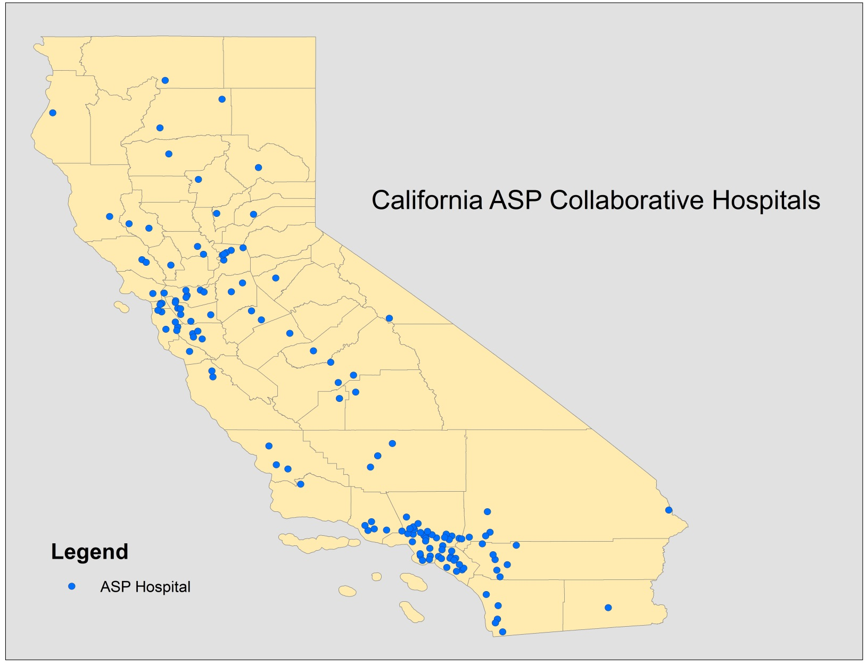
150 California Hospitals Are Participating in 2015 ASP Collaborative
Hospital Type | No. (%)
Community | 122 (81)
Major Teaching | 5 (3)
Pediatrics | 8 (5)
Long Term Acute Care | 9 (6)
Critical Access | 7 (5)

Slide 20
Developing a Model Regional Approach to Antimicrobial Resistance and CDI Prevention
Objectives:
Monitor adherence to infection prevention practices in hospitals and long-term care facilities
Contact precautions
Hand hygiene
Communication when transferring patients with CDI/AR
Start or enhance an antimicrobial stewardship program with particular attention to CDI
Evaluate and enhance environmental cleaning

Slide 21
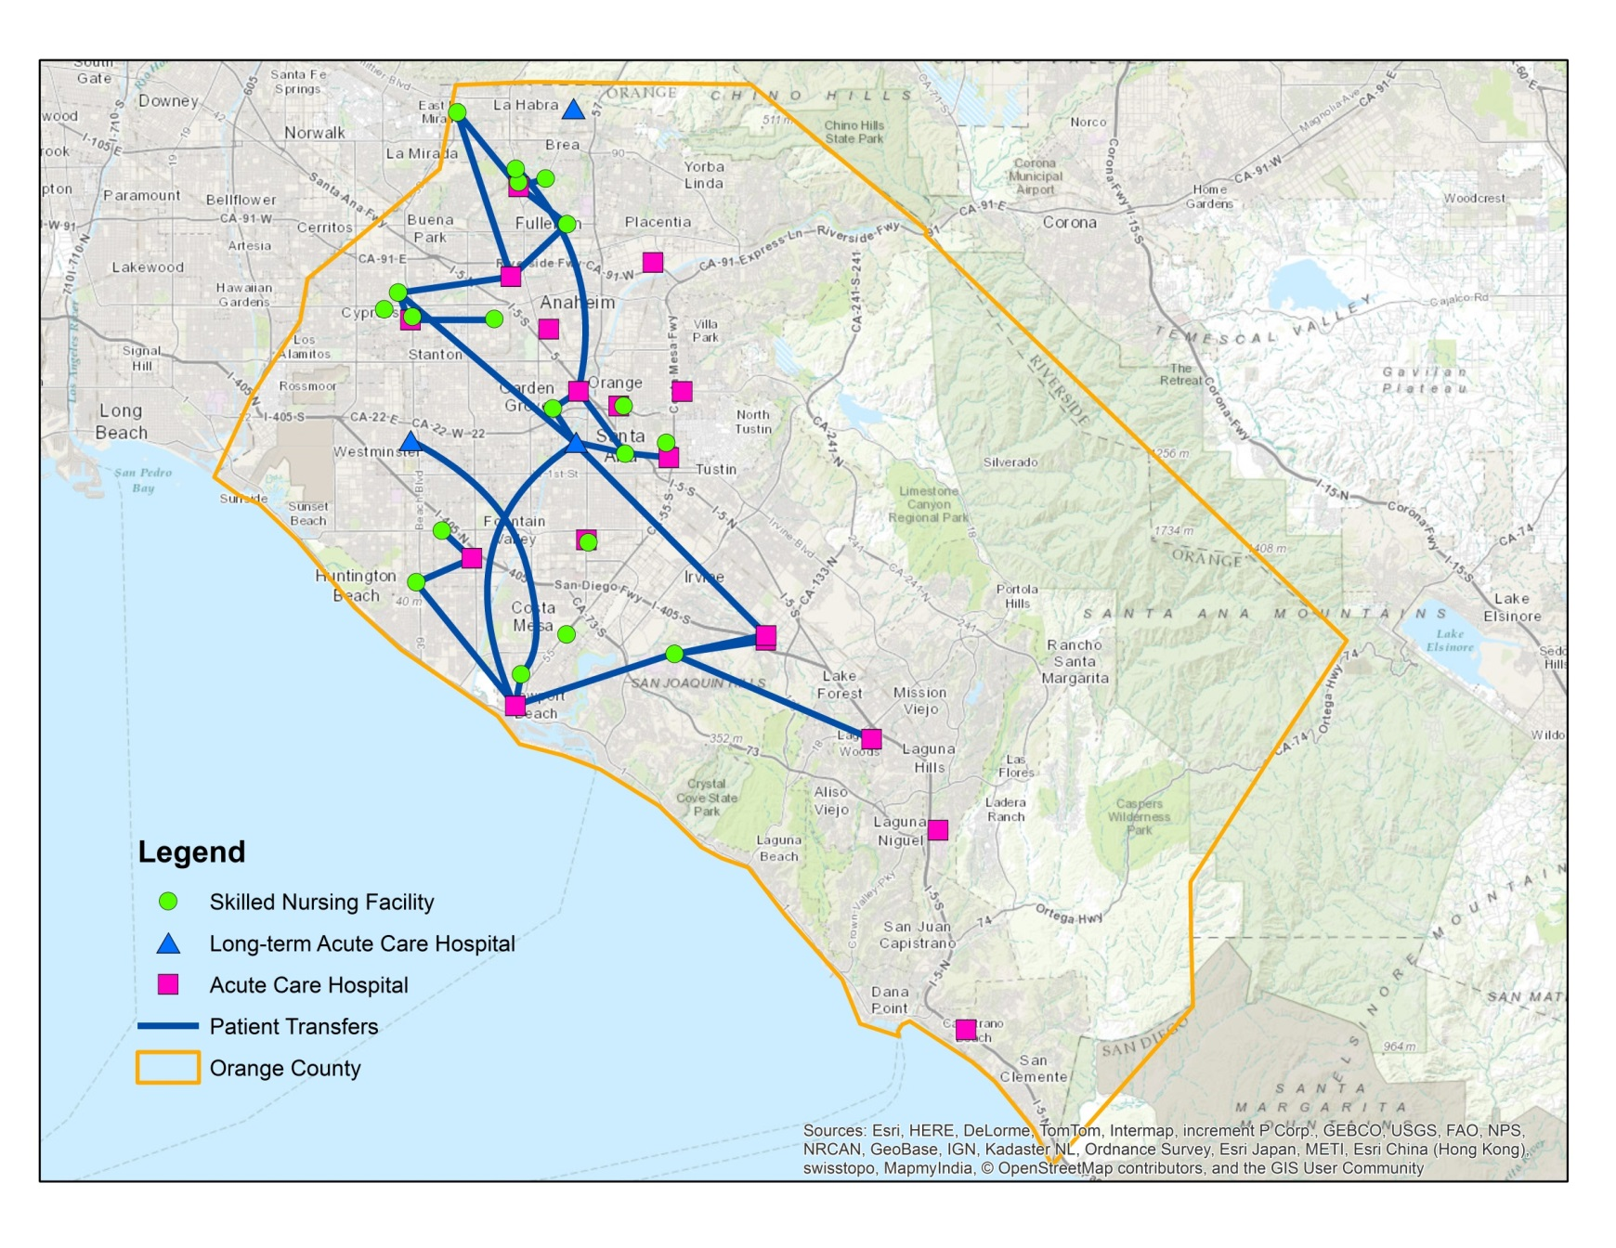
Orange County CDI Collaborative Participants
Notes:
Patient sharing as reported by facilities on their commitment forms.
19 facilities listed facilities with which they share patients

Slide 22
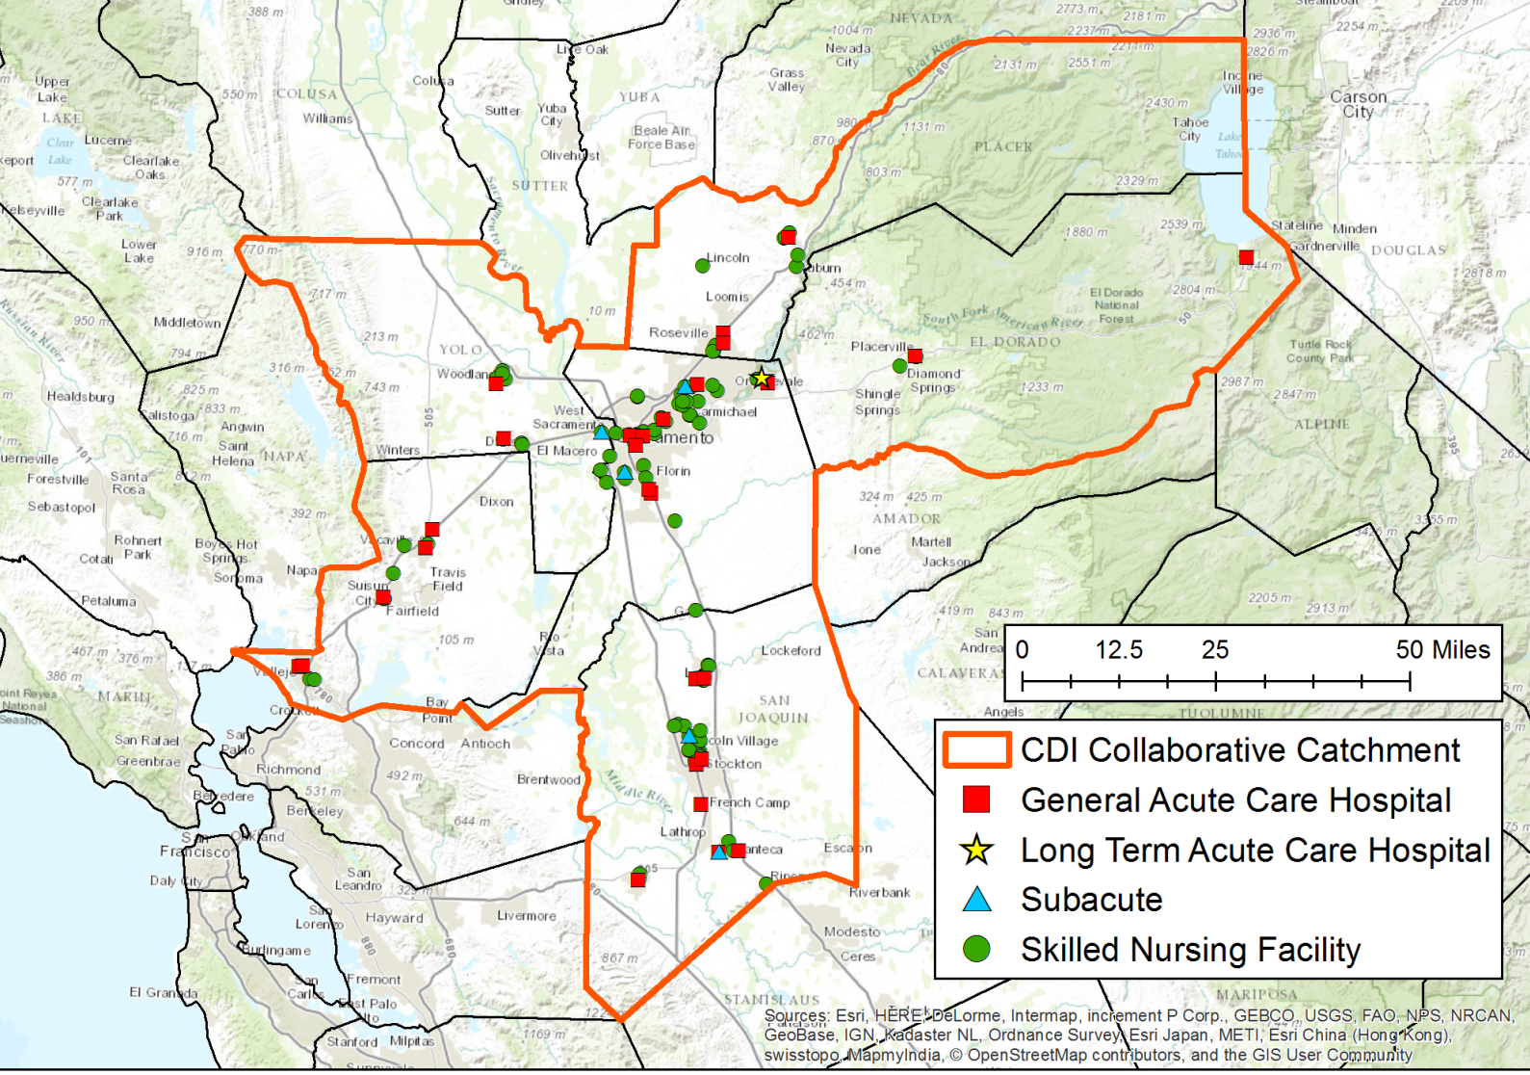
Sacramento Metro CDI Prevention Collaborative
Participating Counties: El Dorado, Placer,
Sacramento, San Joaquin, Solano, Yolo

Slide 23
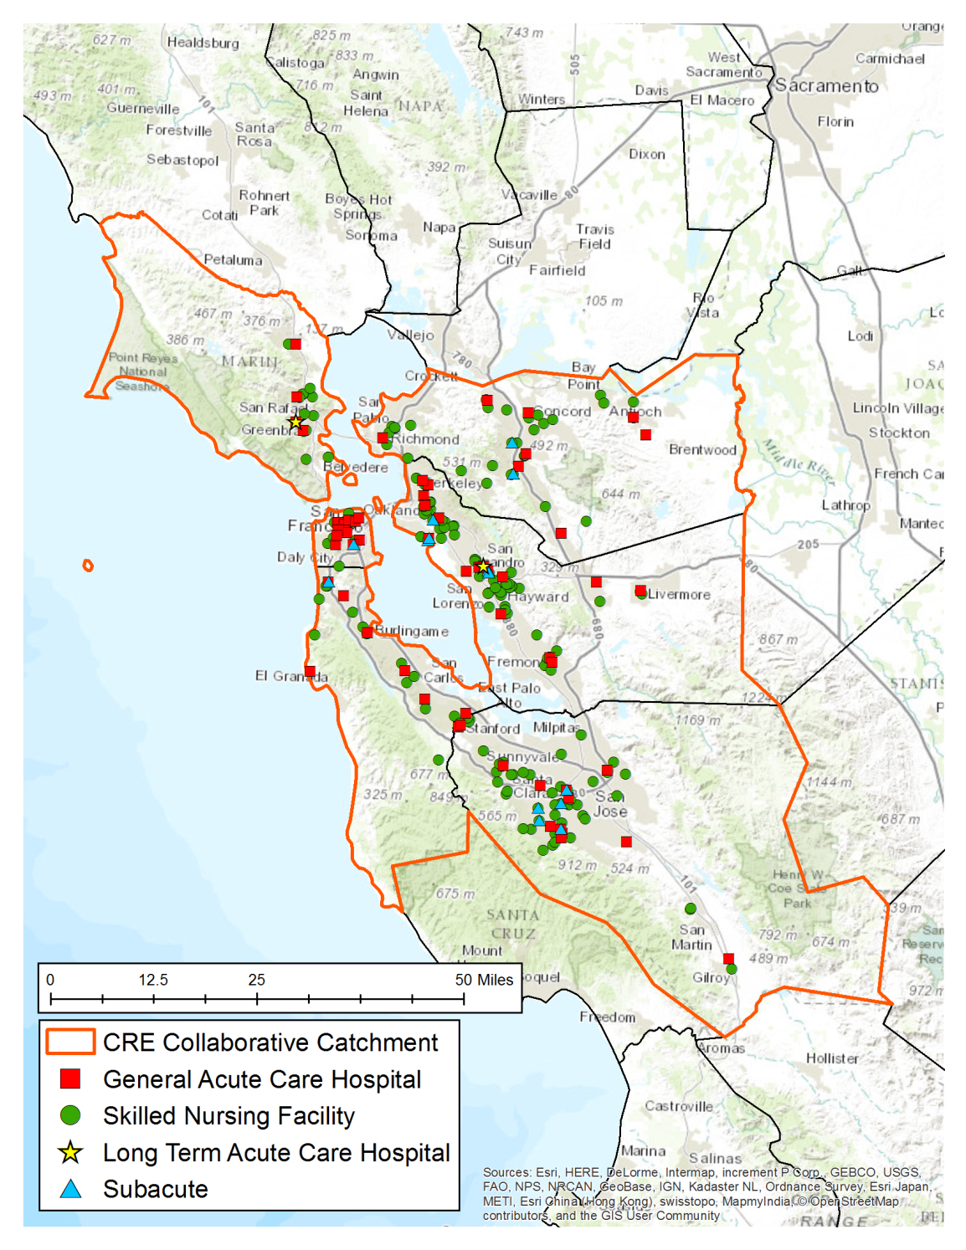
San Francisco Bay Area CRE Prevention Collaborative
Participating Counties
Alameda
Contra Costa
Marin
San Francisco
San Mateo
Santa Clara
Notes:
237 potential facilities
52 General Acute Care Hospitals
2 Long-Term Acute Care Hospitals
183 Skilled Nursing Facilities
6 Free-standing Subacute Facilities
Counting D/P Subacute as part of acute care hospital

Slide 24
CDPH HAI Program Role in Outbreak Investigations
Subject matter experts in infection prevention and control
Provide consultation and support to local public health agencies
Coordinate with CDC content experts for up-to-date guidance and recommendations
Coordinate outbreak investigations that cross local health jurisdiction boundaries
Provide guidance and recommendations to CDPH L&C and other regulatory agencies

Slide 25
HAI Program Outbreak Investigations / Consultations, 2015
By Pathogen: | No. (%)
Legionella species | 14 (24%)
Klebsiella species (CRE) | 7 (12%)
Hepatitis B or C Virus | 6 (10%)
C. difficile infection | 5 (9%)
S. aureus¹ | 4 (7%)
MDRO (other than CRE) | 3 (5%)
Other | 19 (33%)
Total | 58 (100%)
By Facility Type: | No. (%)
Acute Care Hospital² | 24 (41%)
Skilled Nursing Facility | 13 (22%)
Multiple Facility Types³ | 5 (9%)
Outpatient Clinic/Setting | 5 (9%)
Other Residential Care | 5 (9%)
Ambulatory Surgery/ASC | 4 (7%)
Dialysis Clinic | 2 (3%)
Total | 58 (100%)
¹ Includes 2 MRSA and 2 MSSA
² Includes 1 LTAC Hospital
³ Includes Acute Care Hospitals plus Skilled Nursing Facilities or Dialysis Clinics

Slide 26
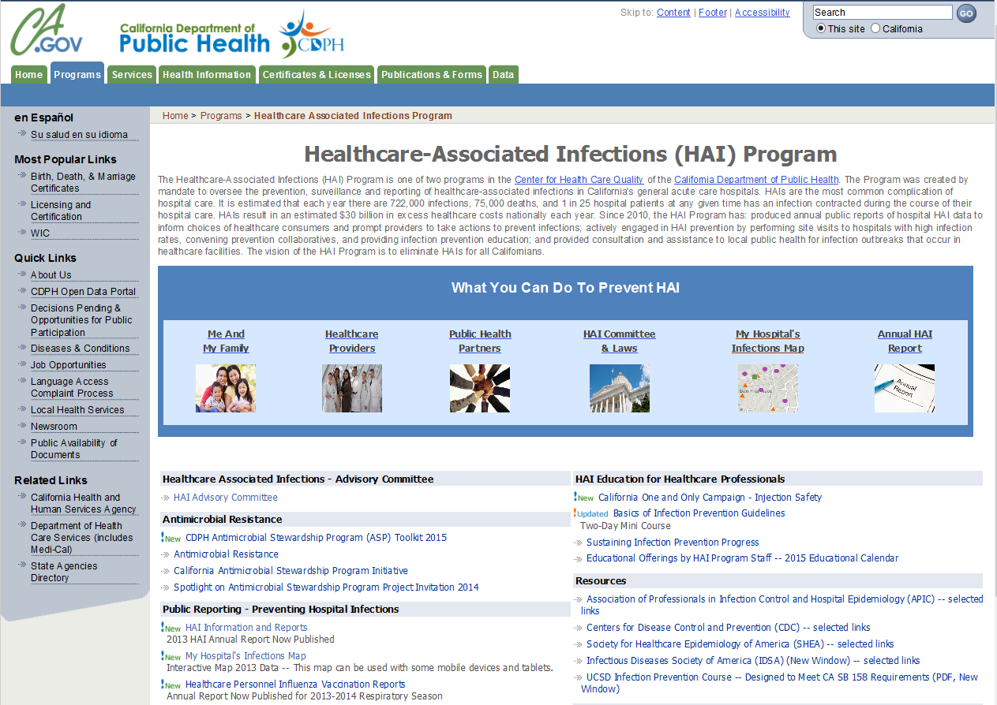
Notes:
HAI Main Page

Slide 27
Webpage Views - CDPH Programs January to July 2015

Slide 28
2015 Top Ten HAI Page Views
 | Pages | Average Time Viewed (Seconds)
1 | Healthcare-Associated Infections Main Page | 73
2 | California Antimicrobial Stewardship Program Initiative | 180
3 | HAI Information and Current Reports | 124
4 | Cleaning, Disinfection and Sterilization (“Basics of IP” course) | 190
5 | Who is at Risk of Getting a MRSA Infection? | 84
6 | What is a CLABSI? | 97
7 | Vancomycin-resistant Enterococci (VRE) | 89
8 | Carbapenem-Resistant Enterobacteriaceae (CRE) | 137
9 | MRSA: Methicillin-Resistant Staphylococcus aureus | 97
10 | Clostridium Difficile Infection (CDI) | 79
Notes:
Average Time Viewed in these ten pages - 115 Seconds
1 Healthcare-Associated Infections (Main Page)
2 California Antimicrobial Stewardship Program Initiative
3 Information and Current Reports
4 Cleaning, Disinfection and Sterilization (Presentation)
5 Who is at Risk of Getting a MRSA Infection?
6 What is a CLABSI?
7 Vancomycin-resistant Enterococci (VRE)
8 Carbapenem-Resistant Enterobacteriaceae
9 MRSA: Methicillin-Resistant Staphylococcus aureus
10 Clostridium Difficile Infection (CDI)

Slide 29
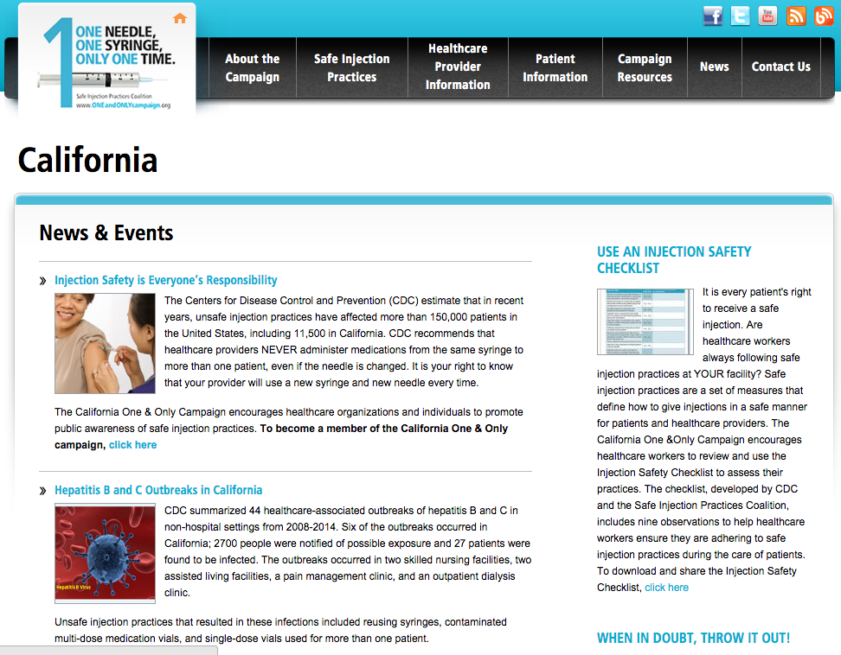
California Injection Safety Program

Slide 30
Summary
The CDPH HAI Program is committed to reducing HAI in California
Using Data for Action to prioritize and focus on hospitals with continued high HAI incidence
A regional approach is being modeled for AR prevention; CDI prevention is a high priority
Ensuring preparedness for Ebola and other emerging infectious diseases has expanded our outreach
External input is sought from the HAI Advisory Committee and others to enhance our efforts

Slide 31
CDPH HAI Program and APIC Discussions
How do you think the HAI Program can be most helpful to your prevention efforts?
Would you be willing to recommend SNF, ASCs, or outpatient clinics that could benefit from an infection prevention assessment?
How would you suggest we proceed?
Other questions?

