Slide 1

APIC Conference presentation by Scholarship recipient: name: Jonathan Schouest
APIC Conference Session Topic or Title:
Demystifying CMS Requirements: Giving them meaning for IPs
Originally presented by Kathleen Gase, MPH, CIC APIC 2016

Slide 2
Objectives
Upon completion of this presentation, APIC members will be able to:
Describe how HAI data is used by CMA to determine reimbursement incentives and penalties
List the differences in how HAI data is used and disseminated in IQR, VBP and HAC programs

Slide 3
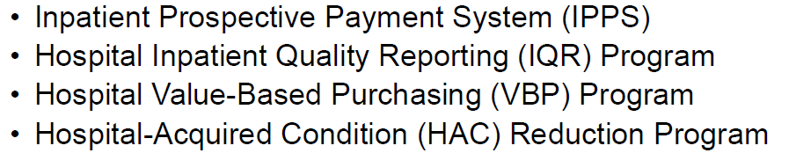
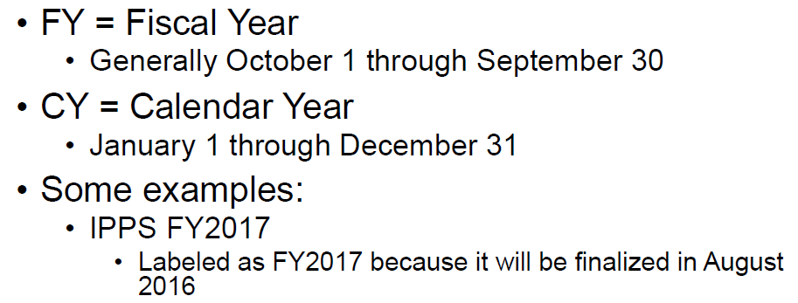
Acronyms and Timelines
And so on!
Notes:
Tougher than it sounds. Make the time, make the plan, don’t be afraid

Slide 4
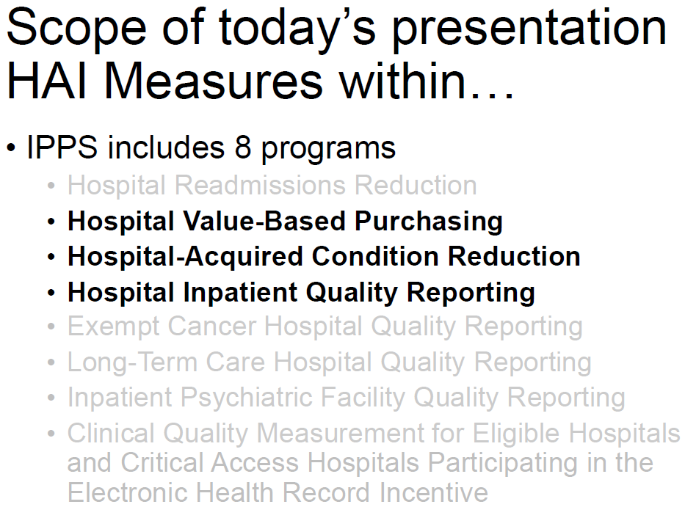
Acronyms and Timelines
Notes:
Tougher than it sounds. Make the time, make the plan, don’t be afraid

Slide 5
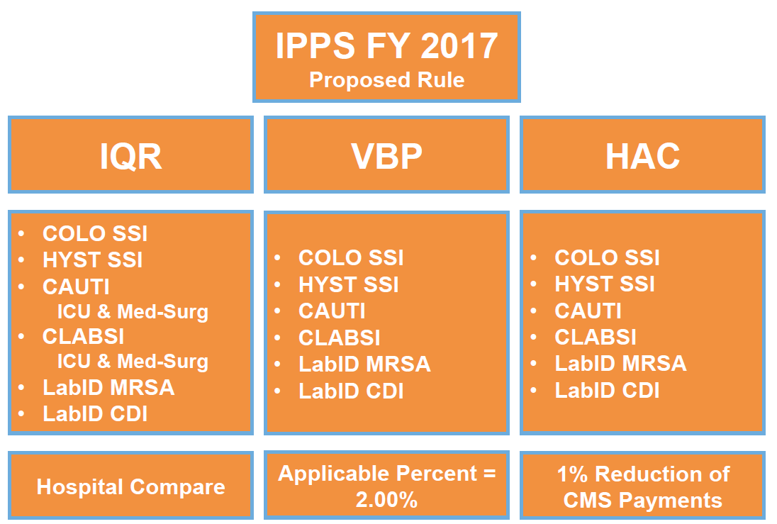
Acronyms and Timelines
And so on!
Soft +
+ or -
Neutral or -
Notes:
Tougher than it sounds. Make the time, make the plan, don’t be afraid

Slide 6
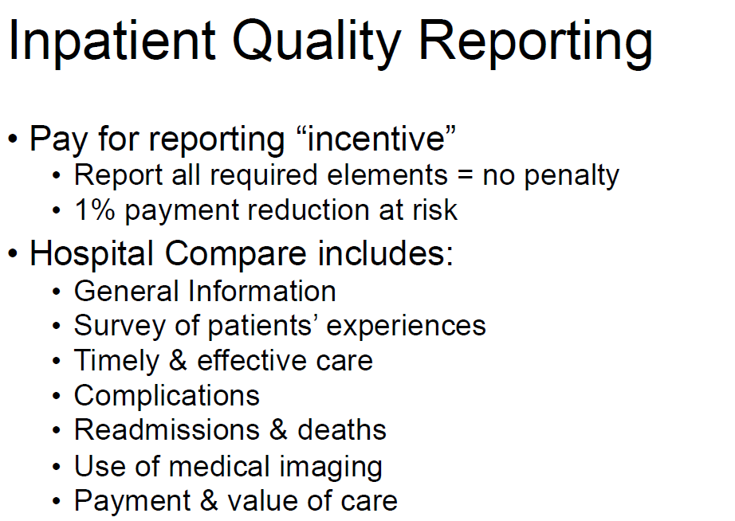
Acronyms and Timelines
And so on!
Notes:
Tougher than it sounds. Make the time, make the plan, don’t be afraid

Slide 7
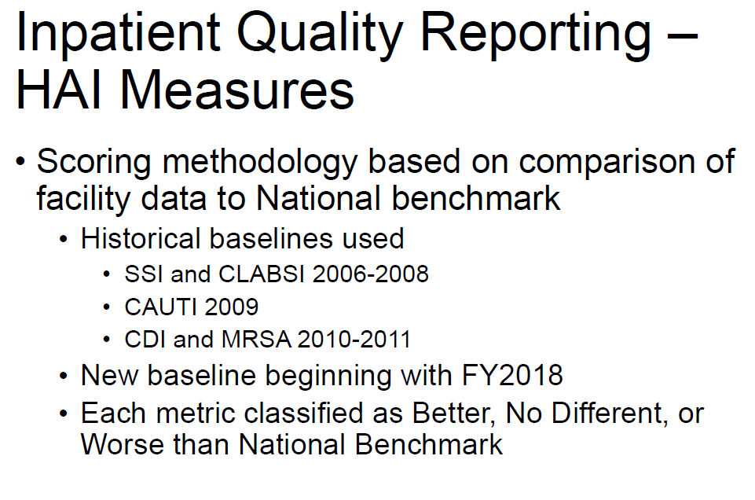
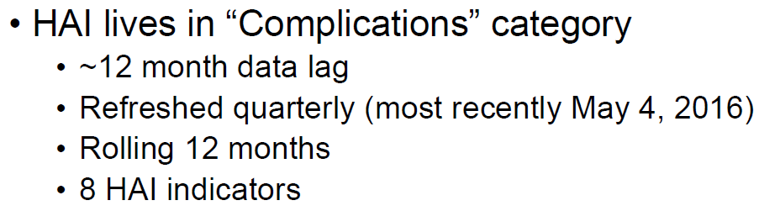
Acronyms and Timelines
And so on!
Notes:
Tougher than it sounds. Make the time, make the plan, don’t be afraid

Slide 8
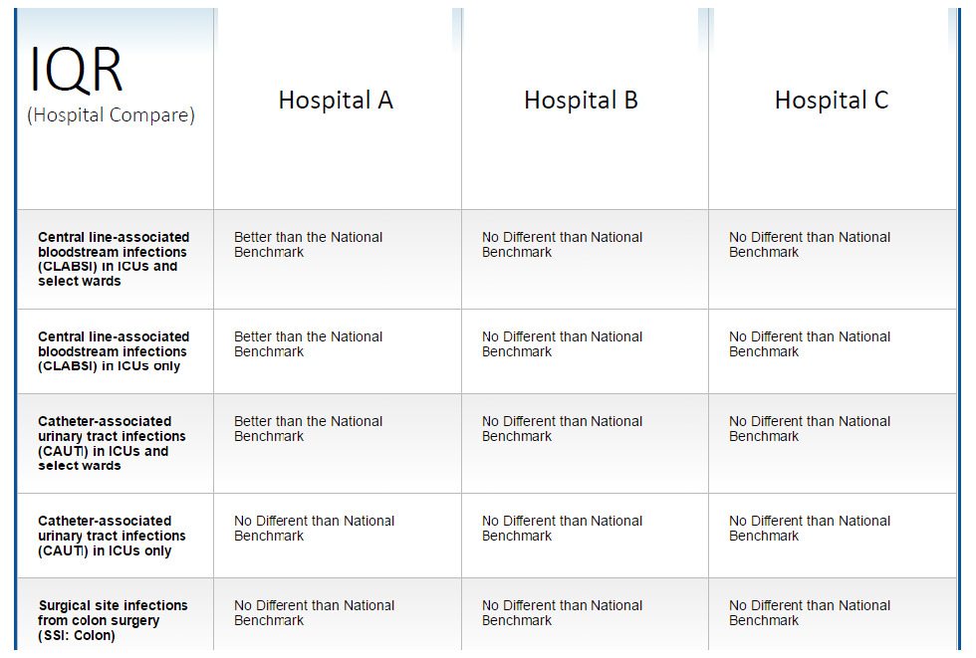
Acronyms and Timelines
And so on!
Notes:
Tougher than it sounds. Make the time, make the plan, don’t be afraid

Slide 9
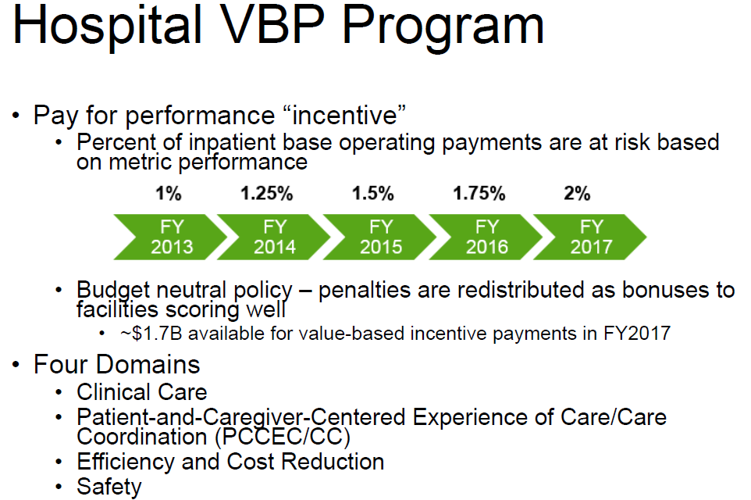
Acronyms and Timelines
Notes:
Tougher than it sounds. Make the time, make the plan, don’t be afraid

Slide 10
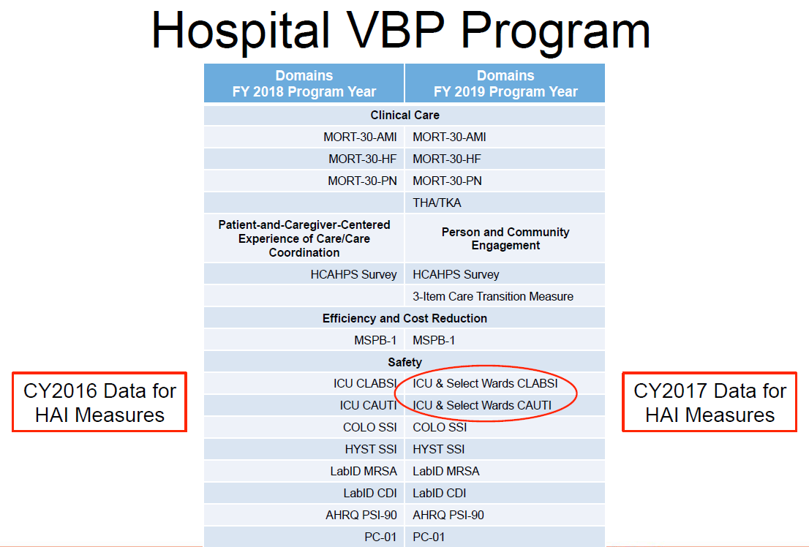
Acronyms and Timelines
And so on!
Notes:
Tougher than it sounds. Make the time, make the plan, don’t be afraid

Slide 11
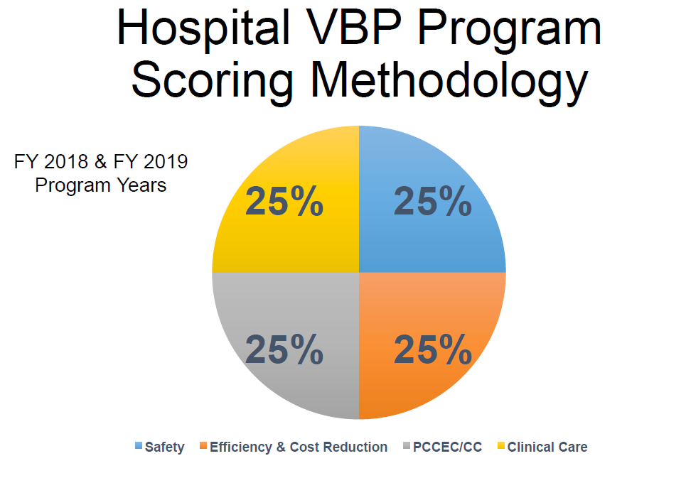
Acronyms and Timelines
Notes:
Tougher than it sounds. Make the time, make the plan, don’t be afraid

Slide 12
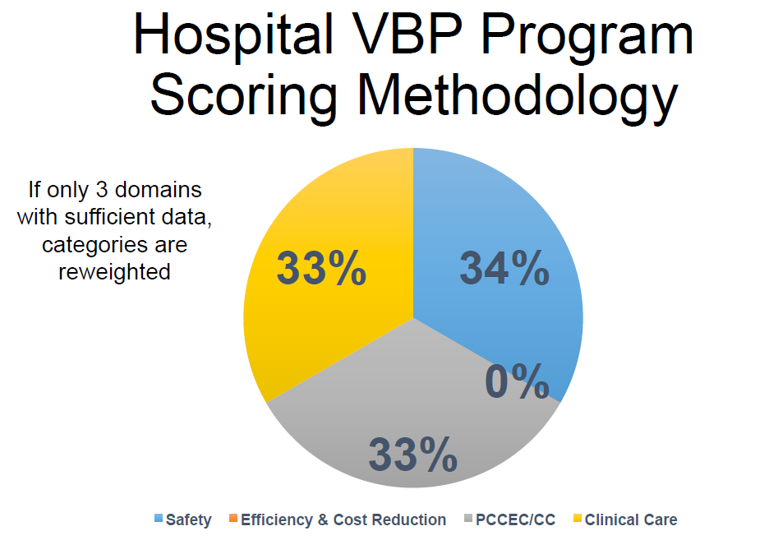
Acronyms and Timelines
Notes:
Tougher than it sounds. Make the time, make the plan, don’t be afraid

Slide 13
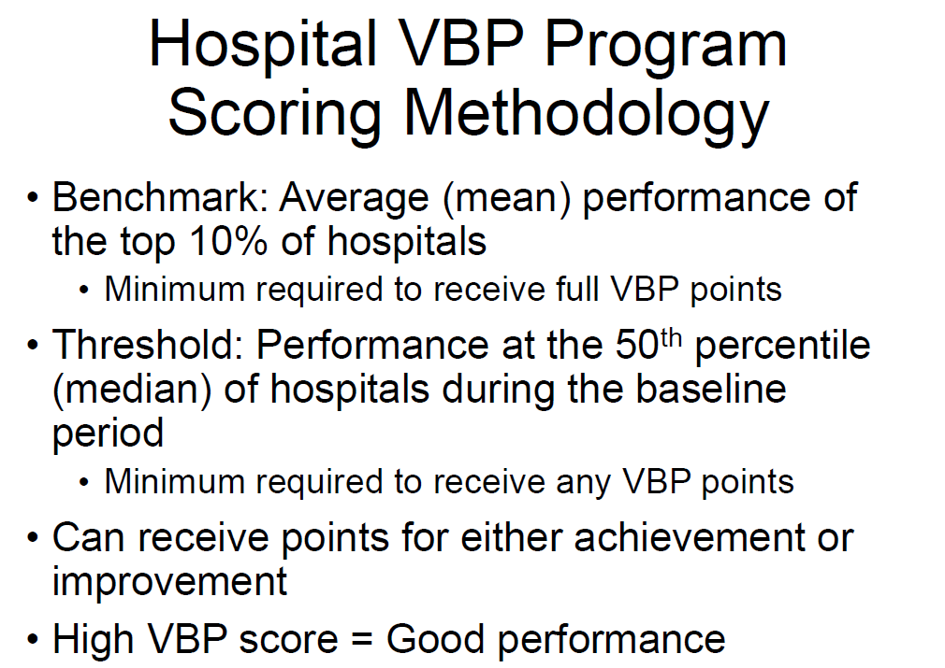
Acronyms and Timelines
Achievement and Improvement points (0-10 scale) are awarded.
Highest score is used to determine TPS
Notes:
Tougher than it sounds. Make the time, make the plan, don’t be afraid

Slide 14
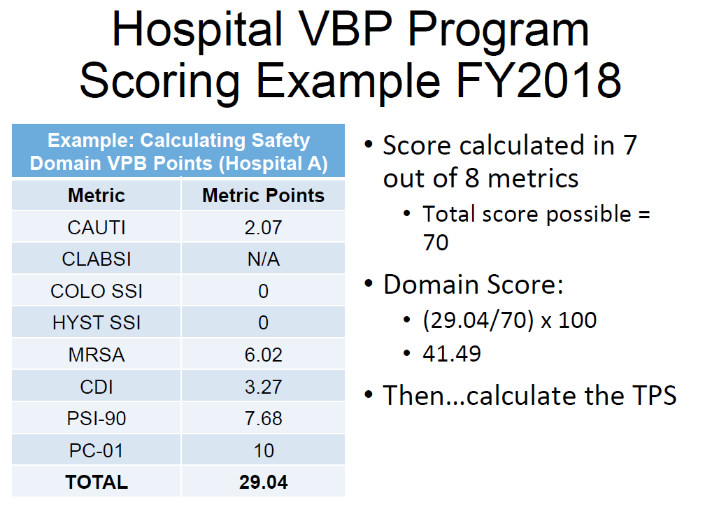
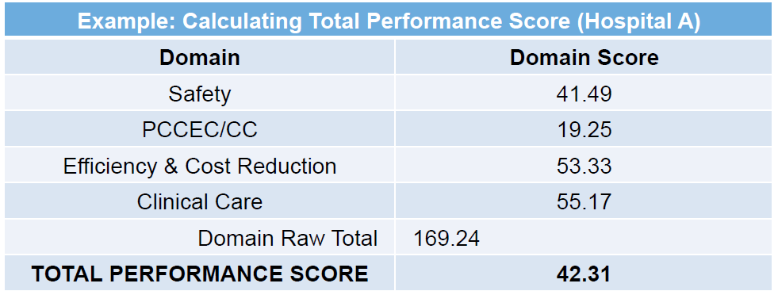
Acronyms and Timelines
Notes:
Tougher than it sounds. Make the time, make the plan, don’t be afraid

Slide 15
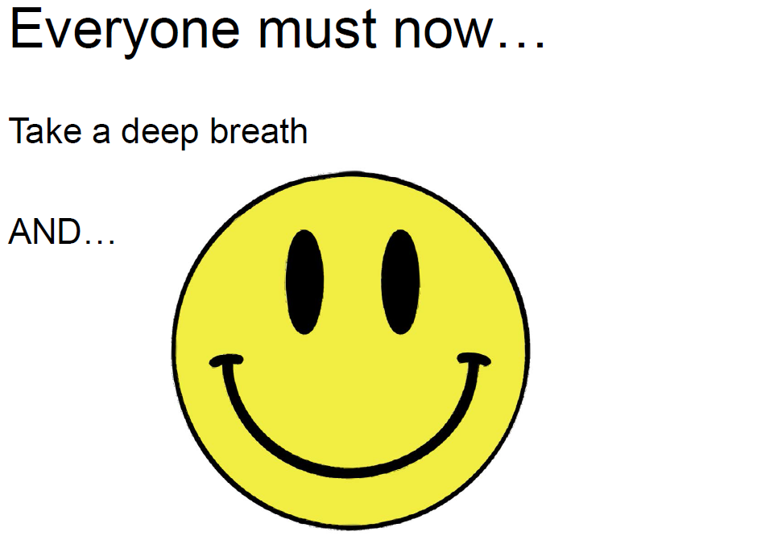
Acronyms and Timelines
And so on!
Notes:
Tougher than it sounds. Make the time, make the plan, don’t be afraid

Slide 16
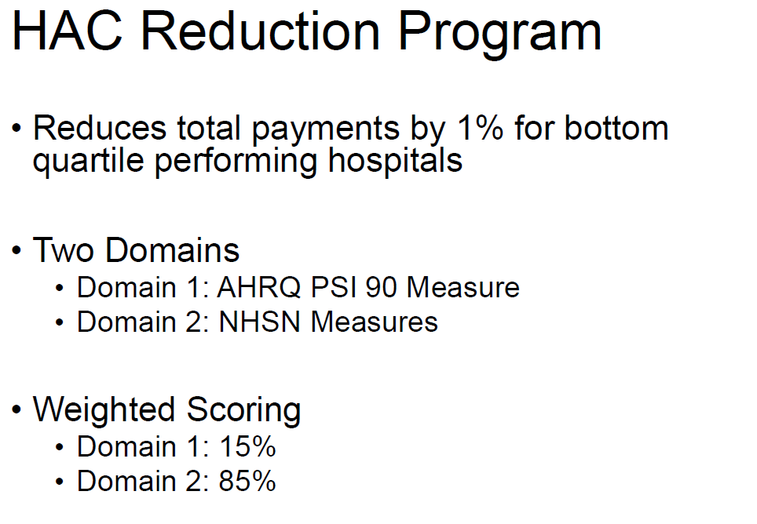
Acronyms and Timelines
i.e. Reduction for Non-performance!
Notes:
Tougher than it sounds. Make the time, make the plan, don’t be afraid

Slide 17
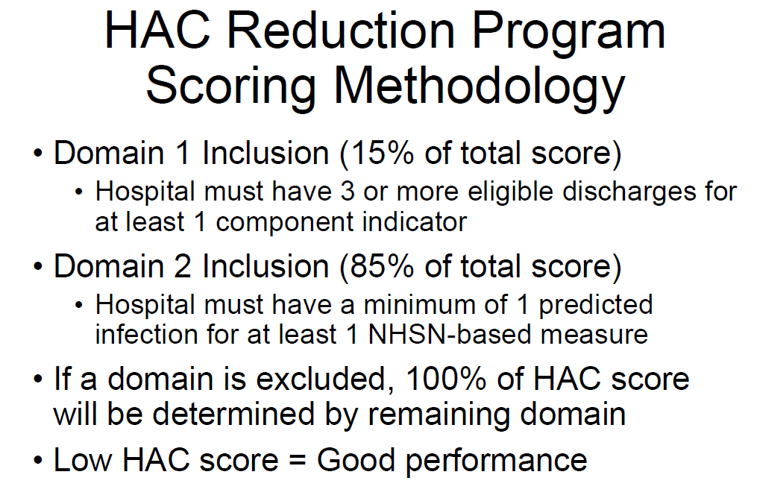
Acronyms and Timelines
Notes:
Tougher than it sounds. Make the time, make the plan, don’t be afraid

Slide 18
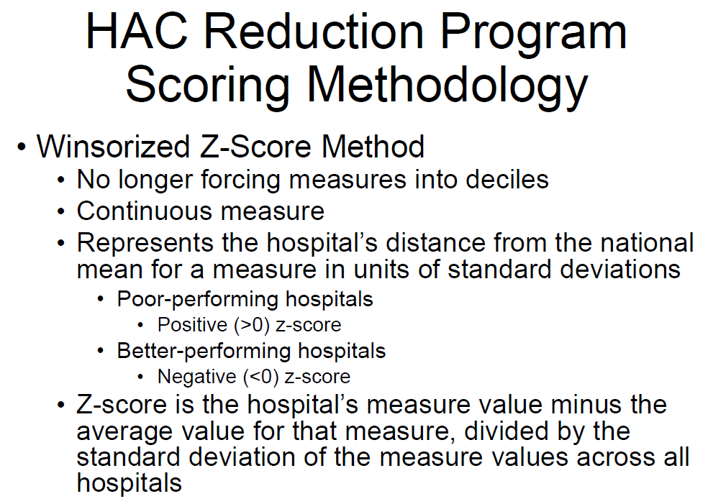
Acronyms and Timelines
Notes:
Tougher than it sounds. Make the time, make the plan, don’t be afraid

Slide 19
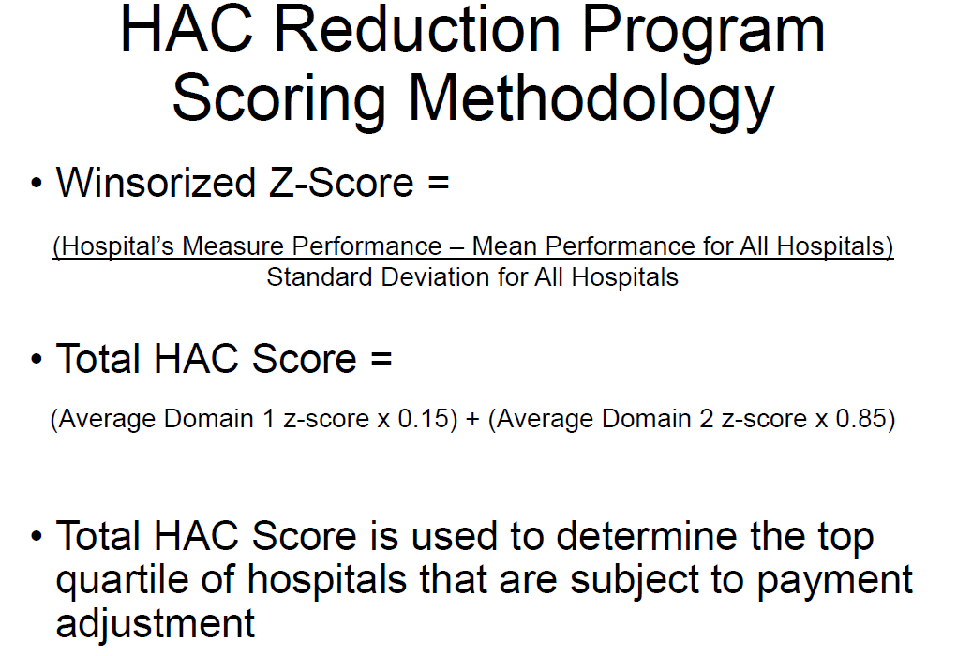
Acronyms and Timelines
And so on!
Notes:
Tougher than it sounds. Make the time, make the plan, don’t be afraid

Slide 20
Acronyms and Timelines
And so on!
Soft +
+ or -
Neutral or -
Notes:
Tougher than it sounds. Make the time, make the plan, don’t be afraid

Slide 21
Key Takeaways
IPPS was well conceived!
positive and negative reinforcement of performance
There will always be a bottom 25%
Process Improvement is exactly that- a continual process!
IP knowledge of the way the programs and domains are visible to agencies and the public can assist organizational strategy
forecasting
Notes:
HAI’s must be acknowledged as defects in care
Defects are defined as shortcomings, faults or imperfections and are viewed by senior leadership as waste.
Fewer complications means improved outcomes
Fewer HAI’s means reduced readmits
Fewer HAI’s means improved patient experience
Fewer HAI’s means elimination of waste
Fewer HAI’s improves chance of getting $$$ back under value based purchasing
Bottom line: It all means better care at a lower cost
Who’s job is it to lower costs? IP’s or executive leadership? It’s shared.
This shows an example of a document used by Ohio Health

Slide 22
Changes at SJHS
After the presentation of this session to my PI department, we came together and decided to pursue forecasting of our HAC scores.
Model currently being developed by Clinical Excellence, Quality
Notes:
HAI’s must be acknowledged as defects in care
Defects are defined as shortcomings, faults or imperfections and are viewed by senior leadership as waste.
Fewer complications means improved outcomes
Fewer HAI’s means reduced readmits
Fewer HAI’s means improved patient experience
Fewer HAI’s means elimination of waste
Fewer HAI’s improves chance of getting $$$ back under value based purchasing
Bottom line: It all means better care at a lower cost
Who’s job is it to lower costs? IP’s or executive leadership? It’s shared.
This shows an example of a document used by Ohio Health

Slide 23

Questions?
Thank You!
Notes:
In closing, Thank you for the gift of scholarship that inspired me to come back and be a better leader. Thank you for your support, generosity and investment in my professional growth and development. I can guarantee you that our community will benefit as a result and I am sincerely grateful.

