Slide 1

Integrating Infection Prevention and Control Programs into the Ambulatory Care Setting: An Evolving Model
Laura Tang, RN
With credits to Infection Preventionists from New York University Medical Center:
Faith Skeete, RN MS CIC
Natalie Fucito, BSN RN CCRN
No Financial Disclosures

Slide 2
Upon completion of this presentation, APIC members will be able to:
List three infection prevention and control concerns in the ambulatory care setting
Describe one way in which to implement new infection prevention and control protocols in your ambulatory care settings
Describe possible ways in which staff in remote outpatient areas can communicate concerns and/or events with their Infection Prevention and Control department

Slide 3
Key Differences Between
Ambulatory & Inpatient
Item | Inpatient Focus | Ambulatory Focus
Screening/ Surveillance | Patient can be screened on admit and tracked | Process surveillance
Isolation Precautions | Transmission Based Precautions | Standard Precautions
Environmental Cleaning | Daily & terminal cleaning | In between patient cleaning and end-of-day cleaning
Hand Hygiene | Environment is defined | Environment less defined

Slide 4
IPC Concerns in Ambulatory Settings
Injection safety & medication handling
Equipment reprocessing
Environmental cleaning
Respiratory etiquette
Developing working relationships with IPC
Occupation Health Services
Hand hygiene (HH) & personal protective equipment (PPE)
http://www.cdc.gov/hicpac/pubs.html

Slide 5
Assessment of Ambulatory Needs: Methods
Setting chosen by location, procedures performed and/or requests from staff
Standardized checklists
Environmental
Administrative
HH & PPE
Storage (clean & dirty)
Injection safety & medication handling
Low level disinfection
Waste disposal
Specimen handling
High level disinfection (HLD) & Sterilization checklists

Slide 6
Assessment of Ambulatory Needs: Results
20 of outpatient settings
4 completed HLD and/or sterilization
16 performed invasive procedures, infusions, and/or injections
Mean time spent inspecting -1.15 hours
Travel
40 minutes (NYC locations) to 3 hours (Brooklyn locations)
public transportation (e.g. train, cab), NYU shuttle service, personal vehicles and walking

Slide 7
Assessment of Ambulatory Needs: Results
Findings:
Fatal (results in injury, ill health or death)
None
Major (results in health problems or requiring medical treatment)
HLD without adequate ventilation
Glucometer storage
Multi dose medication vials without dates and prepared in room with patient
Other injection safety issues- verbalized vs. observed
Quality control for HLD/ sterilization unclear to staff
Ointments/ creams used on multiple patients (for non-intact skin)
Endoscope pre-cleaning, packing, HLD and sterilization completed in one room
Specimens and medications stored together in refrigerator
Mixture of clean and dirty

Slide 8
Assessment of Ambulatory Needs: Results
Minor (results in superficial injuries)
Appropriate pressurization varies/fluctuates in critical areas as well as in storage areas
Incorrect signage (e.g. ‘utility’ vs. ‘supply’)
Shipping boxes in clinical/clean areas
HH (e.g. monitoring, indications for)
No bleach wipes noted
Verbalized incorrect use of disinfection wipes/contact time

Slide 9

From Assessment to Integration

Slide 10
Infection Prevention to
Infection Management
Necessary with the changing landscape of healthcare
Impossible to take an inpatient approach to the ambulatory world.
Program management approach to implementing an Infection Control Program in the ambulatory setting
Assessment
Build relationships
Create an environment of safety
Disseminate data
Expand and evolve your program

Slide 11
Assessment
Assessment of the current Ambulatory Network included the following:
Distributing a needs assessment survey to providers
Gathering information from other teams regarding growth, infrastructure, and services offered at various locations
Stratifying locations by location and risk

Slide 12

Build Relationships
Identify key stakeholders
Environmental Health & Safety
Regulatory
Clinical Compliance
Real Estate and Development
Onsite leadership (Administrative and Clinical)
Communication is key and face time is a must
Work towards a common goal
Identify yourself as a resource

Slide 13
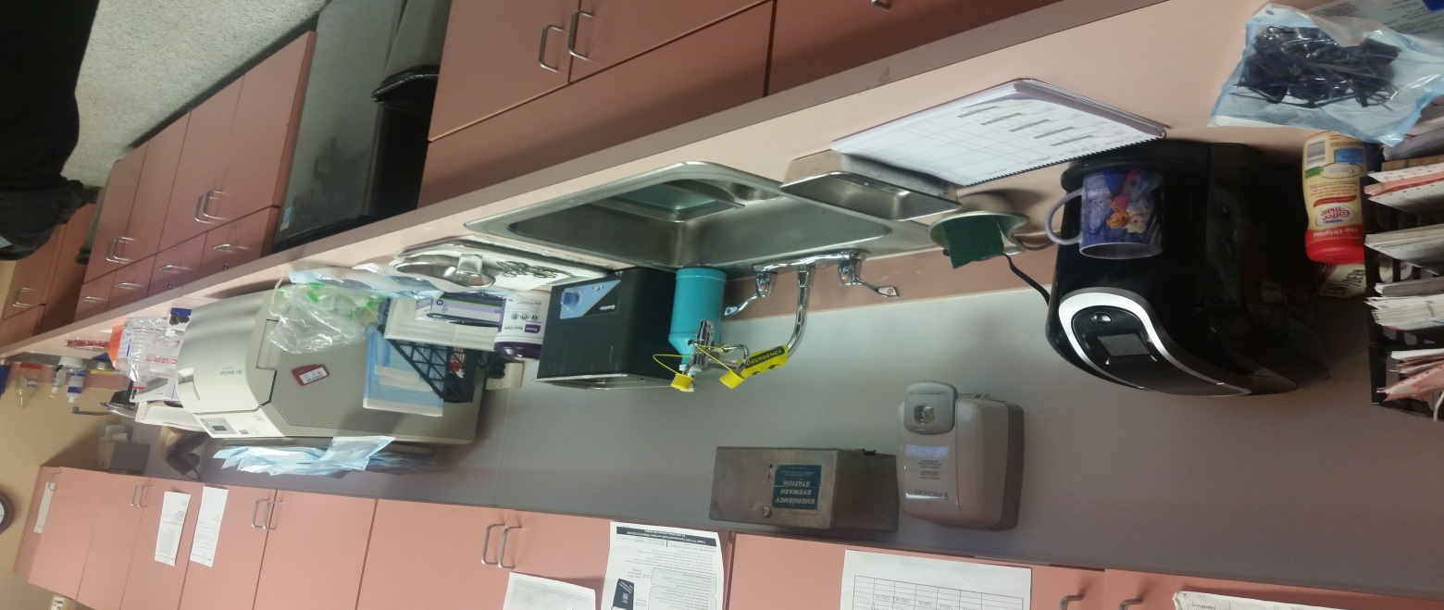
Create an Environment of Safety
Introduce infection control standards to facilities
Non-punitive, constructive, and facilitate change
Do not expect immediate change
Focus on highest risk items
food and drink near sterilized instruments & autoclave
food and drink near disinfection
sink

Slide 14
Disseminate Data
Collect data from each visit
Analyze data
Disseminate data to key stakeholders
Elicit feedback
Collaborate on how to improve

Slide 15
Expand Your Program
Take knowledge gleaned through data and subjectively to implement the following:
Emerging pathogen awareness
SSI surveillance
Central line surveillance
New policies and procedures
Antimicrobial Stewardship
Database development
HH monitoring program

Slide 16
Challenges
Knowledge gaps regarding infection control
Physical layout
Inconsistencies between practices
Increased amount of resources and focus requires a change in practice

Slide 17

Wins
Meeting new people across your institution
Collaborating as a team
Scope of impact is immeasurable
On the forefront of change in infection control and healthcare
Overall IPC is well welcomed!
Interesting and fun!

Slide 18
Communication is Key…
Promote all forms of communication…
Phone
Text
Email
IPC Webpage/social media page
Sharepoint
Webex/go-to-meeting

Slide 19
Conclusion
Implementing an infection control program in your ambulatory care environment requires:
Adequate assessment
Building new relationships
Creating a culture of safety and quality
Data analysis
Expansion to an evolved ICP program
Communication is key. Use your resources to keep the ambulatory world connected to your Infection Prevention and Control Department.

Slide 20
What we know for sure…
The environment of ambulatory care is evolving and requires a thoughtful approach to assessing infection control risks.
Change requires the support of:
Leadership
A dedicated multi-disciplinary team
Additional resources (time and money)
The revolution of healthcare improvement requires an evolution in infection prevention.

Slide 21

With Deepest Appreciation
Thank You!
Notes:
In closing, Thank you for the gift of scholarship that inspired me to come back and be a better leader. Thank you for your support, generosity and investment in my professional growth and development. I can guarantee you that our community will benefit as a result and I am sincerely grateful.

