Slide 1

NHSN Surveillance Definitions
Kim Stanley, MPH, CIC
Peter Kolonoski, RN, MSN, CIC
Karen Anderson, CLS, MPH, CIC
APIC SFBA 11/11/15

Slide 2
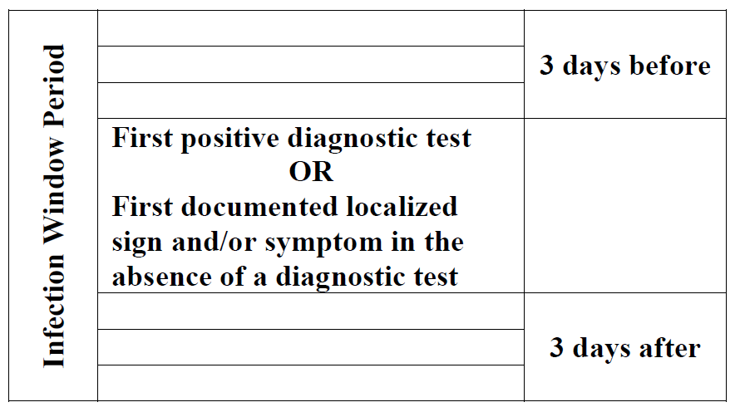
Infection Window Period
Gone are the ‘gap days’!
This is the ‘window’ in which all elements used to meet the site specific infection criteria must occur.
It includes 3 days prior to positive diagnostic test and 3 days after.
The following are considered diagnostic tests:
Laboratory specimen collection
Imaging test
Procedure or exam
Physician diagnosis (can only be used if it is an element of the specific infection definition)
Initiation of treatment

Slide 3
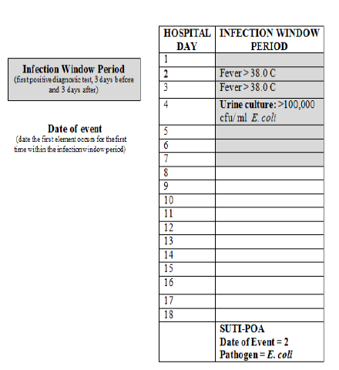
Event Date
2015: Event Date Hospital Day 2= POA
Prior to definition change: Hospital Day 4= HA
Date of FIRST element used to meet site specific infection criteria for first time during the seven-day infection window period. Prior to this change event date was based on the date of the last element used to meet infection criteria.
Note: It is acceptable to use patient reported signs and symptoms that are documented in the medical record (e.g. patient states fever >38 at home).

Slide 4
Case Study-
Infection window period
54 yo male with an intraabdominal abscess was admitted on 9/30 and was taken to the OR (Foley placed). He spiked one fever >38 on 10/1 with no subsequent fevers documented. On 10/4 patient’s Foley removed and urine cultured (why?!). Urine grows >100K E. coli. Does this count as a CAUTI?
Yes and No!
In 2014 this would have been ruled out because of more than 1 ‘gap day’ between symptom and culture, but now the first symptom (fever on 10/1) is within the 7 Day Infection Window (10/1-10/7)
BUT this first symptom is now considered the EVENT DATE and is in the POA window (9/30-10/1).

Slide 5
Unit Attribution-
Transfer rule
If the date of event is on the date of transfer or discharge, or the next day, the infection is attributed to the transferring/discharging location.
Multiple Transfers:
In instances where the patient has been transferred to more then one location on the date of infection, or the day before, attribute the infection to the first location in which the patient was housed the day before the infection’s date of event.

Slide 6
Case example- unit attribution
Patient transferred to unit A on 9/20 at 1452 and transferred to unit B on 9/22 at 0042. On 9/23 patient transferred to unit C at 1427 and blood culture drawn at 1744 positive for Candida glabrata. This patient has a central line and no primary infection site. Which unit gets ‘credit’ for the CLABSI?
UNIT A- even though the patient was only on this unit for 42 minutes of the day before date of event!

Slide 7
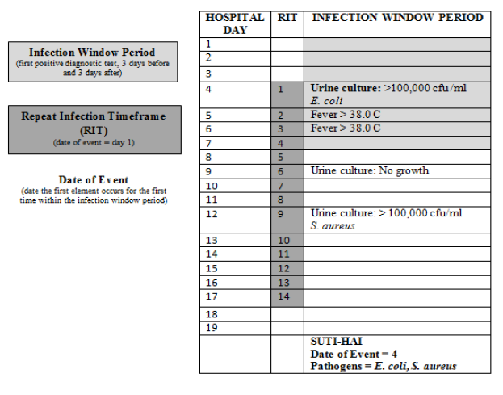
Repeat Infection Timeframe (RIT)
Add additional pathogens to event: E. coli and S. aureus reported as one event.
Ok to have a negative culture between the two positive cultures.
14 day period in which no new infections of the same type are reported, Event Date is Day 1 of this period.
Note: The RIT applies during a patent’s single admission only (including day of discharge and day after).
Notes:
Added in effort to eliminate chronic types of infections. Can be different organisms.

Slide 8
UTI- Repeat Infection Timeframe
Note: Do not change the device-association determination during the RIT.
  Example: A non-catheterized UTI is identified and initiates an RIT. During the RIT, a Foley catheter is placed and more than 2 days later, still in the RIT, another urine culture is collected and reported positive for > 100,000 cfu/ml with a different bacteria. Add this pathogen to the original UTI but do not change the non-catheter associated UTI to CAUTI.
Notes:
Device-association is determined by initial infection. Another example is CLABSI---if CL is added after initial LCBI, it doesn’t become a CLABSI.

Slide 9
Case study-
LCBI Repeat Infection Timeframe
A patient is admitted with an intra-abdominal abscess culture positive for E. coli with a secondary bloodstream infection. 5 days later this patient cultures Staph aureus from his blood.
Can this blood culture be added to the RIT for the E. coli that was POA?

Slide 10
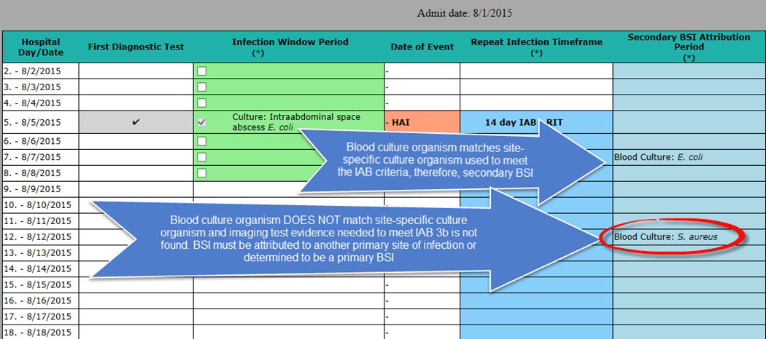
NO
LCBI criteria are not satisfied when a BSI is secondary to another site of infection, therefore no LCBI (BSI) RIT is created. Any BSIs that occur during the IAB RIT would need to be considered as a potential NHSN primary BSI
Notes:
Explain. What if pt had a ABD CT on 8/11 showing fluid accumulation in abdomen. S aureus would then be 2/2 to IAB.

Slide 11
Repeat Infection Timeframe and SSI
If applying RIT to SSI:
  The RIT only applies at the same level of specific type of infection.
    A patient can only have one BONE infection during the RIT, but they can have a BONE and DISC infection (two overlapping RITs)
  Case study
    Spine surgery
      Cervical fusion
      Thoracic laminectomy
    Osteo develops in the cervical area
    Disc infection develops in the thoracic area
  TWO separate SSIs
  What if the disc infection occurs in the cervical area within 14 days of the osteo diagnosis?

Slide 12
Central line Associated Bloodstream Infection (CLABSI)
Patient admitted with CL from OSH on 6/7/15 at 22:00
On 6/8 at 01:30 fever 38.8, lactate was 3.5
On 6/8 at 02:30 patient was transferred to ICU
On 6/8 3 pm patient had exp lap for SBO
On 6/9 at 00:20 blood culture was drawn
Blood culture grew Enterobacter
No S/S of SSI found
Is this a CLABSI?
Is this POA or HAI?

Slide 13
SECONDARY BLOODSTREAM INFECTIONS
In order for a bloodstream infection to be considered secondary:
You must have a matching organism found in a site-specific infection culture
OR
The blood culture must be an element used to meet the site-specific infection criteria.
No more “logical pathogen”!

Slide 14
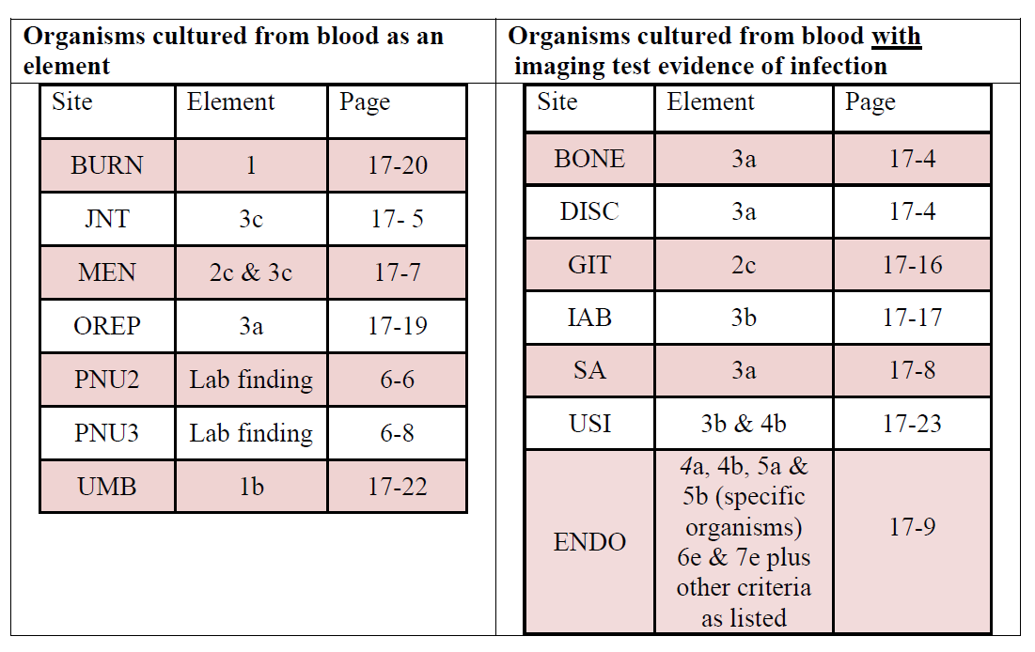
If you do not have a matching culture from the primary infection site- you may only use the below site specific definitions to determine a secondary bloodstream infection.
Note: the site specific infections on the right- also require an imaging test with evidence of infection with that positive blood culture.

Slide 15
SECONDARY BLOODSTREAM INFECTIONS-Case Study
Pt admitted with mitral stenosis/regurgitation.
Hx: IV drug abuse, ESRD, coagulopathy
Pt underwent mitral valve replacement, tricuspid annuloplasty
Recovered poorly, requiring pressor support
On POD #6, Temp = 38.4. Blood cultures grew K. pneumoniae
MD Note POD #6: “ Vasculopathy contributed to compromise perfusion of mesenteric vessels. Suspect bowel necrosis.”
Pt expired on POD#7

Slide 16
SECONDARY BLOODSTREAM INFECTIONS-Case Study
Surgical Pathology: “Focal acute inflammation, consistent with acute endocarditis”
Meets definition of endocarditis (7)

Slide 17
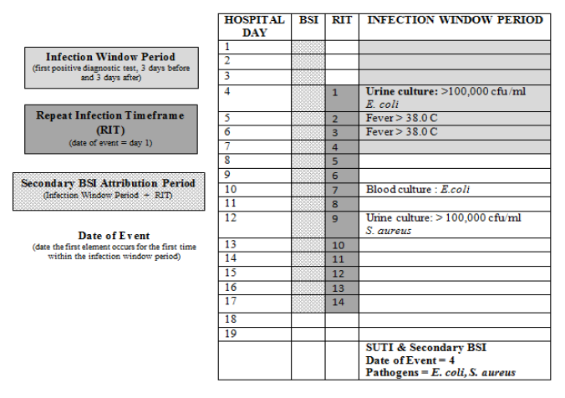
SECONDARY ATTRIBUTION PERIOD
This period includes the Infection Window Period combined with the Repeat Infection Timeframe.
It is 14-17 days in length depending on the date of event.

Slide 18
Secondary BSI Attribution Period
The period of time in which a positive blood culture must be collected to be considered a secondary bloodstream infection to a primary infection site.
For example- if a patient has an IAB infection that meets the following criteria:
  Fever >38
  Abdominal pain
  CT showing abscess
  Positive blood culture: K. pneumoniae
In order for this bloodstream infection to considered secondary to the IAB- it must have been collected 3 days prior to and 13 days after the IAB event date.

Slide 19
Case study- secondary bsi
On 9/22 patient was noted to be more tachycardic and tachypneic with a significant drop in platelets and fever >38. On 9/23 one central blood culture was drawn and positive for Staphylococcus aureus. At time of this positive culture patient with PICC inserted 9/17 and vented via tracheostomy since 9/10. Patient developed an increase in purulent secretions and an endotracheal aspirate is positive for numerous S. aureus, many PMNs. CXRs with no evidence of pneumonia. MD starts treatment for tracheitis.
Can the S. aureus bacteremia be considered secondary to S. aureus tracheitis?

Slide 20
No the BRON definition (which included tracheitis) has been removed from Chapter 17 in 2015.
Per NHSN:
The definition was, in some instances, inappropriately used as a site for assigning a secondary BSI when PNEU, VAP or VAE were not met.
From an NHSN standpoint the primary purpose of Chapter 17 definitions is for secondary BSI assignment and specific site assignment for an Organ/Space SSI infection.
BRON infections are clinically not a likely source of a secondary BSI and BRON is not available as a specific site for an organ space SSI.

Slide 21
case study: Secondary bsi
Postoperative patient has an intraabdominal abscess (IAB) noted during reoperation and purulent material is obtained at that time which grows Escherichia coli. The patient spikes a fever two days later and blood culture shows Bacteroides fragilis.
Can the B. fragilis blood culture be considered secondary to this patient’s IAB?

Slide 22
No
Because the organisms from the site and blood cultures do not match, and no site-specific criterion that includes positive blood culture as an element is met, both a site-specific infection (GI-IAB criteria 1 and 2) and a primary BSI would be reported.

Slide 23
Case study- secondary bsi
Patient is febrile, has a new onset of cough and has positive chest radiographs indicating the presence of an infiltrate. Blood and bronchoalveolar lavage (BAL) cultures are collected. Culture results show Klebsiella pneumoniae > 10K cfu/ml from the BAL and Pseudomonas aeruginosa from the blood.
Can the P. aeruginosa in blood be considered secondary to pneumonia?

Slide 24
Yes
Because the patient can meet PNU2 definition by using the positive blood culture as one of the elements of the infection criterion (i.e. infiltrate on chest x-rays, fever, new onset of cough and positive blood culture), the blood is considered a secondary BSI to a PNEU. No primary BSI would be reported.

Slide 25
Case study- secondary bsi attribution period
A patient (with a central line) cultures positive for Candida albicans on 3/31 and starts to have daily blood cultures drawn which are all positive through 4/6. On 4/7 this patient meets the SKIN primary infection site criteria (WITH a matching skin culture of Candida albicans). Can these blood cultures be considered secondary to this skin infection?

Slide 26
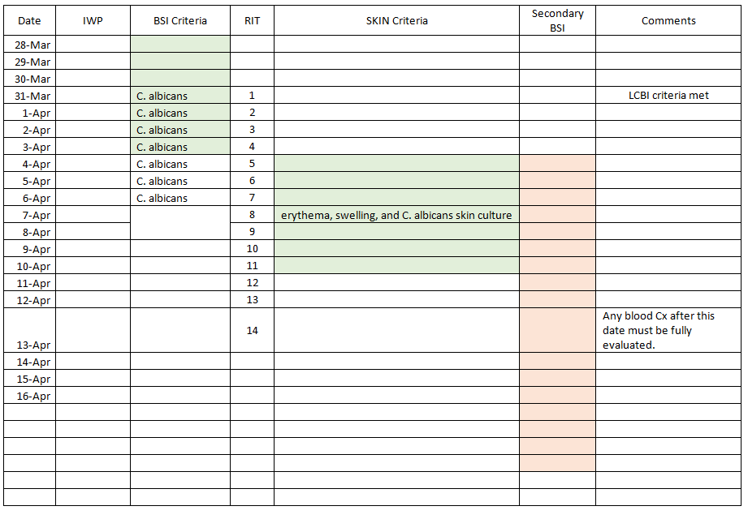
YES and NO! The first 4 blood cultures are outside the secondary BSI attribution period and must be considered a CLABSI. The last 3 are considered secondary to the skin infection.
For this single case we have a primary BSI (CLABSI) and a SKIN infection with
secondary BSI- all with the same organism.

Slide 27
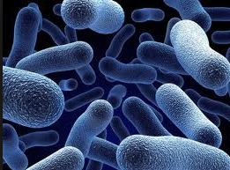
CAUTI
Urine with yeast or bacteria <10⁵ CFU/ml no longer part of CAUTI surveillance.
  CLABSIs with yeast may increase since a primary site of infection of yeast UTI can not be used.

Slide 28
Case study 1: cauti
Patient transferred from OSH on1/24, with F/C in place. On 1/28, urine is noted to be cloudy. UA and culture ordered. UA shows 1+ Leuk Est, 20WBC/hpf. Urine culture grows >100K/mL Klebsiella pneumoniae.
Tmax = 37.8. Pt denies pain.
Is this a CAUTI? POA or HAI?

Slide 29
Case study 1: cauti
NO, not a CAUTI. There are no signs or symptoms.

Slide 30
Case study 2: cauti
Patient transferred from OSH on1/24, with F/C in place. On 1/28, patient has aspiration event. On 1/29, T = 38.9. CXR shows opacity in left lower lobe. Sputum culture grows 2+ Klebsiella pneumoniae.
On 1/31, urine is noted to be cloudy. UA and culture ordered. UA shows 1+ Leuk Est, 20 WBC/hpf. Urine culture grows >100K/mL Klebsiella pneumoniae.
Is this a CAUTI? POA or HAI?

Slide 31
Case study 2: cauti
YES, this is a CAUTI, HAI. Fever is a non-specific symptom of infection and cannot be excluded from UTI determination because it is clinically deemed to be from another cause.

Slide 32
Case study 3: cauti
A 64 yo patient admitted with lumbar stenosis. F/C inserted in OR on day of admission (7/20).
F/C removed on 7/24 @06:00.
Pt had difficulty voiding. F/C reinserted 7/25 @19:30. T = 38.3 on 7/26. Urine culture on 7/26 grew > 100K/mL E.coli
Is this a CAUTI? POA or HAI?

Slide 33
Case study 3: cauti
YES, this is a CAUTI, HAI. There must be one calendar day (NOT 24 hours) without the catheter in place for the catheter day count to start anew.

Slide 34
Case study 4: cauti
F/C was inserted on day of admission (4/18).
On 4/20, T = 39.0. UA was positive, 2+ Leuk est
Urine culture grew >100K/mL E.coli + 1-10K/mL Mixed Urinary Flora
Is this a CAUTI? POA or HAI?

Slide 35
Case study 4: cauti
NO, not a CAUTI. The urine culture grew more than two species of organisms.

Slide 36
Case study 5: cauti
F/C was inserted on day of admission (6/22).
On 6/24, T = 39.0. UA was positive, 2+ Leuk est
Urine culture grew >100K/mL E.coli + 1-10K/mL Candida albicans + 10-25K/mL Candida glabrata.
Is this a CAUTI? POA or HAI?

Slide 37
Case study 5: cauti
NO, not a CAUTI. The urine culture grew more than two species of organisms.

Slide 38
SSI Changes
Infection ‘Present at Time of Surgery’ (PATOS) required for all SSI events
  This only applies if the infections are at the same depth
    Example: if a patient had evidence for intraabdominal infection at time of surgery and returns with a deep or superficial infection after surgery- this does not count as PATOS.
  In 2016 the cases noted to be PATOS will be excluded from SIR analysis
Revision of total or partial HPRO and KPRO: look for previous infection (based on ICD9 code) at joint within 90 days prior to revision.
  In 2016 will be used in the risk adjustment models

Slide 39
SSI Changes
Diabetes
  Use of discharge ICD-9-CM codes in the 250 to 250.93 range are acceptable for use to answer YES to the diabetes field question.
  To allow the use of ICD-9-CM coded data, NHSN eliminated the following exclusion factor – “or a diagnosis of diabetes that is controlled by diet alone”
Multiple Tissue Levels Involved in Infection
  Specified how to identify the date of event:
    If an SSI started as superficial SSI on day 10 of the surveillance period and then a week later, (day 17 of surveillance period) meets criteria for deep incisional SSI the date of the event would be the date of the deep incisional SSI.

Slide 40
SSI Changes
Primary Closure:
  Removed the phrase “all tissue levels” from the definition.
  Rationale: Definition should be easier to apply and is closer to definitions used by other surgical professional groups.
Non-Primary Closure:
  Changed the phrase “superficial layers” to “skin level”
  Removed the following section: “If the deep fascial levels of an incision are left open but the skin is closed, this is considered a non-primary closure since the incision was not closed at all tissue levels.
  Rationale: The above scenarios would actually meet criteria for a primary closure since the skin was closed.

Slide 41
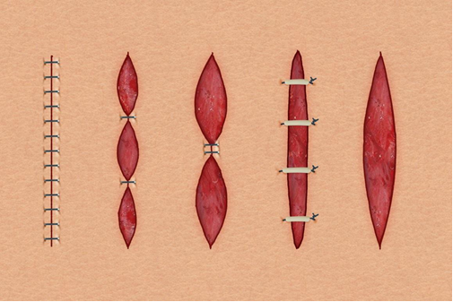
Wound Closure Examples
Primary Closure
Closure other than primary

Slide 42

Got all that?!
Questions?
Kim Stanley: Kim.Stanley@ucsf.edu
Peter Kolonoski: KolonoP@sutterhealth.org
Karen Anderson: AndersK@sutterhealth.org

