Slide 1
Multi-faceted approach to Healthcare Associated Infection (HAI) reduction
Infection Prevention
Jorge Bernett, MD IP Medical Director
Joanna Mills, RN, MSN, CNS, CIC
Kathryn Nunnally, RN, BSN, CIC
Lilia Ryan, MPH, CIC
Jean Lemberger, RN, MSN, CIC
Naomi Alcala RN, BSN ,CEN
Melissa McRae, MSHCA, Quality & Patient Safety Program Manager

Slide 2
Objectives
Describe methods utilized for device HAI reduction
Understand elements of CDI risk assessment and testing protocol
Identify components of a successful hand hygiene program

Slide 3
Background
John Muir Health is a community based healthcare system comprised of two acute care hospitals with a combined total of 799 licensed beds and extensive clinic system in Contra Costa County CA. As of early 2016, John Muir Health (JMH) Medical Centers had sustained high rates of HAIs for a few years with little change despite various practice interventions. It became apparent that to address healthcare associated infections (HAIs) a variety of interventions must be employed in both prevention and reduction strategies.

Slide 4
Methods
There were numerous efforts by multi-disciplinary teams that had an influence on improvement. The areas of focus that comprised the multifaceted approach included:
IP workflow, data analysis, physician engagement
HAI Improvement Team (Nursing)
CDI Task Force
Hand Hygiene Program

Slide 5
Methods: IP workflow, data analysis, physician engagement
The Infection Prevention Department led by the Medical Director conducted in-depth analysis that identified opportunities, developed approaches and disseminated strategies to medical and nursing staff who in turn developed operational action plans.
The IP practitioners streamlined their work flow to focus on rounding, staff engagement, education and participation in Quality nursing councils for trends, analysis and outcomes. They are responsible for the hand hygiene compliance data collection and coaching.

Slide 6
Methods: HAI Improvement Team (Nursing)
Nursing formalized a case review process that engaged bedside staff from all disciplines and empowered them to create the change necessary for improvement.
  Developed case review forms
  Conducted Case reviews, lead by bedside staff on the nursing units
  Extended process to include collaborative coordinated structure which included nursing staff from both Walnut Creek and Concord Medical Centers
  Expanded scope to include all HAIs
Identified obstacles to care, practice issues and implemented practice changes and actions
  Standardized catheter care and timing
  Developed bathing process with Theraworx, completed within 4 hours of a patient transferring from critical care or a stepdown unit to a medical/surgical unit to decrease chance that a bath would not occur for over 24 hours
  Instituted patient hand hygiene standard
  Updated Nurse driven catheter removal policy

Slide 7
Methods: CDI Task force
The CDI task Force began in late 2015 after a review and recommendations from CDPH. In mid 2016 the team expanded membership and refocused efforts to address prompt identification of risk and testing. Utilizing evidence based guidelines, historical analysis trends and clinical case reviews, the team developed, trialed and implemented a testing algorithm that significantly improved outcomes. By the end of 2017 the rate of HO CDI decreased below the CMS baseline.
Interventions included:
  CDI Testing algorithm, prompt risk identification and testing
  Focused and enhanced daily cleaning (New beach based product)
  Patient and staff hand hygiene
  EMR enhancements: documentation, orders and reports
  Antibiotic Stewardship

Slide 8
Methods: Hand Hygiene Program
The Hand Hygiene Program was reintroduced utilizing TJC TST (targeted solutions tool) developed to reduce variation in data quality. The program improved HH practice through standard work, refreshed education, team coaching, and a system of accountability from front line staff up through senior leadership. Implementation utilized a phased approach preceded by a pilot.
  Infection prevention staff function as direct and open observers, collecting compliance data and coaching staff.
  HH coaches were recruited from unit staff and trained to focused on collecting barrier data; the what and why. They also are responsible for coaching when non-compliance is observed, a major factor to create culture change.
  Each department was responsible for Action Plans utilizing the barriers identified by unit coaches.

Slide 9
Results
2017 was a very positive year related to considerable improvement in HAI prevention and outcomes for both Medical Centers. Overall there was a 30% reduction in HAIs. The most significant improvement was in Clostridium Difficile Infection (CDI). Although there was a notable decrease in CAUTI, unfortunately there was not a reduction sufficient to reflect CMS SIR threshold. CLABSI results were also improved falling below the CMS SIR threshold.
The dramatic success of the Hand Hygiene Program not only improved compliance from a baseline 51% to 89% but also served to focus on HAIs that had a direct and indirect impact on improvement.

Slide 10
Process: Improved Hand Hygiene compliance
House-wide Baseline (11/2016-12/2016) | House-wide December, 2017
51% | 89%

Slide 11
Outcome: Successful HAI Reduction
2016-2017 HAI Count Before and After Implementation
HAIs per month Before: 19
HAIs per month After: 11
Measurement period at left: 1/2016-12/2017 (2 years)
HAI count reported is the median
Hand Hygiene (HH) program implemented 1/2017
Change (shift) in HH behavior occurred after 3/2017
“Before” and “after” refer to the change that occurred after 3/2017

Slide 12
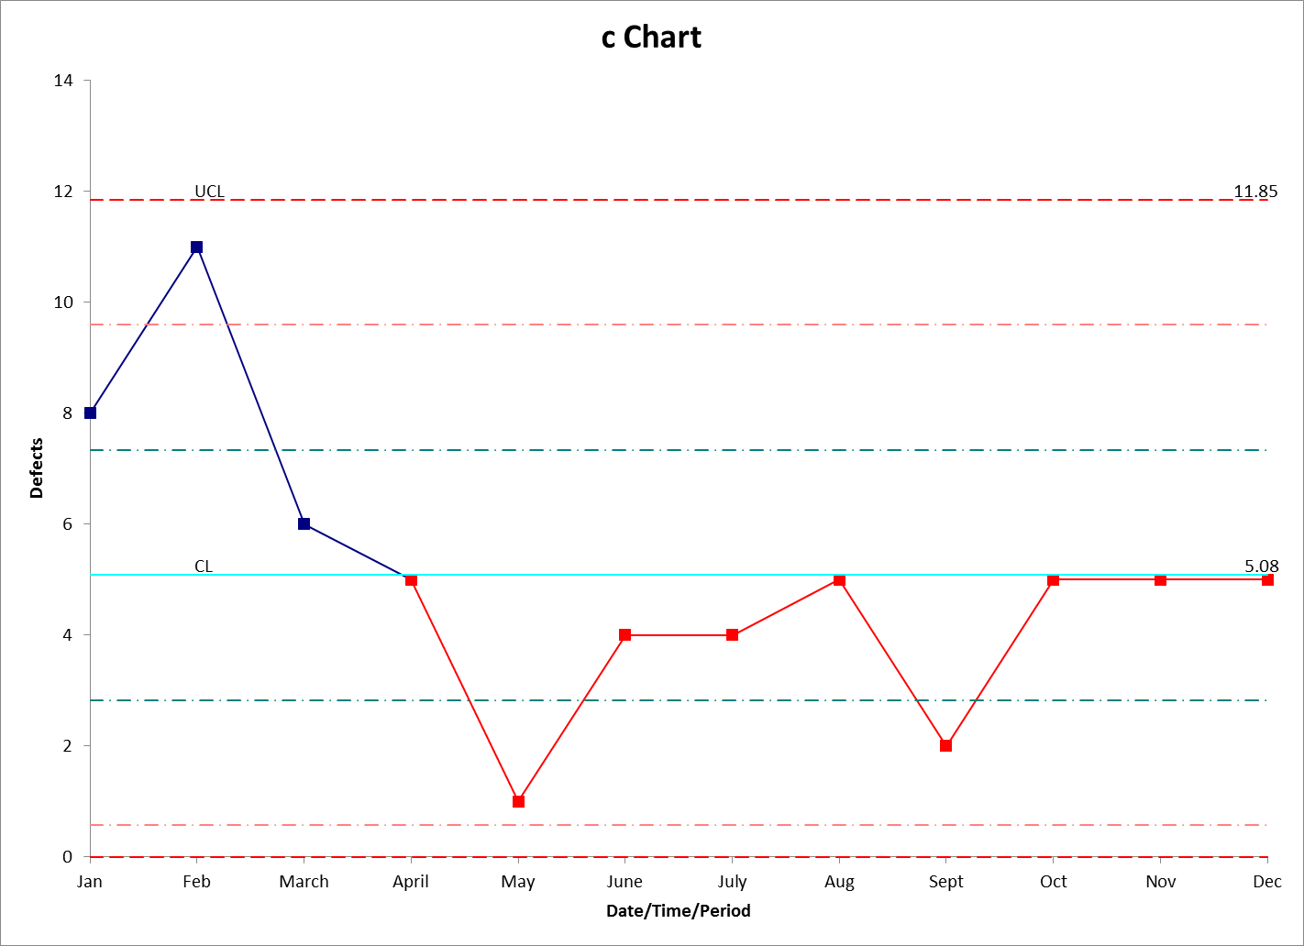
JMH Walnut Creek Medical Center
Process Control CDI
Testing Protocol
EPIC Screening report
BRU Tab Cleaning

Slide 13
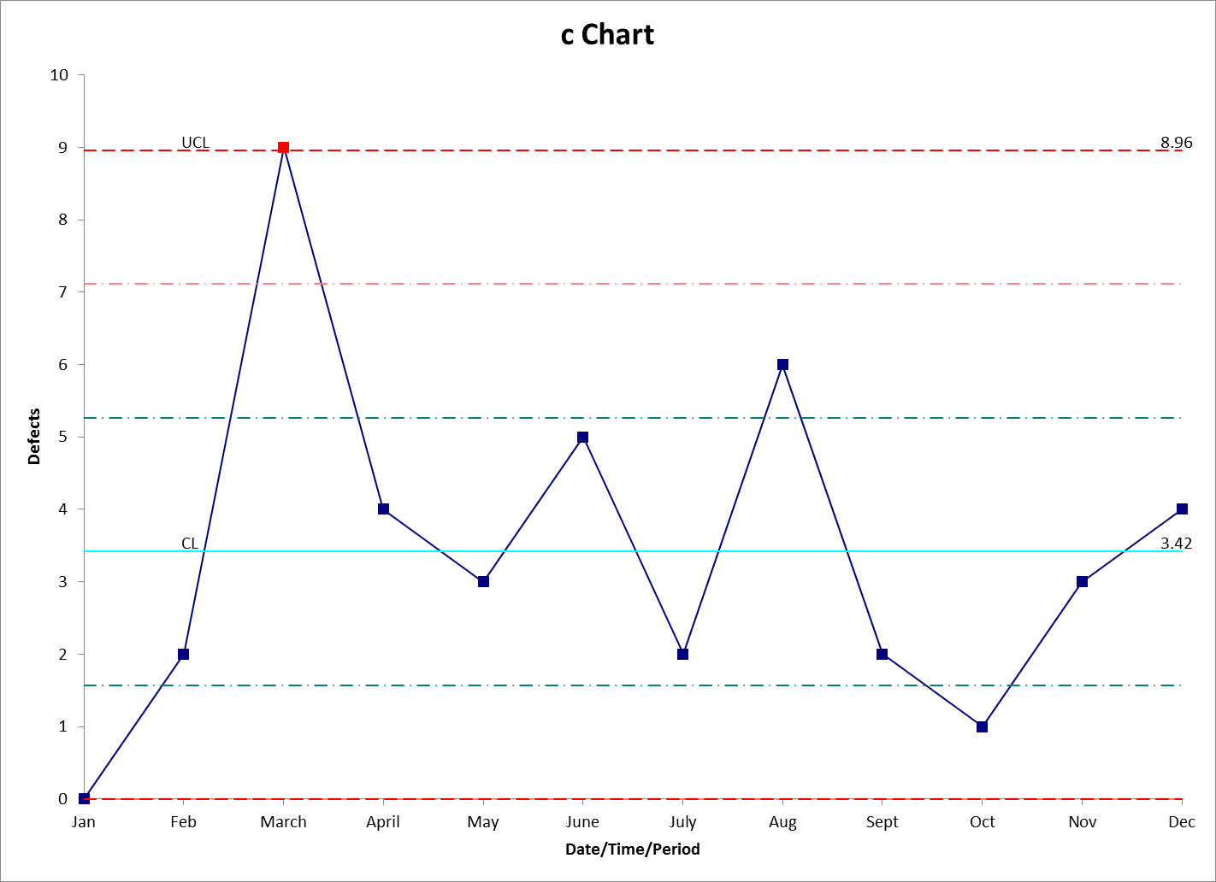
JMH Concord Medical Center
CDI Process Control
Testing Protocol
EPIC Screening report
BRU Tab Cleaning

Slide 14
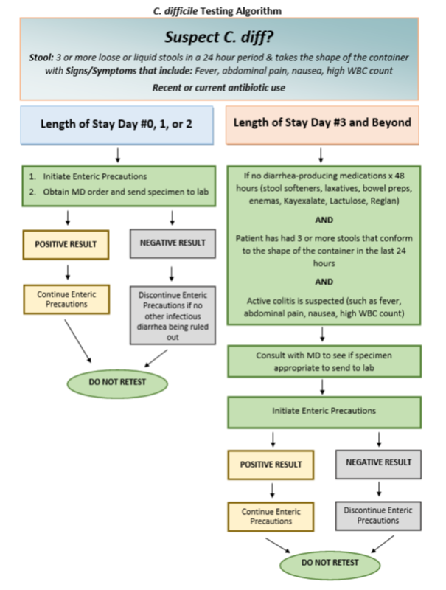

Slide 15
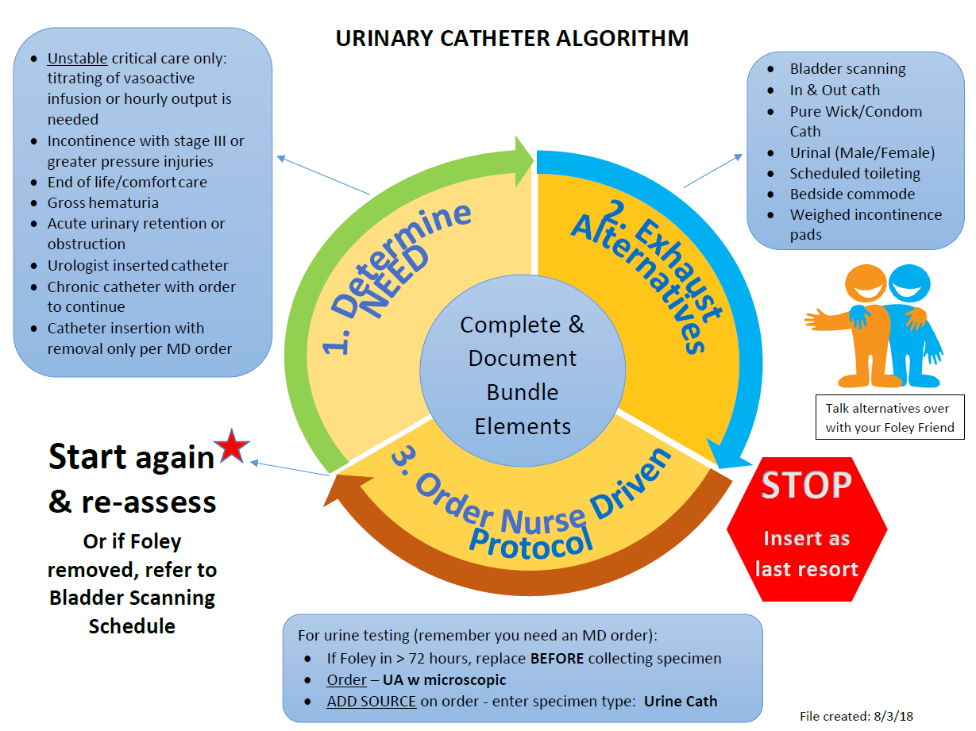

Slide 16
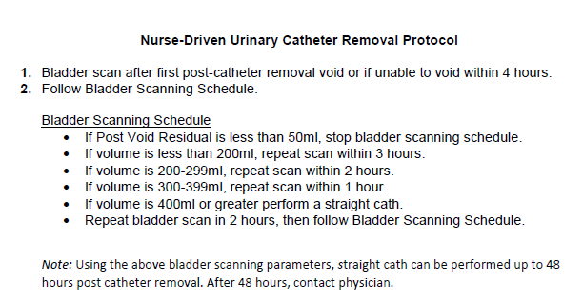

Slide 17
Conclusions
HAI improvement can be a difficult and labor intensive task. The causes and multifactorial nature of HAIs create a situation that can be daunting endeavor for any organization. Our experience with a multi-faceted approach has produced outcomes as intended. It was a collaborative effort dependent on Nursing, Physician, pharmacy, dietary, Environmental services and all ancillary staff to focus on attainable goals with the support and guidance of senior executives. Our work is certainly not completed but with this groundwork and culture we look forward to continue and sustained improvement.

