Slide 1


MEASLES UPDATE FOR
INFECTION PREVENTIONISTS
Presented by
Barbara Keller RN/PHN BSN

Slide 2
MEASLES UPDATE
Disclaimer Statement: I am not affiliated with any company or product.
Currently employed by Contra Costa County Public Health Communicable Disease.

Slide 3
MEASLES UPDATE
Objectives:
Name 2 current U.S. locations of Measles Outbreaks (Outbreak = 3 or more cases)
Preferred Lab testing methods for Measles.
Reporting to Public Health – 24/7.
Resources available to you.

Slide 4
MEASLES
Current Outbreaks in the United States (as of 3/7/2025)
West Texas 198 confirmed cases: This includes six Counties – Dawson, Gaines, Lynn, Martin, Terry, and Yoakum
    New Mexico – 10 confirmed cases
    Oklahoma – 2 cases (unconfirmed)
Alaska, California (5 cases this year), Florida, Georgia, Kentucky, New Jersey, New Mexico, New York City, Pennsylvania, Rhode Island, and Washington.

Slide 5
Measles in the US 2025
U.S. Cases in 2025 Total cases: 222
Age Under 5 years: 76 (34%) 5-19 years: 99 (45%) 20+ years: 40 (18%) Age unknown: 7 (3%)
Vaccination Status Unvaccinated or Unknown: 94% One MMR dose: 4% Two MMR doses: 2%

Slide 6
Measles in the US Currently
U.S. Hospitalizations in 2025: 17% 17% of cases hospitalized (38 of 222).
Percent of Age Group Hospitalized Under 5 years: 28% (21 of 76) 5-19 years: 11% (11 of 99) 20+ years: 13% (5 of 40) Age unknown: 14% (1 of 7)
U.S. Deaths in 2025: 2 There has been 1 confirmed death (Texas) from measles, and 1 death under investigation (New Mexico.

Slide 7
Measles Worldwide
Top 10 countries with measles outbreaks
This table is based on provisional monthly surveillance data reported to the World Health Organization (Geneva) as of February 2025. The data reflected covers July 2024 - December 2024.
.
Source: World Health Organization
Country | Number of Cases
Pakistan | 7,148
Thailand | 6,852
India | 6,203
Yemen | 5,000
Ethiopia | 4,724
Afghanistan | 3,999
Indonesia | 2,873
Russian Federation | 2,090
Kyrgyzstan | 1,890
Viet Nam | 1,837

Slide 8
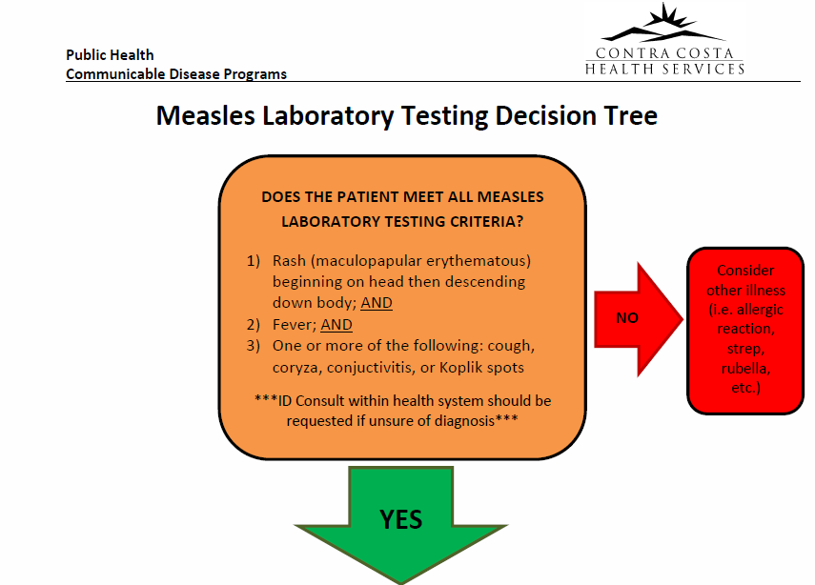

Slide 9
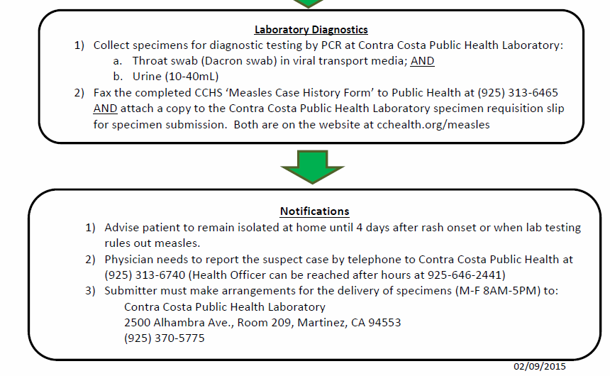

Slide 10
Measles: Transmission
Highly contagious – one of the most contagious of all infectious diseases.
Virus transmitted by infectious droplets when an infectious person breathes, coughs, or sneezes. (Airborne Isolation)
Measles virus can remain infectious in the air.
Up to 2 hours (CDC); 1 hour (CDPH)

Slide 11
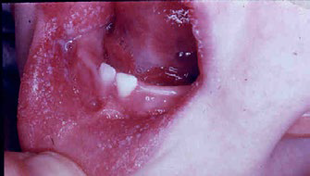
Measles: Clinical Presentation
Prodrome – onset 8-12 days after exposure (range = 7-21 days)
High Fever – 101˚ F or higher.(May spike to 104˚F or >)
Cough, Conjunctivitis, and/or Coryza (runny nose/nasal congestion
Koplik spots

Slide 12
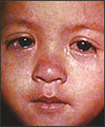
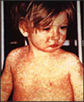
Measles: Clinical Presentation
Rash begins 2-4 days after prodrome
Maculopapular rash
Eyes of a child with measles.
Begins on face and head, then descends down to trunk, arms and legs
Child with a classic
Measles rash after four days

Slide 13
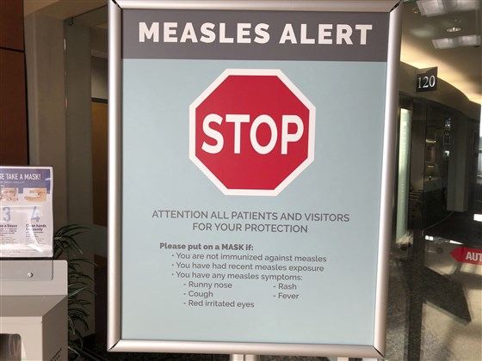
Measles: Prevent Transmission
Hospitals: Place all febrile rashes
in Airborne isolation until Measles is
ruled out.
Notify Public Health Department
while your case is in the E.D. (24/7). Work together!
PCR testing for Measles through your Public Health Lab
If the case is discharged home..
  How will they get home…avoid Public Transportation.
  Suspects should be Quarantined at home until confirmed negative or no longer infectious. Need to consider who they live with. (babies < 1 yr.?; immunosuppressed family?
    Definition of Quarantine: confined to their home. If private home, can not go beyond their property line.

Slide 14
Measles: Contacts/ Exposures
Time Sensitive:
Identify sites of exposures in healthcare and community (Public Health and Hospitals partner)
Identify high risk exposures:
  Infants <1 year
  Pregnant women with no immunity
  Severely immunocompromised persons, irrespective of evidence of measles immunity
  Health care workers w/ no evidence of immunity
    (furlough from work day 5 from the first day exposed;
    Through day 21 from the last day of exposure)

Slide 15
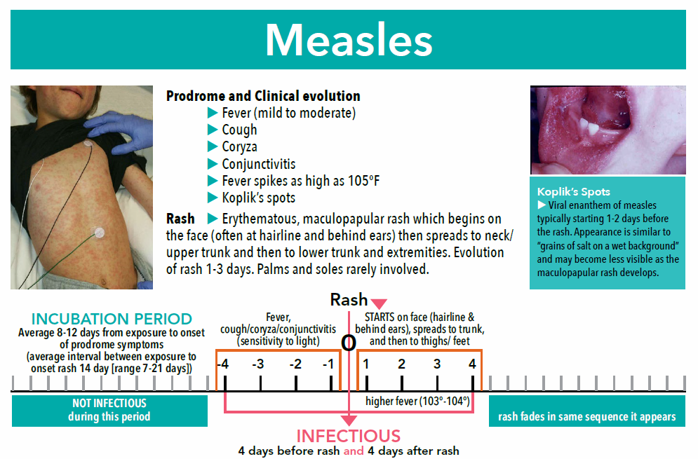
Kaiser Permanente diagnostic tool and it is posted on Contra Costa County Public Health Measles website.

Slide 16
Measles: Lab Testing
Symptomatic
COORDINATE DIAGNOSTIC TESTING WITH YOUR PUBLIC HEALTH DEPT
(not a commercial lab)
PCR diagnostic testing preferred through Public Health Lab. PCR has faster turn around times and Public Health will work with their Lab to prioritize.
  *** Public Health Labs - some will work after hours and on weekends for Measles cases.
  DO NOT submit specimens to a Public Health Lab w/out first notifying or consulting with your local health department.
Specimen collection: Collect BOTH
  Throat swab (Dacron swab) in viral transport media; AND
  Urine (100-400ml)
  (Know the process for your Public Health Lab)
Fax the completed CCHS ‘Measles Case History form’ to Public Health @ 925-313-6465.
County Labs forward on to the State Lab for genotyping

Slide 17
Measles: Lab Testing
Other Testing Methods
Serology: recommend acute and convalescent titers - requires additional time
Serum measles IgM antibody – false negatives can occur
Viral Cultures: Can take up to 14 days

Slide 18
Measles: Resources
CDPH Web Link for hospitals and Infection Prevention: https://www.cdph.ca.gov/Programs/CID/DCDC/CDPH%20Document%20Library/Immunization/Measles-HCFacilityICRecs.pdf
CDPH Measles Quicksheet: https://www.cdph.ca.gov/Programs/CID/DCDC/CDPH%20Document%20Library/Immunization/Measles-Quicksheet.pdf
CDC: https://www.cdc.gov/measles

Slide 19
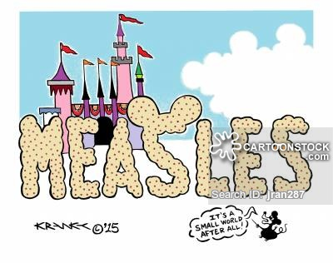
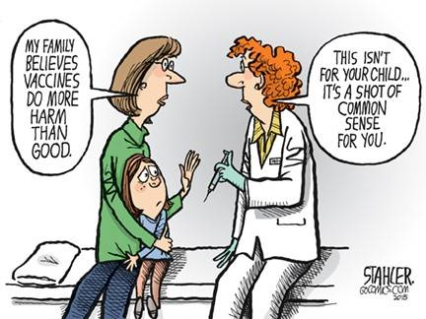
Measles

Slide 20
THANK YOU
QUESTIONS?

