Slide 1
CDPH HAI Program Updates
APIC Chapter
September 10, 2025

Slide 2
Objectives:
1
Review Interim Guidance for Healthcare Personnel with Respiratory Viral Infections
2
Discuss Candida auris Health Advisory Update
3
Review importance of Interfacility Communication
3
Recognize uncertainties in light of termination of the federal Healthcare Infection Control Practices Advisory Committee (HICPAC)
4

Slide 3
CDPH Interim Work Exclusion Guidance for Healthcare Personnel with COVID-19, Influenza, and Other Acute Respiratory Viral Infections – January 10, 2025
HCP with suspected or confirmed respiratory viral infection, regardless of whether testing is performed, should:
Not return to work until at least 3 days have passed since symptom onset* and at least 24 hours have passed with no fever (without use of fever-reducing medicines), symptoms are improving, and they feel well enough to return to work.
If asymptomatic throughout their infection, HCP should not return to work until at least 3 days have passed since their first positive test.
Wear a facemask for source control in all patient care and common areas of the facility (e.g., HCP breakrooms) for at least 10 days after symptom onset or positive test (if asymptomatic), if not already wearing a facemask as part of universal source control masking.
*Where the first day of symptoms is day 0, making first possible day of return to work on day 4.
AFL-25-01 https://www.cdph.ca.gov/Programs/CHCQ/LCP/Pages/AFL-25-01.aspx (supersedes AFL 21-08.9)

Slide 4
Why did CDPH issue this interim guidance?
CDC’s COVID-19 guidance relies on diagnostic testing and includes up to 10 days of work exclusion depending on whether a subsequent negative test is obtained
Updates to CDC’s guidance were deferred to the Healthcare Infection Control Practices Advisory Committee (HICPAC) update to the 1998 Guideline for Infection Control in Healthcare Personnel
Next steps for updating guidance uncertain given termination of HICPAC
Health impacts of COVID-19 have decreased substantially, while other clinically significant respiratory viruses, e.g., influenza and RSV, are circulating in addition to SARS-CoV-2
These respiratory viral infections are generally indistinguishable without testing; however, testing may not be available or routinely performed
Confusion regarding guidance for ill HCP without testing
Prolonged exclusion can exacerbate staffing shortages

Slide 5
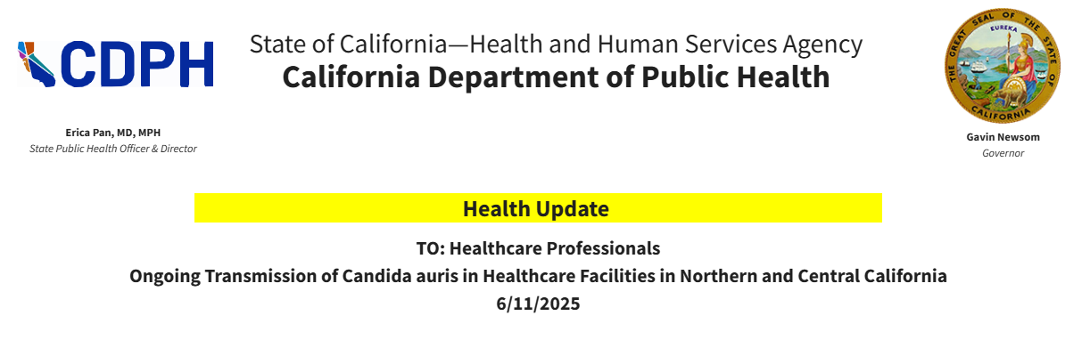
Candida auris Health Advisory Update
Ongoing Transmission of Candida auris in Healthcare Facilities in Northern and Central California https://www.cdph.ca.gov/Programs/OPA/Pages/CAHAN/Ongoing-Transmission-of-Candida-auris-in-Healthcare-Facilities-in-Northern-and-Central-California-.aspx

Slide 6
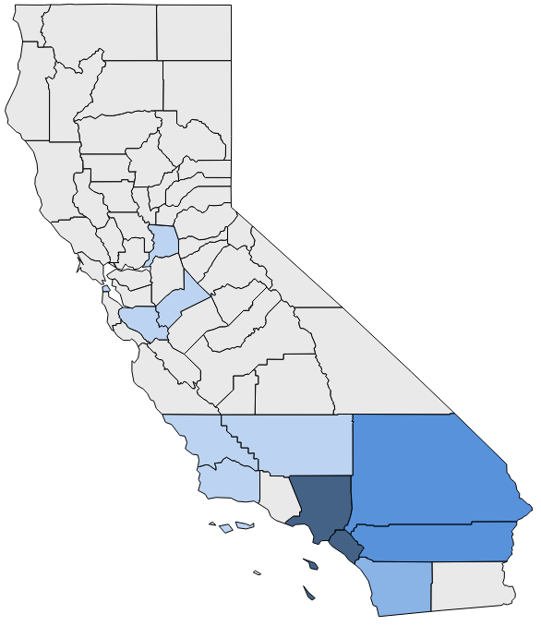
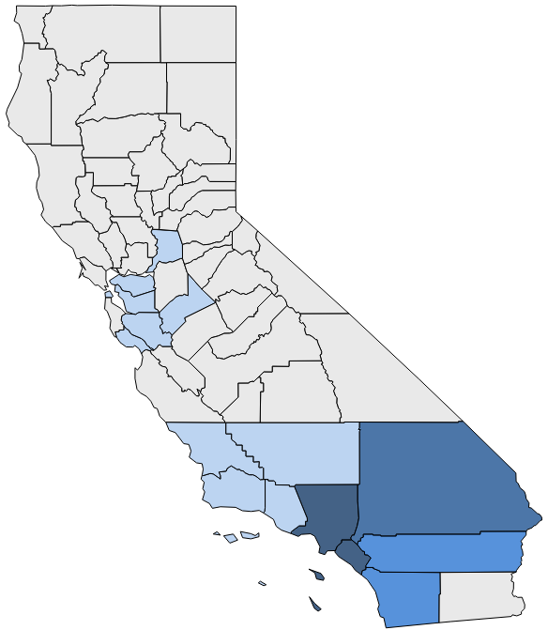
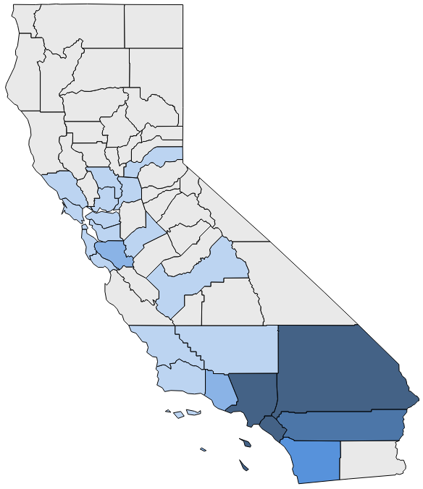

Cumulative C. auris Cases Reported to CDPH by County, 2022–May 2025*
Last CAHAN: March 2023
2022
2023
2024
2025 through May
Number of cases reported:
0
1-10
11-100
101-500
501-1000
>1000
*Data preliminary, current through 5/30/25

Slide 7
Increase in C. auris Cases in Northern and Central California
Increase in jurisdictions reporting C. auris cases: 4 (2022) → 15 (2025)
Ongoing transmission in hospitals (Alameda, Central Valley)
Communication to jurisdictions (Bay Area and beyond) to prioritize follow-up with facilities receiving transfer patients from Alameda hospital
Likely more, undetected regional transmission
→ Update to March 2023 CAHAN

Slide 8
Recommendations for Northern/Central CA
Focus on highest risk settings (high-acuity patients, prolonged lengths of stay)
Long-term acute care hospitals (LTACHs)
Ventilator-equipped skilled nursing facilities (vSNFs)
Acute care hospital (ACH) high-acuity units (e.g., ICUs)
Emphasize proactive screening
Refer to C. auris Quicksheet and Response Phases guidance for additional infection prevention and control strategies for facilities statewide
Environmental cleaning and disinfection
Laboratory surveillance
Other prevention and response activities

Slide 9
Recommendations for LTACHs & vSNFs
LTACHs
Facility-wide
Regular (e.g., every 1-3 months) proactive point prevalence surveys (PPSs)
Admission screening
vSNFs
Focus on vent units
Conduct proactive PPS if not done within past 1 month
Continue regular (e.g., every 3-6 months) proactive PPSs
Consider admission screening as resources allow

Slide 10
Recommendations for ACHs
Implement admission screening strategies based on patient- and unit-level risk for C. auris colonization and transmission, including screening patients on admission:
from any facility with known transmission;
from LTACHs or vSNF ventilator units;
with healthcare exposure outside of the U.S., or in regions with known C. auris endemicity, e.g., Southern California, Nevada, New York;
wherever feasible, to units with high-acuity patients and prolonged (e.g., > 1 week) lengths of stay (e.g., some ICUs, burn units).

Slide 11
Recommendations for SNFs
A very small proportion (<1%) of C. auris cases identified in regular SNFs; extensive transmission and outbreaks uncommon.
SNFs should be prepared to admit and safely care for residents with known or suspected C. auris colonization, including implementation of Enhanced Barrier Precautions (EBP) per AFL 24-15.
All SNFs in compliance with CMS's EBP requirement able to admit and provide care for residents with MDROs, including C. auris: no basis for SNF to refuse admission of resident based on need for EBP or MDRO status.
Residents on EBP do not require placement in a single-person room, even if MDRO-positive. CDPH provides additional guidance for cohorting in the CDPH MDRO Cohorting Guidance.

Slide 12
Interfacility Communication
Effective communication whenever a patient/resident infected or colonized with a multidrug-resistant organism (MDRO) is transferred within or between healthcare facilities
Increases the likelihood appropriate IPC actions will be implemented continuously through transitions of care
Decreases the likelihood of MDROs spreading to others
Communication recommended in addition to education, strengthening IPC practices, detection/screening
MDRO Prevention Strategies | HAIs | CDC https://www.cdc.gov/healthcare-associated-infections/php/preventing-mdros/mdro-prevention-strategies.html

Slide 13
CDC MDRO Prevention Strategies - Communication
Table 6. Recommended communication activities by facility category
Activities | Recommendation by Facility Category
Ensure all healthcare facilities and other providers (i.e., home health, medical transportation agencies, etc.) understand when, what, and how MDRO-related information is communicated to the health department. Objective: To ensure timely and accurate information is shared with health departments to inform public health action. | All – Highly recommended
Ensure all healthcare facilities and other providers (i.e., home health, medical transportation agencies, etc.) understand when, what, and how MDRO-related information should be communicated within and between healthcare facilities or providers. Objective: To ensure the timely application of appropriate IPC actions for those infected or colonized with MDROs to decrease the risk of spread to others within healthcare systems. | All – Highly recommended
Issue health alerts for clinicians and laboratories when novel or targeted MDROs are first identified in a region, or in response to changing epidemiology (e.g., large outbreaks, increasing prevalence).Objective: To increase awareness across healthcare systems on emerging or changing MDRO trends to encourage implementation of prevention and response actions. | All – Highly recommended

Slide 14
CDC MDRO Prevention Strategies - Communication
Table 6. Recommended communication activities by facility category (cont’d)
Activities | Recommendation by Facility Category
Support healthcare facilities to improve interfacility communication within a region. This could include forming a workgroup of healthcare facilities within the same patient/resident sharing network, with representation from different healthcare facility types (e.g., ACH, LTACH, IRF, SNF), to discuss and implement improvements in communication. Objective: To encourage healthcare facilities to identify barriers in communication with each other to innovate solutions to these barriers. | All– Highly recommended
Create Antibiotic Resistance Information Exchanges (ARIEs) [PDF - 24 pages] to support the multidirectional information flow between healthcare facilities and between healthcare facilities and health departments (e.g., a patient safety registry). Objective: To track patients/residents who are colonized or infected with specific MDROs and alert healthcare providers when these patients are admitted to a facility to aid in the timely implementation of appropriate IPC practices. | All – Recommended if capacity remains after infection control improvement and colonization screening efforts are in place.
Mandate interfacility communication between healthcare facilities within a jurisdiction. Objective: To encourage a standard of communication practices between healthcare facilities. | All – Consider

Slide 15
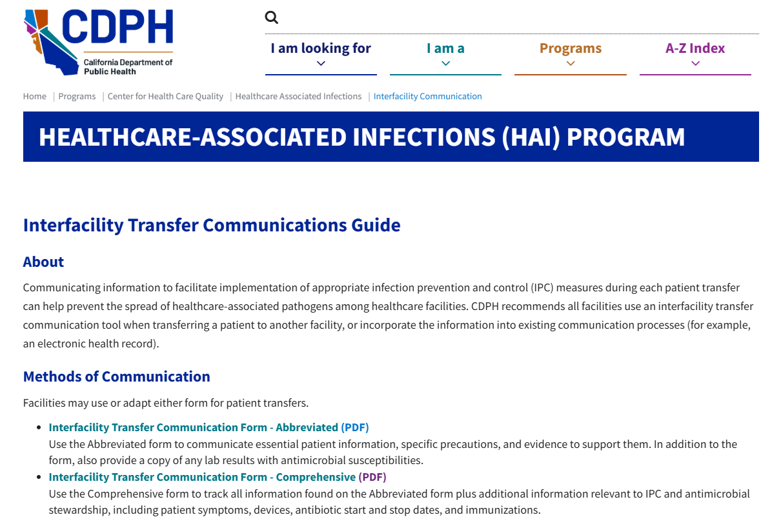
Interfacility Communication https://www.cdph.ca.gov/Programs/CHCQ/HAI/Pages/ InterfacilityCommunication.aspx

Slide 16
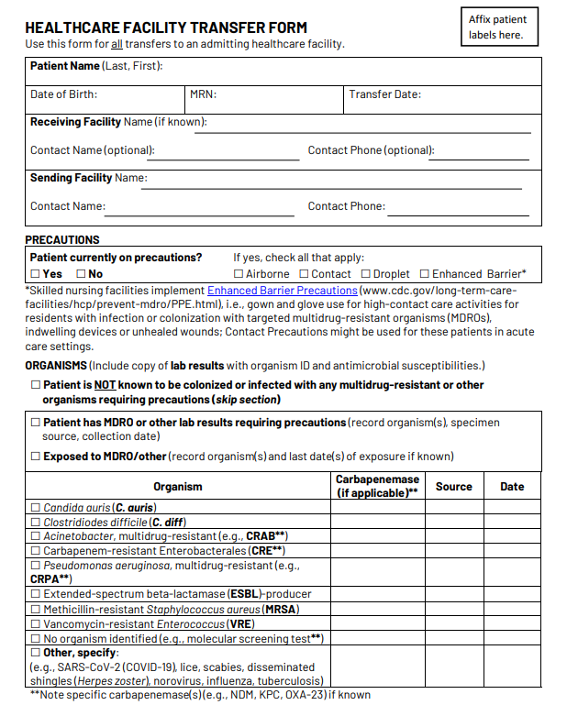
CDPH Transfer Form
Facilities may use or adapt the CDPH forms or incorporate the information into existing communication processes, e.g., electronic health record
Standardization and consistency more important than specific mode of communication
But what’s most important is that the information is recognized and acted upon in the receiving facility…

Slide 17
Regional AR/MDRO Prevention Collaboratives – networks of hospitals and skilled nursing facilities with shared patient population
Enhance AR surveillance and response
Improve infection prevention and control (IPC) practices
HAI/AR Prevention
Strengthen interfacility communication
Support antimicrobial stewardship
Hospital Emergency Department – Skilled Nursing Facility Interface

Slide 18
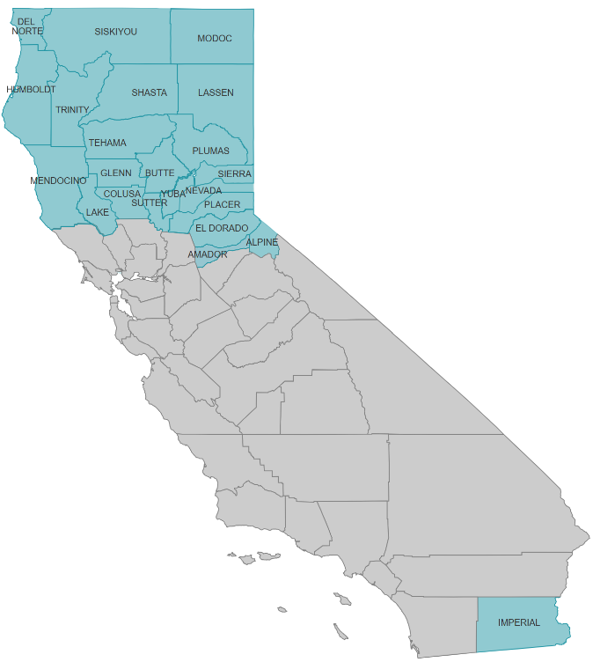
Local Health Jurisdictions Prioritized for AR/MDRO Prevention & Response Capacity Building
Lower capacity for AR/MDRO prevention & response, but increasing numbers of cases
Imperial County
Binational patient population
Northern California counties (22)
Prioritizing Butte, Humboldt, Shasta (public health laboratories, largest numbers of hospitals and SNF)
Capacity building for LHDs, healthcare facilities and laboratories:
LHD peer-to-peer learning
Regional AR/MDRO prevention collaboratives

Slide 19

Regional AR/MDRO Prevention Collaboratives
Interfacility communication during transition of care (TOC) between hospital EDs and SNFs identified as a major barrier to appropriate antimicrobial prescribing.

Slide 20
Barriers to Appropriate Antimicrobial Prescribing
SNF residents return from emergency departments (EDs) on antimicrobials for asymptomatic bacteriuria
Limited time for ED review of SNF paperwork and lab results (easier to use routine order sets often leading to urine studies without indication)
1
SNFs receive incomplete transfer-of-care information from EDs
Lack of standardized communication protocols, competing ED priorities and time constraints
2

Slide 21
Barriers to Appropriate Antimicrobial Prescribing (Continued)
SNFs struggle to obtain missing transfer-of-care information from EDs
Competing ED time pressures, ED shift changes, ED reluctance to share information due to HIPAA concerns
3
SNF providers hesitant to discontinue or modify antimicrobials initiated in the ED
Clinical uncertainty and reluctance to reverse hospital decisions
4

Slide 22
Interfacility Transfer Form
Key Components
MDRO status and isolation precautions
Clinical status
Reason for transfer*
Baseline mental status*
Pre-existing conditions*
Instructions for receiving facility*
e.g., watchful waiting for asymptomatic residents with positive urine tests
Antimicrobial indication and planned duration
Lab results and pending results
* Proposed additional components
Pilot project to include additional information on the form to improve ED-SNF communication to support appropriate antimicrobial prescribing

Slide 23
Challenges with Interfacility Communication Forms
Longstanding issues: requires staff time to fill out; paper or electronic forms get buried or lost; information not seen or acted upon appropriately
Some state/local health departments have mandated form, but limitations with enforcement
Experience mandating the transfer form in Sacramento County
Mandate raised awareness, prompted discussion, creation of solutions between/among specific local healthcare facility referral networks
Paired with other efforts to strengthen IPC practices, screening

Slide 24
AR Information Exchanges, a.k.a. MDRO Registries
Overcome many of the challenges and limitations of paper or electronic forms generated by individual facilities
Support multidirectional information flow between healthcare facilities and between healthcare facilities and health departments
Passive system - healthcare providers or public health staff search the registry for a specific patient/resident
Active system - healthcare provider notified via electronic health record or other alert(s) as soon as an MDRO-positive patient is admitted to a healthcare facility
Los Angeles County Department of Public Health (LACDPH) developed an electronic MDRO registry called Patient Safety Information Exchange (PSIE); CDPH evaluating feasibility of creating/expanding statewide
Notes:
LAC | DPH | Patient Safety Information Exchange
For hospitals and SNFs

Slide 25
Termination of Federal Healthcare Infection Control Practices Advisory Committee (HICPAC)
As of March 1, 2025, per federal Executive Orders, HICPAC terminated as “unnecessary”
HICPAC had been in existence since 1991 and issued > 500 recommendations, including foundational IPC guidelines
Works in progress included an update to the Isolation Guideline Part 1, specific sections of the Infection Control in Healthcare Personnel Guideline
Previously developed HICPAC guidelines still exist
Professional societies (SHEA and APIC) and local/state public health agencies/groups discussing ways forward
Potentially update/issue new guidance, if CDC guidance not forthcoming
Maintain as much consistency as possible across jurisdictions

Slide 26

Thank You!
Questions?
For more information, contact HAIProgram@cdph.ca.gov

Slide 27
Visit the California Department of Public Health website.

