Slide 1

APIC 2023 Annual conference

Slide 2
My experience:
1st Conference since in the Infection Prevention role:
  Opportunity for learning.
  Different fields and areas of research.
  Peers and validation.
  Sharing our experiences.
  Apply what I learn.
  I chose to participate in topics I am not strong in terms of knowledge.
What would I change next:
  Arrived the day earlier.
  Bring a printed calendar.
  Attended Meet and Greet.
Exhibitor Hall most call my attention: UV Light technology.

Slide 3
Topic:
Pharmacy Cleanroom Environmental Monitoring: The microbe Matters
Wendy Littlejohn, MT (ASCP), CIC - University of Michigan
June 28, 2023 at 2:30pm
“Environmental Monitoring is an area of my interest”
Objectives:
To understand the importance of collecting and analyzing environmental data to identify and mitigate microbial contamination risks.
Identify the corrective actions that were taken to remediate the issue.

Slide 4
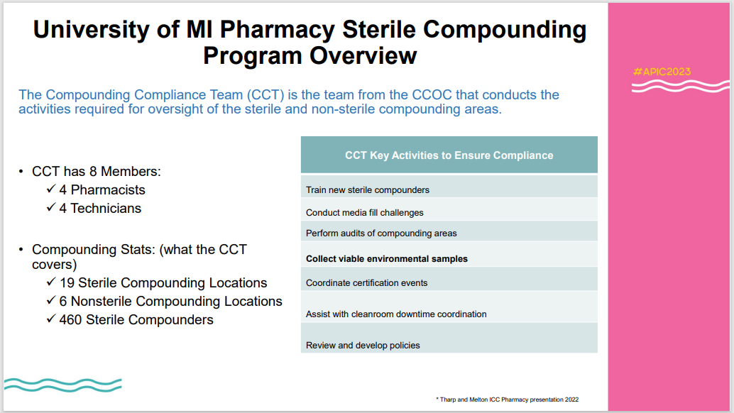
Taken from presentation: Pharmacy Cleanroom Environmental Monitoring: The microbe Matters, APIC Conference, June 28, 2023.

Slide 5
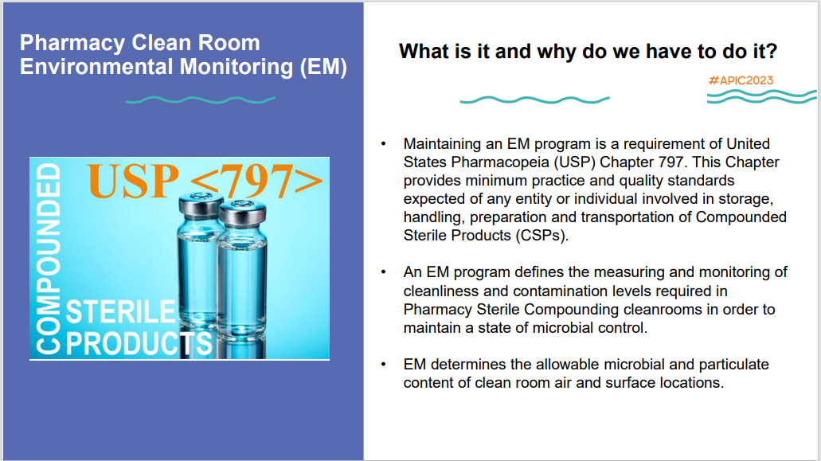
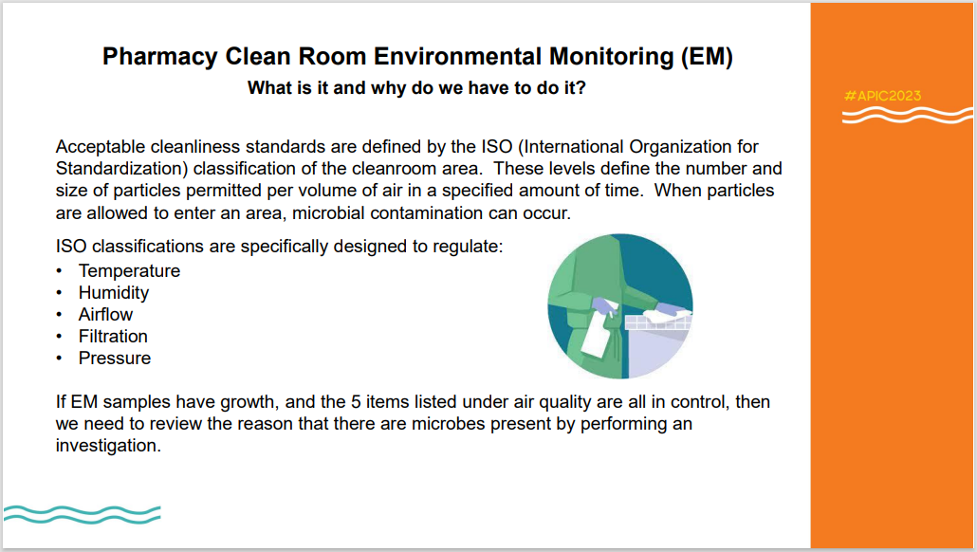
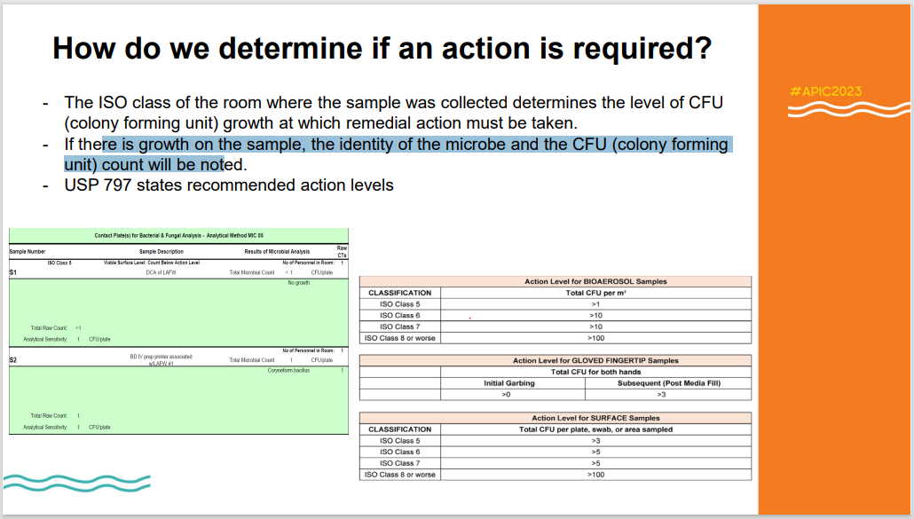
Why doing EM in Pharmacy clean room?
Taken from presentation: Pharmacy Cleanroom Environmental Monitoring: The microbe Matters, APIC Conference, June 28, 2023.

Slide 6
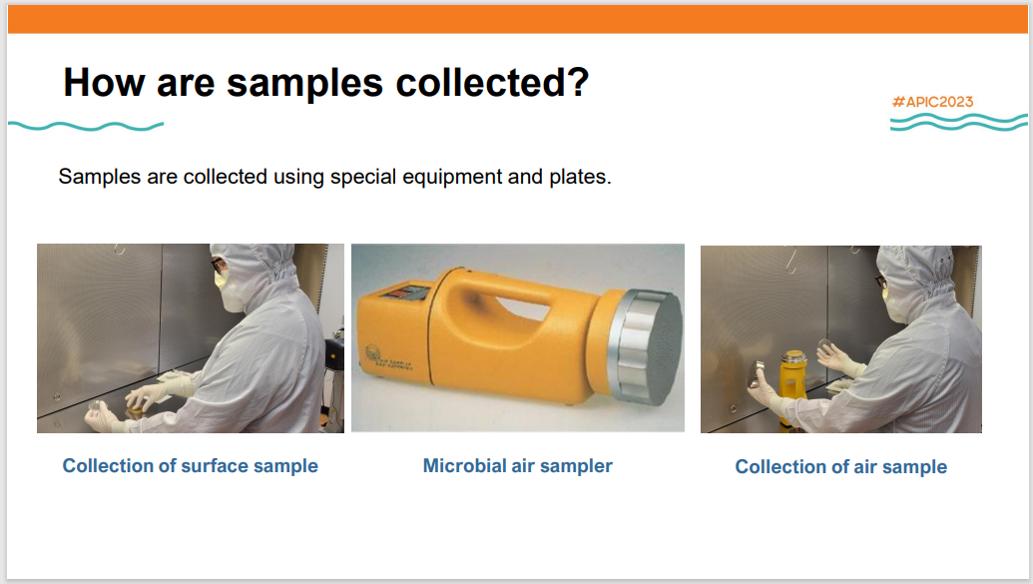
Taken from presentation: Pharmacy Cleanroom Environmental Monitoring: The microbe Matters, APIC Conference, June 28, 2023.

Slide 7
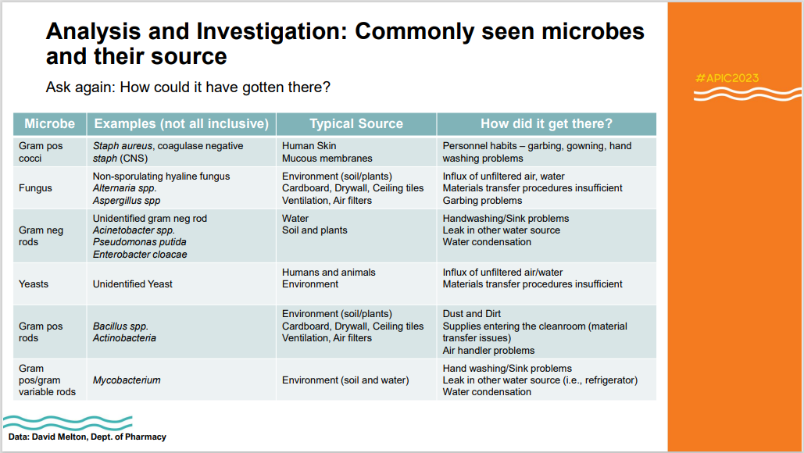
Taken from presentation: Pharmacy Cleanroom Environmental Monitoring: The microbe Matters, APIC Conference, June 28, 2023.

Slide 8
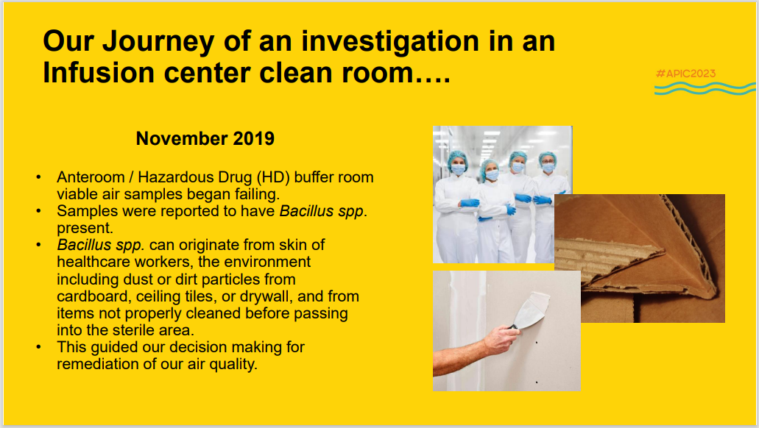
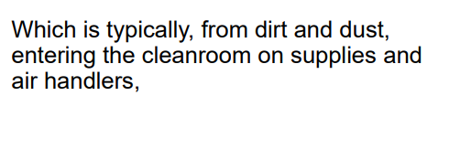
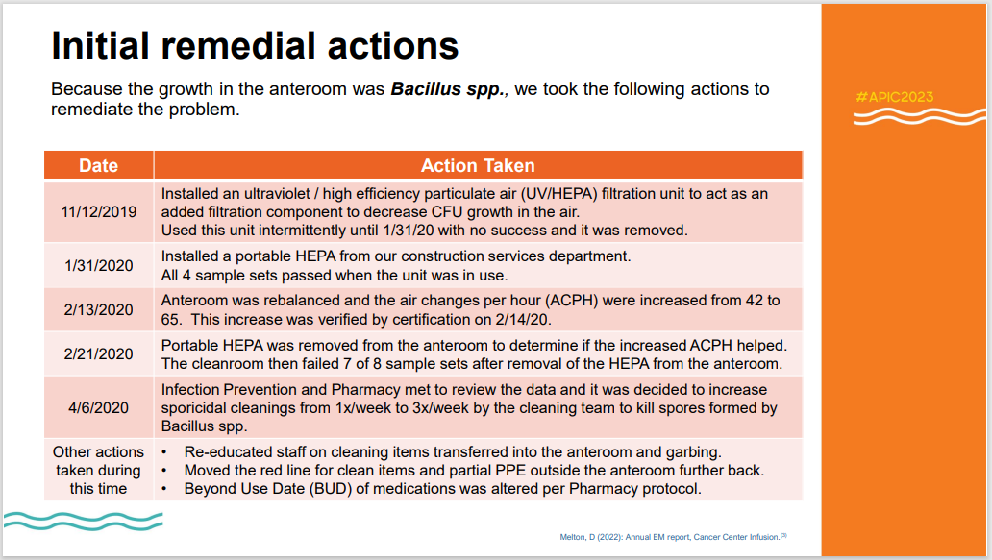
Focus on Bacillus?
Taken from presentation: Pharmacy Cleanroom Environmental Monitoring: The microbe Matters, APIC Conference, June 28, 2023.

Slide 9
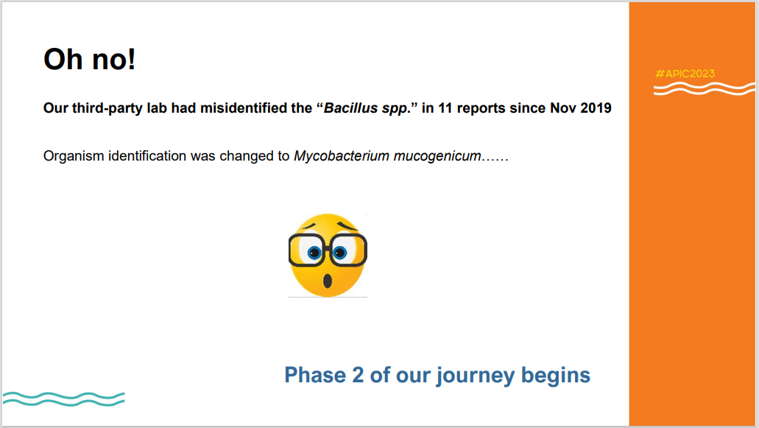
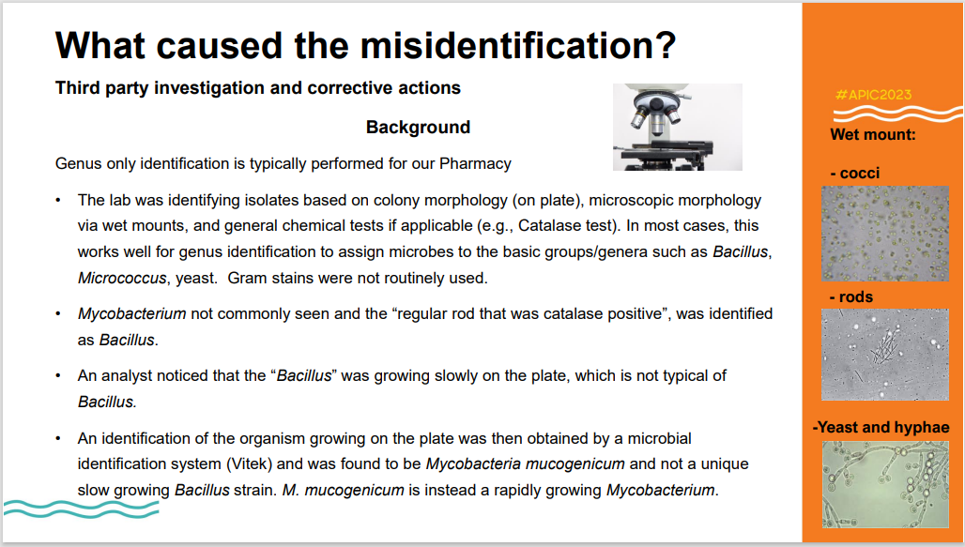
Taken from presentation: Pharmacy Cleanroom Environmental Monitoring: The microbe Matters, APIC Conference, June 28, 2023.

Slide 10
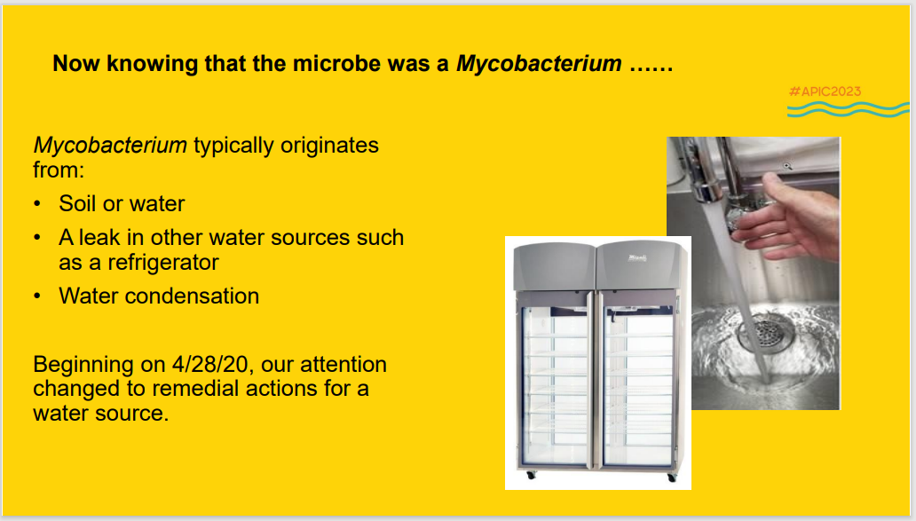
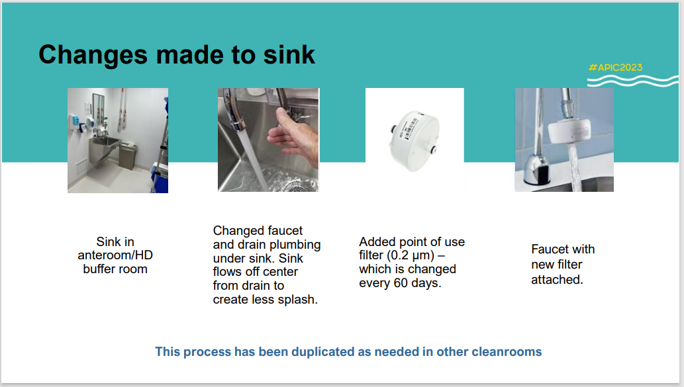
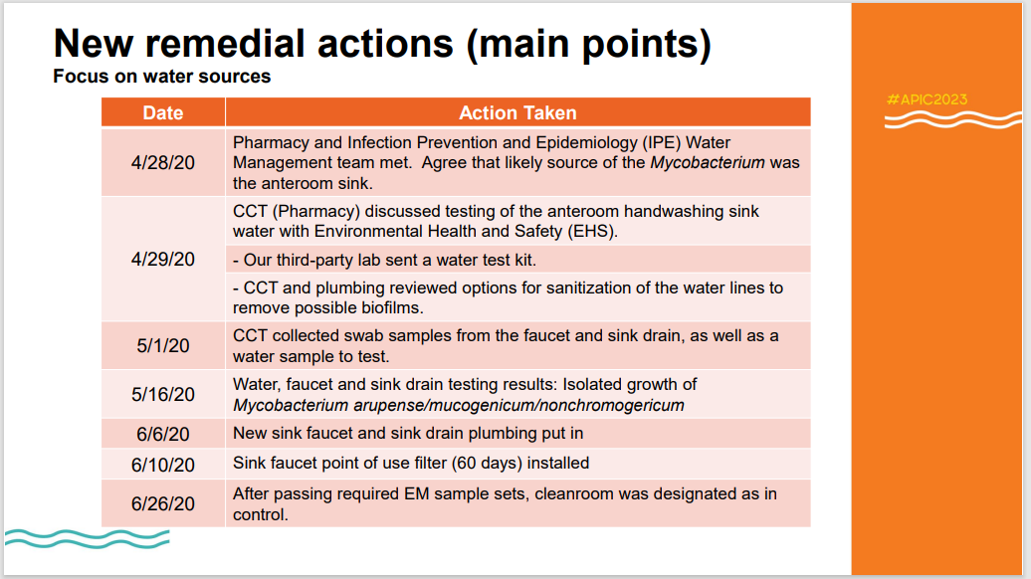
Taken from presentation: Pharmacy Cleanroom Environmental Monitoring: The microbe Matters, APIC Conference, June 28, 2023.

Slide 11
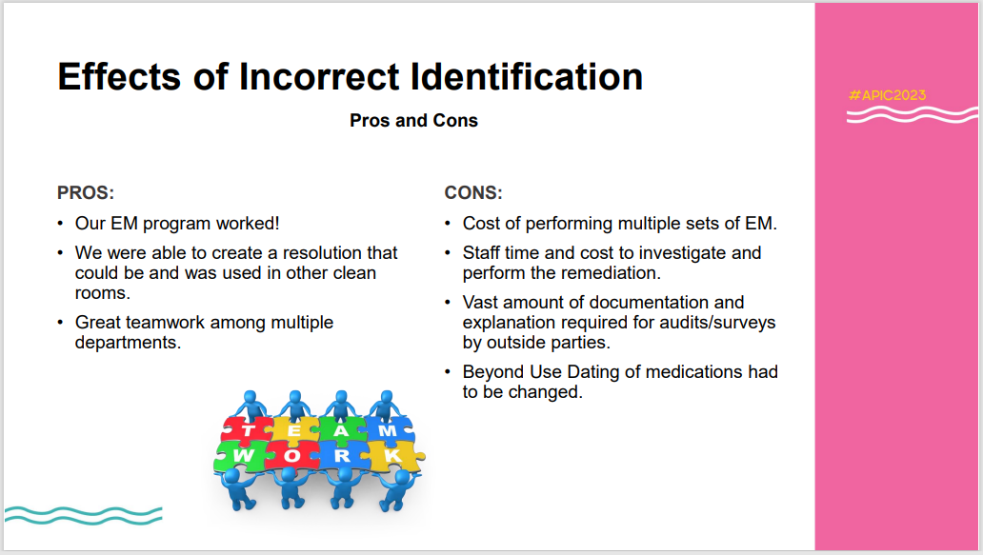
Taken from presentation: Pharmacy Cleanroom Environmental Monitoring: The microbe Matters, APIC Conference, June 28, 2023.

Slide 12
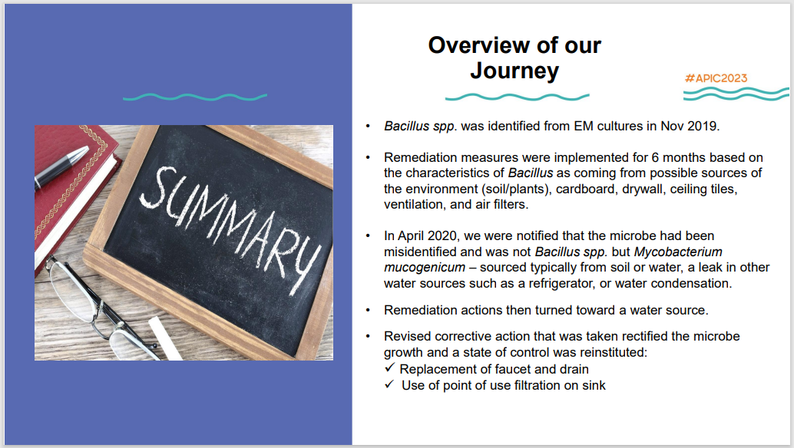
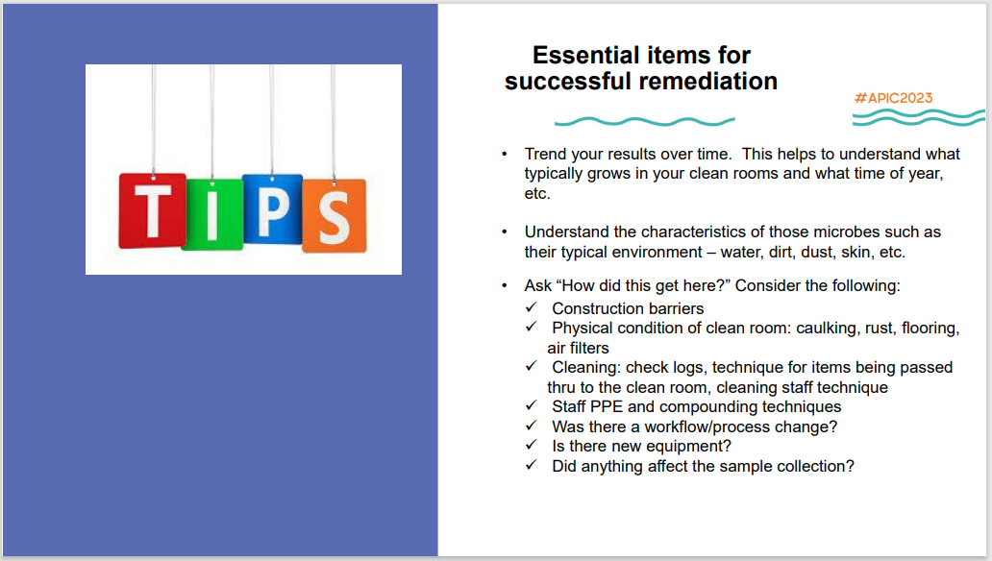
Map where the samples are being collected.
Trend of what is growing inside the SCA.
Taken from presentation: Pharmacy Cleanroom Environmental Monitoring: The microbe Matters, APIC Conference, June 28, 2023.

Slide 13
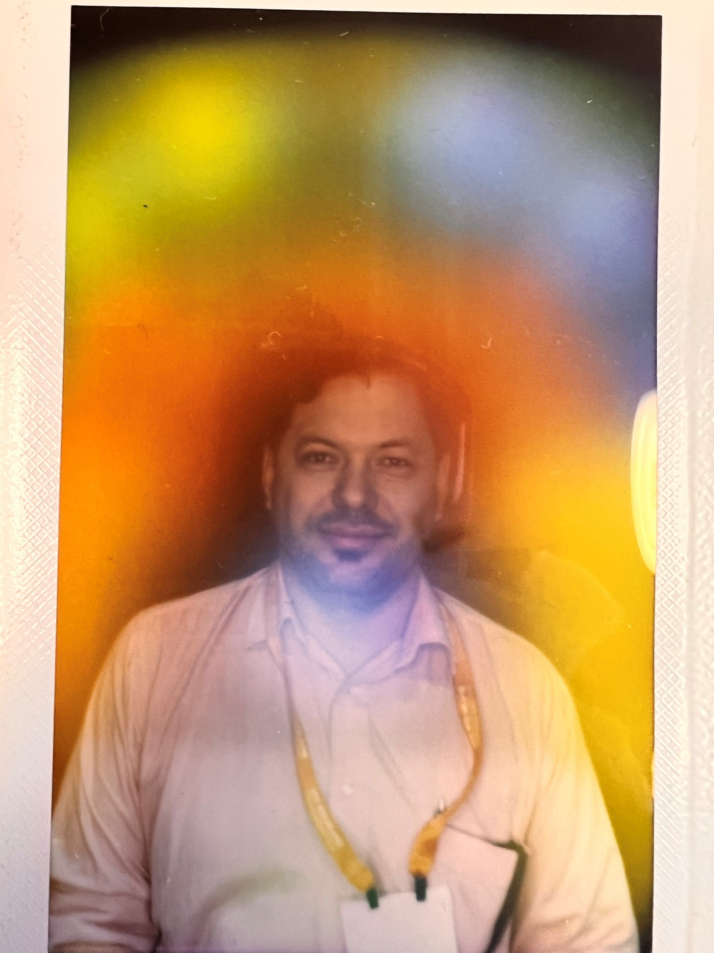
Coolest thing : Take a picture of my aura – Aura Cam (16,000)
Electromagnetic field surrounding the body

