Slide 1

Imposter Syndrome and the Infection Preventionist
Presenter:
Keith Howard, DNP RN, CIC
July 12th, 2023

Slide 2
Objectives:
1
At the end of the presentation, the participant will be able to:
2
Describe imposter syndrome.
3
Describe the different types of human behaviors driving imposter syndrome.
4
Identify six corrective steps to halt and reframe the mind to avoid the imposter syndrome trap.

Slide 3

APIC Keynote:
Bertice Berry, Ph.D.
Award-winning Public Sociologist, Best-selling Author, and Lecturer
Notes:
Okay, Many of you may have already heard of this topic. However, I live under a rock and this was recently new information, which stuck me as I have had this feeling while working in infection control for several years.

Slide 4

“Everybody else knows more than me”
There are an awful lot of people out there who think I’m an expert. How do these people believe all this about me? I’m so much aware of all the things I don’t know.
Margaret Chan,
Director-General, World Health Organisation
2006-2017
Notes:
Have you ever thought this yourself?

Slide 5


“They’re going to find me out”
I have written 11 books but each time I think ‘Uh-oh, they’re going to find out now. I’ve run a game on everybody, and they’re going to find me out.’
Maya Angelou
Notes:
How about feelings of “being found out” that you’ve just been lucky

Slide 6


“I’m a fraud”
‘Sometimes I wake up in the morning before going off to a shoot, and I think, I can’t do this. I’m a fraud.’
The exaggerated esteem in which my lifework is held makes me very ill at ease. I feel compelled to think of myself as an involuntary swindler.
Albert Einstein
Kate Winslet
Notes:
Has this thought ever creeped in?

Slide 7
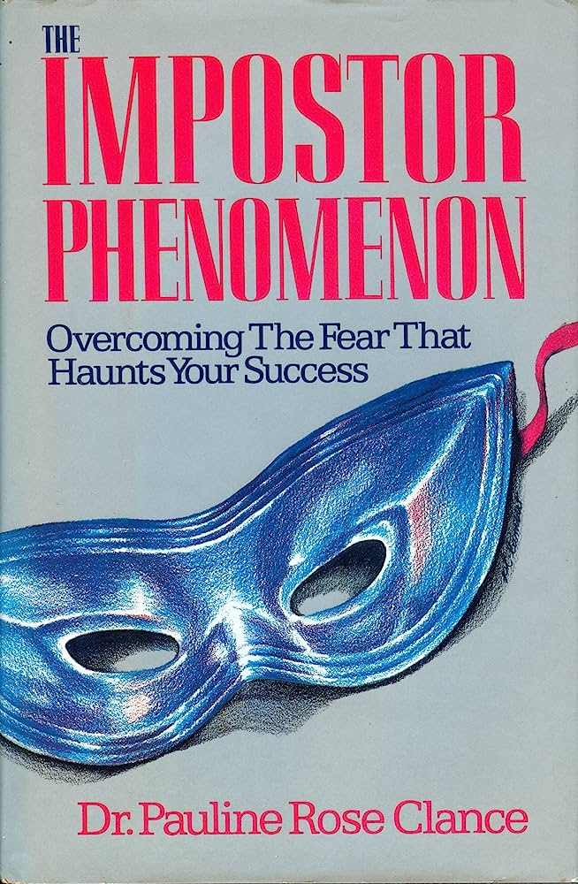
Imposter Syndrome
Coined by Clance and Imes in 1978 to designate an “internal experience of intellectual phoniness”
Notes:
Imposter syndrome is common. Up to 60% of medical students in one study, nursing executives and leaders (think IP’s as leaders during covid), nursing students, and other professionals suffer from imposter syndrome at some point during their career.
Additionally, imposter syndrome thrives in cultures where asking for help and identifying knowledge gaps are treated as a weakness. Therefore, we should normalize identifying knowledge gaps and encourage learners to focus on growth as opposed to the achievement of goals.
Imposter syndrome: defined as a collection of feelings of inadequacy that persist despite evident success
'Imposters' suffer from chronic self-doubt and a sense of intellectual fraudulence that override any feelings of success or external proof of their competence
People with imposter syndrome often feel like they are not as capable or adequate as others perceive or evaluate them to be.
Imposter Syndrome: Do I have it?
If you are wondering whether you suffer from IS, we invite you to consider the following questions:
Do I feel that the opportunities I’ve had so far are due to luck?
When I have new challenges, do I doubt my ability to meet them?
Am I unmotivated about new opportunities?
Do I think things that have gone well in the past are going to go wrong now?
Do I worry that people will find out that you’re a fraud?
Do I compare myself to other people?
Am I not satisfied with the things I do?
Do I think that I don’t deserve the success that I’ve had?

Slide 8
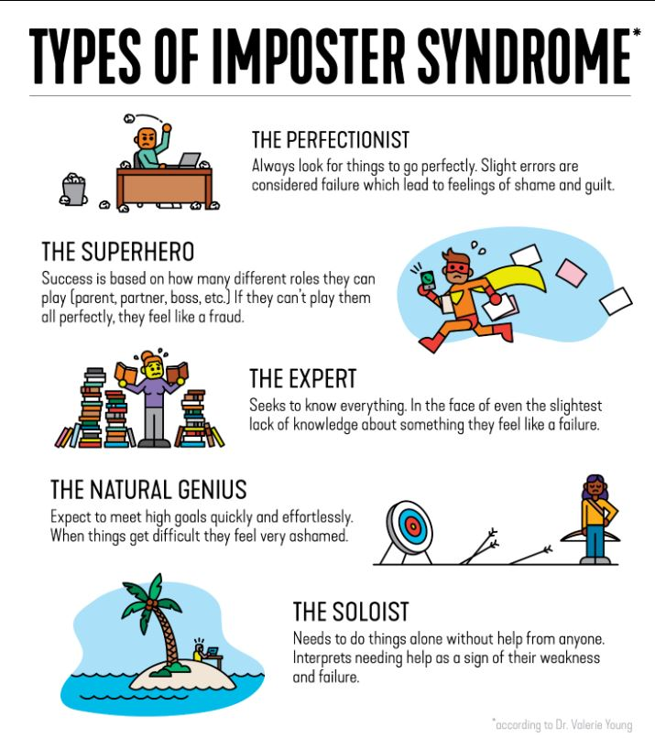
The different types of Imposter Syndrome
Notes:
The perfectionist
They always look for things to go “perfectly”. Their main concern is “how” something is done. A slight error or defect is enough to classify it as a failure and it leads to feelings of shame and guilt.
The expert
Experts seek to know everything. Their main concern is about “what” and “how much” they know or can do. In the face of even the slightest lack of knowledge about something they feel like a failure.
The soloist
They need to do things alone without help from anyone. Their main concern is “who” completes the work. If someone helps them, they interpret it as a sign of their weakness and failure.
The natural genius
They aim to achieve their goals quickly and effortlessly. They begin to doubt themselves and feel very ashamed when things start to get difficult, they can’t achieve it in their first try.
The Super Man / The Super Woman
Their success is based on how many different roles they can play. They need to be a good father/mother, son, partner, boss, brother, and/or friend, among others. They always work longer and do not take days off. If they can’t play any of the many roles perfectly, they feel like a complete fraud.
Why does it happen? Where does the Imposter Syndrome come from?
There are various reasons why we experience the syndrome.
Transition or change
Imposter syndrome can be triggered or exacerbated during times of transition or change. A new job, a new role or a change in your non-work life such as becoming a parent can trigger or increase these feelings. All these events push you out of your comfort zone.
Traditional gender norms
Gender norms affect men and women. There are fewer women than men holding senior positions. Despite the progress being made in representation, a woman’s success in career is compared with the impact on her family, which doesn’t happen to men. These types of conflicting messages hamper women from owning their success. The pressure society places on men to demonstrate high productivity and presence which places enormous pressure and expectations.
Intersectionality and systemic bias
In recent years there has been increasing focus on the impact of intersectional factors on the experience of imposter syndrome.

Slide 9
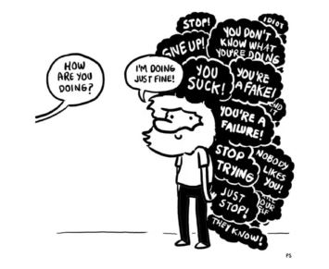
Six steps to reframe thinking and combat imposter syndrome
Step 1: Focus on the Facts
Step 2: Acknowledge, Validate and Let Go
Step 3: Reframe Your Thoughts
Step 4: Share How You’re Feeling
Step 5: Learn From Your Peers
Step 6: Pat Yourself on the Back Once in a While
Notes:
Step 1: Focus on the Facts
Imposter syndrome makes you believe you aren’t qualified for your position.
However, these emotions are frequently founded on fear rather than facts, and separating your feelings from the facts is the most effective strategy to combat imposter syndrome.
That definitely sounds easier said than done, and you might be thinking,” how can I do that?” Well, you can start by building up your confidence by becoming more aware of your strengths.
You can conduct a personal SWOT analysis, where you analyze your strengths, weaknesses, opportunities, and threats
Step 2: Acknowledge, Validate and Let Go
We’ve talked about focusing on the facts, but that doesn’t mean your feelings aren’t valid. Combating imposter syndrome isn’t about ignoring your emotions, rather that while feelings aren’t important, they are just feelings and don’t necessarily reflect reality.
Feeling unqualified doesn’t mean you actually are.
The best method to combat this feeling is to acknowledge that you’re feeling inadequate and validate that it’s okay. And then let go of those feelings.
Step 3: Reframe Your Thoughts
There’s a lot of power in thoughts.
Our perspective on the world and of ourselves can shape our reality, both positively and negatively. Remember, imposter syndrome is the internalized feeling that you were not good enough.
And if you reshape the way you think about yourself and set realistic goals, you’ll begin to see yourself as deserving of your place.
This can mean the deserving of your new role, your place on a team or praises for your accomplishments
Step 4: Share How You’re Feeling
This is easier said than done because imposter syndrome can feel very isolating.
Reach out and talk to someone you trust and share your concerns. This can be a friend or colleague, and you may be surprised to see how many people relate to how you feel.
We also recommend looking for a mentor. Find those in your field that you look up to and have an honest conversation with them about how they’ve improved their technical and soft skills and what challenges they have.
You’ll likely find that even those with lots of experience have been in your shoes and can provide you with the resources you need to improve.
Step 5: Learn From Your Peers
A common symptom of imposter syndrome is comparing yourself to your peers and thinking you’re worse at your job than they are.
The reality is no one is a master at everything, but everyone is a master of something.
So when working with your peers, you can exchange knowledge while mastering new skills. Don’t fall into the habit of comparing yourself to others. Recognize the value you add while learning new things from your peers.
Rather than view each other as competition, you can work together to expand your knowledge.
Step 6: Pat Yourself on the Back Once in a While
Sometimes the best way to overcome imposter syndrome is to face it, head-on.
Celebrate your accomplishments the next time you feel good about something you’ve done. Share your achievements with your coworkers or someone you trust outside of work, such as a friend or family member.
And if you believe that your life is shaped by your actions, choices, and decisions, you can take responsibility for your achievements as well as your shortcomings. Recognize that your expertise and talent empowered you to achieve your goal or complete an important project.
Keep a record of positive feedback and praise. The next time you hear that negative inner voice, this will help you take the sting out of any criticism.

Slide 10

Ways for the IP to Cope:
Notes:
Seek a mentor.
Discuss your insecurities with someone you trust, and respect can help you sperate whets real from your perceptions of insecurity. A trusted mentor can help you gauge if your making good progress and where to focus.
No one knows everything – IPC is a growing field

Slide 11
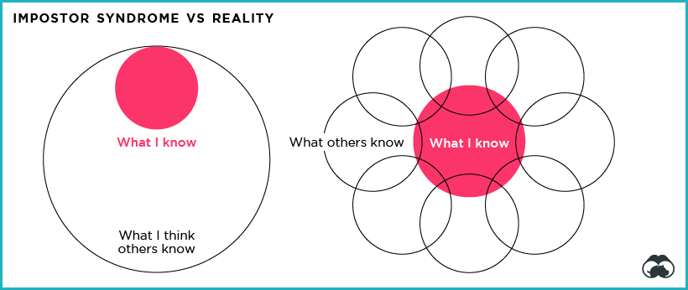
Closing
https://www.visualcapitalist.com/are-you-suffering-from-impostor-syndrome/

Slide 12
References:
Stop Telling Women They Have Imposter Syndrome (bgsf.com)
Dealing with Doubt.
https://web.s.ebscohost.com/ehost/pdfviewer/pdfviewer?vid=6&sid=ed1368c2-17e0-4227-be89-ad0d20a9dab0%40redis
More than meets the eye
https://web.s.ebscohost.com/ehost/pdfviewer/pdfviewer?vid=7&sid=ed1368c2-17e0-4227-be89-ad0d20a9dab0%40redis
A reality Check
https://web.s.ebscohost.com/ehost/pdfviewer/pdfviewer?vid=14&sid=ed1368c2-17e0-4227-be89-ad0d20a9dab0%40redis
Treat the cause
https://web.s.ebscohost.com/ehost/pdfviewer/pdfviewer?vid=15&sid=ed1368c2-17e0-4227-be89-ad0d20a9dab0%40redis
Intellectual self doubt
https://web.s.ebscohost.com/ehost/pdfviewer/pdfviewer?vid=16&sid=ed1368c2-17e0-4227-be89-ad0d20a9dab0%40redis
When you feel like your faking it
https://web.s.ebscohost.com/ehost/pdfviewer/pdfviewer?vid=17&sid=ed1368c2-17e0-4227-be89-ad0d20a9dab0%40redis

