Slide 1

Health Care Management Division
Annual Business Meeting and Awards Ceremony
Academy of Management Annual Meeting
Chicago, Illinois
Monday, August 12, 2024
Notes:
Please save questions until after the business meeting

Slide 2
Agenda
Welcome & Milestones
Year in Review
2024 Sponsors
Program Highlights and Awards
Transition to Incoming Chair
Keith G. Provan Award Keynote Address

Slide 3
Welcome and Milestones
  New members
  First time attendees
  Past chairs
  Past Teaching and Research award winners
  New doctorates
  Tenure
  Promotion
  HCM Division Reception: Monday 6:30 PM - SPIN Chicago
Notes:
Welcome all new members
Thank past chairs
Congratulate milestone

Slide 4
Year in Review: 2023-2024
Monthly Executive Committee meetings
On-going initiatives
  Focus on strategic plan action-items
New initiatives:
  HCM Ambassadors for conference
  Awards Task Force – developed written guidelines
  New Excellence in Teaching award for 2025:
    Now have “early career” and “later career” awards
Notes:
10 elected positions; several appointed, plus all committee chairs
AOM recently switched from requiring strategic planning every 5 years to currently every 3 years. We will need to do it again in spring, 2025.

Slide 5
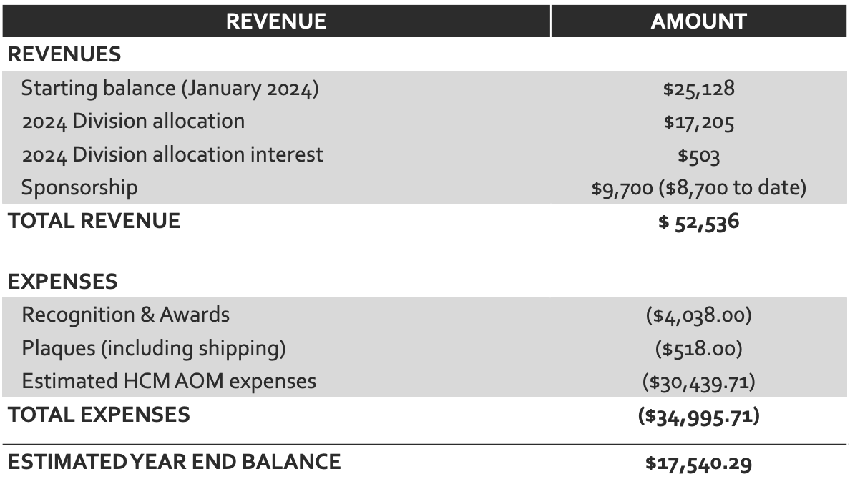
FINANCIAL REPORT (July, 2024)
TOTAL FUNDS IN OPERATING ACCOUNT (July, 2024: $47,991)
Notes:
This year we had a starting balance of $25,128. The allocation and interest were approximately $17,700, when summed. This year we raised $9,700 in sponsorships, including $1,000 for our student awards, with nearly all of that already collected prior to the conference. The revenue prior to expenses was over 52k ($52,536). The amount for AOM socials is estimated to be just over 30k ($30,439.71 - based on minimums). We gave out a total of $3,038.00 dollars in scholarships from our HCM account in addition to $1000 total in student awards, which were covered by sponsorship. We had a total of $38 in bank fees from sending and receiving international funds (1 sponsor donation and 1 student award).

Slide 6
Many Thanks to Outgoing Executive Committee Members!
Yuna Lee, Academic-at-Large
Beth Brooks, Practitioner-at-Large
Gina Theobes, Practitioner-at-Large
Olena Mazurenko, Research Committee Chair
Robin Peeters, Student Representative

Slide 7
2024-2025 Division Leadership Team
PDW Chair: Ingrid Nembhard*
Program Chair: Amber Stephenson
Chair Elect: Deirdre McCaughey
Division Chair: Nick Edwardson
Past Division Chair: Cheryl Rathert
Academics-at-Large:
  Gordon Shen*
  Daan Westra
Practitioners-at-Large:
  Mishell Klatt*
  Andres Pinto*
Secretary: Nate Carroll
Treasurer: Terri Menser
*Denotes new leader
Student Representatives:
  Pejmon (PJ) Noghrehchi
  Ren Lovegood*
International Representative-at-Large:
Abi Sriharan
Committee Chairs:
  Teaching: Patrick Shay
  Practice: Tracy Porter & Jennifer Gutberg
  Research: Dan Walker
  Communications: Tory Hogan
  Membership Engagement: Geoff Silvera
  DEI Committee: Vicky Parker & Charleata Battle
Notes:
New members: Ingrid Nembhard, PDW Chair; Gorden Shen, academic at large; Mishell Klatt & Andres Pinto, 2 practitioners at large; and Ren Lovegood, Student Rep

Slide 8
Thank you HCM Committees & Committee Chairs!
Consider joining a committee!
Committee members serve for 3 years
Can serve a 2nd 3-year term
Members must participate in one initiative per year
  Research – Dan Walker
  Teaching – Patrick Shay
  Practice – Tracy Porter & Jennifer Gutberg
  Student Engagement – PJ Noghrechi & Ren Lovegood
  Communications – Tory Hogan
  Member Engagement – Geoffrey Silvera
  DEI – Charleata Battle & Vicky Parker
  (Listed on HCM website)
Notes:
Committee Chairs stand up
In the interest of time we can’t give committee updates now; but Vicky Parker will take a few minutes to discuss the work of HCM’s newest committee, the DEI committee.

Slide 9
New DEI Committee:
Diversity, Equity, & Inclusion Statement
1. We are dedicated to supporting a diverse, equitable, and inclusive healthcare management and organization field.
2. We are committed to leading policies and practices that foster and promote equitable inclusion for all persons and the benefits of diversity.
3. We value and embrace the many dimensions of diversity among HCM members and respect each other’s voices.
4. These are all means to raise the quality of research, teaching, practice, and mentorship in the field of healthcare management and organization.
5. Together, we share the responsibility to uphold community standards for ethical and bias-free behavior among members.
(Posted on HCM Website)
Notes:
Vicky speak

Slide 10
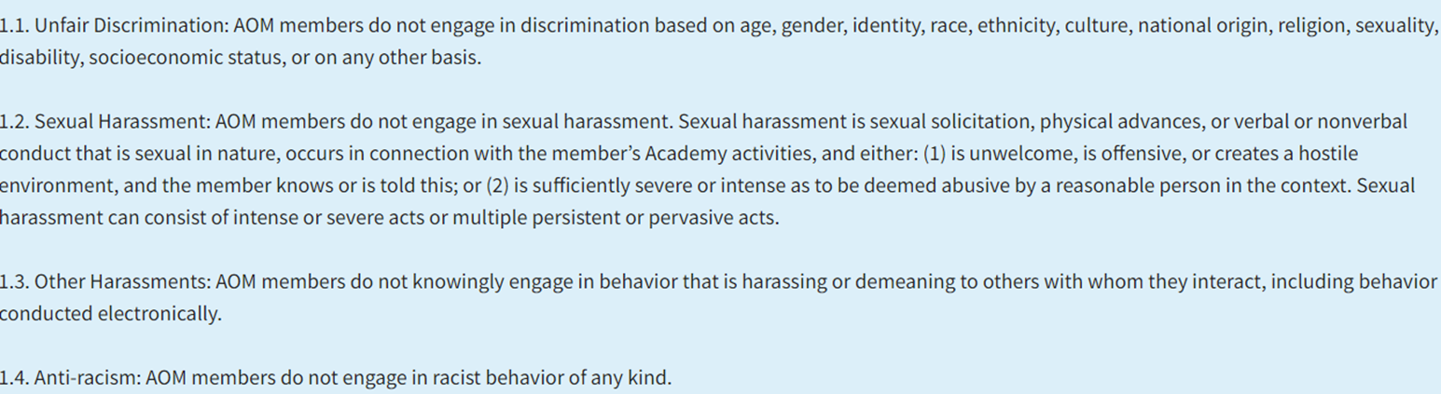
AOM’s Code of Ethics re: Discrimination, Harassment, & Bias
AOM has several relevant resources:
  AOM’s Code of Ethics includes these specific Ethical Standards:
  Any member can contact the Ethics Ombuds Committee at ombuds@aom.org to explore AOM processes for handling complaints
  AOM’s Ethics committees are guided by a set of Policies and Procedures for Handling Ethical Complaints
  HCM members can also contact any HCM division leader with concerns
Notes:
Context: Part of the DEI committee’s charge was to assess the need for an HCM member advocate position . We discovered that many relevant policies and resources already exist at the AOM level, but that many members are not aware of them.

Slide 11

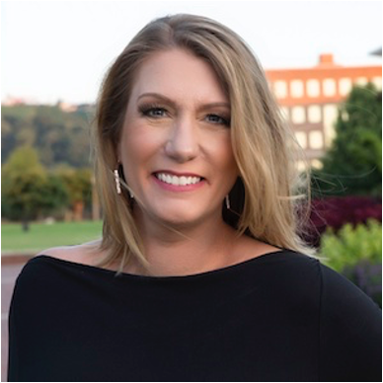



THANK YOU RIA HEARLD!
2020 & 2021: Virtual
2022: Seattle, WA
2023: Boston, MA
2024: Chicago, IL

Slide 12


Slide 13
PROGRAM HIGHLIGHTS & AWARDS
  2024 PDW Chair – Amber Stephenson
  2024 Program Chair — Deirdre McCaughey

Slide 14
2024 HCM
Professional Development Workshops (PDWs)
~ 30 Hours of Programming, ESC + 17 PDWs ~
Friday -
Emerging Scholars Consortium (ESC) -
PDWs -
  5 Sessions:
    Networking
    Becoming an HCM Scholar
    EDIJR
    Team-based Learning
    Strategizing for a Life in Academia
ESC Social – Flight Club
5 Sessions:
The Future of US Healthcare
Transitions in Mentoring
Implementation Science
Should DEI DIE?
A Serious Game: Collaborating in a Health Innovation Network

Slide 15
2024 HCM
Professional Development Workshops (PDWs)
Many Co-Sponsored Sessions!
Co-sponsors: MC, DEI, MED, HR, ODC
Saturday –
PDWs -
  11 Sessions:
    Incubators (3): Research, Teaching, Practice
    Grants (2): Overview of Process; Insights into Review
    AI (2): How AI will Change Teaching; AI as a Catalyst for Collaborative Value Creation
    Helping the Helpers: A Multidisciplinary Approach to Mental Health
    Shaping the Future of Interprofessional Team Research
    Soft Skills
    Deciphering the Relationships of Co-creation: Author, Review, Editor
Sunday –
PDWs -
    1 Site Visit:
    Rush University - Advancing Sustainability Through Healthcare Management

Slide 16
2024 Scholarly Program
Sunday thru Tuesday programming
  18 paper sessions, 3 symposia
144 papers submitted (up 5% YOY); 72 accepted (AOM sets cap)
4 symposia submitted; 3 accepted
231 volunteer reviewers; 178 given assignments
  Please increase your review keywords if you didn’t receive an assignment - AOM uses an algorithm to assign reviews!
19 emergency reviewers - thank you again!!

Slide 17
2024 Program Associate Editors
This year’s program could not have happened without the help of these esteemed colleagues:
Charleata Battle (California State University, Los Angeles)
Seongwon Choi (California State University, Los Angeles)
Jennifer Gutberg (University of Toronto)
Jessica Peck (Cleveland State University)
Tracy H. Porter (Cleveland State University)
Andrew Scarffe (Ottawa Hospital Research Institute)

Slide 18
2024 Emergency Reviewers
THE HCM DIVISION THANKS YOU!!!
Fatma M. AbdelSalam
Hannah Anush
Utpal K. Bhattacharya
Martin P. Charns
Alison Coates
Leeann Comfort
Elizabeth Goodrick
Mengzhen Guo
Shivani Gupta
Kristine Ria Hearld
S. Robert Hernandez
Tory H. Hogan
Ren Lovegood
Bjorn Erik Mork
Robert C. Myrtle
Lori Peterson
Cheryl Rathert
Chad Saunders
Abi Sriharan

Slide 19
2024 HEALTH CARE MANAGEMENT DIVISION PAPER AWARD WINNERS

Slide 20
2024 HCM Outstanding Paper Based on a Dissertation
Best sole-authored paper based on a recent dissertation
Sponsored by: Association of University Programs in Health Administration (AUPHA)
Selection Committee:
  Phatcharasiri (Angie) Ratcharak, 2023 Winner
  Cheryl Rathert, HCM Division Chair
  Daan Westra, HCM Academic at Large

Slide 21
Winner: 2024 HCM Outstanding Paper Based on a Dissertation
“Expertise or Expert Teams:
Team Familiarity, Expertise, and Performance
in the Emergency Department”
Alexandra Bray
University of Pennsylvania

Slide 22
2024 Best Health Care Management Theory-to Practice Award
Best HCM paper for practicing health care managers answering relevant research questions about management practices
Sponsored by AOM Health Care Management Division
Selection Committee:
  Beth Brooks, Practitioner-at-Large
  Gina Thoebes, Practitioner-at-Large
  Larry Hearld, Co-Editor, Health Care Management Review

Slide 23
Winner: 2024 Best Health Care Management Theory-to Practice Award
“The Frame Matters:
Leaders’ Optimistic Realism During Crisis”
Michaela Kerrissey, Harvard University
Ingrid Nembhard, University of Pennsylvania
Amy C. Edmondson, Harvard University

Slide 24
2024 HCM Best International Paper
Best International paper submitted to the Division
Sponsored by AOM Health Care Management Division
Selection Committee:
  Abi Sriharan HCM Division International Representative at Large
  Kristine Ria Hearld, HCM Past Division Chair
  Andrew Scarffe, HCM 2024 Conference Program Associate Editor

Slide 25
Winner: 2024 HCM Best International Paper
“It Does Not Add Up:
A Mixed-Methods Study of
Collaborative Healthcare Networks
Maike Vanessa Tietschert, Erasmus University.
Daan Westra, Maastricht University
.

Slide 26
2024 HCM Best Student-Led Paper
Best paper by a current student as the sole author or first author if multi-authored
Sponsored by: Association of University Programs in Health Administration (AUPHA)
Selection Committee:
  Margo Janssens, 2023 Winner
  Patrick Shay, HCM Teaching Committee Chair
  Amber Stephenson, HCM PDW Chair

Slide 27
Winner: 2024 HCM Best Student-Led Paper
“Post-Acute Transitions
for Traditional Medicare Beneficiaries
with Serious Mental Illness”
Taylor Iris Bucy, University of Kansas Medical Center
Dori Amelie Cross, , University of Minnesota

Slide 28
2024 Health Care Management Best Paper
Sponsored by: American College of Healthcare Executives (ACHE)
The top 10% of the papers submitted to the annual program are considered for this award
Selection Committee:
  Eitan Naveh, 2023 winner
  Yuna Lee, HCM Academic-at-Large & 2023 winner
  Nick Edwardson, HCM Division Chair-Elect
  Andrew Scarffe, HCM 2024 Conference Program Associate Editor

Slide 29
Winner: 2024 Health Care Management
Best Paper
“Effects of a Real-Time
Information-Based Intervention
on Physician prescribing Behavior”
Olivia Zhao, Harvard University
Anna Sinaiko, Harvard University

Slide 30
Outstanding Reviewer Award Winners
Daniele Mascia, Luiss Guido Carli University
Mitchell Tang, Harvard University
Brian Hilligoss, University of Arizona
Sara Singer, Stanford University
Leeann Comfort, Agency for Healthcare Research and Quality
Eva Lilie Josephine Pattyn, University of Ghent
Wardah Qureshi, HRM
Anand Bhardwaj, McGill University
Christy Harris Lemak, University of Alabama (Birmingham)
Sasmira Matta, University of Pennsylvania

Slide 31

AOM 2025
Dates: July 25-29, 2025
Conference Theme: "Copenhagen 2025"
Location:
  Papers - Bella Center (90% of sessions)
  PDWs, Consortia, Socials - off-site, socially embedded
Logistics:
  Attendees will stay in the city center
  Take 10 min public transit metro to Bella Center
More information to come!

Slide 32
HEALTHCARE MANAGEMENT DIVISION AWARD WINNERS
August 2024

Slide 33

HCM Division’s Excellence in Teaching Award
Recognizes innovative and outstanding teaching that takes place in our classrooms and provides the opportunity to encourage, recognize and reward the work of excellent, dedicated and inspiring teachers
Selection is managed by the HCM Teaching Committee’s Excellence in Teaching Award sub-committee, based on nominations from HCM Division members
  Tim Hoff (Chair) Seongwon Choi
  Erin Sullivan Daan Westra

Slide 34
Quotes of Support from Students, Mentees, & Peers
“[Dr. X’s] dedication to student success, ability to create inclusive and supportive learning environments, and genuine care for students’ well-being make [Dr. X] an outstanding educator and mentor. [Their] impact on my life and academic journey is immeasurable.”
“…of the dozens of professors I have worked with and learned from over the years, [Dr. X] stands alone in taking the time outside of the classroom to invest in my future and uplift my perspectives”
“[Dr. X] is one of those teachers who appears only a few times in a student’s academic career. Not only because [Dr. X] is truly exceptional, but because [Dr. X] has the remarkable and rare ability to inspire students to believe in themselves. …[Dr. X’s] ability to connect with individuals from diverse backgrounds and make them feel valued and heard is a testament to their exceptional character and leadership.”

Slide 35
Quotes of Support from Students, Mentees, & Peers
“[Dr. X] is the real-life example of a visionary leader who can motivate large groups of people to drive towards change. Their ability to inspire both students and colleagues is remarkable, and it is evident from the positive impact they have made in the field of health care management.”
“[Dr. X] is a compassionate mentor who genuinely cares about the success and well-being of students. [Dr. X] creates a supportive learning environment where I personally felt empowered to explore new ideas and take intellectual risks. Their mentorship continues to extend beyond the classroom.”
“What makes [Dr. X] unique is that not only do they support students’ success at their own institution, they cross organizational and national boundaries to help other students and teachers flourish. I consider myself lucky to have been taught how to conduct research by [Dr. X], even though there has never been an official relationship between us. [Dr. X’s] students LOVE him because [Dr. X] genuinely cares about each individual uniquely.”

Slide 36
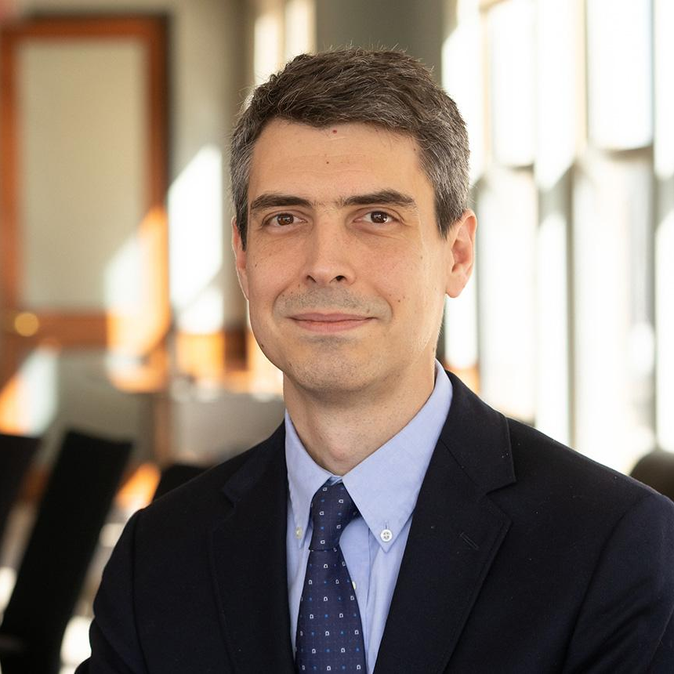
2024 Excellence in Teaching Award Winner
PROFESSOR, CULVERHOUSE SCHOOL OF COMMERCE
THE UNIVERSITY OF ALABAMA
Peter F. Martelli, PhD
Associate Professor, Healthcare Administration
Sawyer Business School
Suffolk University

Slide 37
2024 Myron D. Fottler Exceptional Service Award
Dedicated at least 10 years to HCM and the profession, and established a consistently strong presence in the Division over a long period of time;
Served as a meaningful mentor, not only to colleagues and students in his or her own university, but also to others in HCM;
If the individual has served as a Division officer, he or she must have continued participation for at least five years after serving as an officer.

Slide 38
Accomplishments & Contributions
A career-long, active member of HCMD
Has served as organizer, panelist, discussant, and presenter for a large number of PDW & Emerging Scholars Consortium sessions, and the AOM scientific program
Is especially known for his invited presentation, “The Anatomy of an Empirical Research Manuscript,” which is consistently one of the highest-reviewed sessions at AOM
Is especially recognized for his mentoring activities for junior scholars and peer HCM colleagues
Is a recognized research scholar in health care management

Slide 39
Quotes from Support letters for the candidate’s nomination
Supporting quotes from peers:
“[Dr. X] has been transformative in the lives of so many of the scholars in our division. Whether it be at AOM, through his presentations detailing the structure of an empirical paper or the coterie of his mentees who surround him at any meeting he attends, [Dr. X] has had an outsize presence through his engagement with students. ”
“[Dr. X’s] diversity of engagement has been made possible by the diverse collaborative network of hundreds of colleagues who he has mentored throughout his presence in our community. With over 400 co-authors, [Dr. X] has been a profound academic force in the HCM community.”
“While not listed as a co-author on any of my articles, [Dr. X’s] fingerprints can be found on each of them. I owe him a debt of gratitude for a significant portion of my professional success, which is remarkable considering I was never a student or formal colleague of his.”

Slide 40
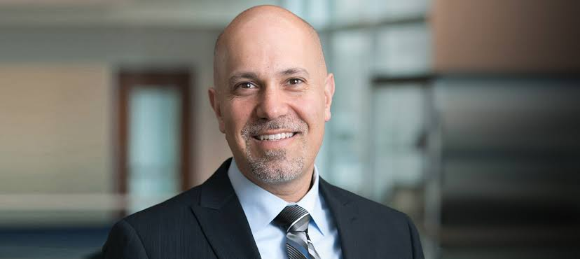
2024 Myron D. Fottler Exceptional Service Award Winner
PROFESSOR, CULVERHOUSE SCHOOL OF COMMERCE
THE UNIVERSITY OF ALABAMA
Nir Menachemi, PhD, MPH
Dean, Professor, and Fairbanks Endowed Chair
Richard M. Fairbanks School of Public Health | Indiana University Indianapolis

Slide 41
2024 HCM Division Research Scholar Awards
THANK YOU!
HCM Early Career Achievement Award
HCM Mid-Career Achievement Award
Keith G. Provan Distinguished Scholar Award
Notes:
Early career: Nominees must have received their doctoral degree within 7 years prior to the annual meeting.
Mid-Career: Nominees must have received their doctoral degree more than 7 years prior to the annual meeting; and must not yet have reached the rank of Full professor or equivalent.
Provan: Contribution to health care management scholarship through high-quality research over an extended career period.

Slide 42
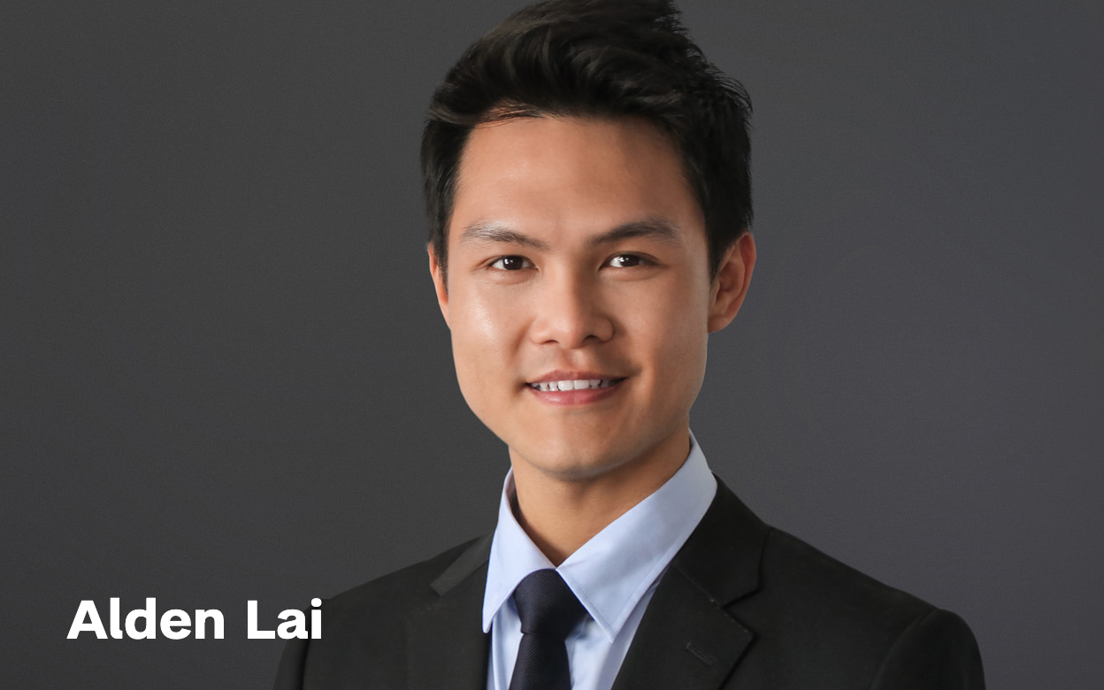
2024 Early Career Achievement Award
PROFESSOR, CULVERHOUSE SCHOOL OF COMMERCE
THE UNIVERSITY OF ALABAMA
Assistant Professor, MPH, PhD
Public Health Policy and Management
School of Global Public Health
New York University

Slide 43
The Strength of Dr. Lai’s Research: Reflections by Nominators
“[Dr. Lai] is distinguishing himself in the field of health care management as a foremost expert in the design of health care work, the impact of that work on employee and organizational outcomes, and the impact of organizational initiatives on the work and experiences of critical frontline staff.”
“Alden’s work is also having a positive impact on practice. He has published 14 articles in practice and policy-oriented outlets and contributed to three technical reports, including one to the New York City Office of Labor Relations. Numerous invited talks further testify to the value of his work to industry and government, both in the US and beyond.”
Notes:
OLENA/DAN
She is poised to make high-value
contributions to our research community and to the key policy and delivery system
stakeholders of health care management research.

Slide 44
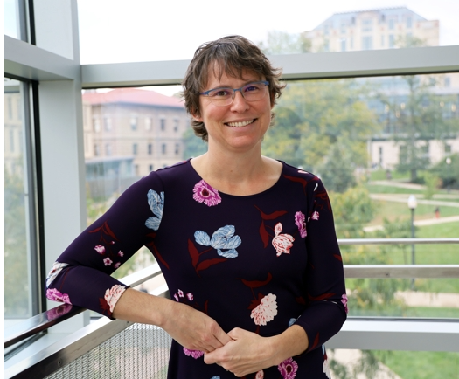
2024 Mid-Career Achievement Award
PROFESSOR, CULVERHOUSE SCHOOL OF COMMERCE
THE UNIVERSITY OF ALABAMA
Jennifer Hefner, PhD
Associate Professor
Health Services Management and Policy
Ohio State University

Slide 45
The Strength of Dr. Hefner’s Research: Reflections by Nominators
Dr. Hefner’s commitment and dedication to research that transforms healthcare by advancing quality and safety work, by improving our understanding of what patients need to engage more fully in their care, and by examining how healthcare organizations can collaborate with community organizations to address patients’ social needs is exemplary.
Her critical work helps us to understand what each partner in these efforts can provide, how to facilitate cross-sector collaboration, and how to leverage institutional resources to share data among partners.

Slide 46
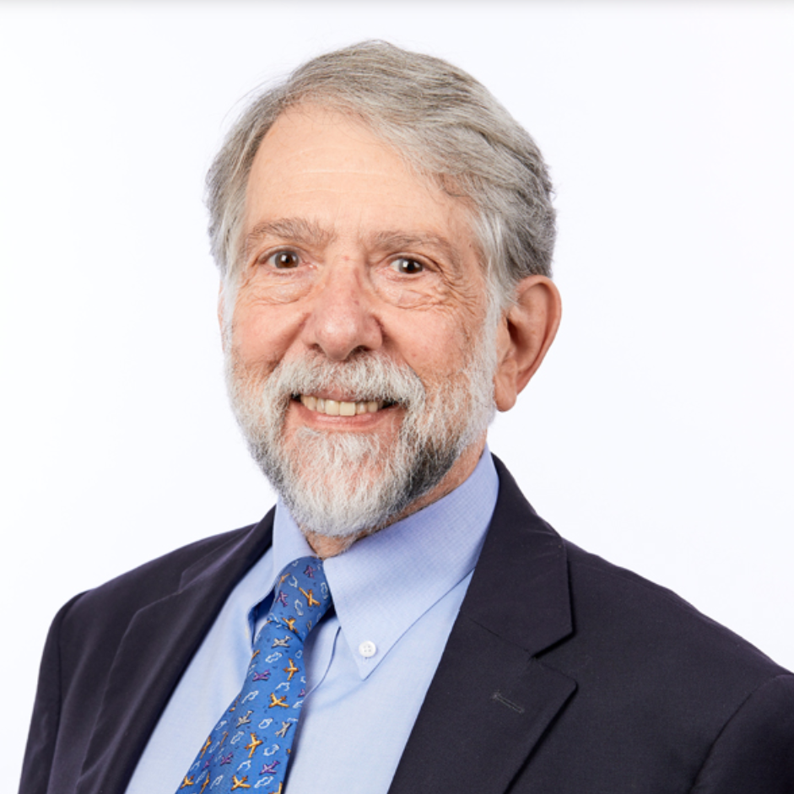
2024 Keith G. Provan Award
PROFESSOR, CULVERHOUSE SCHOOL OF COMMERCE
THE UNIVERSITY OF ALABAMA
Martin P. Charns,DBA
Professor
Health Law, Policy, and Management
School of Public Health, Boston University

Slide 47
The Strength of Dr. Charns’s Research: Reflections by Nominators
Dr. Charns is a highly impactful scholar and a thought leader in establishing conceptual linkages between healthcare management practices and clinical outcomes.
Dr. Charns made important contributions to the field of implementation science and organizational change, leading development of the Organizational Transformation Model, Lean Management Systems (measure of organizational transformation).
Marty has been a thought leader on organizing health services delivery organizations. He conceptualized the variations in service line structures used in hospitals and in healthcare networks, and led empirical studies in both the VA and private sector on this topic.

Slide 48
HCMD Keynote Address by
Dr. Charns
Seeing the Forest and the Trees

Slide 49

THANK YOU AND BEST WISHES TO OUR NEW CHAIR,
NICK EDWARDSON

