Slide 1

HealthCare MANAGEMENT Division
ANNUAL Business MEETING
AND AWARDS CEREMONY
Monday, August 7, 2023

Slide 2
Welcome and Milestones
Welcome:
    New members
    Past chairs
    First time attendees
Celebrate milestones:
    New doctorates
    Tenure
    Promotion

Slide 3
Strategic plan
Action Items
2022-2023
Strategic priorities
  Sustain, nurture, and grow Division while maintaining intimacy
      Launched the Communications Committee: HCM Division Newsletter and AMAZING communications via the Communications Committee
      Launched the HCM Division Membership Committee
      Bylaws revision
  Promote career and professional development of members
      Continuation of mentorship program
      Increasing student engagement and outreach, including non-traditional groups (executive doctoral students, nurse executives, underrepresented departments)
  Promote diversity, equity, and inclusion in the Division and the field
      Launched HCM Division DEI Taskforce
  Clarify and enhance the value of health care management to policymakers and practitioners: “Make management a policy priority”
      Relaunched the HCM Division Practice Committee
      Joint webinar on between AUPHA and HCMD: “AI Tools and Their Influence on Teaching, Learning, and Assessment”
      Webinar: Succeeding as a Health Care Researcher in a “B” School"
Notes:
Highlight some of the activities of the division
First, new strategic planning process—now an ongoing effort as opposed to every 5 years

Slide 4

DEI Task Force
Work to date:
  Survey of members (very limited response)
  Draft HCM DEI statement
Proposed Future Work:
  Finalize and get division membership approval for HCM DEI statement
  Solicit additional HCM member feedback
  Establish award for scholarship that advances understanding of the connections between DEI and healthcare management
Members:
Charleata Battle (Co-Chair), California State University, Los Angeles
Vicky Parker (Co-Chair), The University of New Hampshire
Lois Dankwa, Johns Hopkins University
Lihua Dishman, A.T. Still University
Lambert Li, Stanford University
Nitish Patidar, Quinnipiac University
Gordon Shen, The University of Texas Health Science Center at Houston
Maike Tietschert, Vrije Universiteit Amsterdam
Chinue Uecker, LPI Consultants, adjunct at multiple universities

Slide 5

Draft DEI Statement we need your feedback!
We are dedicated to supporting a diverse, equitable, and inclusive healthcare management and organization field.
We are committed to leading policies and practices that foster and promote equitable inclusion for all persons and the benefits of diversity.
We value and embrace the many dimensions of diversity among HCM members and respect each other’s voices.
These are all means to raise the quality of research, teaching, practice, and mentorship in the field of healthcare management and organization.
Together, we share the responsibility to uphold community standards for ethical and bias-free behavior among members.

Slide 6
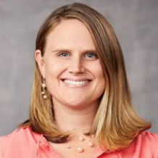
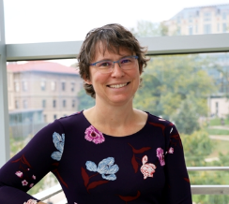
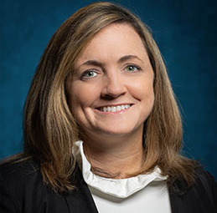
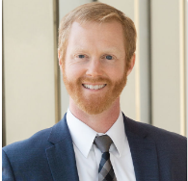
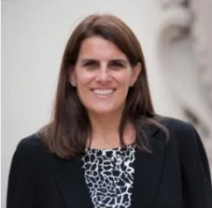
Communications
We are a committee now!
Tory
Hogan, Chair
Jennifer Hefner
Lesley
Clack
Nate
Carrol
Sara
Singer
What do we do?
HCM Quarterly Newsletter
Daily Conference Email Updates
Other Updates:
We are no longer utilizing Twitter/X
All members can use AOM connect to reach out to colleagues in the division. Posts will be approved within 2 business days (How to video on www.hcm.aom.org)
If you aren’t getting communication from AOM Connect/HCM division, check your communication settings (How to video on www.hcm.aom.org)
Update/Manage and develop www.hcm.aom.org,
Manage AOM Connect

Slide 7


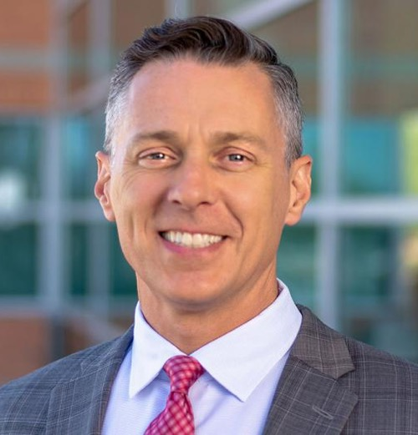
Thank you, Brian Hilligoss!
2019: Boston, MA
2020 and 2023: virtual experience
2022: Seattle, WA
2023: Boston, MA
Notes:
Some introductions and additional thanks

Slide 8
2023-2024 DIVISION Leadership Team
PDW Chair: Amber Stephenson
Program Chair: Deirdre McCaughey
Chair Elect: Nick Edwardson
Division Chair: Cheryl Rathert
Past Division Chair: Ria Hearld
Academics at Large:
  Yuna Lee
  Daan Westra*
Practitioners at Large:
  Beth Brooks
  TBD
Secretary: Nate Carroll
Treasurer: Terri Menser
*denotes new team member or leader
Student Representatives:
  Robin Peeters
  TBD
International Representative:
Nora Ann Colton
Committee Chairs
  Teaching: Patrick Shay
  Practice: Tracy Porter and Jennifer Gutberg
  Research: Olena Mazurenko
  Communications: Tory Hogan
  Membership Engagement: Geoff Silvera
  DEI Taskforce: Vicky Parker & Charleata Battle

Slide 9

















Thank you, 2023 sponsors!
Platinum
Sponsors
Silver
Sponsors
Bronze
Sponsors
Award
Sponsors

Slide 10
Financial Report (July, 2023)
REVENUE | AMOUNT
REVENUES
Starting balance (January, 2023) | $53,388
2023 Division allocation | --
Base portion | --
Sponsorship | $11,000 ($9,000 to date)
TOTAL REVENUE | $ 62,388
EXPENSES
2023 Socials and Scholars Luncheon | ($33,815.49)
Recognition & Awards | $2750 ($2,200 claimed)
Plaques | ($1,443)
TOTAL EXPENSES | ($3,643)
CURRENT YEAR NET INCOME | $24,929.51
TOTAL FUNDS IN OPERATING ACCOUNT (July, 2023: $58,745)
Notes:
This year we had a starting balance of $53,388. There is currently no allocation or base portion posted for 2023 but these are expected to return to their pre-pandemic levels. This year we raised $11,000 in sponsorships, with nearly all of it already collected. The net income prior to social costs is $58,745. The amount for AOM socials and early academic program expenses is estimated to be X ($58,745-costs from Geoff). We gave out a total of $2750 dollars in scholarships from our HCM account, of which $2200 has been claimed to date.

Slide 11
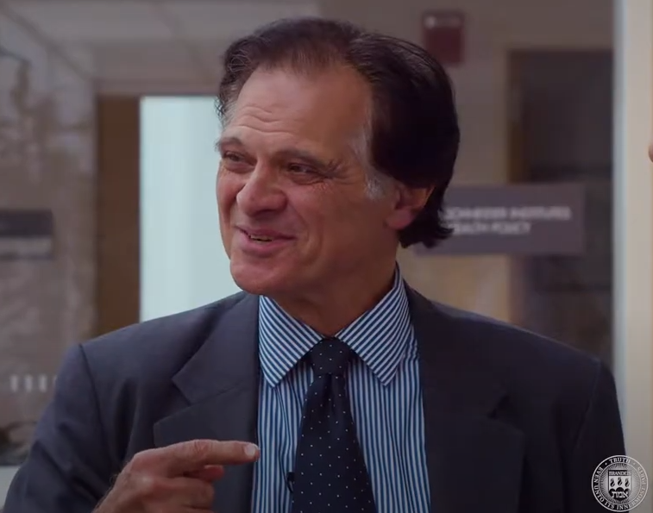
Jon Chilingerian
1951-2023
HCMD Chair, 1997-98
HCMD Myron Fottler Exceptional Service Award, 2010
Professor & Director of EMBA program for physicians, Brandeis University
Visiting Scholar, Healthcare Management Initiative, INSEAD
Stuart Altman, “It is hard to imagine anyone other than Jon accomplishing so much is such a short period of time. He left us much too soon.”
Stephen Chick, “He has impacted healthcare leaders in INSEAD programs that number in the thousands in many countries around the world.”
Regina Herzlinger, “The world of health care management and I will miss him dearly. His many accomplishments are overshadowed by the sheer presence of his personality.”
Forthcoming book: The New Science of Medicine & Management: A Comprehensive Case-Based Guide for Clinical Leaders (Springer)

Slide 12
Program Highlights
  2023 PDW Chair – Deirdre McCaughey
  2023 Program Chair — Nick Edwardson
Notes:
Sarah
Tim
Tia

Slide 13
2023 HCM Professional Development Workshops Deirdre
30 hours of programming, 17 sessions
Friday
Emerging Scholars Consortium – Everyone welcome!
  4 Real-Time Open Sessions:
    Building Collaborations as Emerging Scholars Editors Panel
    Online Teaching Hot Topics Research Roundtables
Emerging Scholars Social – Everyone welcome!
PDWs - 3 Real-Time Open Sessions:
    Managing Pandemic Induced Research Disruptions
    Preparing Health Care Leaders to Become Good Ancestors
    *Informal Mentoring: Senior Scholar Coffee Chats*
Notes:
Cheryl to present

Slide 14
2023 HCM Professional Development Workshops Deirdre
Saturday – PDWs - 6 Real-Time Open Sessions:
    Research in the Rough
    Teaching Incubator
    Dynamics of Crisis Leadership: Developing a Research Agenda
    Promoting Equity in Learning
    Development of a Screen-Based Change Management Simulation
    Mindful Managing
    *Informal Mentoring: Senior Scholars Coffee Chats*
Sunday – PDWs - 1 Real-Time Open Session:
    Organizational Determinants of Health: Equity & Inclusion
Wednesday – Inaugural HCM Research Consortium - 2 Real-Time Sessions
    Pivoting Research in Health Care Management in the Context of COVID-19
    Secondary Data & Empirical Research
Many Co-Sponsored Sessions!
  Co-sponsors: OB, AAT, CAR, OMT, MED, CM, IM, MOC, STR, CM, ODC, PNP, MSR, OCIS, RM, TIM
Notes:
Cheryl to present

Slide 15
2023 Program
29 hours of programming
  15 paper sessions, 4 symposia
137 papers submitted (up 19% YOY); 69 accepted (cap set by AOM)
6 symposia submitted; 5 accepted
198 volunteer reviewers; 152 given assignments
  (Please increase your review keywords if you were one of the 46 who didn’t receive an assignment!)
94% review completion rate* (thank you!)
Notes:
Ria to present

Slide 16
2023 program associate editors
Charleata Battle (California State University, Los Angeles)
Amber Stephenson (Clarkson University)
Daan Westra (Maastricht University)
Notes:
Ria to present

Slide 17
2023 Emergency reviewers
Helped reduce total number of papers receiving only two reviews from 75 to 21, all in the span of <10 days.
Please complete your reviews!
For some, the emergency review was their 6th, 7th, or even 8th AOM conference paper to review
Some of these reviewers completed reviews while on vacations in Italy and on maternity/paternity leave
PLEASE help me get these people drinks at SPIN in one hour.
Notes:
Ria to present

Slide 18
2023 Emergency reviewers
(Thank you!!!)
Afeefa Cholasseri
Amy Yarbrough Landry
Chequeta Allen
Cheryl Mitchell
Cheryl Rathert
Chin Uecker
Chris Brown Mahoney
Clay Thomas
Cory Cronin
Dan Fisher
Deborah M. Mullen
Faisal Lahore
Frank van de Baan
Genevra Murray
Geoffrey A. Silvera
Hanu Tyagi
Ingrid Nembhard
J'Aime C. Jennings
James Bramble
Janis Gogan
Jay Shaw
Justin Benzer
Karin Kee
Karleen Giannitrapani
Kevin Frick
Kristina Leppälä
Krystal Hunter
Lambert Zixin Li
Leeann Comfort
Lihua Dishman
Lori Peterson
Martin P. Charns
Mattia Gilmartin
Michael Stowe
Mike Bellissimo
Minjie Gao
Mitchell Glavin
Morgann Reid
Noa Birman
Olivia Jung
Patrick Shay
Rachel Gifford
Rob Weech-Maldonado
Sara Singer
Seongwon Choi
Sonja Kugler
Thomas Reibel
U.K. Bhattacharya
Wardah Qureshi
Yaminette Diaz-Linhart
Yuna Lee
Notes:
Ria to present

Slide 19
2023 health care Management Division Paper Award Winners

Slide 20
2023 Health Care Management Outstanding Paper
Based on a Dissertation
Best sole-authored paper based on a recent dissertation
Sponsored by: Association of University Programs in Health Administration (AUPHA)
HCM nominee for William H Newman Award All-Academy Best paper based on a recent dissertation
Selection Committee:
  Karla Sayegh, 2022 Winner
  Cheryl Rathert, HCM Chair-Elect
  Yuna Lee, HCM Academic at Large

Slide 21
Runner-Up
“Using Innovation Contests to Increase Employee Voice: A Field Experiment in Community Health Centers”
Olivia Jung
UCLA

Slide 22
2023 Health Care Management Outstanding Paper
Based on a Dissertation Winner
“Emotion Management among Clinical Leads under Leader Identity Threat: A Moderated Mediation Model”
Phatcharasiri (Angie) Ratcharak
University of Greenwich

Slide 23
2023 Best health care Management Theory to Practice Award
Selection Committee:
  Beth Brooks, Practitioner-at-Large
  Larry Hearld, Co-Editor, Health Care Management Review
  Nicole Hartwich, 2022 Winner

Slide 24
Runner-Up
“A Novel Method of Patient Narrative Feedback Reporting and Learning: Results from a Field Experiment”
Ingrid Nembhard, U. of Pennsylvania
Dale Shaller, Shaller Consulting
Sasmira Matta, U. of Pennsylvania
Rachel Grob, U. of Wisconsin, Madison
Yuna Lee, Columbia U.
Mark Schlesinger, Yale U.

Slide 25
2023 best health care Management Theory to Practice Award Winner
“Workload and Errors: Utilizing Data Collected Through Sensors in an Outpatient Cancer Facility”
Eitan Naveh, Technion Israel Institute of Technology
Noa Nissinboim, Technion Israel Institute of Technology
Ryan Leib, Fred Hutch Cancer Center
Jessica Cleveland, Dana-Farber Cancer Institute
Partha Das, DaVita International
David Frank, Winship Cancer Institute
Craig Bunnell, Dana-Farber Cancer Institute
Sara Singer, Stanford U.

Slide 26
2023 health care management
Best International Paper
Sponsored by AOM Health Care Management Division
HCM Nominee for Carolyn B. Dexter Award:
Best paper on an International Theme
Selection Committee:
  Nora Colton, HCM Global Representative at Large
  Brian Hilligoss, HCM Past Division Chair
  Terri Menser, HCM Executive Committee Member

Slide 27
Runner-Up
“Embedding Artificial Intelligence in Healthcare – The Case of AI-enabled Diagnostics”
Sandra Gillner
U. of Bern

Slide 28
2023 health care management best International Paper Winner
“Utterance Based Analysis of Communicative Phases in Multidisciplinary Health Care Team Meetings”
Margo Janssens, Tilburg U.
Samantha Van Der Bruggen, st Elisabeth Hospital
Alexander Schouten, Tilburg U.
Laurens Beerepoot, st Elisabeth Hospital
Roger Leenders, Tilburg U.

Slide 29
2023 health care management
Best student Paper
Sponsored by: Association of University Programs in Health Administration (AUPHA)
Selection Committee:
  Nicole Hartwich, 2022 Winner
  Patrick Shay, HCM Teaching Committee Chair
  Deirdre McCaughey, HCM PDW Chair

Slide 30
Runner-Up
“Psychological Safety as an Enduring Resource for Employees Amid Organizational Crisis”
Hassina Bahadurzada, Harvard U.
Michaela Kerrissey, Harvard U.

Slide 31
2023 health care management
Best student Paper Winner
“Utterance Based Analysis of Communicative Phases in Multidisciplinary Health Care Team Meetings”
Margo Janssens, Tilburg U.
Samantha Van Der Bruggen, st Elisabeth Hospital
Alexander Schouten, Tilburg U.
Laurens Beerepoot, st Elisabeth Hospital
Roger Leenders, Tilburg U.

Slide 32
2023 health care management
Best PAPER
Sponsored by: Foundation of the American College of Healthcare Executives
The top 10% of the papers submitted to the annual program are considered for this award
Selection Committee:
  Karla Sayegh, 2022 winner
  Amber Stephenson, HCM Academic at Large
  Ria Hearld, HCM Division Chair

Slide 33
Runner-Up
“Learning from Patients: The Impact of Using Patient Narratives on Patient Experience Scores”
Ingrid Nembhard, U. of Pennsylvania
Sasmira Matta, U. of Pennsylvania
Dale Shaller, Shaller Consulting
Rachel Grob, U. of Wisconsin, Madison
Mark Schlesinger, Yale U.

Slide 34
2023 health care management
Best PAPER Co-winner
“The Harmony of Creativity and Standardization in High-Stakes Work: Lessons from the Bedside in ICUs”
Yuna Lee, Columbia U.
Robert Litchfield, Washington and Jefferson College
Lucy L. Gilson, U. of New Hampshire

Slide 35
2023 health care management
Best PAPER Co-winner
“Workload and Errors: Utilizing Data Collected Through Sensors in an Outpatient Cancer Facility”
Eitan Naveh, Technion Israel Institute of Technology
Noa Nissinboim, Technion Israel Institute of Technology
Ryan Leib, Fred Hutch Cancer Center
Jessica Cleveland, Dana-Farber Cancer Institute
Partha Das, DaVita International
David Frank, Winship Cancer Institute
Craig Bunnell, Dana-Farber Cancer Institute
Sara Singer, Stanford U.

Slide 36
Outstanding Reviewer Award
Criteria: 2+ Reviews; On-time; High quality; Constructive; Author ratings

Slide 37
Outstanding Reviewer Award
Aaron Spaulding
Ahmad M. Ashkanani
Alison Murphy
Anand Bhardwaj
Brian Hilligoss
Carl Rudolf Blankart
Clayton Thomas
Erin Sullivan
Hanu Tyagi
J'Aime Jennings
Jean-Baptiste Gartner
Jennifer Hefner
Jennifer Gutberg
Jessica N. Mittler
Joshua Adam Gerlick
Karin Kee
Karleen F. Giannitrapani
Kristina Leppälä
Laura McClelland
Mariam Krikorian Atkinson
Matthew John DePuccio
Mattia J. Gilmartin
Meena Andiappan
Minjie Gao
Nadine Gerhardt
Nathan Carroll
Nitish Patidar
Patrick Shay
Patrick Albert Palmieri
Rachel Gifford
Robert Weech-Maldonado
Robin Peeters
Shu Zhang
Thomas Reibel
Victoria Parker
Williams Jr.
Yaminette Diaz-Linhart

Slide 38
Healthcare Management Division Award Winners
August 2023

Slide 39

HCM Division’s
Excellence in Teaching Award
Recognizes innovative and outstanding teaching that takes place in our classrooms and provides the opportunity to encourage, recognize and reward the work of excellent, dedicated and inspiring teachers
Selection is managed by the HCM Teaching Committee’s Excellence in Teaching Award sub-committee, based on nominations from HCM Division members
  Tim Hoff (Chair) Seongwon Choi
  Michele Heath Bjorn Erik Mork William Opoku-Agyeman Daan Westra

Slide 40
Quotes of Support from Students & Peers
“[Dr. X] is a tireless worker and completely dedicated to [their] program and its students. [They’re] an excellent professor and the perfect nominee for such an award.”
“ [Dr. X] has continually strived to help students like me excel in every course by ensuring they have the resources to succeed… Throughout my time with [Dr. X], I have witnessed [Dr. X’s] diligence, ability, and above all [their] professional abilities. I can openly say [Dr. X] is one of the most hardworking, dedicated, and team-oriented individuals I have met throughout my schooling career.”
“ [I’m impressed by this individual’s] drive and determination to excel at all that [they] set forth to accomplish. [Dr. X] uses this same determination to make a positive impact on [their] students as well as [their] colleagues. …I believe that [Dr. X] has made indelible teaching contributions to the field of health care management.”

Slide 41
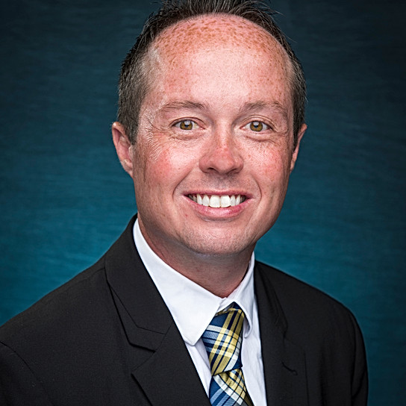
2023 Excellence in Teaching award winner
Professor, Culverhouse School of Commerce
The University of Alabama
Eric Richardson, PhD
Associate Professor & MHA Program Coordinator
College of Health and Human Services
, University of North Carolina Wilmington

Slide 42
2023 Myron D. Fottler
Exceptional Service Award
Dedicated at least 10 years to HCM and the profession, and established a consistently strong presence in the Division over a long period of time;
Served as a meaningful mentor, not only to colleagues and students in his or her own university, but also to others in HCM;
If the individual has served as a Division officer, he or she must have continued participation for at least five years after serving as an officer.

Slide 43
ACCOMPLISHMENTS & CONTRIBUTIONS
A career-long, active member of HCMD;
Served on the 5-year HCM Executive Leadership team (PDW Chair, Program Chair, Division Chair Elect, Division Chair, Past Chair) and has continued service for more than 5 years;
Has served as organizer, panelist, discussant, and presenter for a large number of PDW & Emerging Scholars Consortium sessions, and the AOM scientific program;
Is especially recognized for their mentoring activities for junior scholars and peer HCM colleagues;
Is a recognized research scholar in their area

Slide 44
QUOTES FROM SUPPORT LETTERS FOR OUR AWARD RECIPIENT'S NOMINATION
Supporting letters from 3 peers:
“Dr. X consistently demonstrates the qualities and characteristics that this award seeks to celebrate, embodying the spirit of exceptional service and mentorship. ”
“Dr. X’s commitment, leadership, and mentorship have made a significant impact on the HCM Division and the field of health care management.”
“Dr. X exemplifies what it means to develop others and ‘give back’ to future generations of health care management scholars.”
“Dr. X is a peer who is a delight to know and a colleague who is excellent to work with. She gives her time and efforts to mentor others, has provided countless hours of service to our Division, and has always helped to ensure mutual successes for all involved.”

Slide 45
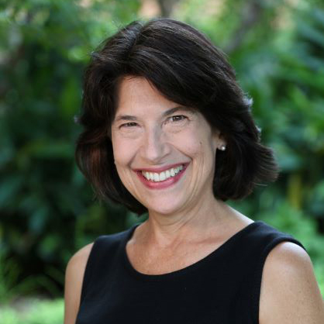
2023 Myron D. Fottler Award Winner
Professor, Culverhouse School of Commerce
The University of Alabama
Rebecca Wells, PhD
Professor, Management, Policy & Community Health
School of Public Health, University of Texas Health Science Center Houston

Slide 46
2023 HCM Division
Research SCHOLAR Awards
Thank you!
HCM Early Career Achievement Award
HCM Mid-Career Achievement Award
Keith G. Provan Distinguished Scholar Award
Notes:
Early career: Nominees must have received their doctoral degree within 7 years prior to the annual meeting.
Mid-Career: Nominees must have received their doctoral degree more than 7 years prior to the annual meeting; and must not yet have reached the rank of Full professor or equivalent.
Provan: Contribution to health care management scholarship through high-quality research over an extended career period.

Slide 47
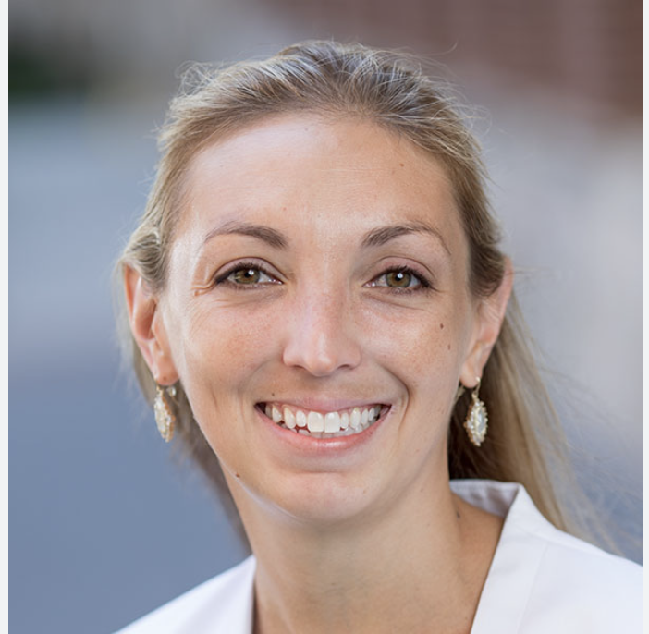
2023 Early career ACHIEVEMENT award
Professor, Culverhouse School of Commerce
The University of Alabama
Dori Cross, PhD
Assistant Professor
Division of Health Policy and Management
School of Public Health, University of Minnesota

Slide 48
The Strength of Cross’s Research: Reflections by nominators
Dr. Cross’s theory-driven analyses details specific ways in which organizations must support implementation and use of IT-enabled workflows.
She also invests the time to build partnerships for embedded research. Her current analysis of hospital discharge planning for patients requiring post-acute care (funded by the Agency for Healthcare Research and Quality) is the result of over three years of relationship building with a local health system.
Dr. Cross has been incredibly productive with nearly 30 peer-reviewed publications, with work broadly disseminated across management, informatics, and clinical audiences.
She holds multiple competitively awarded federal grants as a principal or co-principal investigator, signaling both the quality and importance of her research agenda.
Notes:
OLENA/DAN
She is poised to make high-value
contributions to our research community and to the key policy and delivery system
stakeholders of health care management research.

Slide 49
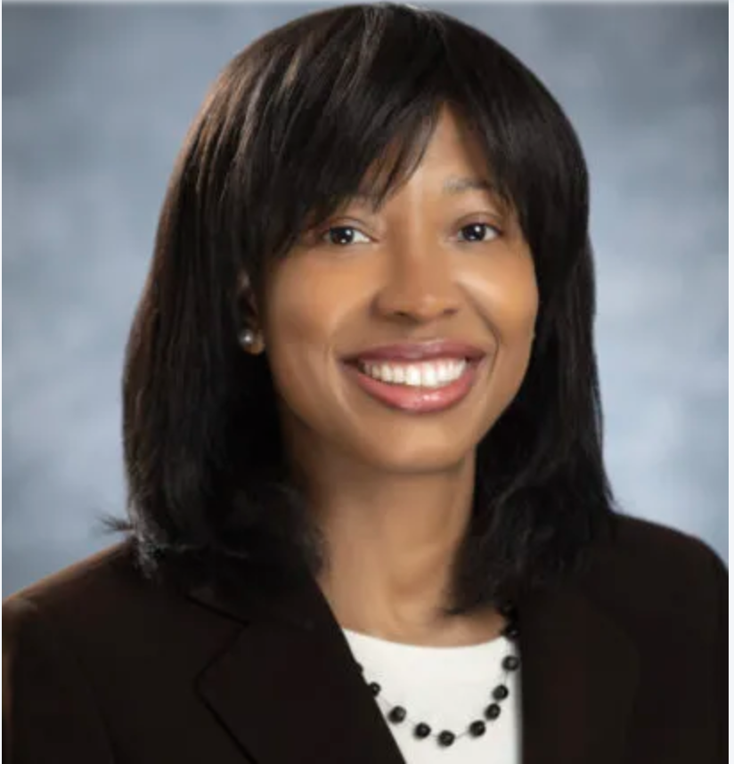
2023 Mid-career ACHIEVEMENT award
Professor, Culverhouse School of Commerce
The University of Alabama
Ingrid Nembhard, PhD
Professor
Health Care Management
The Wharton School, University of Pennsylvania

Slide 50
The Strength of Nembhard’s Research: Reflections by nominators
Her work has made outstanding theoretical and empirical contributions to how and under what conditions learning activities and work environments influence clinical and organizational outcomes.
Professor Nembhard is a superstar in this field. With 64 peer reviewed publications, and an active research pipeline, her record is clearly impressive; and, importantly, a large portion of these papers are published in top journals in both Organizational Behavior (OB) and Healthcare Management (HCM). Her work is also extremely impactful. Her work has been cited over 7,662 times on Google Scholar.
Professor Nembhard has successfully competed for research grants with different coinvestigators over the years and earned a series of impressive fellowships.
Dr. Nembhard has been a nexus of developing the scholarship of others her role on the Editorial Boards of top journals in her field (Academy of Management Discoveries, Medical Care Research and Review) and her critical advisory role in an exciting new outlet (BMJ Leader).
She played a crucial role in significantly elevating the scholarly standing of Health Care Management Review both qualitatively and in terms of its impact factor during her time as Associate Editor.
Notes:
Ingrid’s scholarship in particular as it illuminates how health care organizations can rapidly learn from experience, innovate, and deliver high quality, safe care sustainably. Her work does so by powerfully combining a conceptual sophistication with an empirical rigor that draws upon multiple methods

Slide 51
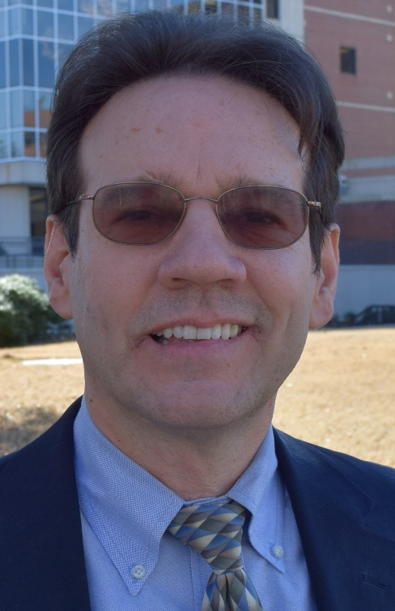
2023 Keith G. Provan award
Professor, Culverhouse School of Commerce
The University of Alabama
Rob Weech-Maldonado, PhD
Professor
Department of Health Services Administration
School of Health Professions, University of Alabama at Birmingham

Slide 52
The Strength of Maldonado’s Research:
Reflections by nominators
“Professor Weech-Maldonado’s primary contributions have been to understanding how to improve long term care and health care diversity, equity, and inclusion…As typifies Professor Weech-Maldonado’s research, [his] studies were grounded in clear conceptual frameworks and entailed appropriately sophisticated statistical analyses. This makes his important findings credible to policy makers as well as follow researchers.”
“Over his career, Dr. Weech-Maldonado has had and continues to have, a strong and impactful record in health care management research. He is one of the most respected researchers in the area of organizational and market factors on access, quality, and costs of care for vulnerable populations, particularly the elderly and racial/ethnic minorities. He has led the path in organizational research into long-term care with a focus on quality outcomes.”
“Usually a researcher remains in a set “comfort zone” of a limited number of research topics. They avoid striking out into new areas of investigation for themselves, as doing so often carries some risk in terms of slower or less optimal scholarly performance. Rob has not done that and instead has challenged himself to become a scholarly expert over a number of some of the most important foci in our field…I’ve had the opportunity in my own work to read a number of Rob’s papers over the years. They are carefully crafted, thoughtful in the empiricism, and reliable pieces of research upon which other researchers can draw value from for their own work.”

Slide 53
A Pioneer for EXAMINING CULTURALLY COMPETENT CARE and Health Disparities
“He led the first work establishing how patient experience differed by race, ethnicity, and preferred language. This work, and his equally important contributions to measuring culturally competent care and demonstrating its link to health care disparities, are foundational in the study of health equity and patient-centered care….Rob’s recent publications linking hospital cultural competency to dimensions such as hospital financial performance and patient safety culture demonstrate his continuing centrality to this area.”
“Rob’s methodological contributions include the first study to demonstrate the role of scale use in understanding racial and ethnic differences in CAHPS global ratings; his substantive contributions include the first major study of patient experience in Puerto Rico.”

Slide 54
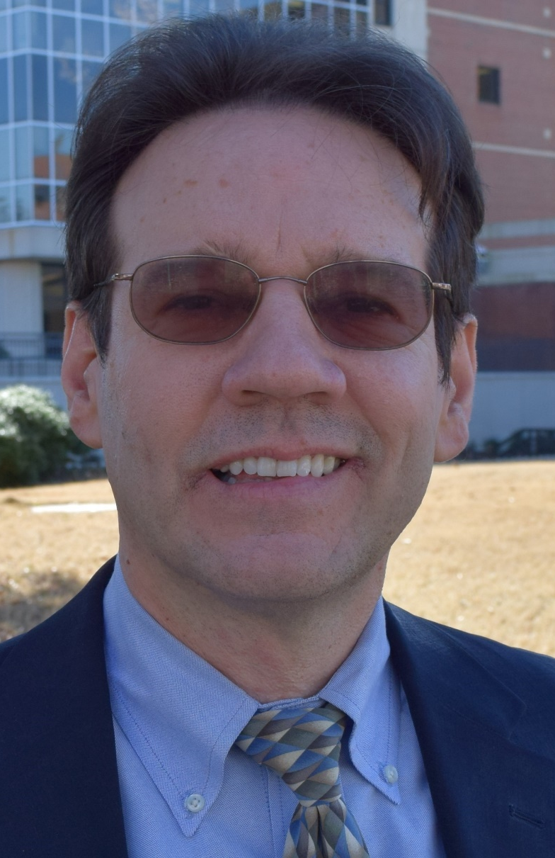
HCMD Keynote Address by
Rob Weech-Maldonado
Title:
Closing the Healthcare Quality Gap for Vulnerable Populations: My Research Journey
* Rob will be introduced by Dr. Nancy Borkowski

Slide 55

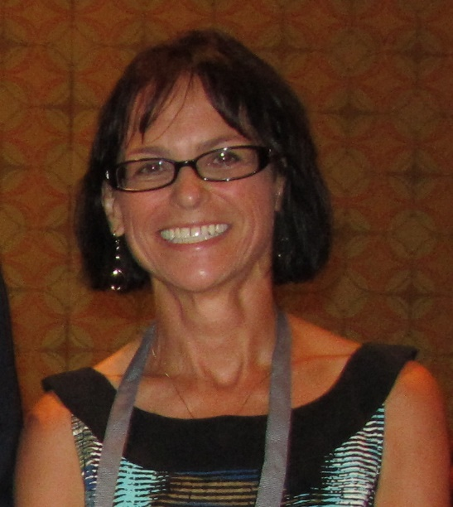
Thank you and best wishes to Our new chair,
Cheryl Rathert
Notes:
…Next year in Chicago

