Slide 1
Leveraging an Experimental Database to Inform an OMARS Designed Experiment
Presented by
Peili Wang, Associate Director
Portfolio Statistics, Pfizer
NCB 2025

Slide 2

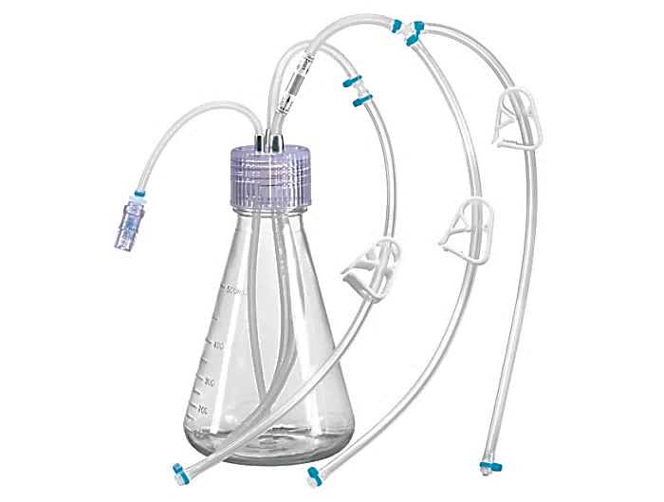

General Bioprocess Flow for Drug Substance
Cell culture
Shake & Culture Bag Expansion
Production Bioreactor
Vial Thaw
Bioreactor
Bioreactor
Purification
Low pH VI
pH adj Neut
Centrifuge
Clarification
Protein A
Filtration
TMAE
Vpro VRF
UF/DF

Slide 3
Outline
Objective: turning historical datasets into knowledge
Building an experimental DoE database
Combining Studies for Any Process Step: Challenges
Prepare Database
Dashboard: Data to Knowledge
Using the Database to Inform OMARS Design
DoE Request
Leverage database to inform design choices

Slide 4
Building a Historical Database
Combining Studies for Any Process Step: Challenges
Prepare Database
Dashboard: Data to Knowledge

Slide 5
Combining Studies for Any Process Step: Challenges
Dimensions
Studies/ Molecules / Compounds
Difficulties: Inconsistency cross studies
Not all compounds study the same attributes.
Outputs / Attributes / Y variables
Each attribute variation could be different
Not all compounds study the same process parameters within the same ranges.
Different design resolution
Data formatting issues: names, units.
Inputs / Process Parameters / Factors / X variables

Slide 6
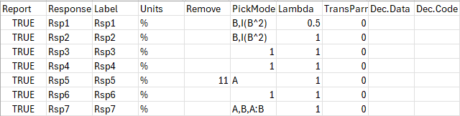
Prepare Database and Dashboard in Dataiku
A set of tables including data, factor information, and selected models.
Example of record selected models
One study: Format the files
Setup KEYS for process parameters and attributes (with scientists) and add into each study.
Make unit consistency: (e.g. mL or L).
Ability to extract: coefficients, effect size, standard error, R-squared,…etc.
Compile studies in Dataiku
Dashboard

Slide 7
Dashboard: Data to Knowledge
FAQ
What the database can answer
Design:
Which factors were studied?
What were the factor ranges?
Which factors are most important? (effect size, frequency of significance)
Do we expect to see any interaction or quadratic effects?
Modeling:
Is the data range typical for the attributes?
Have we seen this effect in other studies?
Studied ranges for all factors.
Data range for all attributes.
Frequency about factors and attributes are studied.
Relative frequency of statistical significance
Main effects
Second order effects (Interaction, Quadratic)
Effect size (factors vs attributes)
Co-significant effects

Slide 8
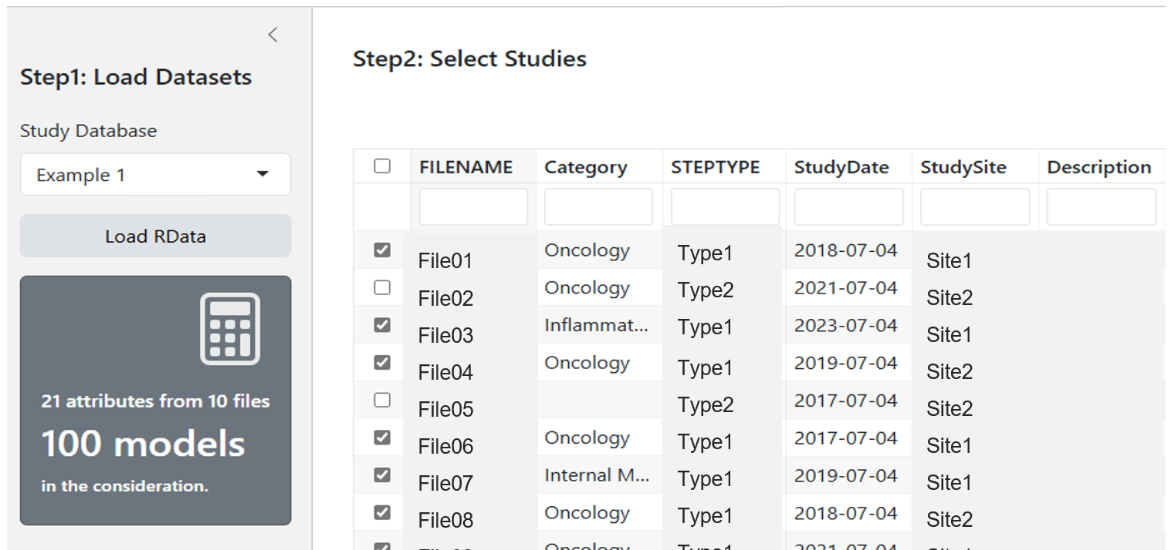
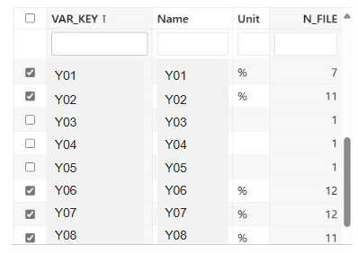
Dashboard: Data to Knowledge
UI to selected studies, factors, attributes
One attribute in one study has one model.

Slide 9
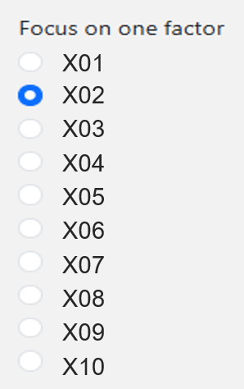
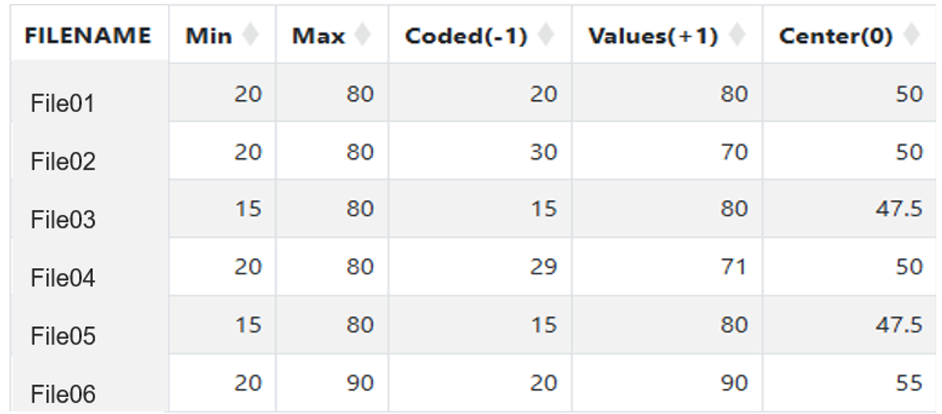
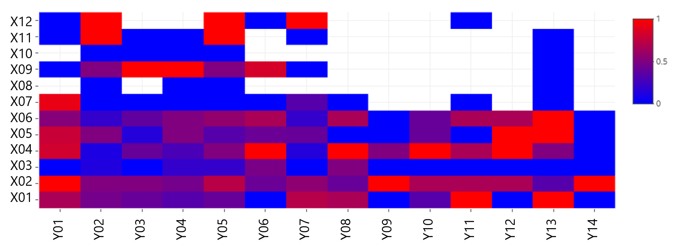
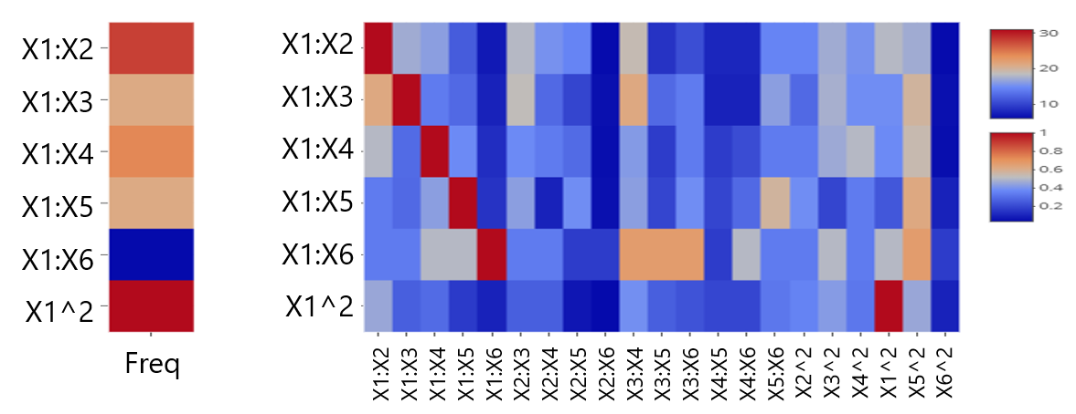

Dashboard: Data to Knowledge
Study range for a factor cross studies
Impact of factors for attributes
This visualization is available for # of studies, # of significance, or effect size.
For second order effects (SOE)
co-significant with other SOE effects

Slide 10
Using the Database to Inform OMARS Design
DoE Request
Leverage database to inform design choices

Slide 11
Request 24-run study with 6 factors
Objective: Process characterization study
Restriction: 24-run design for six factors (27 effects) to ensure a single “block”.
Design Options
Central Composite Design (CCD)
Box-Behnken Design (BBD)
OMARS family: bridges the gap between Definitive Screening Design (DSD) and CCD

Slide 12
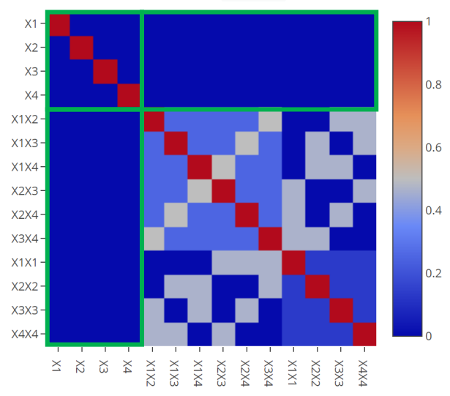
OMARS design
Núñez Ares, Goos 2020 & Núñez Ares, Schoen, Goos 2023
Orthogonal
Minimally
Aliased
Response
Surface
designs
Features of OMARS:
Three levels for each factor (-1, 0, 1).
Each main effect is not correlated with any other effects.
Allow the estimation of partial or complete second-order effects models.
Correlation Matrix for an OMARS Design with Four Factors

Slide 13
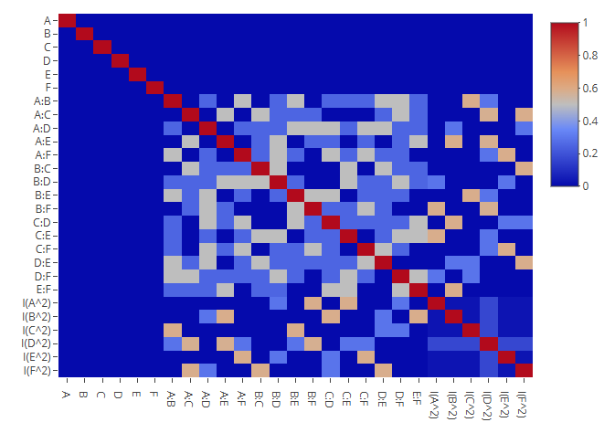
Using the database to inform design choices
Not “equal information” for each factor.
Frequency of quadratic effect
Design Correlation matrix
From Design
From Database

Slide 14

Using the database to inform design choices
Principle: When correlation between two effects are high in the OMARS design, ​assign the factors so that the chance two correlated effects are co-significant is low based on historical data.​
Not “equal information” for each factor.
co-significant with other effects
Design Correlation matrix
From Design
From Database

Slide 15
Summary
DoE Database:
Combining historical DoE studies.
A dashboard is built to answer common questions for DoE and modeling.
Application of database to inform design choices:
OMARS is picked and historical knowledge was used to inform design choices.
Other potential use:
Historical knowledge may inform the model selection process.

Slide 16
Reference
José Núñez Ares & Peter Goos (2020) Enumeration and Multicriteria Selection of Orthogonal Minimally Aliased Response Surface Designs, Technometrics, 62:1, 21-36.
José Núñez Ares, Eric Schoen & Peter Goos (2023) Orthogonal Minimally Aliased Response Surface Designs for Three-Level Quantitative Factors and Two-Level Categorical Factors, Statistics Sinica, 33:107-126.
ENBIS-23 Valencia Conference (10-14 September 2023): Tremendous Impact of the Very New and Promising OMARS DOE in Pharma Industry for Quicker Access to New Vaccines · ENBIS Conferences (Indico)
OMARS Designs Add-in: A Gateway to a New Family of Orthogonal RSDs (2022-EU-30MP... - JMP User Community

Slide 17
Acknowledgements
Statistician
Aili Cheng
Brad Evans
Katie Brickey
Scientists
Paul A Thoday
Chao Ma
Franklin Eduardo Mejia Frias
Pfizer Digital
Adam Nieto

