Slide 1
Virtual Control Groups (VCGs) in Preclinical Drug Safety Assessment
Dean (Dingzhou) Li
Nonclinical Statistics, Pfizer

Slide 2
All procedures performed on animals were in accordance with regulations and established guidelines and were reviewed and approved by an Institutional Animal Care and Use Committee or through an ethical review process

Slide 3

Can we replace control animals in safety studies with historical controls?
FDA Modernization Act (FDAMA) 3.0 focuses on establishing a process for the FDA to qualify and prioritize the review of applications using non-animal testing methods, with the goal of reducing the reliance on animal testing.
  New Approach Methodologies (NAMs)
Why do we need control animals in the first place?
  Reference group
  Quality control
  Statistical power

Slide 4
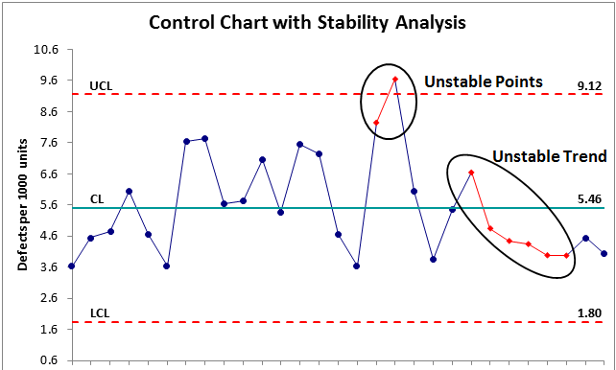
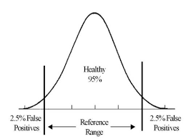
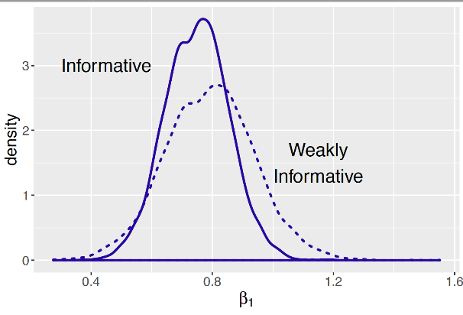
Can we do without concurrent controls?
Pre-dose
Dosing
Recovery
Quality control
Statistical power
Reference group
Notes:
We shall not forget these even when we decide to use VCGs

Slide 5
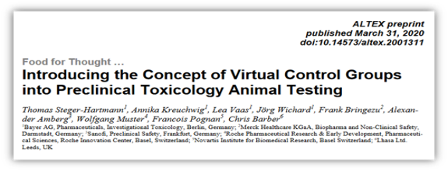
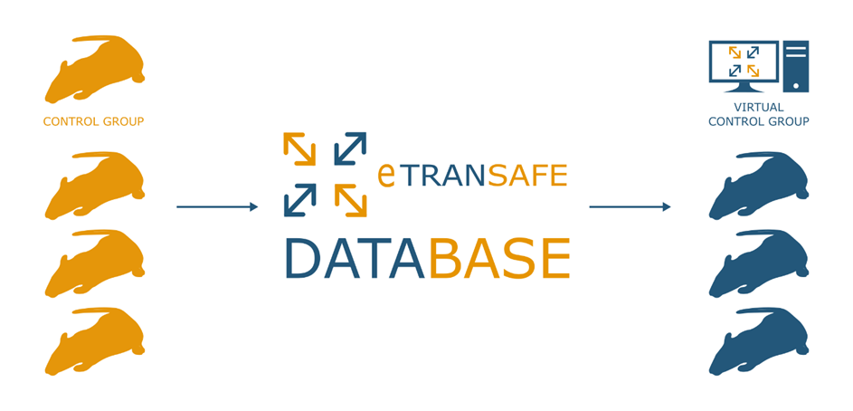
Virtual Control Groups (VCG) started in 2020…
eTRANSAFE (The Enhancing TRANslational SAFEty Assessment through Integrative Knowledge Management) initiative
Since then, ~20 papers have been published on VCGs.

Slide 6
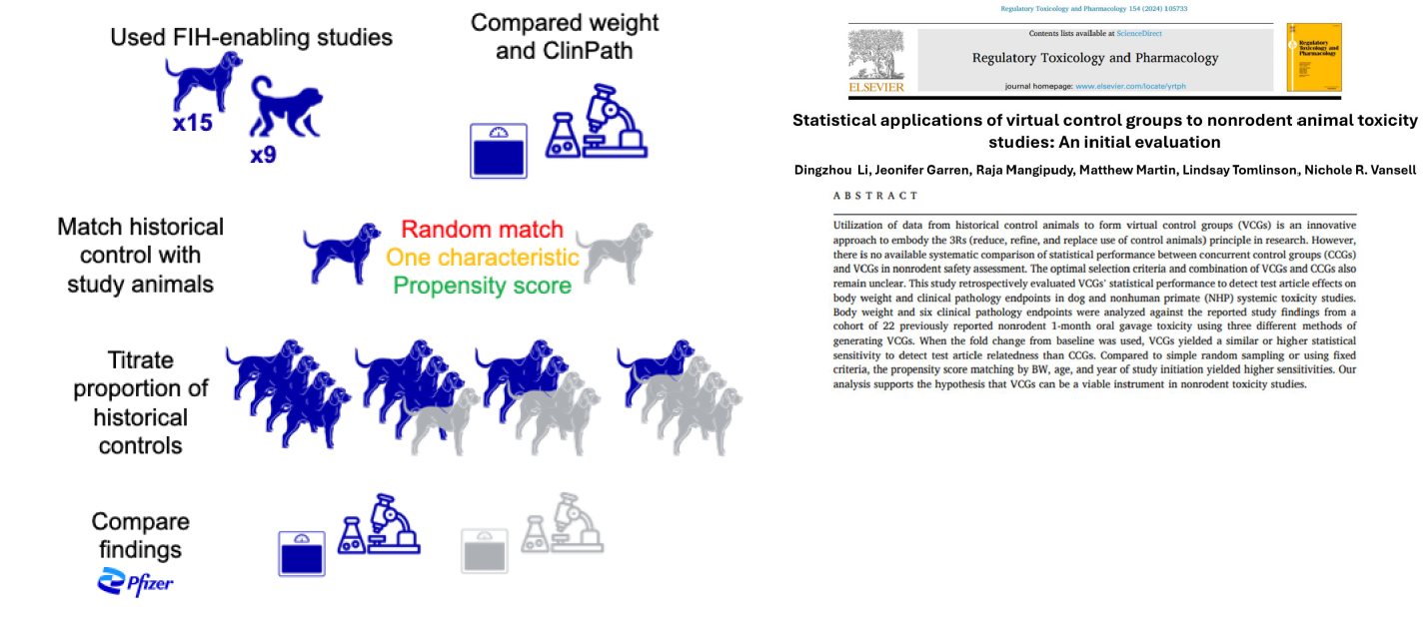
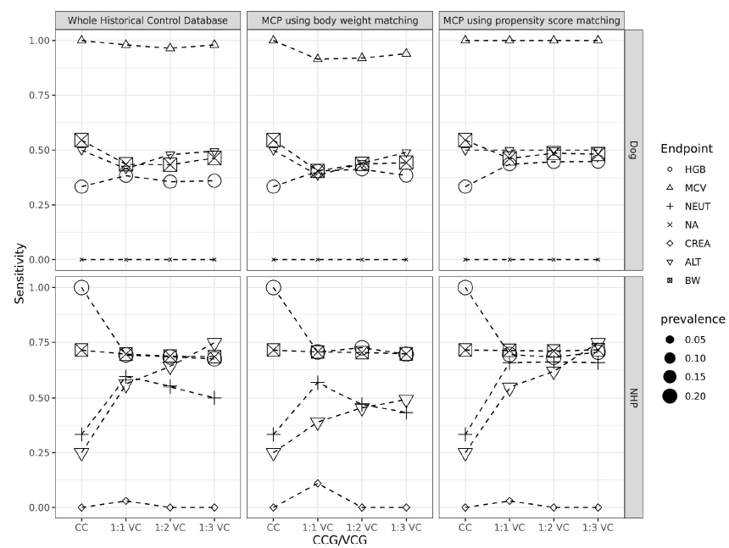

Slide 7
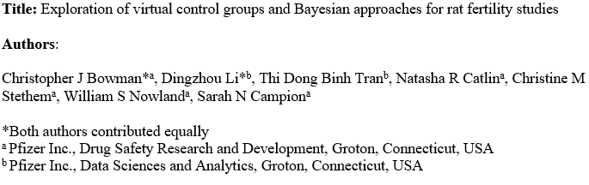
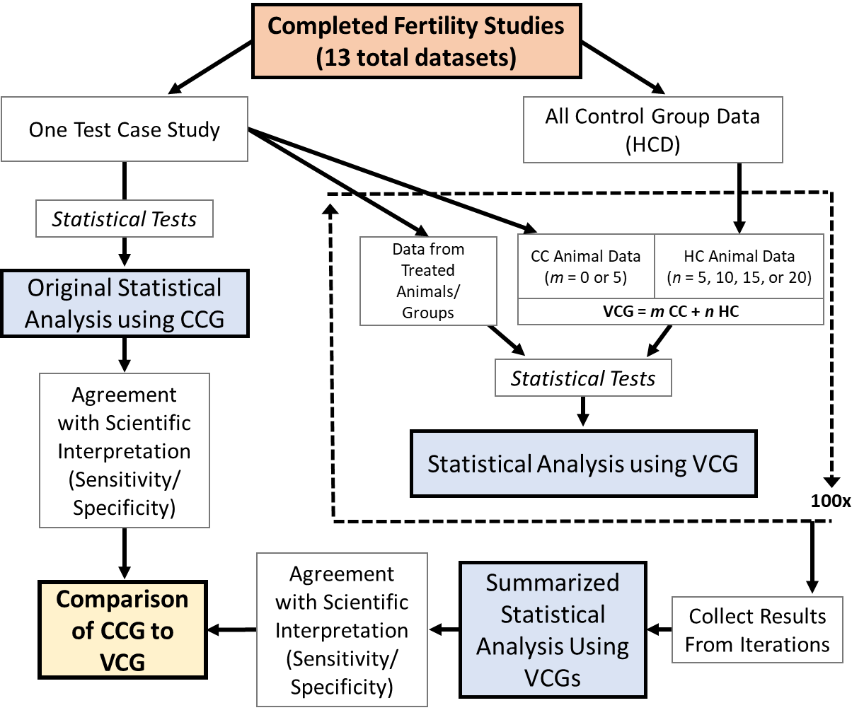

Slide 8




































VICT3R is an Innovative Health Initiative (IHI) consortium for VCG guidance and implementation
Academia, Research Organisations & SMEs
Industry Partners
Associated Network of CROs
SRAB

Slide 9
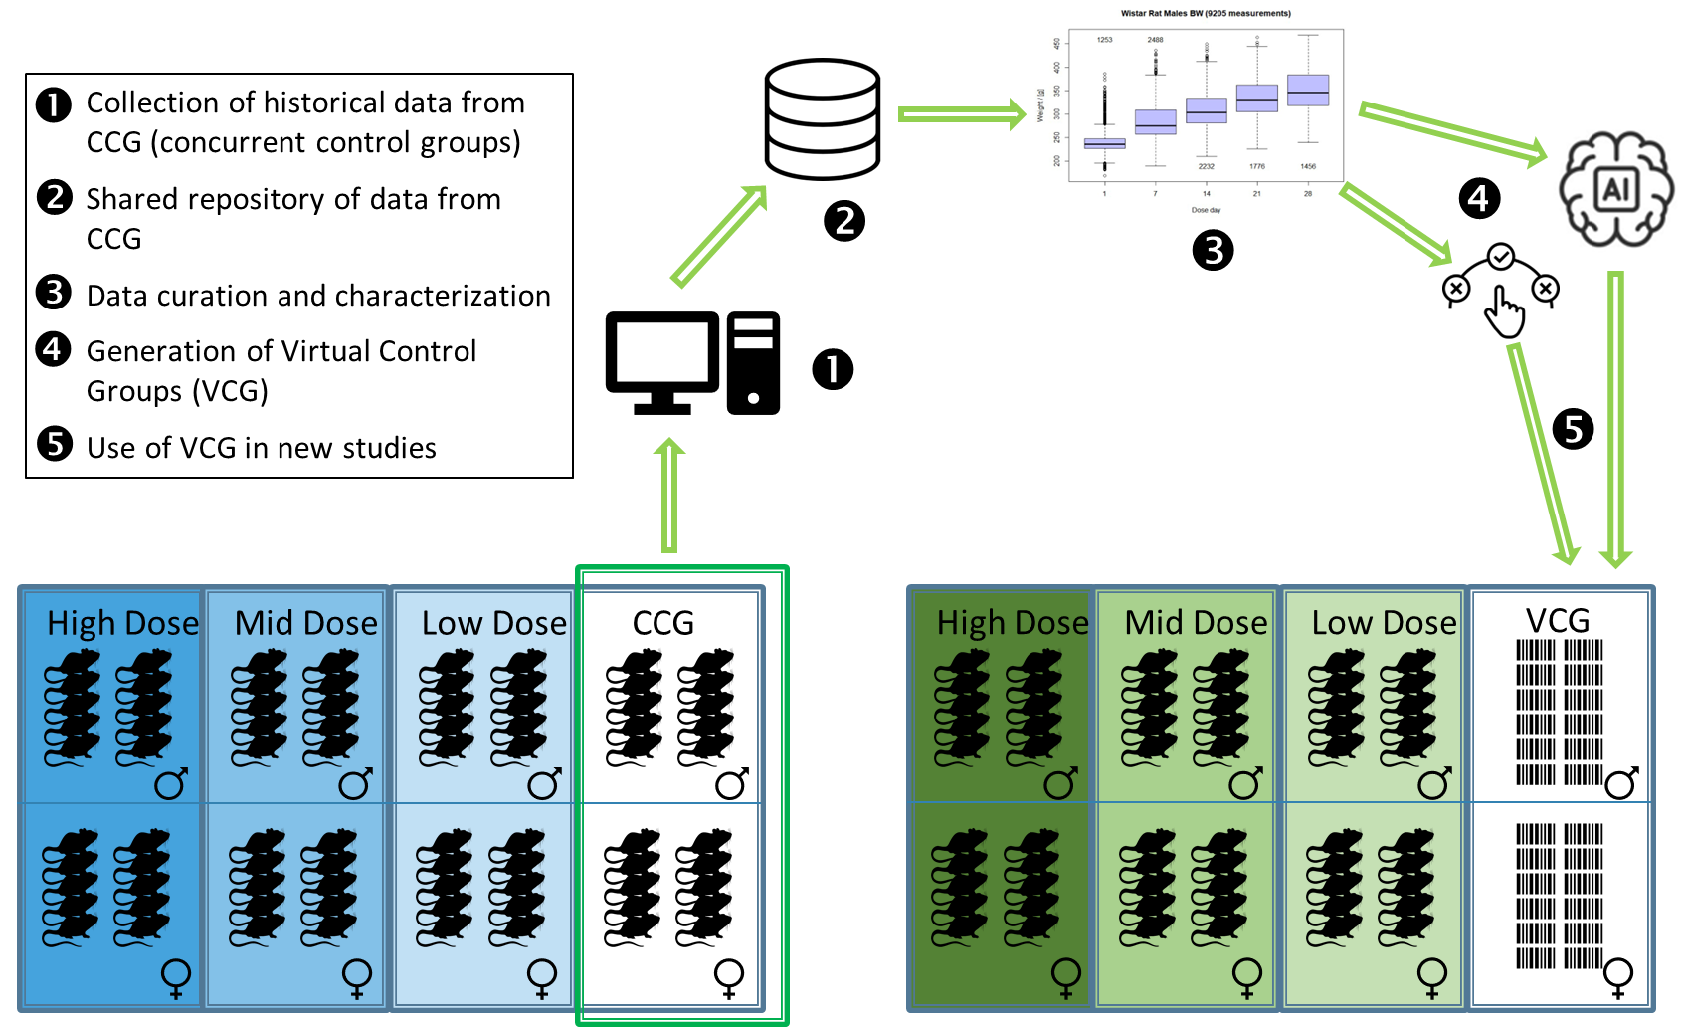
VICT3R : VCG is combined with treated groups of the prospective study
Retrospective
Prospective
Adapted from Steger-Hartmann et al. 2020, ALTEX; https://doi.org/10.14573/altex.2001311

Slide 10
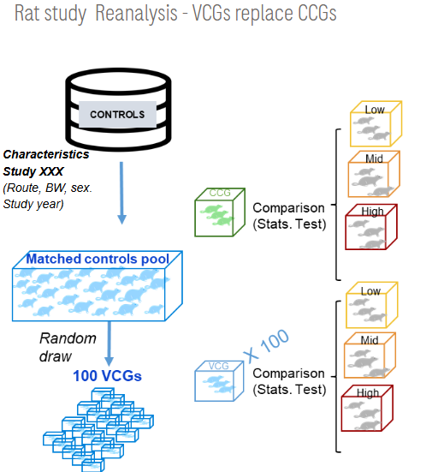
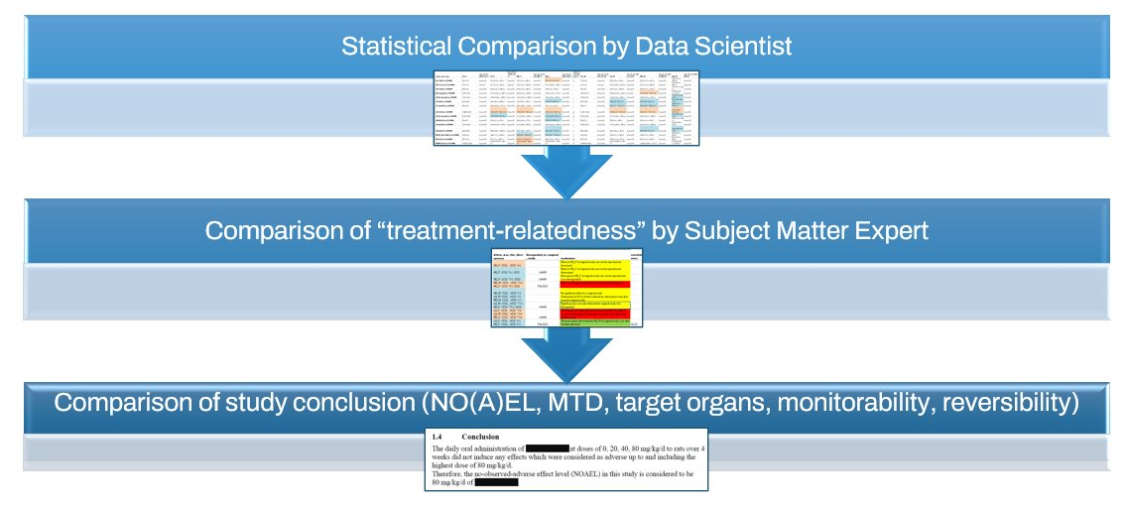
VICT3R: Setting Up a Procedure for Retrospective VCG Testing
Things to consider when selecting animals for VCG creation
Methods for generating VCGs
Reporting
Historical Control Animal Data
- Internal
- Test Facility
- VICT3R DB
Matching algorithms
Sampling algorithms

Slide 11
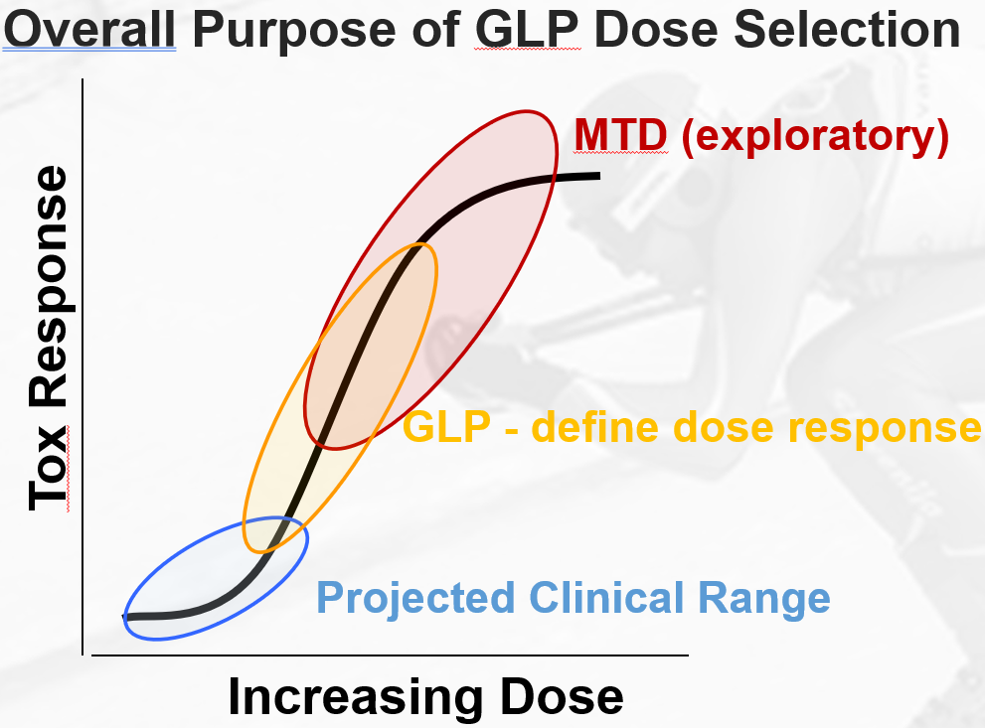
VICT3R: Contexts of Use are qualified in stages
  COU1: Application in dose-range finding non-GLP studies (Current qualification)
    Ten studies (rats, mice, NHPs) have been reanalyzed and results were submitted to EMA​
  COU2: Partial replacement of concurrent controls in pivotal (GLP) systemic toxicity studies
  COU3: Full replacement of concurrent controls in pivotal (GLP) systemic toxicity studies

Slide 12
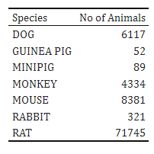
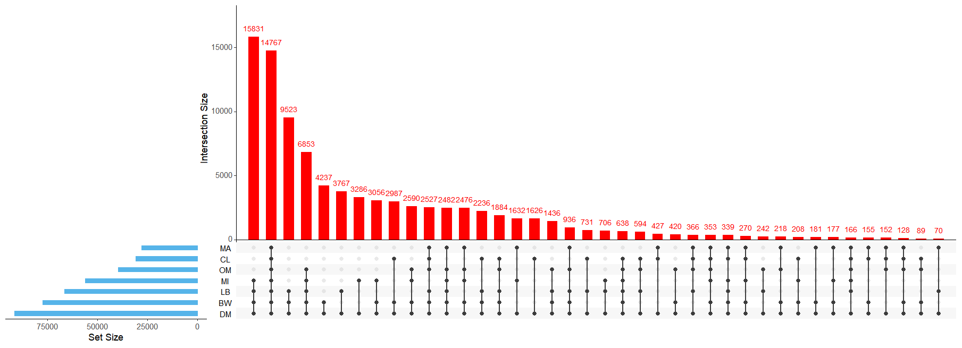
VICT3R database - All Species Version 2.0
Number of animals per species and per SEND domain

Slide 13






NCB VCG White Paper Workstream
Members: 24 statisticians and data scientists from pharma, CRO, academia, and regulatory agencies.
Cochairs: Dean Li (Pfizer) and Guillemette Duchateau-Nguyen (Roche)
Goal: Standardized and harmonized statistical methodology to promote regulatory acceptance and consistent application
  Randomization, matching, validation
Tasks in Phase 1 (months 1 -3)
  1.1: Literature review
  1.2: Methodology development using theory and/or simulation
  1.3: Comparison between VCGs and CCGs
Tasks in Phase 2 (months 4 -6)
  2.1: Paper drafting
  2.2: Peer review
  2.3: Dissemination

Slide 14

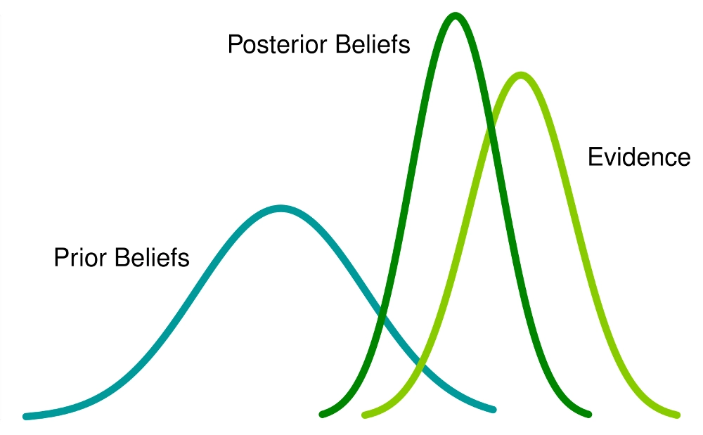
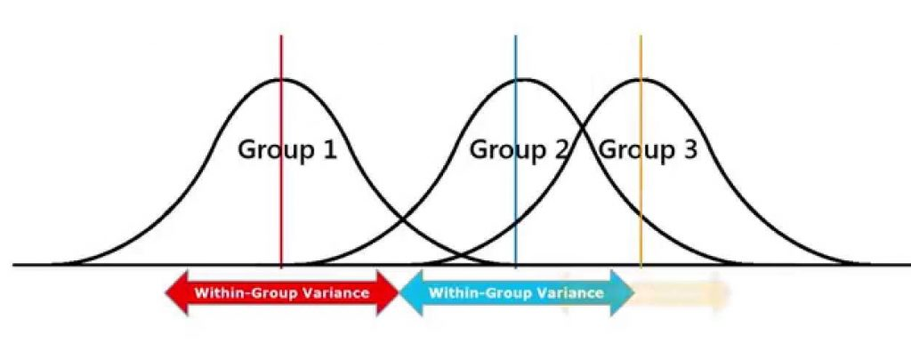

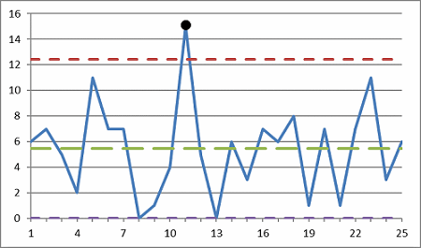

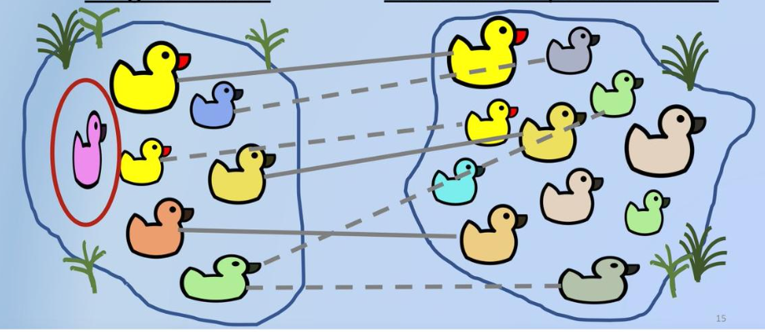

Bayesian statistics for VCG analysis.
Understanding sources of variability is crucial
Balance between randomization and matching
Quality control/outliers/inclusion & exclusion
Hybrid of concurrent controls and virtual controls

