Slide 1
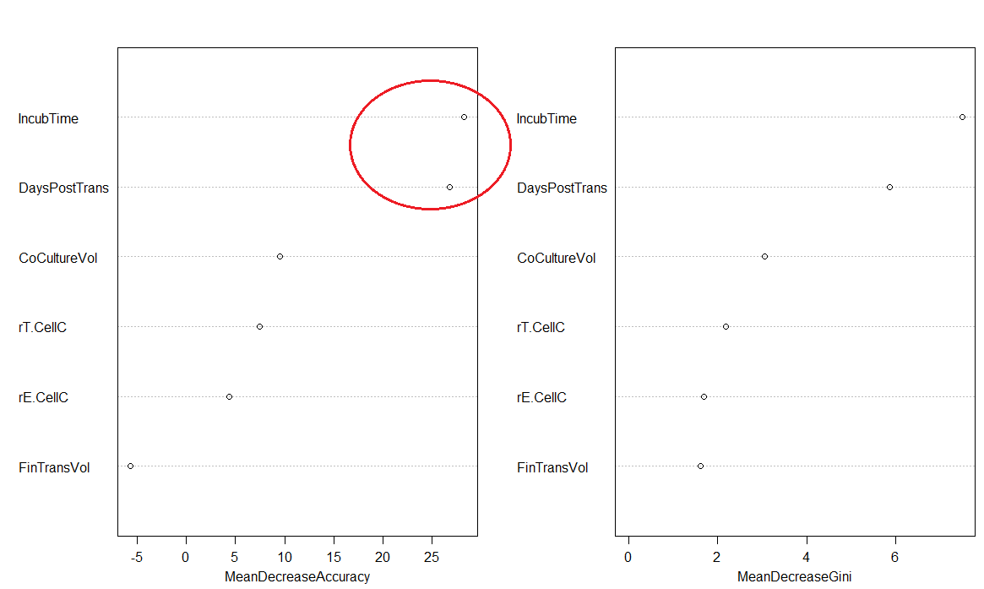
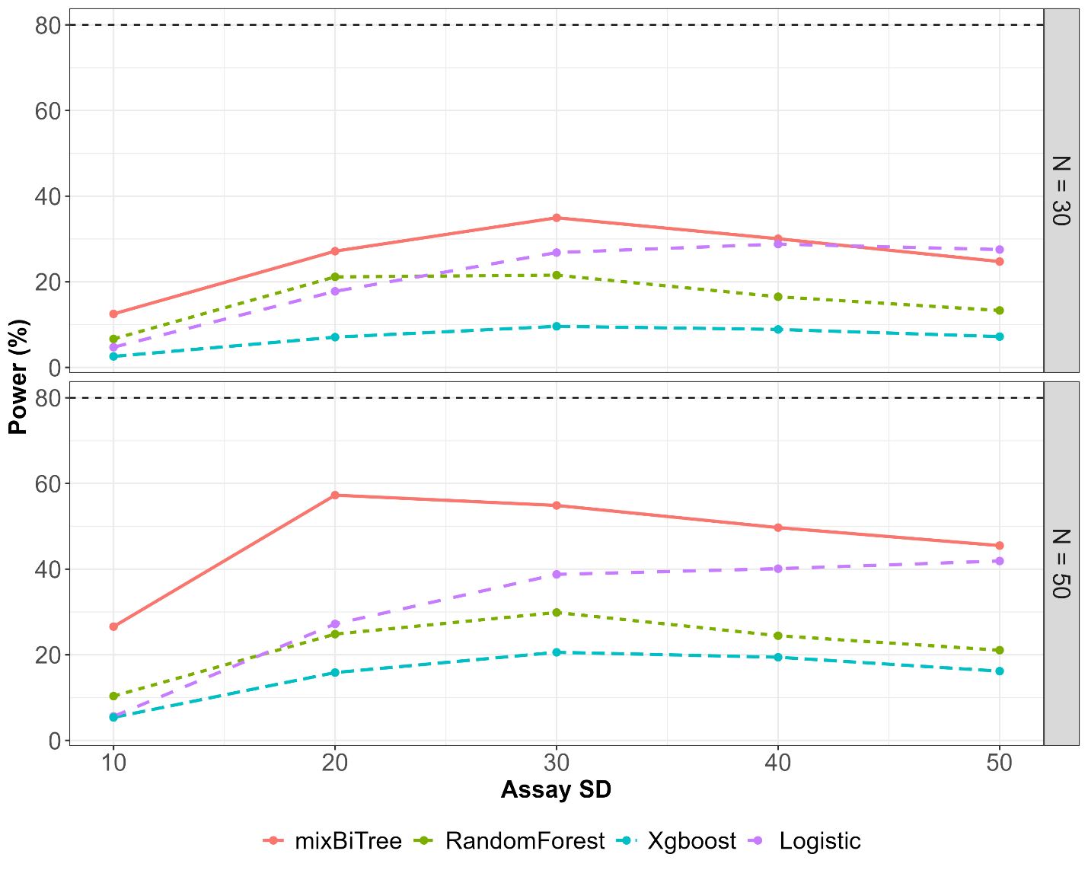
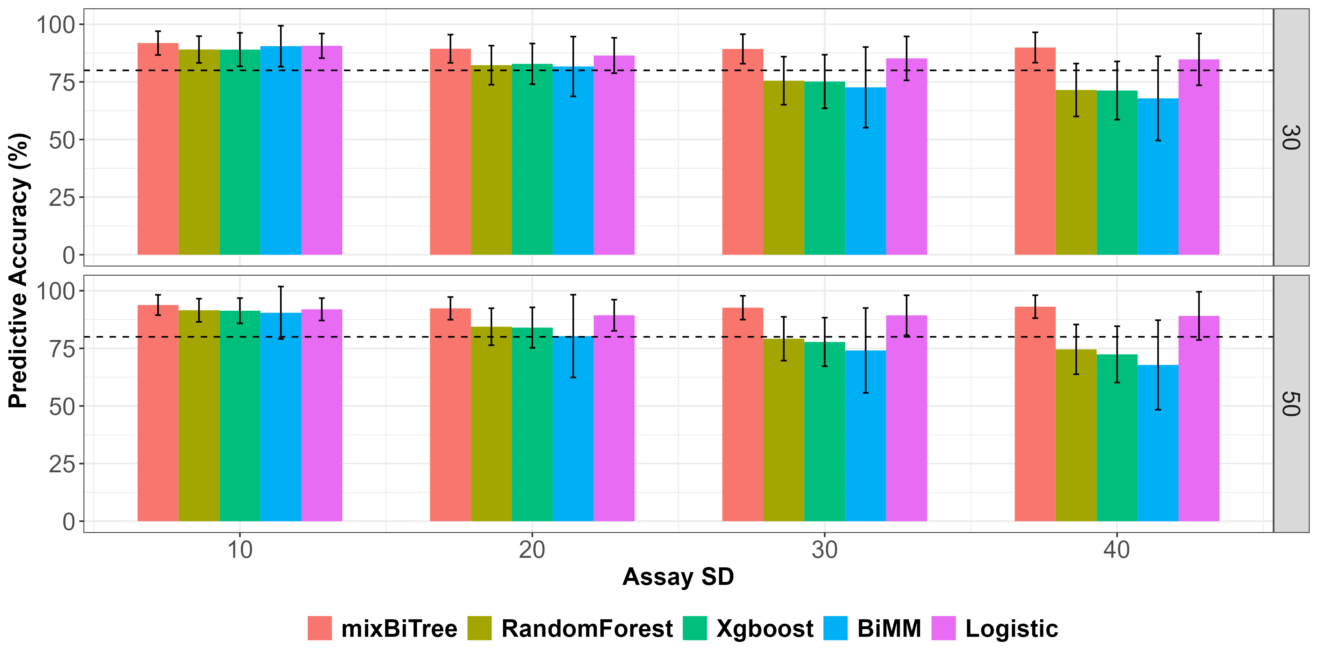
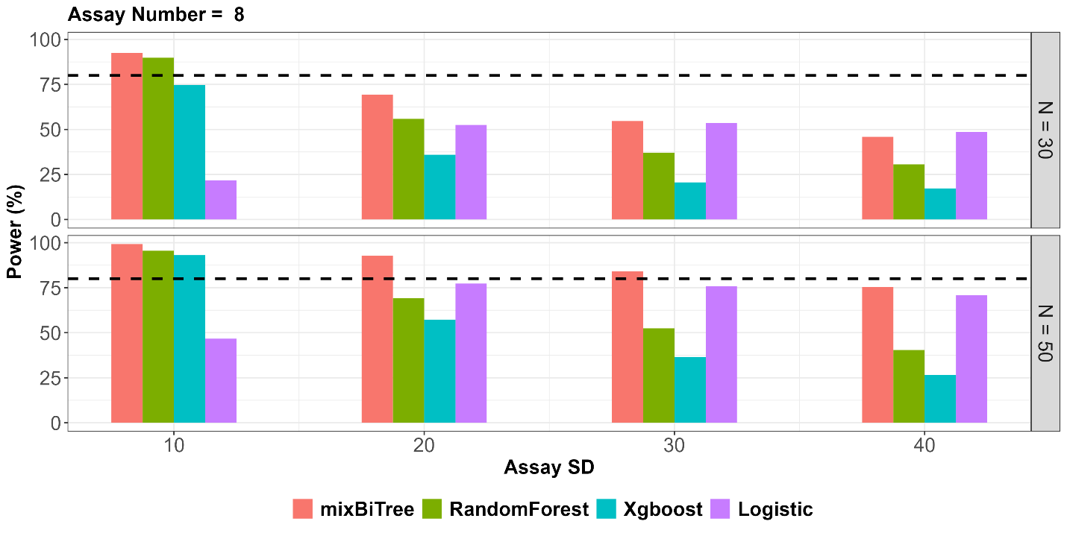
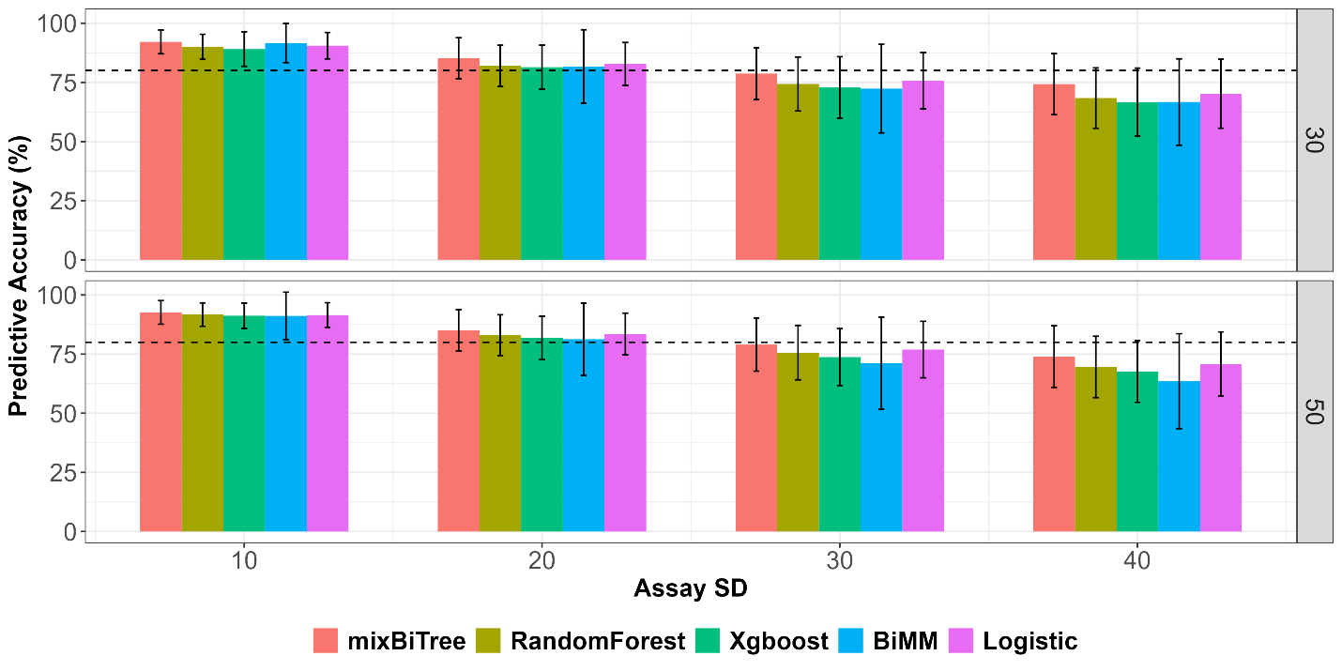


Application of Tree-Based Machine Learning Techniques in Cell Therapy Experimental Designs
Hong Tran
Principal Statistician, Discovery, Manufacturing Statistics, Statistics & Decision Sciences, Janssen R&D
Introduction
Methods
Results
Results
Analysis of design of experiment (DOE) data often relies on classical statistical methods while more cutting-edge methods, i.e. machine learning techniques often applied on large complex observational data to uncover insightful patterns. However, in cell-gene therapy area, only a limited of experimental runs can be conducted. The outcome variable of interest can be binary. Moreover, data inherently exhibit high donor to donor variability or complex interactions among factors. In such cases, the search space for all possible 2-way interactions or higher-order interactions can grow exponentially. Simply using traditional statistical methods, i.e. logistic regression to handle such limited datasets can become impractical. Even though random forest and other tree-based machine learning techniques can handle data with high number of explanatory variables, they are not inherently designed to account for random effects. This research shows that leveraging tree-based machine learning techniques, i.e. random forest [1] or xgboost [2] in experimental design analyses has some enhanced advantages compared to traditional logistic regression. Through simulated data from real cell-gene therapy experiments under different scenarios, such as interactions among factors, varying sample to sample variance and number of experimental runs, our adjusted tree-based machine learning approach, mixBiTree shows better accuracy in predicting binary outcome of interest compared to logistic regression in some scenarios. Our simplified intuitive mixed tree-based machine learning techniques that account for random effects show unique benefits in terms of power to detect important factors in smaller sample sizes settings and additionally causal-effects can be derived when applying to experimental design data. The simulation results were also applied to BiMM [3], one of the few machine learning packages to account for random effects in binary responses.
The The mixBiTree framework involves 2 stages. The first stage of mixBiTree approach involves estimating random effects. To achieve this, generalized mixed models are deployed to fit to the data:
${logit(p}_{ij})=XB+ZU+ε_{ij}$ [1]
Random estimates $\hat{U}$ were extracted and transformed $\hat{U}$’ for the
second stage:
$p_{ij}^{′}=CART(XB+U^{′})$ [2]
Where CART is a tree-based machine learning algorithm. A prediction on a new observation can be made from the population-level or from a group-level.
Algorithm to make prediction on population-level:
At each iteration i,
generate random effect $u_{i}$ from ~N(0, empirical SD)
calculate probability${ prob}_{i}$from CART(XB + $u_{i}$), and thus logit ${ (prob}_{i})$
The loop stops until the average of probabilities for all iterations i is < $ε$. $\frac{\sum_{i}^{n}{{prob}_{i}}}{n}−\frac{\sum_{i=1}^{n−1}{{prob}_{i}}}{n−1}$ $<$ $ε$
Final probability is calculated from average logit of all probabilities.
Final logit = $\frac{\sum_{i=1}^{n}{{logit(prob}_{i})}}{n}$and Final prob = $\frac{1}{1+exp⁡(−Final logit)}$
Figure 2: Power Comparison with number of assay run of 8 and varying number of DOE runs, and assay-to-assay run variability and significant interaction.
Predictive Accuracy
Figure 3: Predictive Accuray Comparison with number of assay run of 8, significant interaction, varying number of DOE runs, and assay-to-assay run variability. Prediction for a new observation from an existing assay group.
Figure 4: Effect of number of observations per batch on confident levels of MPP (between SD = 4, within SD = 10 and B = 3)
Figure 4: Predictive Accuray Comparison with number of assay run of 8, significant interaction, varying number of DOE runs, and assay-to-assay run variability. Prediction for a new observation from a new assay group.
Important Feature Results from real DOE data.
Conclusions
Traditional tree-based machine learning methods perform well compared to logistic in terms of identifying significant features when assay-to-assay variability is small.
When assay-to-assay variability is larger, tree-based machine learning methods that account for random effect, i.e. mixBiTree performs the best in terms of identifying significant features. In addition, mixBiTree has improved predictive accuracy for a new observation from an existing group while only slightly improved predictive accuracy for a new observation from a new group.
When significant interaction presents, tree-based machine learning techniques still perform well, even though interaction terms were not explicitly included in the models.
Simulation results based on real data.
Figure 1: Power Comparison with number of assay run of 8 and varying number of DOE runs, and assay-to-assay run variability and no significant interaction.
Results
References
1. Breiman, L., Random Forests. Machine Learning, 45, 5–32, 2001
2. Chen T., XGBoost: Extreme Gradient Boosting, R package version 0.4-2, 2015.
3. Speiser, J., BiMM tree: A decision tree method for modeling clustered and longitudinal binary outcomes. Commun Stat Simul Comput. 2020 ; 49(4): 1004–1023.
Acknowledgement
My sincere gratitude to several Janssen scientists Pravin Parajuli, Mavis Tenkorang Impraim and others who implemented the experiment and gave scientific insight into the data. My many thanks to Jyh-Ming Shoung, Bill Pikounis, and Yang Cao for their help with DOE and cell therapy subjects. Special gratitude goes to my dad for his invaluable childcare support, allowing me to fully dedicate to this research. His unwavering support and love made this work possible.

