Slide 1
Introduction to Machine Learning in R
Charles South, Ph.D.
Faculty Advisor, Stat Club

Slide 2

Presentation Materials
Available at: https://community.amstat.org/smu-sc/home
Events → Stat Club Meetings
Sign up for DataFest!!
March 22-24
Teams of 2-5
Free food all weekend
Real data problem
Resume builder
Bragging rights

Slide 3

Warning!

Slide 4
Outline
Machine Learning, Defined
Tuning Parameters
Model Fitting Process
Random Forests
Stochastic Gradient Boosting (XGBoost)

Slide 5
Machine Learning?
The phrase ”machine learning” is a broad term.
One way to describe machine learning is to use sophisticated algorithms that try to optimize a certain criteria in order such that the best possible predictions can be made.
Machine learning can do the same thing that multiple linear regression (predict a continuous outcome) or logistic regression (predict a binary outcome) do, just using a different approach.
Traditional statistical methods rely on distributional theory (i.e. certain things are normally distributed); machine learning algorithms don’t.
Traditional statistical methods often produce interpretable models that can be explained; machine learning algorithms are often “black boxes”.

Slide 6
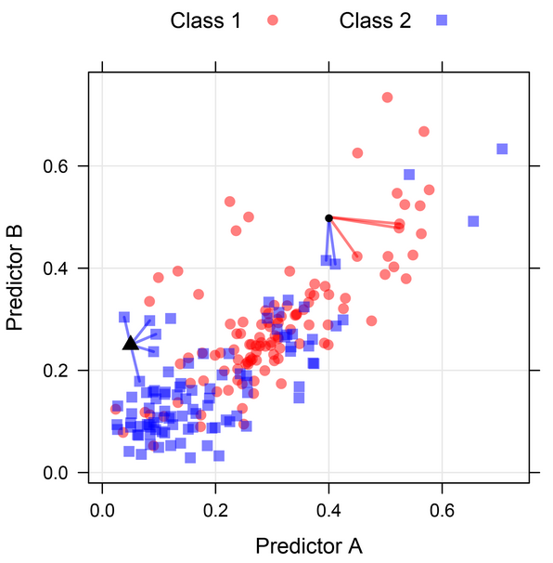

Tuning Parameters
Many of the machine learning frameworks have parameters which cannot be directly estimated from the data.
The lack of analytical formula and need to try a number of values have resulted in these being labeled as tuning parameters.
Example: K-nearest neighbors (shown with $K=5$).

Slide 7
How to Choose Tuning Parameters?
One of the primary goals of any data analysis is to produce a model that is generalizable – that is, it’s predictions will still be accurate even on new data.
It is very possible to build a model that appears to do a great job on your data… but when you get new data it fails miserably.
This means you are dealing with overfitting.
If you do not use machine learning algorithms carefully, you may be at serious risk for overfitting.

Slide 8
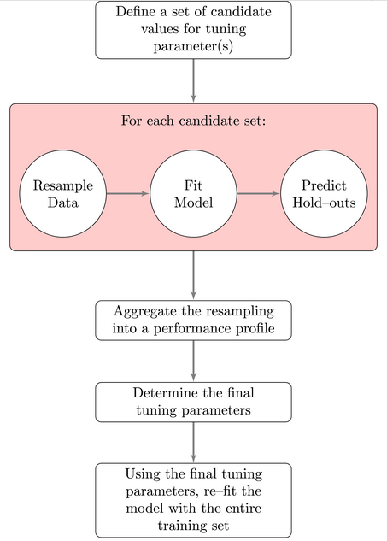
How to Choose Tuning Parameters?
Some options include cross-validation, the bootstrap, repeated cross-validation, etc.
The entire process can be done automatically in R!!

Slide 9
Data Splitting
We call the training data set the samples used to create the model, and the test or validation data set to evaluate model performance.
When the sample size is small, a test set should be avoided because every data point may be needed to estimate model parameters.
Instead, I recommend using repeated k-fold cross-validation.
k-Fold Cross-Validation
Sample is partitioned into k sets of roughly equal size.
Model building process is used on all sets except the last.
Held-out sample is used to estimate the error rate.
This process is repeated, each time holding out one of the sets to estimate the error rate.
Some research has shown that repeating k-fold cross validation can be used to effectively increase the precision of the estimates while still maintaining small bias.

Slide 10
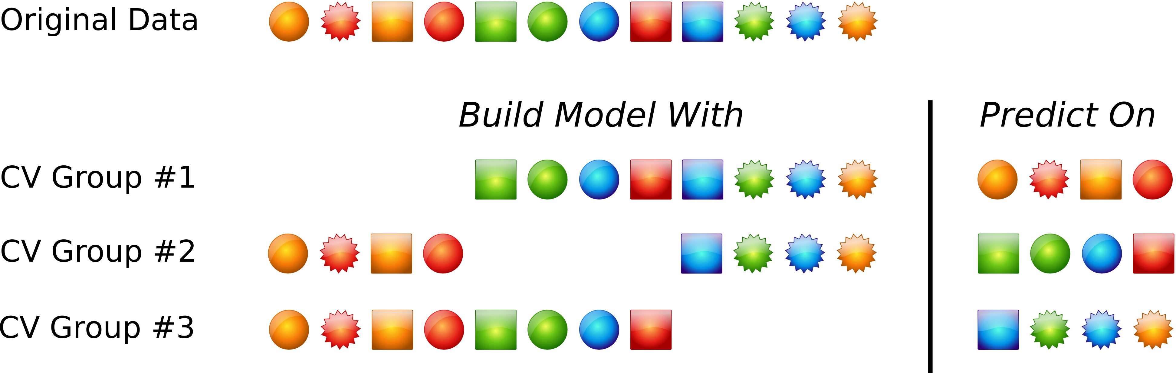
K-Fold Cross-Validation, Visually

Slide 11

College Football Data!
We are going to use some college football data that was originally gathered by Marty Coleman.
Additionally, I created a number of variables that may be useful for prediction.
The goal: predict the point differential between teams! In other words… who is going to win??

Slide 12
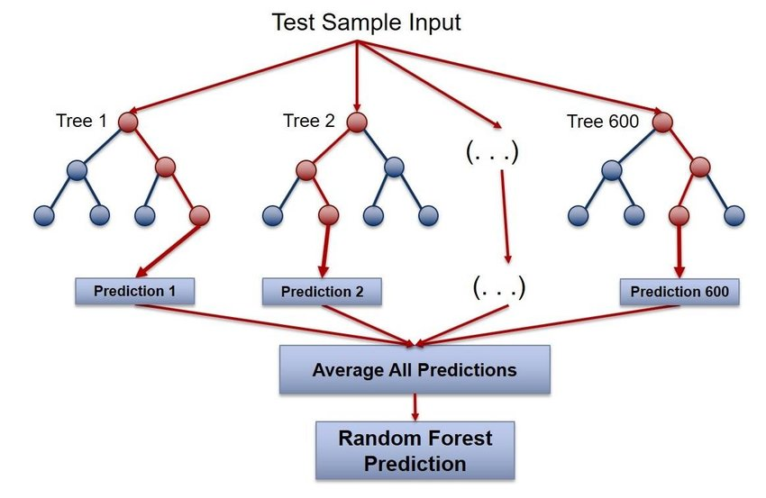
Random Forests
Intro to random forests: https://www.youtube.com/watch?v=J4Wdy0Wc_xQ
Not my video – all credit goes to Josh Starmer!
Idea: build a large number of decision trees (which each make their own prediction), and then use them collectively (i.e., a FOREST of trees!) to make our final prediction.
For classification problems (i.e. the outcome is binary), use “winner take all” vote.
For regression-like problems (i.e. the outcome is continuous), use the average across all decision trees.

Slide 13
The caret Package
The caret package was developed to help analysts tune and build a wide variety of models.
It gives you a high degree of control over all aspects of the model fitting process:
Tuning parameters
Pre-processing
Modeling paradigm
Resampling technique
I am going to use this package to demonstrate all the methods we talk about today!

Slide 14
Random Forests Using caret
There is only one tuning parameter we need to run a random forest: the number of variables we randomly select at each step in our decision tree.
This tuning parameter is referred to as mtry.
Two options: specify a bunch of values of mtry for R to try… or let R pick a range of values on its own.
My choice: let R choose
Warning: tuning models can take a lot of time!!
R code demonstration

Slide 15
Stochastic Gradient Boosting
First, let’s check out “basic” boosting… AdaBoost: https://www.youtube.com/watch?v=LsK-xG1cLYA
Josh Starmer again!
Gradient boosting can be thought of as an “upgraded” AdaBoost that rethinks the problem as an optimization problem.
It trains more heavily on the larger residuals.
Stochastic gradient boosting is a further evolution that samples observations and predictors at each stage to help combat overfitting.
The most popular implementation of stochastic gradient boosting is the XGBoost algorithm.

Slide 16
Stochastic Gradient Boosting
XGBoost is a complicated algorithm that has TONS of tuning parameters to work with:
Eta: a shrinkage factor applied to a piece of the boosting algorithm
Nrounds: the number of boosting rounds
Max_depth: the max depth of the trees
Subsample: the fraction of records to sample without replacement
Lambda and alpha: regularization parameters to help with overfitting
By default, the caret package only tunes nrounds, eta, alpha, and lambda.
You can always tune additional parameters if you want to (and have the time!).
R Code demonstration

