Slide 1
Introduction to Tableau
Stats Club Meeting
Southern Methodist University
Prepared by Shalima Zalsha

Slide 2
Tableau
Interactive data visualization software
Presenting complex, multiple information in an efficient and compelling way
Tableau helps people see and understand their data
Improve your technical skills:
Forbes
Glassdoor

Slide 3
How is Tableau different than SAS,R or Excel?
Interactive
Better graphics
Relatively easy (drag and drop)
Animated
Create a dashboard or story
Adjust multiple variables at the same time:
Size
Color
Shade
Shape

Slide 4
Obtaining Tableau
Free for students and instructors:
”To qualify for a free license through the Tableau for Students program, you must be currently enrolled at an accredited academic institution at the K-12 or postsecondary (undergraduate/postgraduate) level. You must be 13 years of age or older to request a license.”
Go to the following link
Students: https://www.tableau.com/academic/students
Instructors: https://www.tableau.com/academic/teaching
Click “Get Tableau for Free”.
Enter your information, use your @smu.edu e-mail address.
Confirmation e-mail will be sent to your e-mail:
Link to download Tableau Desktop
Product key

Slide 5
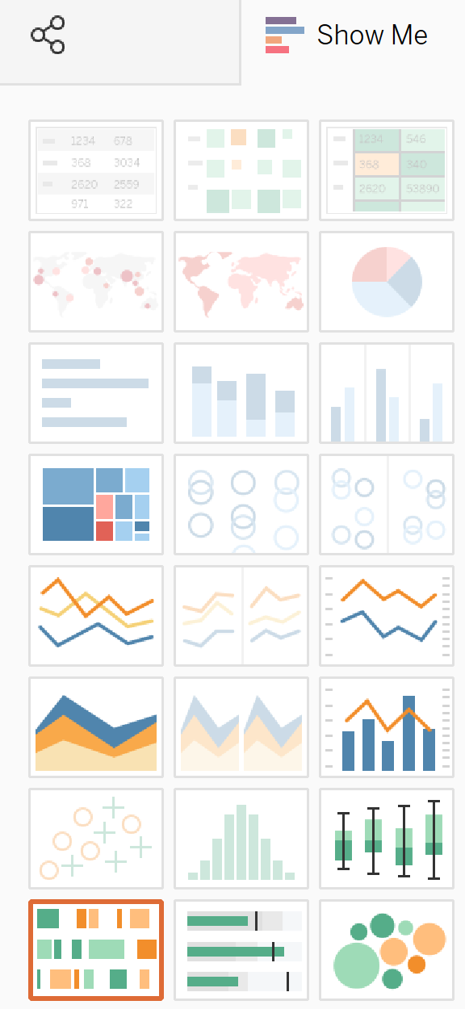
Types of Charts
Preparing your data
Types of charts:
Bar chart
Pie chart
Scatter plot
Box plot
Bubbles chart
Filled map
Box plot
Mapping, and more
Dashboard & Story

Slide 6
Examples
Tableau public gallery
https://public.tableau.com/en-us/s/gallery
Tableau Story: Opioid Data

Slide 7
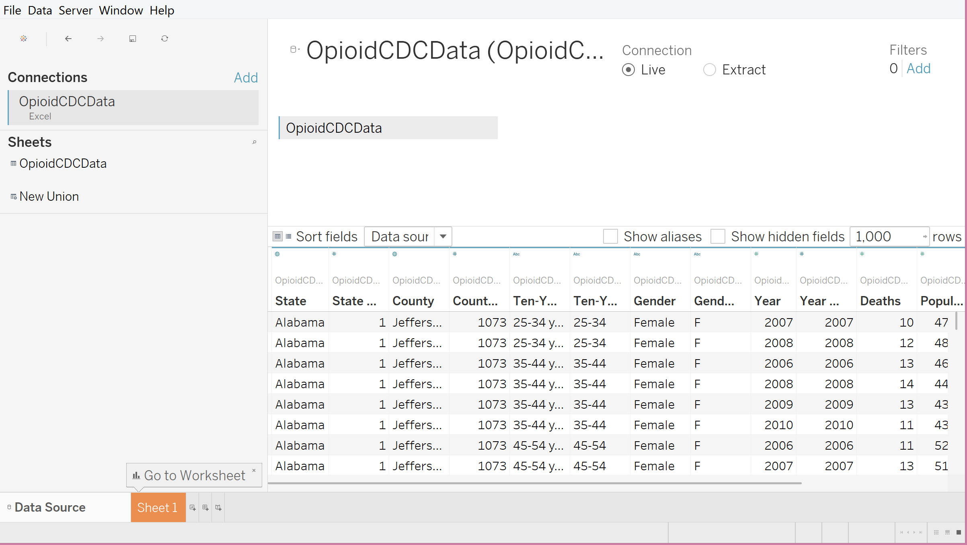
Getting Started
Prepare your data using any software.
Open Tableau
Create a new tableau project: File>New
Load your data (any format: .csv, .xlsx, .sas7bdat, etc): Data source>Connect to a file
Start graphing: Go to Worksheet

Slide 8
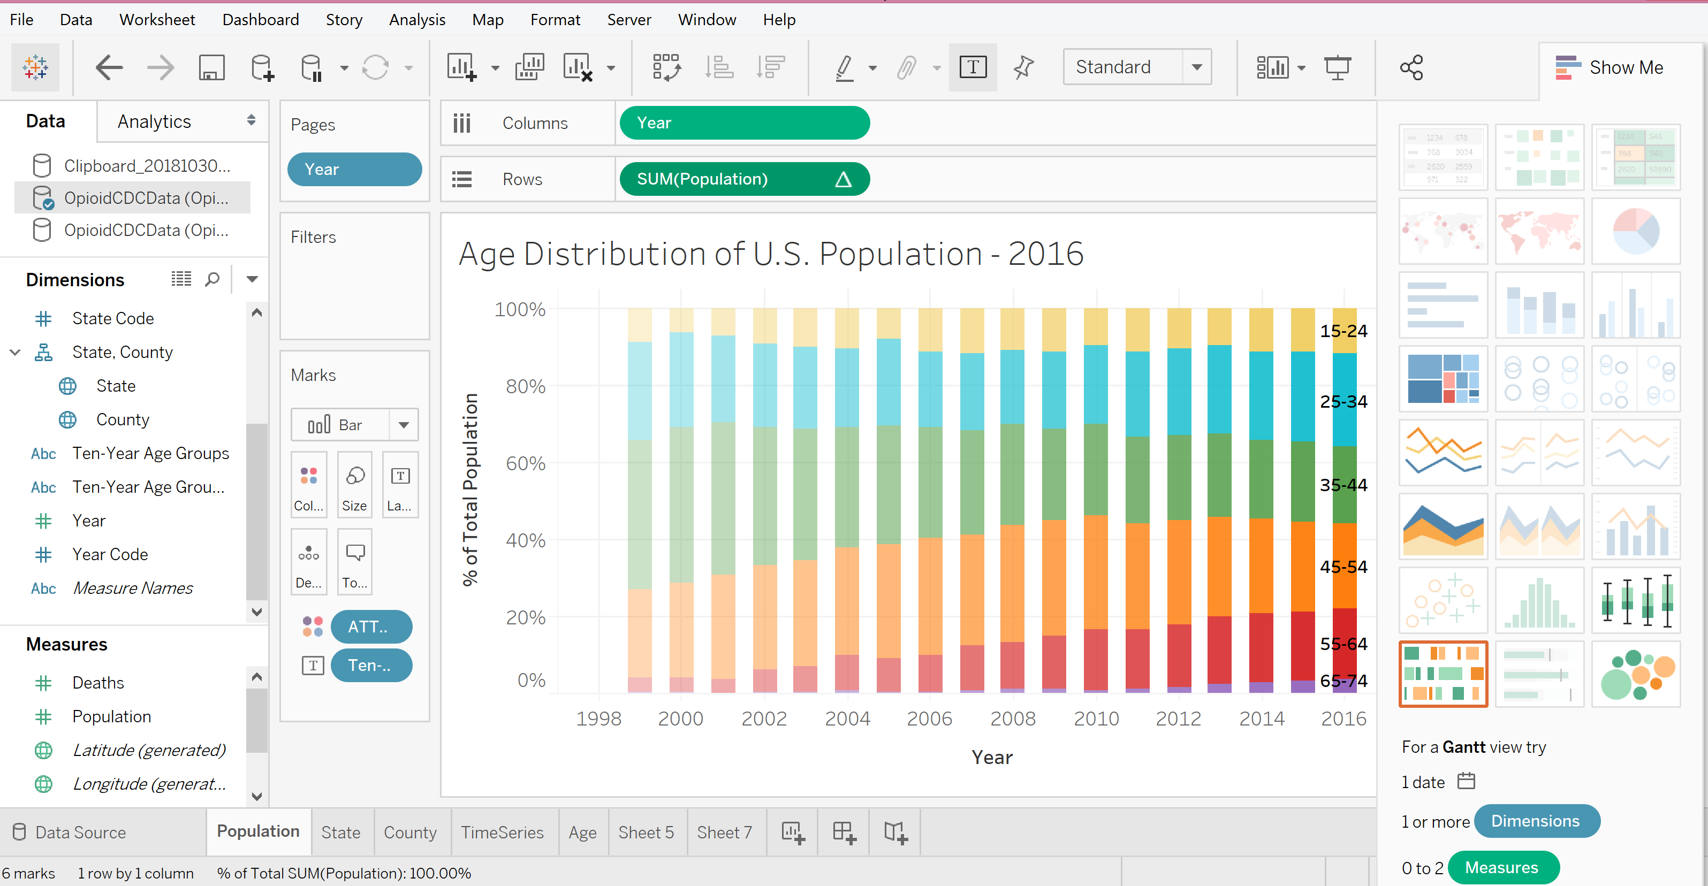
Working Interface
Variables:
Dimensions (Categorical)
Measures (Quantitative)
Columns: X-axis
Rows: Y-axis
Marks:
Size
Color
Shade
Shape
Show Me: all the different charts you can make based on your desired variables.

Slide 9
Today’s topic
Geographic heat maps
Time series (animated)
Changing symbol or shapes
Using Calculated fields
Bar graph
Crosstabs
Tableau story

Slide 10
Tutorial

Slide 11
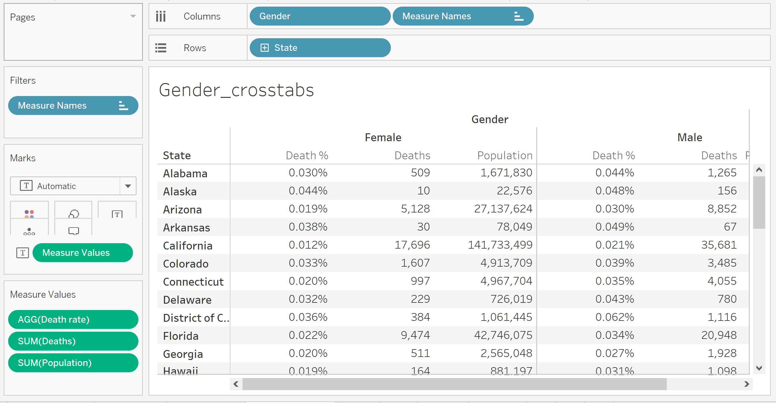
Cross tabulation: state,gender

Slide 12
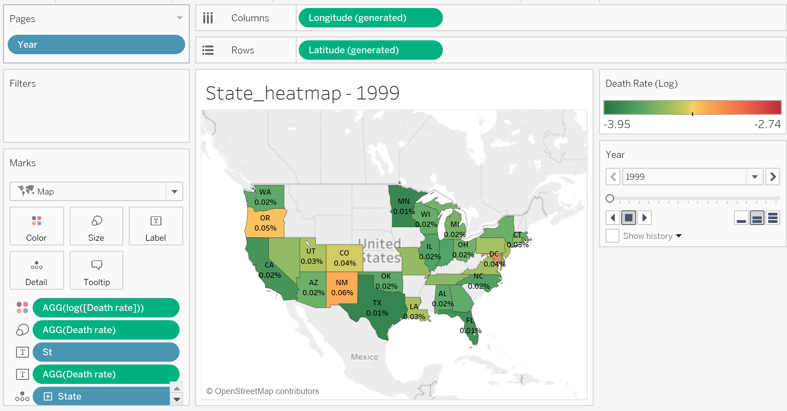
Heatmap: death rate by state

Slide 13
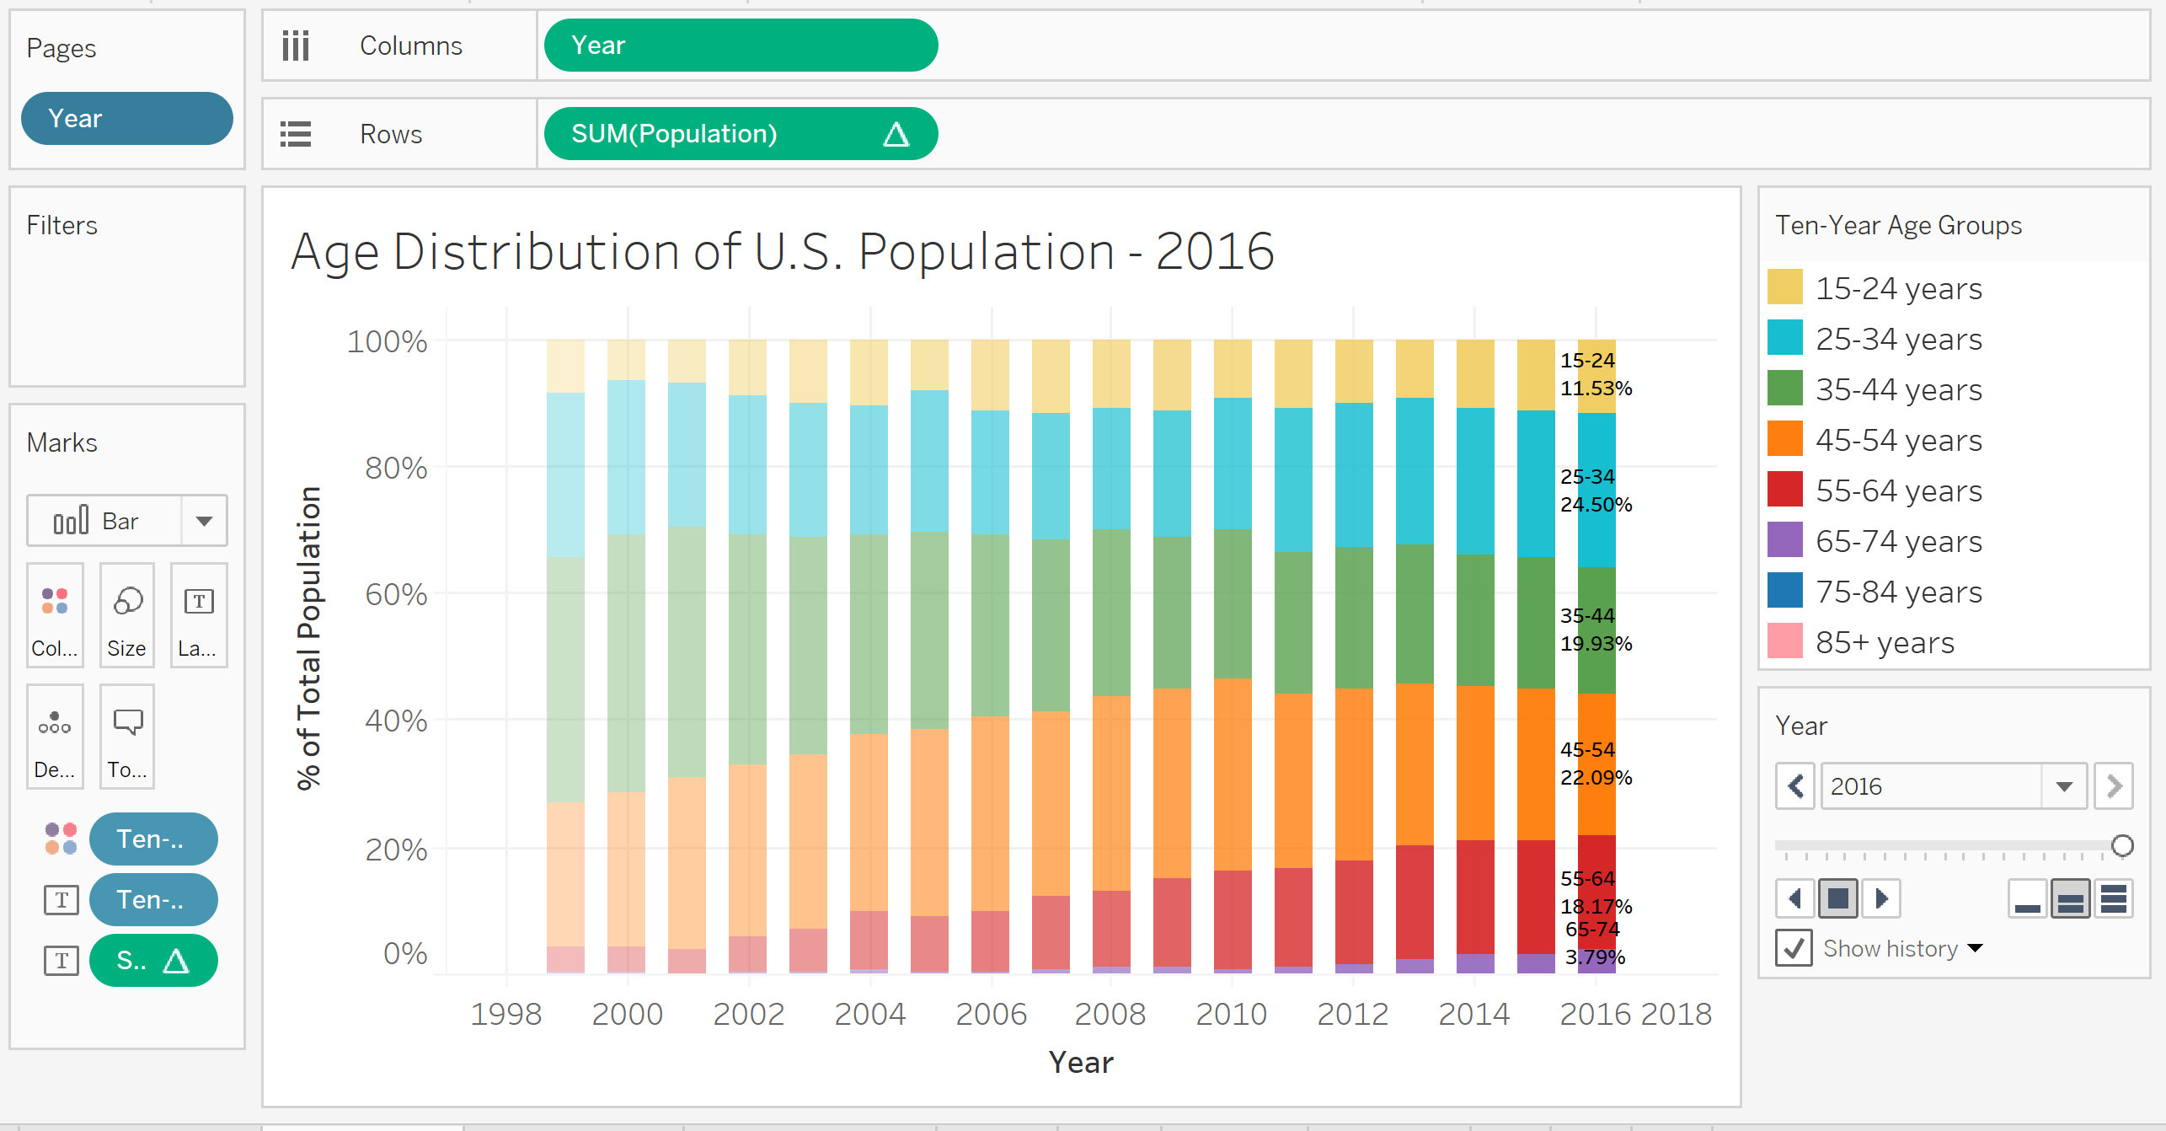
Bar graph: age group distribution over time

Slide 14
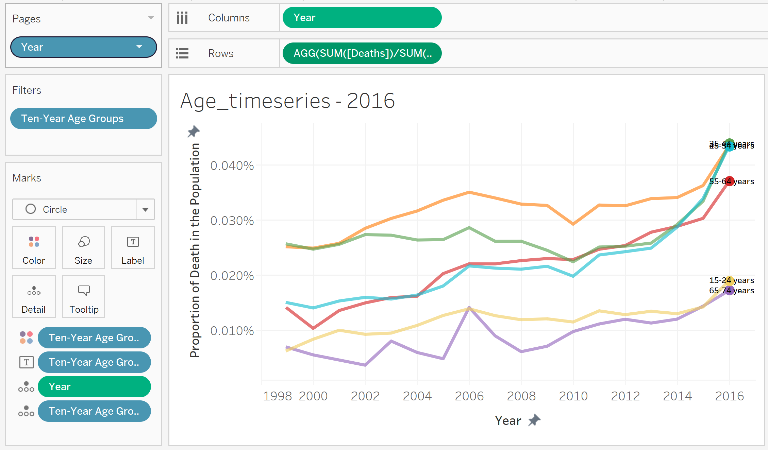
Time series: death rate by age group and time.

Slide 15
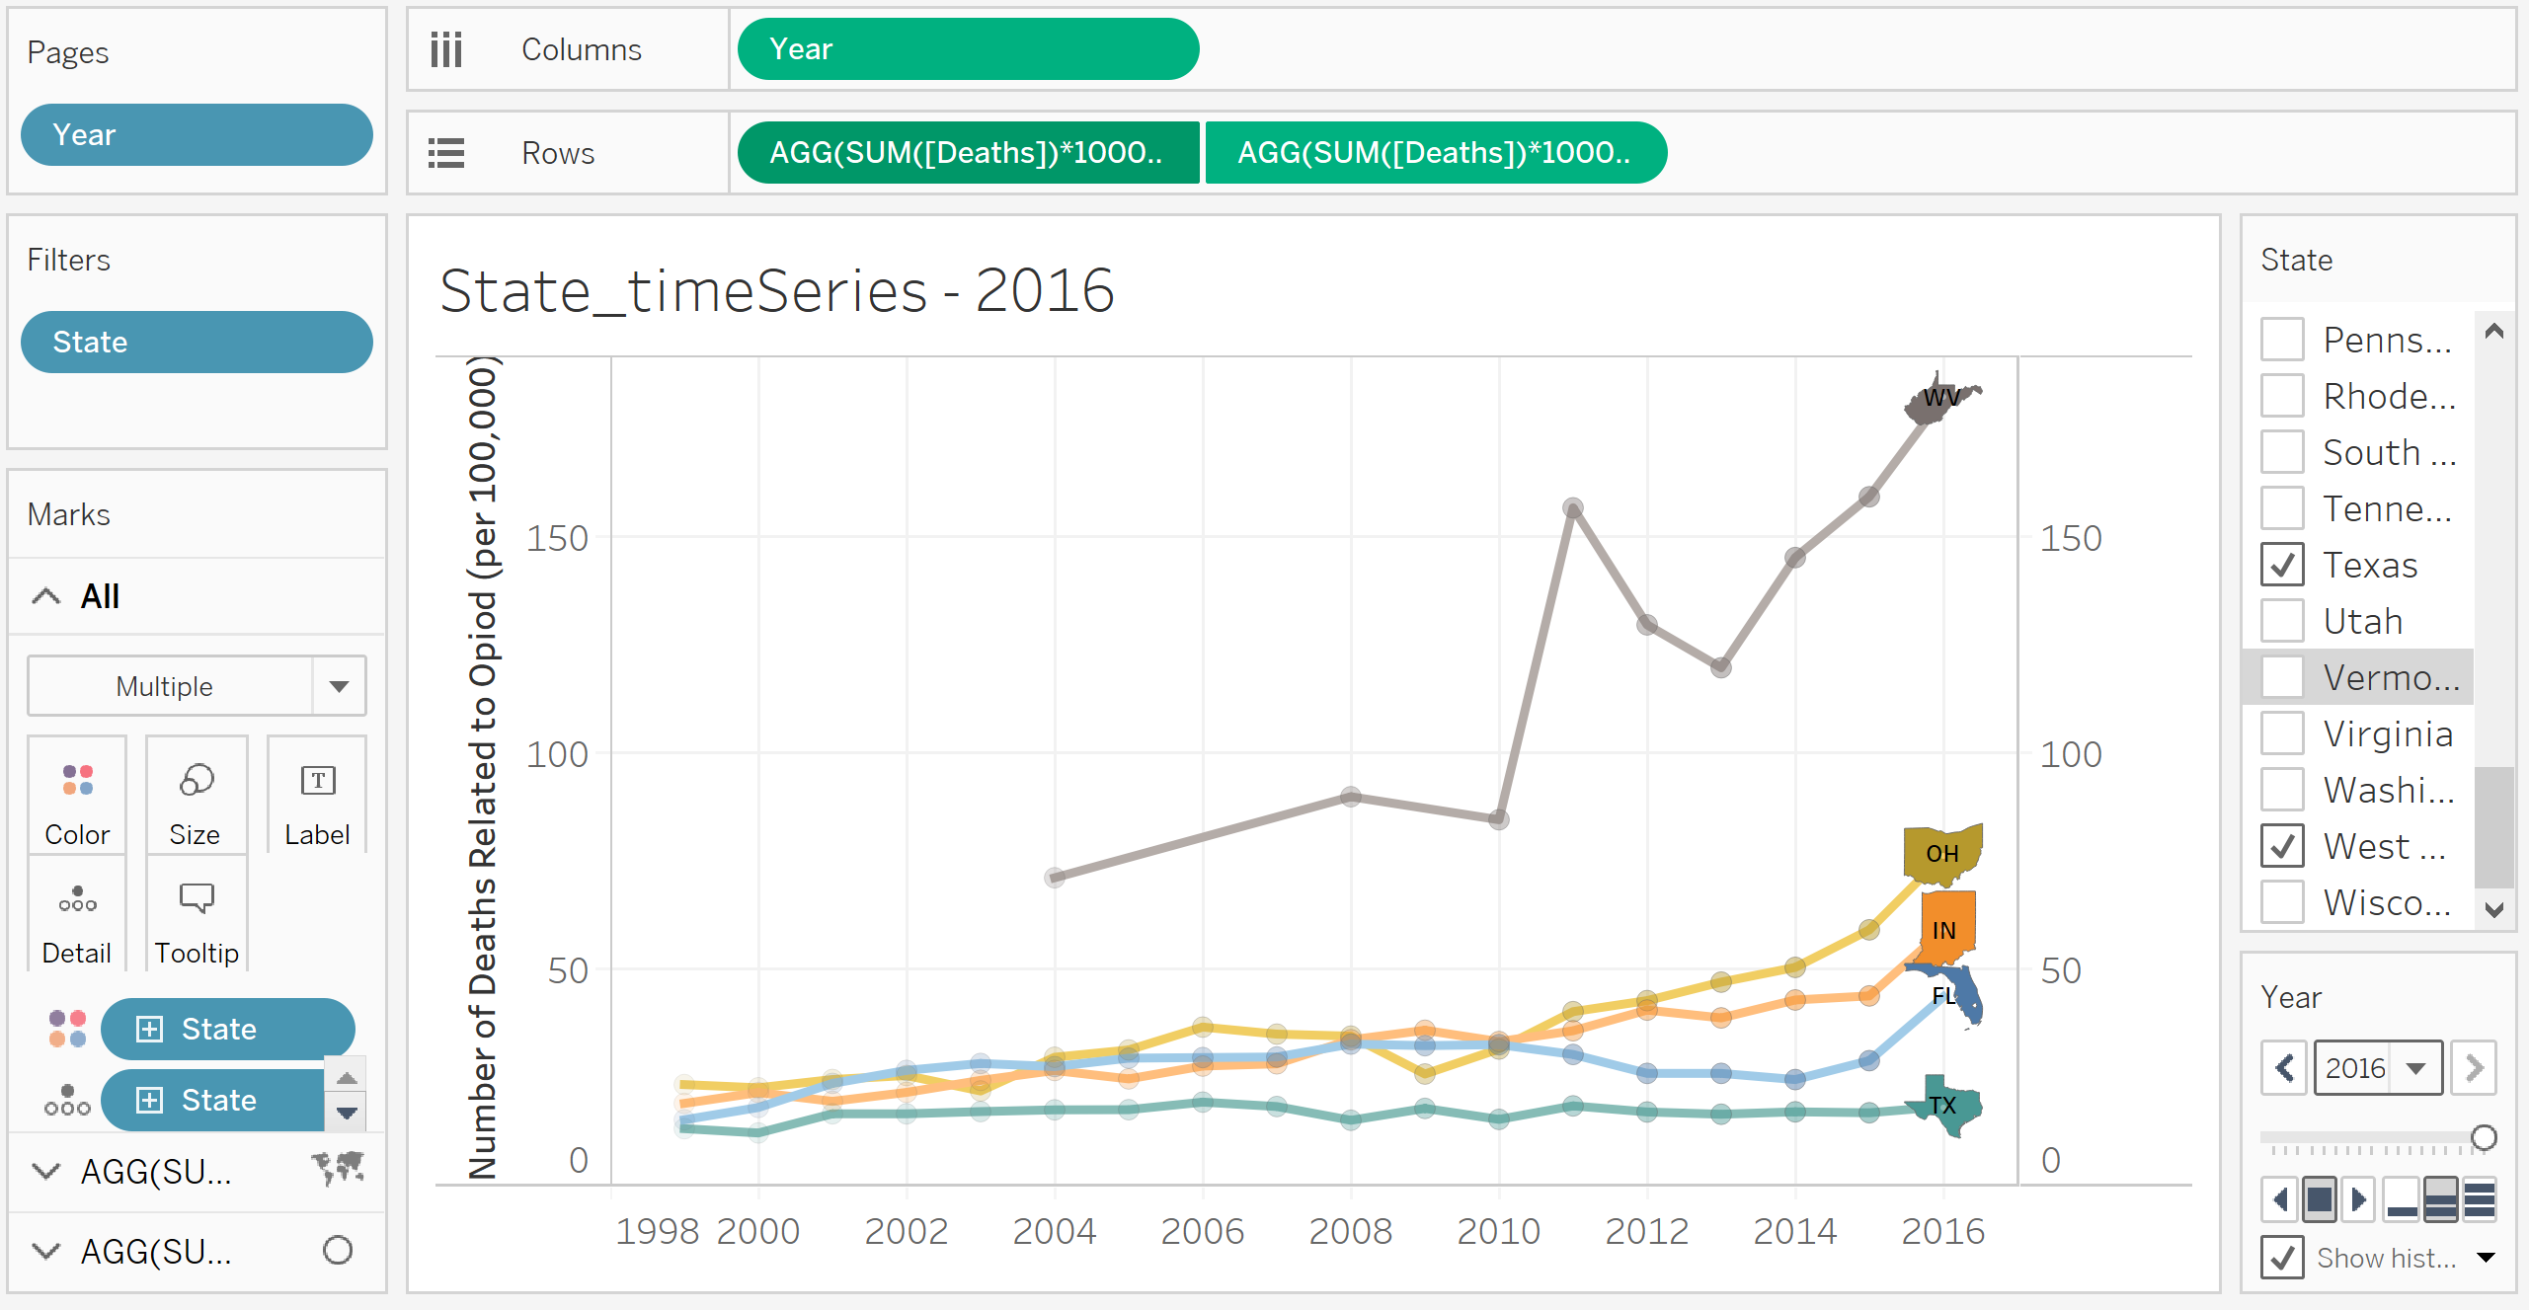
Time series: Death rate by state

Slide 16
Exercise
Create a Tableau story with at least 3 items using the opioid data or any data you would like.
Choose from the following items:
Geographic heat maps
(example: state_heatmap)
Time series graph or bar graph
(example: state_timeseries, age_timeseries, age_bargraph)
Crosstabs
(example: Gender_crosstabs)
Animate one of the graphs.
Use a calculated field.

Slide 17
Resources
Training videos from Tableau:
https://www.tableau.com/learn/training
Tableau tutorial for beginners:
https://www.youtube.com/watch?v=5O-2jQhXvc0

Slide 18
“A picture is worth a thousand words.” Thank you!

Slide 19
More Examples

Slide 20
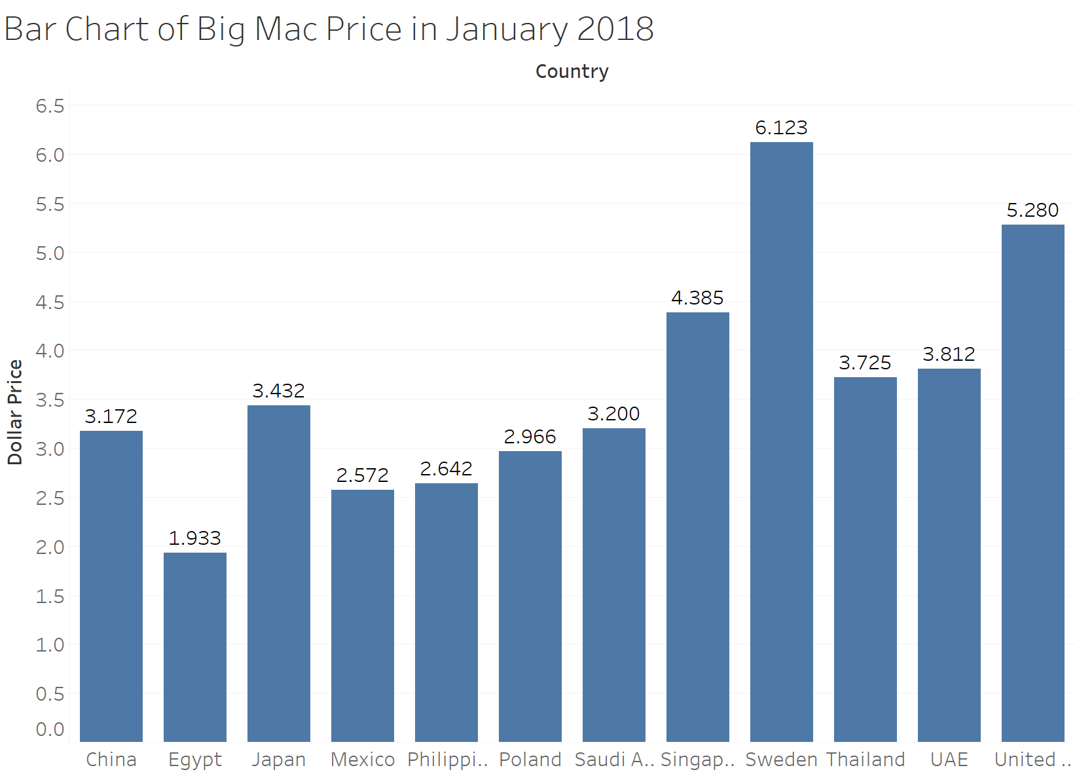

Slide 21
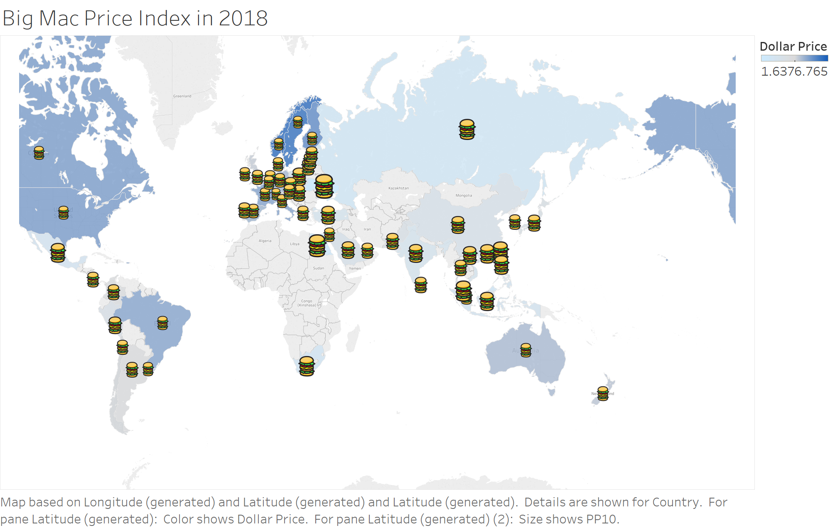

Slide 22
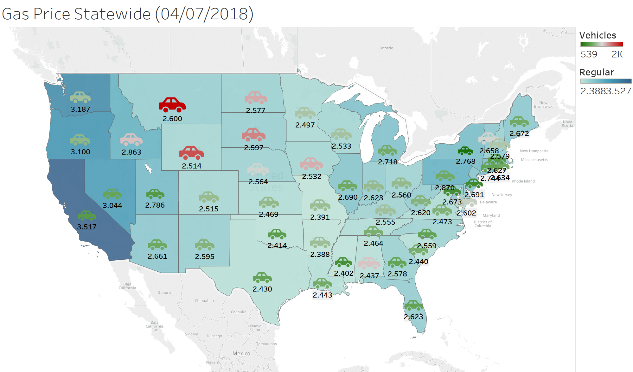
Gas Price Statewide
Vehicles indicate number of vehicles per 1000 people, map color indicates regular gas price.

Slide 23
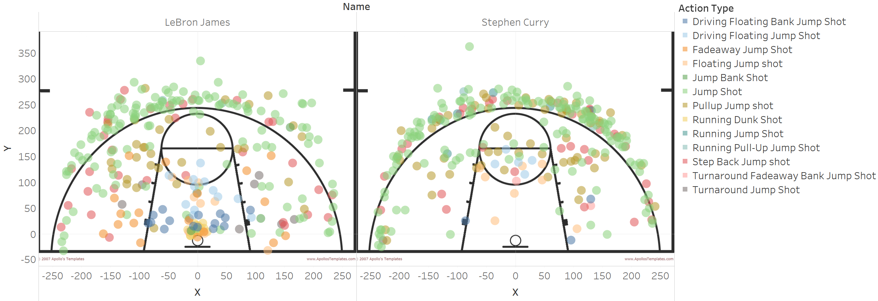
NBA Shot Analytics (2017)
http://nbasavant.com/shot_search.php

Slide 24
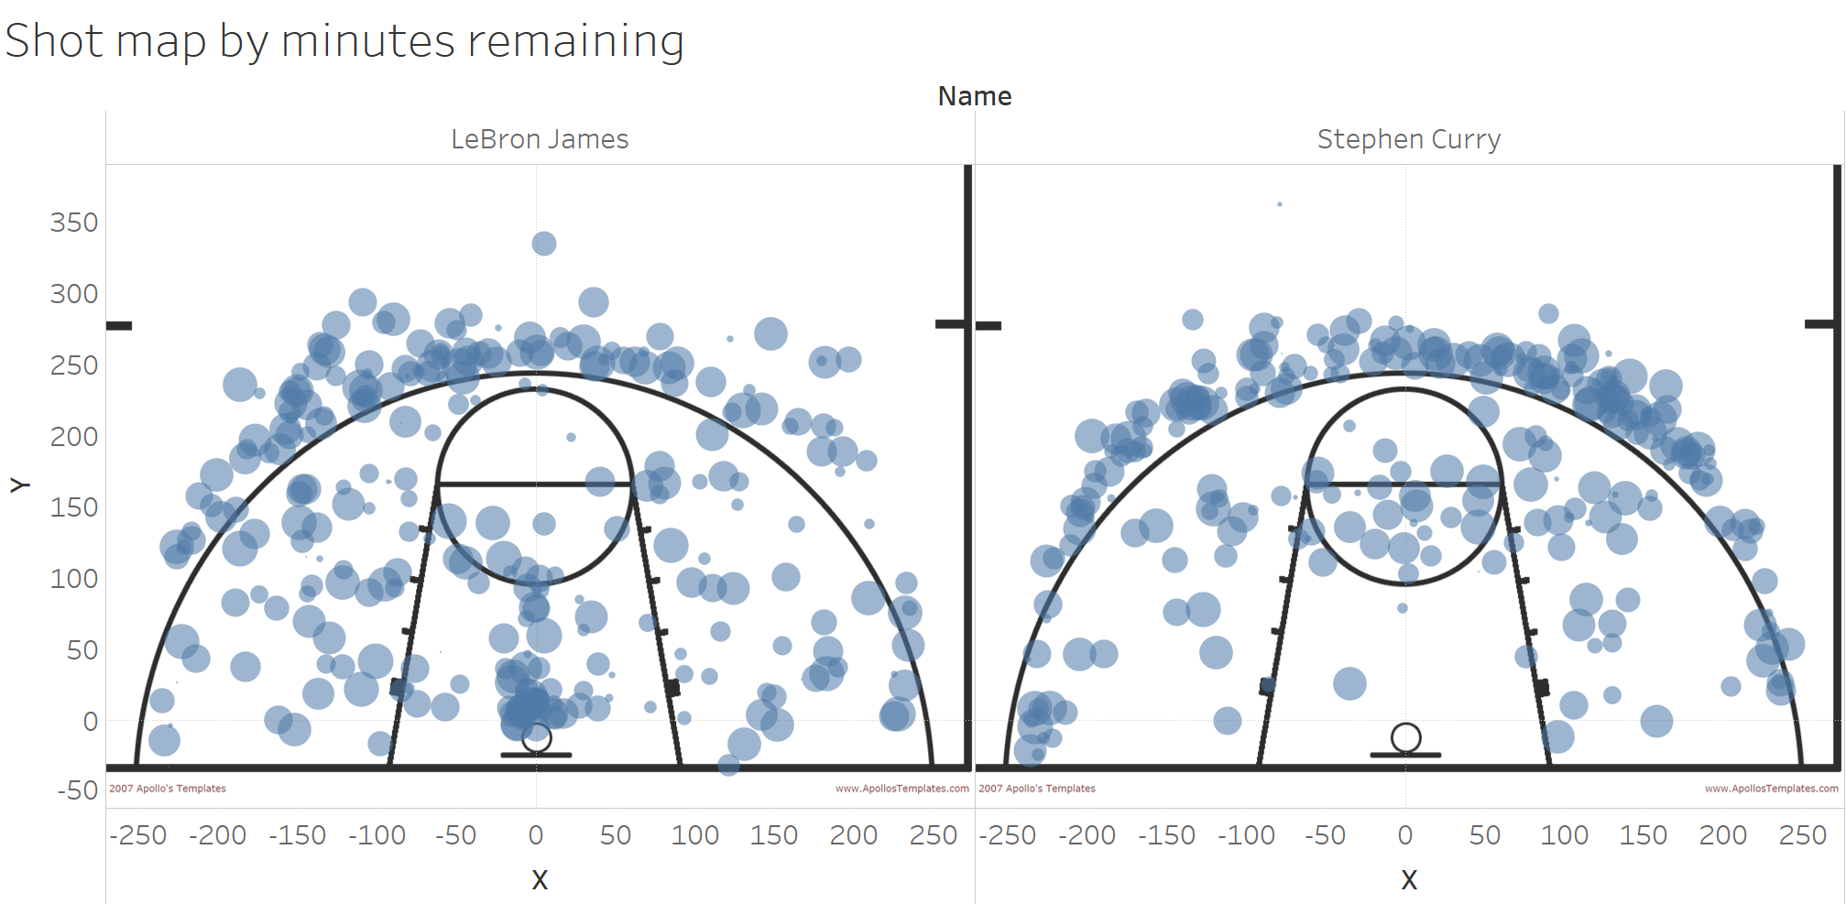
http://nbasavant.com/shot_search.php
https://www.youtube.com/watch?v=1-rsl6IHO_o

Slide 25
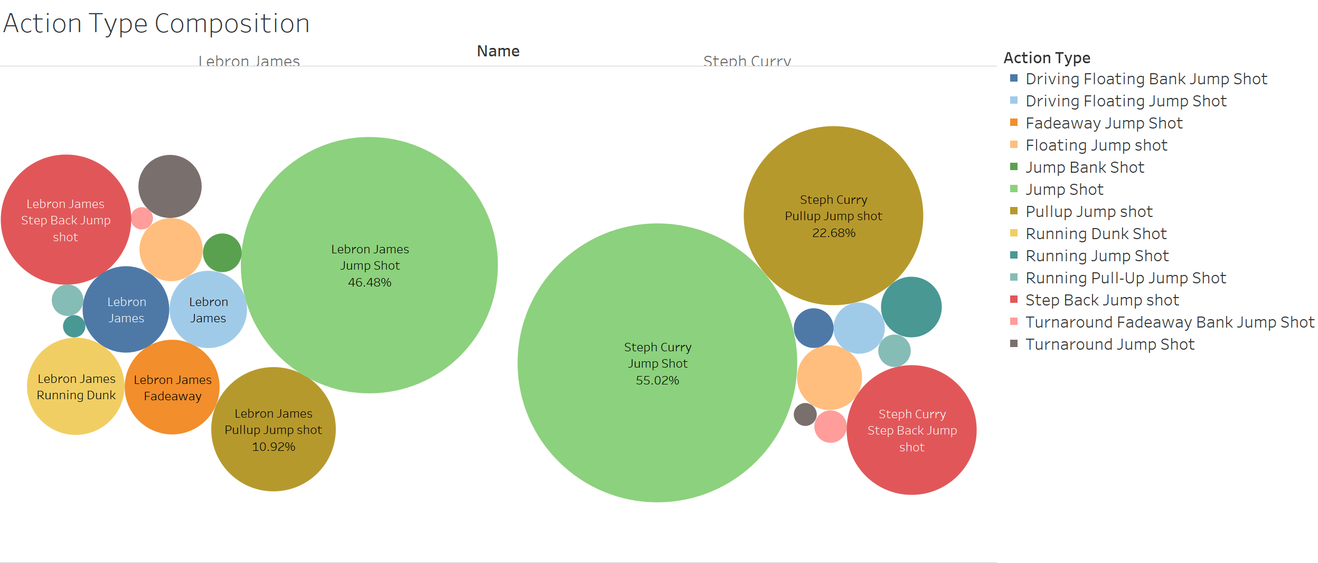
Bubble-chart

Slide 26
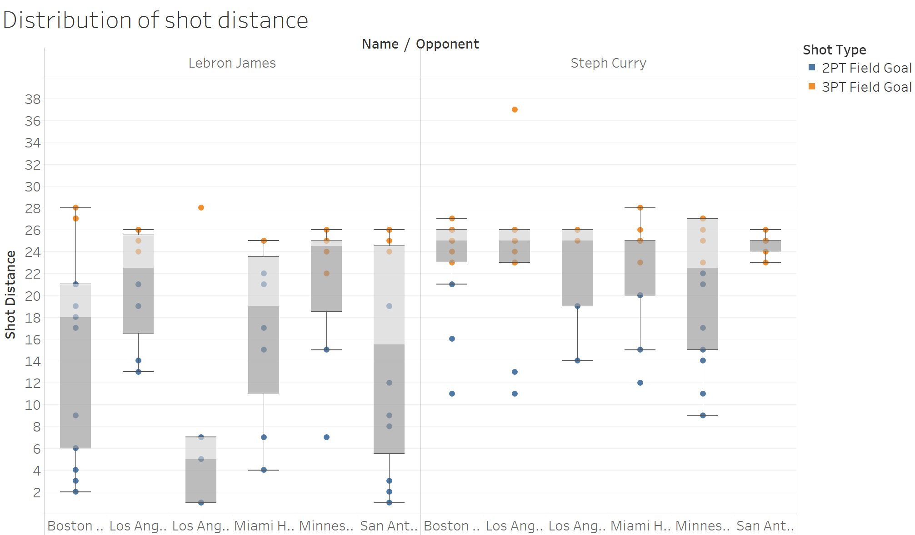
Box-plot

Slide 27


Word cloud – Presidential Inauguration Speech

