Slide 1
Graphics In R
Ben Williams
Statistical Science Dept. 11/27/2017

Slide 2
What is R?
Open-source scripting language
Uses in statistics, data science, and anything to do with data

Slide 3
Benefits
Free!
Flexible
Package Structure
Online Community
Reproducibility
RStudio
Graphics

Slide 4
R and RStudio
R is the underlying program (think a word- processor)
RStudio is an IDE (think Microsoft Word)
RStudio simplifies R and makes work easier

Slide 5
RStudio
Easy package installation
Easy plot viewing
Code help (completion, error checking)
Projects
Keep track of variables
Rmarkdown
Easy to create and deploy online applications

Slide 6
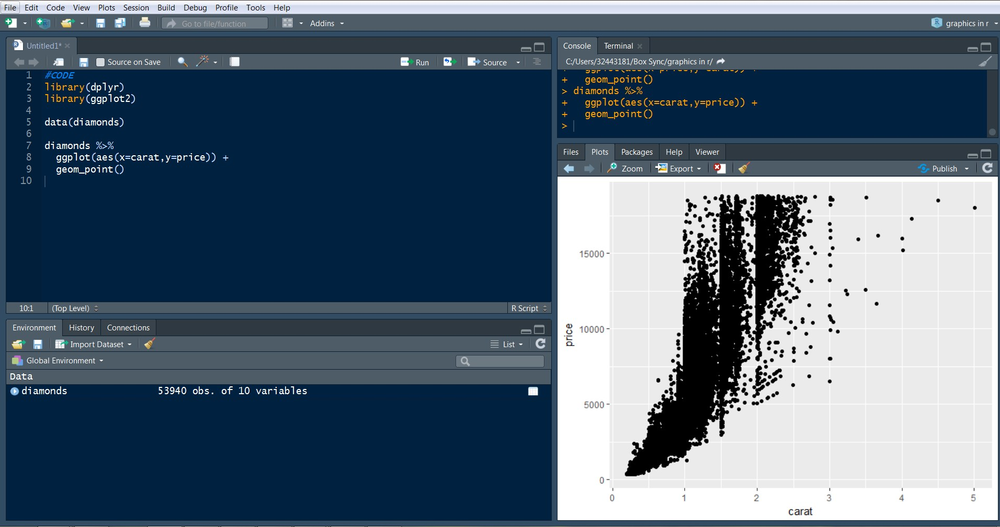

Slide 7
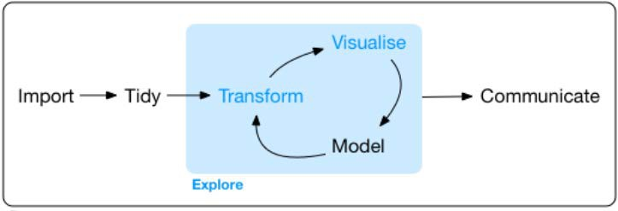
Workflow

Slide 8
Tidy Data
Tidy data is an important principle
Tidy data means one observation per row, one variable per column, each type of observational unit is a table (Wickham)

Slide 9
Data Munging
Easy import – point and click, read_csv()
SQL-like commands with dplyr package

Slide 10
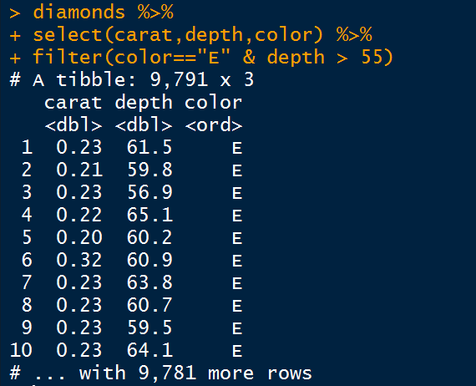
Add columns – summarize(), mutate()
Perform operations by group – group_by(), count(), top_n()
filter() and select()
joins
%>%
spread(), gather()

Slide 11
Graphics
Base vs ggplot2
Flexible because you control the code
Easy to save visuals

Slide 12
ggplot2
Grammar of Graphics (Wilkinson)
Package developed by Hadley Wickham
We can think of a graphic as a language composed of elements of grammar

Slide 13
Data
We need to have our data in the dataframe (or tibble) format
When we work with tidy data, we live in this realm already

Slide 14
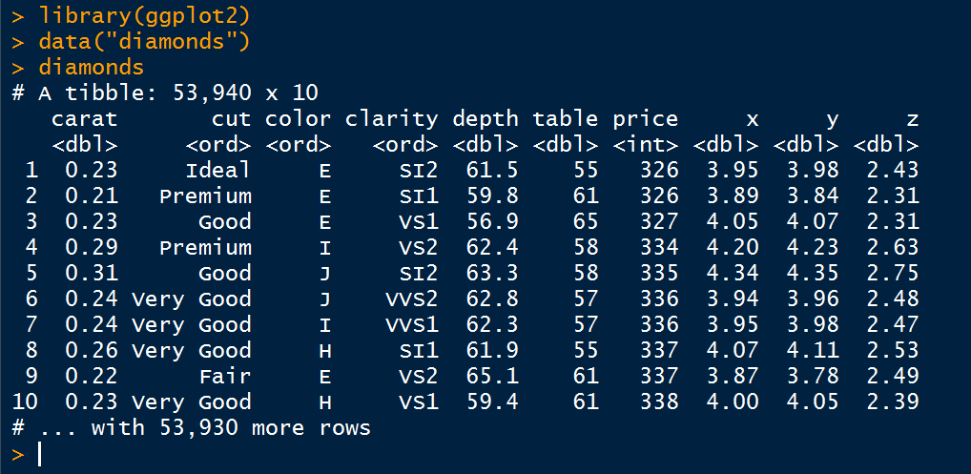

Slide 15
Layering
Start with your tibble, then give ggplot your aesthetics, add on your geometry of choice, add on any extra information
Use ‘+’ to add on more layers

Slide 16
Geometries
We need to tell R exactly what geometries/shapes/objects/lines we want to be depicted in our graphic
There are many types of geometries to use
points, lines, bars, etc.

Slide 17
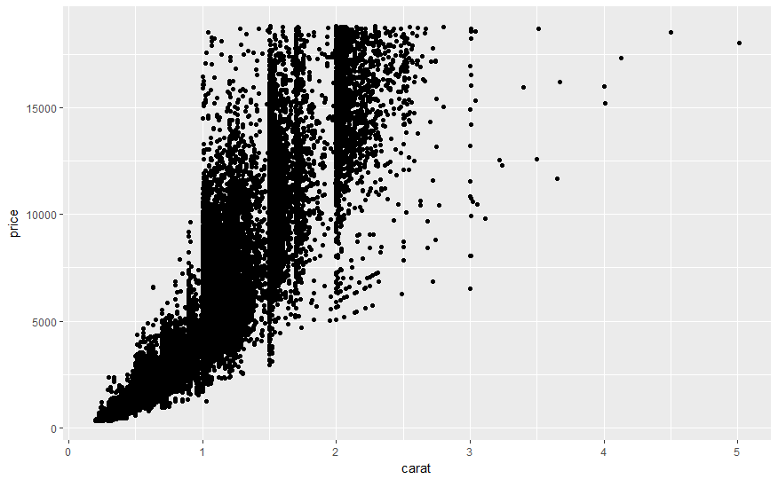

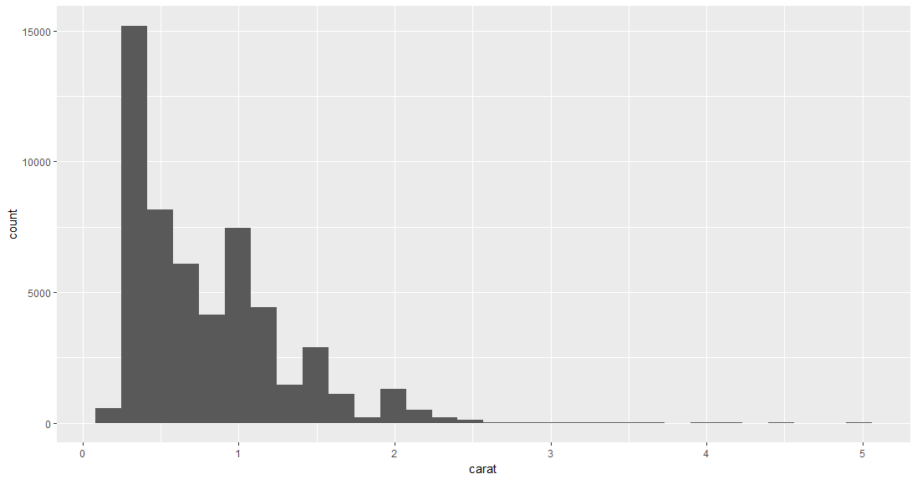
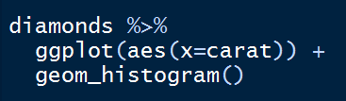

Slide 18
Aesthetics
This is how our tibble is mapped to the geometries
We tell ggplot2 which variables to use for the axes, which variables to use for color, etc

Slide 19
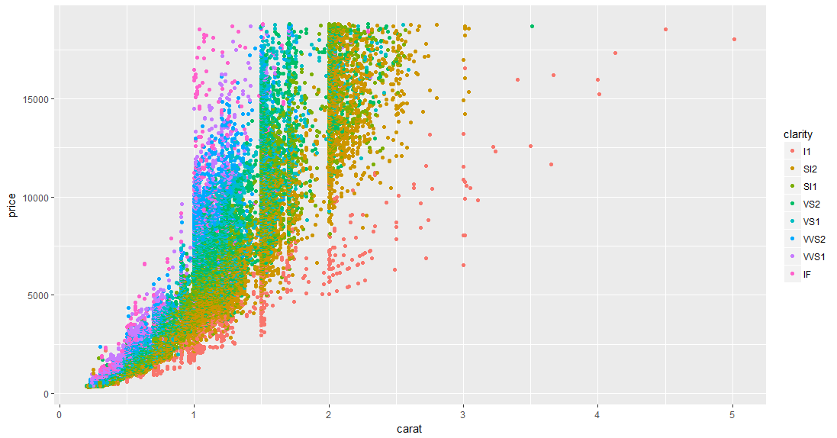


Slide 20
Facets
Allow us to view lots of mini-graphics where each graph corresponds to a value of a variable
Makes each graph neat, while still looking at a lot of information at once

Slide 21
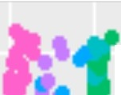

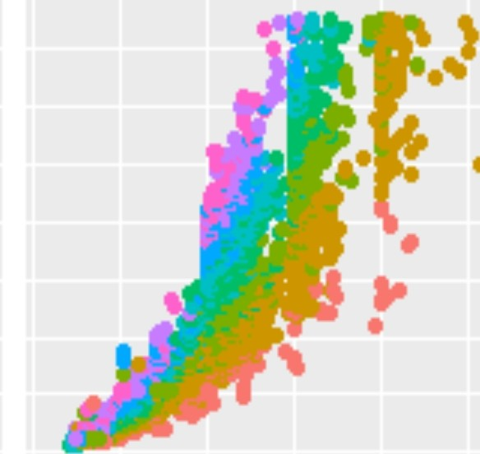


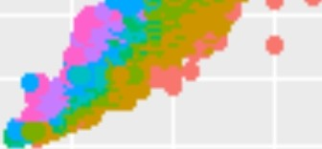
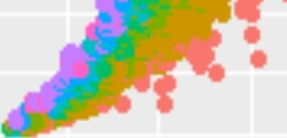
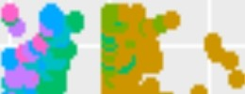
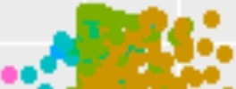

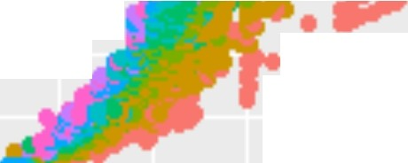
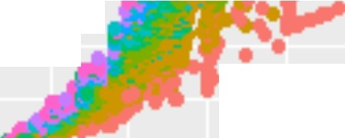
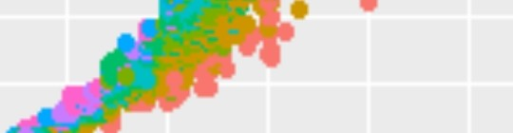

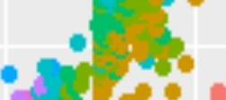
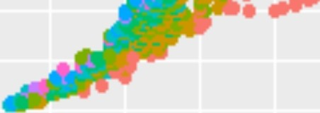
,.
D
..F •
E
F
• •
•
15000 -
"'
• • •
••
•
10000 -
•
•
5000 -
o -
clarity
11
G
H
-
•
•
•
• ••
•
•
•
•
•
S12 S11 VS 2 VS1 W S2 W S1 IF
15000 -
•
• •
I
•
•
• •
•
•
Q)
10000 -
•
••
⁰c
a..
5 000 -
o -
j
0
1
2
3
4
5 0
1
2
3
4
5
• •
•
•
I
•
15000 -
•
•
diamon
ggpl
ds %>%
ot( aes( x=carat,y=price,col o
r=clarity)
) +
1 0000 -
•
geom_poi nt() +
facet_wrap(......col or)
5000 -
o -,
0
1
2
3
5
carat

Slide 22
Labels
Easy to add title, axis labels, format legends, etc.

Slide 23
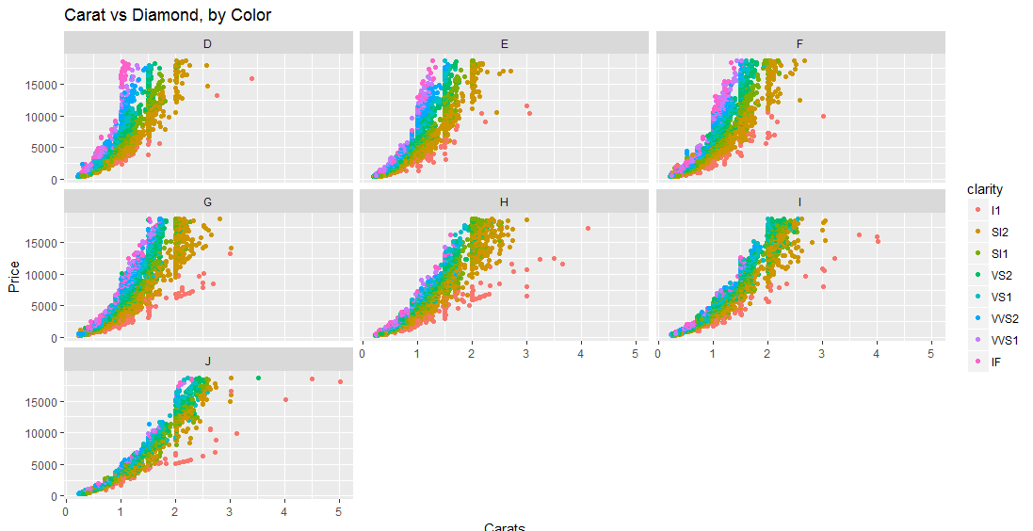
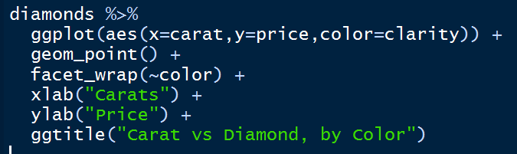

Slide 24
Other
Scales – define tick marks, etc.
Coordinates – coord_flip()
Trend Lines – geom_smooth()
Saving - ggsave(title.pdf)
Sequentially – one code chunk can take data, filter it, then plot it, all works together

Slide 25
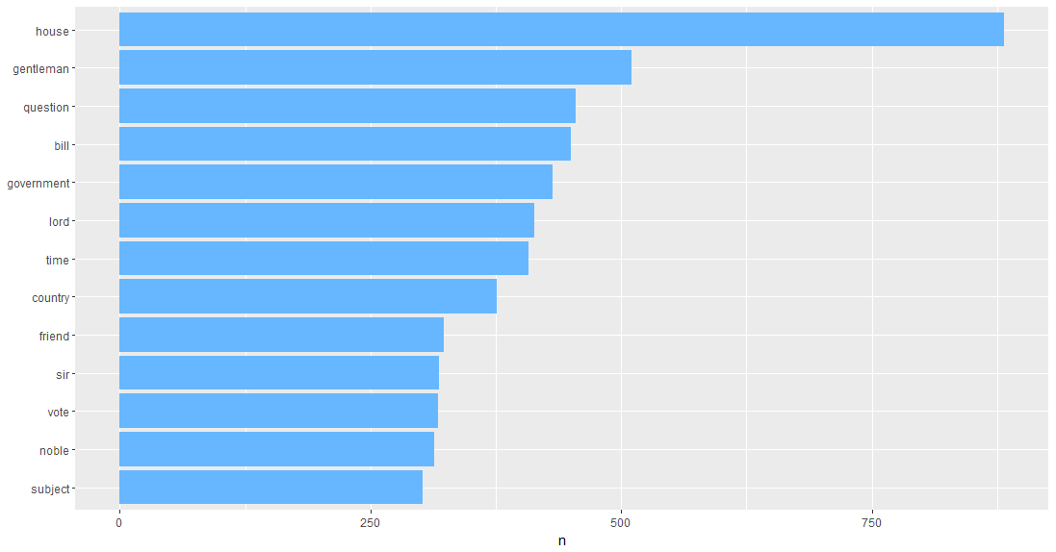
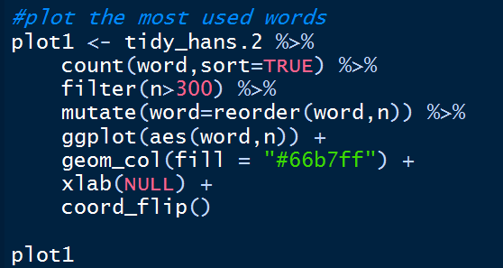

Slide 26
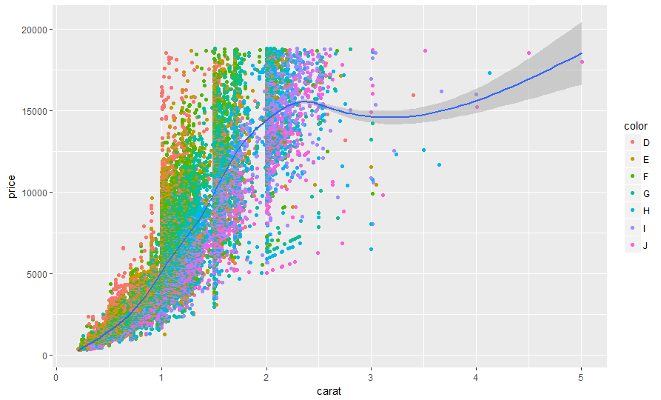
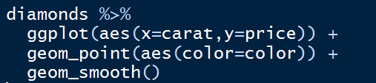

Slide 27
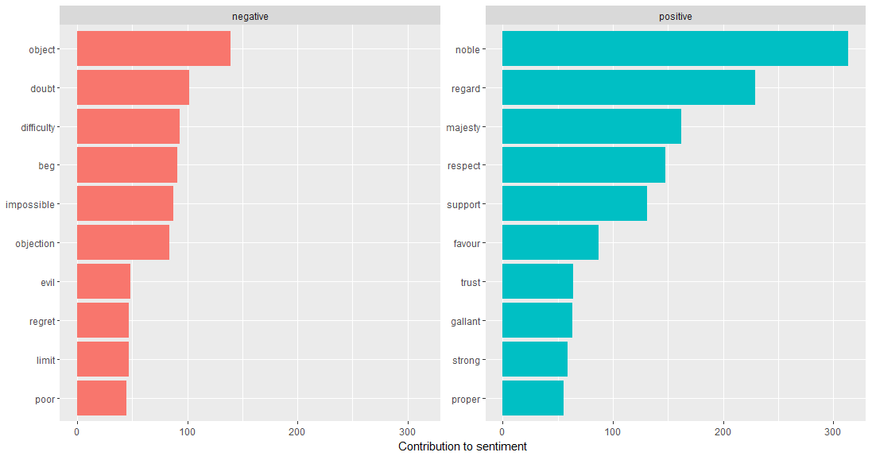
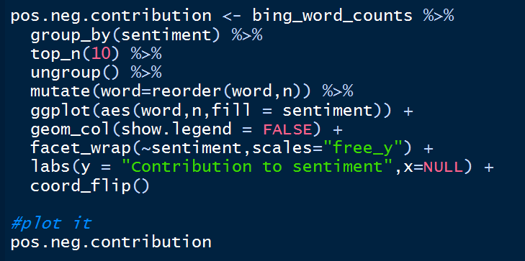

Slide 28
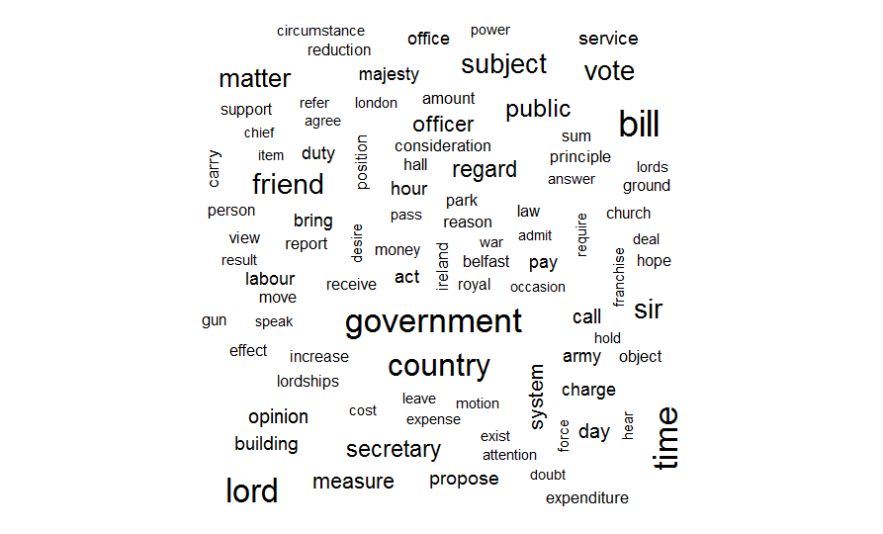
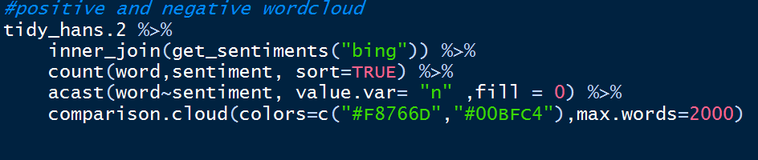
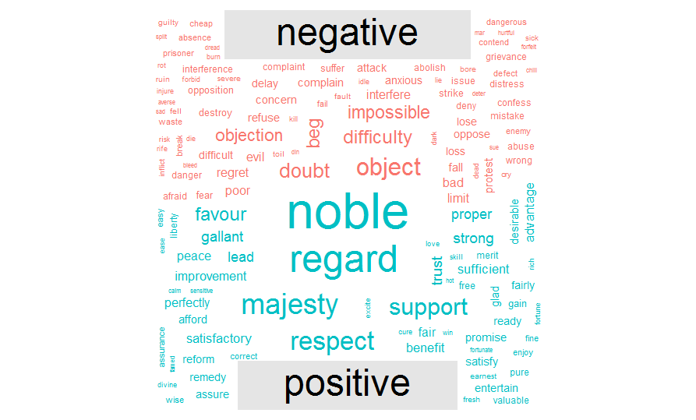


Slide 29
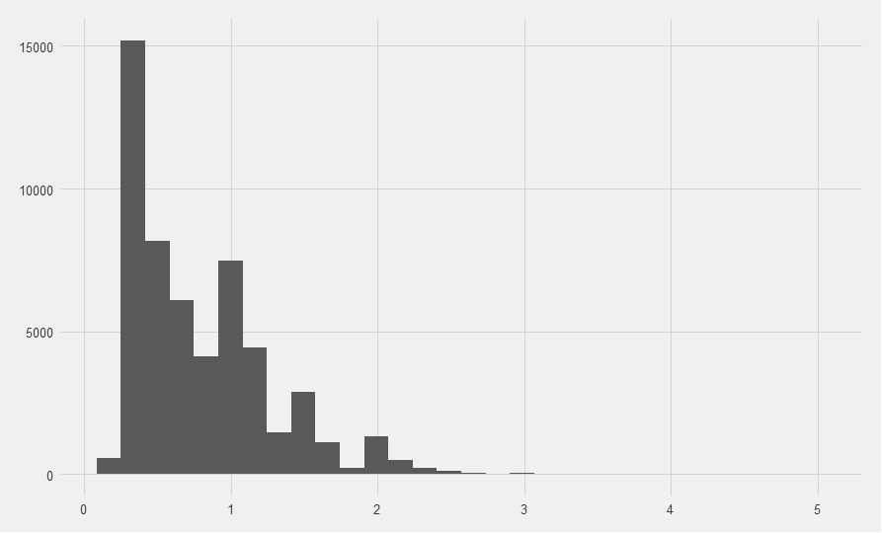
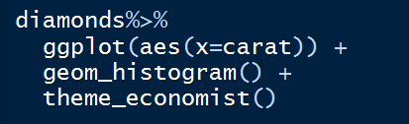
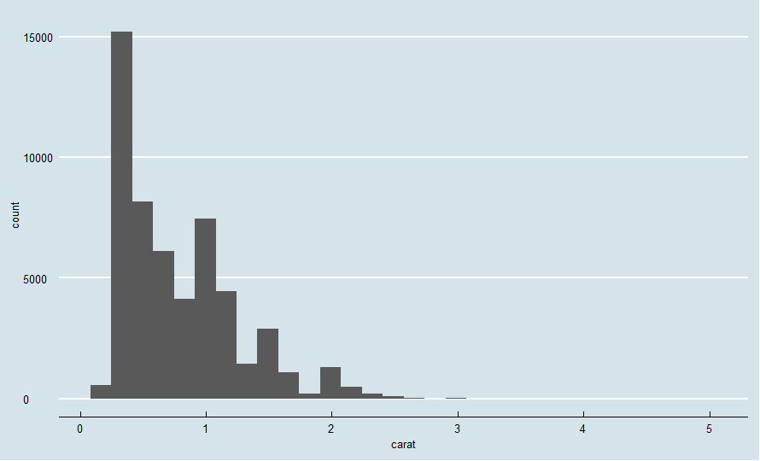
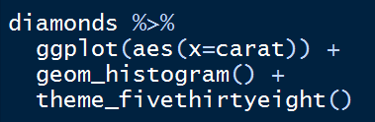
Themes

Slide 30
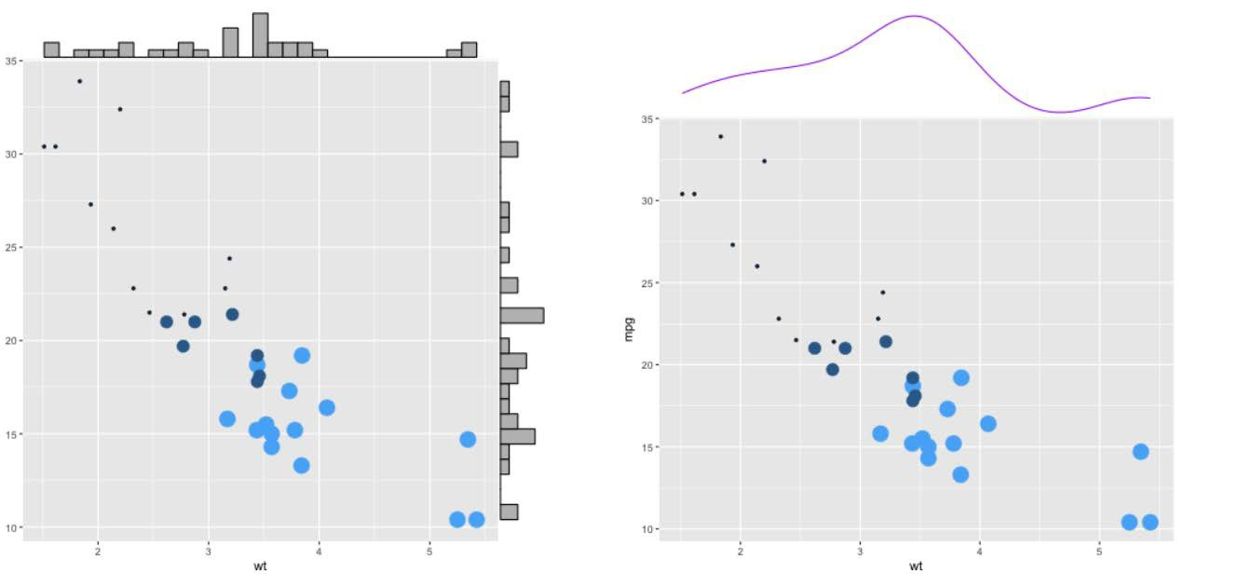
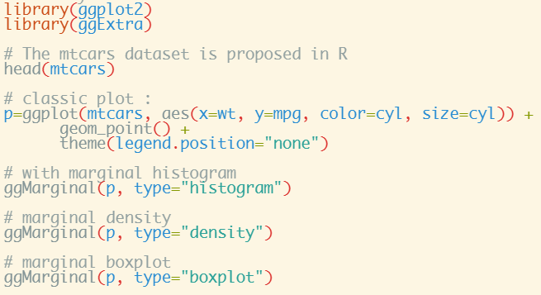

Slide 31
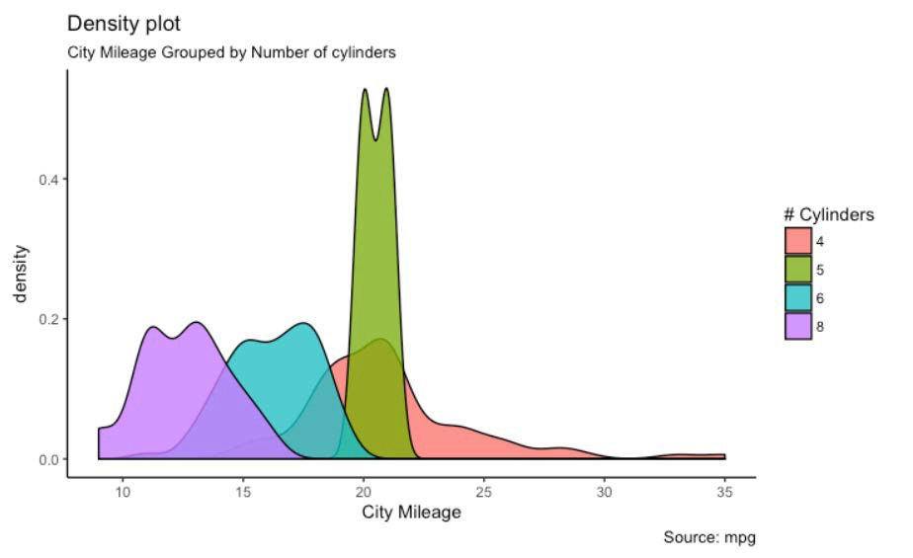
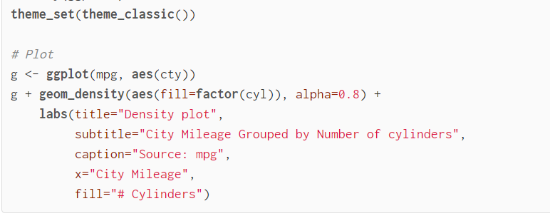

Slide 32
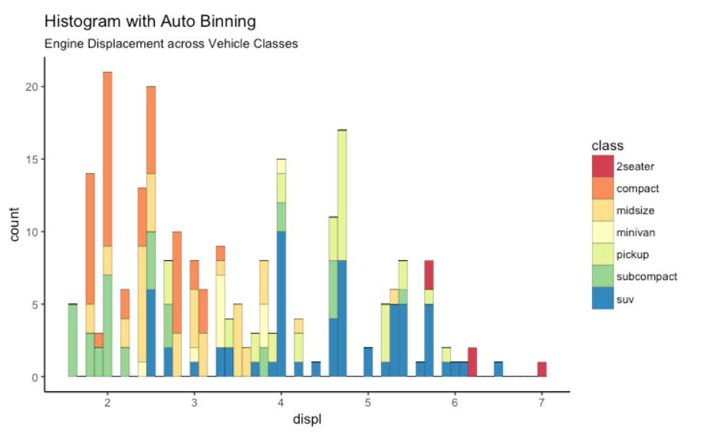
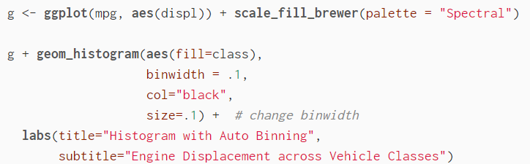

Slide 33
Dashboards and Apps
Easy to deploy
Great online support

Slide 34
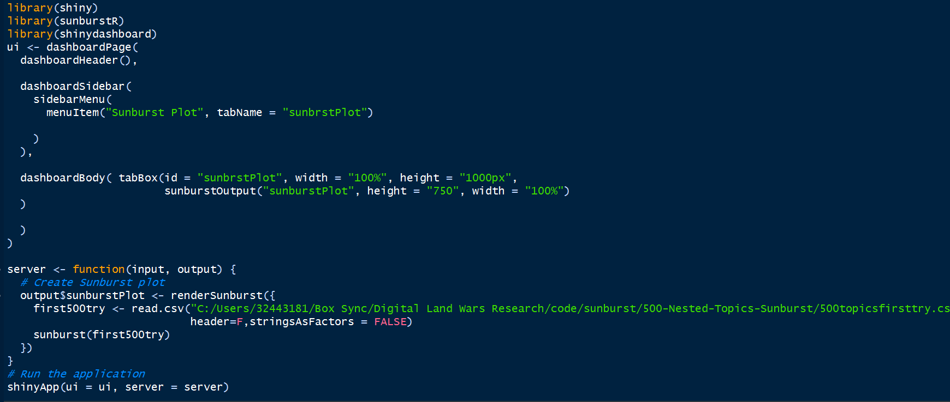
Example

Slide 35
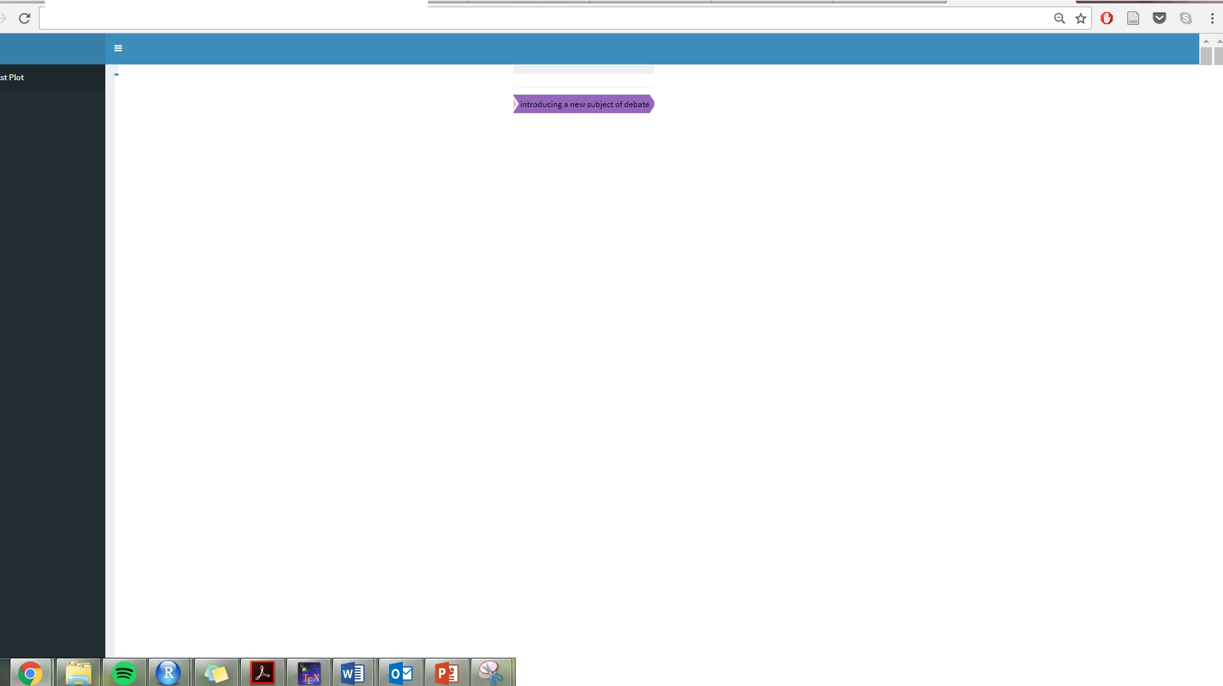


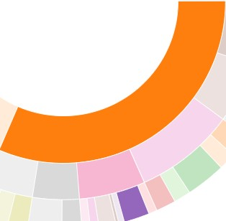
i Sec ure I htt ps:// benwillia ms.s hinyap ps.io /500 - Nested -To pics-Sunburst/
the formalities of prese nting in partia me nt
business in the house of commons a nd the select com mittees
1.80%
D Lege nd
1.80%
tab-pa ne active tab -1399-1

Slide 36
Conclusions
R is powerful and flexible
There is a learning curve, but worth it
Vast online community, many examples online
Free ebook: https://leanpub.com/hitchhikers_ggplot2

Slide 37
Questions?
benjamin@smu.edu

Slide 38
Acknowledgements
 Roger Peng (https://simplystatistics.org/2017/10/30/how-do-you-convince- others-to-use-r/)
 http://r-statistics.co/Top50-Ggplot2-Visualizations-MasterList-R-Code.html
 http://rmarkdown.rstudio.com/flexdashboard/examples.html

