Slide 1
Career as a Biostatistician
ASA Student Chapter at Loyola university in chicago
Chapter meeting – Feb 9, 2017

Slide 2
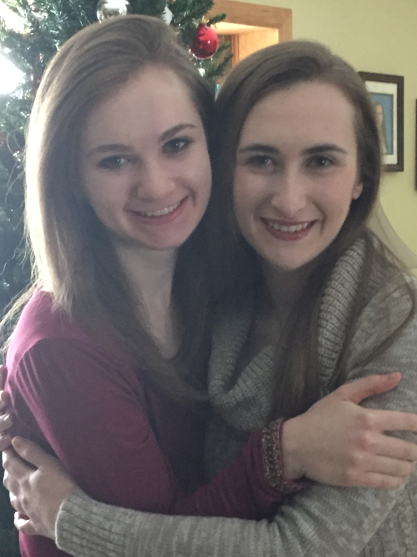
Donna Kowalski
Director, Biostatistics, Data Science
MS in Statistics from NIU, DeKalb, IL (1990)
Summer Intern (1990): Searle
Non-Clinical Statistician (1/1991 – 9/2003): Searle
  4 promotions from Statistician to Senior Statistical Scientist I
Statistical Consultant (9/2003 – 6/2004): Carr Consulting
Independent Consultant (6/2004 – 9/2004)
Contract Statistician (9/2004-7/2005): Takeda
Phase 1 Clinical Statistician (7/2005 – present): Astellas
  3 promotions from Principal Statistician to Director
  Managing 2 Senior Managers

Slide 3
What I enjoy about being a Statistician in the pharmaceutical Industry
Knowing that what I do can actually help improve the health of people around the world.
  Played large role in the development of:
    Celebrex – osteoarthritis
    Myrbetriq – overactive bladder
    Cresemba – invasive aspergillosis and mucormycosis
The science
Drug development
Designing and analyzing both non-clinical and clinical studies
Consulting

Slide 4
What are some Challenges I’ve faced
Nothing is text book
Managing CROs
Working through diversity
  Emotional intelligence (learn to work outside boundaries, don’t be intimidated or entitled, don’t expect recognition but forge forward with confidence, maintain composure while presenting your position calmly and logically, stay focused)
  Managing people – inspiring, developing, help them grow in their careers
Becoming a leader (setting clear expectations, knowing people approach problems differently and your way isn’t always the right way)

Slide 5
Statistical Computing/Programming
Statistical Programming Team (non-statisticians)
  Program in SAS on the UNIX
Statisticians (can do inferential statistics, simulations)
  Program in
    SAS
    R
    EAST
    nQuery
    Etc. – whatever package needed

Slide 6
Satisfaction as a Biostatistician in Pharma Industry
Intellectually challenging – always something new to learn
  Work with regulatory agencies (e.g., FDA)
  Work with Experts from around the world
  Participate with other Statisticians from around the world creating industry standards
  Organize, chair, present at statistical conferences (JSM, ENAR, local chapters, etc.)
Work-Life Balance
  Option to work from home some days or completely remotely (jeans every day)
  80 hrs health/sick
  5 days for Volunteer time
  4 hrs parental school leave
Excellent Compensation and Benefits
Statisticians are in high demand

