Slide 1
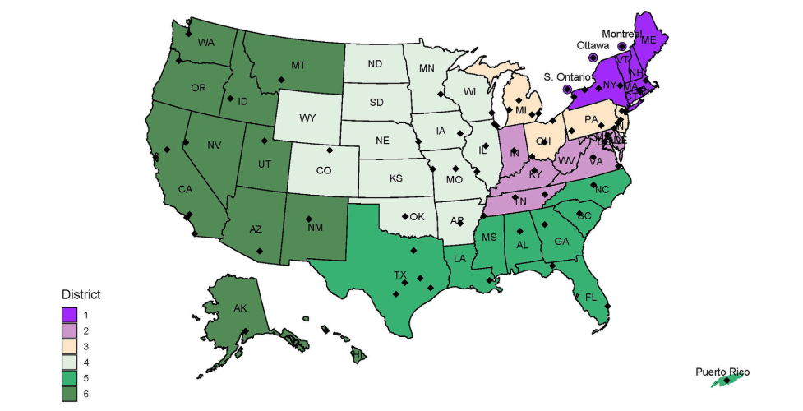
Find Your Table
Notes:
Districts in turn are divided into three regions: region 1 (D1, 2); region 2 (D3, 4); region 3 (D5,6)

Slide 2

Helping Each Other Rejuvenate Our Chapters (Amstat News Cover Story -- November 2023)
Chapter officers appreciation workshop
ASA Council of Chapters
JSM 2025

Slide 3
Welcome
Welcome to the Workshop
COCGB Chair-elect Tom Krenzke
Opening Remarks
COCGB Chair Jessica Kohlschmidt

Slide 4
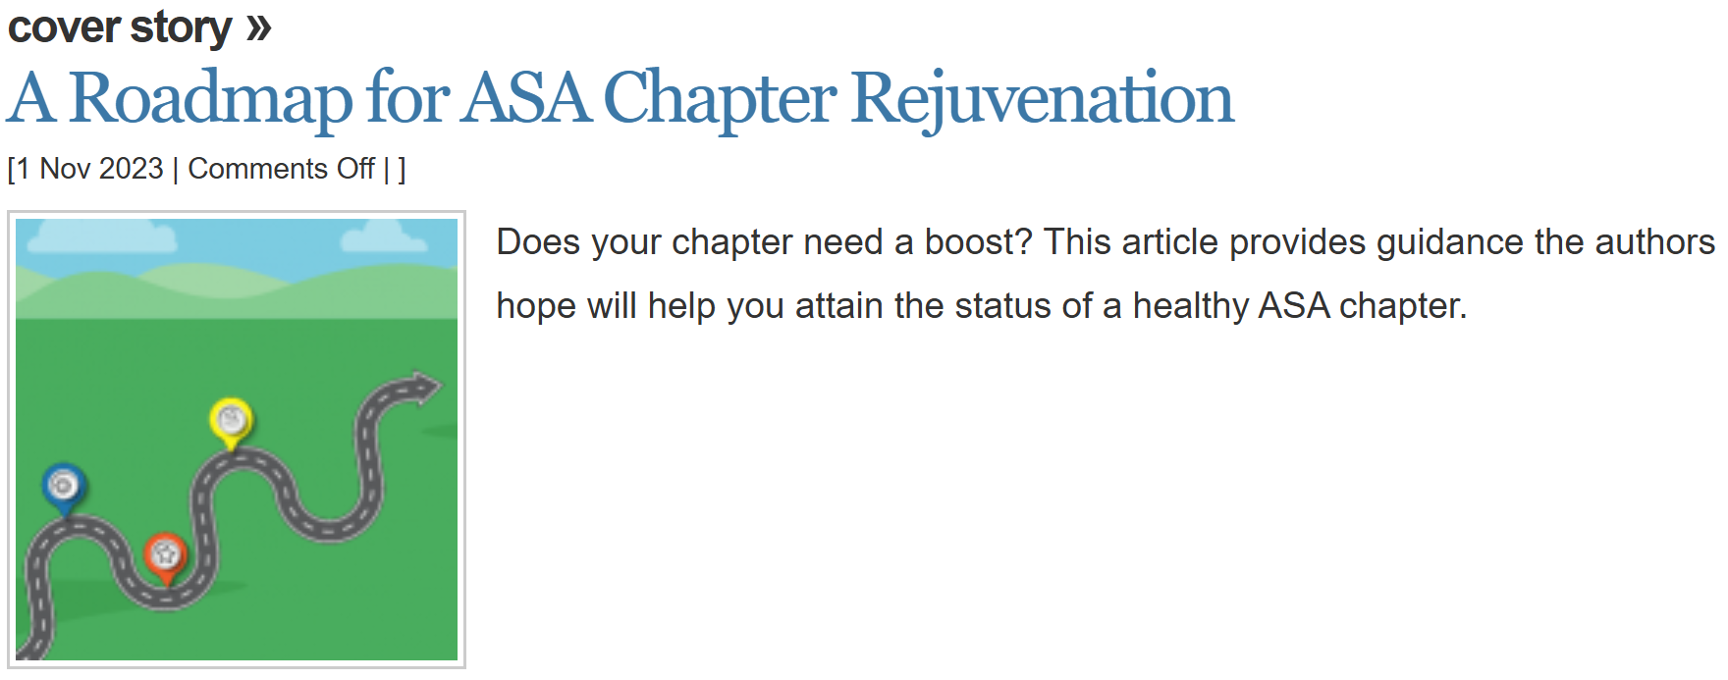

Slide 5
Workshop Outline
Goals
Help each other rejuvenate our chapters
Product – Your notes!
Brief introduction to six topics
Table discussions
Report out and turn in notes ☺
Special guest speaker

Slide 6
Topic 1: Good Standing
Maintain a current constitution on file at the ASA office
Elect officers according to your chapter constitution
Hold at least one chapter meeting per calendar year
Complete the annual report

Slide 7
Topic 2: Benefits of a Healthy Chapter
Community
Service
Continuing education
Network and job support

Slide 8
Topic 3: Timeline of a Healthy Chapter
Fall
Conduct a planning meeting with chapter officers
January
Annual report
Alert ASA of officer changes from annual election
February
Apply for stimulus funds
March
Nominate a member for a chapter service award
July
Alert ASA of officer changes from annual election
April
Hold chapter meeting
September
Hold event, such as a travelling course
IRS filing
Notes:
The system removes you when your end date arrives so then we lack officer information in the meantime. Healthy chapters will keep active rosters of officers with ASA.

Slide 9
Topic 4: Wanted - Officers
Engage or recruit new officers
Send an email to:
Some steps:
Acknowledge their strengths and skills
Talk about benefits of being an officer
Provide details about the role
Address any questions – help them feel confident
Highlight their impact of their contribution
Share success stories of volunteers
Chapter members
Local organizations with statisticians

Slide 10
Topic 5: Wanted – Early Career Statisticians
Contacts
Local universities
Local organizations that employ statisticians
Mentoring program
Review Amstat News articles in April 2019 and February 2015
Identify mentors and mentees
Email local organizations about the program
Match mentors with mentees
Invite the pairs to chapter activities

Slide 11
Topic 6: Ideas for Stimulus Funds
Objective
Requirements
Annual report submission in January
Chapter Stimulus Funding Application Form
Approval by ASA
Up to $1000 for 2025
Receipts for reimbursement
Ideas
Continuing education
Student support
Networking
Outreach
Stimulate growth in chapter membership

Slide 12
Reviving ASA Chapters
Ananda Jayawardhana
Kansas-Western Missouri Chapter

Slide 13
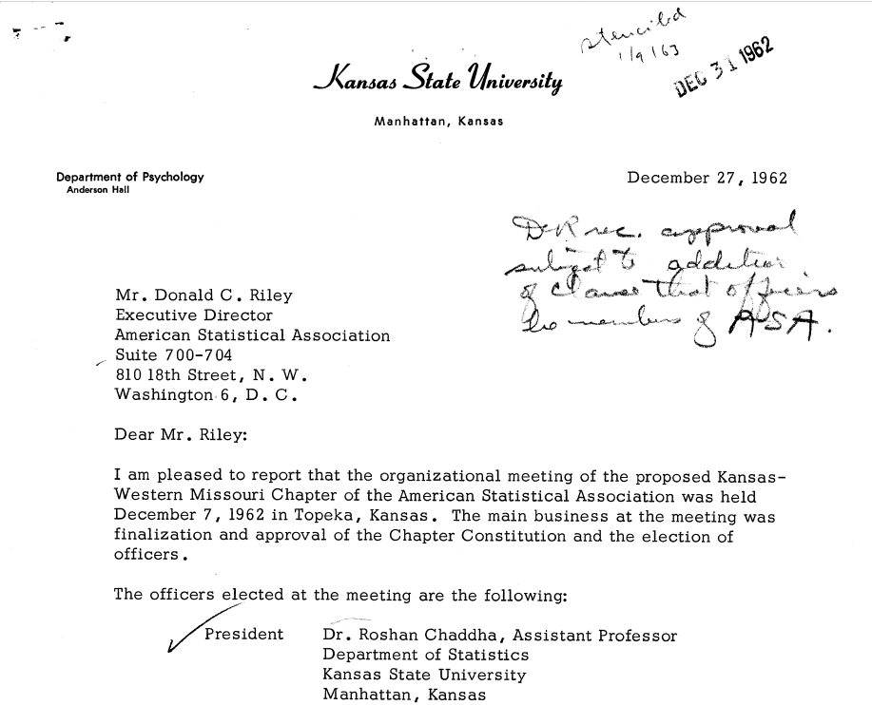

Slide 14
Recent History of KWMCH
Inactive for a short period before 2003.
Revitalized in 2003 with a negative bank balance. Held one short course and one chapter meeting in 2003.
Two meetings every year since 2004 (Fall Meeting in KC area, Spring Meeting at Kansas State University).
At least one short course per year.
KUMC and Cerner Corporation started the Symposium on "Innovations in Design, Analysis, and Dissemination: Frontiers in Biostatistical Methods" in 2008. Our chapter co-sponsored it since 2009.
Free symposium since 2021 paid by the KUMC.

Slide 15
What was my role at KWMCH & COC?
Secretary/Treasurer 2004-2007
VP 2007-2008
President 2008-2009
Secretary/Treasurer of COCGB 2007-2014
Chair Elect/Chair/Past Chair of COCGB 2015-2017

Slide 16
Finances
Our chapter is financially healthy now.
We can afford to lose money in our chapter activities for a few years.
We are cognizant that we need to raise funds even if we are financially healthy.

Slide 17
What did we do, right or wrong?
Reached out to statisticians in industry and academia and received financial sponsorships.
(R/R)
Organized two chapter meetings per year and rotated between KC and Manhattan, KS.
(R/R)
Rotated leadership roles among the institutions in the catchment area.
(R/R)

Slide 18
What did we do, right or wrong?
Often used COC Travelling Courses. (R/W)
Invited well known speakers from neighboring states (mostly professional friends who were happy with a reasonable honorarium). (R/R)
Allowed the starting chapter leaders to choose speakers through their connections. (R/W)
Provided KC BBQ at our meetings and short courses and charged to cover our cost. (R/R/R)

Slide 19
What did we do, right or wrong?
Several corporate sponsors support the symposium now. (R/R)
Held one or two career days for high school students but realized that it was not sustainable.(R/F)
Central Missouri Chapter meetings are held in Columbia, MO, but we never had any joint activities. (W/W)
Notes:
The University of Kansas Medical Center Department of Biostatistics & Data Science, Kansas Western-Missouri Chapter of the American Statistical Association, University of Kansas Cancer Center, Quantitative Omics Core that supports the Kansas Institute for Precision Medicine, K-INBRE, and EMB Statistical Solutions, LLC (KANSAS IDEA NETWORK OF BIOMEDICAL RESEARCH EXCELLENCE)

Slide 20
What did we do, right or wrong?
Tried to accommodate the local SUGI group (R/F)
Invited actuaries and business leaders (R/F)
Invited isolated statisticians (R/R)
Started a chapter of the Mu Sigma Rho Statistics Honorary Society (R/R)
Allowed membership to those who are not ASA members for a reasonable membership fee. (R/R)

Slide 21
Invite budget friendly speakers
Government Employees: Most of the cost is covered by the government
Hope it was true today!
Some ASA elected officers and employees
President
Ron Wasserstein
K-12 Statistical Ambassador
Notes:
Chris Franklin

Slide 22
Dedicated supporters
Dr. John Boyer
Former Chair KSU Department of Statistics
Dr. Matthew Mayo
Founding Chair KUMC Biostatistics Department
Dr. John Shelton
Formerly Quintiles
Several former VPs of Cerner Corporation

Slide 23
Chapter Visioning
Membership/past membership/prospective membership survey
Expectations
Importance of F2F meetings (Students meeting employers)
Cost of events
Member benefits (Low registration cost for short courses)
Service activities
Written comments (Give all of them a voice)

Slide 24
Visioning team
Hand selected, neutral, and diverse group
Spend at least two hours (with a break) going over the survey results and try to makes sense of the data
Rules:
Listen
No bad ideas
No criticisms
Don’t get offended
Protect confidentiality
Collect a few meaningful quotes

Slide 25
Prepare a presentation
Prepare a nice presentation by one or two members
Share it with the visioning team in advance

Slide 26
Presentation of the findings of the visioning group to the chapter
Overview of the findings
Meaningful quotes
Questions and Answers
Appoint a timekeeper and few note takers
Receive more feedback
Try to find collaborative solutions
Use time to focus on the future

Slide 27
Visioning group second meeting
Summarize the findings
Prioritize goals
Focus on the top few goals

Slide 28
Report to the board or pseudo board members
Visioning team meets with the board members
Present their findings
Board appoints a strategic planning team
Write a strategic plan
Implement it!

Slide 29
Table Discussions
Topic at each table
Find your table topic of interest
Introduce yourselves – Name, chapter, role
Identify the note-taker and report-out person
Review “What is this topic about?
Questions to answer:
What challenges have you faced?
What solutions have you identified, or can you identify?
How to get it done?
10 minutes!
Take good notes!

Slide 30
Reporting Out
Topic 1: Good standing
Topic 2: Benefits of a healthy chapter
Topic 3: Timeline of a healthy chapter
Topic 4: Wanted – Officers
Topic 5: Wanted – Early Career Statisticians
Topic 6: Ideas for stimulus funds

Slide 31
Closing (but one more slide…)
Gather Notes from note-takers
Look for upcoming chapter-related articles in the Amstat News

Slide 32


Celebrate!
Southern California Chapter
100 years

