Slide 1
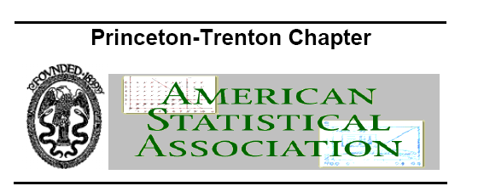
Welcome to the
ASA Princeton-Trenton Chapter
2019 Spring Symposium
May 31, 2019

Slide 2
Acknowledgement
Retiring Chapter Officers (2018-2019)
Yong Lin | Current President (2019 – 2010) | Biostatistics Department, Rutgers School of Public Health
Ming Zhu | Secretary (2018 - 2019)
Ming Zhou | Past President (2018-2019) | Bristol-Myers Squibb
Shou-En Lu | Chapter Representative | Biostatistics Department, Rutgers School of Public Health
Call for Nominations
Nominations are invited for the following positions (for the 2019-2020 term) in ASAPT:
President-Elect
Treasurer
Secretary
Candidates must be a PT-ASA member and motivated to participate in chapter activities. Please send your nominations and a short bio of the candidates to Ming Zhou at ming.zhou@bms.com on or before June 30, 2019

Slide 3
Award for Outstanding Chapter Service
Recipient: Haiyan Xu
In Recognition of many years of outstanding and devoted service to the Princeton-Trenton Chapter of the American Statistical Association.

Slide 4
The Spring Symposium Today
Incorporating Real World Evidence in Regulatory Decision Making

