Slide 1
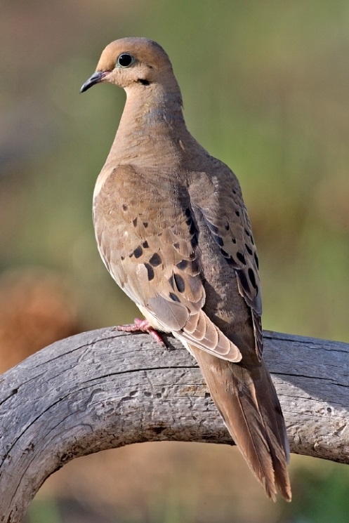
Modeling Mourning Dove Population Dynamics
Wikamedia
Mark Otto
USFWS Patuxent Wildlife Research Center, Laurel, MD
WARNING: Not necessarily the views of the U.S. Fish and Wildlife Service
Notes:
In 2003 the Flyway Councils decided to put mourning doves management of on a more scientific basis. They added to the banding and harvest surveys to monitor population demographics, allowing them to make management decisions on one thing we could control, the harvest.

Slide 2
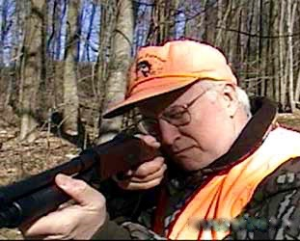
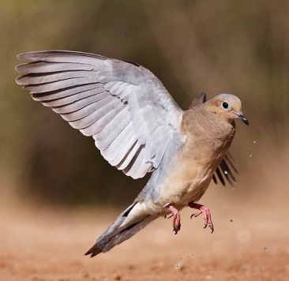
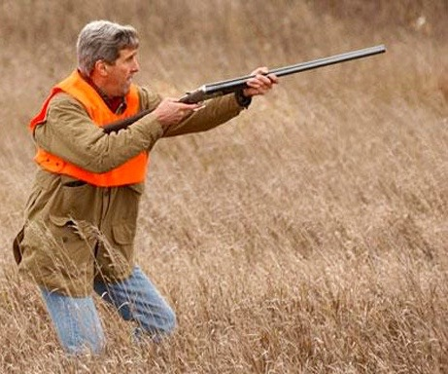
Most hunted bird
850 thousand hunters
14.5 million birds harvested
~$540 million spent
Bi-partisan sport
Important
Interest
Economically
Notes:
Why is this important? They are all around. There are 850k hunters spending over a half billion. It’s a bi-partisan sport. Where particular hunting regulations have played a big part in Federal budget negotiations at least twice during my career.
John Kerry: by ELSPETH REEVE on http://www.thewire.com/politics/2012/12/politicians-holding-guns-photos/60206/
Dick Cheney: http://www.apollospeaks.com/?m=201504
Flushing dove: Larry Ditto, http://www.santaclararanch.com/photogalleries/larryditto/slides/Mourning%20Dove_Larry%20Ditto_70K7356.html
Economics: http://nydovehunting.weebly.com/the-economics-of-dove-hunting.html
Most hunted bird
Bi-partisan sport 2014 harvest stat
Held up the U.S. budget twice because politician didn’t get their hunting season
My point is not political but how this species is managed is important

Slide 3
Optimal State-Dependent
Harvest Policy
Notes:
So in an era of big data, the Department of Interior does Adaptive Resource Management and collect Small Data targeted to make management decisions. In this case, setting hunting regulations in a way that maintains healthy populations. This gets to Christine Fox’s point yesterday in the President's Invited Address, ask the right questions.
To give you a flavor of an ARM analysis: We can propose different closed, restrictive, and liberal hunting seasons. These result lower populations and higher harvests or visa versa but not huge changes.
Your are most likely not interested in our problem, but Adaptive Resource Management could help your clients make better use of your analysis, even before they get your results.

Slide 4
Population Model
Breeding
Season
Reproduction
Breeding
Population
Adults &
Juveniles
Survive
Survive
the harvest
Rest of
The year
Hunting
Season
Notes:
Later, we build a population model with growth, harvest, and survival.
But as many of you in small area estimation know, there is no guarantee that these different surveys will make these things add up—in our case, to next year’s population

Slide 5
Notes:
An integrated population model will impose that restriction. Those are the estimates in the yellow.
There is lots of interesting aspects of these graphs. We can talk about those at the break over my poster.

Slide 6
Notes:
We can also use a logistic model to obtain a maximum sustained yield: the largest harvest, maintaining a sustained population.

Slide 7
Adaptive Resource Management: repeated decisions
Structured Decision Making: complicated one-time decisions
Collect Small Data
Build models for the different possible ways your system works
Monitor and model to decide among your alternatives and maximize your objectives

