Slide 1

MIND THE GAP
The Role of
Eyewitness Testimony, Oral Tradition,
and Memory,
in the Development of the Gospel Tradition
By Peter Kozushko, D.Min.
pkozushko@gmail.com

Slide 2
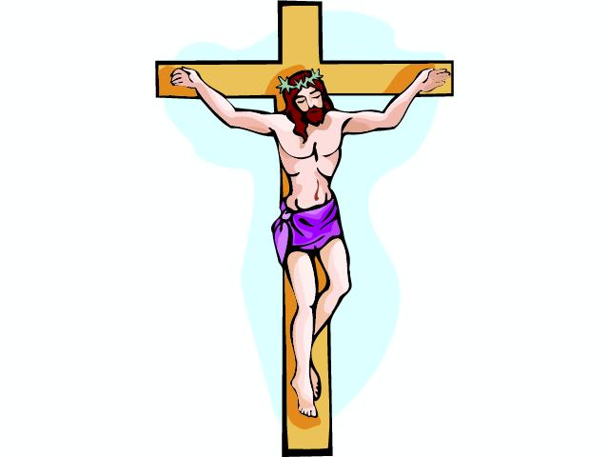

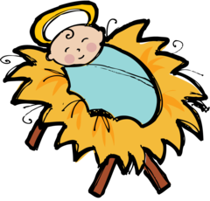
Jesus is Born
Book of Mark
Crucifixion
Last Gospel
THE GAP
33 years
35-45 years
5-15 years

Slide 3
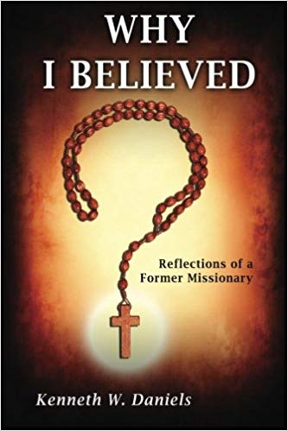
Daniels contends that the discrepancy in the location of Jesus’s post resurrection appearances clearly reveals “an intentional textual manipulation on the part of at least one of the authors” in what is clearly a central element of the story, rendering the historicity of the resurrection accounts suspect.
Kenneth E. Bailey, Ph. D
1930-2016
Notes:
Distinguished by round shaped alter with steps.

Slide 4
Some Gospel Discrepancies
1. The baptism of Jesus
Mark (1:11) and Luke (3:22) The voice from heaven says: “You are my Son, the Beloved; with you I am well pleased.”
Matthew (3:17) the voice says, “This is my Son, the Beloved, with whom I am well pleased.”

Slide 5
Some Gospel Discrepancies
2. The raising of Jairus’ daughter
Mark (5:21-43) and Luke (8:40-56), Jairus urges Jesus to come to his house to heal his daughter who is dying.
Matthew (9:18-26) When Jairus comes to Jesus, his daughter has already died, and his request is not to heal her but to bring her back to life.

Slide 6
Some Gospel Discrepancies
3. The resurrection accounts
-There are differences in the number of witnesses that first arrive at the empty tomb.
-The accounts vary on the time the women approach the tomb.
-There are variations in the way the Gospels report on the messengers at the tomb.
-There are differences in the report of Jesus’ appearances to the women.

Slide 7
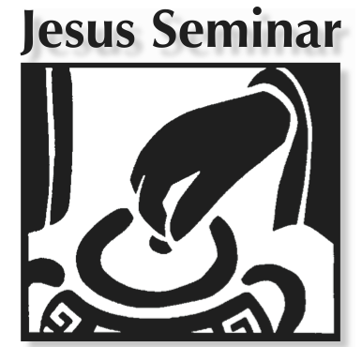
18% - Sayings of Jesus
16% - Deeds of Jesus

Slide 8
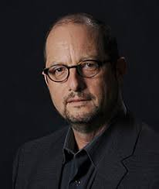
Since 2005, Bart Ehrman has authored four New York Times bestsellers inculcating in various ways the form-critical view for a popular audience.
Bart Ehrman, Ph.D.
University of North Carolina
At Chapel Hill. Bailey, Ph. BBar
Notes:
Distinguished by round shaped alter with steps.

Slide 9

American Bible Skeptics
2010 – 12%
2016 - 22%

Slide 10
MIND THE GAP
The Role of Eyewitness Testimony
The Role of Oral Tradition
The Role of Memory

Slide 11
MIND THE GAP
The Role of Eyewitness Testimony
The Role of Oral Tradition
The Role of Memory

Slide 12
Since many have undertaken to set down an orderly account of the events that have been fulfilled among us, ²just as they were handed on to us by those who from the beginning were eyewitnesses and servants of the word, ³I too decided, after investigating everything carefully from the very first, to write an orderly account for you, most excellent Theophilus, ⁴so that you may know the truth concerning the things about which you have been instructed. (Luke 1:1-4)
Kenneth E. Bailey, Ph. D
1930-2016
Notes:
Distinguished by round shaped alter with steps.

Slide 13
This is the disciple who testifies to these things and who wrote them down. We know that his testimony is true. (John 21:24)
Kenneth E. Bailey, Ph. D
1930-2016
Notes:
Distinguished by round shaped alter with steps.

Slide 14
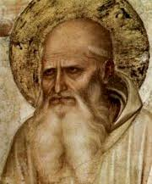
“And if by chance someone who had been a follower of the elders should come my way, I inquired about the words of the elders—what Andrew or Peter said, or Philip, or Thomas, or James, or John, or Matthew, or any other of the Lord's disciples, and whatever Aristion and the elder John, the Lord’s disciples, were saying. For I did not think that information from books would profit me as much as information from a living and abiding voice..”
Papias of Hierapolis
Papias of Hierapolis
Lived 60-130 AD

Slide 15
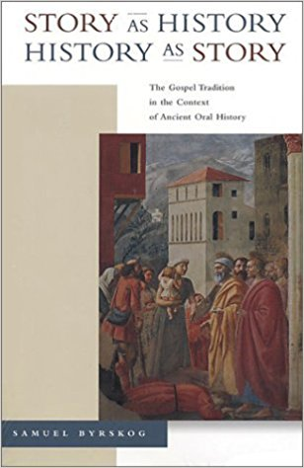
Samuel Byrskog discovered that all the major Greek and Roman historians, including Thucydides, Polybius, Josephus, and Tacitus, wanted to hear from those who had direct experience of the events and who were involved participants.
“Eyes were surer witnesses than ears.”
Heraclitus c. 535 – c. 475 BC
Notes:
Distinguished by round shaped alter with steps.

Slide 16
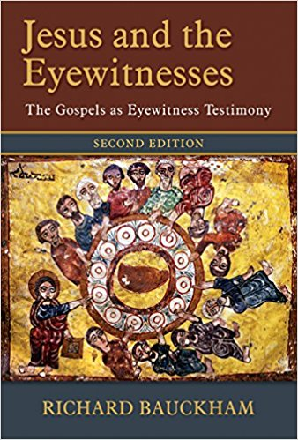
Richard Bauckham discovered that ancient historians inserted in their accounts the names of their eyewitnesses.
Primary eyewitnesses were especially prominent in ancient historical accounts.
The Twelve disciples are the prominent figures in four Gospels, with Peter standing out as the leader.
Peter and the Twelve must have been the authoritative sources and guardians of the Gospels right up to the time when the Gospels were written.
Notes:
Distinguished by round shaped alter with steps.

Slide 17
MIND THE GAP
The Role of Eyewitness Testimony
The Role of Oral Tradition
The Role of Memory

Slide 18
MIND THE GAP
The Role of Eyewitness Testimony
The Role of Oral Tradition
The Role of Memory

Slide 19
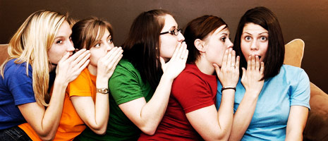
Oral tradition is not like the telephone game.
Notes:
Distinguished by round shaped alter with steps.

Slide 20
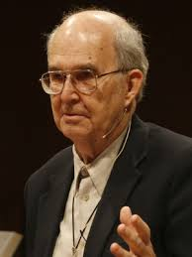
Informal and Controlled oral tradition employed by traditional middle-eastern communities is considered the closest model of oral tradition practices employed by the early Christians.
Kenneth E. Bailey, Ph. D
1930-2016
Notes:
Distinguished by round shaped alter with steps.

Slide 21
Informal:
No official teacher or specifically identified student
Kenneth E. Bailey, Ph. D
1930-2016
Notes:
Distinguished by round shaped alter with steps.

Slide 22
Controlled:
Limits on who can recite
Reciting only done publicly in the gathering
Reciting includes both verbatim and variation in details
Errors in reciting are corrected immediately by the community
Kenneth E. Bailey, Ph. D
1930-2016
Notes:
Distinguished by round shaped alter with steps.

Slide 23
Bailey observed:
“…a story can endure a hundred transmissions through a chain of a hundred and one different people and the inner core of the story remains intact.”
Kenneth E. Bailey, Ph. D
1930-2016
Notes:
Distinguished by round shaped alter with steps.

Slide 24
MIND THE GAP
The Role of Eyewitness Testimony
The Role of Oral Tradition
The Role of Memory

Slide 25
MIND THE GAP
The Role of Eyewitness Testimony
The Role of Oral Tradition
The Role of Memory

Slide 26
“We may conclude that the memories of the eyewitnesses of the history of Jesus score highly by the criteria for likely reliability that have been established by the psychological study of recollective memory.”
          Richard Bauckham
Notes:
Distinguished by round shaped alter with steps.

Slide 27
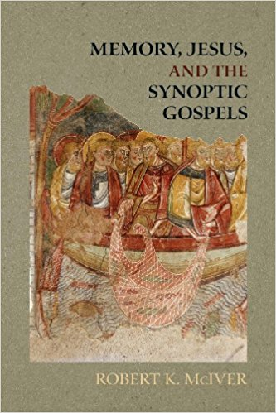
“That the discussion that resulted as various eyewitnesses own memories of the events, and the early Christian communities formulated their own collective memories of Jesus would have lowered this error rate appears likely, given the research into group processes…”
Robert K.McIver
Notes:
Distinguished by round shaped alter with steps.

Slide 28
“It might be concluded, then, that a case can be built to support the assertion that the gospel traditions may be used to form a well-informed broad picture of what Jesus did and said.”
Robert K.McIver
Notes:
Distinguished by round shaped alter with steps.

Slide 29
