Slide 1
Ann Arbor ASA
‘Up and Running’ Series:
JMP
Anamaria S. Kazanis, Pstat
ASKSTATS Consulting
Michigan State University

Slide 2
Disclosure
•Portions of the presentation were taken verbatim from the following sources:
  – JMP 10.0.0 – Help documentation
  – Hinrichs, Curt & Boiler. 2010 JMP Essentials:
  An Illustrated Step-by-Step Guide for New Users.
  Cary, NC: SAS Institute Inc.

Slide 3
Contents
• Introduction
• Launching JMP
• User Interface
• Getting Data into JMP
• Examining Data
• Manipulating Data
• Graphing
• Bivariate Statistics
• Generalized Linear Modeling
• Script

Slide 4
Contents
• Introduction
• Launching JMP
• User Interface
• Getting Data into JMP
• Examining Data
• Manipulating Data
• Graphing
• Bivariate Statistics
• Generalized Linear Modeling
• Script

Slide 5
Introduction
• Interact with data tables and reports
• Compute values using the Formula Editor
• Design experiments
• Use scripting features
• Open SAS data sets, run stored processes, and submit SAS code

Slide 6
Introduction
Terminology
• Data Tables
  – Enter, View, Edit, Manipulate
  – Variable - column
  – Observation – row
• Platform
  – Analyze data
  – Work with Graphs
• Launch windows
  – Set up and run analysis
• Report windows
  – Output of analysis
    • Graph
    • Report
    – Disclosure button
    • Options
    – Hotspots: red triangle menus

Slide 7
Introduction
Hotspots
• JMP uses the space in windows to show results
• Commands that extend the analysis
  – right-clicking inside the outline items
• Hotspots look like a downward red triangle

Slide 8
Contents
• Introduction
• Launching JMP
• User Interface
• Getting Data into JMP
• Examining Data
• Manipulating Data
• Graphing
• Bivariate Statistics
• Generalized Linear Modeling
• Script

Slide 9
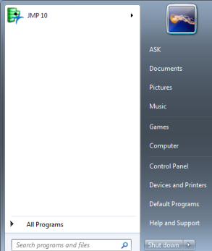

Launching JMP
Start → JMP 10

Slide 10
Contents
• Introduction
• Launching JMP
• User Interface
• Getting Data into JMP
• Examining Data
• Manipulating Data
• Graphing
• Bivariate Statistics
• Generalized Linear Modeling
• Script

Slide 11
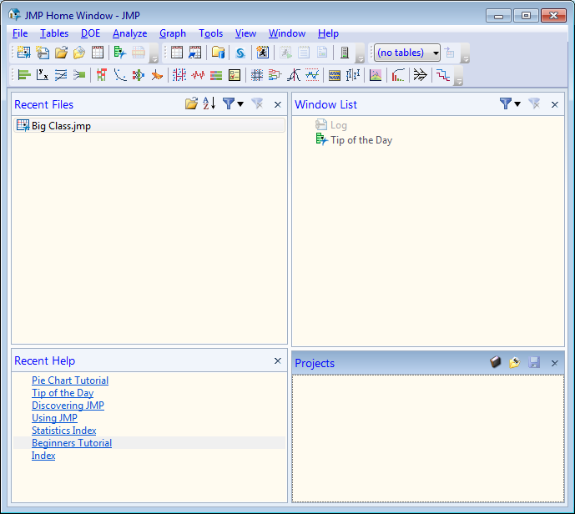
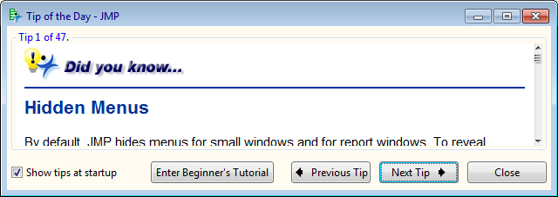
User Interface
Home Window
open recent files
filter recent files
open windows
clear recent files filters
Tip of the Day window
uncheck - Show tips at startup
to not see Tip of the Day window upon launching JMP
Beginner’s Tutorial - basic analysis of data

Slide 12
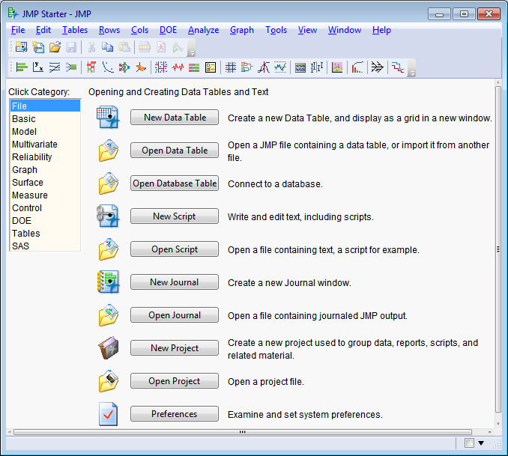
User Interface
JMP Starter Window
Alternative access to most
commands found on the main
menu or on toolbars
View → JMP Starter
File Analyze
Graph
DOE Tables
Interact with SAS

Slide 13
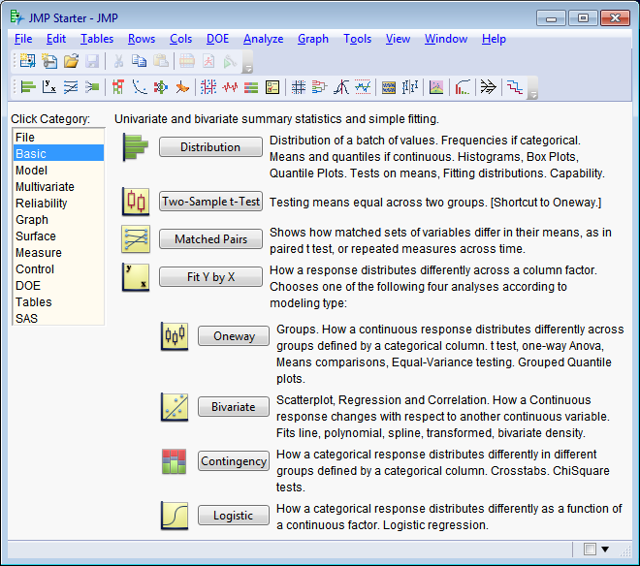
User Interface
JMP Starter Window
Basic
  – Univariate and Bivariate analyses
    • Distributions
    • Single response(y) and a single factor (x)
      – analysis according to whether variables are continuous or categorical

Slide 14
Contents
• Introduction
• Launching JMP
• User Interface
• Getting Data into JMP
• Examining Data
• Manipulating Data
• Graphing
• Bivariate Statistics
• Generalized Linear Modeling
• Script

Slide 15
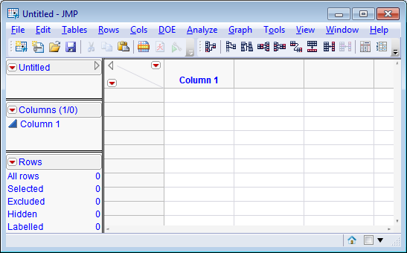
Getting Data into JMP
New Data Tables
File → New → Data Table
  – Empty data table with no rows
  – One numeric column, labeled Column 1

Slide 16
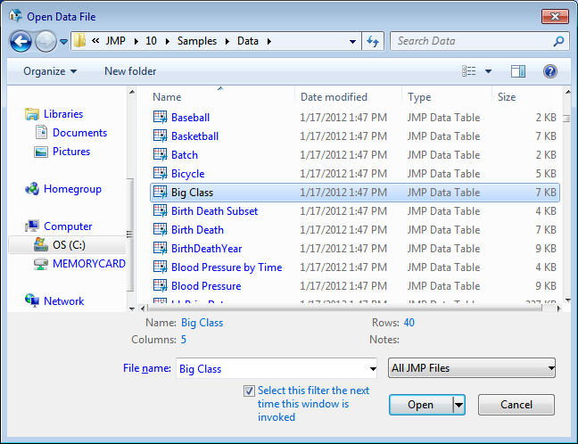
Getting Data into JMP
Sample JMP Files
File → Open → C:\Program Files (x86)\SAS\JMP\10\Samples\Data\Big Class.jmp

Slide 17
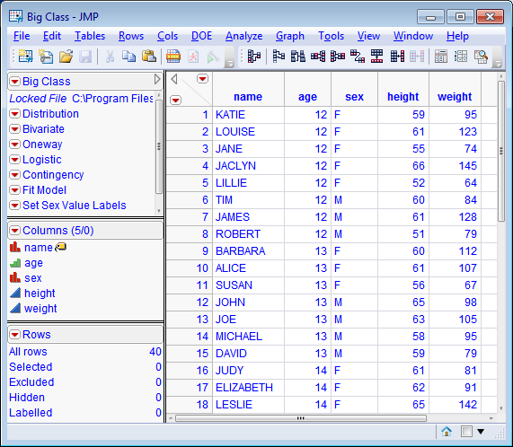
Getting Data into JMP
Sample JMP Files
Sample Data
  –Big Class.jmp

Slide 18
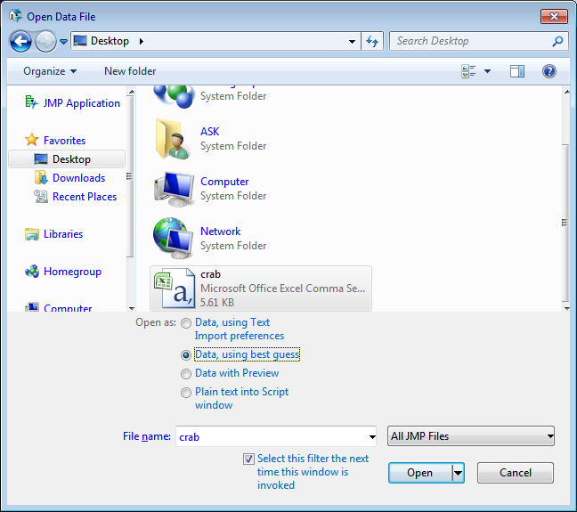
Getting Data into JMP
Importing an Excel *.csv file
• File → Open
Open as:
Data, using best guess
crab.csv

Slide 19
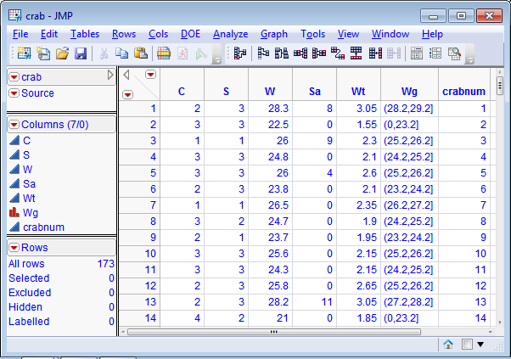
Getting Data into JMP
Importing an Excel *.csv file
Excel
  crab.csv
File → Save as
  crab.jmp

Slide 20
Getting Data into JMP
Import Data
Default
•Comma-separated (.csv)
•.dat files that consist of text
•ESRI shapefiles (.shp)
•Flow Cytometry versions 2.0 + 3.0(.fcs)
•HTML (.htm, .html)
•Microsoft Excel 1997–2003 (.xls)
•Minitab (.mtw, .mtp, but not .mpj)
•Plain text (.txt)
•SAS transport (.xpt, .stx)
•SAS versions 6–9 on Macintosh
  – (.sas7bdat, .ssd, .ssd01, .saseb$data)
•SAS versions 6–9 on Windows
  – (.sd2, .sd5, .sd7, .sas7bdat)
•SPSS files (.sav)
•Tab-separated (.tsv)
ODBC drivers
• Database (dBASE) (.dbf, .ndx, .mdx)
  – supported with a V3+ compliant driver
• Microsoft Access Database (.mdb)
  – supported with a V3+ compliant driver
• Microsoft Excel 2007 (.xlsm, .xlsx, .xlsb)
  – supported with a V3+ compliant driver
  – 64-bit JMP requires a 64-bit driver

Slide 21
Contents
• Introduction
• Launching JMP
• User Interface
• Getting Data into JMP
• Examining Data
• Manipulating Data
• Graphing
• Bivariate Statistics
• Generalized Linear Modeling
• Script

Slide 22
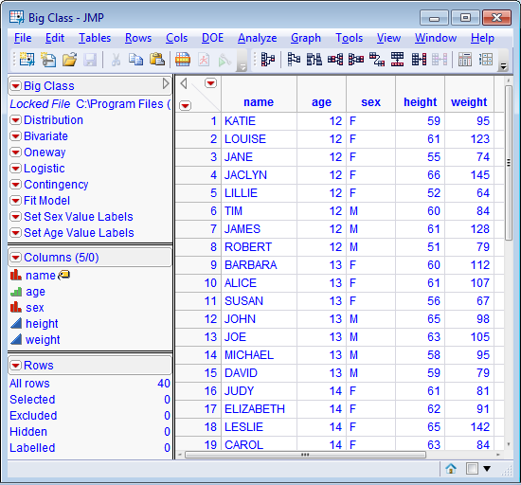
Examining Data
Data Table
•Spreadsheet-like grid
•Metadata
  –Three panels on the left
  –Information about data
•Structured data
  –Columns
    •variables
  –Rows
    •Observations
    •Cases

Slide 23

Examining Data
Data Table Panels
table options
script options
column options
  modeling type :
    nominal
    ordinal
    continuous
row options
data table name
table variable
table scripts

Slide 24
Contents
• Introduction
• Launching JMP
• User Interface
• Getting Data into JMP
• Examining Data
• Manipulating Data
• Graphing
• Bivariate Statistics
• Generalized Linear Modeling
• Script

Slide 25
Manipulating Data
• Data and Modeling Types
• Formatting
• Visual Dimension
• Tables

Slide 26
Manipulating Data
• Data and Modeling Types
• Formatting
• Visual Dimension
• Tables

Slide 27
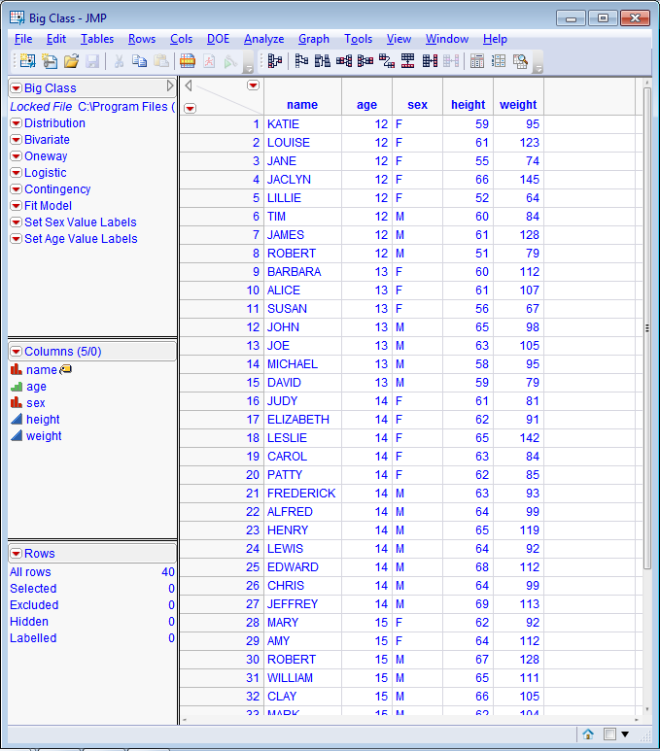
Manipulating Data
Data and Modeling Types
•Data Types – nature of data
  –Numeric – number
  –Character – category
•Modeling Types
  –Nominal – categorical data
    •discrete, count, attribute
    •character or numeric
  –Ordinal – categorical data
    •order, hierarchy
    •categories with sequence or order
    to be retained in any analysis
  –Continuous
    •ratio, interval scale
    •numeric

Slide 28
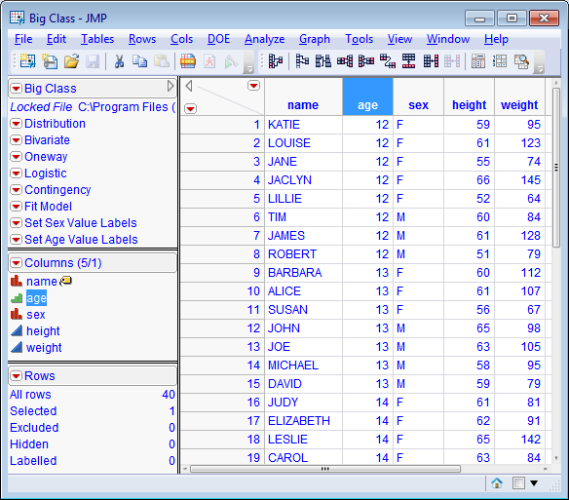
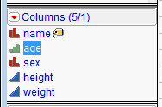
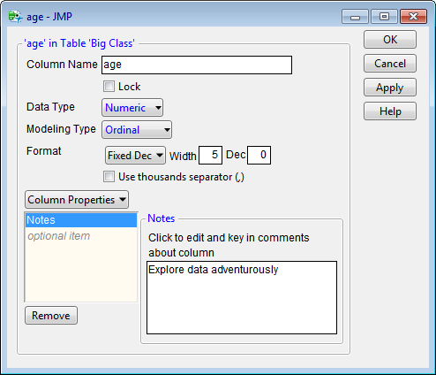
Manipulating Data
Changing Modeling Type
• Changing types affects the graphs or statistics that can be generated for the column
Click icon by column name
Double-click area above an existing column name

Slide 29
Manipulating Data
• Data and Modeling Types
• Formatting
• Visual Dimension
• Tables

Slide 30
Manipulating Data
Formatting
• Cleaning up data format
  – Decimal places
  – Dates
  – Times
  – Currency
• Formula editor
  – New columns from old ones
  – Add IF statements
  – Transform data
• Recode
  – Merge similar responses into a single category

Slide 31
Manipulating Data
Formatting
• Cleaning up data format
  – Decimal places
  – Dates
  – Times
  – Currency
• Formula editor
  – New columns from old ones
  – Add IF statements
  – Transform data
• Recode
  – Merge similar responses into a single category

Slide 32
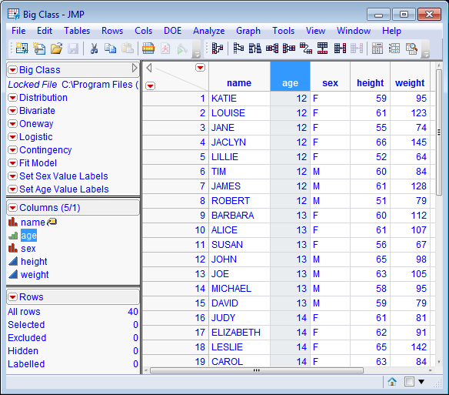
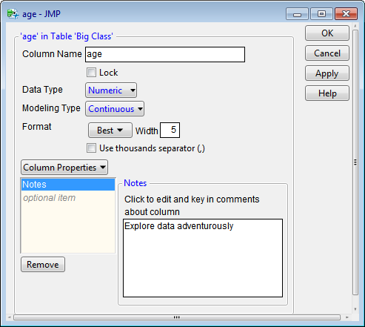
Manipulating Data
Formatting – Cleaning up data format
Double-click area above
an existing column name
• Right-click column name
→ select Column Info

Slide 33
Manipulating Data
Formatting
• Cleaning up data format
  – Decimal places
  – Dates
  – Times
  – Currency
• Formula editor
  – New columns from old ones
  – Add IF statements
  – Transform data
• Recode
  – Merge similar responses into a single category

Slide 34
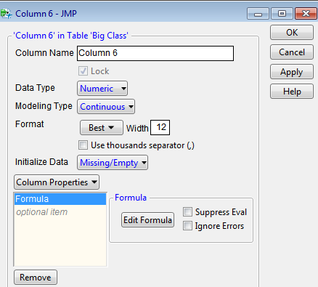
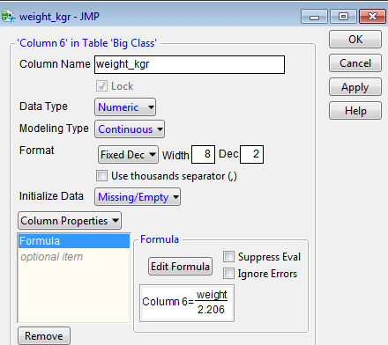
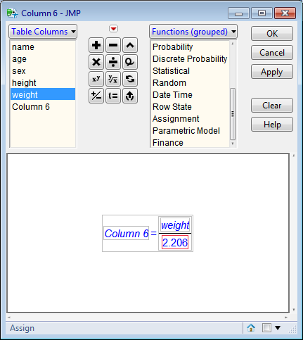
Manipulating Data
Formatting – Formula Editor
• Create new column
  – Values calculated or
  derived from existing
  columns
• Transform data
• Add conditional statements

Slide 35
Manipulating Data
Formatting
• Cleaning up data format
  – Decimal places
  – Dates
  – Times
  – Currency
• Formula editor
  – New columns from old ones
  – Add IF statements
  – Transform data
• Recode
  – Merge similar responses into a single category

Slide 36
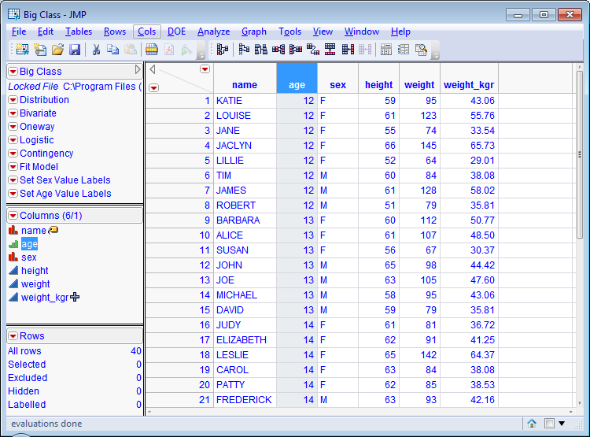
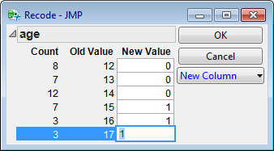
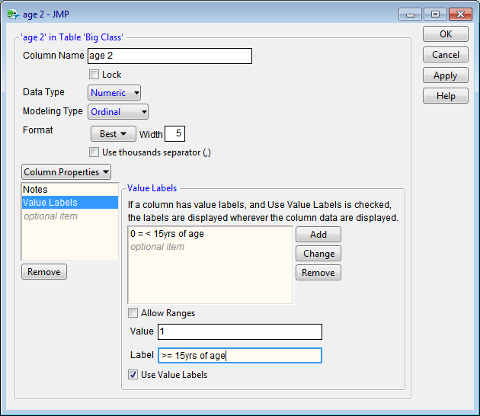
Manipulating Data
Formatting – Recode
Example
Consolidate values from AGE in two groups
Click: age → Click: Cols → Select: Recode→
Assign New Value: 0, 1→ OK
Right click: age 2 → Select: Column Info… →
Select Modeling Type: Ordinal
Column Properties: Values Labels
OldValue NewValue NewValueLabel
12, 13, 14 0 < 15yrs of age
15, 16, 17 1 >=15yrs of age
Help → Sample Data→Examples for teaching→Big Class

Slide 37
Manipulating Data
• Data and Modeling Types
• Formatting
• Visual Dimension
• Tables

Slide 38
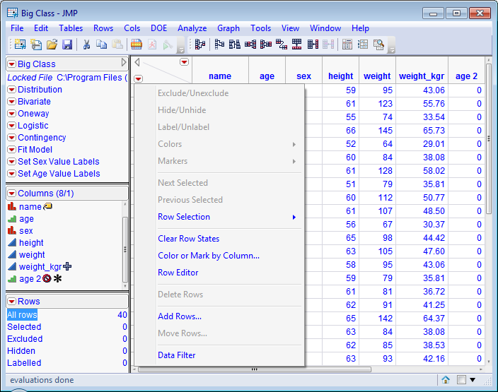
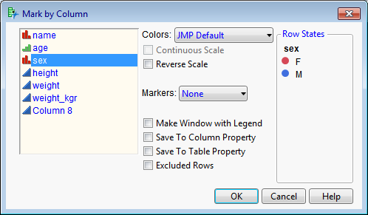
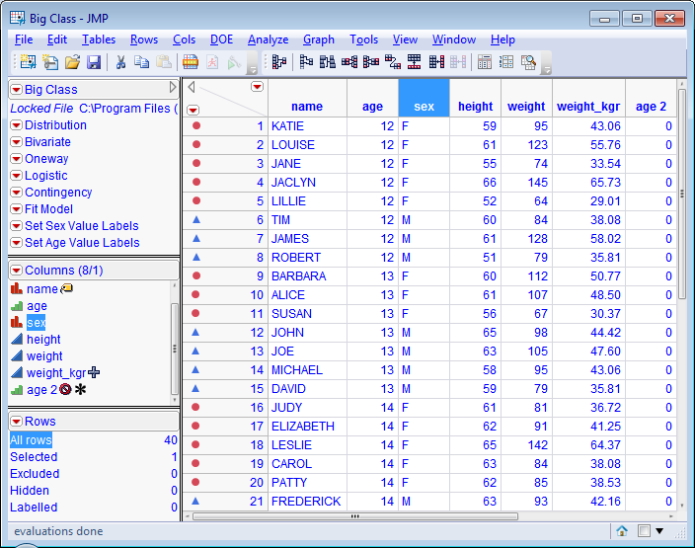
Manipulating Data
Visual Dimension
• Color or Mark by Column
  – Colors
  – Unique Markers
  – Range
  – Value
• Access the Rows menu:
select the rows hotspot
Color or Mark by Column
OK
Help → Sample Data → Examples for teaching → Big Class

Slide 39
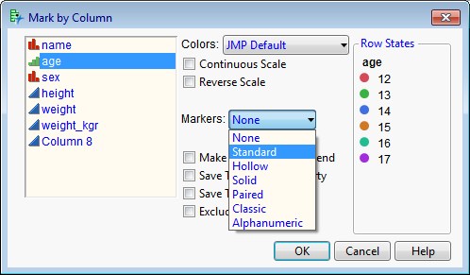
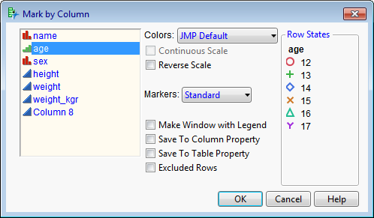
Manipulating Data
Visual Dimension
Distinguish points by
using unique markers
  –Symbols
    •Standard
    •Hollow
    •Solid
    •Paired
    •Classic
  –Alphanumeric

Slide 40
Manipulating Data
• Data and Modeling Types
• Formatting
• Visual Dimension
• Tables

Slide 41
Manipulating Data
Tables
• Structure data into form that JMP will recognize
  – Summary
  – Sorting
  – Joining
  – Dealing with missing data

Slide 42
Manipulating Data
Tables
• Structure data into form that JMP will recognize
  – Summary
  – Sorting
  – Joining
  – Dealing with missing data

Slide 43
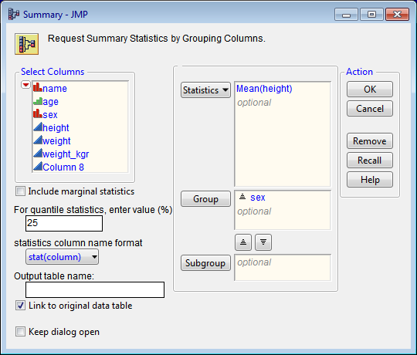
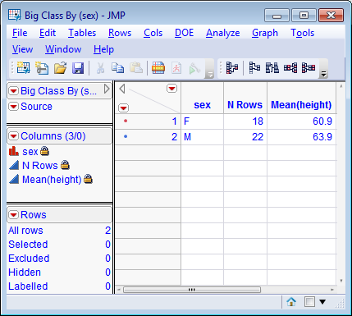
Manipulating Data
Tables - Summary
Summary statistics
Tables → Summary
  – Select Columns: height →
  Statistics: Mean (height)
  – Select Columns: sex →
  Group: sex
  – Action: OK
Help→ Sample Data→ Examples for teaching→ Big Class

Slide 44
Manipulating Data
Tables
• Structure data into form that JMP will recognize
  – Summary
  – Sorting
  – Joining
  – Dealing with missing data

Slide 45
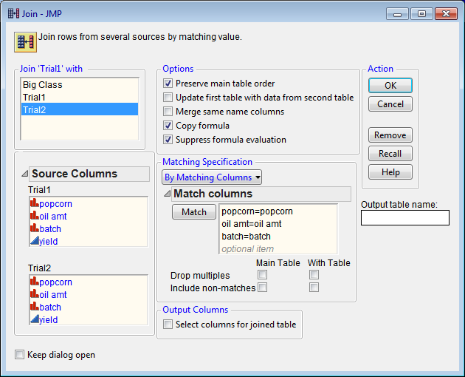
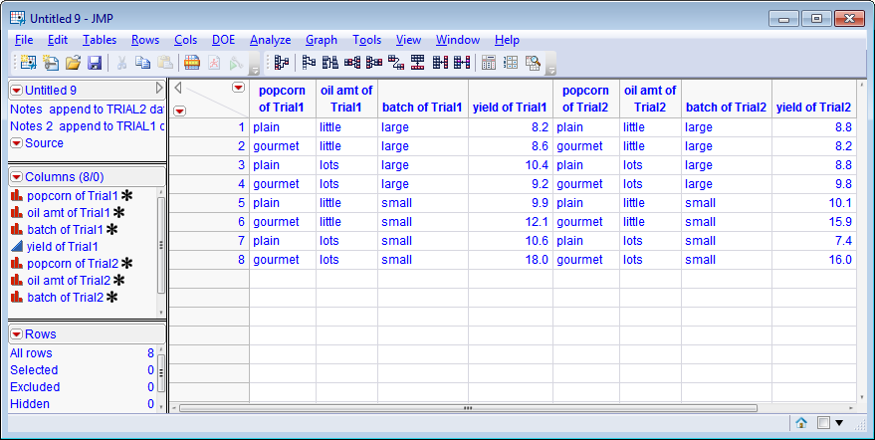
Manipulating Data
Tables - Joining
• Combine or merge two or more different data tables into one
Trial1 → Tables → Join
    – Join ‘Trial1’ with: Trial2
    – Source Columns: Trial1, Trial2
        From each source select :
        Popcorn, oil amt, batch
  → Match
    – Output table name: Popcorn joined
  Action: OK
Help → Sample Data → Open the Sample Data Directory
→ Trial1 → Open
→ Trial2 → Open

Slide 46
Manipulating Data
Tables
• Structure data into form that JMP will recognize
  – Summary
  – Sorting
  – Joining
  – Dealing with missing data

Slide 47
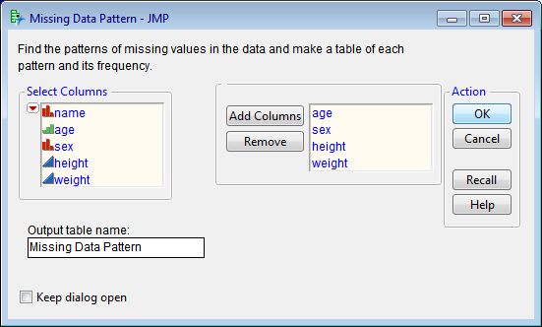
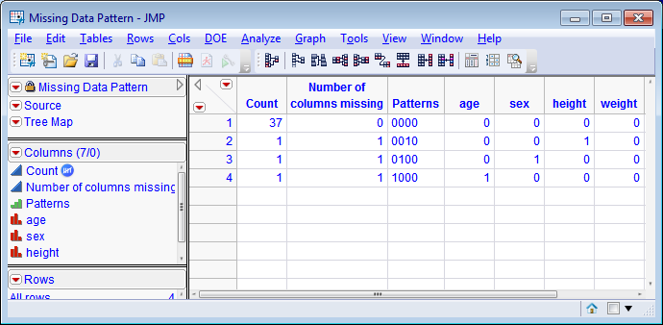
Manipulating Data
Tables – Missing Data
For this example,
delete some data from ‘Big Class’
• Identify quantity of missing data
• Existence of patterns
  – Non-response
  – Data importing
  – Data entry errors
Tables → Missing Data Pattern
Select Columns: age, sex, height, weight →
Add Columns → Action: OK
Help→ Sample Data→ Examples for teaching→ Big Class

Slide 48
Contents
• Introduction
• Launching JMP
• User Interface
• Getting Data into JMP
• Examining Data
• Manipulating Data
• Graphing
• Bivariate Statistics
• Generalized Linear Modeling
• Script

Slide 49
Graphing
• Graphs of One Column
  – Distribution – examine data
  – Normal Quantile Plot
  – Time Series
• Comparing Two Columns
  – Fit Y by X
• Graph Builder

Slide 50
Graphing
• Graphs of One Column
  – Distribution – examine data
  – Normal Quantile Plot
  – Time Series
• Comparing Two Columns
  – Fit Y by X
• Graph Builder

Slide 51
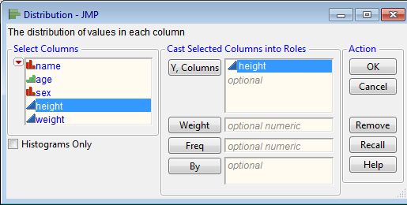
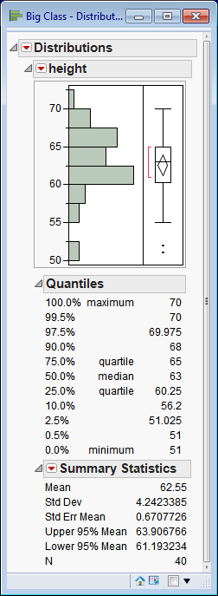
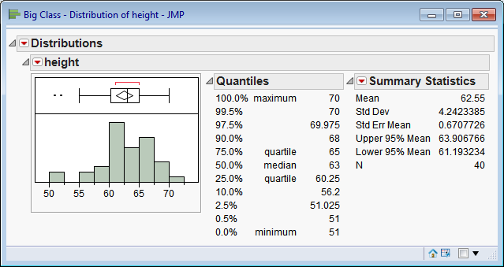
Graphing
One Column - Distribution
• Continuous
  – Shape
  – Range
  – Data density
Analyze → Distribution
Select Columns: height
Y, Columns: height
Action: OK
Help → Sample Data → Examples for teaching → Big Class
height
Display Options → Horizontal Layout

Slide 52
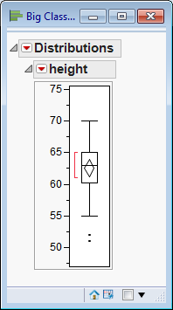
Graphing
One Column - Distribution
• Outlier Box Plot
  – Chart for detecting extreme values
  – Properties of a continuous distribution
• Quartiles
• Moments
• Outliers
Analyze → Distribution
height → Outlier Box Plot
Help → Sample Data → Examples for teaching → Big Class

Slide 53
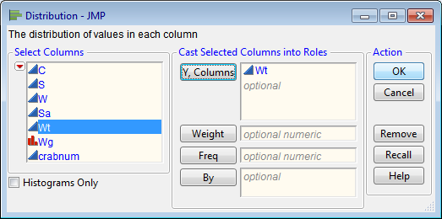
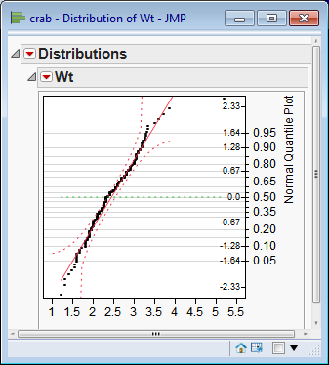
Graphing
One Column – Normal Quantile Plot
– Chart for visualizing the extend to which a column is normally distributed
  • Points would fall upon the line
  • Point would not fall beyond confidence curves
Analyze → Distribution
Select Columns: Wt → Y, Columns: Wt
→ Action: OK
Wt → Normal Quantile Plot
CRAB data
Agresti, 2002, p.127

Slide 54
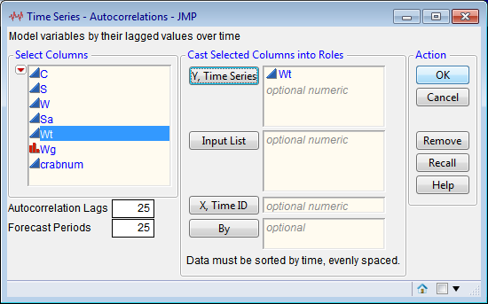
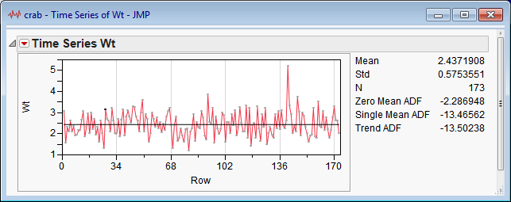
Graphing
One Column – Time Series
• Separate platform
  – Forecasting techniques
  – Statistical Results
• Graph of numeric variable
  Random sample from population
    Independent and identically distributed (i.i.d.)
    Check: Time Series
• View and fit
  – variability over time
  – potential seasonality of a variable over time
Analyze → Modeling → Time Series
Select Columns: Wt →
Y, Time Series: Wt → Action: OK
CRAB data
Agresti, 2002, p.127

Slide 55
Graphing
• Graphs of One Column
  – Distribution – examine data
  – Normal Quantile Plot
  – Time Series
• Comparing Two Columns
  – Fit Y by X
• Graph Builder

Slide 56
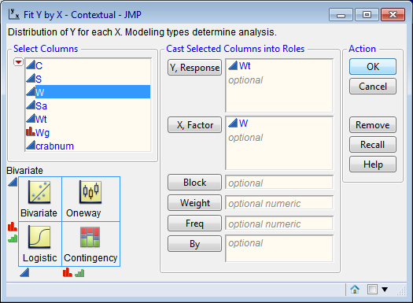
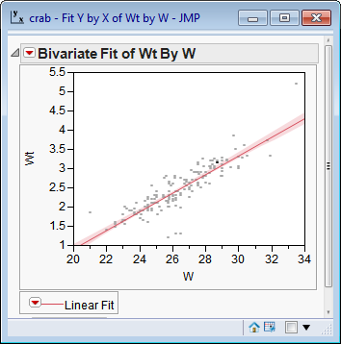
Graphing
Comparing Two Columns – Fit Y by X
• Relationship of two columns
• Graph are always based on Modeling Type
  – Continuous
  – Nominal
  – Ordinal
• Matrix in Fit Y by X window provides visual preview of graphs
  – See icons on margin of matrix
Analyze→ Fit Y by X → Y, Response: Wt
X, Factor : W
Bivariate Fit of Wt By W → Fit Line
Linear Fit → Confid Shaded Fit
CRAB data
Agresti, 2002, p.127

Slide 57
Graphing
• Graphs of One Column
  – Distribution – examine data
  – Normal Quantile Plot
  – Time Series
• Comparing Two Columns
  – Fit Y by X
• Graph Builder

Slide 58
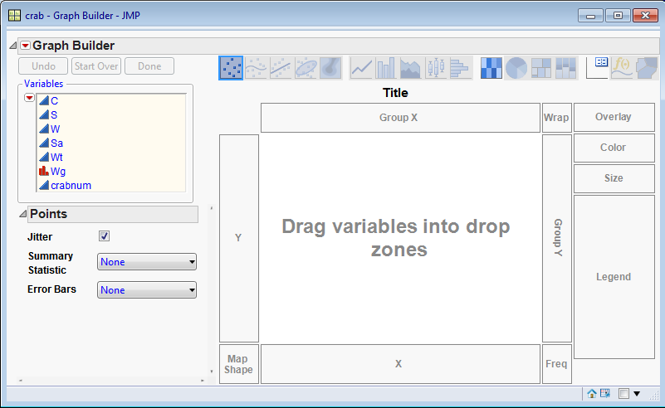
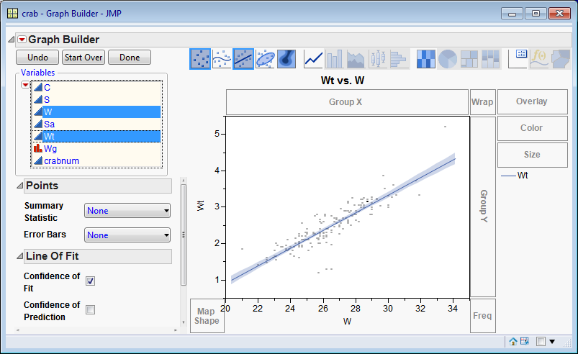
Graphing
Graph Builder
• Visual initial data exploration
• Works in drag-drop manner
  – Select column
  – Drag to desired zone
Graph → Graph Builder
CRAB data
Agresti, 2002, p.127

Slide 59
Contents
• Introduction
• Launching JMP
• User Interface
• Getting Data into JMP
• Examining Data
• Manipulating Data
• Graphing
• Bivariate Statistics
• Generalized Linear Modeling
• Script

Slide 60
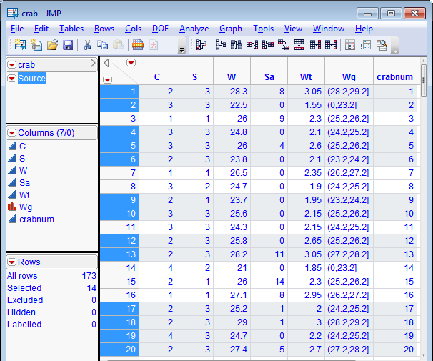
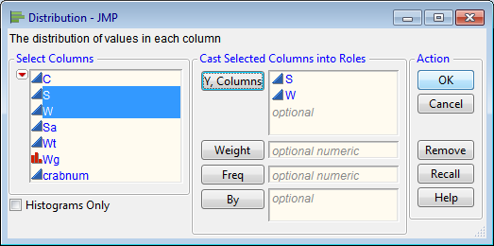
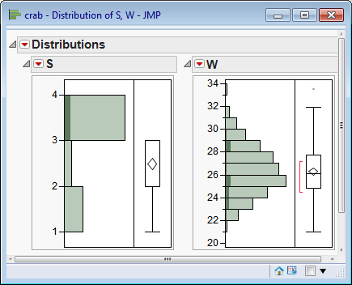
Bivariate Statistics
Comparing One Column to Another
Analyze → Distribution
Dynamic Link of Graphs and data
CRAB data
Agresti, 2002, p.127

Slide 61

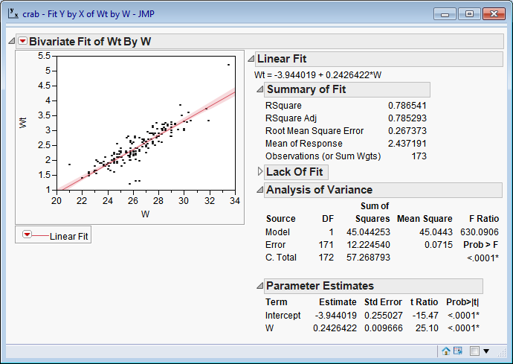
Bivariate Statistics
Comparing One Column to Another
Fit Y by X Relationship of one column
to another column. Modeling type
of the column determines the type
of analysis that is produced. Picture
previews are references of the kind
of analysis, according to the
modeling type of the columns.
CRAB data
Agresti, 2002, p.127

Slide 62
Contents
• Introduction
• Launching JMP
• User Interface
• Getting Data into JMP
• Examining Data
• Manipulating Data
• Graphing
• Bivariate Statistics
• Generalized Linear Modeling
• Script

Slide 63


Generalized Linear Modeling
Poisson Regression
Analyze → Fit Model
Y → Sa - number of satellites
Construct Model Effects →
Add: W – carapace width
Personality: Generalized Linear Model
Distribution: Poisson
Link Function: Log
CRAB data
Agresti, 2002, p.127

Slide 64
Contents
• Introduction
• Launching JMP
• User Interface
• Getting Data into JMP
• Examining Data
• Manipulating Data
• Graphing
• Bivariate Statistics
• Generalized Linear Modeling
• Script

Slide 65

Script - JSL
• JSL: JMP Scripting Language
• Open a data table and make changes
  – add rows and columns
  – change values
  – make a formula column
  – run analyses

Slide 66

Script
File → New → Script
Type:
current data table () <<get script;
Select text:
→ Edit → Run Script
→ View → Log
Help → Sample Data → Examples for teaching → Big Class

Slide 67

QUESTIONS

Slide 68
JMP Use www.jmp.com/applications
Analytical Application Development
Data Visualization
Design of Experiments
Exploratory Data Analysis
Modeling and Predictive Analytics
Quality Improvement
Reliability
Six Sigma
Statistics

Slide 69
JMP
Why JMP Pro v10
Why JMP v10

