Slide 1

A website for young statistics professionals navigating a data-centric world
A central location for young professional statisticians
Career information and resources
Information about ASA and the statistics profession
Membership in ASA is not needed to access the website
http://stattrak.amstat.org/
Notes:
What is it?
Website that provides a central location for young professional statisticians to access career information and resources, as well as to learn more about the ASA and the statistics profession.
Who is it for?
Individuals who are in a statistics program, recently graduated from a statistics program, or who recently entered the job world.
How do I find it?
Individuals do not have to be a member of ASA to access the website
http://stattrak.amstat.org

Slide 2

What It Provides
Articles and career advice to help new statisticians advance their careers, e.g.
Tips for statisticians starting a career in business
Advice, professional development tips for graduate students
Making the transition from coursework to research
Some advice for beginning graduate students in statistics
Frequently Updated
Notes:
What It Provides
STATtr@k site features articles and career advice, most written by ASA members, which will help new statisticians advance their careers.
Examples of recent articles include:
Tips for statisticians starting a career in business
Advice, professional development tips for graduate students
Making the transition from coursework to research
Some advice for beginning graduate students in statistics
Content is updated monthly, usually by the 10th of every month

Slide 3
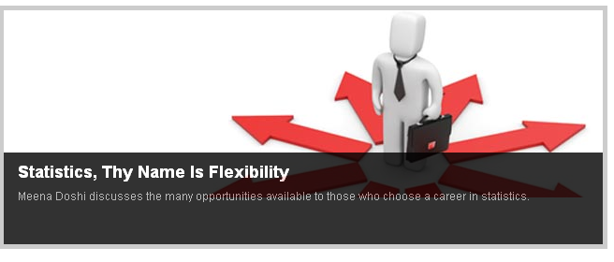
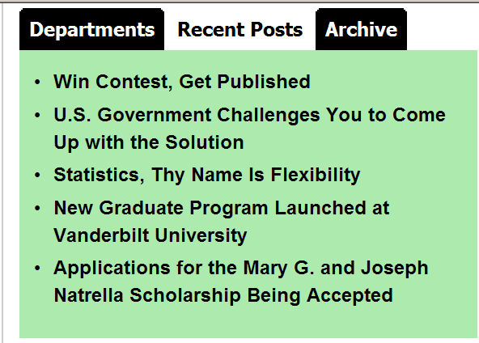
Supports Job Searching
Announcements
Information on conferences, competitions, and other items of interest
Internships
List of internships maintained by ASA
News Articles
Links to recent news articles of interest
STATtr@k does not provide job listings or job posting capabilities, but….
http://www.amstat.org/jobweb
Notes:
Supports Job Searching
STATtr@k provides information helpful for career development
“News and Announcements” section with information on conferences, competitions, and other items of interest
List of internships that is maintained by the ASA
“Making News” link to recent news articles of interest to young professionals
STATtr@k does not provide job listings or job posting capabilities
http://www.amstat.org/jobweb link to job postings listed on ASA

Slide 4

Get Involved
Open invitation to utilize the website
Do not need to be a member of ASA
Can join ASA from the STATtr@k website
Wish to contribute?
….
….
Notes:
Get Involved!
STATtr@k is open to everyone via the website
In addition, individuals can become a member of ASA and can join on the STATtr@k website.
A student membership is $15 per year, and post-graduate membership is available for $55 per year. (dollars in notes)
How to contribute (Need contact information/or other information on how a statistician can contribute to the website?? )

