Slide 1
CE Courses at JSM and Other Meetings
Want to take a course?
More than 20 courses offered at JSM
  Duration: 4 hr to 2 day
  Statistical Theory to Effective Consulting
Notes:
JSM and other ASA sponsored meetings are a traditional venue for picking up new skills.
Want to take a course? Last year JSM offered more than 20 short courses ranging from a few hours to 2 days, and covering a broad range of topics. The Conference on Statistical Practice had 10 courses covering topics like “Analyzing Messy Data” to “Managing Your Time and Priorities”.

Slide 2
CE Courses at JSM and Other Meetings
Submit Proposal to Advisory Committee for Continuing Education
Guidelines on ASA website - Education tab
Want to give a course?
Notes:
Want to give a course? The ASA welcomes proposals for new short courses. Guidelines are available on the web-site.

Slide 3
What if I can’t go to JSM?

Slide 4
Web-based Lectures
Seminar conducted over World Wide Web
Generally sponsored by Sections
Occur throughout the year
Interactive
Notes:
Beyond JSM, the ASA education office regularly hosts educational webinars that are sponsored by groups like the BioPharmaceutical Section, or the Section for Statistical Programmers and Analysts.
A webinar is a seminar conducted over the World Wide Web. The webinar is “live’’, with a starting and ending time. Listeners can ask questions, usually by typing into a box on the screen, and the lecturer can answer. Electronic copies of the ‘slides’ can be downloaded. Webinars are available to anyone, but members of the sponsoring section get a discount, and any number of people can be in the room watching.

Slide 5
Can I view Webinars on my own schedule?

Slide 6

Previous webinars available on pay-per-view basis
LearnSTAT OnDemand catalog
Unrestricted number of viewers at same connection
Notes:
LearnSTAT OnDemand is an extension of the popular live webinar program.
Previous webinars are recorded and made available on a “pay-per-view” basis. Cost is $60 for ASA members and $85 for non-members, but any number can watch from the same connection.
Go to the LearnSTAT OnDemand catalog to see a list of offerings.
In additional to personal education, this can be a good lunchtime activity with colleagues, or a low-cost option for a chapter educational event.

Slide 7
Can we bring in “live” courses for a chapter or department event?

Slide 8
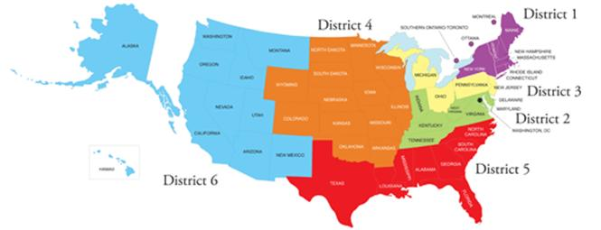
Council of Chapters Traveling Courses
Council of Chapters covers: Speaker travel expenses, honoraria, and course materials
Sponsor Chapter covers: Advertising, local arrangements, and registration ($500 go back to ASA???)
Notes:
As another continuing education option, the Council of Chapters’ “Traveling Courses” provide low cost, high quality, in-person local courses to ASA Chapters. The Council of Chapters sponsors this activity by covering speaker travel expenses, honoraria, and course materials. The Chapter, in turn, covers advertising, local arrangements (including hotel and local travel) and registration ($25 for each attendee or $500 to go back to the ASA).
This year’s courses include “Applied Mixed Models”, “Applied Survival Analysis”, and “Monte Carlo Methods with R”. Application forms are on the ASA website. A traveling course can be a great local chapter activity.

Slide 9
Continuing Education: Not just JSM!!
CE Courses at JSM
Web-based Lectures
LearnSTAT OnDemand
Council of Chapters Traveling Courses
http://www.amstat.org/education/index.cfm
If you have questions about anything related to Continuing Education, please contact Rick Peterson at rick@amstat.org
Notes:
As you can see, there are lots of opportunities to continue your education through the ASA, and continuing education is not just JSM!! See the ASA website under the Education TAB, or contact Rick Peterson for more information.

