Slide 1
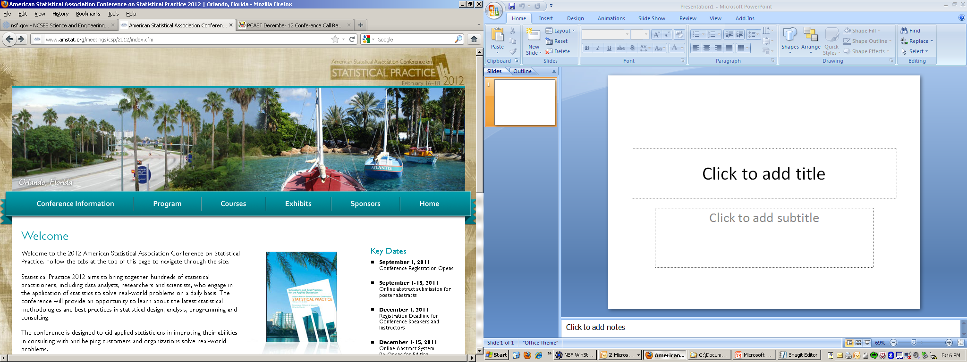
Conference on Statistical Practice
Aimed at professionals who engaged in:
  Statistical analysis
  Statistical design
  Statistical consulting
Notes:
CSP is different from JSM. JSM, Joint Statistical Meetings, is the largest annual meeting of statisticians held in North America. JSM is done in conjunction with several statistical societies and is lead by the American Statistical Association. CSP, Conference on Statistical Practice, started in 2012, has a different focus.
Purpose
The purpose is to serve the needs of those who engage in statistical analysis, design, and consulting as a major component of their job
Format of meeting is different
The conference is a three-day event with an opening plenary session, full- and half-day short courses, concurrent invited paper and contributed poster sessions, innovative tutorials and exhibits, a closing session. Specifically designed not to overlap with JSM.
Focus on applied topics
Specific focus on applied topics which will vary from year to year. In 2012, the applied focus is on business analytics and R&D, operations and engineering.
Educational component focused on soft skills
Short courses will be aimed at communication, impact, and career development.
Location will vary every year (same as JSM)
http://www.amstat.org/meetings/csp/2013/conferenceinfo.cfm

Slide 2
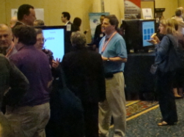
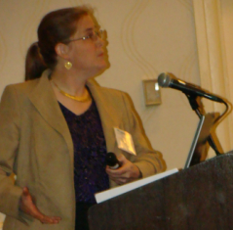
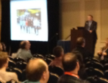
At the CSP, you can:
Meet other statisticians, data analysts, and researchers
Take short courses on communication, impact, and career development
Attend sessions that focus on selected technical themes in applied topics
Notes:
Meet other:
Statisticians
Data analysts
Researchers
Scientists
Take short courses
Topics include areas such as networking, collaborating across disciplines, best practices in statistical consulting, and accreditation.
Focus on applied topics
Learn new statistical methodologies and best practices in statistical analysis, consulting, and statistical programming.

Slide 3

Attend CSP 2013
Next year: February 21 - 23, 2013
New Orleans, LA
Technical themes
1: Data Collection and Analysis
2: Prediction and Analytics
3: Software and Graphics
Career themes
1: Effective communication
2: Management skills
3: Leadership skills
Notes:
Where:
Planned as an annual conference. Conference locations will change yearly. In 2012, CSP was held in Orlando, FL. The 2013 CSP is planned for New Orleans, LA.
How to participate?
Attendance is open to all
Invited presenters are determined by the Conference committee
Abstracts may be submitted for contributed posters. Proposals are due May 11, 2012 for CSP 2013.

Slide 4

Help organize CSP
CSP Steering Committee
http://www.amstat.org/committees/committeelist.cfm
Notes:
Organizing body
The Conference on Statistical Practice Steering Committee has six members appointed by the ASA President-Elect and up to nine more members appointed by the chair of the CSPSC.
Volunteer for planning committee
http://www.amstat.org/committees/committeelist.cfm

