Slide 1

How to Write an “A” Paper
Gerald C. Kane, University of Georgia

Slide 2

Disclaimer and background
Story of where this paper came from (in two parts).
Insights gathered from:
  Explicit lessons during Ph.D. work
  Reviewers’ comments on my submissions.
  Advice that I most frequently pass on during editorial work.
Expressly written in light of Baird (2001).
  I intentionally did not duplicate his insights, particularly where I agreed (else, why write it?)
  I sought to disagree where possible to provide a little creative tension.
This is just one (my) approach. Others are undoubtedly valid.

Slide 3
What a paper is not:
A simple report of your research
You are NOT simply writing what you did (I see this all the time).
You tell a story about why your research and its findings are important.
You are not lying or misrepresenting what you did, you are simply framing your research in the most compelling way possible.
Less is More: Leave it out if it doesn’t help you tell this story.
  Removing material from the paper may be the most important, difficult, and often overlooked decision (story of my dissertation paper).
  You may leave out entire ideas or lines of inquiry that didn’t pan out, potentially saving them for another paper.
  Months of work and entire tables may be boiled down into simple sentences or footnotes.
  Less content means less for reviewers to complain about.

Slide 4
insights BEFORE YOU START WRITING
Your target audience is first-year doctoral students.
One reviewer misunderstood this as ONLY first-year doctoral students, which is not what I mean.
Instead, make it accessible to our field's broadest audience (I differ from Baird here).
First, start with an interesting research question.
A practice I learned from my “writing poems” class in undergraduate. Start with a list of 10 rhymes, throw that list as too obvious and start with #11.
Not literal, but many researchers seem to explore the most obvious question available in a setting or a dataset. Dig deeper! (e.g., MISQ Wikipedia Paper).
Aim for the “minimum publishable unit.”
A paper is always about one and only one thing (see slide 6).
As a result, I’m a big fan of the “Research Note” category, and I have used it as a successful editorial strategy.

Slide 5
my formula for “A” papers
Title and Abstract
Introduction
Theory Section
Methods and Setting
Discussion and Conclusion
Conclusion

Slide 6
Title and Abstract:
“The First Shall be Last”
I underappreciated the value of the title and abstract earlier in my career (Kane and Fichman 2007 example).
These draw an audience to your paper, and this audience will cite your work.
Citations are critical later in your career, but the early papers can have the greatest impact.
Disclaimer: I am terrible at titles.
Hearing Berente and Recker discuss my paper on their podcast, it seems I’m not alone here.
JAIS could likely do the whole workshop on this point alone.
But titles are essential for attracting an audience. Don’t overlook it, or get too fancy.
Think of it as “Search Engine Optimization” for your paper.
Don’t worry about this part too much until a paper has been accepted.
Submitted papers already have an audience – editors and reviewers.

Slide 7

Introduction:
Where I spend the most time writing
Word-for-word, I spend more time on the introduction than any other part of the paper.
It makes a succinct case for why your paper is important and why reviewers should care.
The introduction should be 2 – 2.5 pages maximum (Thank You Peter Gray, UVA).
  If you can’t get it down to that, you don’t yet know what the paper is about.
  I spend a TON of time on this process, moving material between the introduction and elsewhere.
  Papers with 5-7 page introductions (about 50% of those I see) rarely make it far because reviewers don’t know why they should care or what they should pay attention to.
It should answer the question, “what will a reader get wrong if they don’t read your paper?” (Thank You, Brian Butler, UA).
  It seems like a high bar, but that’s what it takes.
  Don’t say, “this has never been studied before.” It may not have been studied because it’s not important.
  Don’t use the word “wrong,” but extension, clarification, revisiting assumptions, etc. (e.g. Davis 1971)

Slide 8
Theory section:
An Unorthodox view
This is not a “literature review.” A paper is not a doctoral dissertation.
It builds a compelling case for why you would expect something to be true (or not) based on previous research.
My experience is that junior faculty and doctoral students tend to get pushed around by the literature.
Use the literature to support your argument, don’t expect to draw your argument from it.
I start without the literature and build a 3-6 point logical argument for my hypothesis.
Fill in the literature later. If literature is not relevant to one of these points, leave it out.
Like Baird’s advice of choosing one classic and one newer reference to “bookend” the idea.
Don’t write “Authors (year) found that…..” – it smacks of a literature review - the idea is important, but the researchers aren’t.

Slide 9
Methods and setting:
“All the news that Fits”
Here’s where you present the facts and report what you did.
  Don’t wax philosophical about implications. Simply, “H1 was supported, H2 was not.”
STILL don’t need to include every table and every analysis, summarize your methods wherever possible so you don’t get in the way of the argument and the implications.
  Not a huge fan of the multiple tables of robustness checks that take up half the paper.
  If necessary, provide them to reviewers and then reference them in a sentence in your paper.
  To me, watching people do statistics is like watching paint dry.
Put in as much detail as you can in limited space, but don’t derail the central argument of the paper.

Slide 10

Discussion:
Color By Numbers
Discussion has a fixed formula.
2-3 Paragraph summary of the paper.
2-4 Theoretical Implications.
  What will researchers do differently because of your paper? Only list the most important ones.
1-3 Practical Implications.
  If you have more than that, save them for a practitioner outlet. (Very different writing).
Limitations and Future Research
  I often don’t include these in the first draft. If I knew them, I’d have already addressed them.
  Really, it’s a “great points raised by reviewers that I can’t do much about now” section.

Slide 11

Conclusion:
End on a positive or Provocative note
Don’t end with limitations, it’s such a downer; but you’ve already summarized the paper.
What to do?
Just wrap things up:
  Write a paragraph or two of nice, polite, fairly generic language.
  Bull Durham, “Cliches, they’re your friend. Know them. Use them.”
PRO TIP: Invest in Grammarly Premium. I think it’s the most valuable tool outside of statistics software for academics. Just helps me avoid typos and other grammatical errors that just take time to find and fix.

Slide 12

How to write an “A” Paper: GenAI Edition
GenAI can be a valuable writing partner, but not a replacement.
Treat it like a research assistant.
Get it to do mundane work, but only under close supervision. You are responsible for final output!
These are my opinions only. When in doubt, disclose what you did.

Slide 13
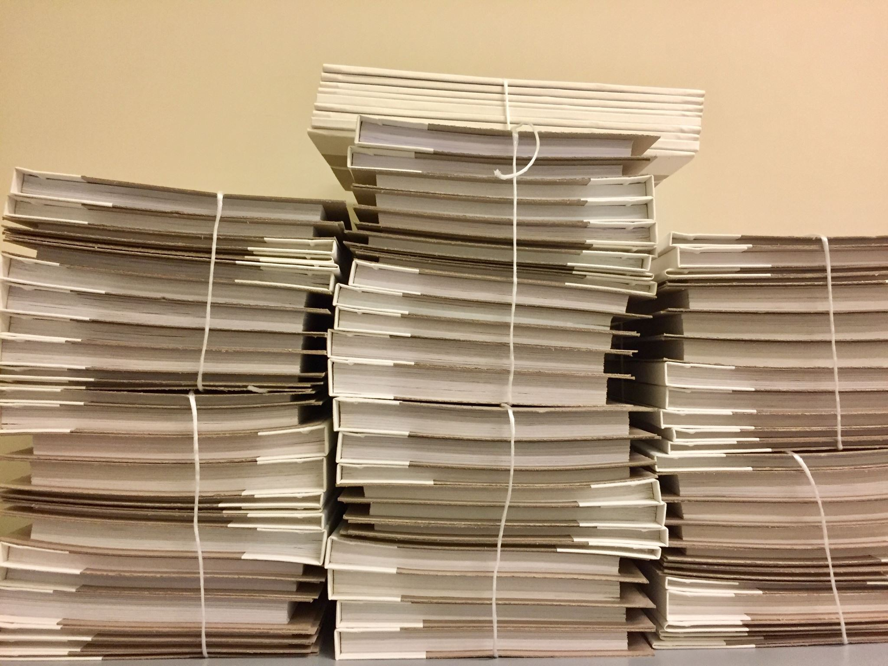
Title and Abstract Generator
Upload your entire paper to GenAI, and ask it:
To develop 10 engaging titles for the paper.
  Pick the one you like the best.
To create an engaging abstract that highlights the key points and encourages people to read the paper
  Ask it to include terms that would appear in a search.

Slide 14
Writing help
You should always write the first draft of a paper.
  OK to ask GenAI to clean up the paper, similar to using Grammarly.
  For best results, ask it to clean up the writing paragraph by paragraph.
  Always check carefully to ensure it doesn’t change the meaning.
Ask co-authors to comment on versions of the paper.
  Ask GenAI how you should respond to those comments, one by one.
  Breaks it down into processable units, also makes it easier for you to check and confirm the recommendations.

Slide 15

Discussion section
For an MISQ Research Commentary Paper, we were not happy with how the discussion section turned out.
The team engaged in a structured discussion on Zoom (following the structure I outlined earlier).
  Recorded the conversation and created a transcript.
  Uploaded the transcript to GenAI and asked it to write the discussion section based on our conversation.
Results were very effective
  Captured the discussion effectively
  Allowed rounds of iteration far more quickly than commenting on versions.

Slide 16
USE Gen AI as friendly Reviewer
Ask it how your paper can be improved.
Be careful and intentional about what improvements you accept and which you do not.
Ask it to help find references for particular claims
Be sure to tell it only to include references from the MIS Literature.
Always double check to ensure that references a) exist and b) are relevant.

Slide 17
CRITICAL Framework Can Help
Component
Definition
Prompt Starters
Context
Strategic scene and background
"I work for...", "We are in the process of..."
Role
Expert persona assignment
"Act as a...", "You are an expert in..."
Intent
Ultimate business objective
"The goal is to...", "I need this to..."
Task
Clear, actionable instruction
"Write a...", "Create a list of..."
Instruction
Steps and constraints
"Follow these steps...", "Do not include..."
Criteria
Output format requirements
"Format as...", "Use bullet points..."
Audience
End-user specification
"The audience is...", "Write for..."
Learning
Reasoning explanation
"Explain your reasoning...", "Why..."

Slide 18
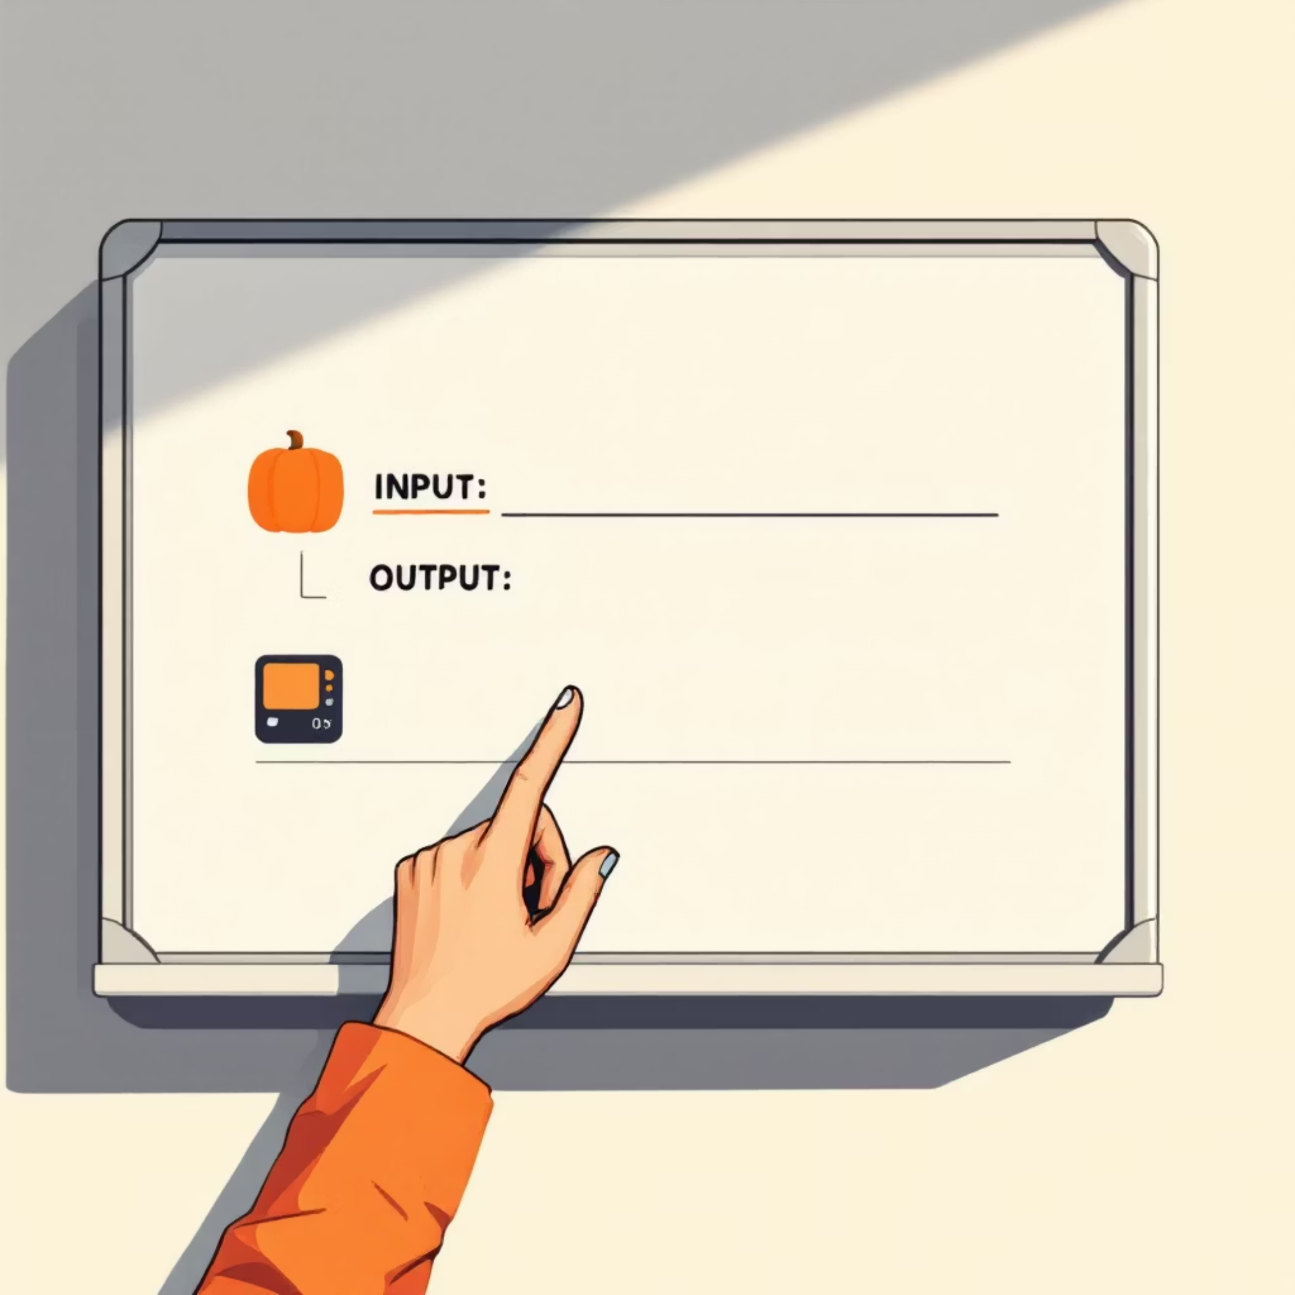
Advanced Technique: Few-Shot Prompting
Teaching by Example
Provide one or more examples of your previously published papers so that it can imitate your style.
Can even create Custom GPTs or Gems to be your writing assistant.
Example: "Extract student name, course, and question following this format:"
INPUT: "Hi, this is David Banner. I'm in MKTG 3100 and wondering about the final project deadline."
OUTPUT: Name: David Banner | Course: MKTG 3100 | Question: Final project deadline

Slide 19

summary
Gen AI is too powerful of a tool for researchers to simply ignore.
BUT, it will not do the writing for you.
  Have it do routine stuff so you can focus on the value-added contributions.
  Have it make suggestions that you choose from.
This is your reputation on the line, don’t outsource too much to GenAI.
  It should enhance you, not replace you.

