Slide 1

From Revision to Acceptance:
A Guide to Navigating the R&R Journey
Jason Bennett Thatcher
Leeds School of Business
Colorado University Boulder

Slide 2
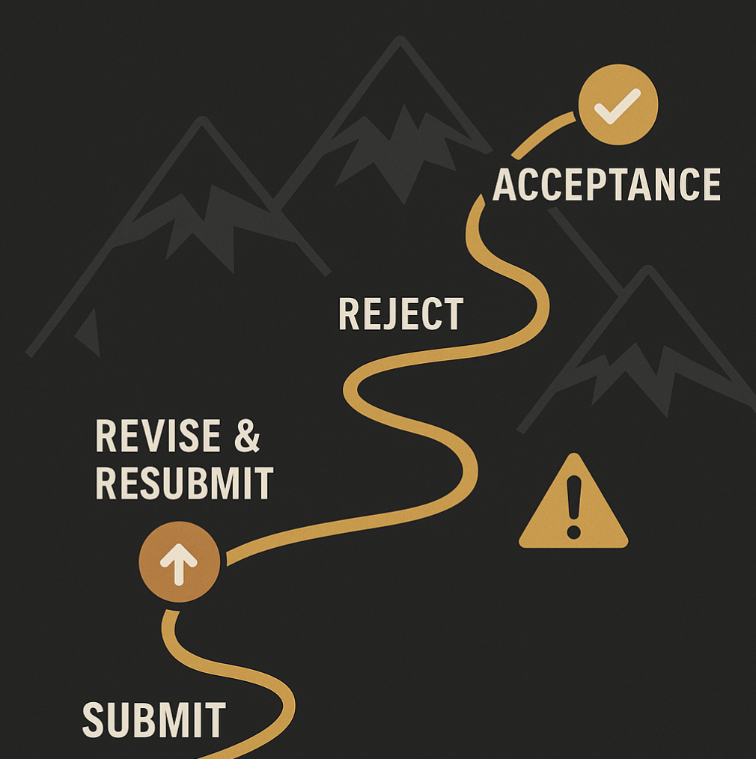
Notes:
Each paper plays a distinct role in your scholarly menu—from review to method to synthesis. A great paper set is more than its parts—it’s how they’re plated together.
Think of your research as a five-course meal:
Appetizer – methods or tools
Side – theory or review
Main – empirical anchor
Bread/wine – tutorials or scales
Dessert – synthesis paper
Each dish has its purpose—but it’s the orchestration of the meal that leaves a lasting impression.

Slide 3
Why This Talk?
Most R&Rs fail—not because of the idea, but the response.
Success hinges on how you revise and explain.
Reviewer comments are rarely direct. We’ll decode what they really mean and how to respond.
Coauthor dynamics can stall progress. You’ll learn how to manage collaboration without blame.

Slide 4
Why This Talk?
You need more than good writing skills. Strategy, structure, and tone drive success.
You’ll leave with tactics, templates, and confidence. This talk offers a toolkit for turning pain into publication.

Slide 5
Today’s Agenda
Understanding Revisions
Facing the Reality of R&Rs
Building a Smart Revision Strategy
Your Three Big Tasks
  Make Sense of the Reviews
  Revise the Manuscript
  Write a Compelling Response
Executing the Revision
Writing the Response Letter
Final Tips and Encouragement

Slide 6
Revisions vary by tractability and effort. Know what you’re dealing with.

Slide 7
A Typology of Revisions
 | Tractable | Impossible
Low Effort | Quick Wins Add citations, clarify text | Unwelcome Surprises Add theory that doesn’t fit or data you don’t have
High Effort | Surgical Strike Rework theory, rerun analyses | Full Rebuild New model, new data, new framing

Slide 8
Your response should reflect the level of tractability and effort demanded in the review package.

Slide 9
A Typology of Revisions
 | Tractable | Impossible
Low Effort | Quick Wins Do immediately. Show goodwill. | Unwelcome Surprises Add theory that doesn’t fit or data you don’t have
High Effort | Surgical Strike Rework theory, rerun analyses | Full Rebuild New model, new data, new framing

Slide 10
A Typology of Revisions
 | Tractable | Impossible
Low Effort | Quick Wins Do immediately. Show goodwill. | Unwelcome Surprises Add theory that doesn’t fit or data you don’t have
High Effort | Surgical Strike Plan & prioritize. Show value. | Full Rebuild New model, new data, new framing

Slide 11
A Typology of Revisions
 | Tractable | Impossible
Low Effort | Quick Wins Do immediately. Show goodwill. | Unwelcome Surprises Explain limitations, propose alternative.
High Effort | Surgical Strike Plan and prioritize. Show value. | Full Rebuild New model, new data, new framing

Slide 12
A Typology of Revisions
 | Tractable | Impossible
Low Effort | Quick Wins Do immediately. Show goodwill. | Unwelcome Surprises Explain limitations, propose alternative.
High Effort | Surgical Strike Plan and prioritize. Show value. | Full Rebuild Contact editor. Negotiate expectations.

Slide 13
How do you discriminate between cells in the grid?
Read the reviews.

Slide 14
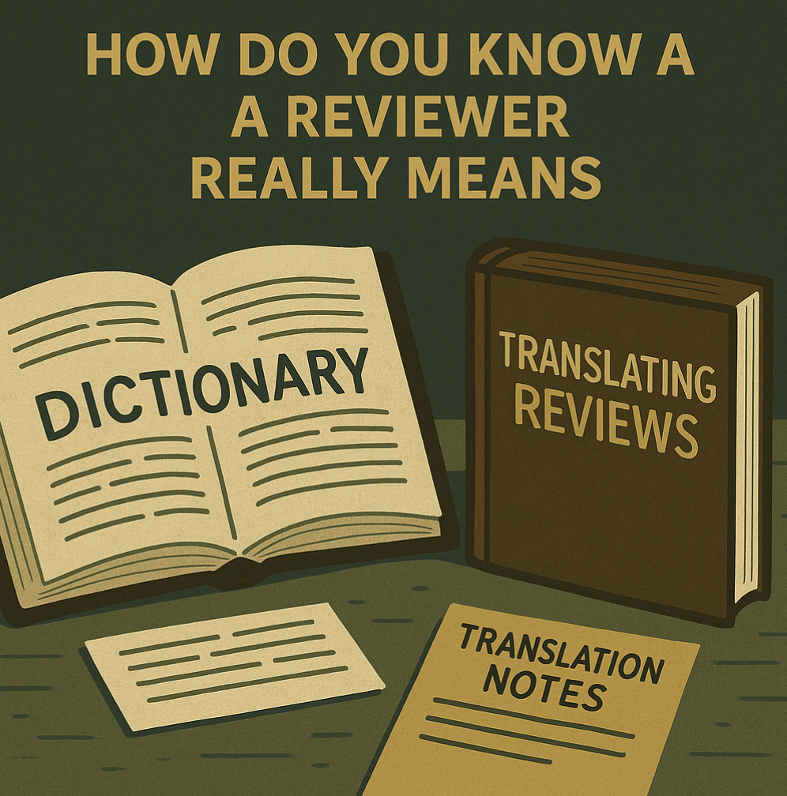
Read the reviews.

Slide 15
Reviewer Phrase | What It Really Means
“The contribution is unclear” | You have not convinced us this paper matters.
“The theoretical framing could be strengthened” | Your theory doesn’t guide the work—or it’s the wrong one.
“This is interesting, but...” | I’m about to deliver a body blow.
“The method is novel, but underdeveloped” | I don’t trust your analysis.
“I encourage the authors to consider additional analyses” | Add robustness checks or else.
“The writing could be improved for clarity” | I stopped reading after page 3.
“The manuscript raises interesting questions” | ...but doesn’t answer them well.
“I recommend a major revision” | Buckle up—this is going to be a grind.

Slide 16
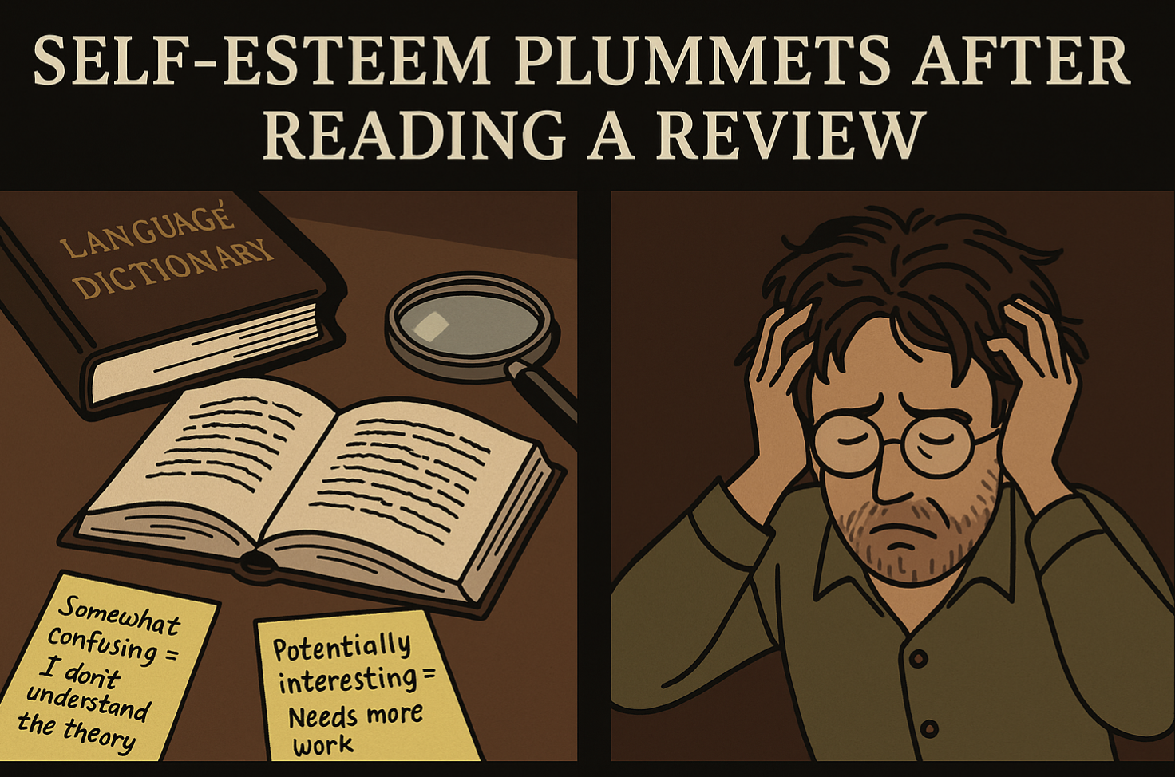

Slide 17
Strategies to Rebuild Your Self-Esteem
Remember: You earned an R&R—most papers get rejected outright.
Remind yourself: They’re critiquing the manuscript, not your worth.
Call a friend or mentor who can remind you what you’re good at.

Slide 18
Strategies to Rebuild Your Self-Esteem
Read a published paper that’s worse than yours (yes, we all do it).
Reframe: This is a team sport. You’re one revision away from a win.
Take a walk. Take a nap. Take back your confidence.

Slide 19
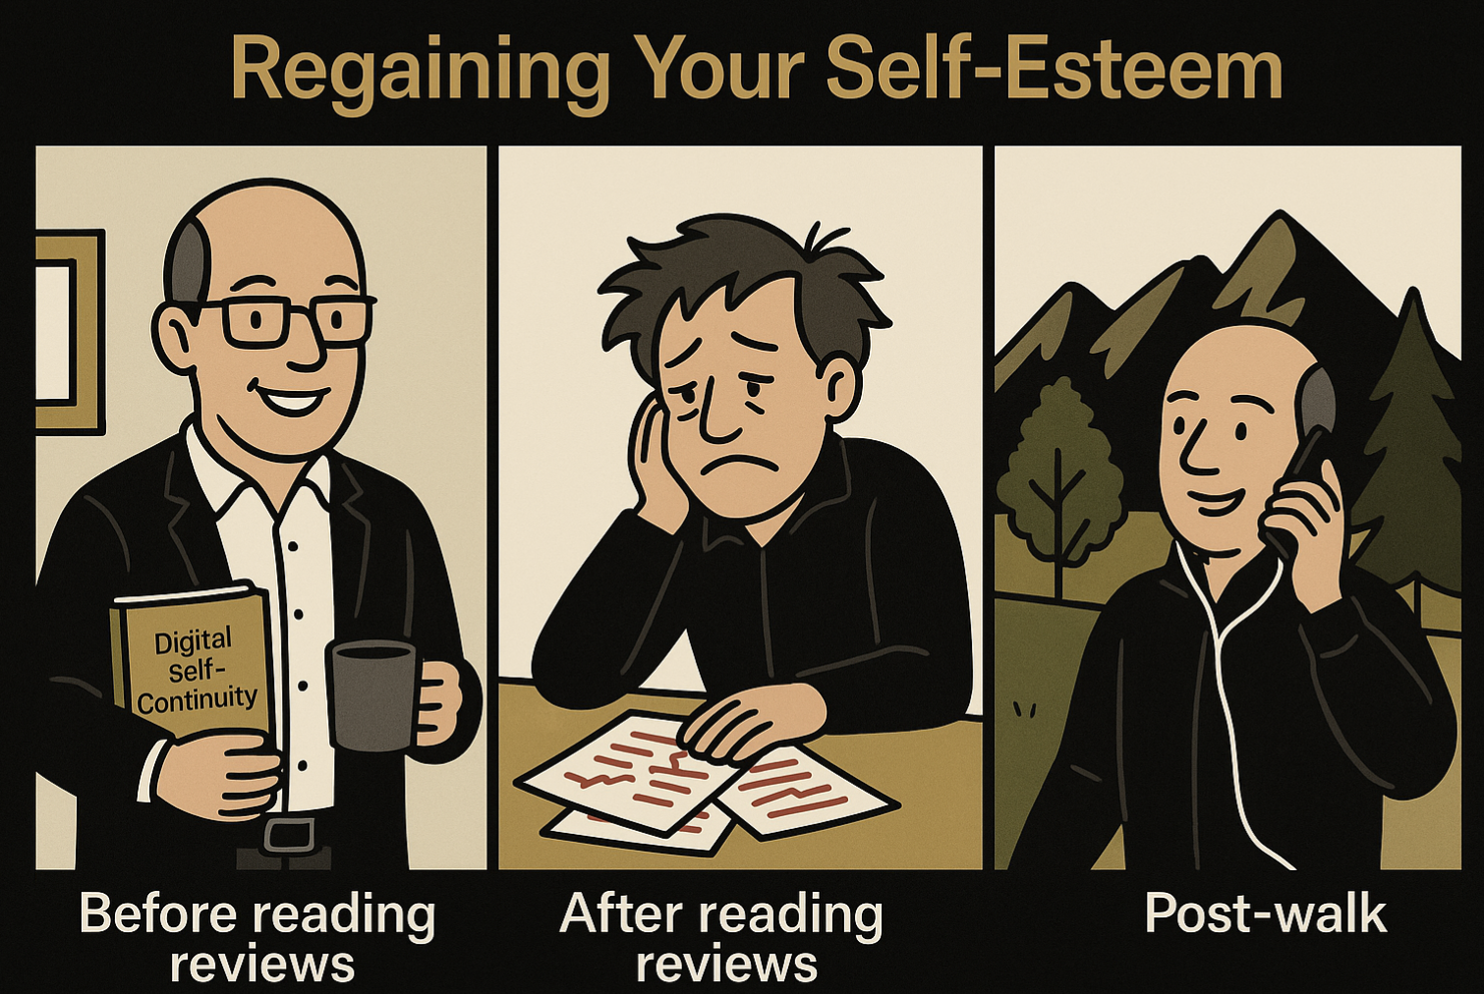
Usually.
At this point.
Rebuild your self-esteem.

Slide 20
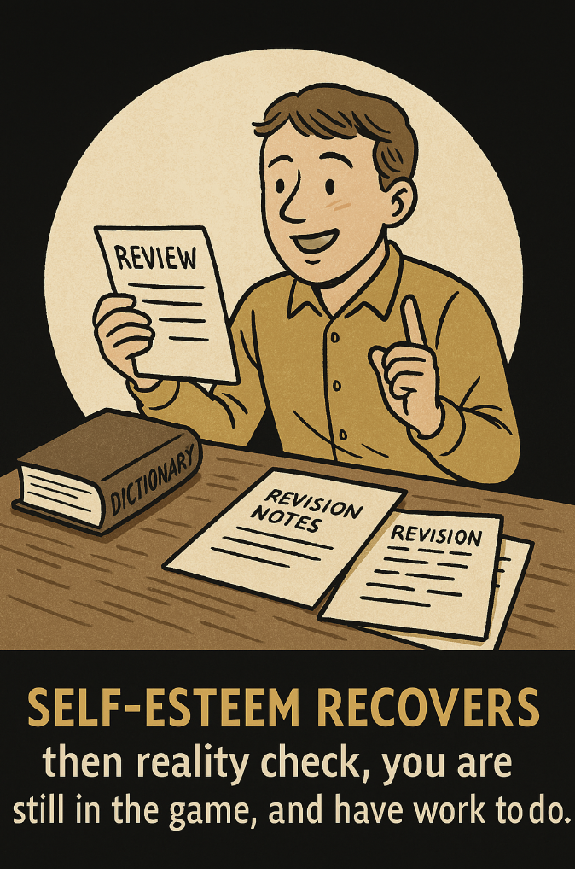
Notes:
R&R = Opportunity, Not a Victory Lap
Your job now: Clarify, Revise, Communicate
Most accepted papers improve (with some effort) dramatically post-R&R

Slide 21
Now you have three big tasks
      Make sense of reviews
      Revise the manuscript
      Craft compelling responses

Slide 22
Task 1 – Identify themes and prioritize

Slide 23
Task 1 – Identify Themes and Prioritize
What are the major critiques?
Where is there consensus across reviewers?
Use color codes
  (Red = hard, Green = easy)

Slide 24
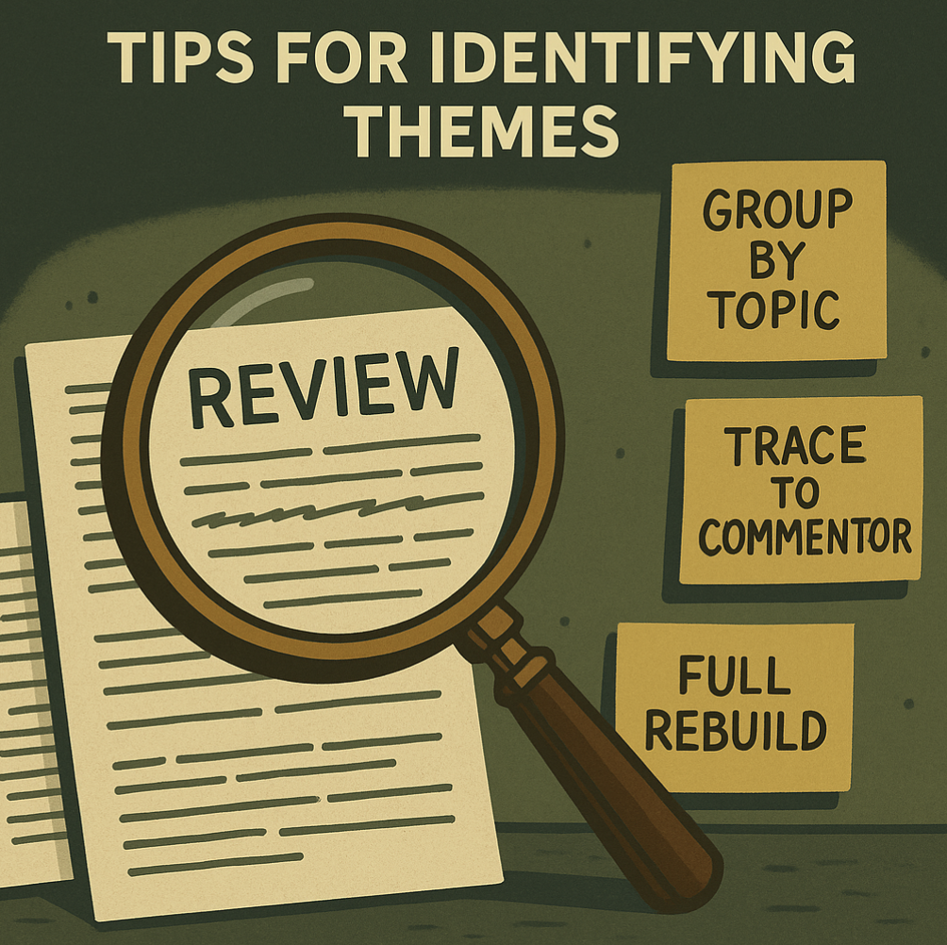

Slide 25
Tips for Identifying Themes in Reviewer Feedback
Print everything: Decision letter, AE note, and all reviewer comments.
Highlight recurring issues: Look for repetition—multiple reviewers saying the same thing means it's major.
Map concerns: Create a matrix by reviewer and comment category (e.g., theory, method, contribution).

Slide 26
Tips for Identifying Themes in Reviewer Feedback
Look for convergence: Do different reviewers raise similar concerns with different words?
Tag alignment gaps: Mark where the paper’s key message missed the mark.
Summarize in bullets: Aim for 3–5 core themes that will anchor your revision strategy.

Slide 27
Own the Problems
Ask: Why didn’t reviewers get it?
Weak intro?
Unclear contribution?
Poorly contextualized theory?

Slide 28
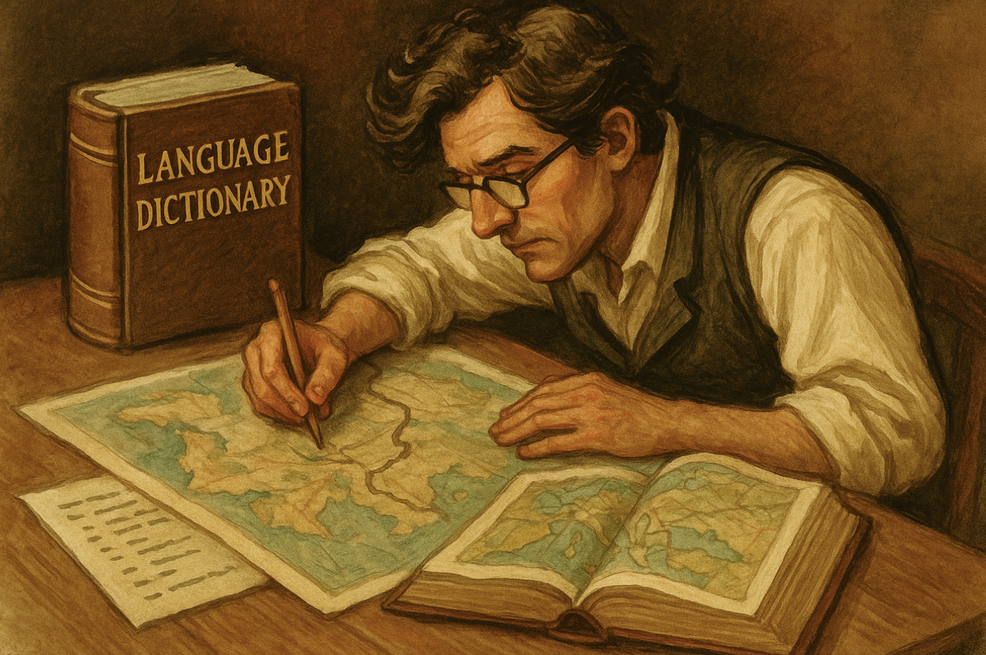
Devise a revision strategy.

Slide 29
Devise a Revision Strategy
This is your shared blueprint—for both your team and the editor.
Start with a bullet list of 3–5 headline changes.
Identify themes, source of concern (SE, AE, R1...), and your planned fix.

Slide 30
Devise a Revision Strategy
Color-code or prioritize based on difficulty and importance.
Flag any disagreements or interpretation gaps to resolve as a group.
Keep it under 1.5 pages and share early with the team—and possibly with the SE.

Slide 31
Remember: “It’s us, not them.”

Slide 32
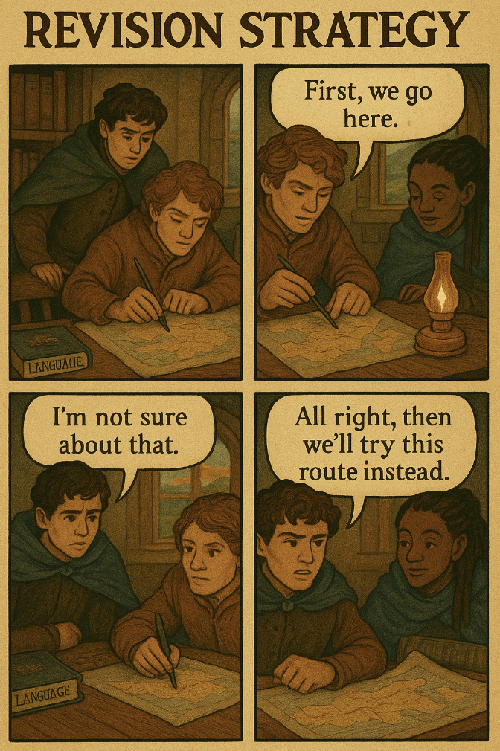

Slide 33
This means navigating some egos.

Slide 34
Manage your coauthors
Frame revision as a shared project: “We’ve all learned a lot since the first submission.”
Focus on forward movement: “Let’s agree on what the paper needs now.
Use language that invites collaboration: “How would you like to approach these comments?”

Slide 35
Manage your coauthors
Assign by expertise, not blame: “You’re best positioned to handle this theory critique.”
Document decisions neutrally: Keep shared notes that track changes and responsibilities.
Thank coauthors for their flexibility and reinforce shared goals.

Slide 36
Remember: “It’s us, not them.”

Slide 37
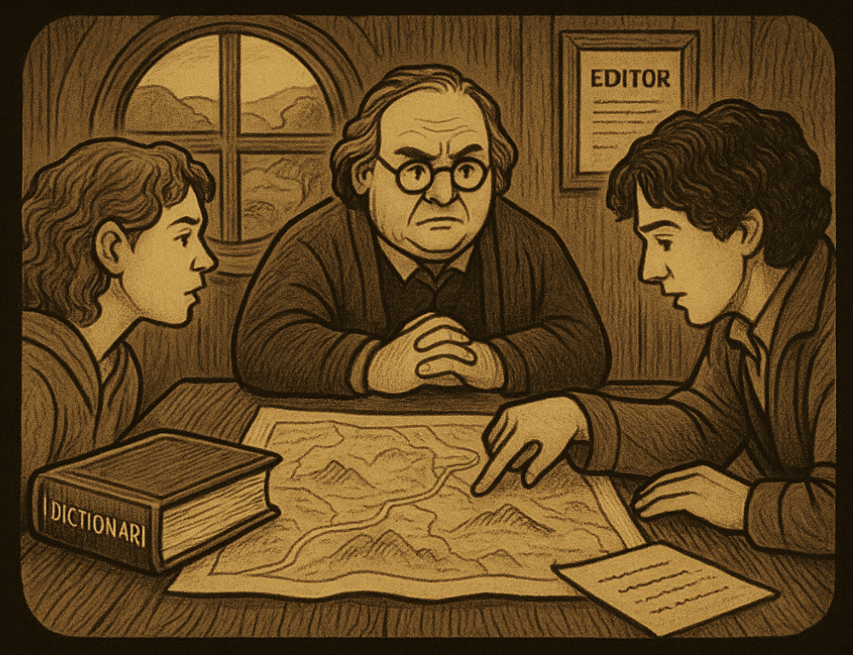
Communicating Your Strategy
with your editor.

Slide 38
Communicate with the Editor
Editors want to help
Share your revision plan early
Avoid surprises at resubmission

Slide 39
But…

Slide 40
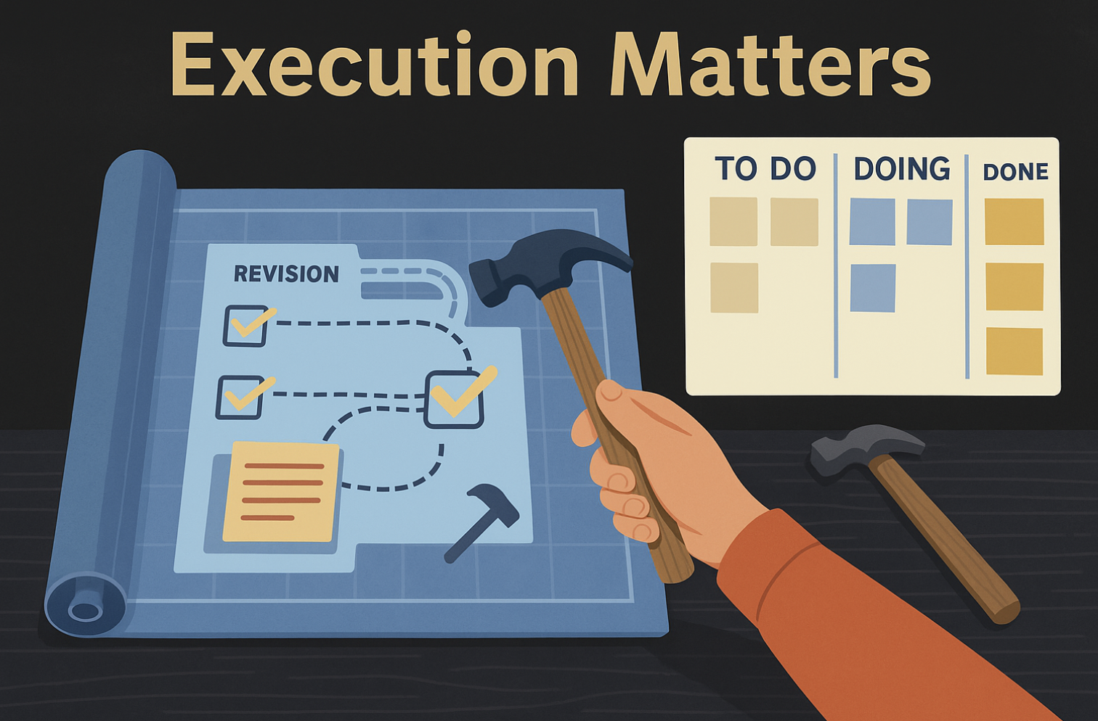

Slide 41
Execution Matters
Treat your revision strategy as a communication tool, not a binding agreement.
Use it to align the team on what to do, who’s doing it, and when.
Break big changes into small, trackable steps.

Slide 42
Execution Matters
Set internal deadlines and accountability checkpoints.
Maintain a shared document to monitor progress and note roadblocks.
Revisit your strategy mid-revision: adjust if needed.

Slide 43
The strategy buys goodwill—
execution earns publication.

Slide 44
Task 2 – Revising the Manuscript

Slide 45
Revising the Manuscript
It’s no longer your paper—it’s our paper
  So assign work to colleagues
Focus on clinical edits that serve the new goals
  Everything is malleable; except your integrity
Don’t cling to pet arguments

Slide 46
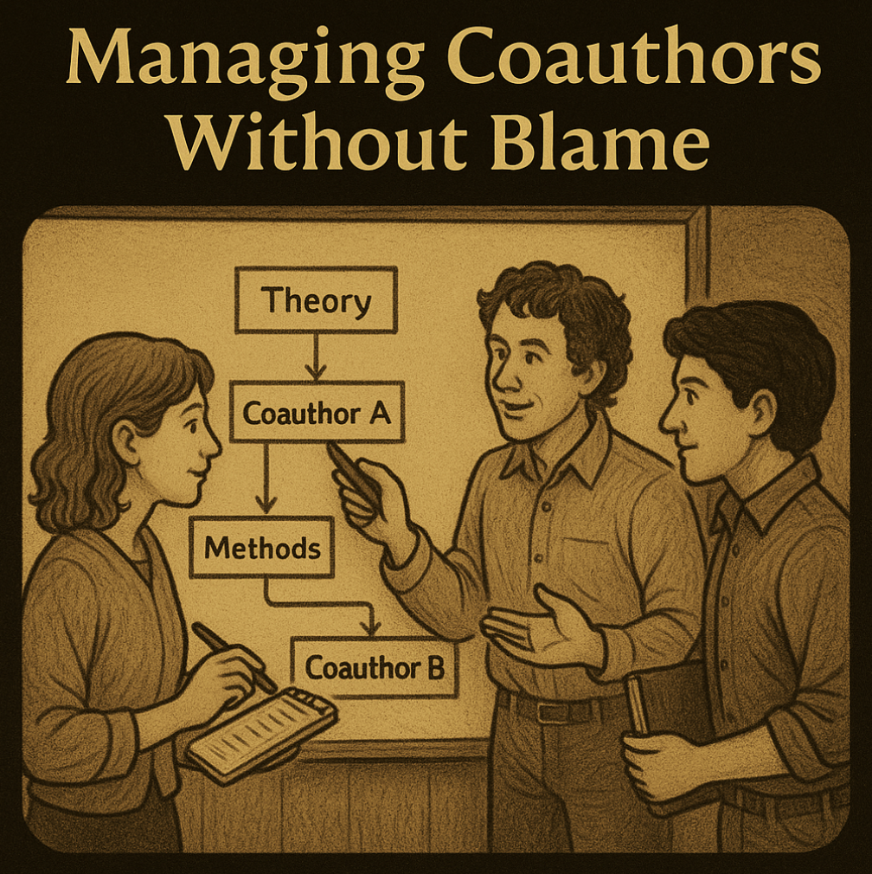

Slide 47
Strategies for Owning Problems
Without Blame
Use reflective language: “Our framing may not have clearly conveyed...”
Take collective responsibility: “The manuscript did not adequately emphasize...”
Attribute issues to clarity, not intelligence: “The logic was present, but poorly signposted.”

Slide 48
Strategies for Owning Problems
Without Blame
Avoid defensiveness: Don’t explain why you wrote it that way—focus on how you’ve now fixed it.
Frame changes as improvements, not concessions: “We can enhance the theoretical clarity by...”
Say: “Our original wording led to confusion.”

Slide 49
Fixing Common Pain Points
Contributions: Link to theory and practice
Theory: Clarify boundary conditions
Method: Add robustness, transparency
Lit Review: Right-size and update
Reviewer Education: Teach gently

Slide 50
Ask for Help
Present the paper internally or at a workshop
Ask colleagues for feedback on stuck points
Fresh eyes can help address intractable issues

Slide 51
Task 3 – Writing the Response Document

Slide 52
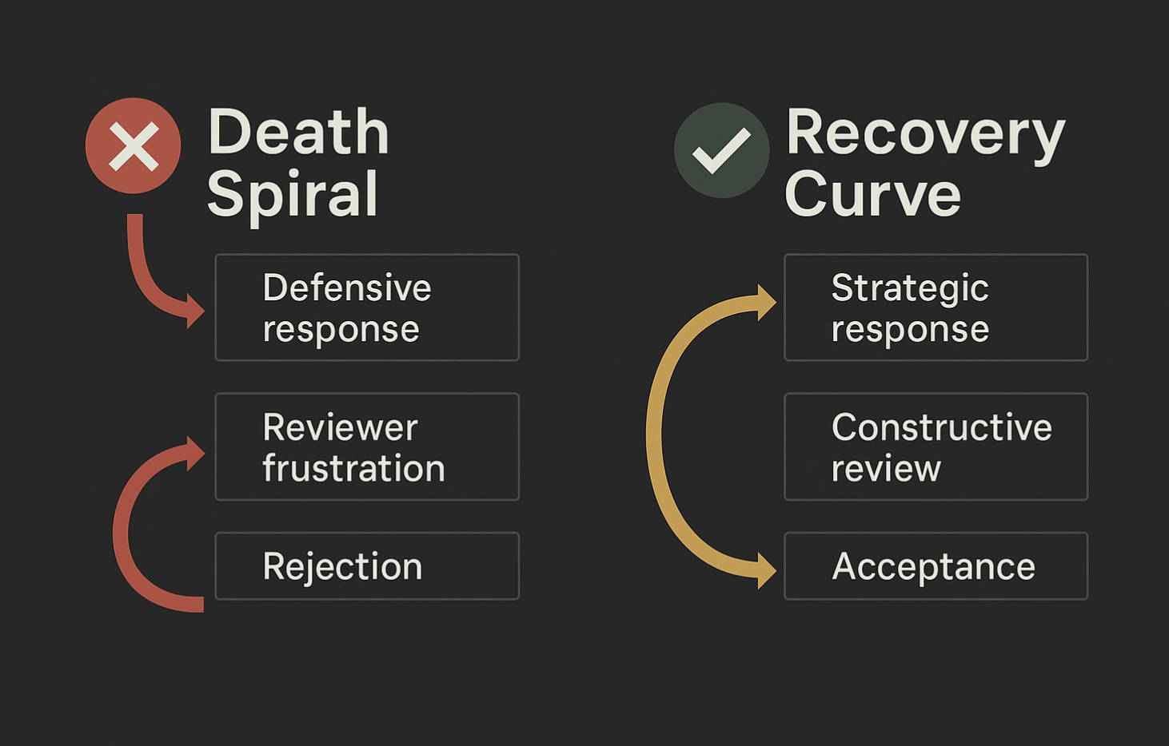

Slide 53
Writing the Response Document
Start with a 1-page summary of major changes
Then address every comment. Point by point.
Be thorough, be respectful, be honest

Slide 54
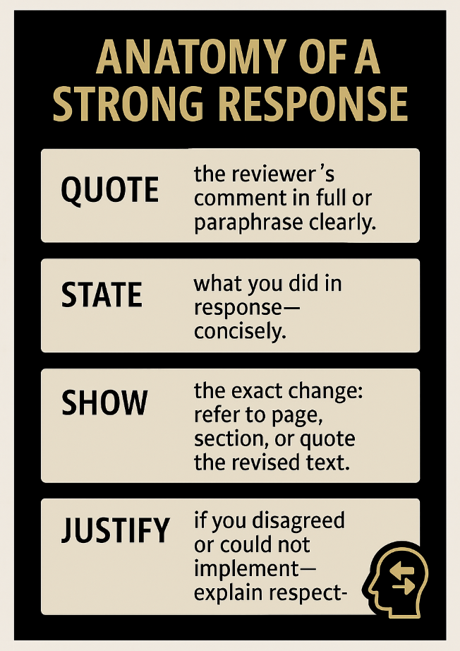

Slide 55
Phrases that Work
  “We thank the reviewer for this valuable suggestion. In response, we have added...”
  “To clarify this point, we revised the discussion on p. 14 to now state...”
  “We understand the reviewer’s concern. However, due to data limitations, we instead...”

Slide 56
Avoiding Traps
  Don’t say: “We disagree.”
  Do say: “We appreciate the reviewer’s concern and have clarified...”
  Don’t ignore minor points.
  Do show that you read and addressed everything.

Slide 57
Signal Openness to Further Feedback
  Use language that invites continued dialogue:
  “We welcome further guidance from the review team.”
  Acknowledge complexity:
  “We recognize there may be other interpretations and remain open to adjustment.”

Slide 58
Signal Openness to Further Feedback
  Convey collaborative tone:
  “We hope our revisions move the paper in the direction envisioned by the reviewers.”
  End your response document with:
  “We are happy to make additional revisions as needed.”

Slide 59
Signal Openness to Further Feedback
  Remember:
  signaling flexibility builds trust and keeps the door open for a smoother next round.

Slide 60
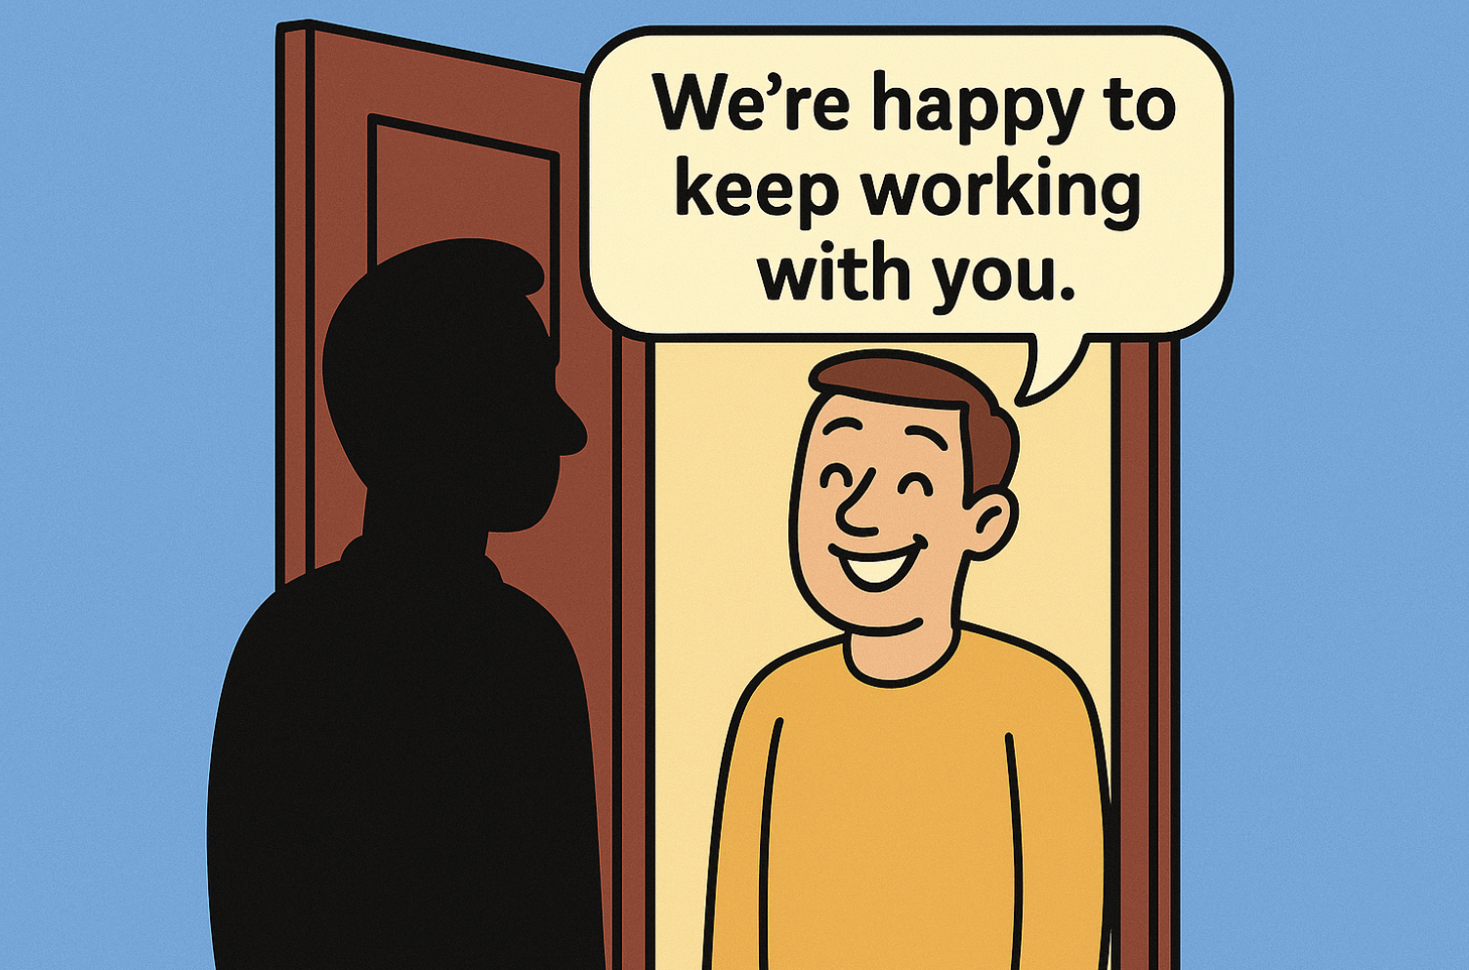

Slide 61
Don’t forget the three golden rules.

Slide 62
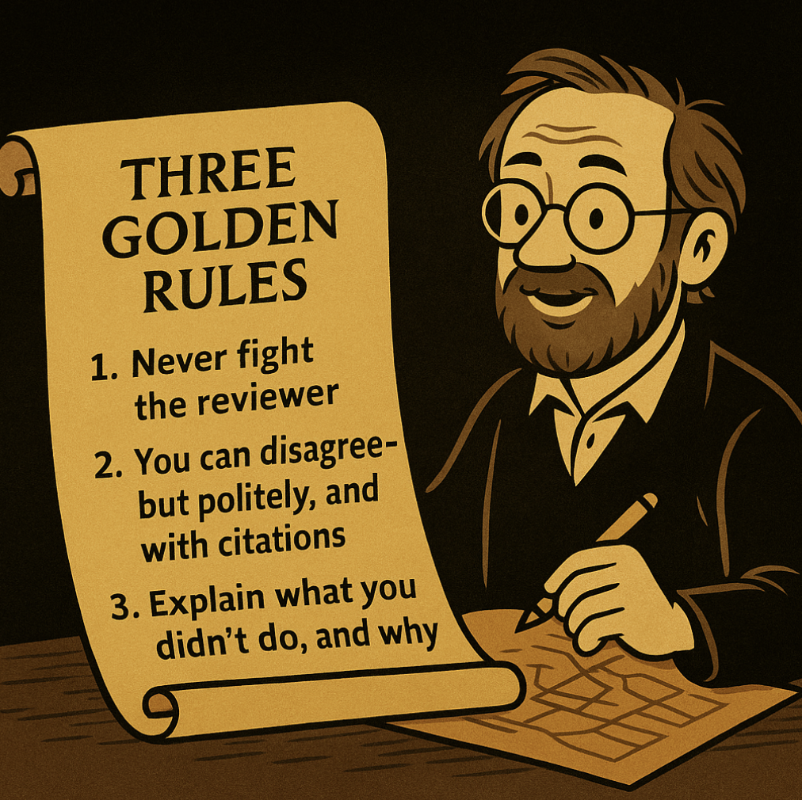

Slide 63
A plea.

Slide 64
Be the Reviewer You Want to Have
Reviewing helps you write better responses
Learn how others revise and succeed
Empathy builds excellence

Slide 65
Final thoughts.

Slide 66
Revision are hard—but it’s how good work gets great.
Engage reviewers as collaborators, not adversaries.
Your best paper is on the other side
of the revision.

Slide 67

Questions?
(feel free to complain
about Reviewer 2)
)

Slide 68
(jason.thatcher@colorado.edu)

