Slide 1



Awards Banquet
Wednesday
20 May 2026
Time
6:00 PM Social (Cash Bar)
6:45 PM Dinner
7:45 PM Awards Presentation
Location
Univ of Dayton – East Ballroom
Link to register: https://forms.osi.apps.mil/r/iDB9cqpqUt
Contact Angela.Gladney@us.af.mil if questions
Come and Support your Fellow Dayton-Cincinnati Section Award Winners!
Awards Ceremony is Joint with ASME
Awards and Recognition to be given out include:
National Award Winners
AIAA Fellows and Associate Fellows
AIAA Member Longevity Recognition
DCASS Symposium Awards Including:
Best Presentation Winners
Art in Science Winners
Section Awards Including:
Science Fair Awards
Outstanding Management Contribution Award
Outstanding Technical Contribution Award - Scientific
Outstanding Technical Contribution Award - Applied
Chairman’s Awards
And other individual awards
Come join all the wonderful researchers and leaders in the area both current and future. This evening is our opportunity to congratulate them all on their achievements. Please socialize and celebrate with us all!
Dinner Menu
Choice of Entrees:
Caesar Chicken: coated in crushed croutons and parmesan cheese with herbs
Or
Salmon Filet w/ Lemon Sauce
First 2 entrees include Broccoli Florets and Baby Carrots and Yukon Gold Garlic Mashed Potatoes
Or
Penne Pasta with Mushroom Pesto: Portobello and button mushrooms with chopped walnuts & chef’s vegetable
All include Romaine and Spinach Salad and Dessert
Please inform choice when make reservation
$25 Professional/Spouse
$15 Student
$ 0 Award Winners
Please make reservations early, but no later than May 15th. Everyone attending must register – even award winners
Please make your dinner selection when you register
Parking will be free in C lot off Irving Avenue – near Kettering Labs
No-shows will be billed for the cost of the dinner.
Notes:
1
1

Slide 2
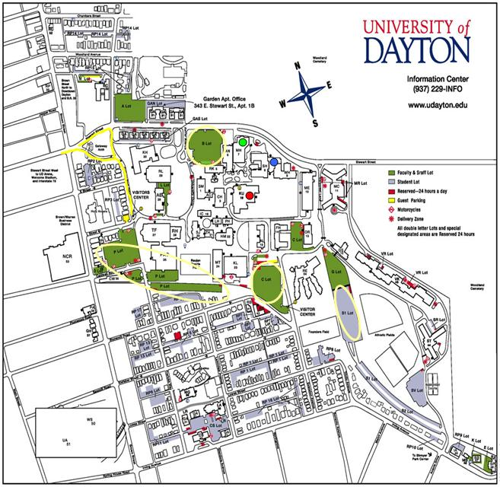
Kennedy Union is Here
Ballroom on the Second Floor
Park Here
Come up Irving Ave
To Evanston

