Slide 1

Room for Change:
A Unique Approach to
Housing Accommodations
Gina Gonzales
Assistant Director, University & Community Housing Services
Annika Gilbert
Coordinator, Housing Disability Accommodations
UCSB University & Community Housing Services

Slide 2
Let’s Get You Thinking…
True or False? Take Your Best Guess!
UCSB’s Disabled Students Program supports students through every step of the housing accommodation process, from request to placement.
University housing decisions are based on documentation provided by UCSB’s Disabled Students Program.
UCSB’s Disabled Students Program partners with Housing Services to identify appropriate living spaces within university housing.
UCSB designated a dedicated Housing Services staff member to work directly on housing accommodations and support students throughout the process.

Slide 3
Answers:
Were you right?
UCSB’s Disabled Students Program supports students through every step of the housing accommodation process, from request to placement. FALSE
University housing decisions are based on documentation provided by UCSB’s Disabled Students Program. FALSE
UCSB’s Disabled Students Program partners with Housing Services to identify appropriate living spaces within university housing. FALSE
UCSB designated a dedicated Housing Services staff member to work directly on housing accommodations and support students throughout the process. TRUE

Slide 4
Did anything surprise you? How does this compare to your institution—what similarities or differences stand out?

Slide 5
Overview of Housing at UC Santa Barbara
UCSB Housing is managed by Housing, Dining & Auxiliary Enterprises, which oversees student housing and related services.
The university has 16 housing communities, including residence halls, undergraduate apartments, a graduate apartment community, and housing for students with families.

Slide 6
Overview of Housing at UC Santa Barbara 2
Upcoming changes include the loss of a large residence hall for 2026–27 and new student housing developments to include undergraduate apartments, efficiency apartments, and residence hall spaces in two locations by 2028-29.

Slide 7
Overview of Housing at UC Santa Barbara 3
Approximately 10,000 residents will live in university housing for the upcoming academic year and 3,500 more by 2028-29 with staff also supporting as many students living off-campus.
Housing beyond the first two years is not guaranteed, and there is no residency requirement. UCSB Housing supports students in finding off-campus housing and navigating the local rental market.

Slide 8
What challenges come to mind when you think about typical housing accommodation models?

Slide 9
Common Challenges in Typical Housing Accommodation Models
Housing and Disability Services typically operate as separate departments, with different roles
  Disability Services determines eligibility
  Housing manages room assignments and availability
Communication gaps can lead to delays or unclear implementation of accommodations
Departments often have different priorities
  access and compliance vs. occupancy and operations

Slide 10
Common Challenges in Typical Housing Accommodation Models 2
Limited shared systems and data can result in inefficient coordination and errors
Timing misalignment between accommodation approvals and housing deadlines can limit placement options
Lack of shared understanding or cross-training can create inconsistent implementation
Students may experience being passed between offices, increasing stress and confusion
Privacy requirements can limit how much detail is shared, sometimes affecting effective placement

Slide 11
Are there any specific challenges you’ve experienced that haven’t been mentioned?

Slide 12
UCSB’s Integrated Approach
The Disabled Student Program and Housing Services staff can distinguish between academic and housing accommodations.
  Students may contact Housing Services directly or connect with the Disabled Students Program where staff refers students to university housing when appropriate.
  This coordination is supported by interdepartmental collaboration and prospective and continuing student outreach efforts.
Students receive link to request housing accommodations via secure portal.

Slide 13
UCSB’s Integrated Approach 2
Students are provided with important process requirements and details including timelines (typically around 2-4 weeks, up to 4–6 weeks during summer months), space availability, and documentation requirements.
Students submit a personal statement of need(s) and upload clinical documentation in the form of a brief questionnaire.
Once submitted, the application enters the review queue for evaluation.

Slide 14
UCSB’s Integrated Approach 3
The Housing Accommodations Committee, including a support animal sub-committee, is comprised of staff from Housing Services, Disabled Students Program, and Student Health Services.
The main committee meets bimonthly and the sub-committee meets monthly to review individual submissions and make recommendations based on the available information.

Slide 15
UCSB’s Integrated Approach 4
The Housing Disability Accommodations Coordinator documents the decision, communicates the outcome to the student, and manages the case from start to finish. If approved, they also identify an appropriate space and coordinate the student’s assignment or relocation.

Slide 16
(Emotional) Support Animals
Details:
Submit personal statement + clinician letter/questionnaire
Upload all documents (no clinician submission)
Committee review
If approved: submit animal license (dogs/cats) + photo
Attest to animal guidelines → Receive formal approval to bring animal into university housing

Slide 17
Support Animals +
Important:
Apply with student status regardless of application/contract status (advance planning)
Documents must support necessity for atypical animal
*Students with Service Animals DO NOT navigate this process; rather, we ask two questions then approve and request license, photo, and share campus guidelines*

Slide 18
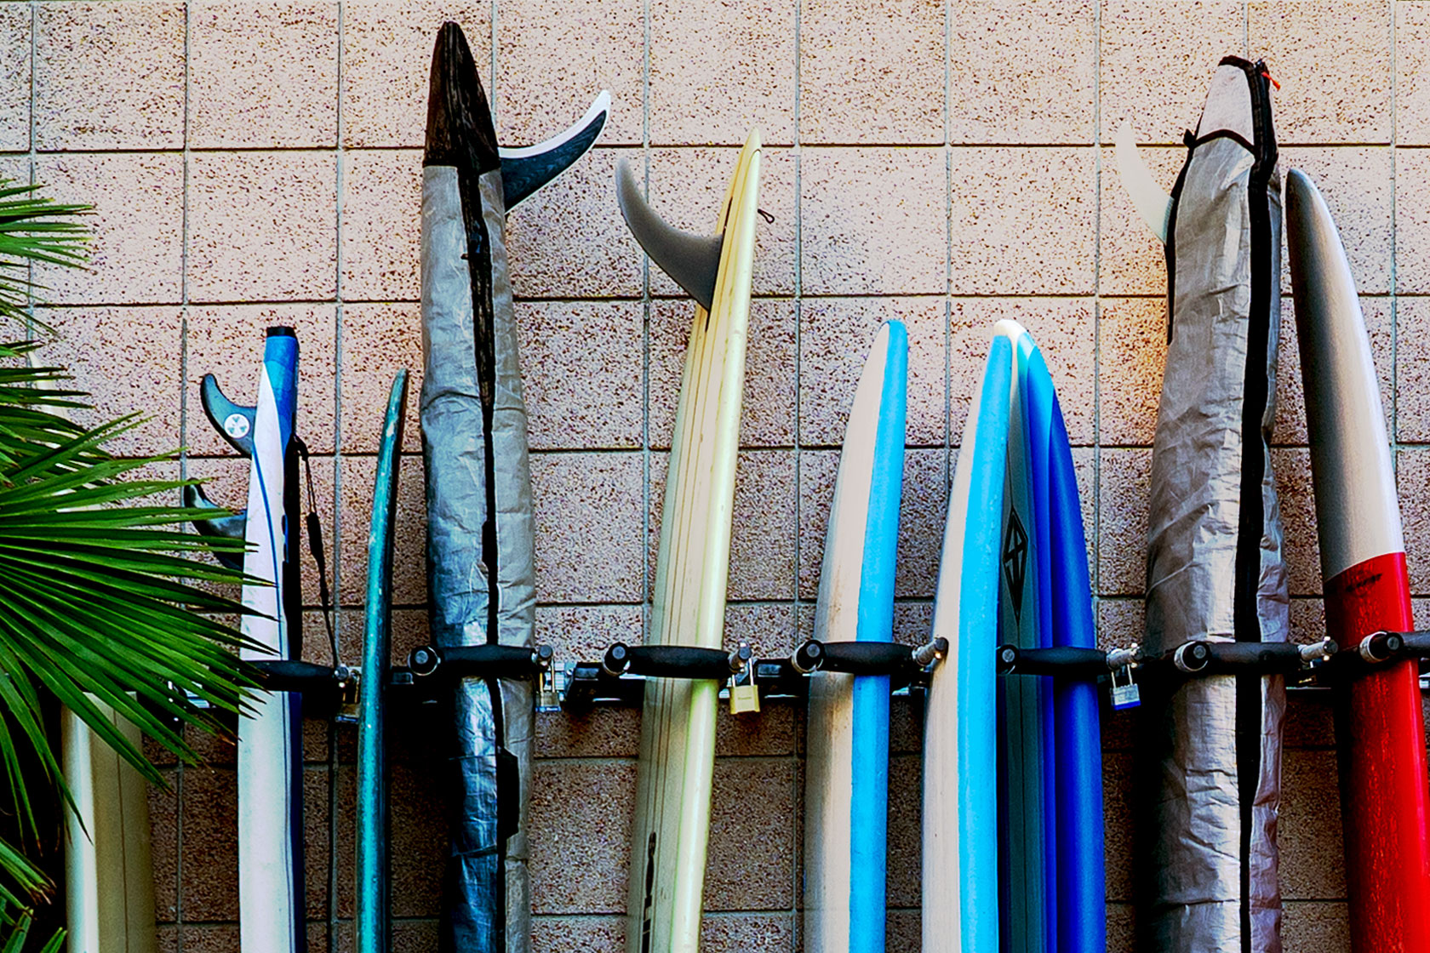
Housing Accommodation Overview
July 2024 – June 2025

Slide 19
Process Improvements
Communication timeline: Demonstrated improvement of review times from 6–8 weeks to 4–6 weeks, with cases completed in as few as 1–2 weeks
Increased trust: Dedicated staff results in increased capacity for individualized case management and interactive process with ongoing opportunities for students to engage and experience higher satisfaction due to a more personalized approach

Slide 20
Process Improvements 2
Better issue navigation: Availability of coordinator supports more immeditate friction management through a range of modalities
Workload management: Supports student resident accommodations from start to finish which serves the student well and frees up other staff
Campus connection: Advocates for accessibility beyond housing and frequently collaborates with campus stakeholders, including the Advisory Committee on Campus Access

Slide 21
Areas for Continued Growth
Application: Engage accommodations process through accessible website in addition to available staff support rather than getting the link from staff
Campus education: Improve clarity and strengthen distinction between campus classroom accommodations and housing accommodations through training with departments like Admissions, Orientation Programs, etc.

Slide 22
Areas for Continued Growth 2
Studio and single spaces: Increase opportunities for single room and apartment accommodations commensurate with the expected growth in student population
Data collection and analysis: Improve collection, management, and long-term planning
Community housing: Increase advocacy for and explore partnerships with private property providers in areas surrounding campus to expand affordable, accessible options

Slide 23
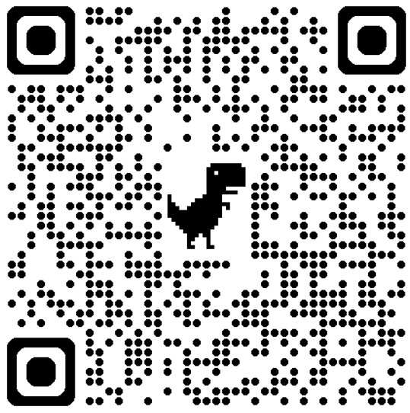
Session Evaluation tiny.cc/8zu1101
Thanks for attending! Your feedback is appreciated.

