Slide 1
Session 2.07:
What Narratives Your Office Advance?
A Tool to Assess Your Office’s Intersectional Equity & Impact
Jewls Griesmeyer-Krentz, PhD (candidate)
Pacific University

Slide 2
Conference Civility Statement
We ask you to join us in creating a culture that reflects…
Access and Inclusion
and
Civility and Respect
…this week and in all aspects of our organization.

Slide 3
Title: Elastic Positionality — Dynamic Forces and Salience Exploration Tool
A THEORY TO PRAXIS MODEL
Elastic Positionality
Dynamic Forces and Salience
Exploration Tool
This tool is designed to assist higher-education student services in understanding the forces that act on multiply marginalized students — and whether their own practice feeds dominant deficit narratives or reinforces the counter-narratives that empower students’ agency and welcomes their whole selves.
To use the interactive model: drag each societal arena’s pulls, reinforcers, and pushes sliders and watch positionality and salience respond; type real examples in each societal arena’s boxes.
Notes:
Title. One slide per click of the guided demo, with concept and example slides interleaved.

Slide 4
Agenda
Theoretical foundations
Applying dynamic forces & salience
Debrief and takeaways
Introducing elastic positionality
Notes:
Agenda.

Slide 5
Agenda
Theoretical foundations
Applying dynamic forces & salience
Debrief and takeaways
Introducing elastic positionality
Notes:
Agenda.

Slide 6
Theoretical Foundations
Critical Race Dis/ability Studies (DisCrit)
Translocationality
Critical Whiteness Studies

Slide 7
DisCrit
DisCrit
Disability Critical Race Theory
Racism and ableism are interconnected, mutually constitutive forces — circulating in tandem, often in neutralized and invisible ways, to uphold notions of normalcy and marginalize Dis/abled Students of Color.
See Annamma, Connor, & Ferri, 2013
Notes:
DisCrit grounding before translocationality.

Slide 8
Translocationality
Translocationality
Positionality is Relational and Situational Across Place and Time
Intersectionality is more than a list of fixed identities — it is contextual.
See Anthias, 2013, 2022
Notes:
Theoretical grounding (Anthias): positionality is relational and situational.

Slide 9
Translocationality Diagram
Gender
Generation
Race & ethnicity
Ability
Class
Critical Whiteness Studies
Critical Whiteness Studies
Migration status
Multiple, intersecting social locations
Social positions (identities) are engaged differently across societal arenas (contexts), place, and time.
Origin society
Host society
Institution
Country of origin
→
Receiving society
→
Disability services
excluded
belonging
excluded
belonging
excluded
belonging
Belonging and exclusion are produced relationally — position is situational, not fixed.
Concept: Floya Anthias — translocational positionality
Notes:
Trans-locationality diagram (landscape). (Fully editable: native shapes and text.)

Slide 10
Higher Education Foundations
Higher Education Foundations
Emerged from and supports white supremacy
White Supremacy is reproduced across interlocking societal arenas and reinforces systems of Whiteness, Racism, and Ableism
Notes:
Bridge: the foundations reproduce across the interlocking arenas just shown.

Slide 11
Critical Whiteness Studies — definition
Critical Whiteness Studies
Naming the Default that Structures the Rest
Whiteness as the underlying force that animates racial oppression — a set of default, normalizing conditions, not a fixed trait.
Whiteness intersects capitalism, patriarchy, genderism, and ableism — so the DSO becomes a site where oppressions collude (Foste & Irwin, 2020).
Reproduced through normalization; largely invisible to those who benefit, acutely visible to those who do not (Irwin, 2022).
Turn the gaze inward: name harm, expose the consequences of whiteness, and act — rather than centering white comfort (Foste et al., 2022).
What it names
Where it collides
How it works
Toward praxis
Notes:
Critical Whiteness Studies — grounds the whiteness strand of the framework.
What it names
Whiteness as the underlying force that animates racial oppression — a set of default, normalizing conditions, not a fixed trait.
Where it collides
Whiteness intersects capitalism, patriarchy, genderism, and ableism — so the DSO becomes a site where oppressions collude (Foste & Irwin, 2020).
How it works
Reproduced through normalization; largely invisible to those who benefit, acutely visible to those who do not (Irwin, 2022).
Toward praxis
Turn the gaze inward: name harm, expose the consequences of whiteness, and act — rather than centering white comfort (Foste et al., 2022).

Slide 12
Title: Elastic Positionality — Dynamic Forces and Salience Exploration Tool
How do you turn all this theory and my research into practical action?
Elastic Positionality
Dynamic Forces and Salience
Exploration Tool
Notes:
Title. One slide per click of the guided demo, with concept and example slides interleaved.

Slide 13
Agenda
Theoretical foundations
Applying dynamic forces & salience
Debrief and takeaways
Introducing the elastic positionality tool
Notes:
Agenda.

Slide 14
Higher education foundations diagram
White Supremacy
Whiteness
Racism
Ableism
Unmarked norm, default
Racial hierarchy, exclusion
Normate body and mind
Interlocking systems, mutually constituting
Reproduced across interlocking societal arenas
Organizational
Representational
Intersubjective
Experiential
Institutions, policies, admissions, accommodation, documentation gates
Curriculum, canon, images, discourse; whose knowledge counts as legitimate
Everyday interactions and practices; who is read as belonging, capable
Lived, felt, and internalized experience of these systems
Material effects on multiply marginalized students
Compounded barriers for Dis/abled, foreign-born Students of Color
Notes:
Higher-education foundations diagram (landscape). (Fully editable: native shapes and text.)

Slide 15
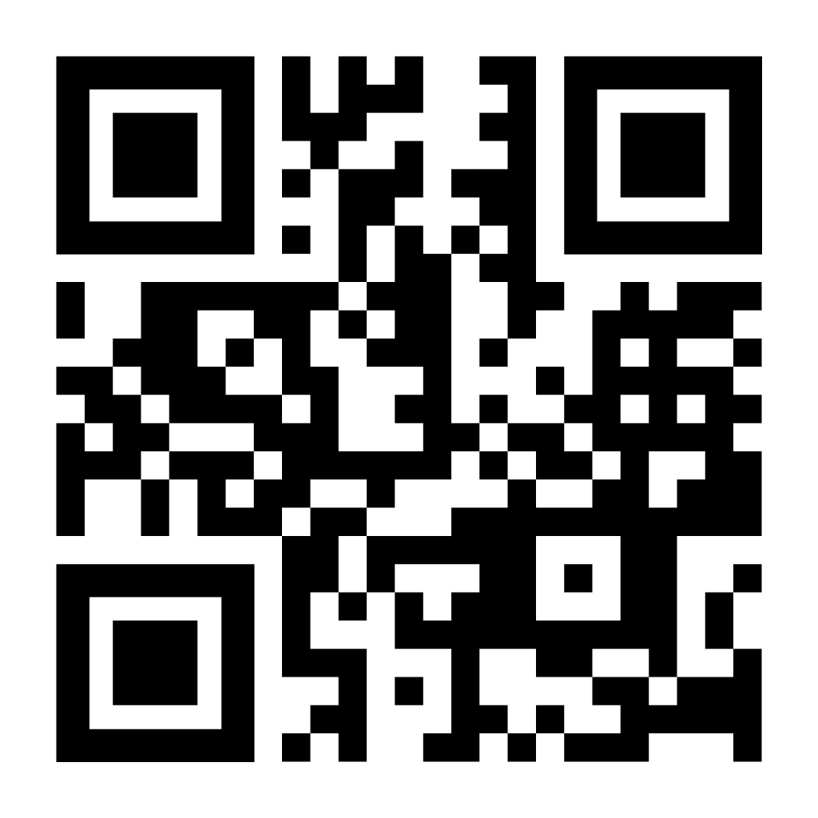
Introducing
Elastic Positionality
Theory to Praxis Model
Dynamic Forces and Salience
Exploration Tool
Go to
elastic-positionality.com
Frame-by-frame images of the animated version of the tool to follow.

Slide 16

Narration: The systems of oppression
Higher education is built upon and reinforces white supremacy, whiteness, ableism, and racism …
Notes:
Sentence beat (dim background). Next click reveals/demonstrates it.

Slide 17

THE SYSTEMS
THE SYSTEMS
Notes:
Frame + the four -isms appear.

Slide 18
Narration: Dominant deficit narratives
… yielding dominant deficit narratives — the result: “Ability as property.”
Notes:
Sentence beat (dim background). Next click reveals/demonstrates it.

Slide 19
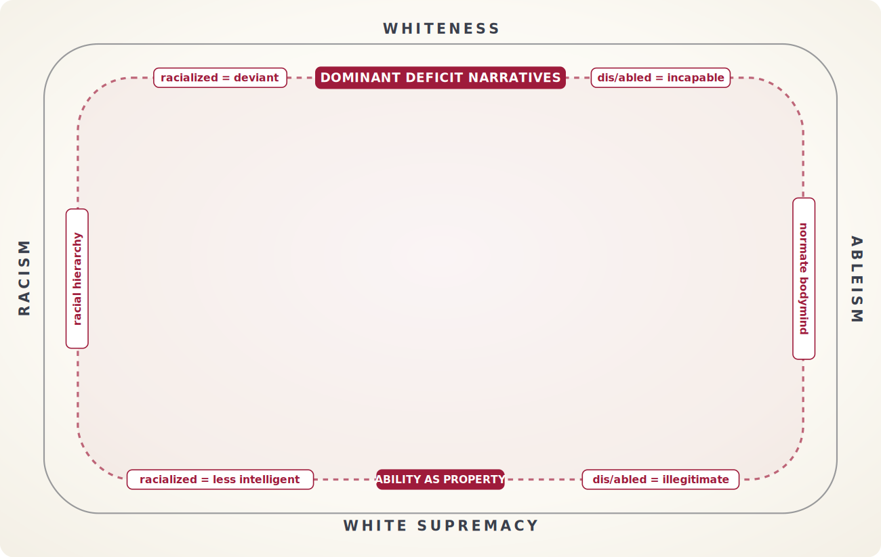
DOMINANT DEFICIT NARRATIVES
DOMINANT DEFICIT NARRATIVES
Notes:
The crimson narrative field appears.

Slide 20
Dominant Deficit Narratives — definition
Dominant Deficit Narratives
Marginalized Identities Framed as Problems
What they are
Examples
Widespread stories that say certain identities are “less than” or “broken.”
“Students of color don’t value education” or “Disability means inability.”
Impact
Power
These stories become the default way people think and act.
They reinforce systems of oppression and justify inequality.
Notes:
Dominant Deficit Narratives — native, editable.

Slide 21
Narration: Elastic positionality
An individual’s positionality — their intersecting social positions within context, place, and time — is ELASTIC
Notes:
Sentence beat (dim background). Next click reveals/demonstrates it.

Slide 22
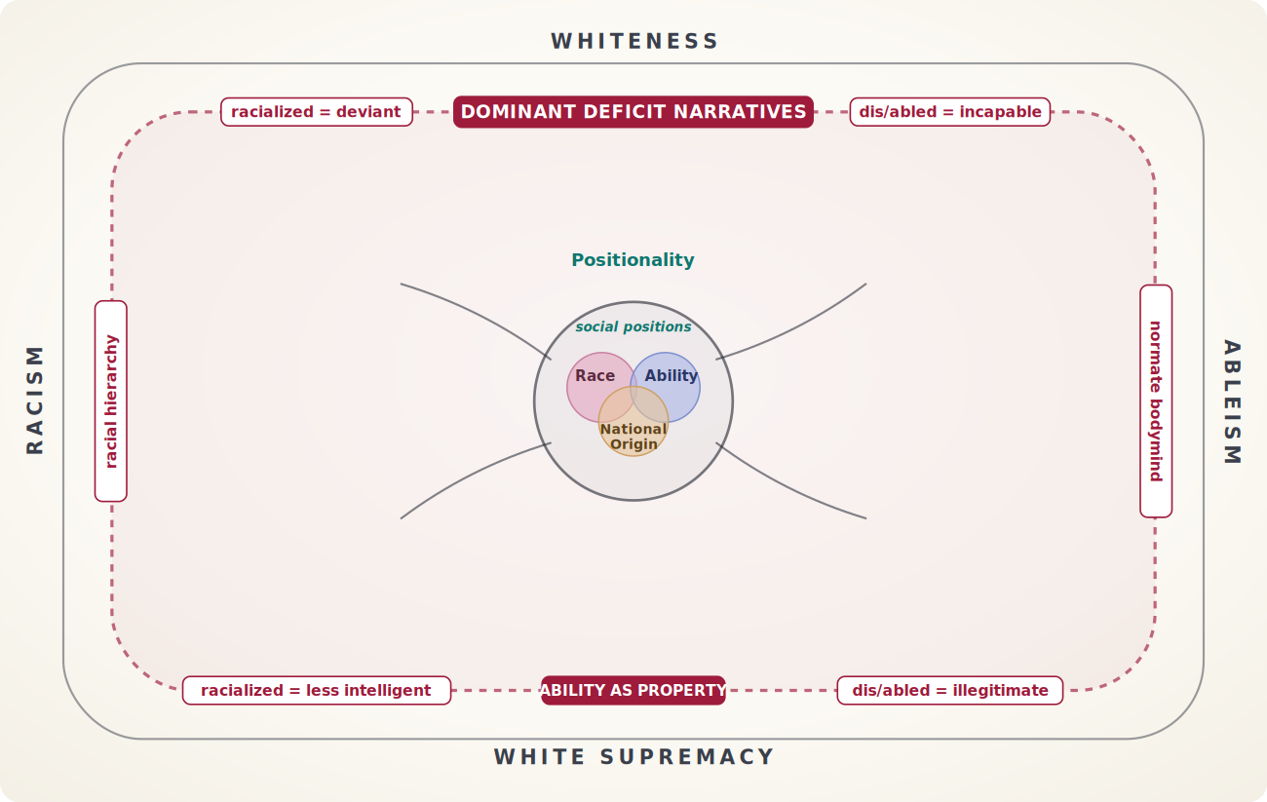
ELASTIC POSITIONALITY
ELASTIC POSITIONALITY
Notes:
Blob, social positions, neutral lines appear.

Slide 23
Narration: Societal arenas named
Societal arenas (organizational, representational, intersubjective, experiential) are the contexts an individual’s positionality engages.
Notes:
Sentence beat (dim background). Next click reveals/demonstrates it.

Slide 24
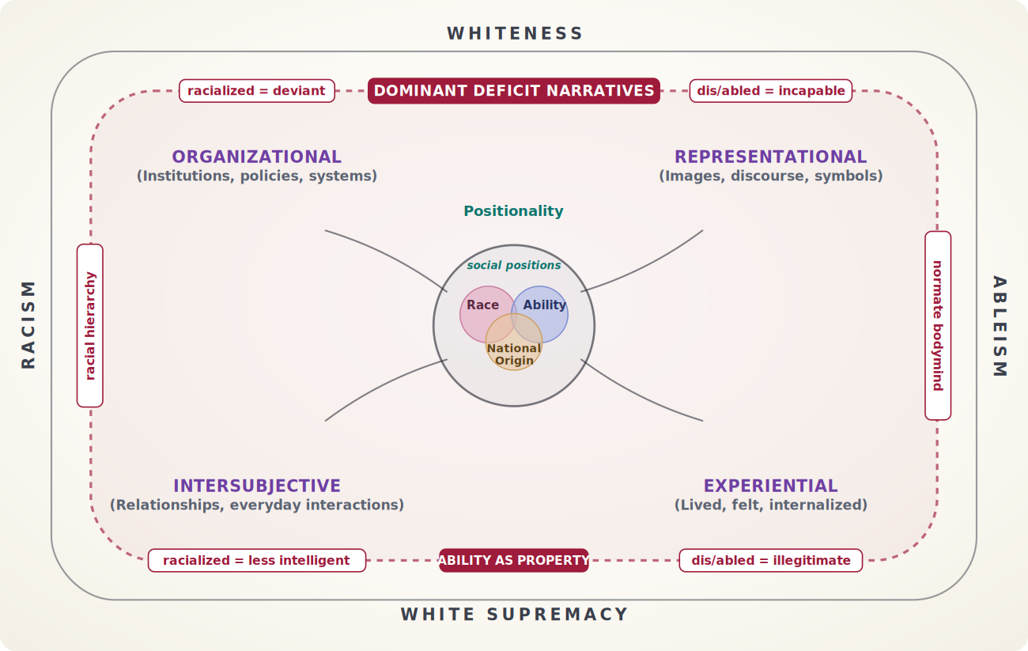
SOCIETAL ARENAS
SOCIETAL ARENAS
Notes:
Arena labels appear.

Slide 25
Societal Arenas — examples
Societal Arenas
Where Positionality (Identity) Happens — students engage their identities in context.
Organizational
Representational
Institutional structures and policies
Messages, images, and information
Intersubjective
Experiential
Daily interactions and relationships
Personal stories and lived experiences
Notes:
Societal Arenas — native, editable.

Slide 26
Narration: Dynamic positionality forces
Within each arena, dynamic positionality forces engage with the individual and shape their identification, expectations, and sense of belonging within their social positions.
Notes:
Sentence beat (dim background). Next click reveals/demonstrates it.

Slide 27
DYNAMIC POSITIONALITY FORCES
DYNAMIC POSITIONALITY FORCES
Notes:
All four arenas pulse together in the live demo.

Slide 28
Narration: Pulls
Pulls stretch positionality toward those dominant deficit narratives …
Notes:
Sentence beat (dim background). Next click reveals/demonstrates it.

Slide 29
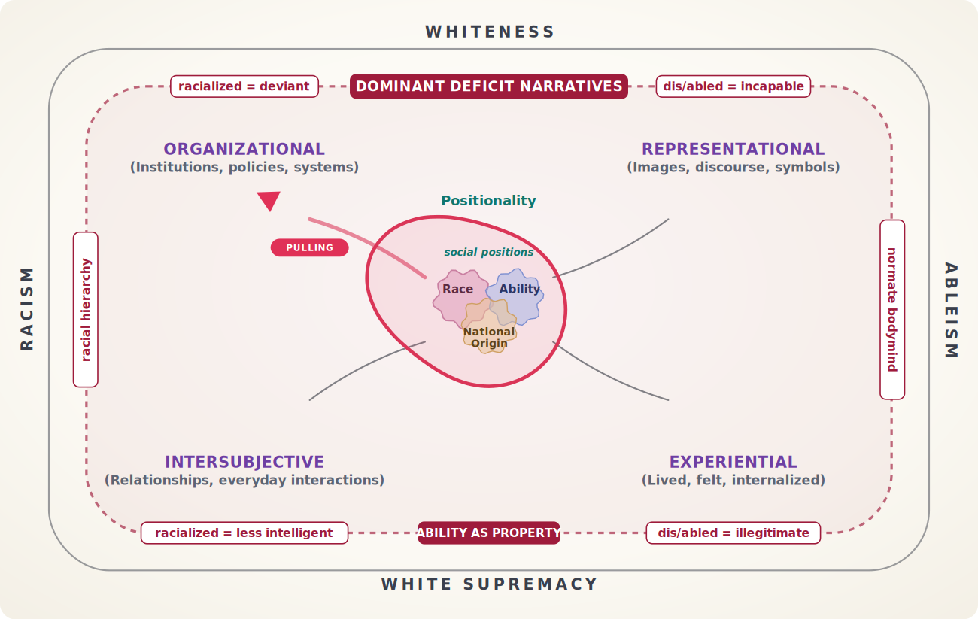
PULLS · ORGANIZATIONAL FIRST
PULLS · ORGANIZATIONAL FIRST
Notes:
Organizational pulls surge; blob distorts; deficit box glows.

Slide 30
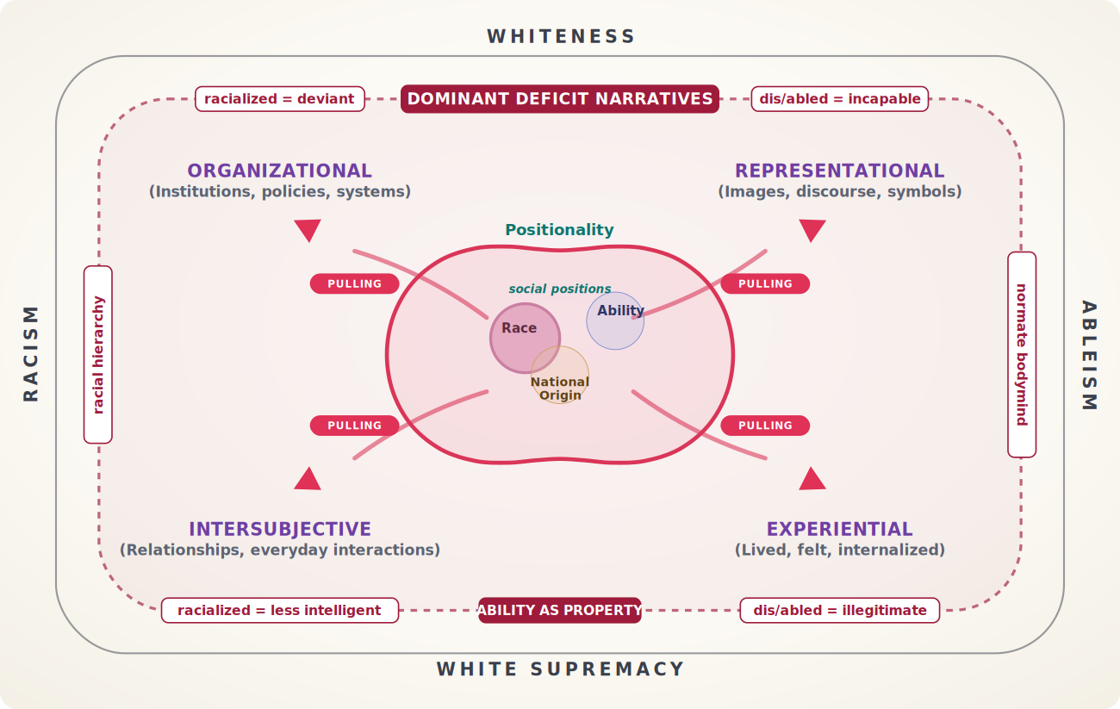
PULLS · ALL ARENAS
PULLS · ALL ARENAS
Notes:
Remaining arenas follow.

Slide 31
Positionality Pulls — examples
Positionality Pulls
Negative forces that drag students toward deficit narratives.
Organizational
Representational
Inaccessible buildings, inadequate disability services
Stereotypes, deficit-focused messaging
Intersubjective
Experiential
Microaggressions, low expectations from faculty
Isolation, invisibility, feeling unwelcome
Notes:
Pulls examples — native, editable.

Slide 32
Narration: Reinforcers
… reinforcers build resilience and counter-narratives …
Notes:
Sentence beat (dim background). Next click reveals/demonstrates it.

Slide 33
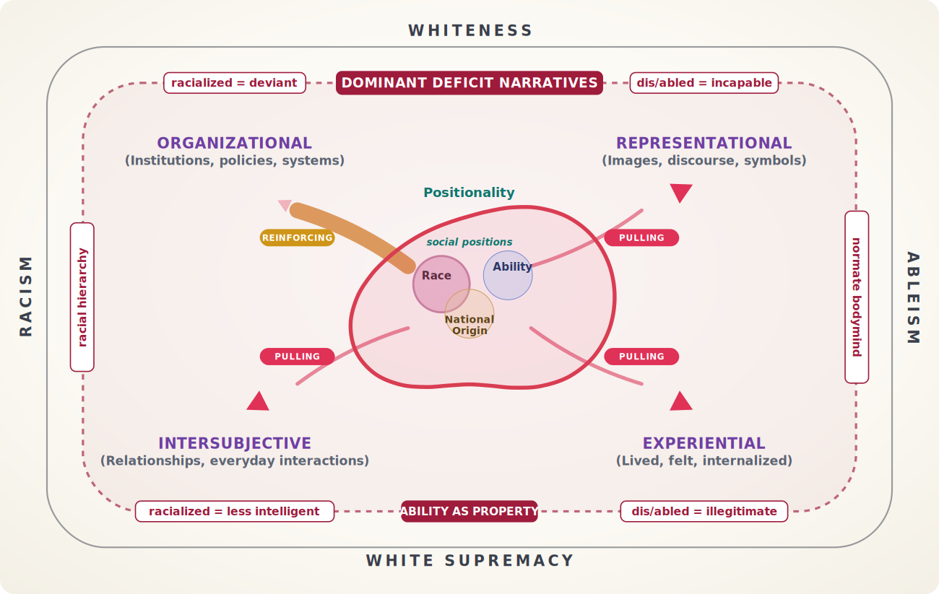
REINFORCERS · ORGANIZATIONAL
REINFORCERS · ORGANIZATIONAL
Notes:
Reinforcers rise, pulls drop — band turns gold.

Slide 34
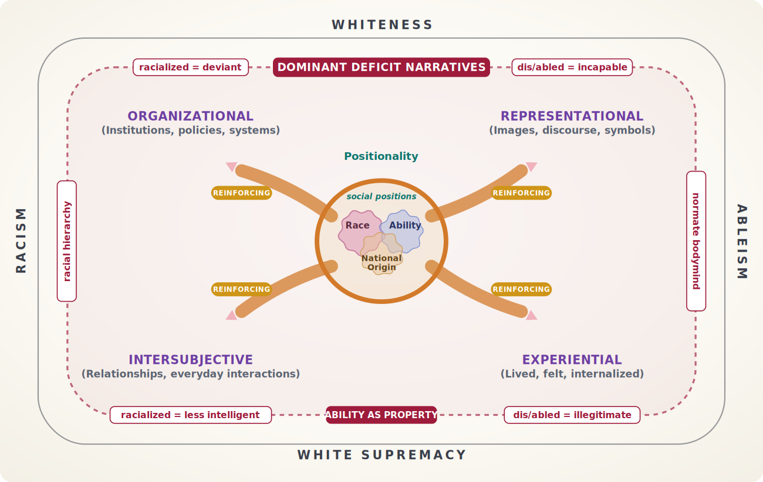
REINFORCERS · ALL ARENAS
REINFORCERS · ALL ARENAS
Notes:
All four reinforcing.

Slide 35
Positionality Reinforcers — examples
Positionality Reinforcers
Positive forces that build resilience and counter-narratives.
Organizational
Representational
HBCUs, Deaf community spaces, culturally responsive services
Positive role models, affirming images and stories
Intersubjective
Experiential
Mentorship, supportive relationships, community
Identity-affirming spaces, cultural pride, achievement
Notes:
Reinforcers examples — native, editable.

Slide 36
Counter-Narratives — definition
Counter-Narratives
Alternatives that Challenge Deficit Narratives
What they are
Examples
Stories that highlight strength, resilience, and capability.
“Our communities have rich traditions of learning” or “Disability is part of human diversity.”
Impact
Power
They build pride and create new possibilities.
They protect against negative forces and fuel resistance.
Notes:
Counter-Narratives — native, editable.

Slide 37
Narration: Pushes
… and, thus empowered, the individual pushes back on the oppressive systems to create change.
Notes:
Sentence beat (dim background). Next click reveals/demonstrates it.

Slide 38
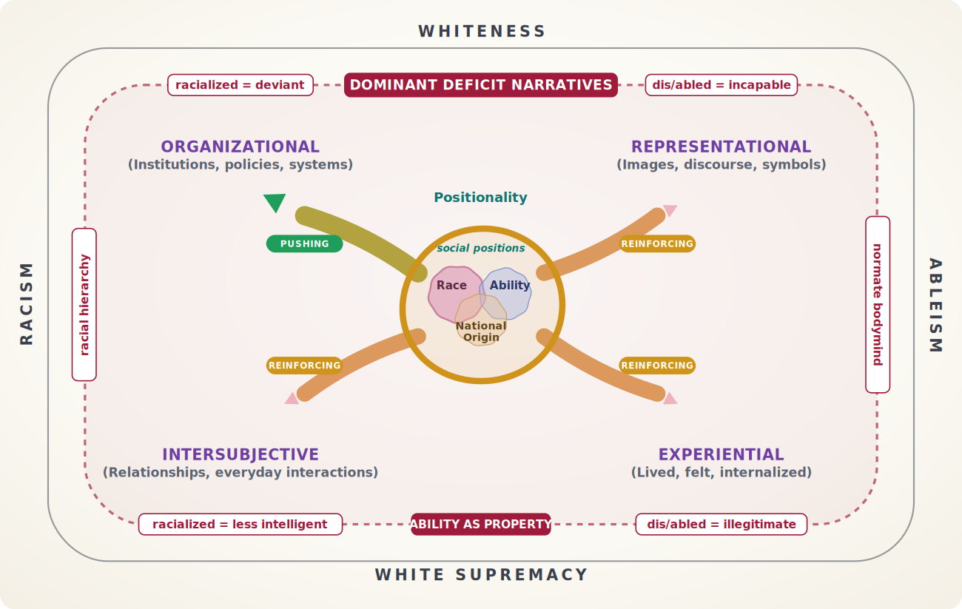
PUSHES · ORGANIZATIONAL
PUSHES · ORGANIZATIONAL
Notes:
Push capacity unlocked by reinforcement; green arrow fires.

Slide 39
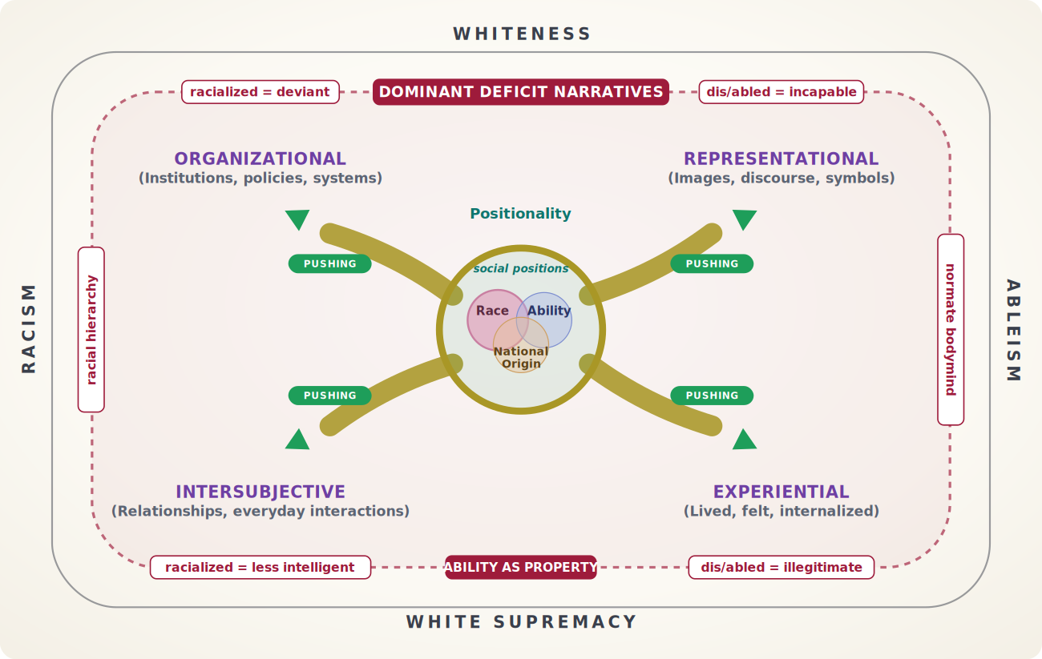
PUSHES · ALL ARENAS
PUSHES · ALL ARENAS
Notes:
All four pushing.

Slide 40
Positionality Pushes — examples
Positionality Pushes
Active forces where students push back and create change.
Organizational
Representational
Policy advocacy, demanding institutional change
Creating counter-narratives, sharing stories
Intersubjective
Experiential
Self-advocacy in classrooms, educating others
Building community, organizing, resistance movements
Notes:
Pushes examples — native, editable.

Slide 41
Intersectional Identity Stress
Intersectional Identity Stress
Results of Unequal and Conflicting Systems
Conflicting experiences of oppression & privilege — exclusion & belonging — at different social positions, across societal arenas, time, and place, increase intersectional stress.
Notes:
Intersectional Identity Stress — native, editable.

Slide 42
Narration: Dynamic salience
The dynamic salience spectrum shows how social positions cohere — fractured, stressed, strategic, or synergistic — as intersectional stress rises or falls under the influence of the dynamic positionality forces across the different societal arenas.
Notes:
Sentence beat (dim background). Next click reveals/demonstrates it.

Slide 43
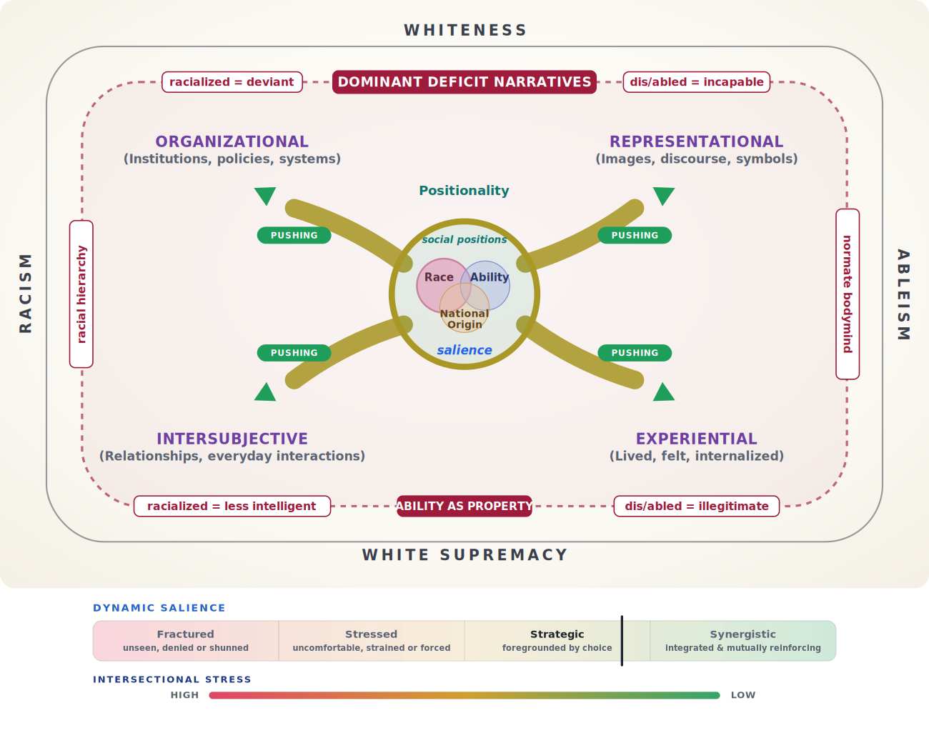
DYNAMIC SALIENCE
DYNAMIC SALIENCE - INTRODUCED
Notes:
Salience spectrum + intersectional stress appear.

Slide 44
Dynamic Salience Defined
Social positions (identities) are apparent or attended to in varying degrees depending on social contexts (societal arenas), place, and time — directly related to intersectional stress and the results of oppression/privilege.d
Fractured
Stressed
One or more positions are ignored or blocked.
One or more positions are given attention, but it is uncomfortable — not by choice.
Strategic
Synergistic
An individual intentionally chooses which positions to enact in a context.
An individual enacts most positions freely — bringing their full self to a context.
Notes:
Dynamic Salience definitions — native, editable.

Slide 45
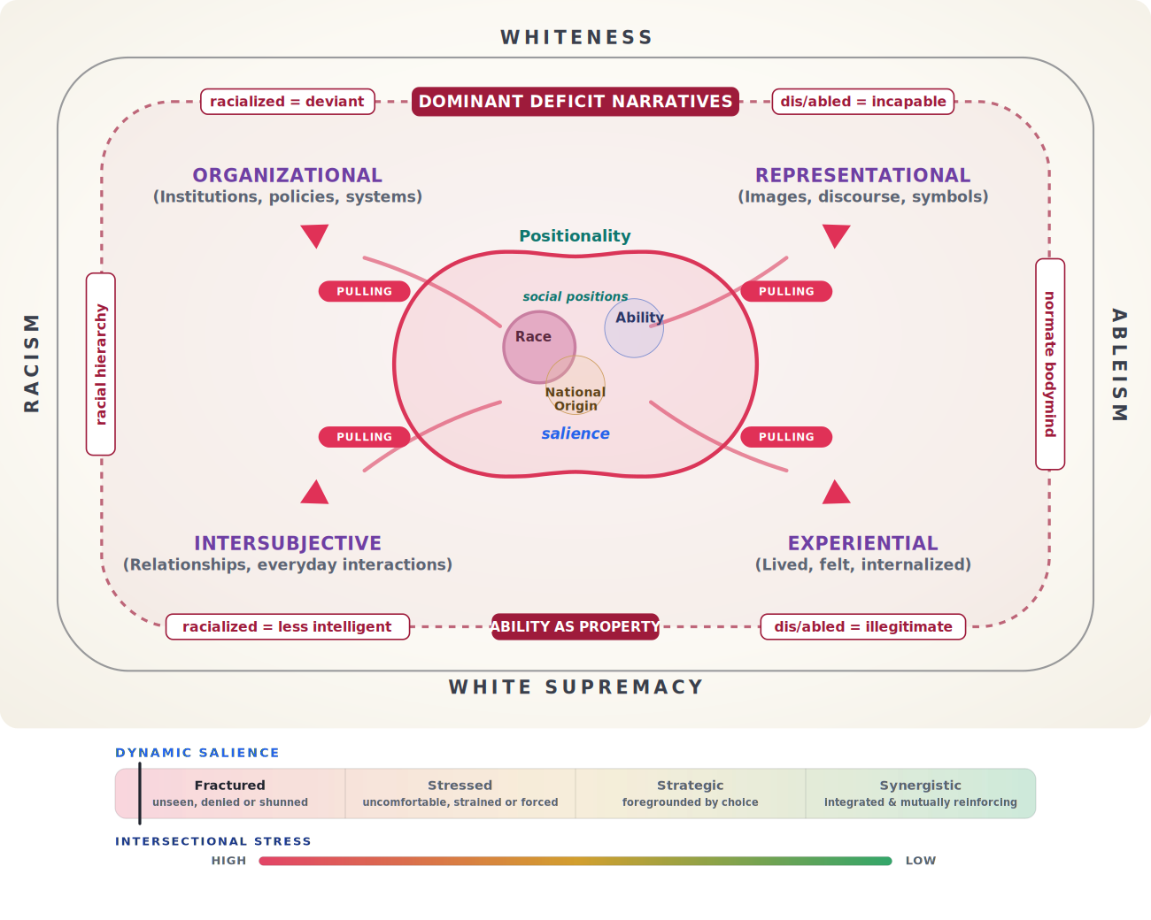
SALIENCE · FRACTURED
SALIENCE · FRACTURED
Notes:
Heavy pulls: Ability breaks away; Race dominates.

Slide 46
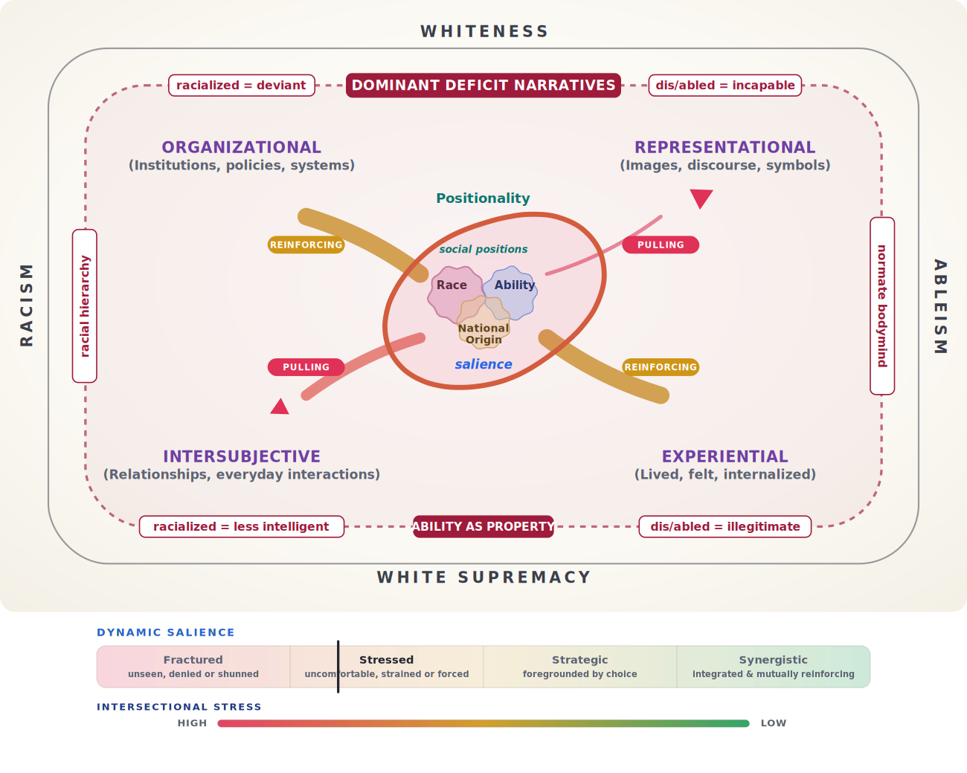
SALIENCE · STRESSED
SALIENCE · STRESSED
Notes:
Reinforcers counter pulls: even spacing, jagged outlines.

Slide 47
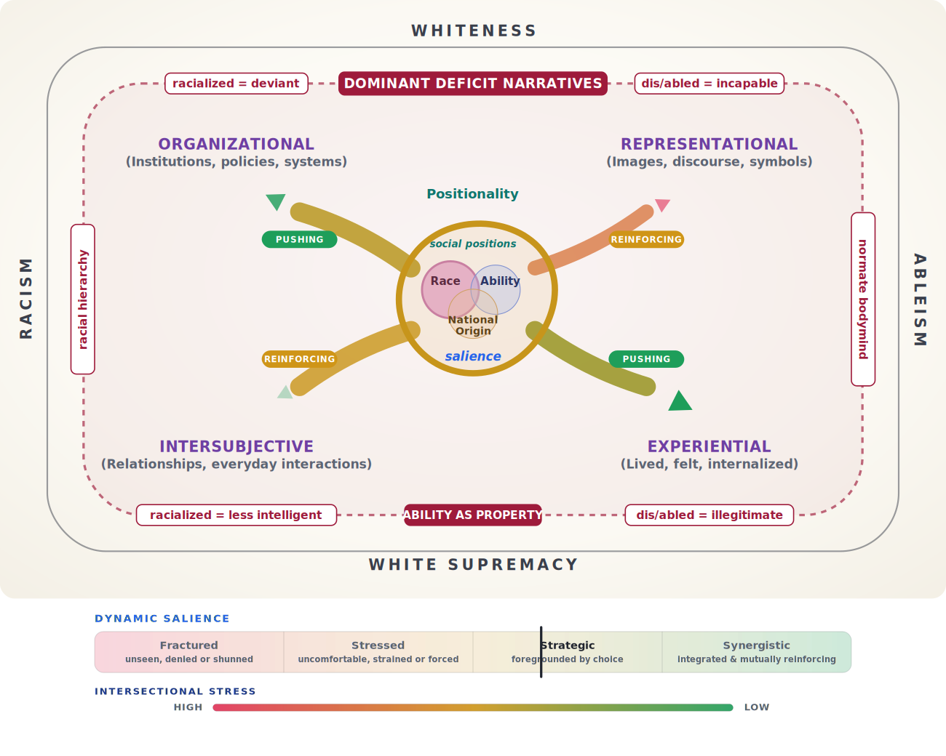
SALIENCE · STRATEGIC
SALIENCE · STRATEGIC
Notes:
Reinforcement leads: overlap grows, one foregrounded.

Slide 48
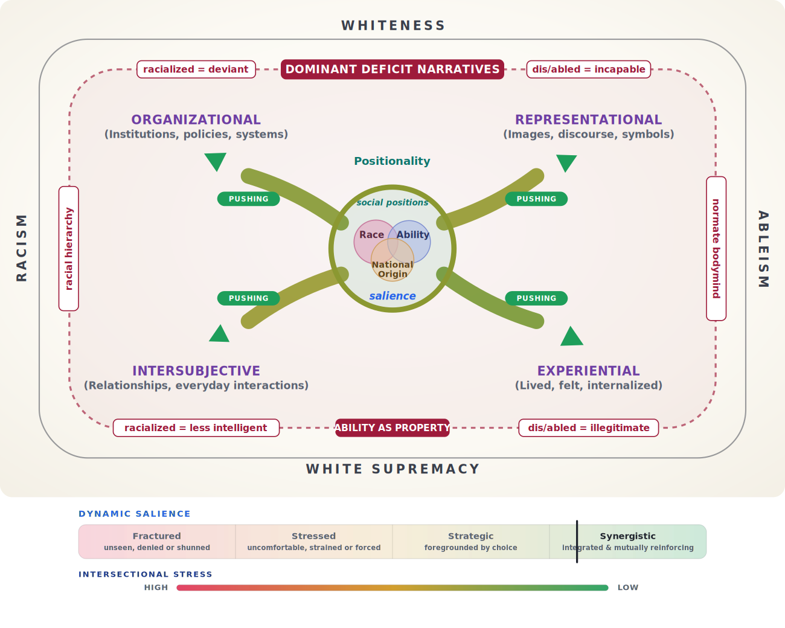
SALIENCE · SYNERGISTIC
SALIENCE · SYNERGISTIC
Notes:
Pulls gone: full overlap, even brightness.

Slide 49
The model in one paragraph
THE THEORY-TO-PRAXIS MODEL IN ONE PARAGRAPH
Higher education is built upon and reinforces white supremacy, whiteness, ableism, and racism, yielding dominant deficit narratives — the result: “Ability as property.” An individual’s positionality — their intersecting social positions within context, place, and time — is ELASTIC. Societal arenas (organizational, representational, intersubjective, experiential) are the contexts an individual’s positionality engages. Within each arena, dynamic positionality forces engage with the individual and shape their identification, expectations, and sense of belonging within their social positions. Pulls stretch positionality toward those dominant deficit narratives, reinforcers build resilience and counter-narratives, and, thus empowered, the individual pushes back on the oppressive systems to create change. The dynamic salience spectrum shows how social positions cohere — fractured, stressed, strategic, or synergistic — as intersectional stress rises or falls under the influence of the dynamic positionality forces across the different societal arenas.
Notes:
The complete explainer paragraph, exactly as it accumulates in the interactive tool.

Slide 50
Agenda
Theoretical foundations
Applying dynamic forces & salience
Debrief and takeaways
Introducing elastic positionality
Notes:
Agenda.

Slide 51
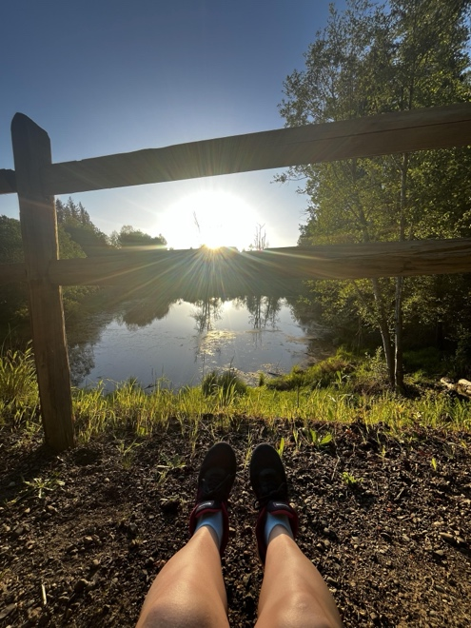
Group Exercise
Case Study: Meet Aurora
Steps in the Exercise:
Map the Pulls
Plan the Reinforcers
Capacity
Debrief
Materials Needed:
Tool: elastic-positionality.com
Find Vignette and Instructions in ”Workshop Tools” under “About this tool” at the top
Find Participant Worksheet in ”Workshop Tools” under “About this tool” at the top

Slide 52
Meet Aurora — student vignette
Meet Aurora
I’m Aurora. I’m 32, from Brazil — I came here in 2016. Back home I was just Brazilian; I didn’t get racialized until I arrived in the United States. Here, when I fill out a form, my skin color is not there, because my ethnicity is mixed up. When I have to, I say Afro-Latina — that’s not on the form either. I’m working on my master’s in social work, and I registered with the disability services office for my low vision. I also live with depression and anxiety, but I didn’t ask for accommodations for those. Honestly, the office felt like more of a disservice than a service — everything has to be requested, and my white classmates seem to know everything that’s available from the get-go. If you come as an outsider from another country, everything is just so different; it’s harder when you have to jump through a lot of hoops.
Notes:
Read the vignette aloud; participants have it as a 14-pt handout.

Slide 53
Meet Aurora — student vignette
Meet Aurora, continued
And when I do ask, it feels like my race comes in front of everything else — like being brown and having a disability is “too much,” so whatever’s in the back isn’t a priority. Nobody asks me, “What are your accessibility needs?” So I do a lot of self-advocacy, and it’s tiring. When I meet someone, I’m not going to lead with what I struggle with — I’ll tell you what I do best, that I’m from Brazil, Latina, Afro-Latina. That comes first. I’m already down on privilege. These days I mostly manage: friends in class fill me in when I miss something on the screen, and I bought a tablet so I can make the files as big as I need. My disability doesn’t define me — it didn’t stop me from being here. But I keep thinking: in Brazil, some of this just felt automatic.
Notes:
Read the vignette aloud; participants have it as a 14-pt handout.

Slide 54
Workshop — Map the pulls
WORKSHOP · ROUND 1 · 10 MIN
Map the pulls
In your arena group, name the pulls acting on Aurora in your societal arena.
At least one pull must be something a disability services office itself produces or tolerates — a form, a phrasing, a delay, an eligibility gate.
Report out — we’ll type them in, raise the red sliders, and watch the model respond.
Notes:
Round 1 instructions.

Slide 55
Positionality Pulls — fill-in
Positionality Pulls - Examples
Organizational
Representational
TO BE ADDED
TO BE ADDED
Intersubjective
Experiential
TO BE ADDED
TO BE ADDED
Notes:
Fill-in: pulls per arena — type answers live.

Slide 56
Dynamic Salience — fill-in
Dynamic Salience – Examples from Pulls
Fractured
Strategic
TO BE ADDED
TO BE ADDED
Stressed
Synergistic
TO BE ADDED
TO BE ADDED
Notes:
Mark and fill Aurora’s salience after this round.

Slide 57
Workshop — Reinforce
WORKSHOP · ROUND 2 · 10 MIN
Plan Reinforcers
What does — or could — your office do that builds counter-narratives in Aurora’s positionality?
We’ll raise the gold sliders; pulls come down only where practice genuinely removes one.
1
2
Notice: Reinforcement doesn’t erase pulls —
It contests them!!
Notes:
Round 2 instructions.

Slide 58
Positionality Reinforcers — fill-in
Positionality Reinforcers – Examples
Organizational
Representational
TO BE ADDED
TO BE ADDED
Intersubjective
Experiential
TO BE ADDED
TO BE ADDED
Notes:
Fill-in: reinforcers per arena — type answers live.

Slide 59
Dynamic Salience — fill-in
Dynamic Salience – Examples from Reinforcers
Fractured
Strategic
TO BE ADDED
TO BE ADDED
Stressed
Synergistic
TO BE ADDED
TO BE ADDED
Notes:
Mark and fill Aurora’s salience after this round.

Slide 60
Workshop — The capacity lesson
WORKSHOP · ROUND 3 · 10 MIN
The capacity lesson
Try pushing where reinforcers are still low — the slider will not move!!
Try again when a reinforcement is in place. Notice how much further the student can push.
Name a push — a way Aurora acts on the system.
Student agency is not a personality trait; it is capacity.
Our practice can either builds or starves capacity!!
Notes:
Round 3 instructions.

Slide 61
Positionality Pushes — fill-in
Positionality Pushes - Examples
Organizational
Representational
TO BE ADDED
TO BE ADDED
Intersubjective
Experiential
TO BE ADDED
TO BE ADDED
Notes:
Fill-in: pushes per arena — type answers live.

Slide 62
Dynamic Salience — fill-in
Dynamic Salience – Examples from Pushes
Fractured
Strategic
TO BE ADDED
TO BE ADDED
Stressed
Synergistic
TO BE ADDED
TO BE ADDED
Notes:
Mark and fill Aurora’s salience after this round.

Slide 63
Agenda
Theoretical foundations
Applying dynamic forces & salience
Debrief and takeaways
Introducing elastic positionality
Notes:
Agenda.

Slide 64
Debrief — what about your office?
DEBRIEF · 10–15 MIN
What about your office?
What would Aurora say your office’s sliders are actually set to?
Which pulls on our list does your office have the authority to remove next semester? Are there places that your office needs to focus first?
How might your office reinforce students’ counter-narratives and resilience next semester, especially when pulls are not readily removable?
Where do you see your students exercising agency and resistance? Are you ready to make changes in response to their advocacy?
Notes:
Debrief discussion; capture answers on the fill-in slides.

Slide 65
My 1-1-1 commitment
My 1-1-1 commitment
What will you do — starting next semester? Name one concrete action in each.
One pull to remove:
TO BE ADDED
One reinforcer to add:
TO BE ADDED
One push to empower:
TO BE ADDED
Notes:
Each participant writes a 1-1-1 commitment.

Slide 66
Selected References
Annamma, S. A., Connor, D., & Ferri, B. (2013). Dis/ability critical race studies (DisCrit): Theorizing at the intersections of race and dis/ability. Race Ethnicity and Education, 16(1), 1–31. https://doi.org/10.1080/13613324.2012.730511
Anthias, F. (2013). Intersectional what? Social divisions, intersectionality and levels of analysis. Ethnicities, 13(1), 3–19.
Aubrecht, K., & La Monica, N. (2017). (Dis)embodied disclosure in higher education: A co-constructed narrative. Canadian Journal of Higher Education, 47(3), 1–15. https://doi.org/10.7202/1043235ar
Banks, J., & Gibson, S. (2016). The voices of African American male students with disabilities attending historically Black universities. Journal of African American Males in Education, 7(1), 70–86.
Banks, J., & Hughes, M. S. (2013a). Double Consciousness: Postsecondary Experiences of African American Males with Disabilities. The Journal of Negro Education, 82(4), 368–381.
Boveda, M., & Annamma, S. A. (2023). Beyond Making a Statement: An Intersectional Framing of the Power and Possibilities of Positioning. Educational Researcher, 52(5), 306–314. https://doi.org/10.3102/0013189X231167149
Braun, V., & Clarke, V. (2022). Thematic analysis: A practical guide. Sage.
Brooks, C. M., & Poudrier, J. (2014). Anti-oppressive visual methodologies: Critical appraisal of cross-cultural research design. Qualitative Sociology Review, 10(4), 32–51.
Chapple, R. L., Bridwell, B. A., & Gray, K. L. (2021). Exploring intersectional identity in Black Deaf women: The complexity of the lived experience in college. Affilia - Journal of Women and Social Work, 1–22. https://doi.org/10.1177/0886109920985769
Notes:
Selected references.

Slide 67
Selected References
Clandinin, D. J. (2016). Engaging in narrative inquiry. Routledge.
Comeaux, E., Mireles, D., & Acha, A. (2021). Dis/abled student campusmaking: Sites of new possibility. Education Sciences, 11(11). https://doi.org/10.3390/educsci11110745
Connor, D. J., & Gabel, S. L. (2013). “Cripping” the Curriculum Through Academic Activism: Working Toward Increasing Global Exchanges to Reframe (Dis)Ability and Education. Equity and Excellence in Education, 46(1), 100–118. https://doi.org/10.1080/10665684.2013.750186
Crenshaw, K. (1991). Mapping the Margins: Intersectionality, Identity Politics, and Violence against Women of Color. Stanford Law Review, 43(6), 1241–1299. https://doi.org/10.2307/1229039
Dirth, T. P., & Branscombe, N. R. (2018). The social identity approach to disability: Bridging disability studies and psychological science. Psychological Bulletin, 144(12), 1300–1324. https://doi.org/10.1037/bul0000156
Dolmage, J. T. (2017). Academic ableism: Disability and higher education. University of Michigan Press.
Erevelles, N., & Minear, A. (2010). Unspeakable offenses: Untangling race and disability in discourses of intersectionality. Journal of Literacy & Cultural Disability Studies, 4, 127–146. https://doi.org/10:3828/jlcds.2010.11
Foste, Z., & Irwin, L. (2020). Applying critical whiteness studies in college student development theory and research. Journal of College Student Development, 61(4), 439–455.
Foste, Z., Tevis, T. L., & Davis, T. (2022). On the enormity of whiteness in higher education. In Z. Foste & T. L. Tevis (Eds.), Critical whiteness praxis in higher education (pp. 1–18). Stylus.
.
Notes:
Selected references.

Slide 68
Selected References
Foste, Z., & Whitehead, M. A. (2022). Starting from the margins: Reflections on challenging whiteness in higher education. In Z. Foste & T. L. Tevis (Eds.), Critical whiteness praxis in higher education. Stylus
Friedensen, R. E., & Kimball, E. (2017). Disability and college Students: A critical examination of a multivalent identity. In Theory and Method in Higher Education Research (Vol. 3, pp. 227–245). Emerald Publishing Limited. https://doi.org/10.1108/S2056-375220170000003013
Garland-Thomson, R. (2012). Disability studies: A field emerged. American Quarterly, 65(4), 915–926.
Gillborn, D. (2015). Intersectionality, Critical Race Theory, and the Primacy of Racism: Race, Class, Gender, and Disability in Education. Qualitative Inquiry. https://doi.org/10.1177/1077800414557827
Goethals, T., De Schauwer, E., & Van Hove, G. (2015). Weaving intersectionality into disability studies research: Inclusion, reflexivity and anti-essentialism. DiGeSt. Journal of Diversity and Gender Studies, 2(1–2), 75–94. https://doi.org/10.11116/jdivegendstud.2.1-2.0075
Goodley, D. (2018). The dis/ability complex. DiGeSt. Journal of Diversity and Gender Studies, 5(1), 5. https://doi.org/10.11116/digest.5.1.1
Irwin, L. N. (2022). White normativity: Tracing historical and contemporary (re)productions of whiteness in higher education. In Z. Foste & T. L. Tevis (Eds.), Critical whiteness praxis in higher education: Considerations for the pursuit of racial justice on campus (pp. 48–69). Stylus Publishing, LLC.
Kafer, A. (2016). Un/safe disclosures. Journal of Literary & Cultural Disability Studies, 10(1), 1–20. https://doi.org/10.3828/jlcds.2016.1
Kim, H., Ruppar, A. L., Baker, D., Kim, S., & Yu, B. (2023). Interweaving disentangled: Korean American students with autism go to college. Race Ethnicity and Education, 26(7), 892–913. https://doi.org/10.1080/13613324.2020.1842349
Notes:
Selected references.

Slide 69
Selected References
Mireles, D. (2022). Theorizing Racist Ableism in Higher Education. Teachers College Record: The Voice of Scholarship in Education, 124(7), 17–50. https://doi.org/10.1177/01614681221111428
Museus, S. D., & Griffin, K. A. (2011). Mapping the margins in higher education: On the promise of intersectionality frameworks in research and discourse. New Directions for Institutional Research, 2011(151), 5–13. https://doi.org/10.1002/ir.395
Nishida, A. (2019). Critical disability praxis. In K. Ellis, R. Garland-Thomson, M. Kent, & R. Robertson (Eds.), Manifestos for the future of critical disability studies, Volume 1 (pp. 239–247). Routledge.
Pearson, H. E. (2017). Moving towards the trialectics of space, disability, and intersectionality: Intersecting spatiality and arts-based visual methodologies. Knowledge Cultures, 5(5), 43–68. https://doi.org/10.22381/KC5520174
Pearson, H., & Samura, M. (2017). Using a spatial lens to examine disability as diversity on college campuses. Disability as Diversity in Higher Education: Policies and Practices to Enhance Student Success, 89–103. https://doi.org/10.4324/9781315644004
Peña, E. V., Stapleton, L. D., & Schaffer, L. M. (2016). Critical perspectives on disability identity. New Directions for Student Services, 154, 85–96. https://doi.org/10.1002/ss.20177
Ramirez-Stapleton, L. D., Torres, L. E., Acha, A., & Mchenry, A. (2020). Disability justice, race, and education. Journal Committed to Social Change on Race and Ethnicity, 6(1), 29. https://adapt.org
Ressa, T. W., & Danforth, S. (2023). Disability, Race, and Origin Intersectionality in the Doctoral Program: Ableism in Higher Education. Scandinavian Journal of Disability Research, 25(1), 147–159. https://doi.org/10.16993/sjdr.911
Seidman, I. (2019b). Interviewing as qualitative research: A guide for researchers in education and the social sciences (5th ed.). Teachers College Press.
Notes:
Selected references.

Slide 70
Selected References
Shallish, L. (2020). “I have to be Black before I am disabled”: Understanding agency, positionality, and recognition in higher education. In L. Ware (Ed.), Critical Readings in Interdisciplinary Disability Studies (pp. 171–179). Springer. https://doi.org/10.1007/978-3-030-35309-4_14
Shallish, L. E., Smith, M. D., & Taylor, A. (2022). Collusive symbiosis: Notes on disability as white property in higher education. In S. Annamma, B. A. Ferri, & D. J. Connor (Eds.), DisCrit expanded: Reverberations, ruptures, and inquirie (pp. 31–44). Teachers College Record.
Sins Invalid. (2019). Skin, tooth, and bone: The basis of movement is our people. (2nd ed.).
Solorzano, D. G., & Yosso, T. J. (2001). Critical race and LatCrit theory and method: Counter-storytelling? International Journal of Qualitative Studies in Education, 14(4), 471–495. https://doi.org/10.1080/09518390110063365
Stapleton, L. (2015). When being deaf is centered: d/Deaf women of color’s experiences with racial/ethnic and d/Deaf identities in college. Journal of College Student Development, 56(6), 570–586.
Stapleton, L., & Croom, N. (2017). Narratives of black d/deaf college alum: Reflecting on intersecting microaggressions in college. Journal of Student Affairs Research and Practice, 54(1), 15–27. https://doi.org/10.1080/19496591.2016.1204308
Stienstra, D., & Nyerere, L. (2016). Race, ethnicity and disability: Charting complex and intersectional terrains. In Disability in the Global South (pp. 255–268). https://doi.org/10.1007/978-3-319-42488-0
Vaccaro, A., & Kimball, E. (2016). “It’s a very deep, layered topic”: Student affairs professionals on the marginality and intersectionality of disability. In E. Kim & K. C. Aquino (Eds.), Disability as diversity in higher education: Policies and practices to enhance student success (pp. 138–152). Routledge.
Vaccaro, A., Moore, A., Kimball, E., Troiano, P. F., & Newman, B. M. (2019). “Not gonna hold me back”: Coping and resilience in students with disabilities. Journal of Student Affairs Research and Practice, 56(2), 181–193. https://doi.org/10.1080/19496591.2018.1506793
Notes:
Selected references.

Slide 71

Thank you for attending!!
Contact me with questions or comments.
Jewls Griesmeyer-Krentz
Pacific University
Forest Grove, OR
jewls@pacificu.edu

Slide 72
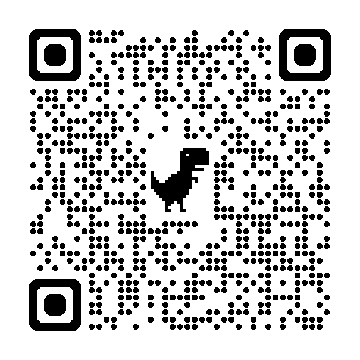
Session Evaluation
tiny.cc/8zu1101
Thank you for attending!
Your feedback helps shape future programming.

