Slide 1

Sustaining the Disability Rights Movement through the Difficult Days Ahead
2026 Opening Plenary Session
Paul D. Grossman, JD, Executive Counsel, AHEAD

Slide 2
Caveat
The author and presenter of this PowerPoint deck assumes no responsibility for reliance on the information set forth in the deck.
This deck is provided for informational purposes only and is not to be construed as legal advice. You should seek the advice of counsel in order to resolve any legal issues that you are responsible for addressing.
Providing or sharing this PowerPoint deck does not create an attorney-client relationship between its author, persons conveying, presenting, or posting this deck, and any other person. Further, this deck has not been written, posted, or conveyed to recommend any particular transaction.
No copyright is claimed as to the graphics or works of others including photographic works.

Slide 3
Verklempt
SNL: Mike Meyers as Linda Richmond
On “Coffee Talk”

Slide 4

My 40-Minute Floor Routine
I am grateful for the trust placed in me
by Katy, Stephan, Elisa and all of you
And, to be clear, today, I speak only for myself
Sokha Grossman, leaping 15-year-old girl in blue and white tights, doing a gymnastics floor routine

Slide 5
An Obnoxious Ad for Life Insurance
“We don’t like to talk about it in our society,
but some day we are going to die. We are all going to die.

Slide 6
Suddenly, My Generation is Seeking Grace
(In the sense of an inner peace)

Slide 7
In the Pursuit of Grace,
We Are Writing
All Sorts of Strange Letters
Hate letters
Way too late love letters
Expressions of penitence and apology
Overdue insightful expressions of appreciation

Slide 8
A Love Letter to
My Brothers and Sisters of AHEAD

Slide 9
AHEAD Is Not a
Professional Organization
It is more, a Community
A community that I am confident has the potential to withstand the current onslaught to our civil rights

Slide 10
We Are Community of Mentors and Mentees
Essential to: family and community, courage,
the preservation of historic lessons learned,
to our own growth as a font of solutions

Slide 11
I Cherish This Community,
For What it Has Done for Me
I learned how my disability works
I met and bonded with at least four of my best friends
I learned the value of being a mentor and mentee
I gained a voice and a purpose/mission in life
I became part of a community
AHEAD Louisville, July 2009

Slide 12
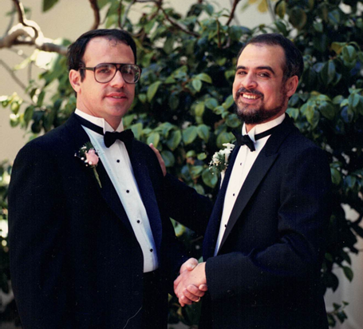
I Cherish This Community for Who YOU Are (1)
You are “other-directed” selfless, caring people
You are tight-rope walking diplomats
You welcome and include everyone into our community
You are the “guardians of our humanity”
You affirm the humanity of every person
Richard and Paul: 2 brothers in tux

Slide 13
I Cherish This Community for Who YOU Are (2)
You have the capacity to individualize again and again
You are “creative-types” and original problem solvers
You are an agent of legal compliance
Particularly through universal design,
you are engines for innovation in high education
By removing barriers for disabled students,
you remove them for many other students

Slide 14

You Foster Diversity
Haben Girma
Freda Kahlo

Slide 15
My Highly Dishonest and Unethical Path to Academic Success
Absent a matter of safety or direct threat,
is any single academic requirement truly “essential”?

Slide 16
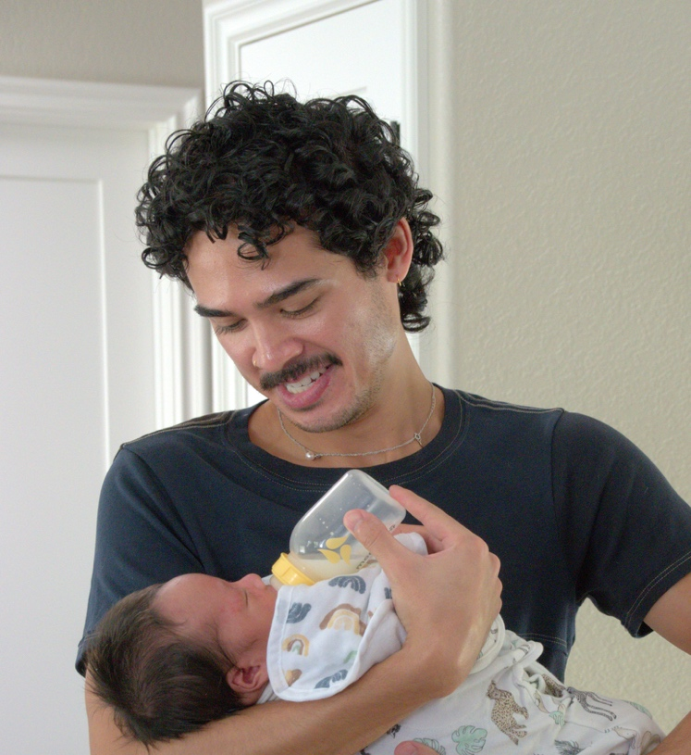
My Mentor Son, Seth
“The entire DSS industry is a scam; calculated to keep dependent young people with disabilities, dependent adults by giving them a lot of false expectations about how they will be treated in the real world, especially the world of work.”

Slide 17
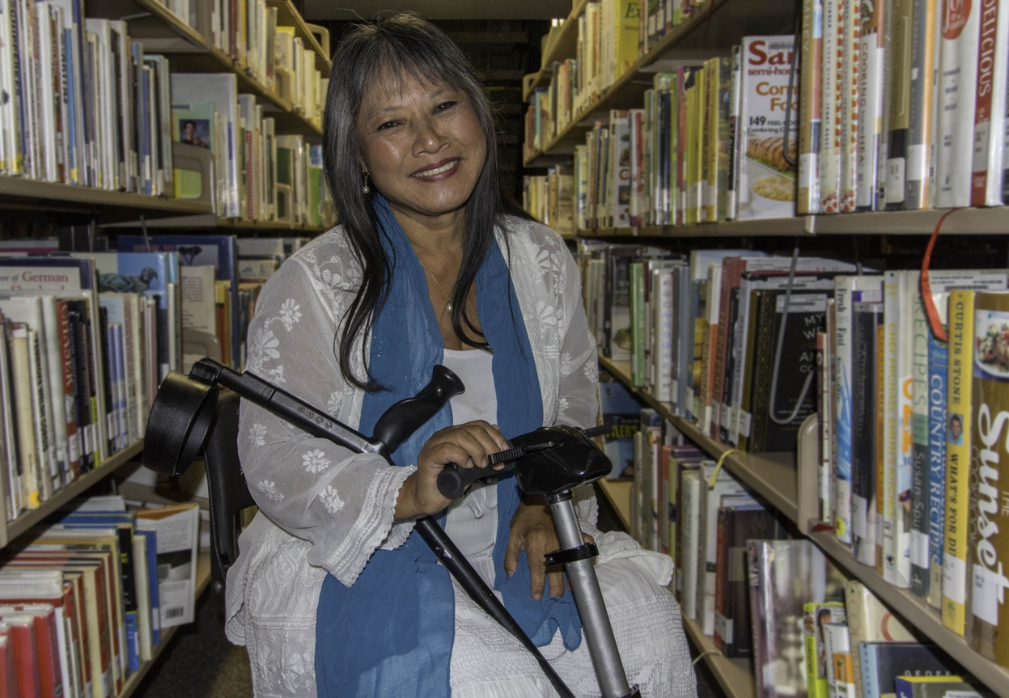
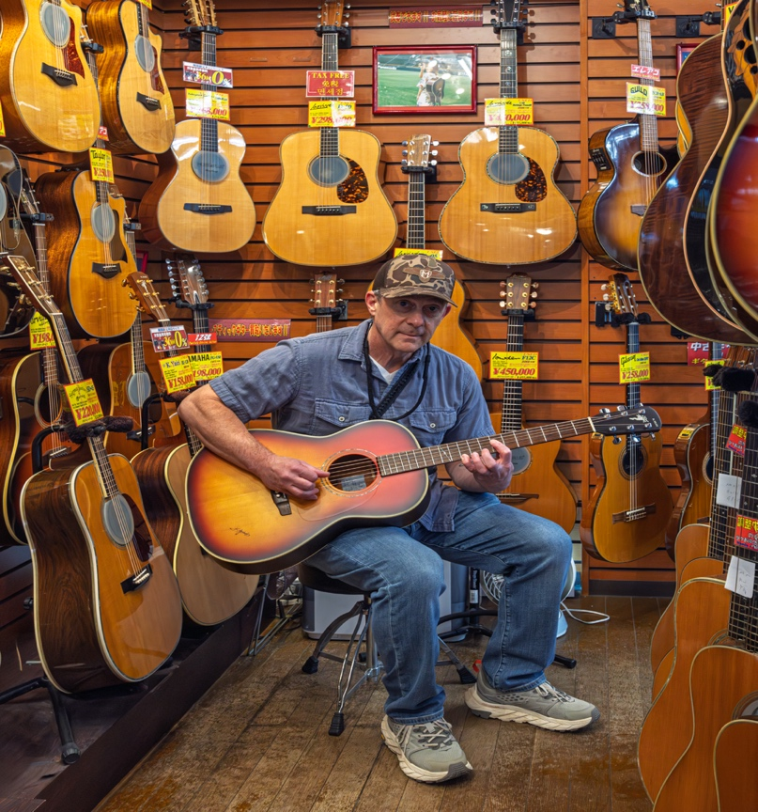
My Most Important AHEAD Mentors/Mentees
Very cool male playing a guitar in a musical instrument shop in Tokyo – Jamie Axelrod, M.S.
Well-published, Asian female “scholar on a scooter”
in some library stacks – Mary Lee Vance, Ph.D.

Slide 18
Here, Now, This Morning,
I Seek a Commitment from Each You
Before you leave Providence,
volunteer to mentor someone in AHEAD,
and ask someone in AHEAD to be your mentor

Slide 19
“Difficult Days AHEAD”

Slide 20
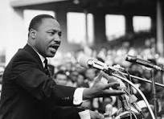
Dr. King Spoke of “Difficult Days AHEAD”
They Are Back
Martin Luther King Jr. spoke of "difficult days ahead" in an address, known as "I've Been to the Mountaintop," delivered on April 3, 1968, at Bishop Charles Mason Temple in Memphis. He was assassinated the following evening.

Slide 21
The “Promised Land” Has Been Postponed
The Moral Arc of the Universe Is
Currently Not Bending In A Good Direction

Slide 22
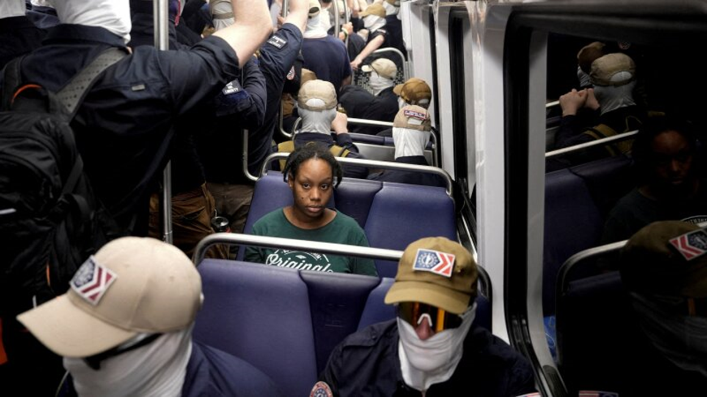
With Courage,
You, AHEAD, Our Community,
Will Have to Stand Up, and Fight Back
Young Black woman surrounded by masked white nationalists while seated on DC Metro Orr, Cheney, Reuters, 4 July 2026

Slide 23
Fortunately, We Have Mentors Holding a Torch with a Powerful Flame
Ready to Hand it to Us,
You must keep it bright!

Slide 24
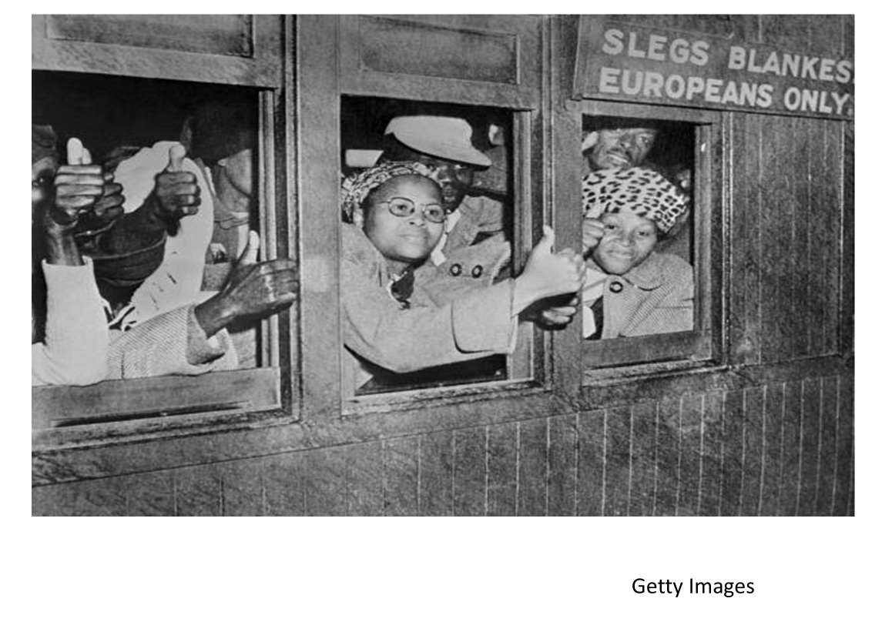
What Gandhi Learned from The Buddha
Buddhism through a Hindu lens (480 BCE)
Reverence for all living beings
The Buddha taught that suffering, when faced with equanimity and grace, leads to liberation
Gandhi (1869-1948), a London-educated lawyer living in South Arica, transformed this into a political tool: voluntarily accepting suffering (imprisonment, fasting, beatings) to awaken the conscience of the oppressor
All beings are connected; injustice anywhere harms everyone, including the perpetrator

Slide 25
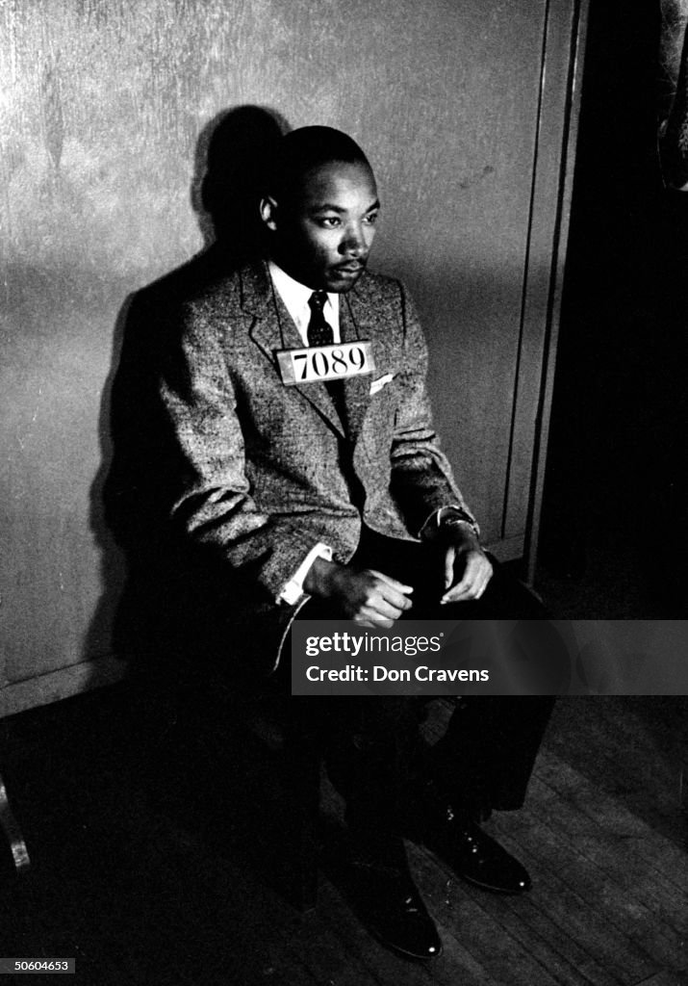
What M.L. King, Ph.D. Learned from Ghandi
From Gandhi, Dr. King learned that nonviolence wasn't passive — it was a purposeful, even aggressive, moral confrontation
With the courage of his faith in Jesus, Dr. King adopted Gandhi's insight that willingly absorbing violence exposes the moral bankruptcy of the oppressor and shifts public sympathy
Filling jails, marching in the face of fire hoses —Dr. King learned from Gandhi that physically occupying space and accepting consequences was itself a form of advocacy speech
Dr. King sits for mug shot, in jail, during the Montgomery Bus Boycott Feb. 21, 1956 Getty Images

Slide 26
What Asst. Sec. Judy Huemann Learned from MLK
Dr. King reframed Black identity to a rights-bearing political identity – Heumann reframed disability as a civil rights issue, not a medical problem needing a cure or a matter of charity or pity
She practiced direct action and civil disobedience
She engaged in coalition building across difference
Dr. King's movement rejected the idea that Black Americans should be grateful for whatever small bits of inclusion/integration they were offered – Judy Heumann (1947-2023) carried this same uncompromising demand for full inclusion with regard to disability; particularly while battling for strong regulations implementing Section 504 --- making the regs. you implement, sacred

Slide 27
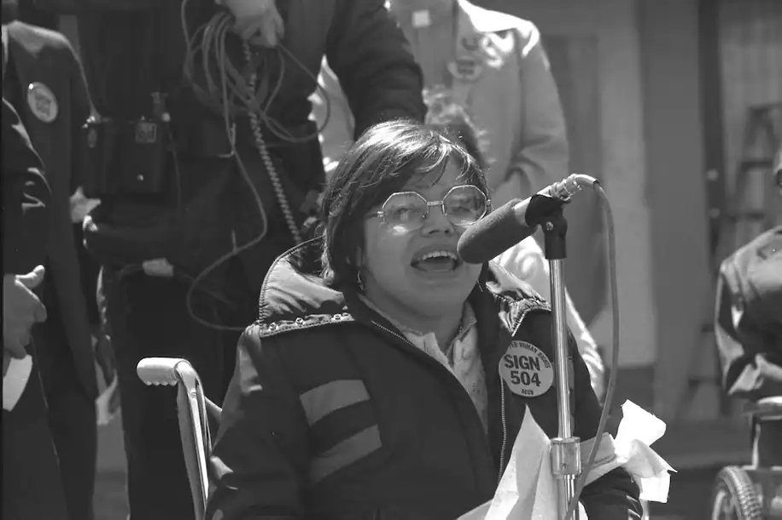
Judy during 504 sit-in
Picture of Judy Heumann, seated in a wheelchair, in front of a microphone, wearing a parka, with a yellow pin saying, “Sign 504”
Photograph by HoLynn D’Lil

Slide 28
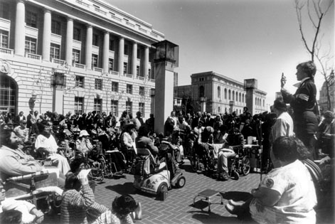
Crowd Gathering for 504 Sit-In
Picture of 250 individuals with disabilities, gathered at 50 United Nations (UN) Plaza, in April 5, 1977 listening to speeches from State Senator Tom Hayden, Rev. Cecil Williams, the Black Panthers, feminists, union officials, the queer community, and other Civil Rights groups. The Sit-in began on began April 5, 1977; the regulations were signed on April 28; the demonstrators left 1 or 2 days later. Photo credited to HolLynn D’Lil

Slide 29
What We Must Learn from Judy Huemann
Demonstrate courage in the fashion of Ghandi & King—bow to no one
Never forget the lessons of the Holocaust – protect the most vulnerable and consequently, the larger society from the “slippery slope”
Do not forget our history: honor the contributions of persons with polio, children of Holocaust survivors, persons who were medically fragile, the deaf, and queer people for their sacrifices and compelling strategic leadership on behalf of disability rights

Slide 30
My Last Meeting with Judy
March 3, 2022, 3 AM PST

Slide 31
Our Difficulties Ahead

Slide 32
The Decimation of OCR: Salami Tactics
Half as many employees, fewer than half as many offices
Despite OCR receiving a record number of new discrimination complaints in 2025, nearly 24,000, OCR reached just 112 resolution agreements—the fewest in at least 12 years; “providing meaningful relief in just 1% of cases.”
  1.4% for disability
  OCR’s resolution agreements fell 78%—from 507 case resolution agreements in 2024 to
The proposed budget requests for OCR suggest that OCR will be 33% smaller than in the last administration

Slide 33
Decimation of OCR: Enforcement Effort “Collapse”
“Compared to 2024, … OCR reached settlement agreements in:
  92% fewer cases involving academic adjustments
  93% fewer disability harassment cases
  33% fewer accessibility cases”
“GAO found that from March 2025 to September 2025, 90% of OCR’s case resolutions were dismissals”
    April 28 Report by the US Senate HELP [Health, Education, Labor, and Pensions] Committee staff, which in turn is based on a February 2026, Government Accountability Office (GAO) report

Slide 34
Decimation of OCR: Dispatching OSERS and OCR
Agreements are now in place to move OSERS to HHS raising fears of a return to the medical model and moving OCR to DOJ
  Manifestly violates the ED Organization Act
  What stays in ED and what moves to DOJ is unclear – new legislative proposals as to OSERS and OCR do not resolve this question
  OCR is an administrative agency; DOJ is an enforcement agency
  Maybe to get a tight grip by the AG on “hot topics” like transgender sports and disparate impact, with other OCR functions remaining at ED, for now?
  Isolates the human capital at OCR from other sources of education expertise https://www.ed-ocralum.org/our-work

Slide 35
A Perfect Tool for a Federally Controlled Dictatorship:
OMB Docket#: 2026-0034 Proposed Federal Funding Rule
The largest overhaul in years of the rules for every federal grant (2 C.F.R. Part 200) --- but comments might turn it back
Gives senior political appointees broad new power to decide who gets funded.
Attaches ambiguous and vague conditions on “illegal DEIA,” “racial preferences,” and “anti-American values” — none defined
Lets Federal grantors cancel awards at any time, with no hearing and no appeal

Slide 36
Other Bad Stuff
Delay in implementation of the DOJ Web Access and Phone App regulation – with complete revocation still possible
Comprehensive elimination of disparate impact liability across the Federal government for all protected groups
Proposed rescission of Section 504 Building-Accessibility Standards in a Department of Energy Rule
Comprehensive elimination of gender dysphoria as a group protected from disability discrimination
Making it harder to sue, harder to win, and less likely to get a cost-beneficial remedy in litigation

Slide 37
We Have Spoken of Community Earlier This Morning
DoJ Understands Its importance, as well
The misconstruction of Olmstead v. LC by the DoJ OLC

Slide 38
The Worst Symbol: Turning the Dissent in Olmstead v. LC into the Majority Opinion
Olmstead v. LC, 527 U.S. 581 (1999)
State of Texas v. Kennedy (formerly Texas v. Becerra), No. 5:24-cv-00225 (N.D. Tex., filed Sept. 26, 2024)
  14 Republican AGs filed suit alleging that Section 504 and the Olmstead mandate were unconstitutional
  Thanks to people power, it is now 7 states and the claim has been narrowed to the challenge to Olmstead -- Alaska, Florida, Louisiana, Missouri, Montana, South Dakota, and Texas
  This matter is at the briefing stage

Slide 39
Our Most Sacred Democratic Tool:
The Vote

Slide 40
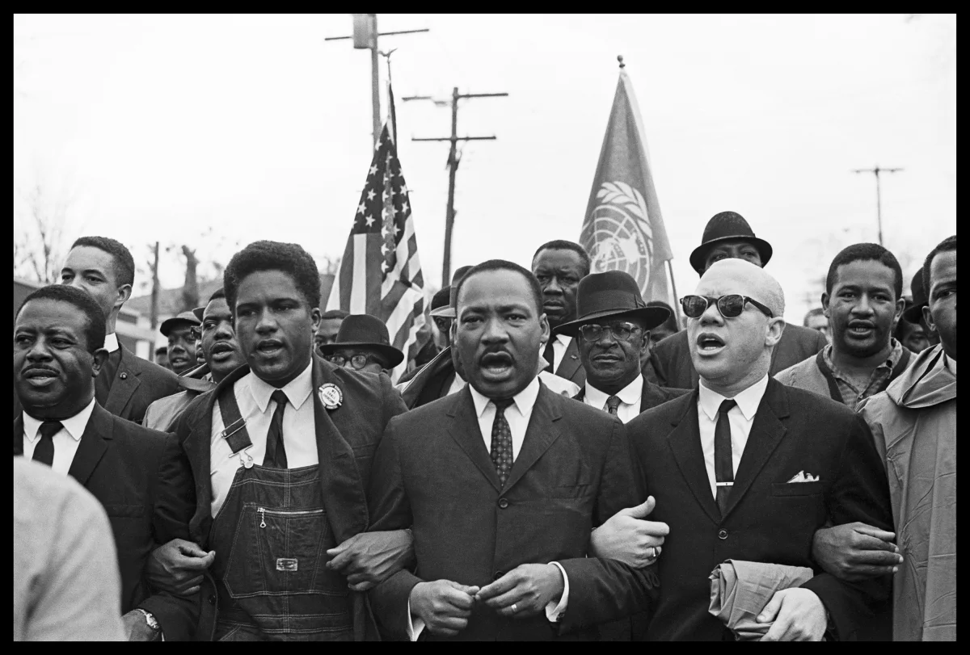
Preparing to Cross the Edmund Pettus Bridge
Preparing to cross the Edmund Pettus Bridge on “bloody Sunday,” March 7, 1965, before the marchers were heavily attacked by Alabama State Troopers and alleged clan members
Four Black males with arms linked, in suitcoats and ties, Rev. Ralph Abernathy, James Forman, Dr. Martin Luther King Jr. and Rev. Jess Douglas leading the voting rights march from Selma Alabama to the Montgomery County Courthouse, the site for voter registration in Douglas County. Photo by Spider Martin/posted by the Briscoe Center for American History

Slide 41
A Return to Jim Crow: “Hollowing Out” of the Voting Rights Act of 1965
As the result of four Supreme Court decisions, most recently, Louisiana v. Callais, 608 U.S. ___ (2026), the Voting Rights Act, a formerly affirmative tool, has become very hard to use, particularly with regard to challenging gerrymandering that has an adverse impact on the basis of race but can be justified, instead, on partisan grounds
  See also Shelby County v. Holder, 570 U.S. 529 (2013) [ended preclearance requirements]; Rucho v. Common Cause, 588 U.S. 684 (2019) [partisan gerrymandering claims present nonjusticiable political questions beyond the reach of federal courts]; Brnovich v. Democratic National Committee, 594 U.S. 647 (2021) [made it substantially harder to win a results-based challenge to a restrictive voting rule]

Slide 42
As Democrats, Republicans, and Independents,
What Can We Do, Now?

Slide 43
Voting Data Suggests
A Two-Party/Nonpartisan Approach is Necessary
Within my life-time, largely due to the large number of Americans with disabilities (44-54 million), multiple wars (vets), both parties have supported disability rights, e.g. George H.W. Bush, Bob Dole, Orrin Hatch-- though evidence of this is aging with regard to the Republican Party
Most people form their voting preferences early in life based on the influences of those around them, particularly parents and family
Race, national origin, religious affiliation, family, union membership, have historically been much more powerful determinants of voting preference than disability

Slide 44
What You Can Do on Your Campus (1)
Foster a disabled students’ organization on your campus
Encourage your students to seek out campus governance positions like student body president or member of the honors committee
Push for the adoption of universal design in assessment, curriculum, and architectural access
Walk down to your campus Vet Center with pizza and technology – if there is no Vet Center foster the creation of one
Capitalize on the fact that America is aging when designing campus programs

Slide 45
What You Can Do on Your Campus?(2)
Affirmatively offer to meet with other student organizations
Propose mandatory faculty training on disability discrimination analogous to what is available with regard to sexual or racial harassment
Run for a position with AHEAD to weigh in on the difficult questions like, in this era or retribution, do we or don’t we become an amicus party
Participate in disability-related research and scholarship like JPED

Slide 46
What We Can Do (1)
Form disability rights organization of your own:
  It may be small but influential; e.g., the OCR Alumni Collective
  Communicate directly with your State & Fed. Senatorial and House Reps
    How I got entrée through a back door to the Senate HELP Committee Staff
  “Sign on to” or respond to: letters, Rule comments, editorials, and litigation of others
    Propound supporting affidavits for litigators

Slide 47
What We Can Do (2)
Join, volunteer for, and donate to disability rights organizations
Money, Money, Money
Examples:
  National Federation of the Blind (NFB) - nfb.org/
  National Association of the Deaf (NAD) - nad.org
  American Association of Persons with Disabilities (AAPD) - aapd.org
  National Disability Rights Network-P&A (NDRN) - ndrn.org
  the Bazelon Center for Mental Health Law - www.bazelon.org/
  the American Civil Liberties Union (ACLU) - aclu.org
  Disability Rights Education Defense Fund (DREDF) - dredf.org
  Disability Rights Advocates (DRA) - dralegal.org
  Council of Parent Attorneys and Advocates (COPAA) - copaa.org
  the ARC of the United States (ARC) - thearc.org
  National Council of Independent Living (NCIL) - ncil.org
  Autistic Self Advocacy Network (ASAN) - asan.org
  and a growing number of state-based/focused disability rights organizations (my personal favorite is DREDF)

Slide 48
What We Can Do? (3)
Join, volunteer for and donate to existing education/civil rights organizations
National Organization of Women (NOW) - now.org
Democracy Forward https://democracyforward.org
The NAACP Impact Fund - www.impactfund.org
Education Law Center (ELC) - edlawcenter.org
Mexican American Legal Defense and Education Foundation (MALDEF) - maldef.org
American Council on Education (ACE) - acenet.edu
American Association of University Professors (AAUP) - aaup.org
Facilitate a disability-related alliance, become a leader, in any pertinent professional organization to which you belong

Slide 49
What We Can Do (4)
Act at the State and local level
  Show up at a congressional or state town hall: in whose interest is it to severely downsize OCR?
  If you don’t like how your AG or County Attorney are behaving, let them know
  Run for local office, like school board
  Help both parties to develop a bigger/deeper bench of disabled politicians

Slide 50

Can We Heal?
The War in Vietnam,
An Era of Conflict That Was Even Greater than Now?
June 8, 1972, The Terror of War won a Pulitzer Prize in 1973

Slide 51
“Find Your Community, Find Your Mentors And With Then Make A Difference”
Attributed to Judy Heumann. See Heumann, Judith, and Kristen Joiner. Being Heumann: An Unrepentant Memoir of a Disability Rights Activist. Beacon Press, 2020

