Slide 1


What Does Disability Have to Do with It?
A workshop with Eli Clare (www.eliclare.com)

Slide 2
Workshop Material On-line
PowerPoint handout small—http://tinyurl.com/ dis-id-ppt-big
PowerPoint handout big—http://tinyurl.com/ dis-id-ppt-small
Disability Resources 12 pt—http://tinyurl.com/dis-resources-12
Disability Resources 18 pt—http://tinyurl.com/dis-resources-18
Disability Ally Flyer 12 pt—http://tinyurl.com/dis-ally-12
Disability Ally Flyer 18 pt—http://tinyurl.com/ dis-ally-18

Slide 3
Agenda
What is disability identity?
What do disability identities among disabled students have to do with access and accommodations?
What work are you and your office doing to foster disability identities? What are the barriers to this work?

Slide 4
Self-Reflection: Identity
Spend 5 minutes making a list of some of your identities (who you are)
Of the things you listed:
Which are things you chose?
Which were you born with or into?
Which did you acquire but had little control over?
Which were difficult for you to accept?
Which bring you joy?

Slide 5
Disability Identity Brainstorm
What do you think of when you encounter the phrase “disability identity”?
Let’s use the Zoom chat to brainstorm.
There are no right or wrong answers.

Slide 6

Characteristics of Disability Identity
beyond diagnosis
sense of how disability has shaped who we are
awareness of ableism
internal acceptance
sometimes pride
disability community
connection to disability culture
embracing interdependence
finding joy
resisting stereotypes (including overcoming and being seen as inspirational)

Slide 7
Descriptively vs. Politically Disabled
“When I say ‘descriptively disabled,’ I mean someone who has the lived experience of being disabled. They may not talk about ableism, discrimination or even call them selves ‘disabled,’ but they know what it feels like to use a wheelchair, experience chronic pain, have people stare at you, be institutionalized, walk with a brace, be isolated, etc. There are many people who are descriptively disabled who never become or identify as ‘politically disabled.’ When I say ‘politically disabled,’ I mean someone who is descriptively disabled and has a political understanding about that lived experience. I mean someone who has an analysis about ableism, power, privilege, who feels connected to and is in solidarity with other disabled people (regardless of whatever language you use). I mean someone who thinks of disability as a political identity/experience, grounded in their descriptive lived experience.” --Mia Mingus from her blog “Leaving Evidence”

Slide 8
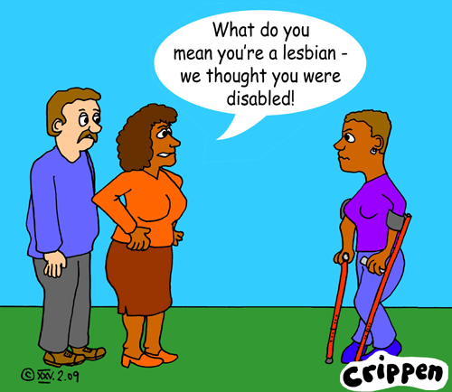
Disability Identity Never a Singular Identity
No one is only one identity.
Race, class, gender, sexual orientation, immigration, age, and religion/spirituality always connected.
Some identities may be more important than others for some people.

Slide 9
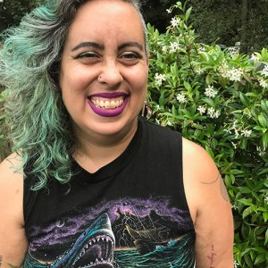
Multiple Identities
“Queer women of color never say we are disabled if we have any choice about it. We come from families who believe in being tough, in sucking it up. We do not want any more identities than we already have to wrestle with. Our bodies are already seen as tough, monster, angry, seductive, incompetent. How can we admit weakness, vulnerabllity, interdependence and stlll keep our jobs, our perch on the ‘thin edge of barbwire’ we live on?
Why would we join crips who are all white in the mainstream [disability] rights movement?” --Leah Lakshmi Piepnza-Samarasinha

Slide 10
Disability Identity Development
Resource: The work of Anjali J. Forber-Pratt “Finding ourselves: What we know about disability identity development” (https://notables.vkcsites.org/2017/07/finding-ourselves-what-we-know-about-disability-identity-development/3)

Slide 11
Disability Identities, Access & Accommodations
You all are working hard to create broad-based access and individual accommodations for disabled students on campus.
Disability identity may feel irrelevant to this work.
But….

Slide 12
Connections Between Disability Identities & Access
Disabled students who have claimed a disability identity or are working toward that are:
less likely to live with secrecy and shame
more likely to know what access they need and be able to advocate for it when necessary
more likely to name and confront ableism when it occurs, rather than internalizing the lack of access as personal failings
more prepared to navigate getting their access needs met and ableism in the world once they graduate

Slide 13
Connections Between Disability Identities & Access cont.
In other words fostering disability identities among disabled students is an integral part of supporting them and of ending ableism on campuses.

Slide 14
The Work of Fostering Disability Identities I
This work includes:
supporting disabled students in disability-affirming ways
for disabled staff, modeling strong, visible disability identities
encouraging students in becoming experts about their own access needs
minimizing the importance of diagnosis
framing access and accommodation failures as ableism
educating the students you work with about ableism

Slide 15
The Work of Fostering Disability Identities II
This work includes (continued):
connecting the students you work with together
hiring disabled students to work in your office
displaying disability art and culture in your office
providing staff the time to mentor disabled students
finding disabled staff and faculty to mentor disabled students
sponsoring disability culture and community events on campus

Slide 16
The Work of Fostering Disability Identities III
This work includes (continued):
encouraging students to found and join disability-focused student clubs
collaborating with others on campus doing diversity work
insisting that disability is part of diversity both on a policy and a practice level
pushing your campus to actively recruit, retain, and value disabled students
encouraging the integration of disability studies into the curriculum

Slide 17
Barriers to this Work
Not enough time
Don’t know enough about disability identity
Students not engaged or seemingly uninterested
On an institutional level disabled students perceived as a burden or legal liability
Ableism

Slide 18
Self-Reflection: The Work You’re Doing
What are you and your office doing to foster disability identities?
What would you like to be doing?
Is there support and motivation to do this work in your office?

Slide 19
Closing
In the Zoom chat, write three words about what you’re leaving this training with.

Slide 20

Thank you all!
www.eliclare.com
eliclare@buffalo.edu

