Slide 1
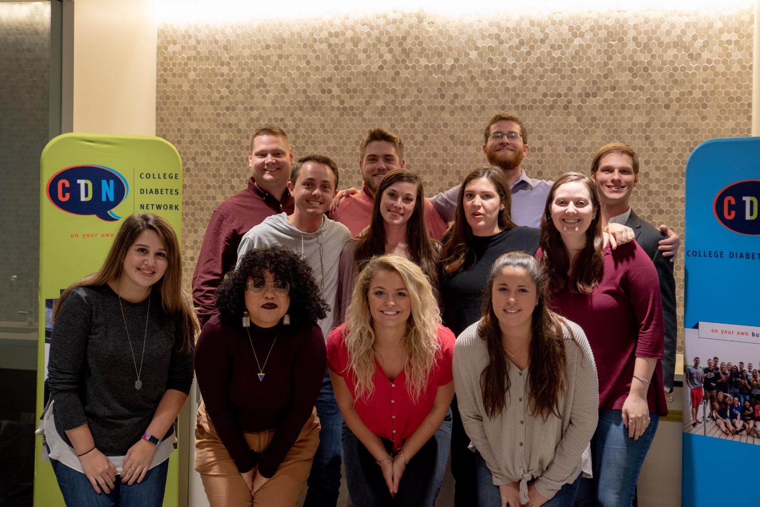


collegediabetesnetwork.org
THE COLLEGE DIABETES NETWORK

Slide 2

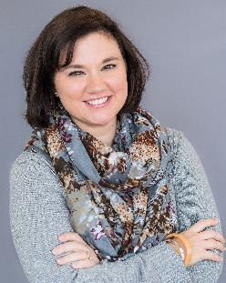
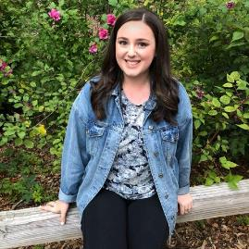

TODAY’S PRESENTERS
Anna
CDN’s Director of Young Adult Programs
Amanda Smith
STEM Outreach and Engagement Liaison for Penn State Center for Science
Lauren Kneeland
CDN NextGen Fellow

Slide 3



GOALS FOR TODAY
T1D is complex, but with support students can thrive on campus.
More confident in working with young adults with T1D.
Connect with CDN through resources, students, and Chapters.

Slide 4
CHALLENGES YOUNG ADULTS WITH T1D FACE
Young adults living with type 1 diabetes face a unique set of challenges as they make the transition to independence
HEALTH successfully managing their condition on their own
FINANCIAL navigating the complexities of health insurance
EMOTIONAL feeling isolated and unsupported
SOCIAL feeling misunderstood by their peers or colleagues

Slide 5




HOW IS TYPE 1 DIABETES MANAGED?
Treatments for this condition are focused on maintaining “in range” blood sugar levels through:
Regular Monitoring
Insulin
Therapy
Exercise
Diet

Slide 6
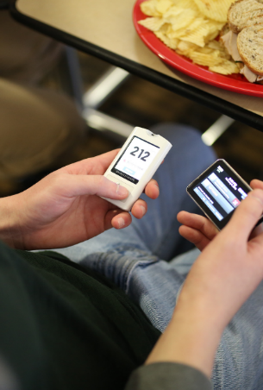
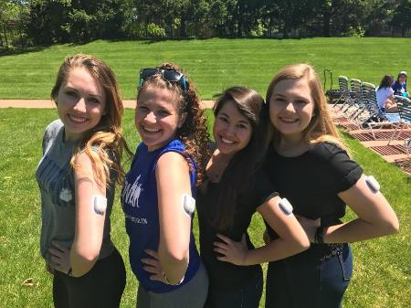
WHAT’S NEW IN T1D TECH?

Slide 7
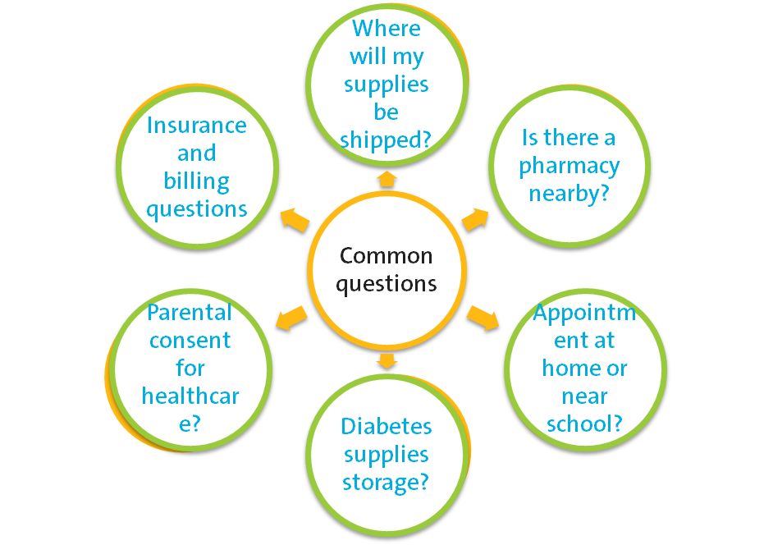
IS MY DIABETES AN ADULT?

Slide 8
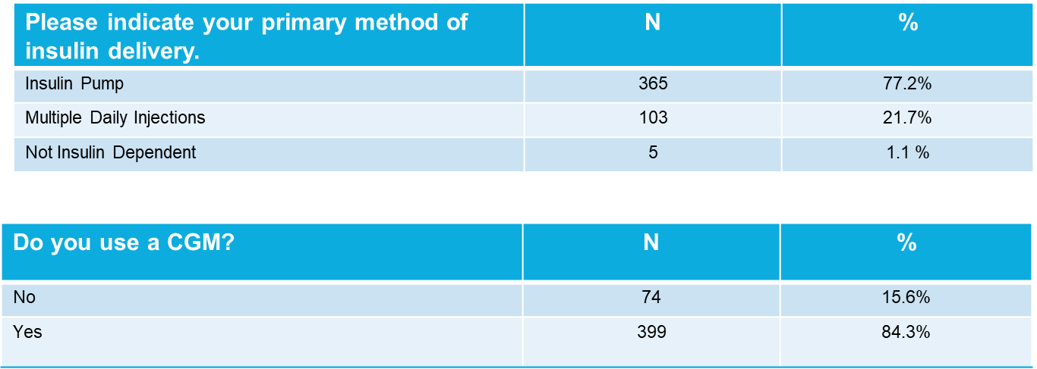
DEVICE USE

Slide 9
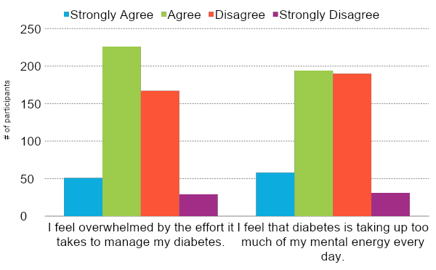
MENTAL HEALTH IMPACTS

Slide 10
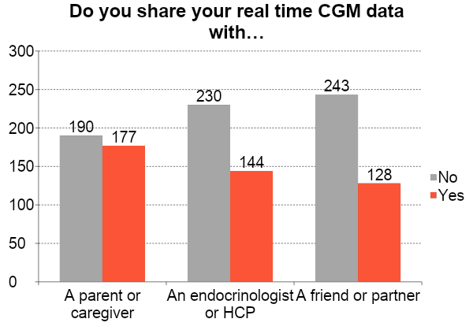
SHARING DATA

Slide 11
COMMONLY REQUESTED ACCOMMODATIONS
Priority housing and registration for classes.
Request of refrigerator and AC unit in dorm room.
Proximity housing to dining hall and bathroom.
Access to technology (cell phone) in the classroom.
Flexible/additional time for exams/assignments.
Food/drink allowed in classrooms.

Slide 12
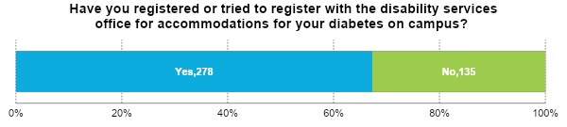
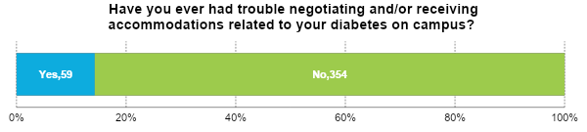
ACCOMMODATIONS

Slide 13
COVID-19 IMPACTS
What is your biggest long term worry (beyond next 90 days) related to the COVID-19 crisis?
“The biggest long term worry is the amount of supply that will be able for diabetics with everyone being out of work. It is already hard enough to afford medication, I can't imagine how hard it will be when supplies are scarce.” -20F
“I'm in the engineering program which has internships incorporated into my schedule - that's why it's a 5 year program. I'm afraid they will be cancelled and I had looked forward to the experience and that's how I planned to fund a lot of my college expense.” -19M
“My biggest long term worry during COVID-19 is the impact it is causing on my school work. Honestly, it is not the same doing online homework. I do not want it to make me fall behind on my graduation plans.” -21F
Notes:
What is your biggest long term worry (beyond next 90 days) related to the COVID-19 crisis?
“My biggest long term worry is contracting the virus and taking a turn for the worst and passing away due to my diabetes.” -20F
“The biggest long term worry is the amount of supply that will be able for diabetics with everyone being out of work. It is already hard enough to afford medication, I can't imagine how hard it will be when supplies are scarce.” -20F
“Long term, I am worried that the United States will not learn from this experience, and the healthcare system will continue to put people with health challenges (diabetes, chronic illness, etc.) in compromising financial situations.” -24F
“I'm in the engineering program which has internships incorporated into my schedule - that's why it's a 5 year program. I'm afraid they will be cancelled and I had looked forward to the experience and that's how I planned to fund a lot of my college expense.” -19M
“My biggest long term worry during COVID-19 is the impact it is causing on my school work. Honestly, it is not the same doing online homework. I do not want it to make me fall behind on my graduation plans.”
-21F

Slide 14

MEET THE COLLEGE DIABETES NETWORK
The College Diabetes Network (CDN) is a 501c3 non-profit organization singularly focused on providing young adults with T1D the peer connections they value, and expert resources they need, to successfully manage the challenging transition to independence at college and beyond.
“Being involved in CDN has made a huge difference for myself personally, and their resources have helped me to feel empowered and capable of managing my diabetes.”
– CDN Student Member
Notes:
What started as an informal student group on the University of Massachusetts, Amherst campus in 2009 quickly brought to light a major gap in support, resources, and education for young people managing diabetes while in college. Students realized there was a need to help each other navigate this major life transition. They could learn tips and strategies from their peers and connect with each other both in-person and online. Today, CDN is a nationally recognized non-profit organization with Chapters in nearly all 50 states, on more than 270 college campuses, serving thousands of students, their families, and the community of healthcare professionals eager to help young adults navigate the transition to not only living independently with diabetes, but thriving.

Slide 15






WHO DO WE SUPPORT?
High School Students
College Students
Young Professionals
Parents and Families
Clinicians
College Administrators

Slide 16
OUR REACH ACROSS CAMPUS
275
400
3,500
College Campus Chapters
Student Leaders
Student
Members
74%
30+
300+
of CDN Students feel empowered to take care of their diabetes on their own
Educational Resources
Campuses with CDN Materials

Slide 17





CDN CHAPTER NETWORK
Valuable source for peer support
Community of like-minded people with similar goals
Connections to others in the diabetes community
Advocates for diabetes awareness on campus
Leadership and skill building opportunities
TEXT
TEXT

Slide 18
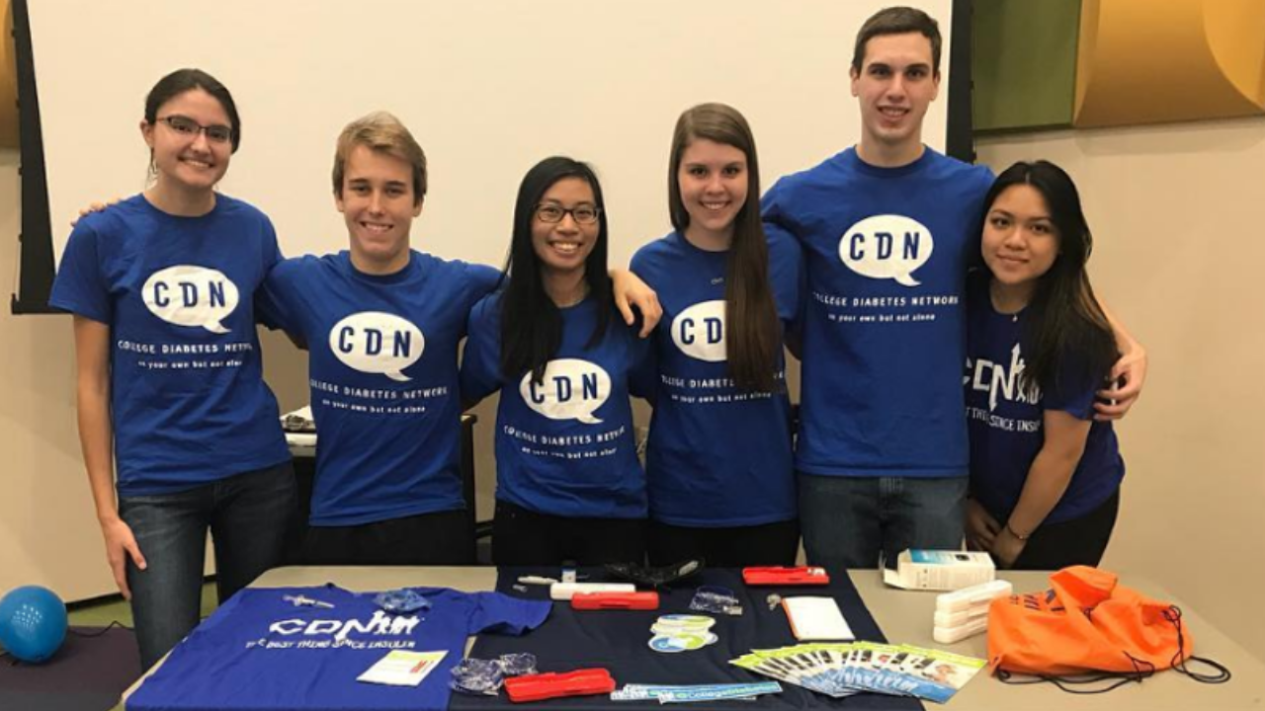
FROM THE STUDENTS
"CDN is the missing piece to the puzzle that we call diabetes. It has provided me with a communal space where I may demonstrate advocacy, gain knowledge and perspective, in addition to expanding my T1D family network.” -CDN Chapter Leader
<#>
16

Slide 19




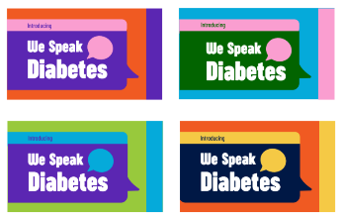
EDUCATIONAL RESOURCES
Bringing the young adult diabetes experience to the forefront.

Slide 20

INSIGHTS AND INFLUENCE
NextGen Fellowship
Professional Mentorship
“I am doing SO well through the Rutgers fellowship in my advocacy role at Sanofi. I know my personal life with diabetes was transformed when I attended my first CDN chapter event...and the NextGen program was a pivot point AND a trampoline for my career. It’s amazing that CDN is able to create that for an entire generation of people with diabetes.”
-NextGen Participant

Slide 21

CDN REACH™
A multi-year initiative harnessing a coalition of leading organizations to better support students with diabetes on college campuses.
BUILD consensus to better support student health and well-being
COMMUNICATE best-practice guidelines & standard protocols
DEVELOP resources specifically designed for campus professionals
COLLABORATE on university specific initiatives & programs

Slide 22



ADVOCACY IN 2021
Engaging campus leadership. Reducing student risk.
Leveraging CDN Members to connect with campus professionals
Ensuring awareness on campus of COVID-19 impacts.
HBCU discovery & needs assessment
Resources available at: collegediabetesnetwork.org/resource-hub

Slide 23













CDN REACHTM PARTNERS
Coalition Partners
Our supporting partners are leaders in the higher education and diabetes space.
Corporate Sponsors
A special thank you for helping to fund the launch of this initiative.

Slide 24
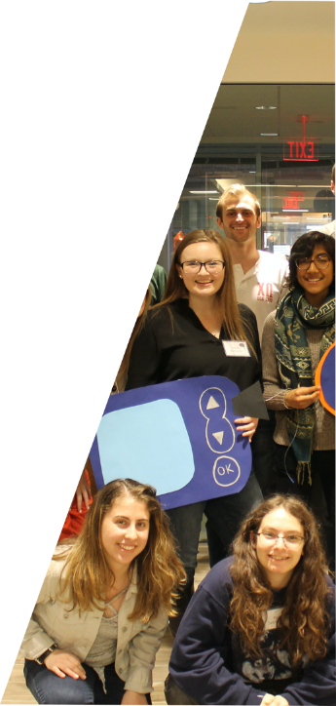
HELP US HELP YOUR STUDENTS
Help Support a CDN Chapter!
www.collegediabetesnetwork.org/find-a-chapter
Join our Community
Instagram @collegediabetes
Receive monthly newsletters www.collegediabetesnetwork.org/join
“Parents of the College Diabetes Network” Facebook Group
Download and Offer Our Resources collegediabetesnetwork.org/resource-hub
<#>

Slide 25
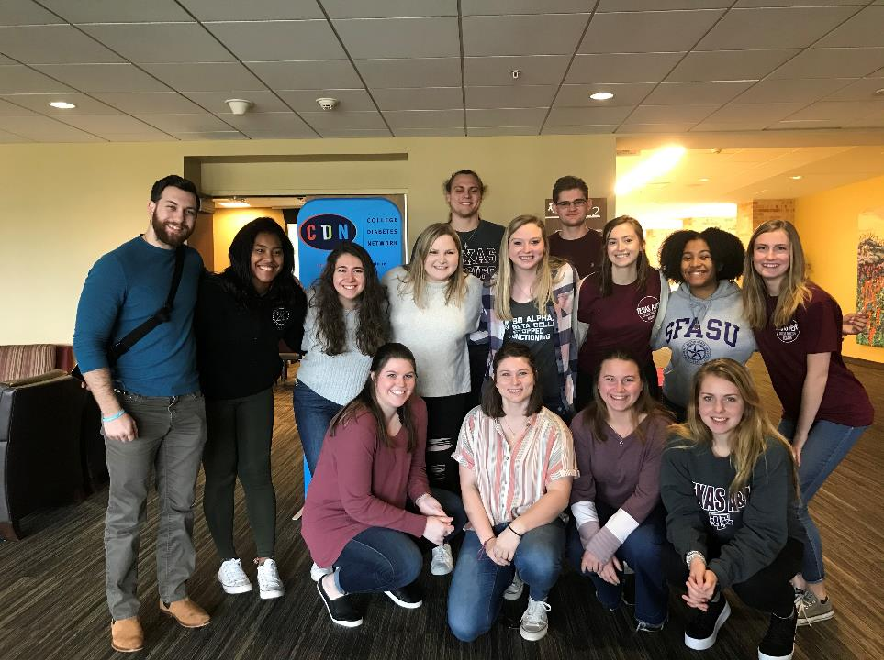

Q&A

